Slide 1




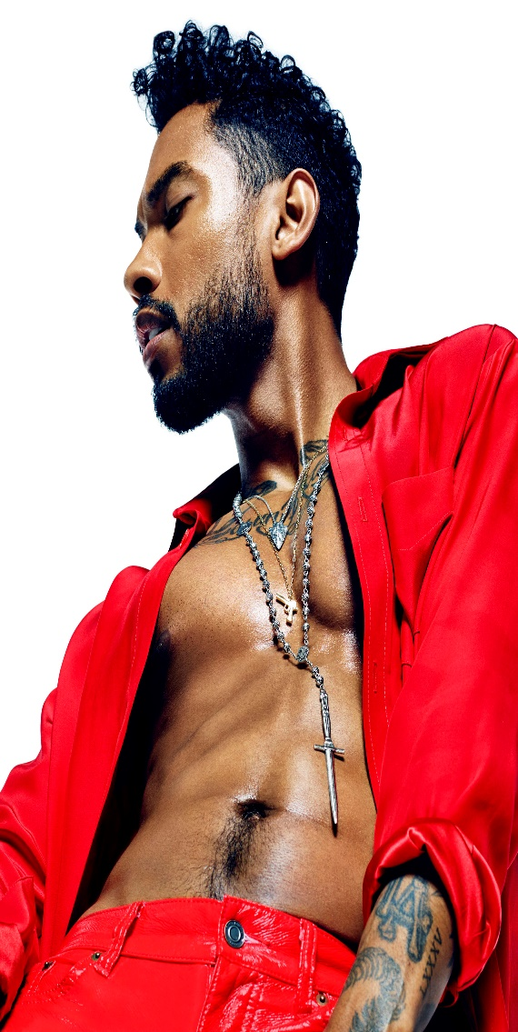


POP PROMOTION

