Slide 1

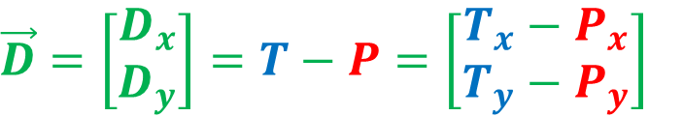

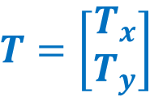
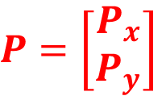




$$P=\left[\begin{matrix}P_{x} \\ P_{y}\end{matrix}\right]$$
$$T=\left[\begin{matrix}T_{x} \\ T_{y}\end{matrix}\right]$$
$$T$$
$$D$$
$$\vec{D}=\left[\begin{matrix}D_{x} \\ D_{y}\end{matrix}\right]=T−P=\left[\begin{matrix}T_{x}−P_{x} \\ T_{y}−P_{y}\end{matrix}\right]$$
$$P$$
$$y$$
$$x$$

Slide 2
$$P=\left[\begin{matrix}P_{x} \\ P_{y}\end{matrix}\right]$$
$$T=\left[\begin{matrix}T_{x} \\ T_{y}\end{matrix}\right]$$
$$T$$
$$D$$
$$\vec{D}=\left[\begin{matrix}D_{x} \\ D_{y}\end{matrix}\right]=T−P=\left[\begin{matrix}T_{x}−P_{x} \\ T_{y}−P_{y}\end{matrix}\right]$$
$$P$$
$$y$$
$$x$$

Slide 3

$$P=\left[\begin{matrix}P_{x} \\ P_{y}\end{matrix}\right]$$
$$T=\left[\begin{matrix}T_{x} \\ T_{y}\end{matrix}\right]$$
$$T$$
$$D$$
$$\vec{D}=\left[\begin{matrix}D_{x} \\ D_{y}\end{matrix}\right]=T−P=\left[\begin{matrix}T_{x}−P_{x} \\ T_{y}−P_{y}\end{matrix}\right]$$
$$e$$
$$P$$
$$y$$
$$x$$

Slide 4
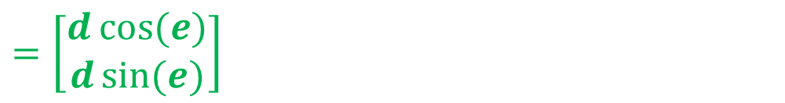

$$P=\left[\begin{matrix}P_{x} \\ P_{y}\end{matrix}\right]$$
$$T=\left[\begin{matrix}T_{x} \\ T_{y}\end{matrix}\right]$$
$$d$$
$$T$$
$$D$$
$$\vec{D}=\left[\begin{matrix}D_{x} \\ D_{y}\end{matrix}\right]=T−P=\left[\begin{matrix}T_{x}−P_{x} \\ T_{y}−P_{y}\end{matrix}\right]$$
$$e$$
$$P$$
$$y$$
$$=\left[\begin{matrix}d\cos{(e)} \\ d\sin{(e)}\end{matrix}\right]$$
$$x$$

Slide 5

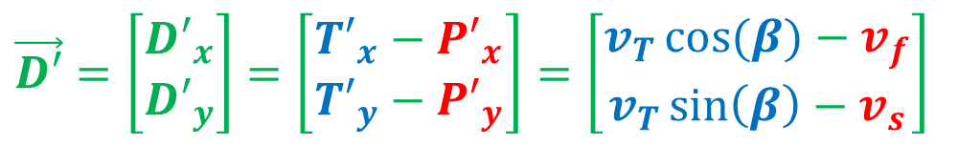

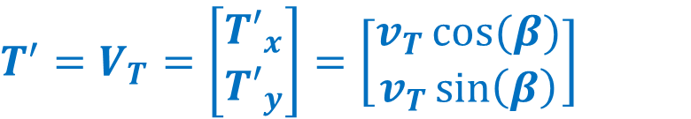
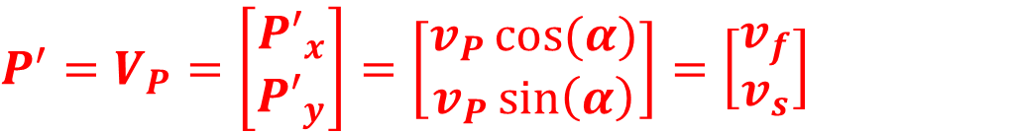


$$P=\left[\begin{matrix}P_{x} \\ P_{y}\end{matrix}\right]$$
$$P^{′}=V_{P}=\left[\begin{matrix}{P′}_{x} \\ {P′}_{y}\end{matrix}\right]=\left[\begin{matrix}v_{P}\cos{(α)} \\ v_{P}\sin\left(α\right)\end{matrix}\right]=\left[\begin{matrix}v_{f} \\ v_{s}\end{matrix}\right]$$
$$β$$
$$V_{T}$$
$$T=\left[\begin{matrix}T_{x} \\ T_{y}\end{matrix}\right]$$
$$T^{′}=V_{T}=\left[\begin{matrix}{T′}_{x} \\ {T′}_{y}\end{matrix}\right]=\left[\begin{matrix}v_{T}\cos{(β)} \\ v_{T}\sin\left(β\right)\end{matrix}\right]$$
$$T$$
$$V_{P}$$
$$D$$
$$\vec{D}=\left[\begin{matrix}D_{x} \\ D_{y}\end{matrix}\right]=T−P=\left[\begin{matrix}T_{x}−P_{x} \\ T_{y}−P_{y}\end{matrix}\right]$$
$$α$$
$$P$$
$$y$$
$$=\left[\begin{matrix}d\cos{(e)} \\ d\sin{(e)}\end{matrix}\right]$$
$$x$$
$$\vec{D′}=\left[\begin{matrix}{D′}_{x} \\ {D′}_{y}\end{matrix}\right]=\left[\begin{matrix}{T′}_{x}−{P′}_{x} \\ {T′}_{y}−{P′}_{y}\end{matrix}\right]=\left[\begin{matrix}v_{T}\cos{(β)}−v_{f} \\ v_{T}\sin\left(β\right)−v_{s}\end{matrix}\right]$$

Slide 6
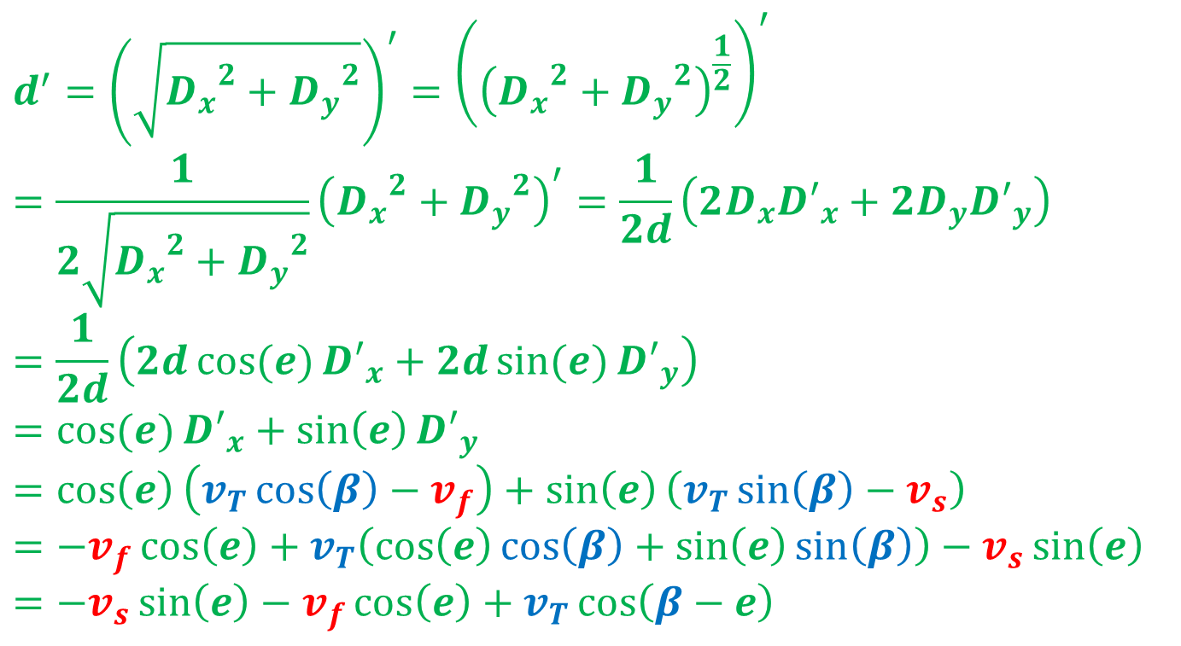
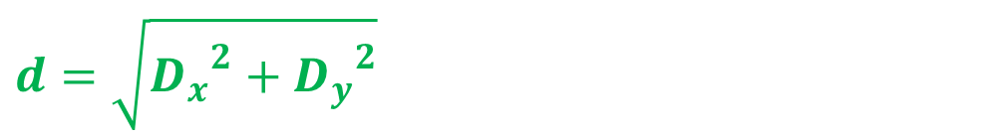
$$d=\sqrt{{D_{x}}^{2}+{D_{y}}^{2}}$$
$$d^{′}={\left(\sqrt{{D_{x}}^{2}+{D_{y}}^{2}}\right)}^{′}={\left({\left({D_{x}}^{2}+{D_{y}}^{2}\right)}^{\frac{1}{2}}\right)}^{′}=\frac{1}{2\sqrt{{D_{x}}^{2}+{D_{y}}^{2}}}{\left({D_{x}}^{2}+{D_{y}}^{2}\right)}^{′}=\frac{1}{2d}\left(2D_{x}{D′}_{x}+2D_{y}{D′}_{y}\right)=\frac{1}{2d}\left(2d\cos{(e)}{D′}_{x}+2d\sin{(e)}{D′}_{y}\right)=\cos{(e)}{D′}_{x}+\sin\left(e\right){D′}_{y}=\cos\left(e\right)\left(v_{T}\cos\left(β\right)−v_{f}\right)+\sin\left(e\right)\left(v_{T}\sin\left(β\right)−v_{s}\right)=−v_{f}\cos\left(e\right)+v_{T}\left(\cos\left(e\right)\cos\left(β\right)+\sin\left(e\right)\sin\left(β\right)\right)−v_{s}\sin\left(e\right)=−v_{s}\sin\left(e\right)−v_{f}\cos\left(e\right)+v_{T}\cos\left(β−e\right)$$

Slide 7

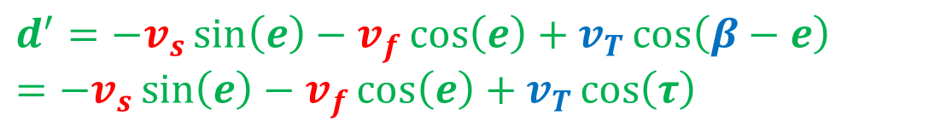

$$d^{′}=−v_{s}\sin\left(e\right)−v_{f}\cos\left(e\right)+v_{T}\cos\left(β−e\right)=−v_{s}\sin\left(e\right)−v_{f}\cos\left(e\right)+v_{T}\cos\left(τ\right)$$
$$τ$$
$$V_{T}$$
$$β$$
$$τ=β−e$$
$$T$$
$$V_{P}$$
$$D$$
$$e$$
$$P$$
$$y$$
$$x$$

Slide 8
$$d^{′}=v_{T}\cos\left(τ\right)−v_{f}\cos\left(e\right)−v_{s}\sin\left(e\right)$$
$$τ$$
$$V_{T}$$
$$T$$
$$V_{P}$$
$$D$$
$$e$$
$$P$$
$$y$$
$$x$$

Slide 9
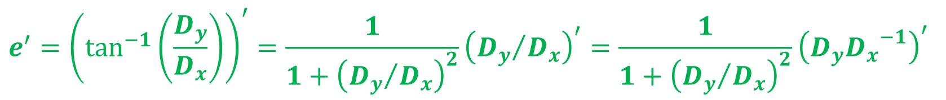
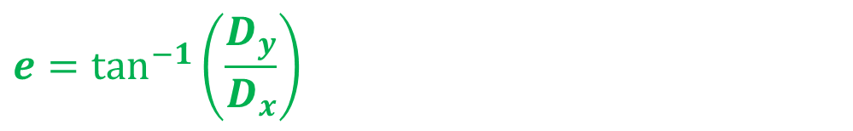
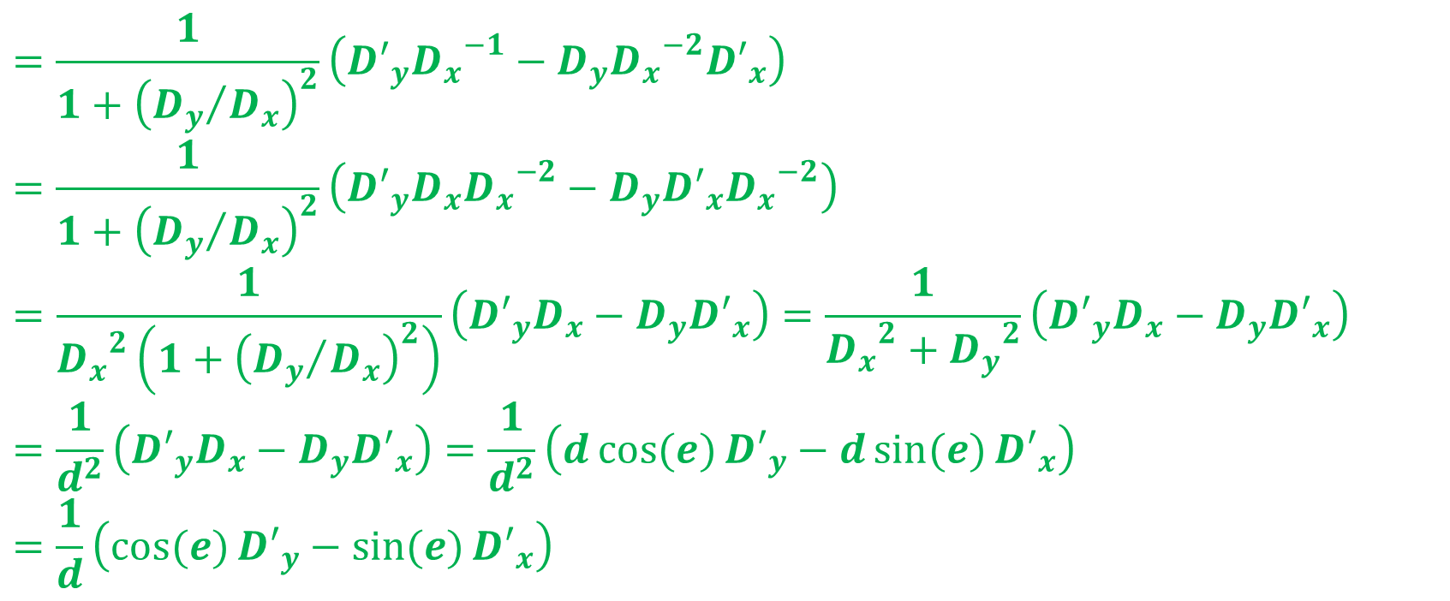
$$e=\tan^{−1}\left(\frac{D_{y}}{D_{x}}\right)$$
$$e^{′}={\left(\tan^{−1}\left(\frac{D_{y}}{D_{x}}\right)\right)}^{′}=\frac{1}{1+{\left({D_{y}}/{D_{x}}\right)}^{2}}{\left({D_{y}}/{D_{x}}\right)}^{′}=\frac{1}{1+{\left({D_{y}}/{D_{x}}\right)}^{2}}{\left(D_{y}{D_{x}}^{−1}\right)}^{′}$$
$$=\frac{1}{1+{\left({D_{y}}/{D_{x}}\right)}^{2}}\left({D′}_{y}{D_{x}}^{−1}−D_{y}{D_{x}}^{−2}{D′}_{x}\right)=\frac{1}{1+{\left({D_{y}}/{D_{x}}\right)}^{2}}\left({D′}_{y}D_{x}{D_{x}}^{−2}−D_{y}{D′}_{x}{D_{x}}^{−2}\right)=\frac{1}{{D_{x}}^{2}\left(1+{\left({D_{y}}/{D_{x}}\right)}^{2}\right)}\left({D′}_{y}D_{x}−D_{y}{D′}_{x}\right)=\frac{1}{{D_{x}}^{2}+{D_{y}}^{2}}\left({D′}_{y}D_{x}−D_{y}{D′}_{x}\right)=\frac{1}{d^{2}}\left({D′}_{y}D_{x}−D_{y}{D′}_{x}\right)=\frac{1}{d^{2}}\left(d\cos{(e)}{D′}_{y}−d\sin{(e)}{D′}_{x}\right)=\frac{1}{d}\left(\cos{(e)}{D′}_{y}−\sin{(e)}{D′}_{x}\right)$$

Slide 10
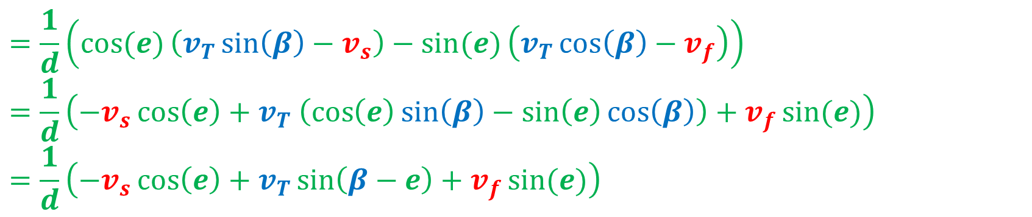
$$e=\tan^{−1}\left(\frac{D_{y}}{D_{x}}\right)$$
$$e^{′}=\frac{1}{d}\left(\cos{(e)}{D′}_{y}−\sin{(e)}{D′}_{x}\right)$$
$$=\frac{1}{d}\left(\cos{(e)}\left(v_{T}\sin\left(β\right)−v_{s}\right)−\sin{(e)}\left(v_{T}\cos\left(β\right)−v_{f}\right)\right)=\frac{1}{d}\left(−v_{s}\cos\left(e\right)+v_{T} \left(\cos\left(e\right)\sin\left(β\right)−\sin\left(e\right)\cos\left(β\right)\right)+v_{f}\sin{(e)}\right)=\frac{1}{d}\left(−v_{s}\cos\left(e\right)+v_{T}\sin\left(β−e\right)+v_{f}\sin{(e)}\right)$$

Slide 11
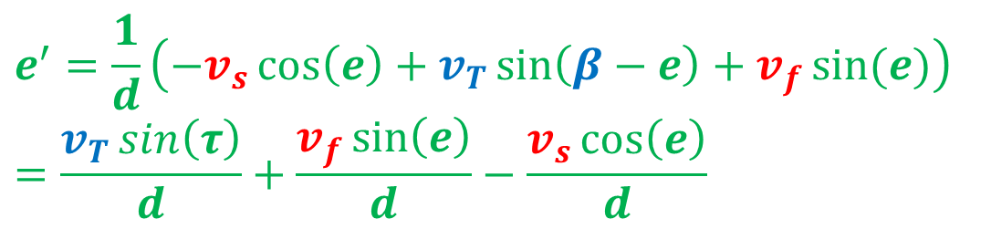
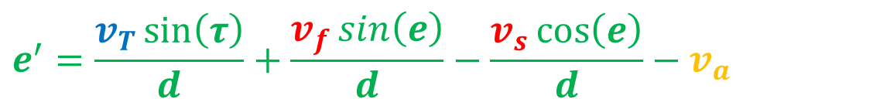
$$e^{′}=\frac{1}{d}\left(−v_{s}\cos\left(e\right)+v_{T}\sin\left(β−e\right)+v_{f}\sin{(e)}\right)=\frac{v_{T}\sin\left(τ\right)}{d}+\frac{v_{f}\sin\left(e\right)}{d}−\frac{v_{s}\cos\left(e\right)}{d}$$
$$τ$$
$$V_{T}$$
$$β$$
$$T$$
$$τ=β−e$$
$$V_{P}$$
$$D$$
$$e$$
$$P$$
$$y$$
$$e^{′}=\frac{v_{T}\sin\left(τ\right)}{d}+\frac{v_{f}\sin\left(e\right)}{d}−\frac{v_{s}\cos\left(e\right)}{d}−v_{a}$$
$$x$$

Slide 12

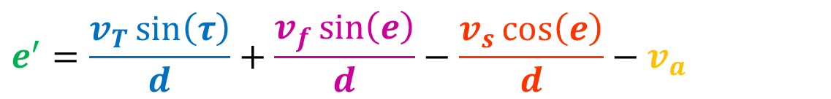
$$d^{′}=v_{T}\cos\left(τ\right)−v_{f}\cos\left(e\right)−v_{s}\sin\left(e\right)$$
$$τ$$
$$V_{T}$$
$$T$$
$$V_{P}$$
$$D$$
$$e$$
$$P$$
$$y$$
$$e^{′}=\frac{v_{T}\sin\left(τ\right)}{d}+\frac{v_{f}\sin\left(e\right)}{d}−\frac{v_{s}\cos\left(e\right)}{d}−v_{a}$$
$$x$$

