Slide 1
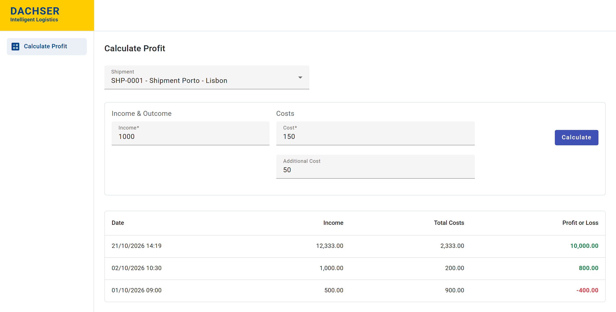
Calculate Profit
Profit or loss for every shipment, built with Angular and Spring Boot
Francisco Conceição
Software Engineer technical exercise · DACHSER Corporate IT Hub Porto
Notes:
~30 s. Introduce yourself and the exercise.
"I built Calculate Profit: a small full-stack application where the Finance Department picks a shipment, enters its income and costs, and immediately sees whether it made a profit or a loss — and keeps a history of every calculation."
Stack in one breath: Angular 17 frontend, Spring Boot 3 REST API, H2 database.

Slide 2
The problem and the goal
BUSINESS NEED
The Finance Department needs to know whether each shipment made a profit or a loss.
THE RULE
Profit = Income
− (Cost + Additional cost)
Pick a shipment
Enter income, cost and an optional additional cost
See the result and keep a history of every calculation
A negative result is a loss and is shown in red.
API
Backend
UI
Frontend
Java 17 · Spring Boot 3.1.5 · Spring Data JPA · Bean Validation · H2 in-memory database · Maven
Angular 17.1 standalone components · Angular Material 17.3 · Bootstrap 5.3 · Reactive Forms · RxJS
Notes:
~30 s. Set the context before the solution.
The users are the Finance Department — customers are not users of the app.
The rule is simple: profit = income − (cost + additional cost); a negative number is a loss.
Scope I delivered: choose a shipment, enter values, calculate, and see the full history. Versions follow the ones pinned in the assessment (Java 17, Boot 3.1.5, Angular 17.1, Material 17.3, Bootstrap 5.3).

Slide 3
Requirements and use cases
Calculate Profit application
Rules the app enforces
Select a shipment
Income and cost are required
Every amount must be 0 or more
Additional cost is optional — empty or 0 is not stored
Profit = Income − (Cost + Additional cost)
A negative result is a loss, shown in red
Every calculation is kept, newest first
View calculation history
Enter income and costs
Calculate profit or loss
Finance user
Sort the history by column
API-only extra: find a shipment by its code (GET /api/shipments/code/{code}).
Notes:
~45 s. One actor: the Finance Department user (customers are not users).
Walk the five use cases top to bottom — this is everything the UI supports, nothing more.
Then the rules on the right: they are enforced on the client (form validators), on the server (Bean Validation) and in the database (CHECK constraints) — I come back to that on the design slide.
Mention the extra endpoint: find a shipment by code exists in the API and the Postman collection, but not in the UI.

Slide 4
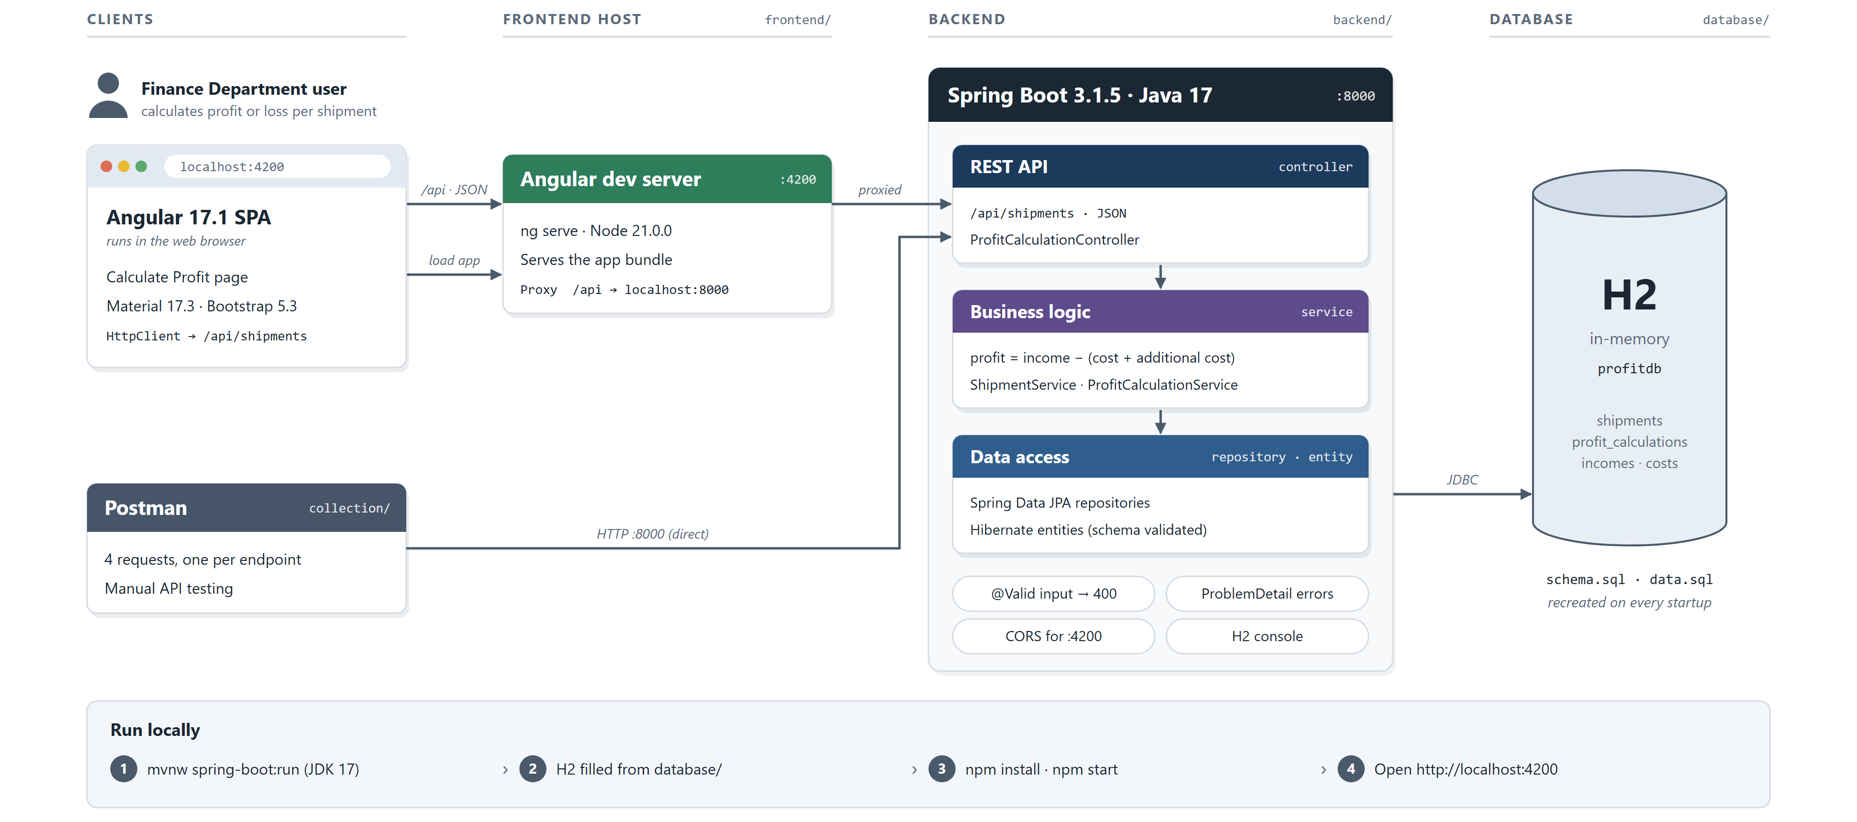
System architecture
Notes:
1–1.5 min — one of the key slides. Go left to right.
1) The Angular SPA runs in the browser. During development the Angular dev server on :4200 serves the bundle and proxies /api to the backend, so the browser only talks to one origin (CORS is also configured for :4200).
2) Spring Boot on :8000 has three layers: the REST controller (HTTP + JSON, validation), the services (business rule and transactions) and Spring Data JPA repositories.
3) Data lives in H2 in-memory; schema.sql and data.sql recreate it on every start and Hibernate only validates the entities against it.
Cross-cutting: @Valid → 400, a global exception handler that returns ProblemDetail (RFC 7807) for 404/400/500, and the H2 console for inspection.
Postman calls the API directly on :8000.

Slide 5
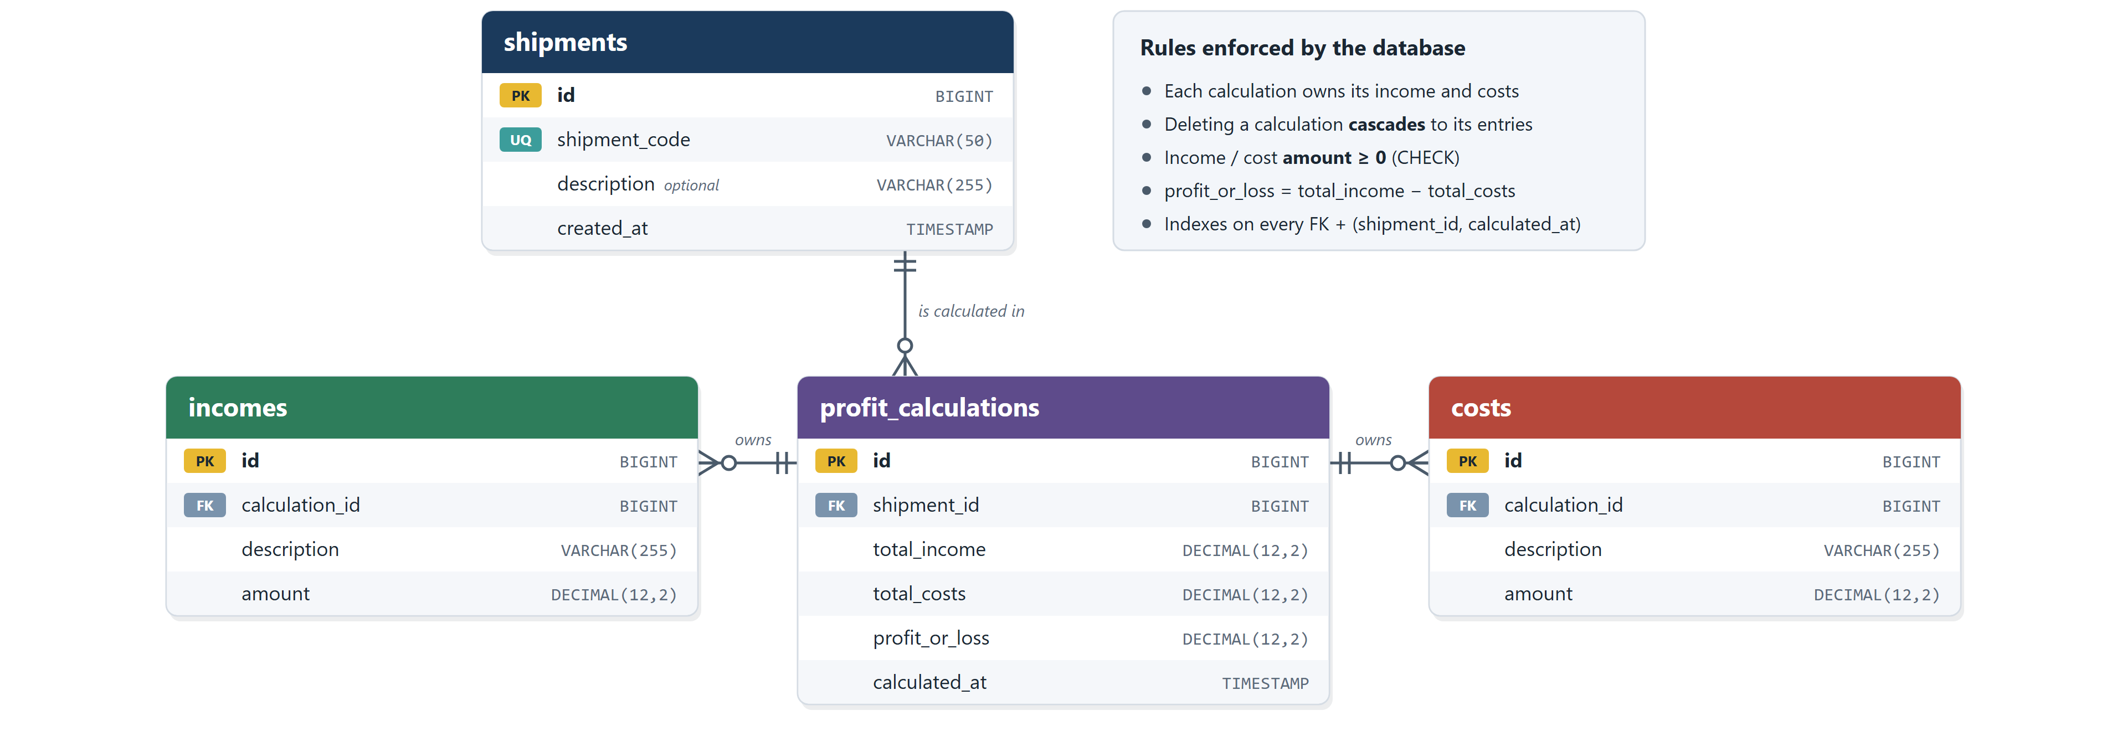
Data model
€
Where the figures come from: the income and costs entered are stored as rows of the calculation; their sums are saved as total_income and total_costs, and a CHECK guarantees profit_or_loss = total_income − total_costs.
Notes:
~1 min. Four tables.
shipments: the shipment code is the business key shown in the UI.
profit_calculations: one row per calculation = one row of the history. It belongs to a shipment.
incomes and costs belong to a calculation (calculation_id, ON DELETE CASCADE). Costs are told apart by description: "Cost" and "Additional cost".
How the figures are obtained: the service creates one income and one or two costs, sums them with BigDecimal and stores the totals and the result on the calculation, so the history is read without re-summing. The database double-checks with a CHECK constraint, and amounts can never be negative.
Why each calculation owns its entries: the history in the prototype (1000/200/800 and 500/900/−400) only makes sense if every calculation is independent — running totals could not produce those rows.

Slide 6
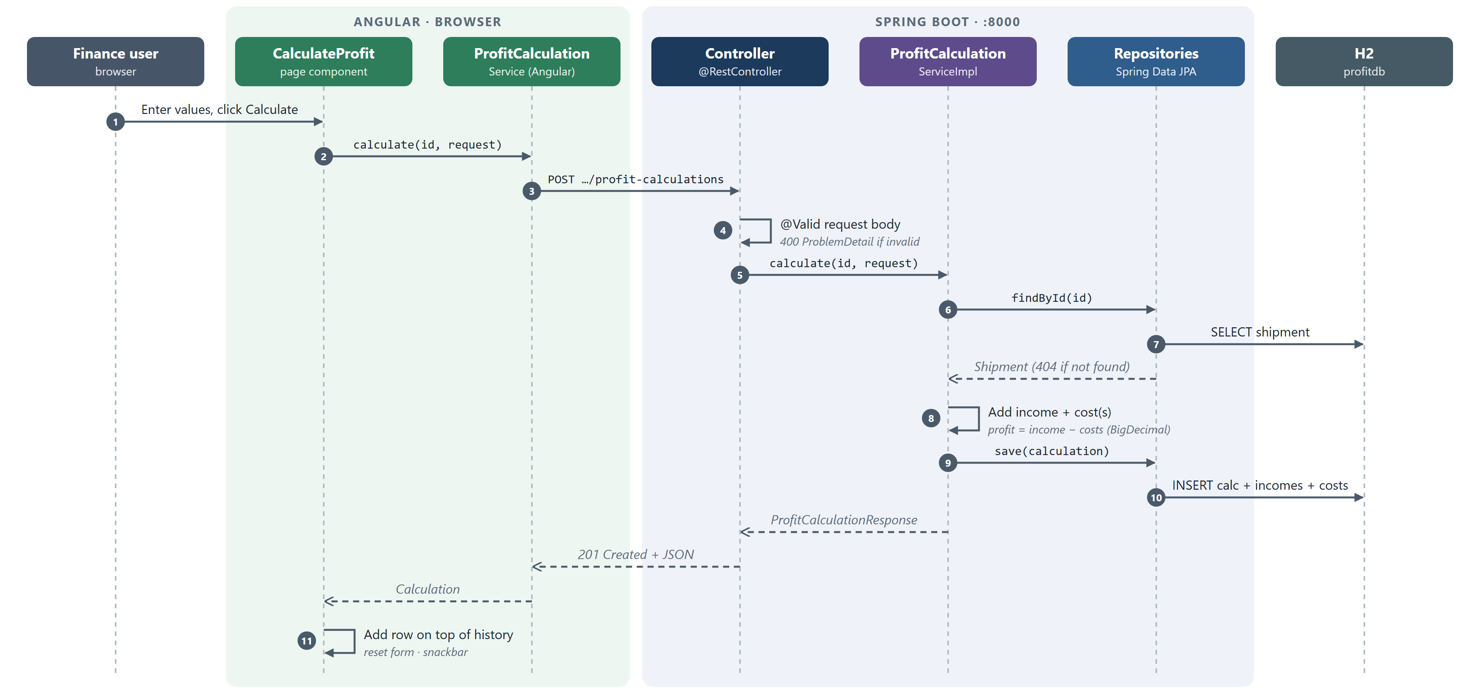
Calculation flow
Notes:
~1 min. Trace one POST from left to right and back.
1–3: the user clicks Calculate; the form (already validated in the browser) emits a CalculationRequest; the page calls the Angular service, which POSTs JSON to /api/shipments/{id}/profit-calculations.
4: the controller validates the body with @Valid — invalid data stops here with a 400 ProblemDetail.
5–7: the service loads the shipment; if it doesn't exist → ShipmentNotFoundException → 404.
8: it builds the calculation with one income and the cost(s) and computes profit = income − costs with BigDecimal.
9–10: a single save() inside @Transactional inserts the calculation and, by cascade, its income and costs.
Back: the mapper turns the entity into a ProfitCalculationResponse, the API answers 201 Created, and the page puts the new row on top of the history, resets the form and shows a snackbar.

Slide 7
Implementation and demonstration
Sample calculation
Income
1,000.00
Cost
150.00
Additional cost
50.00
Profit
800.00
Detail: one calculation, one transaction
ProfitCalculation owns its Income and Cost rows (cascade ALL), so one save() in a @Transactional method writes all of them — and a CHECK rejects any row where profit ≠ income − costs.
The running app: SHP-0001 history with profits in green and a loss in red.
1
Pick a shipment
2
Enter values
3
Calculate
4
Row added on top
calculation.addIncome(newIncome(income));
calculation.addCost(newCost(COST, cost));
repository.save(calculation);
Notes:
1–2 min. Ideally switch to the live app here (backend: mvnw spring-boot:run, frontend: npm start, open localhost:4200).
Demo script: select SHP-0001 → history loads → enter income 1000, cost 150, additional cost 50 → Calculate → a new row 1,000.00 / 200.00 / 800.00 appears on top, in green, with a snackbar. Optionally show a validation error (empty income) and sort a column.
Implementation detail to explain: ProfitCalculation is an aggregate that owns its incomes and costs. addIncome/addCost keep both sides of the relation in sync, and cascade = ALL lets a single save() inside @Transactional persist everything together — either all rows are written or none. The database CHECK constraint is a last guard that the stored result is consistent.

Slide 8
Testing and edge cases
27
9
11
6
backend tests, all passing
controller · MockMvc
service · Mockito
repository · real H2
Implemented — case | Expected
Normal calculation (230.50 − 200) | 201 · profit 30.50
Cost + additional cost summed | profit 800
Costs exceed income | −400 (loss)
Empty or zero additional cost | not stored
Missing income | 400 · "income: …"
Negative amount · malformed JSON | 400 Bad Request
Unknown shipment | 404 ProblemDetail
Unexpected server error | 500 · generic message
Inconsistent profit saved directly | rejected by DB CHECK
Deleting a calculation | removes its income & costs
Would add next
not implemented yet
Angular unit tests: form validation and page state
End-to-end test of the full flow (Playwright)
Full-stack test over real HTTP + H2
Zero values and the 10-digit amount limit
Two calculations at the same time
Notes:
~1 min. Be explicit about what exists versus what I would add.
Implemented (backend, JUnit 5): 9 controller tests with @WebMvcTest + MockMvc (HTTP status codes and ProblemDetail bodies), 11 service tests with Mockito (the rule, negative results, the optional additional cost, not-found), 6 repository tests with @DataJpaTest on a real H2 (custom queries, cascade save/delete, the CHECK constraint) and 1 context-load test = 27.
Edge cases covered: loss (−400), zero/empty additional cost, missing income, negative amount, malformed JSON, unknown shipment, unexpected error → 500 with a generic message.
Not implemented — would add: Angular tests, an end-to-end test, a full-stack HTTP test, zero income/cost and the @Digits(10,2) limit, and concurrency.

Slide 9
Design decisions and improvements
1
Controller · service · repository
With more time
HTTP, business rules and persistence change for different reasons — and each layer is tested on its own.
Login and roles with Spring Security
PostgreSQL with Flyway migrations instead of in-memory H2
Frontend and end-to-end tests in CI
OpenAPI / Swagger documentation
Pagination and filters for long histories
Docker Compose to start everything with one command
2
Validation at three levels
Angular validators for fast feedback, @Valid → 400 ProblemDetail on the API, CHECK constraints in the database.
3
Each calculation is independent
It owns its income and costs, matching the prototype history; totals are stored, not re-summed.
4
Money as BigDecimal and DTO records
No floating-point rounding (DECIMAL 12,2); entities never leave the API, mappers build the responses.
Notes:
~1 min.
Layers: the controller only knows HTTP (paths, status codes, validation), the service holds the rule and the transaction, the repository only persistence. That is why I could test each with the right tool (MockMvc, Mockito, @DataJpaTest).
Validation: the same rules on three levels — the UI gives instant feedback, the API never trusts the client (Bean Validation + a global handler returning ProblemDetail), and the database is the final guard.
Independent calculations: a conscious decision driven by the prototype's history rows.
Money: BigDecimal end to end and DECIMAL(12,2) in the database; DTO records + mappers keep JPA entities out of the API contract.
Improvements: security first, then a real database with migrations, more tests in CI, API docs, pagination and one-command startup.

Slide 10
Conclusion
WHAT I BUILT
KEY DECISION
WHAT I LEARNED
A full-stack app — Angular UI, Spring Boot REST API and H2 — that calculates profit or loss per shipment and keeps its history.
Each calculation owns its income and costs and is saved in one transaction, with the result guarded by the database.
Letting the prototype drive the data model, and validating at every layer to keep errors clear and data consistent.
Thank you — Questions?
Notes:
~30 s. Summarise in three sentences, using the three cards.
Personalise "What I learned" with your own words before the interview.
Then stop and invite questions: "Thank you — I'm happy to take questions, or show any part of the code."

