Slide 1

App Scheduling
Members:
Jorge Galarza Bryan Jimenez
Steven Leiva
Elian Llorente
David Muñoz

Slide 2
Project Description
Design a web page that allows the management and control for scheduling appointments in which each user can register and once registered, access to schedule appointments, such as an agenda, the user can also create services and employees in which all this is saved in the database and each of these data can be viewed from the website.

Slide 3
How are you tackling this situation?
To solve this situation, a web application will be developed in which wFor this case, we worked with a team of 5 people in which each one had a role within the project, which for the frontend part was carried out with Angular which facilitated us for teamwork since in this way it helps us to work. by components and to be able to assign a task to each member of the team; For the backend part, Nodejs was used which, as it is controlled by events, perfectly adjusts to the needs of the problem to be solved and facilitates the connection to the database which was chosen by the group as MYSQL.

Slide 4

MOCKUPS

Slide 5
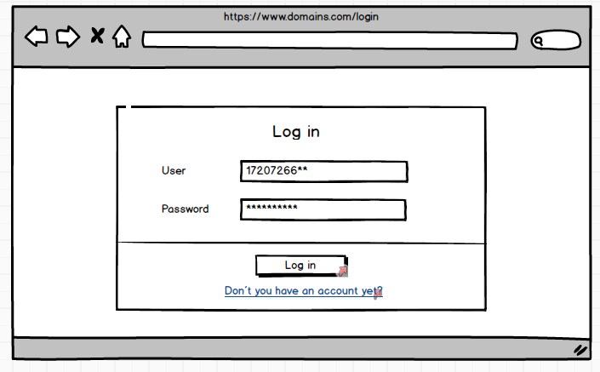
LOGIN

Slide 6
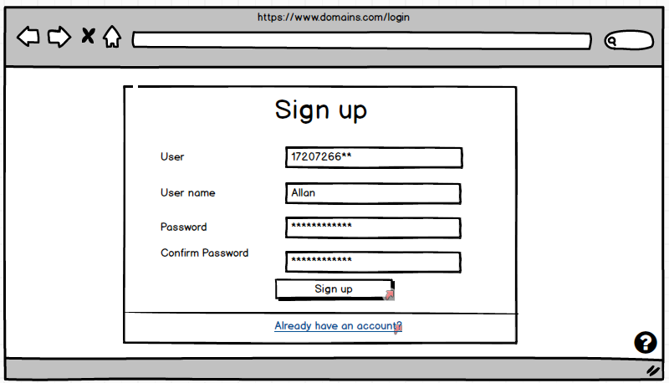
SIGN UP

Slide 7
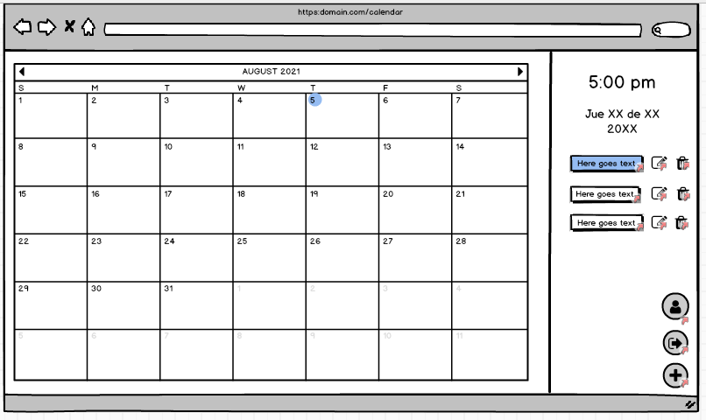
APPOINTMENT

Slide 8
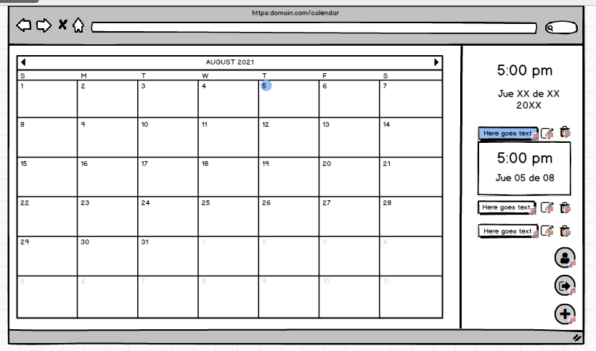
APPOINTMENT/DESCRIBE

Slide 9
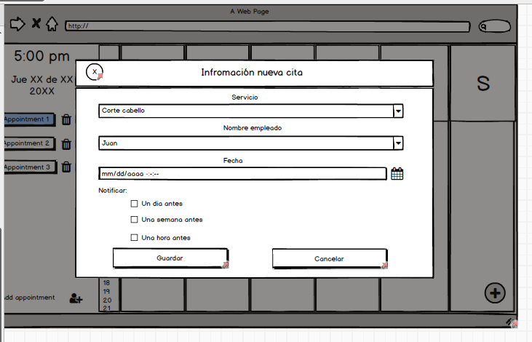
CREATE APPOINTMENT

Slide 10
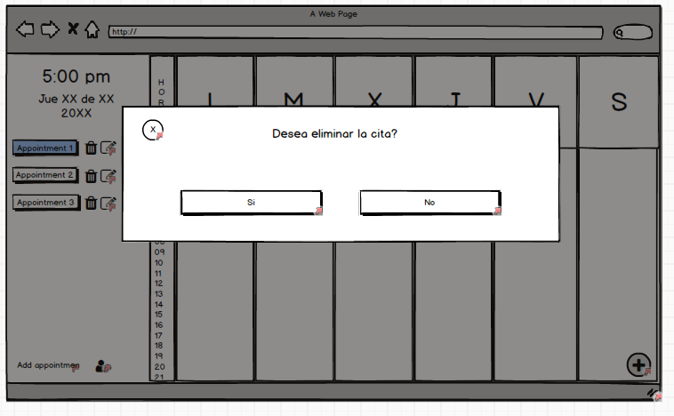
DELETE APPOINTMENT

Slide 11
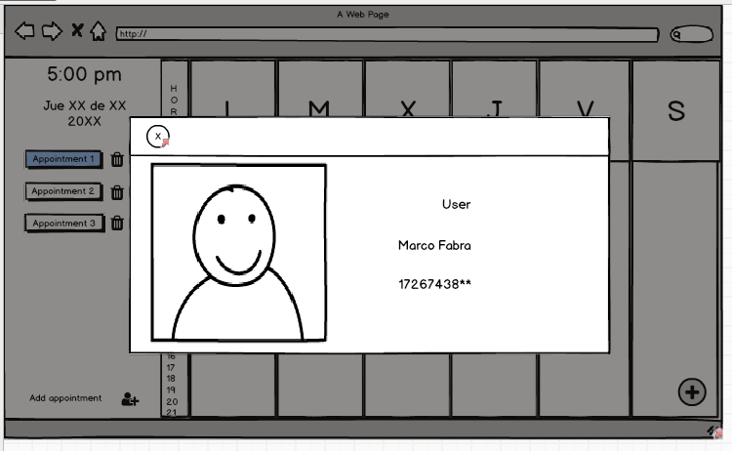
USER/INFO

Slide 12
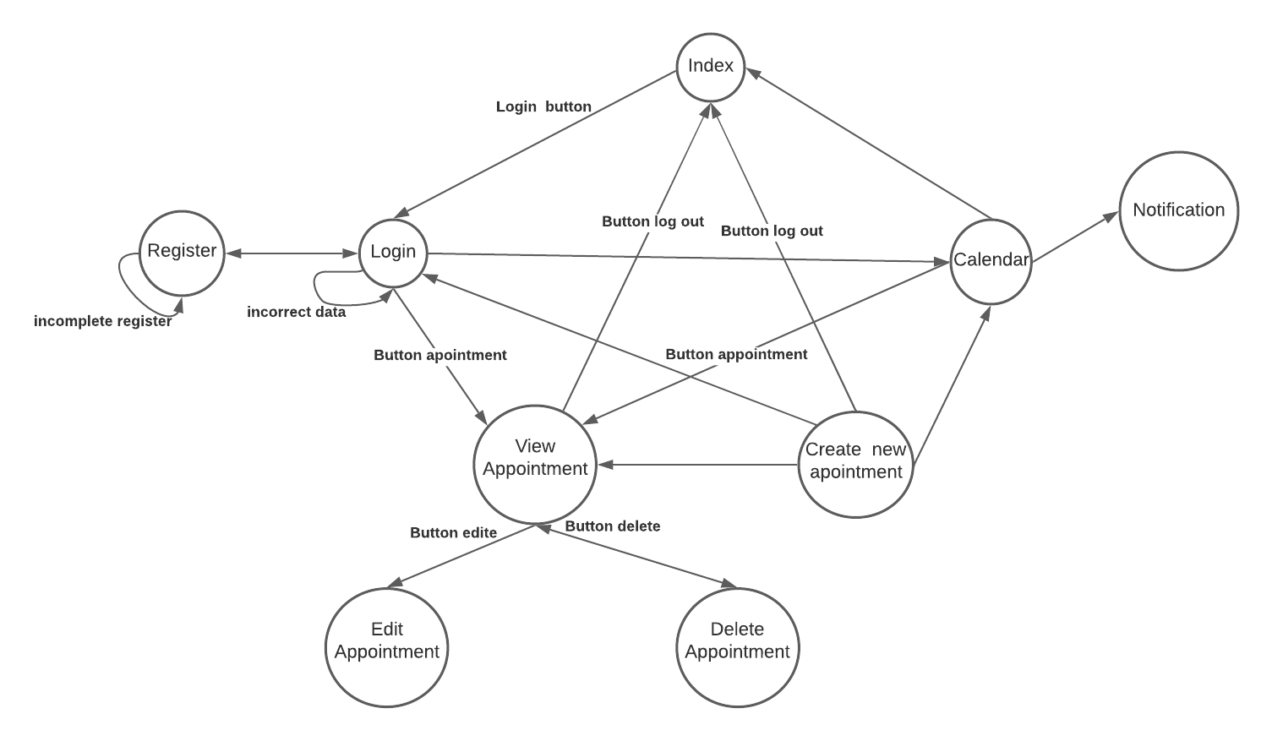
NAVIGABILITY

Slide 13
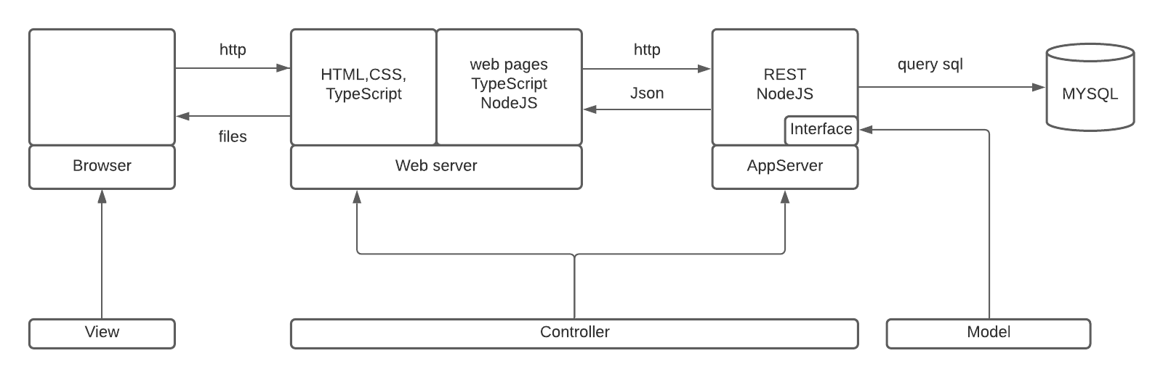
ARCHITECTURE

