Slide 1

Progress Report Meeting
Francisco de Melo Jr
December 12, 2016
École Polytechnique de Montréal
Laboratoire DORSAL

Slide 2

1
Outline
  1. Research Questions
  2. Review of Enhanced Calling Context Tree (ECCT)
  3. Analysis methods
  4. Results
  5. Conclusion and future work
  6. General View of ECCTView
POLYTECHNIQUE MONTREAL – Francisco de Melo

Slide 3
2
1.1 Research Questions
1.1 Hypothesis
Is it possible to find useful information by analyzing segments of traces from calling context trees?
1.2 Methodology
Which methods can be used to do this process?
POLYTECHNIQUE MONTREAL – Francisco de Melo
Notes:
With latest techniques and work of pioneers, we have achieved very high tracing speeds and minimum overhead – well and good
But adding more features, newer techniques will drag down the desired performance of tracers
My goal is to attack those underlying techniques and algorithms so that tracers become future and feature ready and have uniformity
JIT really improvesJIT only when necessary – method or trace
Explore opportunities for optimizing – like specializing bytecode or improve JITing techniques
Like determine instruction type, using specialized instructions. Similar to LuaJIT

Slide 4
3
1.2 Research Questions
1.2 Automation of a task in Tracecompare
Automate the process of finding the root cause of a performance problem based on performance metrics
POLYTECHNIQUE MONTREAL – Francisco de Melo
Notes:
With latest techniques and work of pioneers, we have achieved very high tracing speeds and minimum overhead – well and good
But adding more features, newer techniques will drag down the desired performance of tracers
My goal is to attack those underlying techniques and algorithms so that tracers become future and feature ready and have uniformity
JIT really improvesJIT only when necessary – method or trace
Explore opportunities for optimizing – like specializing bytecode or improve JITing techniques
Like determine instruction type, using specialized instructions. Similar to LuaJIT

Slide 5
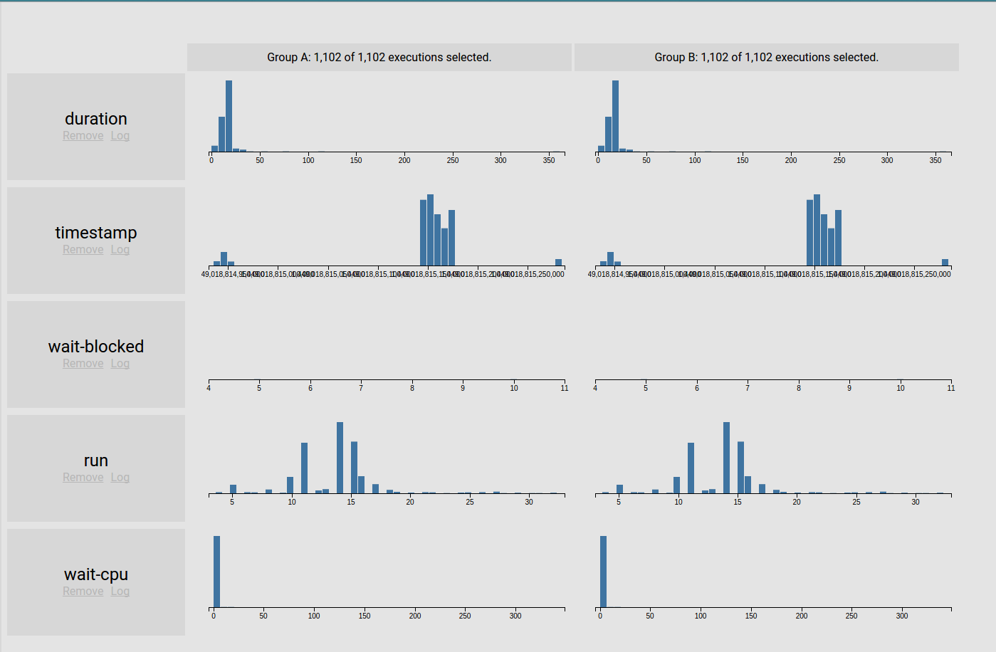

4
1.2 Stages
1.2 One image explanation
Trace Compare view
Trace Compare view
POLYTECHNIQUE MONTREAL – Francisco de Melo
Notes:
With latest techniques and work of pioneers, we have achieved very high tracing speeds and minimum overhead – well and good
But adding more features, newer techniques will drag down the desired performance of tracers
My goal is to attack those underlying techniques and algorithms so that tracers become future and feature ready and have uniformity
JIT really improvesJIT only when necessary – method or trace
Explore opportunities for optimizing – like specializing bytecode or improve JITing techniques
Like determine instruction type, using specialized instructions. Similar to LuaJIT

Slide 6
5
1.2 Stages
1.3 Diagram
Overview of the system
POLYTECHNIQUE MONTREAL – Francisco de Melo
Notes:
With latest techniques and work of pioneers, we have achieved very high tracing speeds and minimum overhead – well and good
But adding more features, newer techniques will drag down the desired performance of tracers
My goal is to attack those underlying techniques and algorithms so that tracers become future and feature ready and have uniformity
JIT really improvesJIT only when necessary – method or trace
Explore opportunities for optimizing – like specializing bytecode or improve JITing techniques
Like determine instruction type, using specialized instructions. Similar to LuaJIT

Slide 7
2.1 ECCT Review
6
Review of the Enhanced Calling Context Tree
Aggregate calls with the same context
More efficient than Call Graph and Dynamic Call Tree
Can aggregate metrics from the context
POLYTECHNIQUE MONTREAL – Francisco de Melo
Notes:
With latest techniques and work of pioneers, we have achieved very high tracing speeds and minimum overhead – well and good
But adding more features, newer techniques will drag down the desired performance of tracers
My goal is to attack those underlying techniques and algorithms so that tracers become future and feature ready and have uniformity
JIT really improvesJIT only when necessary – method or trace
Explore opportunities for optimizing – like specializing bytecode or improve JITing techniques
Like determine instruction type, using specialized instructions. Similar to LuaJIT

Slide 8
2.2 ECCT Review
7
In one image
Dynamic tree
Calling Context
A
A
2
B
C
B
B
C
D
E
D
D
E
POLYTECHNIQUE MONTREAL – Francisco de Melo
Notes:
With latest techniques and work of pioneers, we have achieved very high tracing speeds and minimum overhead – well and good
But adding more features, newer techniques will drag down the desired performance of tracers
My goal is to attack those underlying techniques and algorithms so that tracers become future and feature ready and have uniformity
JIT really improvesJIT only when necessary – method or trace
Explore opportunities for optimizing – like specializing bytecode or improve JITing techniques
Like determine instruction type, using specialized instructions. Similar to LuaJIT

Slide 9
3.1 ECCT Model
8
View of the model
Implementation details:
Read the trace
Create a summary tree
Record the information from the context
POLYTECHNIQUE MONTREAL – Francisco de Melo
Notes:
With latest techniques and work of pioneers, we have achieved very high tracing speeds and minimum overhead – well and good
But adding more features, newer techniques will drag down the desired performance of tracers
My goal is to attack those underlying techniques and algorithms so that tracers become future and feature ready and have uniformity
JIT really improvesJIT only when necessary – method or trace
Explore opportunities for optimizing – like specializing bytecode or improve JITing techniques
Like determine instruction type, using specialized instructions. Similar to LuaJIT

Slide 10
3.2 ECCT Model
9
Chart
Summary of ECCT
POLYTECHNIQUE MONTREAL – Francisco de Melo
Notes:
With latest techniques and work of pioneers, we have achieved very high tracing speeds and minimum overhead – well and good
But adding more features, newer techniques will drag down the desired performance of tracers
My goal is to attack those underlying techniques and algorithms so that tracers become future and feature ready and have uniformity
JIT really improvesJIT only when necessary – method or trace
Explore opportunities for optimizing – like specializing bytecode or improve JITing techniques
Like determine instruction type, using specialized instructions. Similar to LuaJIT

Slide 11
4. Analyzing the ECCT
10
1.1 Regression models
1.2 Grouping techniques
POLYTECHNIQUE MONTREAL – Francisco de Melo
Notes:
With latest techniques and work of pioneers, we have achieved very high tracing speeds and minimum overhead – well and good
But adding more features, newer techniques will drag down the desired performance of tracers
My goal is to attack those underlying techniques and algorithms so that tracers become future and feature ready and have uniformity
JIT really improvesJIT only when necessary – method or trace
Explore opportunities for optimizing – like specializing bytecode or improve JITing techniques
Like determine instruction type, using specialized instructions. Similar to LuaJIT

Slide 12
4. Analyzing the ECCT
11
4.1 Regression analysis
4.1.1 Statistical process for estimating the relations among variables
4.1.2 Group the data
4.1.3 Analysis of association between groups
4.1.4 Build a regression rule of those relations
4.1.5 Demonstration
POLYTECHNIQUE MONTREAL – Francisco de Melo
Notes:
With latest techniques and work of pioneers, we have achieved very high tracing speeds and minimum overhead – well and good
But adding more features, newer techniques will drag down the desired performance of tracers
My goal is to attack those underlying techniques and algorithms so that tracers become future and feature ready and have uniformity
JIT really improvesJIT only when necessary – method or trace
Explore opportunities for optimizing – like specializing bytecode or improve JITing techniques
Like determine instruction type, using specialized instructions. Similar to LuaJIT

Slide 13
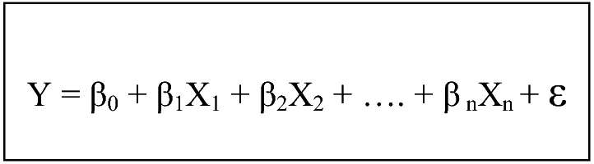
4. Results for Linear Model
12
5.2 Analysis
MRL
Y= 213764395.0B0 +4.9281714M1+1.3205339M2
PCA
Associated right the workload metric with the duration
Explanation
The model is able to explain ~ 80% of the duration
Linear output
POLYTECHNIQUE MONTREAL – Francisco de Melo
Notes:
With latest techniques and work of pioneers, we have achieved very high tracing speeds and minimum overhead – well and good
But adding more features, newer techniques will drag down the desired performance of tracers
My goal is to attack those underlying techniques and algorithms so that tracers become future and feature ready and have uniformity
JIT really improvesJIT only when necessary – method or trace
Explore opportunities for optimizing – like specializing bytecode or improve JITing techniques
Like determine instruction type, using specialized instructions. Similar to LuaJIT

Slide 14
4. Analyzing the ECCT
13
4.2 Automatic classification
4.2.1 Classifying a set a metric by using a non-supervised method (k-means and elbow method)
4.2.2 Do this process for each metric
4.2.3 Analysis of the classification
4.2.4 Use the current information to deduce the problem
4.2.5 Demonstration
POLYTECHNIQUE MONTREAL – Francisco de Melo
Notes:
With latest techniques and work of pioneers, we have achieved very high tracing speeds and minimum overhead – well and good
But adding more features, newer techniques will drag down the desired performance of tracers
My goal is to attack those underlying techniques and algorithms so that tracers become future and feature ready and have uniformity
JIT really improvesJIT only when necessary – method or trace
Explore opportunities for optimizing – like specializing bytecode or improve JITing techniques
Like determine instruction type, using specialized instructions. Similar to LuaJIT

Slide 15
4. Results for automatic classification
14
5.1 Representation scheme
Classification explanation
POLYTECHNIQUE MONTREAL – Francisco de Melo
Notes:
With latest techniques and work of pioneers, we have achieved very high tracing speeds and minimum overhead – well and good
But adding more features, newer techniques will drag down the desired performance of tracers
My goal is to attack those underlying techniques and algorithms so that tracers become future and feature ready and have uniformity
JIT really improvesJIT only when necessary – method or trace
Explore opportunities for optimizing – like specializing bytecode or improve JITing techniques
Like determine instruction type, using specialized instructions. Similar to LuaJIT

Slide 16
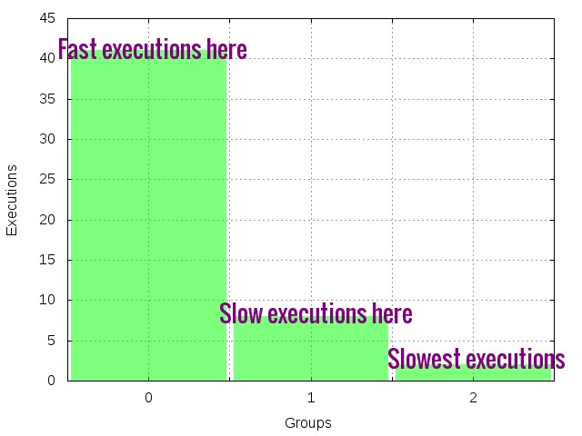
4. Results for automatic classification
14
5.1 Workload analysis - Instructions
Classification output
POLYTECHNIQUE MONTREAL – Francisco de Melo
Notes:
With latest techniques and work of pioneers, we have achieved very high tracing speeds and minimum overhead – well and good
But adding more features, newer techniques will drag down the desired performance of tracers
My goal is to attack those underlying techniques and algorithms so that tracers become future and feature ready and have uniformity
JIT really improvesJIT only when necessary – method or trace
Explore opportunities for optimizing – like specializing bytecode or improve JITing techniques
Like determine instruction type, using specialized instructions. Similar to LuaJIT

Slide 17
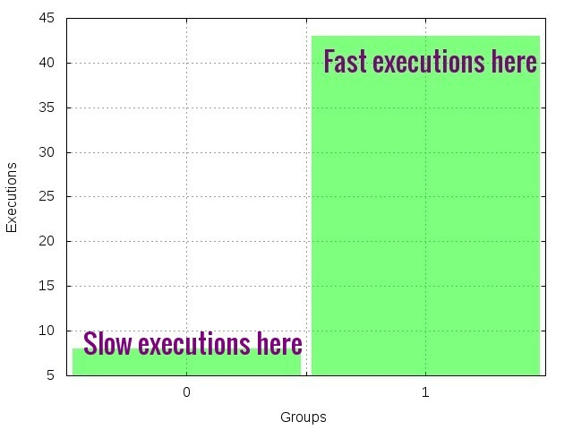
4. Results for automatic classification
15
5.2 Second workload analysis
Chart 1 – Workload cache misses
Classification output
POLYTECHNIQUE MONTREAL – Francisco de Melo
Notes:
With latest techniques and work of pioneers, we have achieved very high tracing speeds and minimum overhead – well and good
But adding more features, newer techniques will drag down the desired performance of tracers
My goal is to attack those underlying techniques and algorithms so that tracers become future and feature ready and have uniformity
JIT really improvesJIT only when necessary – method or trace
Explore opportunities for optimizing – like specializing bytecode or improve JITing techniques
Like determine instruction type, using specialized instructions. Similar to LuaJIT

Slide 18
5. Conclusion and Future work
16
(i) It is possible to classify the data
(ii) There still an analysis phase, which may not be deterministic
5.1 Conclusion
POLYTECHNIQUE MONTREAL – Francisco de Melo
Notes:
With latest techniques and work of pioneers, we have achieved very high tracing speeds and minimum overhead – well and good
But adding more features, newer techniques will drag down the desired performance of tracers
My goal is to attack those underlying techniques and algorithms so that tracers become future and feature ready and have uniformity
JIT really improvesJIT only when necessary – method or trace
Explore opportunities for optimizing – like specializing bytecode or improve JITing techniques
Like determine instruction type, using specialized instructions. Similar to LuaJIT

Slide 19
5. Conclusion and Future work
17
5.2 Future work
1. Testing with real use cases and software
2. Applying a more advanced technique for 2D and matrix
POLYTECHNIQUE MONTREAL – Francisco de Melo
Notes:
With latest techniques and work of pioneers, we have achieved very high tracing speeds and minimum overhead – well and good
But adding more features, newer techniques will drag down the desired performance of tracers
My goal is to attack those underlying techniques and algorithms so that tracers become future and feature ready and have uniformity
JIT really improvesJIT only when necessary – method or trace
Explore opportunities for optimizing – like specializing bytecode or improve JITing techniques
Like determine instruction type, using specialized instructions. Similar to LuaJIT

Slide 20
6. Demonstration of the View
18
General view of ECCTView + features
POLYTECHNIQUE MONTREAL – Francisco de Melo
Notes:
With latest techniques and work of pioneers, we have achieved very high tracing speeds and minimum overhead – well and good
But adding more features, newer techniques will drag down the desired performance of tracers
My goal is to attack those underlying techniques and algorithms so that tracers become future and feature ready and have uniformity
JIT really improvesJIT only when necessary – method or trace
Explore opportunities for optimizing – like specializing bytecode or improve JITing techniques
Like determine instruction type, using specialized instructions. Similar to LuaJIT

Slide 21

Questions
isnaldo-francisco.de-melo-jr@polymtl.ca
Any other info?
19
POLYTECHNIQUE MONTREAL – Francisco de Melo

Slide 22
References
20
Doray, F, and M. R. Dagenais, "Diagnosing Performance Variations by Comparing Multi-Level Execution Traces", IEEE Transactions on Parallel and Distributed Systems, vol. pp,issue: 99 no. 1, 2016.
Andrea Adamoli and Matthias Hauswirth. Trevis: A context
tree visualization & analysis framework and its use for classifying
performance failure reports. In SoftVis ’10: Proceedings
of the ACM Symposium on Software Visualization, 2010.
J. M. Spivey. Fast, Accurate Call Graph Profiling. Softw.
Pract. Exper., 34(3):249–264, 2004.
W. N. Sumner, Y. Zheng, D. Weeratunge, and X. Zhang. Precise Calling
Context Encoding. In ACM International Conference on Software Engineering,
2010.
POLYTECHNIQUE MONTREAL – Francisco de Melo
Notes:
With latest techniques and work of pioneers, we have achieved very high tracing speeds and minimum overhead – well and good
But adding more features, newer techniques will drag down the desired performance of tracers
My goal is to attack those underlying techniques and algorithms so that tracers become future and feature ready and have uniformity
JIT really improvesJIT only when necessary – method or trace
Explore opportunities for optimizing – like specializing bytecode or improve JITing techniques
Like determine instruction type, using specialized instructions. Similar to LuaJIT

Slide 23

21
Obrigado
POLYTECHNIQUE MONTREAL – Francisco de Melo

