Slide 1
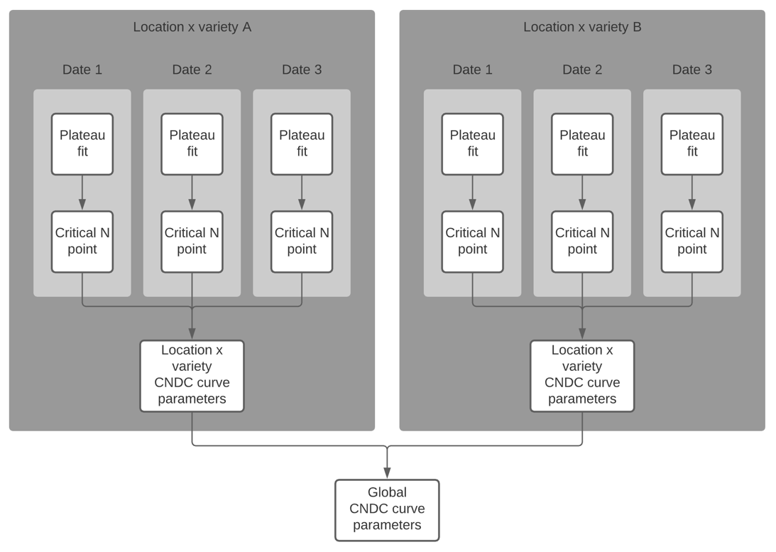

Slide 2
Location 1
Variety 1
Variety 2
Date 1
Date 2
Date 3
Date 4
Data
Data
Data
Data
L-P Curve
L-P Curve
L-P Curve
L-P Curve
Crit. Point
Crit. Point
Crit. Point
Crit. Point
CNDC: L1 x V1
CNDC: L1 x V2
CNDC: L1
Location 2
Variety 1
Variety 2
Date 1
Date 2
Date 3
Date 4
Data
Data
Data
Data
L-P Curve
L-P Curve
L-P Curve
L-P Curve
Crit. Point
Crit. Point
Crit. Point
Crit. Point
CNDC: L1 x V1
CNDC: L1 x V2
CNDC: L1

Slide 3
Location 1
Location 2
Variety 1
Variety 2
Variety 3
Variety 4
Date 1
Date 2
Date 3
Date 4
Date 5
Date 6
Date 7
Date 8
Data
Data
Data
Data
Data
Data
Data
Data
L-P Curve
L-P Curve
L-P Curve
L-P Curve
L-P Curve
L-P Curve
L-P Curve
L-P Curve
Crit. Point
Crit. Point
Crit. Point
Crit. Point
Crit. Point
Crit. Point
Crit. Point
Crit. Point
CNDC: L1 x V1
CNDC: L1 x V2
CNDC: L2 x V3
CNDC: L2 x V4
CNDC: L1
CNDC: L2
CNDC

