Slide 1
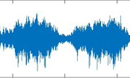
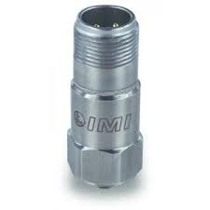


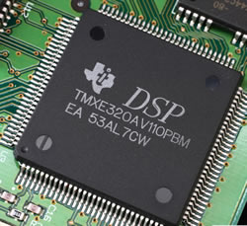


Disrupting oil purity detection technology using low cost acoustic sensors and machine learning
Situation: An oil and gas company was looking for a low cost sensor that could provide real time oil extraction rate from a drill site. Real time oil extraction rate not only provides an instant feedback to engineered changes in drill site conditions it also allows companies to better forecast oil production onsite.
1
2
Data Collection
Advanced Signal processing
Outputs and Impact
Accelerometer collects real time pipe vibration data from the pipe body along with drill site data (temp., pressure)
Differences in oil purity cause differences in vibration signal captured by sensor
Deloitte proprietary algorithms based on insights drawn from voice recognition and signal processing are used to extract features from the vibration signal
Outputs
The machine learning solution was able to correctly predict oil purity for new drilling sites
Proved to be more accurate than more expensive existing technologies
Non-invasive
Easily implemented in new drilling sites
Impact
Led to better feedback to engineers, based on which they could better change drilling techniques for optimum oil extraction
Cost effective (costs <$1000, competing technology costs >$20,000). Proven savings of over $20k per pipeline.
Cost effective. Current technology uses an infrared beam to estimate oil purity, it is both expensive and invasive.
White box solution , provides flexibility & full access to signal processing algorithms.
3
Real-Time Feedback
Advanced machine learning algorithms “learn” features of the signal and provide real time oil purity rates.
Provide drilling engineers real time feedback to changes in drilling techniques, injected water pressure and other variables.
Vibration Signal
Real Time Model Processing
Transmit Reports
Pure Oil
Oil & Water

