Slide 1
Optimization & Decision

Slide 2
Introdution
Problem: Optimizing battery dispatch in a smart grid to minimize energy costs while ensuring demand is met.
Goal: Use a simplified linear programming model solved by the Simplex Method for efficient and cost-effective energy management

Slide 3
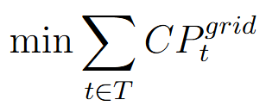
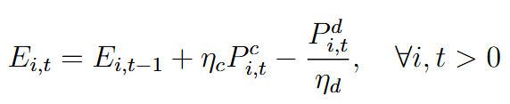
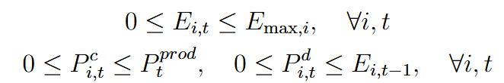
Basic Linear Programing Formulation
Objective Function:
Minimize the total cost of grid energy consumption:
​Constraints:
Energy balance:
Battery Limits:

Slide 4
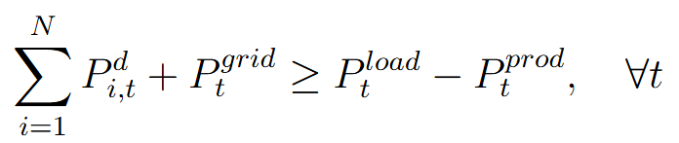
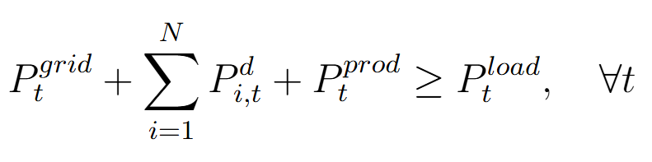
Constraints:
Grid Sufficiency Constraint:
Power Balance Constraint:

Slide 5
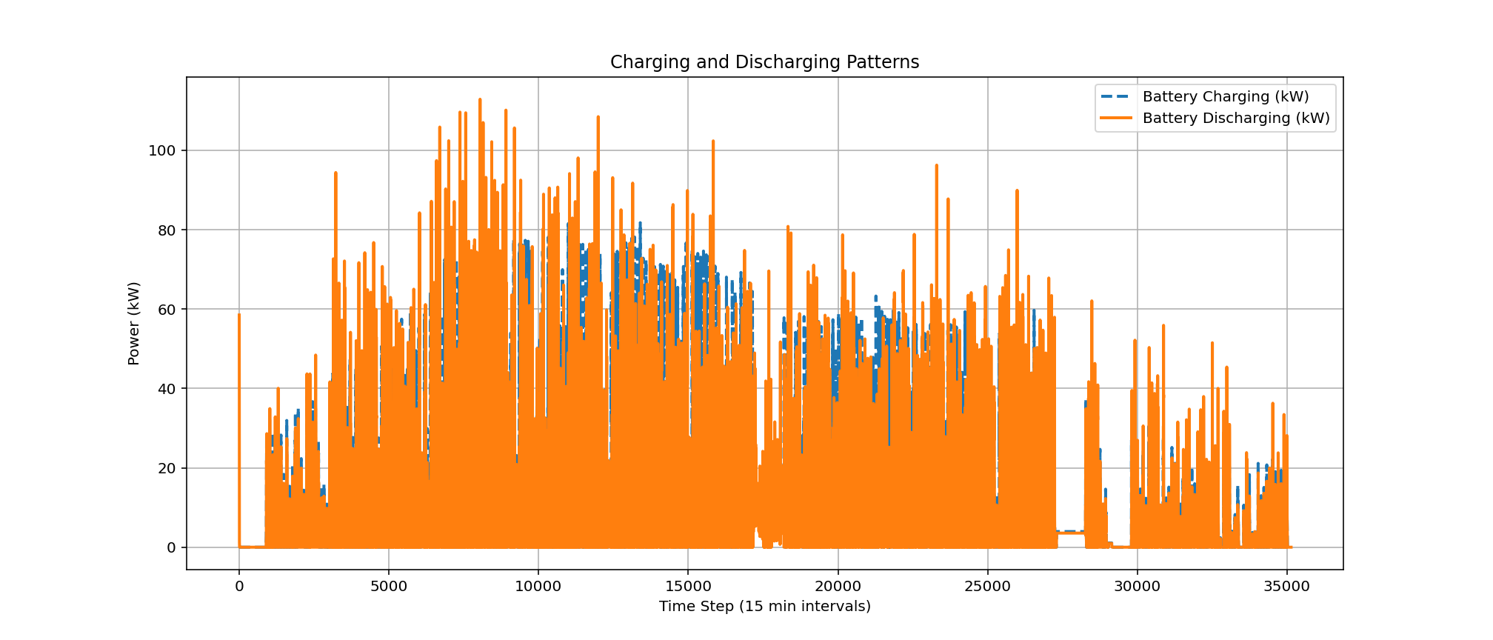
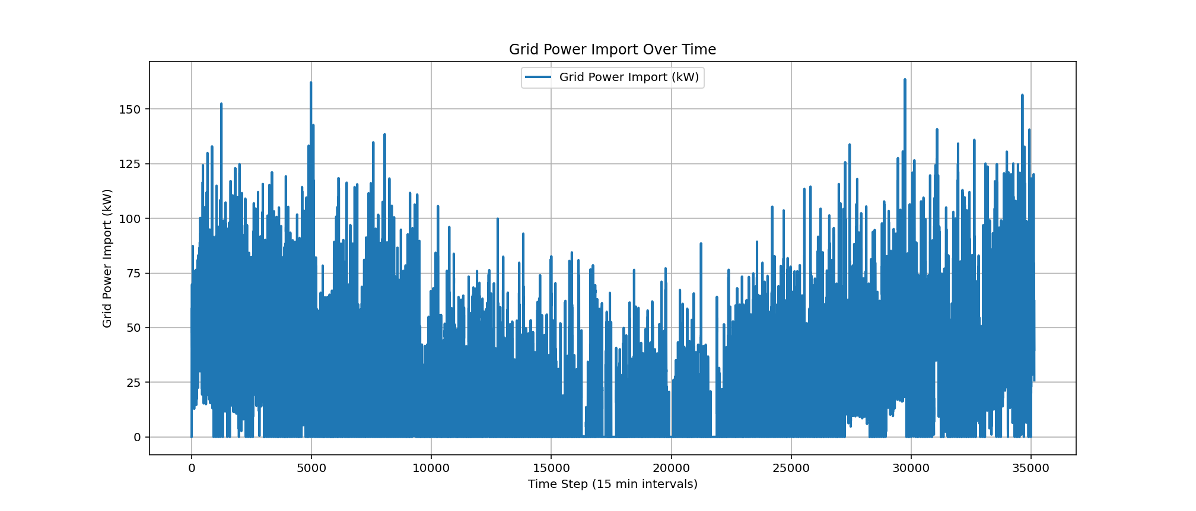
Results

