Slide 1
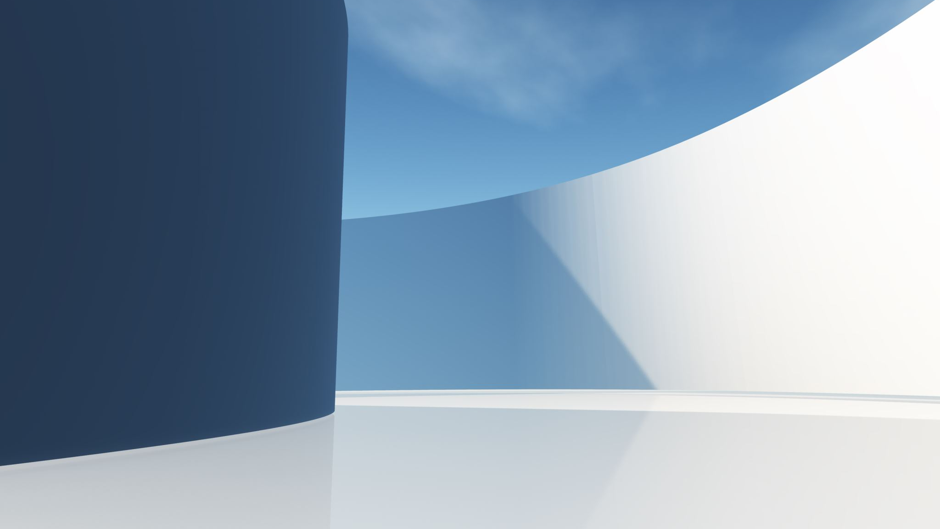
Activera Consulting: The Art of Framework Finding
By: Rowan Kaul, Damien Gonzalez, William Foytlin, Francisco Fuentes, Rayan Khalil, Chibuike Ngwakwe, Rebekah Conner, and Katy Chiv

Slide 2
Table of contents
Project Overview
Phase 1 (Finding Frameworks)
Phase 2 (Creating PowerPoints)
Phase 3 (Refining Classifications)
Phase 4 (Classifying Frameworks)
Live Demonstration
Phase 5 (Next Steps)
Conclusion/Q&A

Slide 3
Project Overview
Build an inventory of 100~ frameworks
Classify frameworks based on variables to solve that problem
Building a database of frameworks
Stretch Goal: Build a light-weight recommendation engine

Slide 4
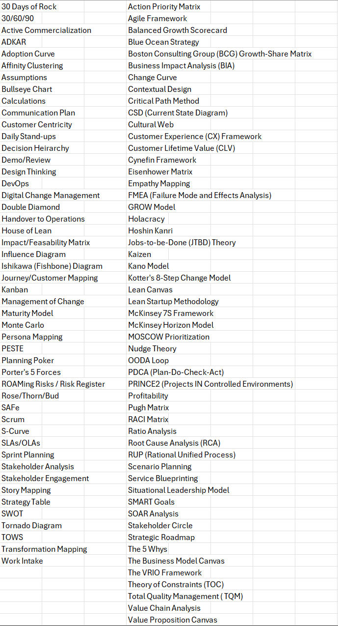
Phase 1: Finding frameworks
Our task was to find frameworks for the database/recommendation engine
Left column: 48 frameworks by Activera
Right column: 52 frameworks found by our group
Notes:
In order to build a proper recommendation engine, we had to expand from the original 48 frameworks provided by Activera so that results from the engine could include more frameworks or even touch base on more parameters. During our time working on this project, we were able to research and add an additional 52 frameworks (included with PowerPoints) bringing the total pool of frameworks to 100. Our original goal when first starting this project was to bring the total to at least 100 frameworks or above and having completed this we were able to shift to more important parts of the project (defining new parameters) quicker.

Slide 5
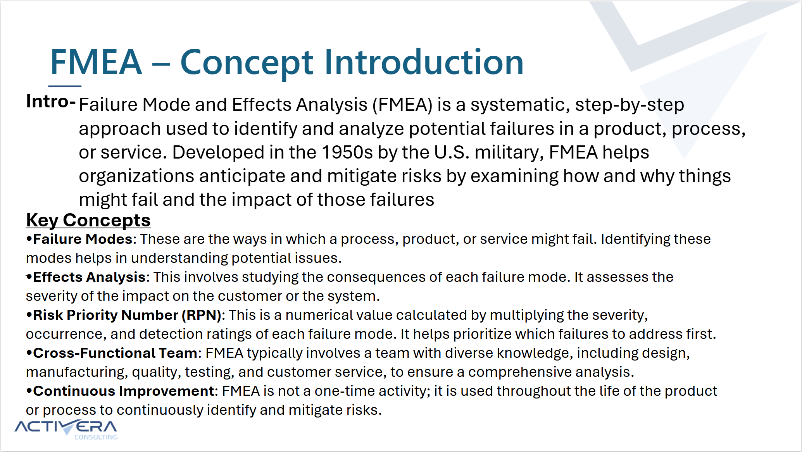
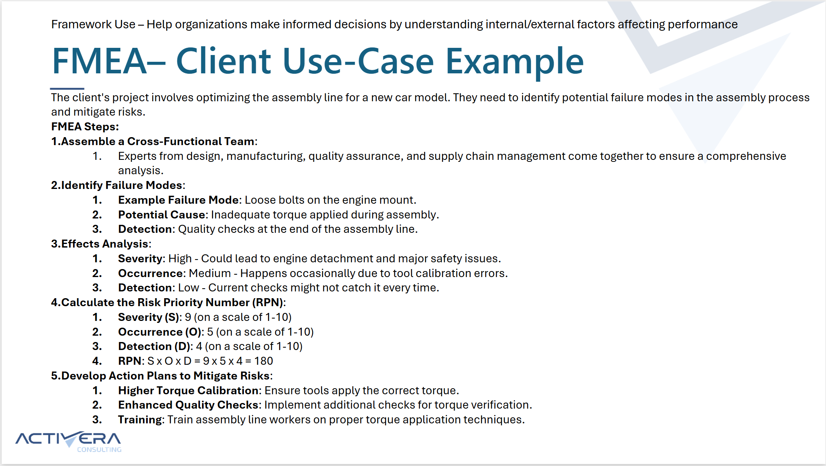
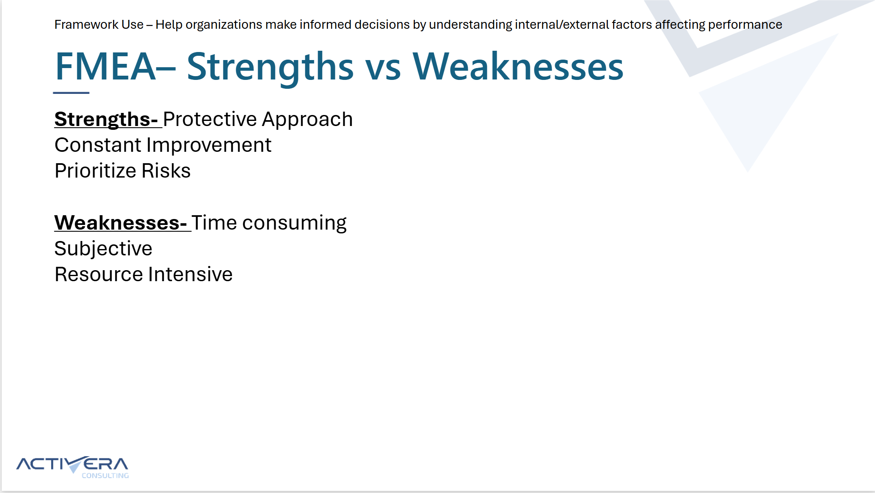
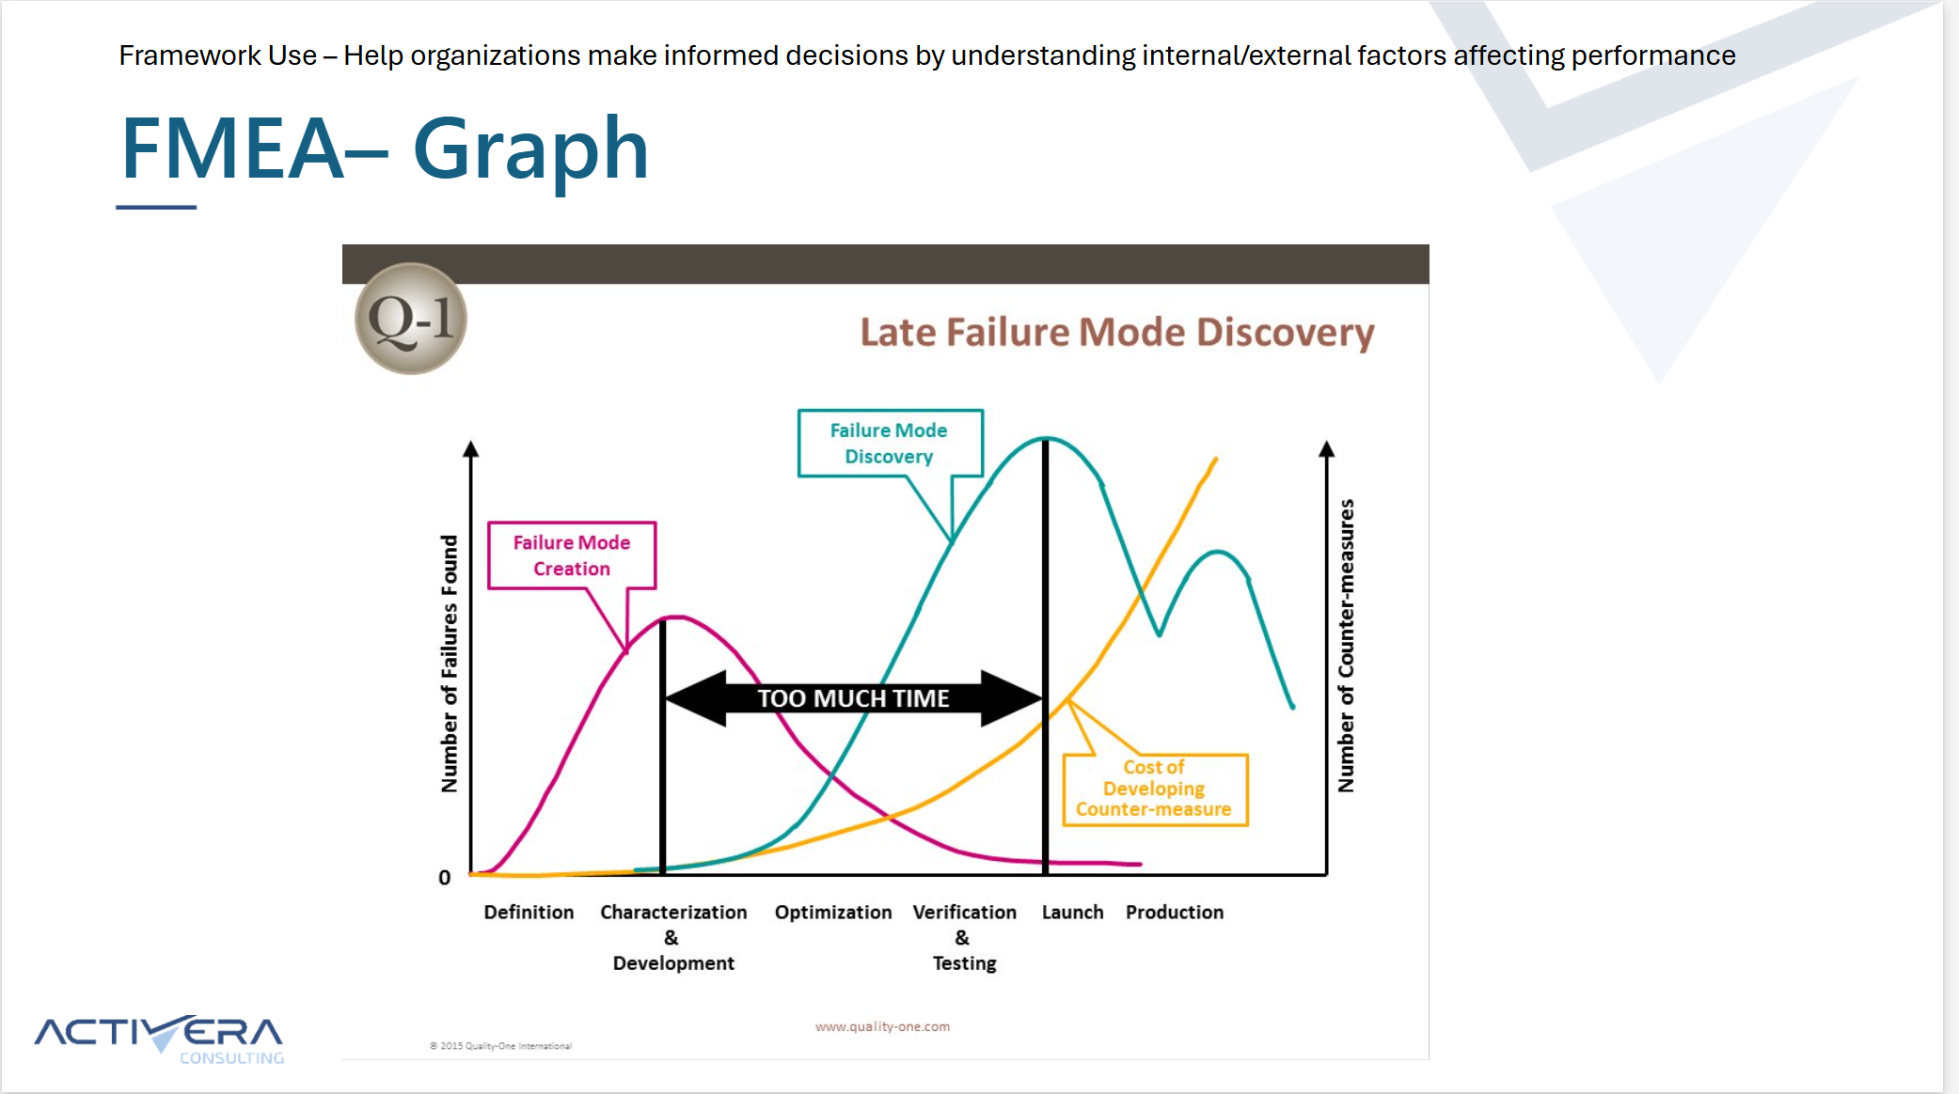
Phase 2: Creating PowerPoints
The 100 frameworks were divided among 8 of us.
PowerPoints were made using the Activera template
Concept Introduction
Client Situation
Use-Case Example
Strengths Vs. Weaknesses
Graph
Example:
FMEA (Failure Mode and Effects Analysis!).pptx
Notes:
For Phase Two, we decided to divide 100 frameworks among 8 of us. We used the Activera powerpoint template. On the powerpoints we mentioned some quick definitions, key concepts, client use examples, strengths vs weaknesses, and a graph to show the effectiveness of the framework. Breaking down each framework on these powerpoints will help show how to execute each framework effectively.

Slide 6
Phase 3: Refining Classifications
Original Parameters | Additional Parameters
Change Factor Planning Type Timeline Range Problem Type Repeatability | Ease of Integration Market Dynamics Risk Tolerance Organization Structure Company Size
New parameters were added to better align frameworks with client needs.
Replaced ‘Planning Type’ with an ‘Ease of Integration’ scale to enhance user experience.
Notes:
Our objective was to ensure that the frameworks matched the client’s resources for tailored framework recommendations.
Ease of Integration: Replacing "Planning Type" with "Ease of Integration" enhances user experience by broadening framework choices and reducing constraints on client options.
Market Dynamics: Understanding market stability (volatile vs. stable) helps tailor framework recommendations to expected changes in daily operations.
Risk Tolerance: High-risk tolerance frameworks offer quicker results with more risk, while low-risk tolerance frameworks ensure gradual progress with less risk.
Organization Structure & Size: Classifying frameworks based on company structure and size filters recommendations, aligning with decision-making flow and resource capacity.
Refinement Rationale: Our research showed that frameworks varied beyond initial classifications, prompting the addition of new parameters for better client alignment.

Slide 7


Phase 4: Classifying Frameworks
How Frameworks were classified
We enlisted the help of Artificial Intelligence chatbots to analyze descriptions of the 100 Frameworks we worked on to determine the most relevant classifications.
Engines such as ChatGPT and Perplexity were used in our framework categorization
Excel Document: Activera Consulting Framework Finding Engine
Notes:
One of the key ways we assessed a frameworks classification is by comparing its strengths and weaknesses
Ex. A strength of Porter’s value chain analysis is Organizational changes , making "Internal" the most applicable classification
By providing practical examples and analyzing strengths and weaknesses we determined which frameworks belonged in certain classifications
The tornado diagram proved helpful in a situation where there were multiple high risk factors. So Volatile proved most correct.

Slide 8
DEMO Slide
Company X Parameters
Company Y Parameters
Change Factor: External
Problem Type: Other
Company Size: Medium
Time Horizon: 1-3 Months
Ease of Integration: Easy
Market Dynamics: Volatile
Risk Tolerance: High
Organizational Structure: Other
Repeatability: Yes
Change Factor: Internal
Problem Type: Organization
Company Size: Small
Time Horizon: 1-3 Months
Ease of Integration: Easy
Market Dynamics: Stable
Risk Tolerance: Low
Organizational Structure: Flat
Repeatability: Yes
Framework Finding Engine Demo.xlsx
Notes:
Demo 1 should only have one framework recommendation and Demo 2 should have two outputted. I have screenshots of the pivot table output if we want to put that in the slides but I don’t think we'll need them since we're doing a live demo of it.

Slide 9

Phase 5: Next Steps
Expanded Database of Frameworks
Excel linked to engine app
Integrated AI Chatbot

Slide 10

Conclusion / Q&A
Notes:
What we learned:
Throughout this project, our team has gained extensive knowledge and grown considerably. We had the opportunity to explore a diverse set of frameworks, learning how each one could be applied in different contexts to address various challenges. This exposure allowed us to identify the strengths and limitations of each framework and, as a result, develop additional classifications to better organize them. By refining and expanding these classifications, we enhanced the structure and usability of the current framework engine, making it more functional and adaptable. This experience has not only sharpened our technical skills but also fostered a collaborative problem-solving approach that will be invaluable in future projects.
Thanks:
As we conclude this project, I want to extend our heartfelt thanks to Activera Consulting for the opportunity to contribute. We’ve thoroughly enjoyed not only learning about various frameworks but also getting to know Activera itself.

