Slide 1

1/9
AI IN CYBERSECURITY:
ANOMALY DETECTION SYSTEMS​
Francisco Fuentes & Jimmy Ma​

Slide 2

2/9
Challenges of traditional threat detection methods​
How AI-based anomaly detection works​
Real-world cybersecurity use cases​
Risks and limitations of AI adoption​
Governance and best practices for organizations​
AGENDA/
OVERVIEW
www.aicybersecurity.com

Slide 3

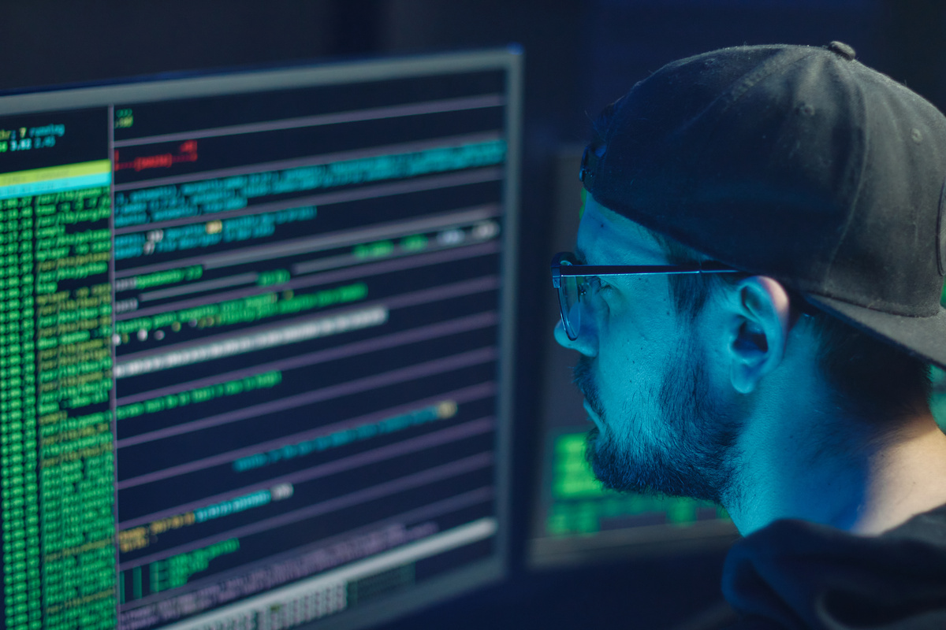
3/9
TRADITIONAL THREAT DETECTION​ LIMITATIONS
Traditional systems rely on predefined rules and known attack signatures​
New or evolving threats may go undetected if they do not match existing patterns​
Large numbers of false positives can overwhelm security analysts​
Manual investigation slows response time and increases analyst fatigue​
​
www.aicybersecurity.com

Slide 4



4/9
AI can analyze large volumes of network and user activity much faster than humans​
Machine learning identifies unusual behavior that may indicate a cyber threat​
AI helps reduce analyst workload by prioritizing suspicious events​
Faster detection can shorten breach lifecycles and improve incident response​
​
AI-BASED THREAT DETECTION​
www.watchguard.com

Slide 5


5/9
EXAMPLES OF AI CYBERSECURITY​
IBM Security on Threat Detection​
Automating Vulnerability Discovery
As AI develops, cyber attacks continue to become sophisticated and difficult to manage.​
IBM Security has utilized AI in threat detection to accelerate alert investigations and triage by 55% with AI-powered risk analysis.​
Dynamic Application Security Testing (DAST) is a method that simulates attacks on an application while running to identify potential vulnerabilities.​
Implementations of AI within DAST applications have created the automation of certain tasks and allowed for humans to redirect their focus and attention.​
www.IBM.com

Slide 6

6/9
AI systems can misclassify threats and still produce false positives or false negatives​
Overreliance on AI may reduce human judgment in high-risk security decisions​
Attackers may target AI systems through adversarial inputs or prompt injection techniques​
Some AI tools lack transparency, making it difficult to explain how decisions were made​
​
​
RISKS
LIMITAITIONS
www.aicybersecurity.com

Slide 7
7/9
GOVERNANCE AND BEST PRACTICES​
01
02
03
In the current landscape of modern technology, firms should prioritize hiring and training talent with AI expertise in cybersecurity for an understanding of AI systems and attack methods.
Organizations should thoroughly assess the business practices and governance policies of third-party vendors with an emphasis on clear communication.
System transparency is critical for avoiding black box systems, especially for cybersecurity firms that work to protect sensitive information.
www.harvard.edu/blog

Slide 8

8/9
THANK
YOU!
www.aicybersecurity.com

Slide 9
9/9
Artificial Intelligence (AI) cybersecurity solutions. IBM. (n.d.). https://www.ibm.com/solutions/ai-
cybersecurity ​
Short, L. (2025, August 1). Ai and the future of Cybersecurity. Harvard Extension School.
https://extension.harvard.edu/blog/ai-and-the-future-of-cybersecurity/#How-AI-Enables-the-Next-
Generation-of-Cyber-Attacks- ​
Vazquez, I. (2023, September 21). Economic impact of automation and Artificial Intelligence:
WatchGuard Technologies. WatchGuard Blog. https://www.watchguard.com/wgrd-
news/blog/economic-impact-automation-and-artificial-intelligence ​
Watkins, O. (2024, April 19). 4 use cases for AI in cyber security. Red Hat.
https://www.redhat.com/en/blog/4-use-cases-ai-cyber-security ​
REFERENCES
www.aicybersecurity.com

