Slide 1




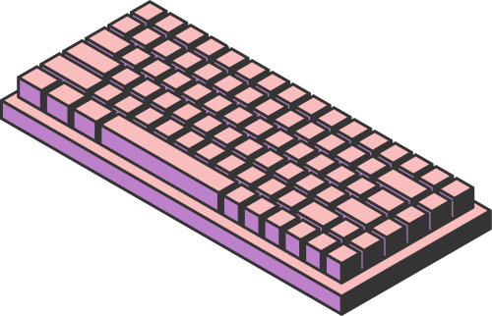
FRANCISZEK
KALEMBKIEIWCZ
PREDICTION
IN SPORTS
Can we predict sports results? Let’s explore two methods and check if predictions can be trusted. In this presentation, I’ll show two different approaches to predicting football results and discuss their reliability.
Page 01

Slide 2

FRANCISZEK
KALEMBKIEIWCZ
INTRODUCTION
Sports are full of surprises. Predicting results is difficult because of the human factor, unexpected events, and the nature of the game itself.
In this presentation, I will test two prediction methods — one based on statistics and another using machine learning — to check if it is possible to predict the final results of a football season.
The main goal is to answer:
Are sports predictable, or are predictions always uncertain?
Page 02

Slide 3


FRANCISZEK
KALEMBKIEIWCZ
PREDUCTION
METHODS OVERVIEW
STATISTICAL METHOD (ELO + PROBABILITY)
MACHINE LEARNING METHOD
Based on historical team performance and ELO ratings, this method calculates the probability of each match outcome and simulates the entire season.
A model trained on past seasons' data predicts the average number of points each team will get in the upcoming season.
Page 03

Slide 4
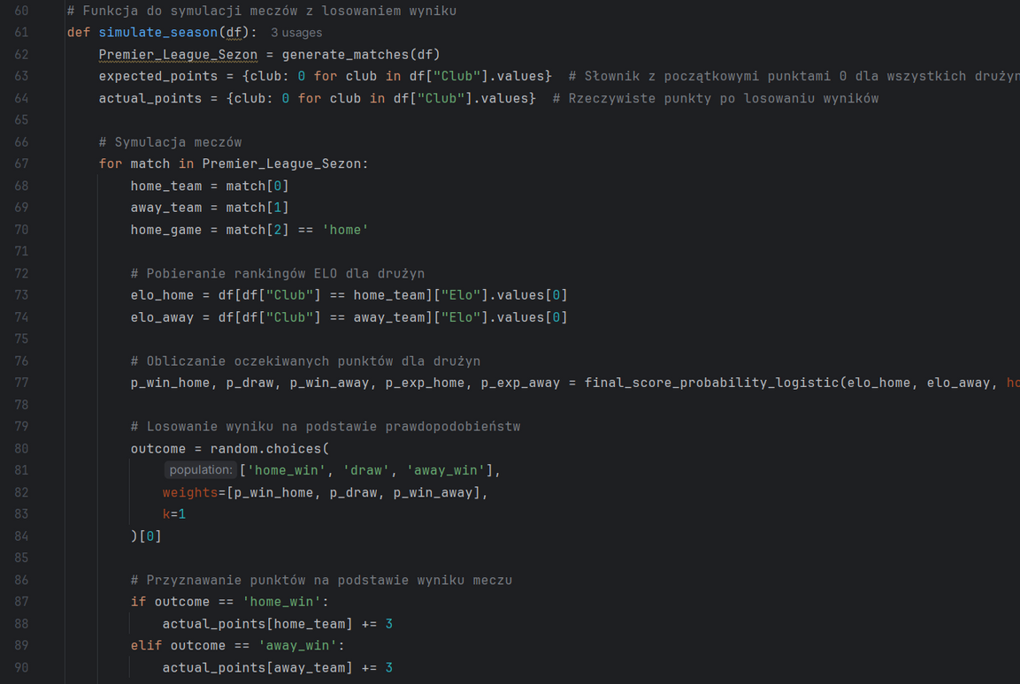
FRANCISZEK
KALEMBKIEIWCZ
STATISTICAL METHOD
ELO & PROBABILITY
This method uses historical ELO ratings to calculate the probability of each match result.
Based on these probabilities, two types of results are generated:
— Expected Points — the average points a team should get, calculated from probabilities.
— Simulated Points — random points generated from the same probabilities, representing one possible scenario of the season.*
This approach shows how likely each outcome is, but not the exact final result.
Page 04

Slide 5
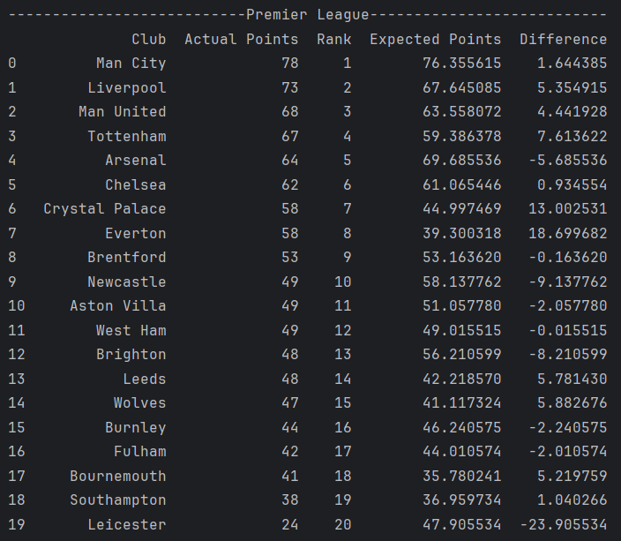
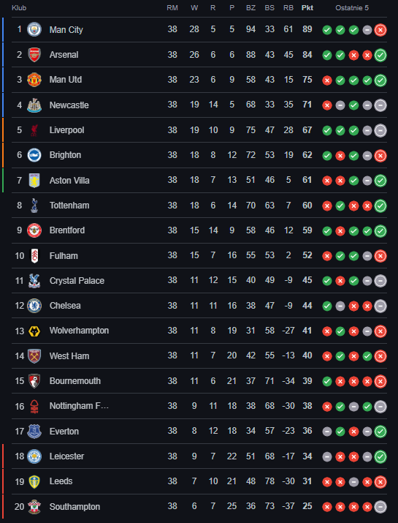
STATISTICAL METHOD
RESULTS
FRANCISZEK
KALEMBKIEIWCZ
Page 05

Slide 6
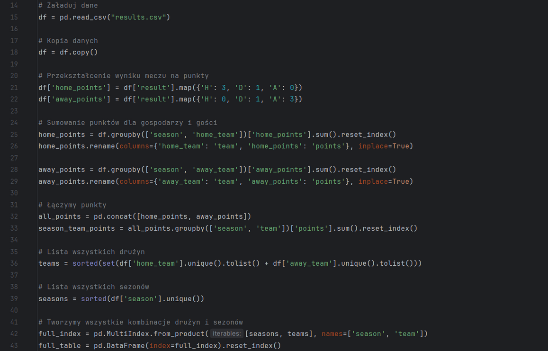
FRANCISZEK
KALEMBKIEIWCZ
MACHINE LEARNING
METHOD PREDICTING POINTS
This method uses historical season data to train a machine learning model.
The model predicts the expected average number of points a team will collect in the upcoming season, based on patterns from past results.
Unlike the statistical method, here the prediction is not based on probabilities, but on learned trends in the data.
Page 06

Slide 7

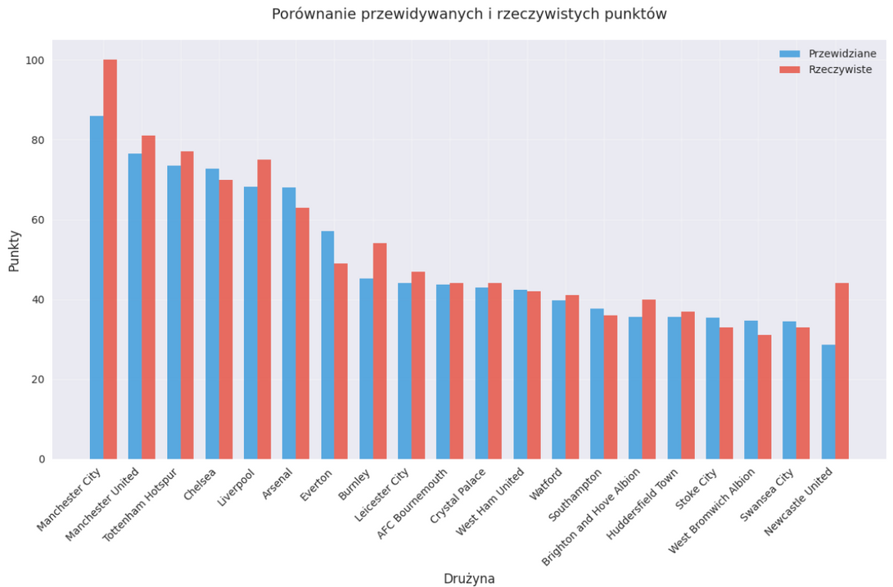
MACHINE LEARNING
RESULTS
FRANCISZEK
KALEMBKIEIWCZ
Page 07

Slide 8



FRANCISZEK
KALEMBKIEIWCZ
CONCLUSIONS
PREDICTION LIMITS
MIDDLE OF THE TABLE IS PREDICTABLE
TOO MANY HUMAN FACTORS
PREDICTIONS ARE NOT REALITY
Sports results depend on injuries, motivation, mistakes, and emotions. Numbers alone can’t capture all of this.
Predictions for mid-table teams are usually close to reality, but extreme cases — top and bottom teams — are much harder to predict.
Even advanced models can only show likely scenarios, not exact outcomes. The real world is always more random.
Page 08

Slide 9
FRANCISZEK
KALEMBKIEIWCZ
FINAL
CONCLUSION
After testing both prediction methods, the hypothesis has been confirmed.
It is not possible to predict sports results with full accuracy.
While mathematical models and machine learning can show us tendencies and give a general view of possible outcomes, the real world is far more complex.
Human factors, emotions, unexpected events and pure luck make football — and sports in general — too unpredictable for any model to be fully reliable.
Predictions are useful for understanding the game, but they will always remain only an approximation, not a guarantee.
Page 09

Slide 10




FRANCISZEK
KALEMBKIEIWCZ
THANK YOU
FEEL FREE TO ASK QUESTIONS
Page 10

