Slide 1
Project 6
One channel EEG sleep staging with open source and open hardware NeuroOn sleep mask
Project Leader:
Franciszek Rakowski PhD
Participants:
Andrey Alekseenko, Charlie Sexton, Michał Narbutt

Slide 2
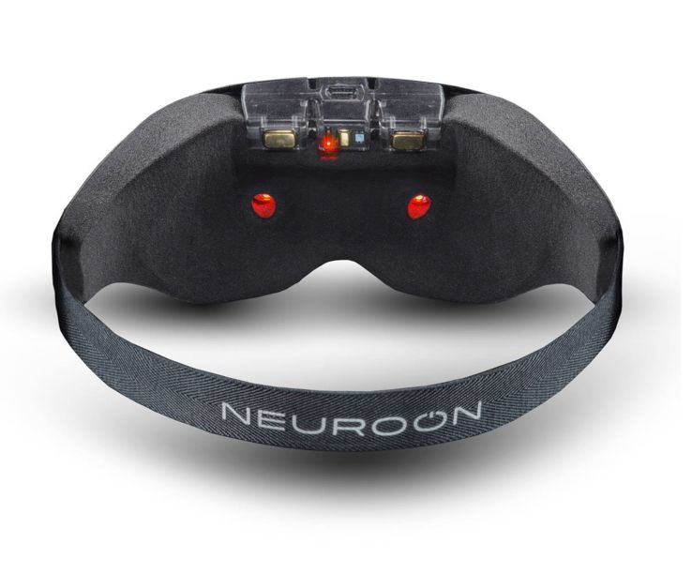
Goal
Detect sleep stages from single channel differential EEG Δ(FP1, FP2)

Slide 3
Method
Preprocessing
Features
Classification
Jitter removal

Slide 4
Preprocessing
11 sleep recordings
Each divided into 30s epochs
Removal of corrupt epochs – NaN
Removal of one recording with >40% corrupt epochs
Butterworth Filter, Bandpass 0.5-25 Hz
Power Spectral Density – Welch

Slide 5
Method
Preprocessing
Features
Classification
Jitter removal

Slide 6
Feature Engineering
Power spectrum of different waves (alpha, beta, delta, theta, mu, SMR, K-complexes)
Also their logarithms
Signal mean, stdev, skew, and kurtosis
Hjorth parameters
SEF50, SEF90

Slide 7
Method
Preprocessing
Features
Classification
Linear SVM
Not worked: Random Forest, CNN ¯\_(ツ)_/¯
Jitter removal

Slide 8
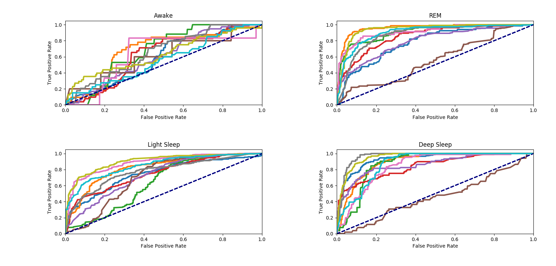
ROC Curves

Slide 9
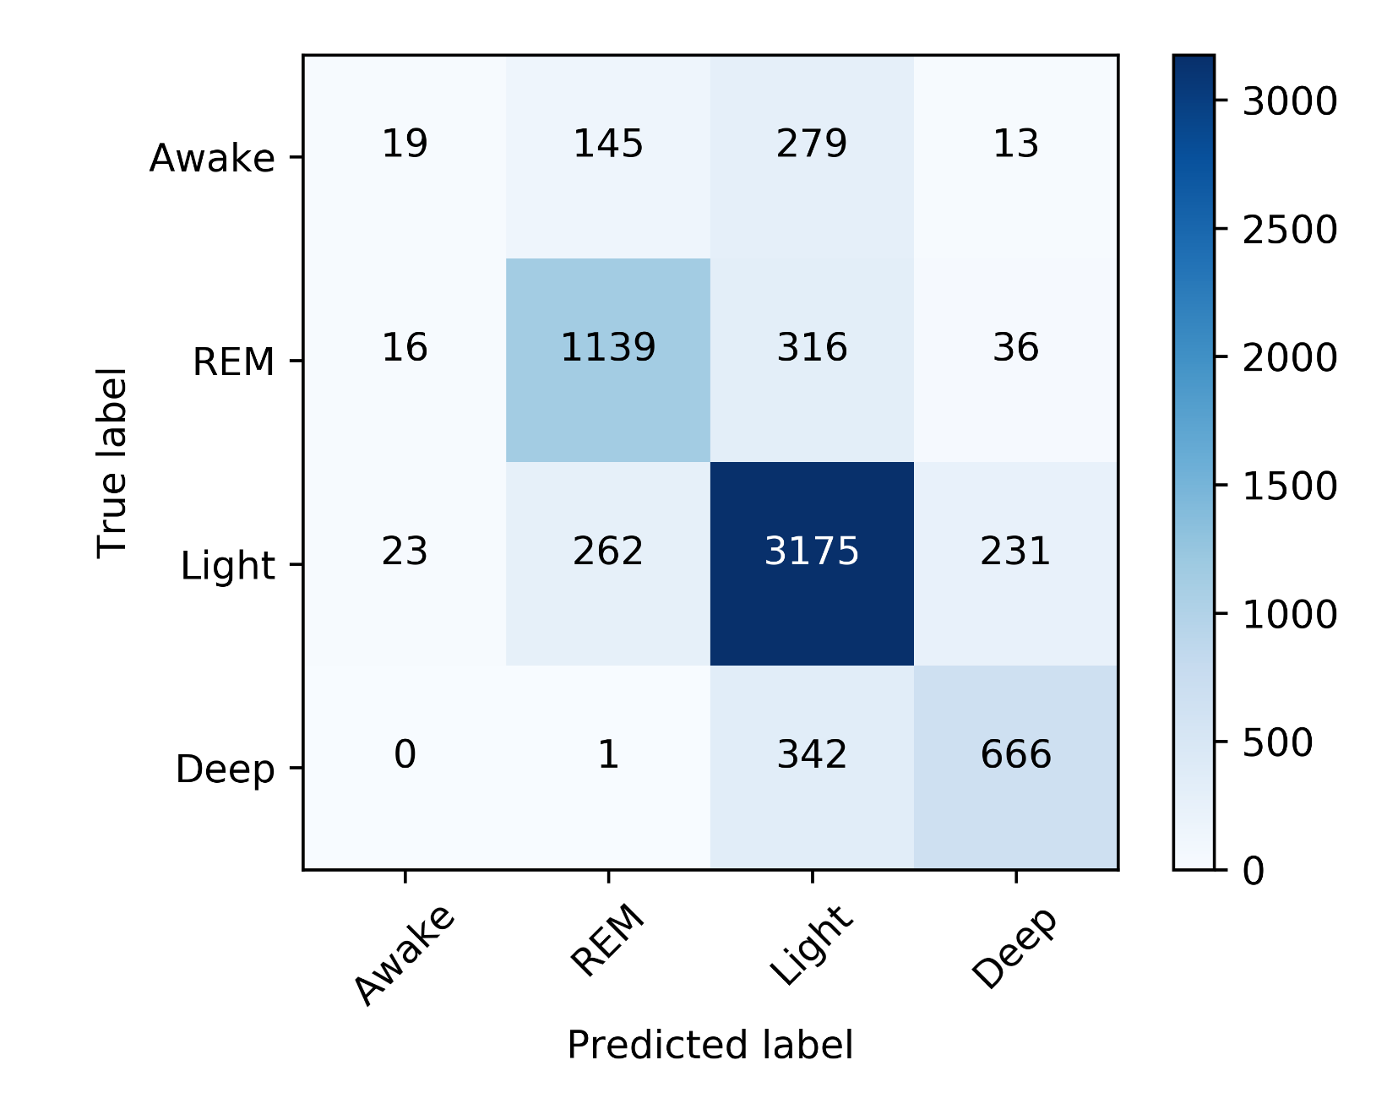
Confusion Matrix

Slide 10
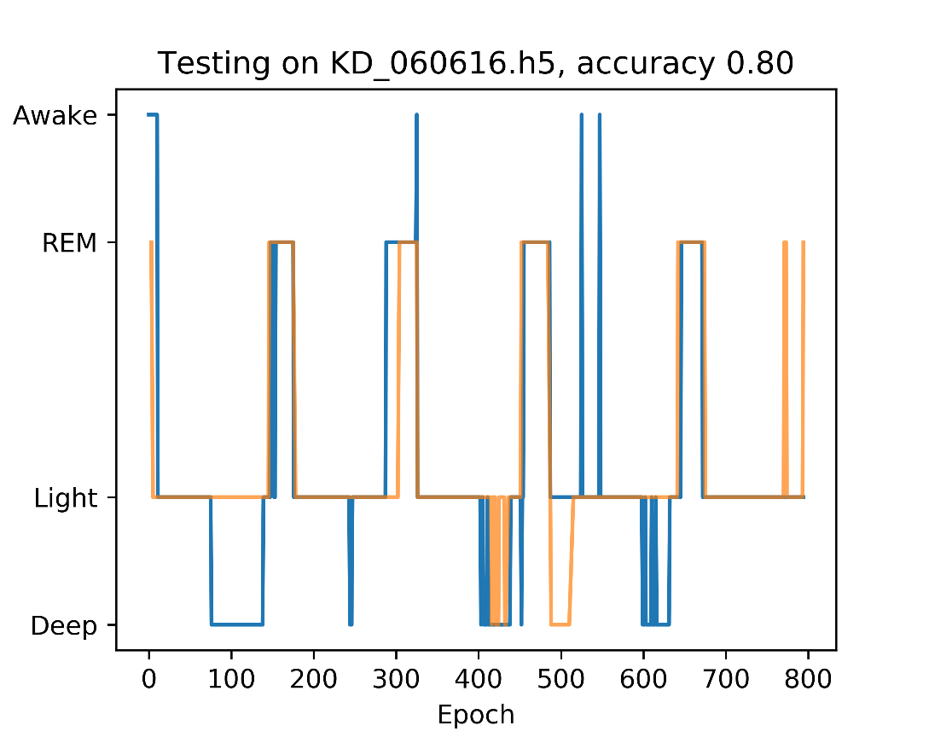
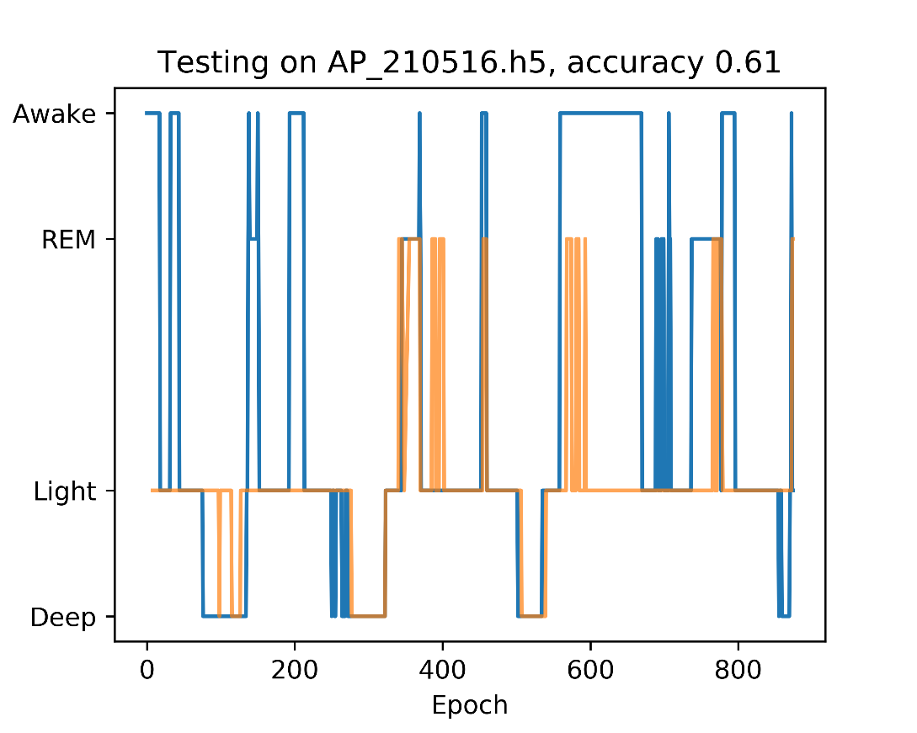
Classification results
Reference, Classification

Slide 11
Conclusion
Accuracy 75±6 % on Δ(FP1, FP2)
State of the art:
90% on Pz-Oz [1]
77±4 % on FP1, FP2 [2]
Does not detect wakefulness well
[1] da Silveira, Kozakevicius, Rodrigues, 2017.
[2] Huang, Lin, Ko, Liu, Su, Lin, 2014.
Notes:
90%: da Silveira, T.L.T., Kozakevicius, A.J., Rodrigues, C.R., 2017. Single-channel EEG sleep stage classification based on a streamlined set of statistical features in wavelet domain. Med. Biol. Eng. Comput. 55, 343–352. doi:10.1007/s11517-016-1519-4
77%: Huang, C.S., Lin, C.L., Ko, L.W., Liu, S.Y., Su, T.P., Lin, C.T., 2014. Knowledge-based identification of sleep stages based on two forehead electroencephalogram channels. Front. Neurosci. 8, 1–12. doi:10.3389/fnins.2014.00263

