Slide 1
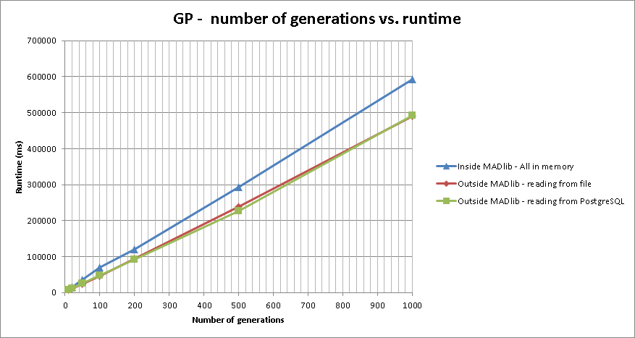
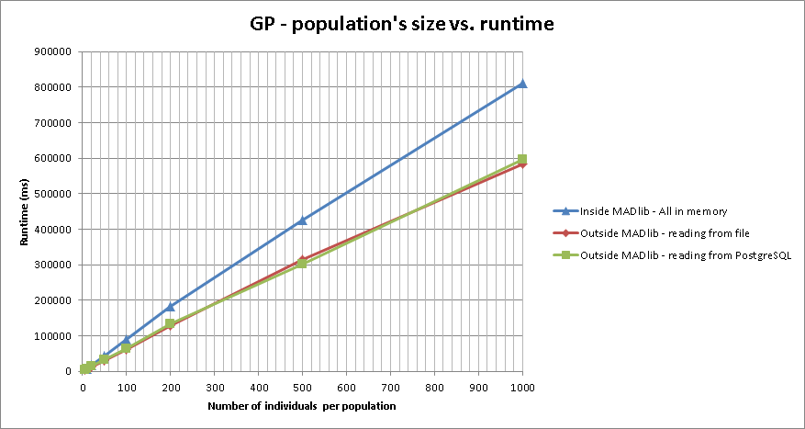
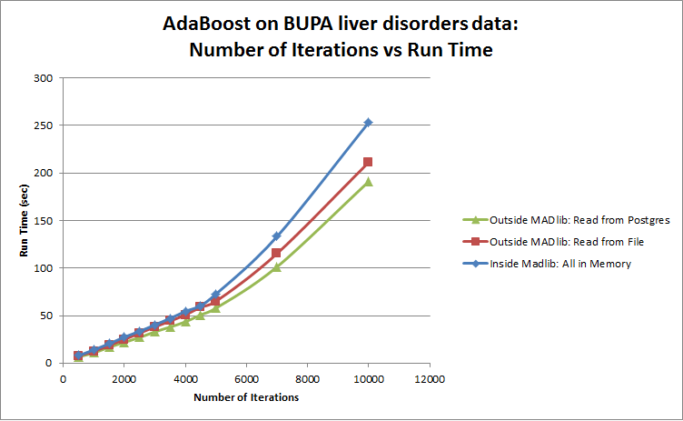
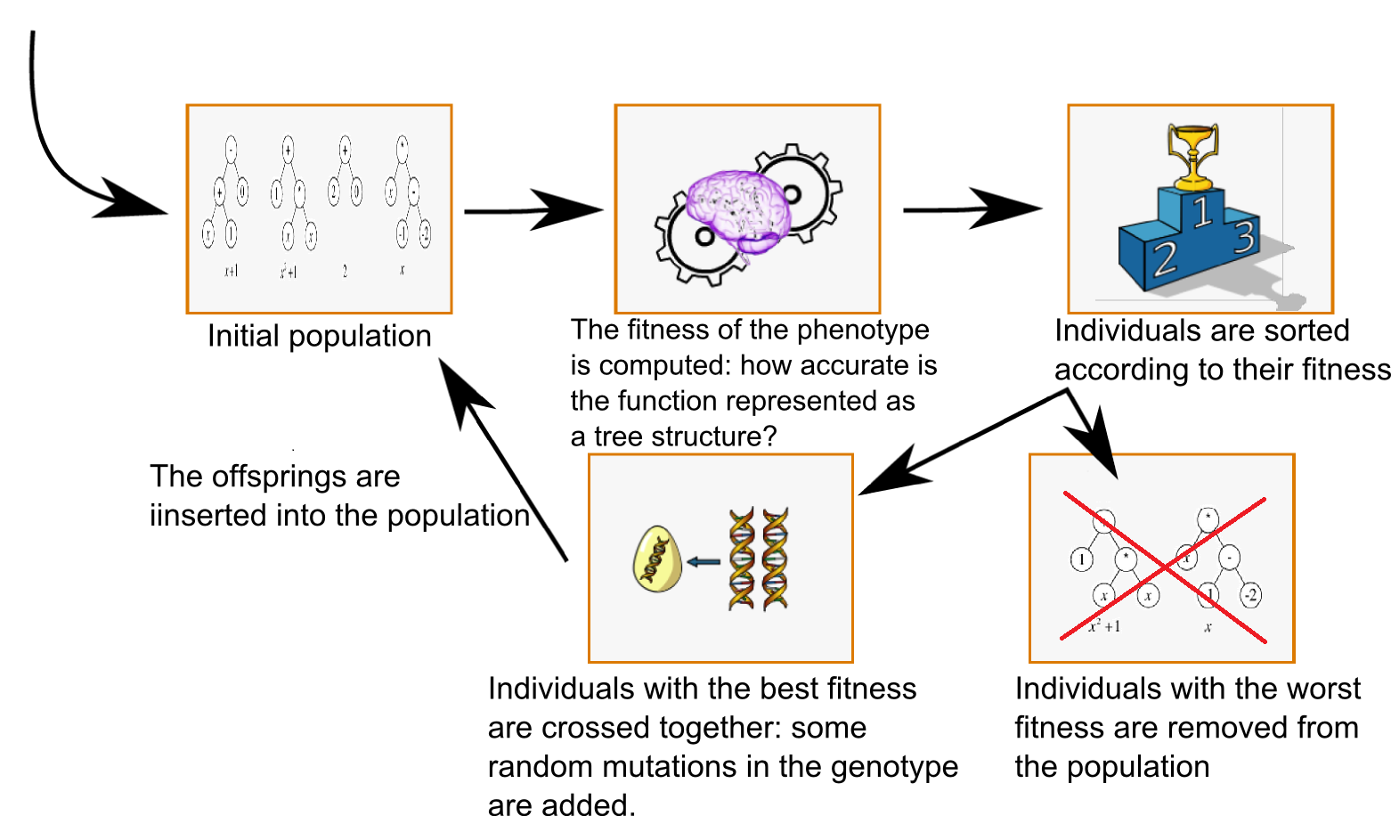
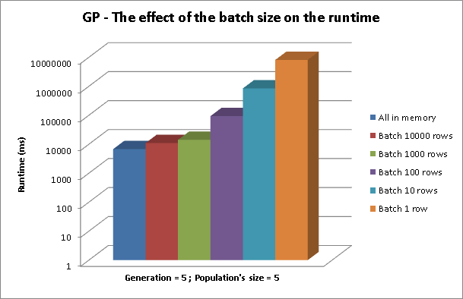
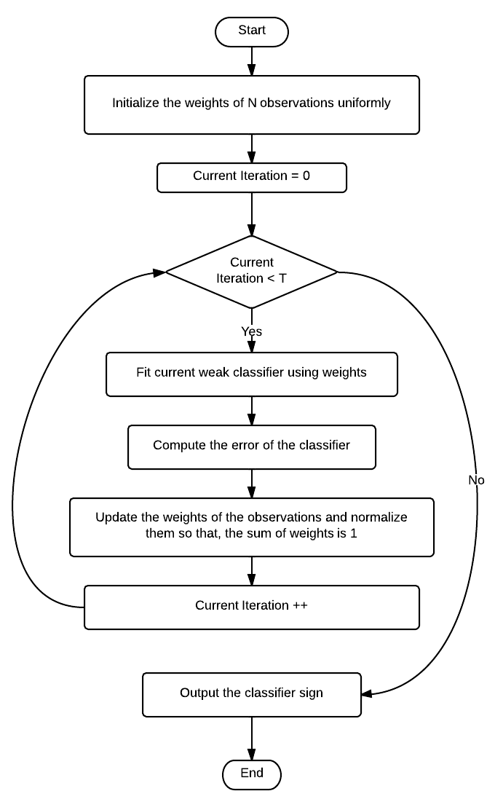
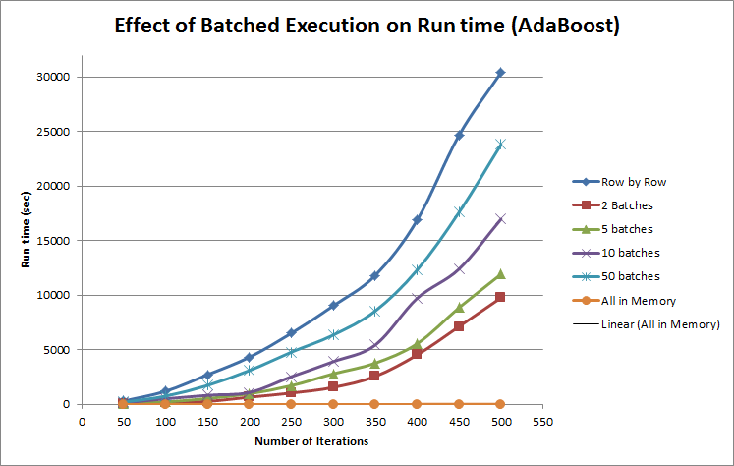
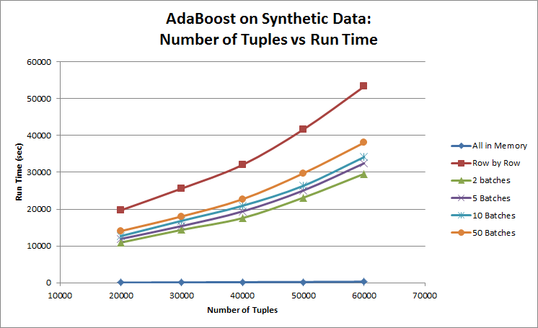
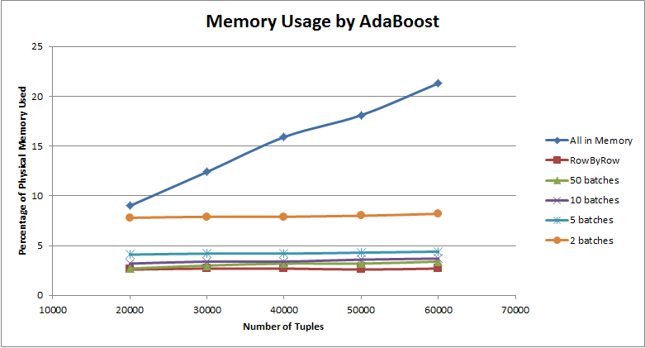

Machine Learning Algorithms for In-Database Analytics
Franck Dernoncourt and Sumaiya Nazeen
MIT
6.830
Spring
2013
Introduction
Performance Analysis
Our project focused on extending the functionality of MADlib. MADlib is an open source machine learning and statistics library which works with Postgres or Greenplum to provide in-database analytics.
Although some machine learning algorithms have been implemented in MADlib, there is room for additional contributions. We implemented two different machine learning algorithms, symbolic regression with genetic programming and adaptive boosting for MADlib, and are in the process of contributing our code to the MADlib community codebase.
We also assess the performance of our implementations and compare their performance with the same algorithms outside MADlib.
Effect of Varying Independent Variables on Run Time:
Performance With and Without MADlib:
Implemented Algorithms
Symbolic Regression using Genetic Programming:
Effect of Batched Execution on Run Time:
Adaptive Boosting:
Effect of Varying Independent Variables on Memory Usage:
Implementation Challenges
Challenge: Both the algorithms are iterative in nature so they need to make many passes over a data set.Traditional SQL based workarounds do not seem to work well to solve this problem.
Workaround: We chose to implement complex iterative UDFs in Python to control the iterations over datasets. One potential pitfall of such implementation is the UDF has to pull a large amount of data out of database. Our UDFs store intermediate results of each iteration into temorary tables and reuses them in subsequent iterations. Final outputs are also written in tables.
Conclusions
Run time increase as we increase the number of independent variables.
Running the algorithms using MADlib takes more time than bypassing MADlib altogether when data can be fit into memory.
Running the algorithms using MADlib is advantageous when the dataset cannot be fit into memory.
Batched execution is more efficient in terms of run time than row by row execution in terms of run time. It is more efficient than reading the whole dataset into memory in terms of memory usage.
Benchmark Components
Experimental Setup: We ran the benchmark on PostgreSQL 9.1.9 and MADlib v3.0 on a single machine on a gigabit ethernet cluster which runs Ubuntu 12.04 LTS and has 4GB RAM, a 10GB SATA HDD and a Core 2 Duo 2.4GHz CPU.
Dataset: For benchmarking the performance of GP for Symbolic Regression we used a synthetic dataset containing 100,000 rows, 3 inputs and 1 output. The function we use to generate the data is x1*(x2^2+x3).
For benchmarking the performance of AdaBoost, we used BUPA liver disorder dataset which contains blood test results of 345 male individuals. We also used synthetic datasets which consisted of Nx11 matrices where first 10 columns are real valued random numbers and the last column indicate the class.
References
Hellerstein, Joseph M., et al. "The MADlib analytics library: or MAD skills, the SQL." Proceedings of the VLDB Endowment 5.12 (2012): 1700-1711.
Cohen, Jeffrey, et al. "MAD skills: new analysis practices for big data." Proceedings of the VLDB Endowment 2.2 (2009): 1481-1492.
6.830 : Database System – Poster Session – May 15, 2013

