Slide 1
Panther Food Pantry Management System
Software architecture: four options and one recommendation
CINS 5318 Software Engineering · Prairie View A&M University · Fall 2026
Notes:
Introduce the team and the goal of this talk: we considered four architectures for the pantry system, chose one, and will show why it is correct, secure and finishable by November 19.

Slide 2
Our recommendation: Option B
A React single-page app and a FastAPI modular monolith over PostgreSQL, shipped as one Docker container.
1
2
3
Uses every tool we committed to
Splits cleanly across 8 people
Finishable by November 19
Jira, Figma, VS Code, GitHub Actions, API tests and Docker (Homework 2) each have real work to do.
Two UI developers, two backend developers, DevOps and testing, project management and documentation.
Six one-week sprints, code freeze Nov 15, and a fallback to the simpler Option A if we are behind on Oct 29.
The rest of this deck shows the four options, how they compare, and the detailed design of Option B.
Notes:
Lead with the answer. Three reasons: it fits the tools in our Homework 2 report, it gives every team member clear ownership, and it can be finished on time, with a pre-agreed fallback.

Slide 3
The problem and who uses the system
Today (Proposal §1)
Student
S
Paper forms, spreadsheets and in-person messages
Stock counts drift from what is on the shelves
Students cannot see food availability or request status
Staff re-type the same data into several places
Requests help with a pickup slot, tracks status and history
T
Pantry staff
Approves requests, records donations and distributions
A
Administrator
Manages users, reviews dashboards and reports
Request
Staff review
Pickup slot
Distribution
Stock update
Record
Core workflow from Homework 2 p.1. The distribution step must never leave the stock count wrong.
Notes:
Problem from Proposal section 1. Three roles from Proposal section 3. The workflow chevrons come from Homework 2 page 1. Highlight distribution: it is the step where the system can go wrong, and the design is built around protecting it.

Slide 4
Decisions we made to unblock the design
Question | Decision | Why
Technology stack | Python + FastAPI, React, PostgreSQL | Widely known; transactions and constraints protect stock
Login | Own email + password accounts, httpOnly session cookie | Campus single sign-on needs IT approval we cannot get by Nov 19
Student without an account | Staff help create one; provisional profile if that fails | Stock stays accurate and nobody is turned away
Request vs. appointment | One object: every request includes a pickup slot | One status field, fewer screens, fewer bugs
Inventory detail | Items (catalog) + lots (each delivery, own expiry and shelf) | Enables expiry alerts and first-expired-first-out
Notifications | In-app status now, email next, no SMS | SMS costs money and adds a vendor
Hosting | Free-tier platform + local Docker fallback | Assumed $0 budget; free tiers can sleep when idle
API testing | Bruno instead of Postman | Postman's free plan covers one user (Homework 2 p.3)
Notes:
The proposal left these questions open. Each decision is reversible, but cheaper to change now than later. The one we expect questions on is login: we chose the app's own accounts because campus single sign-on requires IT approval.

Slide 5
Four architecture options
Same requirements, same data model, four different ways to build it
Notes:
All four options implement the same requirements and the same twelve database tables. What changes is where the code runs and who operates it.

Slide 6
From simplest to most cloud-native
A
B
RECOMMENDED
C
D
Server-rendered Django monolith
React SPA + FastAPI modular monolith
Supabase backend-as-a-service
AWS serverless and event-driven
The server builds every HTML page; Django Admin provides staff screens almost free.
One container serves the React app and a JSON API with separate internal modules.
The browser talks to a hosted Postgres; database policies enforce who sees what.
Lambda functions behind API Gateway; events drive email and daily expiry scans.
Best when time is very short or JavaScript skills are weak.
Best for this project: modern, testable, finishable.
Best when a tiny team needs basic screens fast.
Best for many campuses with a paid AWS budget.
Notes:
One sentence per option. A: a classic server-rendered monolith. B: our pick. C: backend-as-a-service, where the database itself enforces security. D: fully serverless and event-driven. The differences are about where logic lives and who runs the infrastructure, not just language choice.

Slide 7
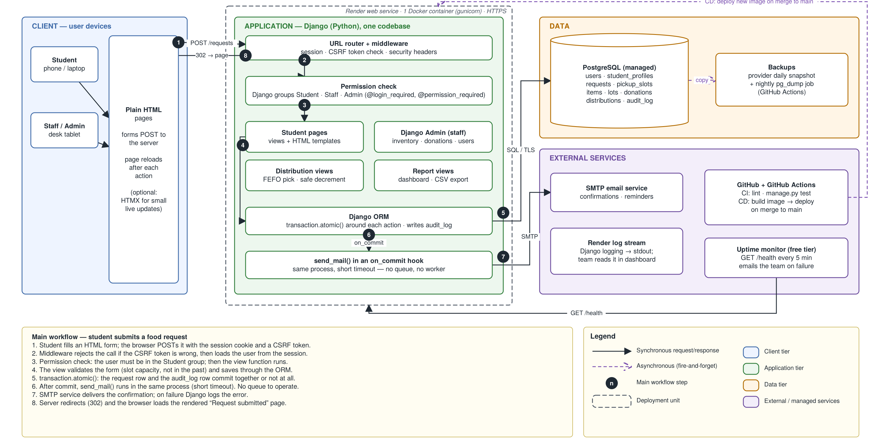
Option A — Server-rendered Django monolith
Steps 1–8: form POST → CSRF + session → permission check → view → transaction → email after commit → redirect to rendered page
Notes:
Walk the numbered steps: 1 the browser posts an HTML form with a CSRF token. 2 middleware checks the token and loads the session. 3 group permission check. 4 the view validates and saves through the ORM. 5 one transaction writes the request and the audit row. 6 and 7 email is sent after commit, inside the same process. 8 the server redirects to a rendered page. Everything runs in one container on Render.

Slide 8
Option A: fastest to build, least to show
+
Strengths
−
Weaknesses
Security
Session cookie, CSRF protection and Django groups built in.
Least code of all four options
Django Admin gives inventory and donation screens almost for free
One language, very well documented
Strong security defaults (CSRF, HTML escaping)
No separate API, so our API-testing plan weakens
Interface feels dated without extra work
Two UI developers have less to own
Email runs inside the request, so a slow mail server slows the click
Cost and scale
One web service and one database, free tier for class. Comfortable far beyond pantry scale; add copies to grow.
Choose it when: the team is weak in JavaScript or time is cut in half. It is our fallback if Option B slips.
A
Notes:
Option A is the safest plan. We keep it as the fallback: if one feature is not working end-to-end on the deployed site by October 29, we switch to server-rendered pages.

Slide 9
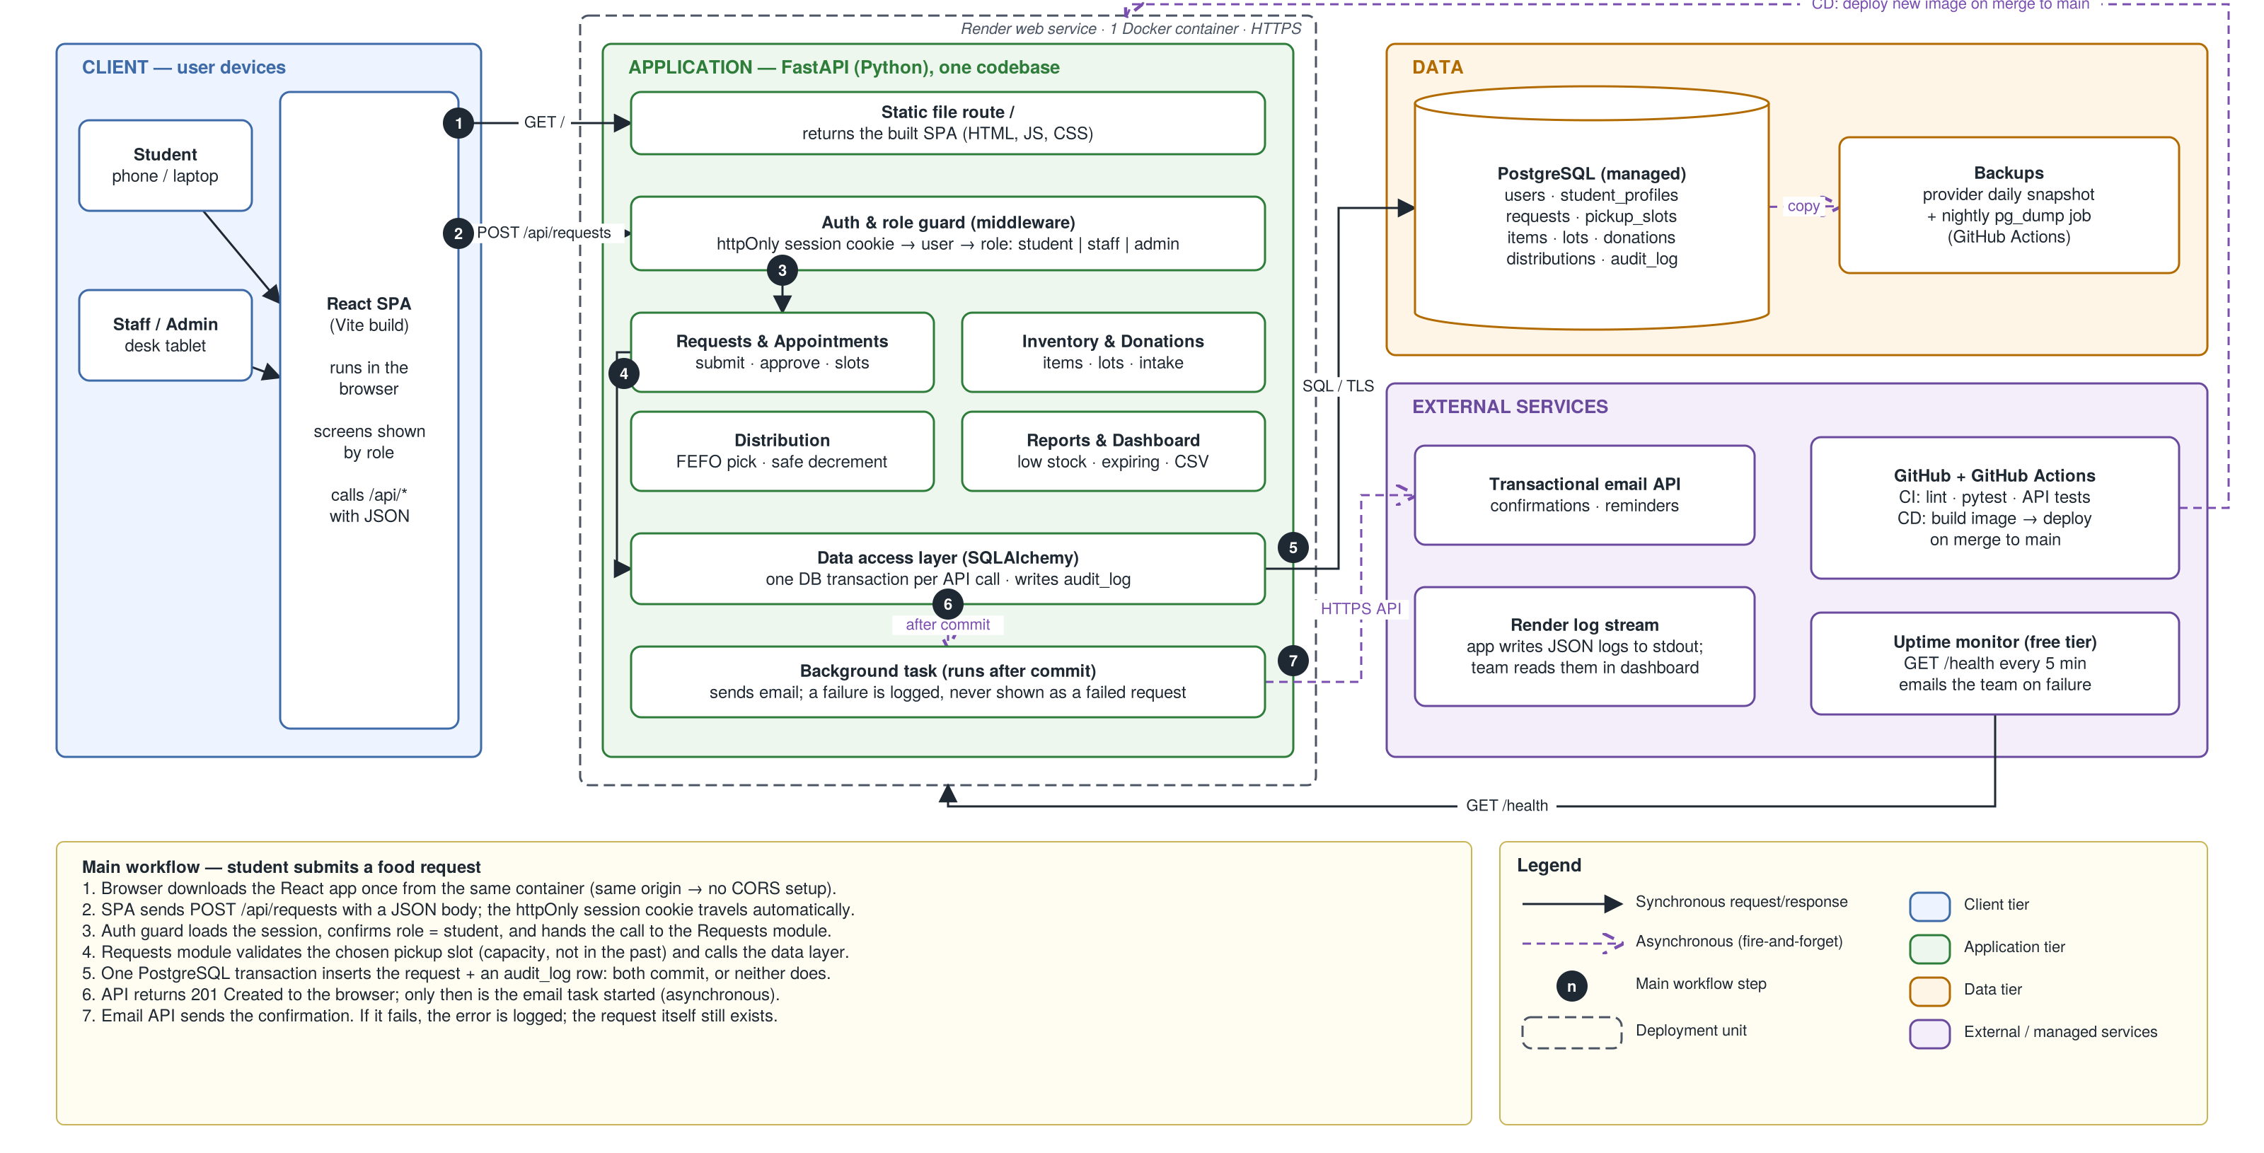
Option B — React SPA + FastAPI modular monolith (recommended)
Steps 1–7: load SPA → POST /api/requests → role check → Requests module → one transaction → email after commit
Notes:
Walk the steps: 1 the browser downloads the React app from the same container. 2 the app sends POST /api/requests with JSON; the httpOnly cookie goes along automatically. 3 the auth guard confirms the role. 4 the Requests module validates the slot. 5 one PostgreSQL transaction writes request plus audit row. 6 the API returns 201, then a background task sends email. 7 the email API delivers it; a failure is logged, never shown as a failed request. GitHub Actions deploys on merge to main; an uptime monitor pings /health.

Slide 10
Option B: modern and still finishable
+
Strengths
−
Weaknesses
Security
Same origin, so the session cookie is httpOnly and SameSite; every endpoint declares its roles; argon2 password hashing.
Clean frontend / backend split for 8 people
Automatic API documentation at /docs
API tests run in CI on every pull request
Same API could later serve a mobile app
Two languages: Python and JavaScript
Staff screens must be built, not generated
More code than Option A
Cost and scale
Same as A. One container handles far more than one pantry; run a second copy behind the load balancer to grow.
Choose it when: the team wants a defensible, modern design that can ship in six weeks. This project.
B
Notes:
Why B: it is a monolith in deployment, so it is simple to run, but modular in code, so eight people can work in parallel without stepping on each other. Same origin means no CORS configuration and safer cookies.

Slide 11
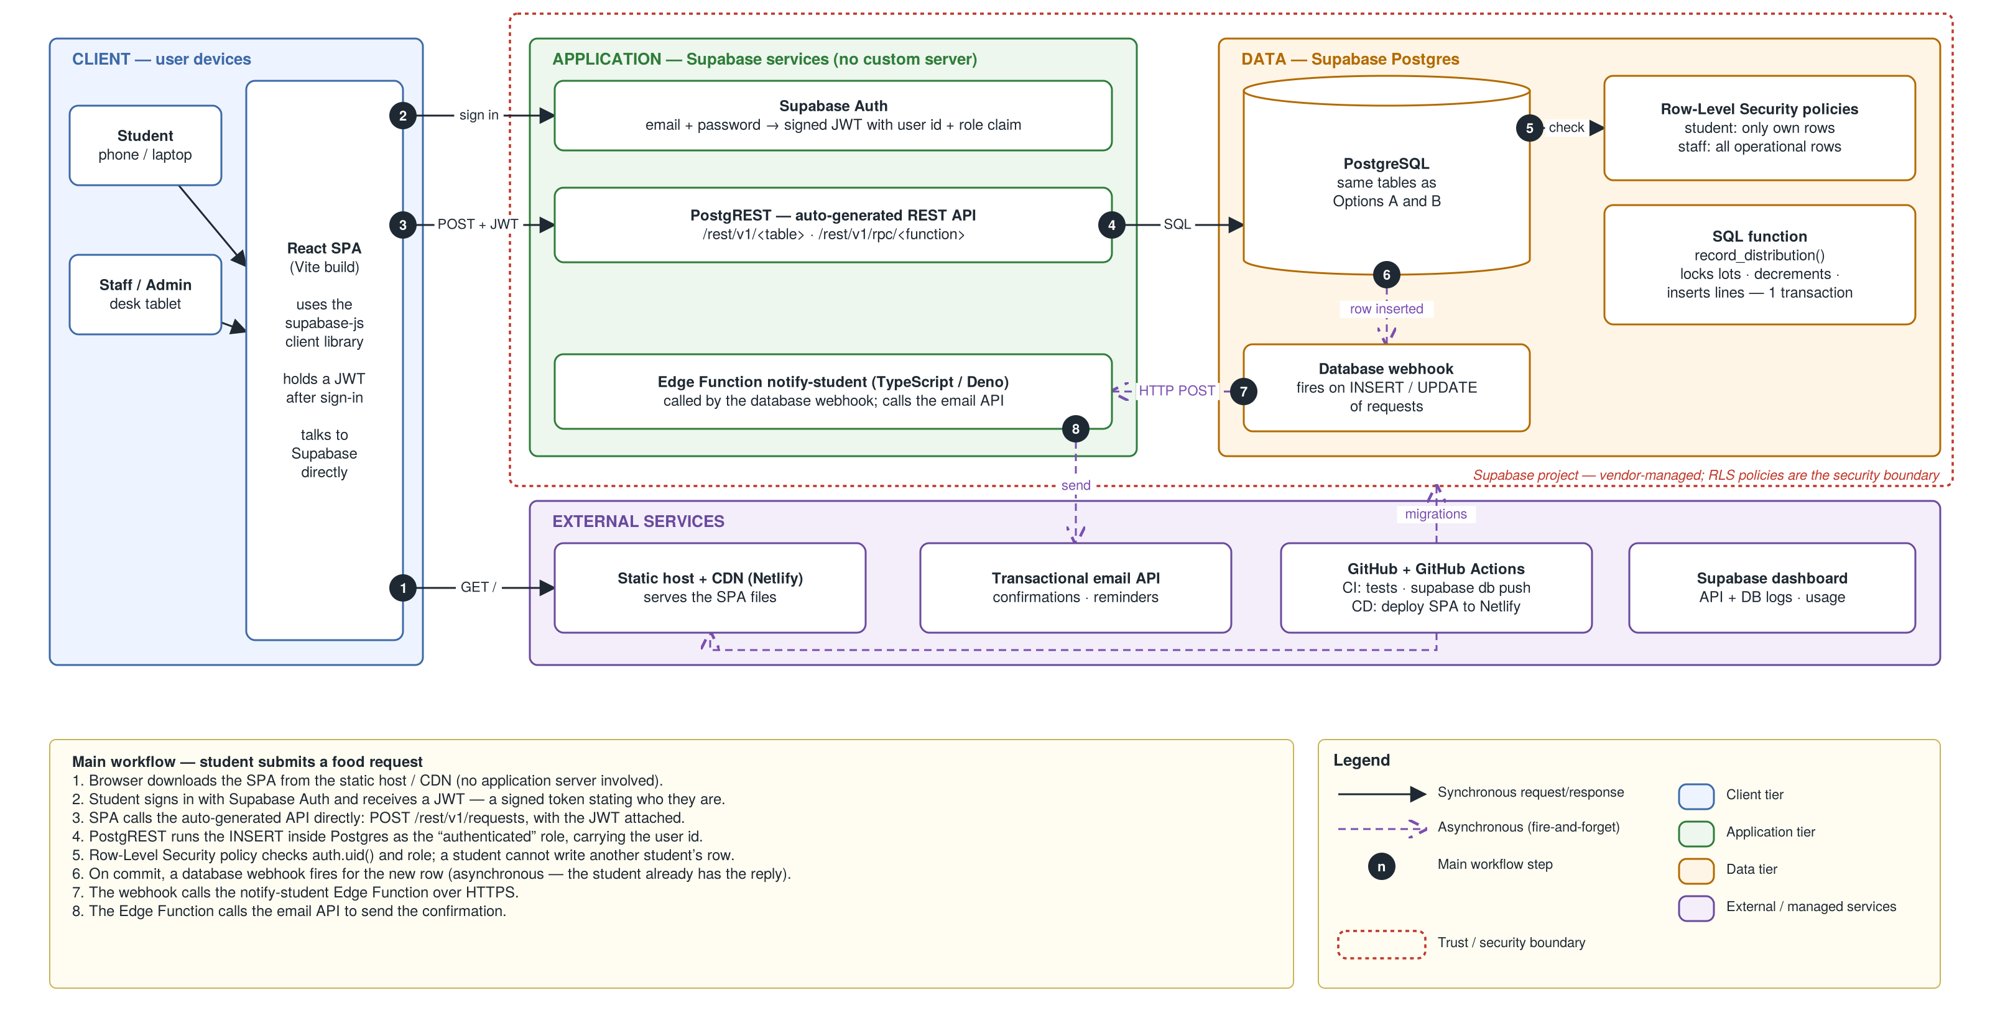
Option C — Backend-as-a-Service with Supabase
Steps 1–8: SPA from CDN → sign in → POST with JWT → Postgres → Row-Level Security → webhook → Edge Function → email
Notes:
Walk the steps: 1 the app loads from a CDN. 2 the student signs in with Supabase Auth and gets a JWT, a signed token stating who they are. 3 the app calls the auto-generated REST API directly. 4 the insert runs inside Postgres as the authenticated role. 5 Row-Level Security checks the user. 6 and 7 a database webhook calls an Edge Function. 8 the function sends the email. The red dashed line is the trust boundary: the RLS policies are the security.

Slide 12
Option C: fast start, security lives in the database
+
Strengths
−
Weaknesses
Security
The browser talks straight to the database API, so every table needs a correct policy.
Fastest path to login and basic screens
Authentication built in
Strong data security when policies are right
One missing Row-Level Security policy exposes a table
Policies and SQL functions are hard to unit-test
Vendor lock-in; logic split across SQL, TypeScript and UI
Our Docker plan barely applies
Cost and scale
Free tier is enough for a demo but free projects can pause. Cost driver is a paid plan for backups.
Choose it when: a tiny team must build basic screens fast and someone is strong in SQL.
C
Notes:
Supabase is attractive, but it moves our security model into database policies none of us have written before. One missing policy is a data leak, and that risk is hard to test away in six weeks.

Slide 13
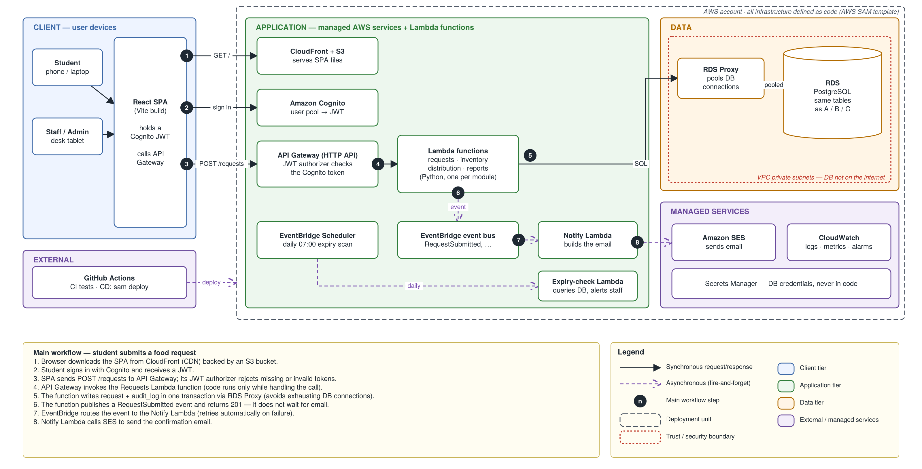
Option D — Serverless and event-driven on AWS
Steps 1–8: CloudFront → Cognito → API Gateway → Lambda → RDS Proxy → event → EventBridge → Notify Lambda → SES
Notes:
Walk the steps: 1 the app loads from CloudFront and S3. 2 Cognito sign-in returns a JWT. 3 API Gateway validates the token before any code runs. 4 it invokes a Lambda function. 5 the function writes through RDS Proxy into PostgreSQL in a private network. 6 it publishes an event and returns. 7 EventBridge routes the event. 8 a Notify function sends email through SES. A scheduler runs a daily expiry check.

Slide 14
Option D: scales furthest, costs the most effort
+
Strengths
−
Weaknesses
Security
Token checked before code runs; database in private subnets; secrets in Secrets Manager.
No servers to patch
Built-in retries and scheduling
Strongest isolation: private database, per-function permissions
Great resume material for cloud roles
About 12 managed services to learn in six weeks
Hard to run locally; debugging spans many logs
Easiest design to misconfigure
Cold starts slow the first call
Cost and scale
Conflicts with a $0 budget: RDS is free only in the first year, and Lambdas inside a private network need paid networking to reach the internet.
Choose it when: many pantries share one system, traffic is spiky, the budget is real and someone already knows AWS.
D
Notes:
We include D to show we considered a cloud-native design and rejected it for cost and complexity, not because we did not know about it.

Slide 15
How the four options compare
Criterion | A Django | B SPA + FastAPI | C Supabase | D AWS serverless
Fit with proposal + H2 tools | Good; weak API testing | Best; uses every tool | Fair; Docker, API tests unused | Fair; breaks $0 budget
Implementation complexity | Lowest | Medium | Low CRUD, hard policies | Highest (~12 services)
Cost drivers | 1 web service + 1 DB | Same as A | Paid plan past free tier | Database, networking, requests
Scalability | Campus-level; add copies | Same as A | Vendor scales; plan limits | Highest
Reliability | 1 container; auto-restart | Same as A | Vendor-run; free tier pauses | Managed + retries; many parts
Security | Strong defaults | Strong with role tests | Only as good as policies | Strongest; easy to misconfigure
Maintainability | High | High; clear modules | Medium; logic split | Low for this team
Beginner feasibility | High | High | Medium | Low
Ratings are team judgments with the reason stated, not measured scores.
Notes:
Read across the B column. B ties A on cost, scale and reliability because both are one container and one database, and beats it on fit with our tools and team. C and D lose on fit, feasibility and, for D, cost.

Slide 16
When we would switch to another option
Option B is the right design for one pantry and six weeks. These triggers would change that.
Fall back to Option A
If on Oct 29 one feature is not working end-to-end on the deployed site.
A
Move to Option C
If the pantry wants a phone-first app quickly and no one will maintain a server.
C
Move to Option D
If the system serves many campuses with spiky traffic, a paid AWS budget and AWS skills.
D
Split B into services
Only when separate teams must deploy modules independently. Not before.
μ
Notes:
Senior engineers respect a design that names its own limits. These are the concrete conditions that would make another option better.

Slide 17
Detailed design of Option B
Request lifecycle · the stock invariant · data model · security
Notes:
These views are shared by all four options, but we present them for Option B.

Slide 18
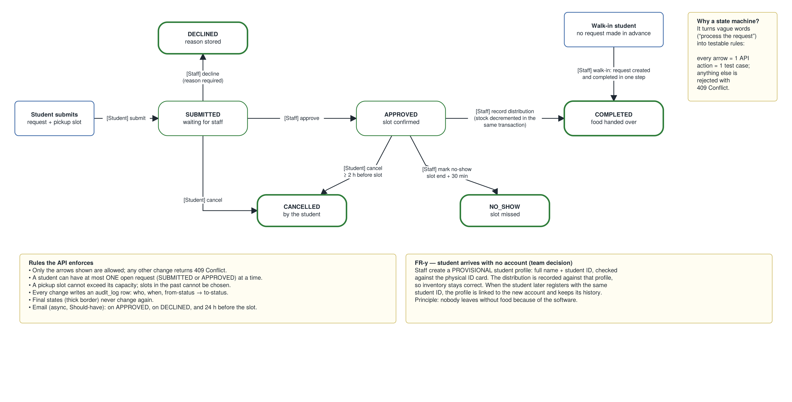
Life of a food request: six statuses, fixed transitions
Thick border = final state. Any change not shown returns 409 Conflict. Every change writes an audit_log row.
Notes:
Each box is a value of requests.status. Arrows are the only allowed changes, and each shows who makes it. Every arrow is one API action and at least one test; any other change returns 409 Conflict. Point out the walk-in path on the right and the no-account rule at the bottom right.

Slide 19
The invariant: the stock count is never wrong
For every lot, at every moment: 0 ≤ qty_on_hand and qty_on_hand = Σ ledger deltas
1
Row lock
2
CHECK constraint
3
One transaction
SELECT … FOR UPDATE: if two staff hand out the last box at once, the second waits, then sees 0 and gets 409.
The database itself refuses a negative quantity, even if our code has a bug.
The stock change, the distribution record and the audit row are saved together or not at all.
Proof: an automated test fires two simultaneous hand-outs of the last item and expects exactly one success and one 409.
Notes:
This is the most important slide. The invariant is enforced three independent ways, and we prove it with a concurrency test in CI. If asked what happens when two people take the last item: one succeeds, one is told only zero are left.

Slide 20
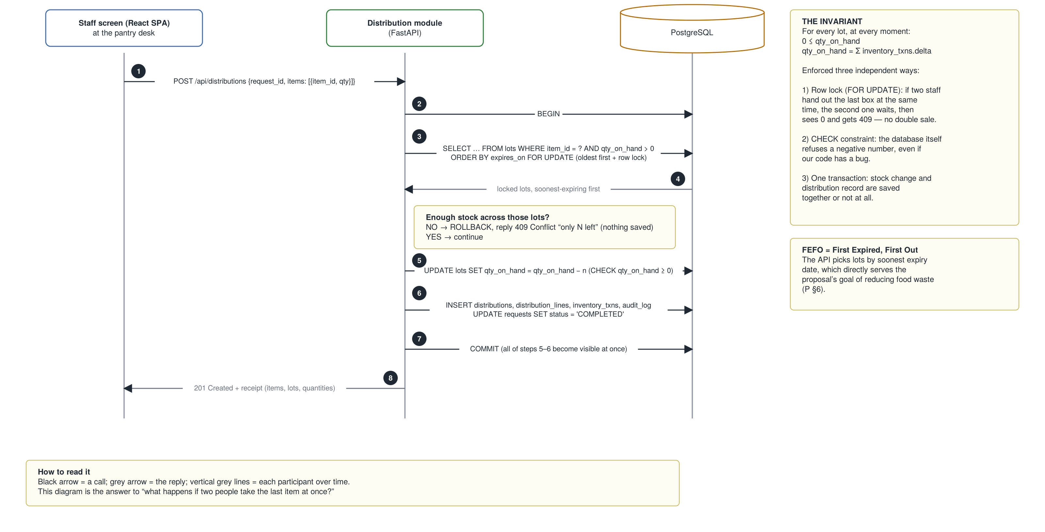
Recording a distribution: one transaction, oldest food first
FEFO = first expired, first out. Short stock → ROLLBACK and 409 Conflict, nothing saved.
Notes:
Sequence diagram, time flows down. 1 staff screen posts the distribution. 2 begin a transaction. 3 select matching lots ordered by expiry date and lock them. 4 locked rows return. If stock is short, roll back and return 409. 5 decrement with a CHECK constraint. 6 insert distribution, lines, ledger and audit rows and complete the request. 7 commit. 8 return a receipt. FEFO means first expired, first out, which serves the proposal's food-waste goal.

Slide 21
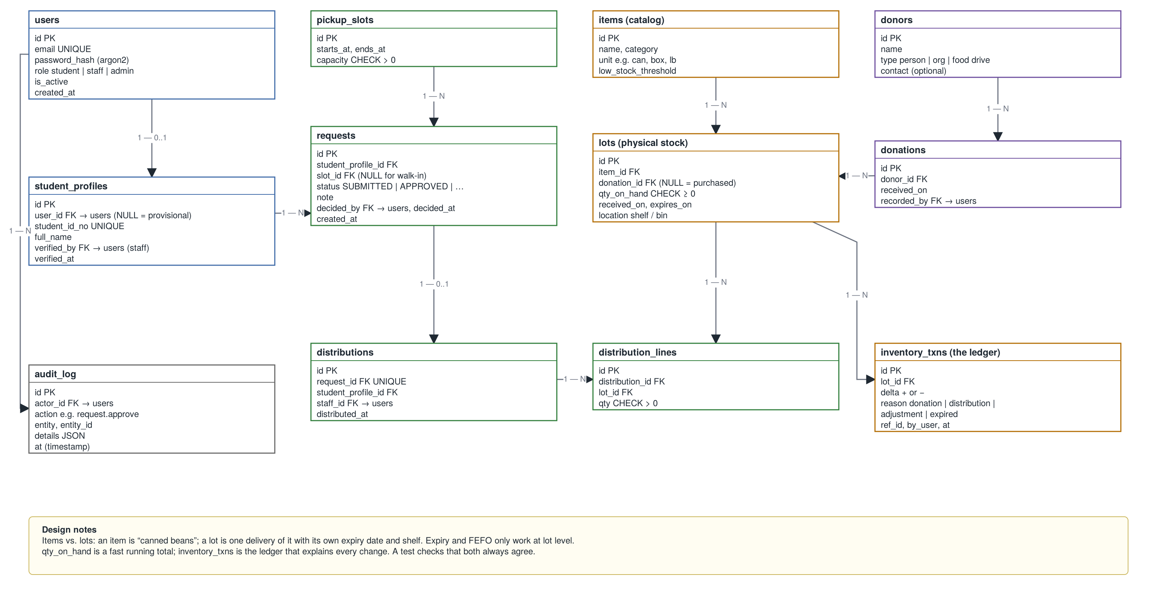
Data model: 12 PostgreSQL tables
Items vs. lots: an item is “canned beans”; a lot is one delivery of it with its own expiry date and shelf.
Notes:
Key idea: items versus lots. Canned beans is an item; each delivery of beans is a lot with its own expiry date and shelf. qty_on_hand is a fast running total; inventory_txns is the ledger that explains every change, and a test checks they agree. Student profiles can exist without a user account: that is the provisional profile for walk-ins.

Slide 22
Security and privacy
1
Who you are
2
What you can do
3
Your own data only
Email + password, hashed with argon2. Login attempts rate-limited. Staff verify the student ID card once.
Every API endpoint declares its allowed roles: student, staff or admin. Tests check forbidden calls fail.
Students can read only their own requests and history, checked in code and covered by tests.
4
Safe sessions
5
Accountability
6
Privacy by design
Same-origin httpOnly, Secure, SameSite cookie: page scripts cannot read it; the server can revoke it.
Every staff action writes an audit_log row: who, what, when, from-status and to-status.
We never ask why a student needs food. Reports show counts, not names. Retention policy: open question.
Notes:
Records of who uses a food pantry are sensitive. We minimize what we collect, restrict who can see it, and audit every staff action. The honest gap is data retention: we will set that with pantry staff.

Slide 23
Delivery plan
MVP scope · six sprints · who owns what
Notes:
How we get from today to a working demo on November 19.

Slide 24
MVP scope: the full loop, demonstrated live
Donation in → request → approval → distribution out → stock correct. Cuts are agreed now, not argued in week 6.
Must
Should
Could
Won't (this term)
Accounts and roles; staff-assisted signup
Provisional profile for walk-ins
Items and lots; donation intake
Requests with pickup slots
Approval queue; no-show
Safe distribution (oldest first)
Dashboard: low stock, expiring
Audit log
Email on approve, decline, reminder
Monthly reports + CSV export
Admin user management
Dashboard charts
Search across all records
SMS
Barcode scanning
Campus single sign-on
Multiple pantry sites
Mobile app
Notes:
Must-haves are the loop we demo. Should-haves are first to go if we slip. The Won't list is as important as the Must list: it tells the audience we scoped deliberately.

Slide 25
Six one-week sprints to November 19
0
1
2
3
4
5
Oct 8–14
Oct 15–21
Oct 22–28
Oct 29–Nov 4
Nov 5–11
Nov 12–18
Repo, Docker Compose, CI, schema, wireframes
Login and roles; items, lots, donations
Requests, slots, approval queue + tests
Safe distribution, concurrency test, walk-ins
Dashboard, reports, email, admin
Freeze Nov 15, fixes, rehearsals, paper
Oct 22 Requirements presentation (mid-term project milestone)
Oct 29 checkpoint One feature live end-to-end, or fall back to Option A
Notes:
Sprint 0 is the foundation: every laptop can run the whole stack with one command, and CI runs on every pull request. The Oct 29 checkpoint is our go or no-go for Option B. Code freezes Nov 15 so we can rehearse twice.

Slide 26
Who owns what
Roles follow the team description in Proposal §8.
PM
Project management + requirements
Cecilio · Damario Johnson
Jira board, requirements document, pantry interview
UI
Frontend (React)
Samuel · Alvi Anowar
Figma wireframes, student and staff screens
API
Backend + database (FastAPI)
Oluwafemi Bamidele · Joshua Gado
Modules, schema, migrations, the distribution transaction
Ops
DevOps + testing
Franck Darole
Docker, CI/CD pipeline, deployment, test suite
QA
Integration + presentation
Usman Jibril
End-to-end tests, documentation, final presentation
Notes:
Every module has an owner and a backup. DevOps and testing start first, because everyone depends on the pipeline in Sprint 0.

Slide 27
Risks and how we handle them
Risk | Impact | Response
We have not interviewed the pantry yet | Requirements may not match reality | 30-minute interview before Oct 22; mark assumptions in the requirements document
Free hosting sleeps or changes limits | Slow or failed live demo | Open the site 5 minutes early; local Docker copy ready
Eight people, one codebase | Merge conflicts, blocked work | Module owners, small pull requests, CI must pass to merge
React + FastAPI is new to some | Sprint 1–2 slip | Oct 29 checkpoint with Option A fallback
Notes:
The biggest risk is that we have not talked to the people who run the pantry. We will do that before the requirements presentation.

Slide 28
Questions
Option B: React SPA + FastAPI modular monolith + PostgreSQL
One container · one transaction per action · stock never wrong
Notes:
Restate the recommendation in one sentence and open the floor. The appendix has prepared answers to the most likely questions.

Slide 29
Prepared answers to likely questions (1 of 2)
Why not microservices?
One pantry, eight students, six weeks. Microservices add network calls, deployments and failure modes. Our modules have clean boundaries, so we can split later if separate teams need it.
Q
Two staff give out the last item at once?
Both lock the same lot rows. The second waits, sees zero and gets 409. A CHECK constraint stops negatives even if our code is wrong. A CI test proves it.
Q
Isn't one container a single point of failure?
Yes. The platform restarts it and the pantry can use paper for a few minutes. For more availability, run two copies; the app keeps no state in memory.
Q
Why cookies instead of JWTs?
App and API share one origin, so an httpOnly cookie is simpler and safer: scripts cannot read it and we can revoke it. JWTs help when many services verify tokens.
Q
Notes:
Whoever presents the matching slide should be able to give these answers without notes.

Slide 30
Prepared answers to likely questions (2 of 2)
How do you protect student privacy?
Own-records-only access, tested. Reports show counts, not names. Staff actions audited. We do not collect why a student needs food. Gap: retention policy.
Q
What if email is down?
Email runs after commit, so the request is already saved. The failure is logged. A queue with retries is the next step if delivery matters more.
Q
How would this scale to every campus?
Add a pantry_id, run more copies, add read replicas for reports. At that point Option D starts to earn its cost. We have no traffic data, so we have not guessed.
Q
How do you know it works?
Unit tests per module, a test for every allowed and forbidden status change, the concurrency test, and API tests in CI on every pull request.
Q
Notes:
Whoever presents the matching slide should be able to give these answers without notes.

