Slide 1
Move semantics
Part 1: Value categories, move and (some types of) copy elision

Slide 2
Index
Prerequisites
  Basics of move semantics
  Basics of copy elision
  What’s an expression
Value categories
  Brief introduction
  Identifying categories
  Summarizing
Guaranteed copy elision more in depth
Tips for calls to std::move
Questions
References

Slide 3

Basics of move semantics
Moving an object A to an object B means that B will have the data of A and that A will be in a valid but unspecified state
  Methods of A can be called (mainly its destructor) but you don’t know which data it contains
Now “str” contains the string “bonjour les gens” and “otherStr” contains something unspecified
  But most of the time “otherStr” will contains an empty string because the content of “str” and “otherStr” was swaped

Slide 4
Basics of copy elision
Sometimes compilers can elide copies (and moves) to optimize the code
  In C++17 some copy-elisions are mandatory
Without copy elision:
The right object is constructed with “1” and “’2’”
The left object is move-constructed with the right object
With copy elision:
The left object is constructed with “1” and “’2’”
That’s all

Slide 5
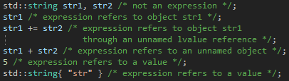
What’s an expression
An expression is a computation that may produce a result
  If it doesn’t return a result, it’s called a void expression
Expressions refer to entities, some of these entities are:
  Values: data not stored in the memory, used to build objects
  Objects / subobjects: data stored in the memory
  References: refer an object

Slide 6
Value categories: disclaimers
What is described here is what the standard say for C++17
For C++14, if copy elision is not disabled everything will be mostly the same, some things may be described differently in the standard but at the end the binary generated will be the same
If copy elision is disabled the things explained here won’t be 100 % accurate, but because it should never be disabled, and because in C++17 it won’t be possible to disable it, i chose to not talk about how it will work in this configuration

Slide 7
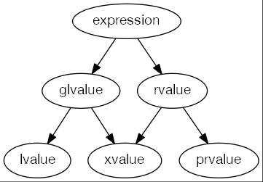
Value categories
Types of data transfer
of expressions :
lvalue: copy
xvalue: copy / move
prvalue: copy / move / copy elision

Slide 8
Identifying categories
Has an identity
  You can compare two entities to know if they are the same
  Basically you can know their address
Can be moved from
  Can be used by a move constructor / assignment
  Basically can be bind to an rvalue reference

Slide 9
Identifying lvalues
Has an identity but can’t be moved from
  You can apply the unary & operator on it
  You can’t pass it to a move constructor / assignment
It’s an lvalue if it refers to (not exhaustive):
  An lvalue reference or a named rvalue reference
  An object that isn’t a subobject of an rvalue
    Static data members are complete objects
The expression of a function that return an lvalue reference is an lvalue

Slide 10
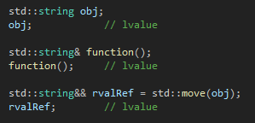
Identifying lvalues

Slide 11
Identifying xvalues
Has an identity and can be moved from
  You can’t apply the unary & operator on it but can have the address from the object it refers
  You can move construct / assign from it
Xvalue means eXpiring value, they refer to objects that you can move but that can still be accessed from elsewhere, like:
  Unnamed rvalue references
  Subobjects of rvalues
    Static data members are complete objects
The expression of a function that return an rvalue reference is an xvalue

Slide 12
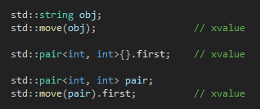
Identifying xvalues

Slide 13
Identifying prvalues
Don’t have an identity but can be moved from
  You can’t get the address of the entity refered by a prvalue or deduce it from another entity
  You can move construct / assign from it
If it’s neither an lvalue or an xvalue, it’s a prvalue
  That means prvalues don’t refer to objects or references, they refer to values (and some others entities)
The expression of a function that don’t return a reference is a prvalue

Slide 14
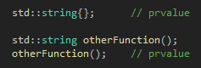
Identifying prvalues

Slide 15
Summarizing value categories
Lvalues refer to objects that can still be used after the expression, they exist “physically” in the memory and must kept their “data” until they are destroyed
Xvalues refer to objects that are expiring, they exist “physically” in the memory but they won’t be used anymore so their “data” can be moved to another object
Prvalues don’t refer to objects, they don’t exist “physically” in the memory, they don’t have an address, they are accessible only in the expression that created them, so their “data” can safely be moved somewhere else

Slide 16
Guaranteed copy elision (C++17)
Copy elision is linked to prvalues
Prvalues don’t refer to “physical” object, but to values that are used to construct objects
When an object is needed for computation, a temporary can be materialized from a prvalue
  That means an xvalue is produced from the prvalue
All of this means that passing prvalues is free because there is no object to move, the compiler just wait until a temporary is materialized to see where to build it
  But in fact the object is still constructed when the prvalue is created, it’s just not constructed where the prvalue was created

Slide 17
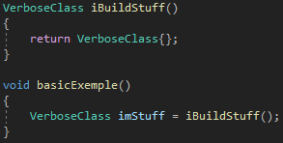

Guaranteed copy elision (RVO)
-fno-elide-constructors --std=c++14
--std=c++14
https://godbolt.org/z/jwWFoj

Slide 18
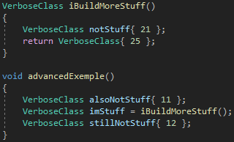
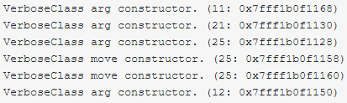

Guaranteed copy elision (RVO)
-fno-elide-constructors --std=c++14
--std=c++14
https://godbolt.org/z/jwWFoj

Slide 19
When to use std::move
Lvalues:
  Move them whenever you can, it will prevent some copies to be made, making the software faster
  Moving const objects is useless because for the move constructor / assignment to work the object need to be non-const
Xvalues:
  It’s useless to move them because it will just convert them into xvalues, what they already are
Prvalues:
  Don’t move them because it will prevent copy elision, forcing objects to be moved so making the software slower

Slide 20
Questions

Slide 21

What’s next
In the second part we will see:
  Forwarding references
  std::forward
  Why this code is bad:

Slide 22
References
https://en.cppreference.com/w/cpp/language/value_category
https://stackoverflow.com/questions/3601602/what-are-rvalues-lvalues-xvalues-glvalues-and-prvalues
https://en.cppreference.com/w/cpp/language/implicit_conversion#Temporary_materialization
https://en.cppreference.com/w/cpp/language/copy_elision
https://en.cppreference.com/w/cpp/language/return#Notes
https://stackoverflow.com/questions/3106110/what-is-move-semantics

