Slide 1
Move semantics
Part 1: Value categories, move and (some types of) copy elision

Slide 2
Index
Prerequisites
  Basics of move semantics
  Basics of copy elision
  Expression vs object
Value categories
  Brief introduction
  Identifying categories
  Some properties of categories
Guaranteed copy elision more in depth
Tips for calls to std::move
Questions
References

Slide 3

Basics of move semantics
Moving an object A to an object B means that B will have the data of A and that A will be in a valid but unspecified state
  Methods of A can be called (mainly its destructor) but you don’t know which data it contains
Now “str” contains the string “bonjour les gens” and “otherStr” contains something unspecified
  But most of the time “otherStr” will contains an empty string because the content of “str” and “otherStr” was swaped

Slide 4
Basics of copy elision
Sometimes compilers can elide copies (and moves) to optimize the code
  In C++17 some copy-elisions are mandatory
Without copy elision:
The right object is constructed with “1” and “’2’”
The left object is move-constructed with the right object
With copy elision:
The left object is constructed with “1” and “’2’”
That’s all

Slide 5
Warning : Type of types
Type of an object is not the same thing as type of an expression
The object “str” is of type “lvalue reference to string”
The expression “(str)” is an lvalue of type “string”

Slide 6
Disclaimers
What is described here is what the standard say for C++17
For C++14, if copy elision is not disabled everything will be mostly the same, some things may be described differently in the standard but at the end the binary generated will be the same
If copy elision is disabled the things explained here won’t be 100 % accurate, but because it should never be disabled, and because in C++17 it won’t be possible to disable it, i chose to not talk about how it will work in this configuration

Slide 7
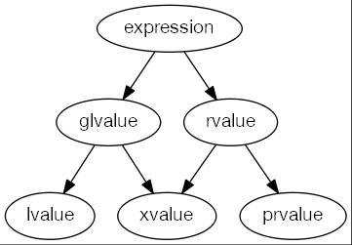
Value categories
Types of resources transfer of expressions :
lvalue: copy
xvalue: copy / move
prvalue: copy / move / copy elision

Slide 8
Identifying categories
Has an identity
  You can compare two objects to know if they are the same
  Basically you can know his address
Can be moved from
  Can be used by a move constructor / assignment
  Basically can be bind to an rvalue reference

Slide 9
Identifying lvalues
Has an identity but can’t be moved from
  You can apply the unary & operator on it
  You can’t pass it to a move constructor / assignment
Most of the time if it has a name it’s an lvalue
  That means named rvalue references are lvalues
  Except for (not exhaustive):
    Non-static data members of rvalue objects
    Non-static members functions
The expression of a function that return an lvalue reference is an lvalue

Slide 10
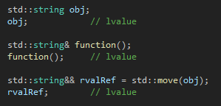
Identifying lvalues

Slide 11
Identifying xvalues
Has an identity and can be moved from
  You can’t apply the unary & operator on it but can have the original address of the object that it’s constructed from
  You can move construct / assign from it
Xvalue means eXpiring value, an object that you can move but that can still be referenced elsewhere
  A non-static data member of an rvalue is an xvalue
An unnamed rvalue reference is an xvalue
  The expression of a function that return an rvalue reference is an xvalue

Slide 12
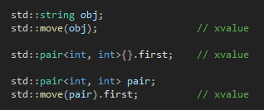
Identifying xvalues

Slide 13
Identifying prvalues
Don’t have an identity but can be moved from
  You can’t get the address of a prvalue or deduce it from another object
  You can move construct / assign from it
Most of the time if it doesn’t have a name it’s a prvalue, except for (not exhaustive):
  Unnamed rvalue references that are xvalues
  Non-static member functions that are prvalues
The expression of a function that don’t return a reference is a prvalue

Slide 14
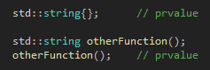
Identifying prvalues

Slide 15
Summarizing value categories
Lvalues represent named objects, they exist “physically” in the memory and must kept their “value” until they are destroyed
Xvalues represent objects that exists “physically” in the memory but that won’t be used anymore so their “value” can be moved to another object
Prvalues represent objects that don’t exists “physically” in the memory, they don’t have an address, they are accessible only in the expression that created them, so their “value” can safely be moved somewhere else
  If a prvalue is bound to a reference, it is materialized (it now exists “physically”) and its lifetime is extended to the lifetime of the reference it was first bound

Slide 16
Guaranteed copy elision (C++17)
Copy elision is linked to prvalues
Prvalues don’t represent “physical” object, but object that are “waiting” for being constructed
When the object represented by a prvalue is needed for real work, the prvalue is materialized
  That means a temporary object is constructed with the prvalue, resulting in a xvalue
All of this means that passing prvalues is free because there is no object to move, you just pass data for how to construct an object
  But in fact the physical object is still constructed when the prvalue is built, it’s just not constructed where the prvalue was first built

Slide 17
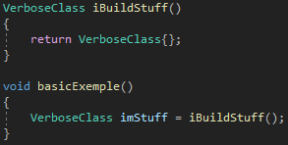

Guaranteed copy elision (RVO)
-fno-elide-constructors --std=c++14
--std=c++14
https://godbolt.org/z/jwWFoj

Slide 18
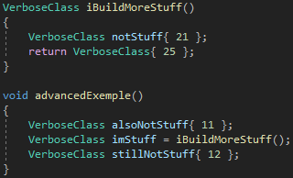
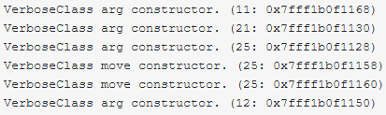

Guaranteed copy elision (RVO)
-fno-elide-constructors --std=c++14
--std=c++14
https://godbolt.org/z/jwWFoj

Slide 19
When to move
Lvalues:
  Move them whenever you can, it will prevent some copies to be made, making the software faster
  Moving const objects is useless because for the move constructor / assignment to work the object need to be non-const
Xvalues:
  It’s useless to move them because it will just convert them into xvalues, what they already are
Prvalues:
  Don’t move them because it will prevent copy elision, forcing objects to be moved so making the software slower

Slide 20
Questions

Slide 21

What’s next
In the second part we will see:
  Forwarding references
  std::forward
  Why this code is bad:

Slide 22
References
https://en.cppreference.com/w/cpp/language/value_category
https://stackoverflow.com/questions/3601602/what-are-rvalues-lvalues-xvalues-glvalues-and-prvalues
https://en.cppreference.com/w/cpp/language/implicit_conversion#Temporary_materialization
https://en.cppreference.com/w/cpp/language/copy_elision
https://en.cppreference.com/w/cpp/language/return#Notes
https://stackoverflow.com/questions/3106110/what-is-move-semantics

