Slide 1
Expected-like types
Error codes aren’t the only alternative to exceptions

Slide 2
Index
Error codes : The old and deprecated way
Exceptions : The modern way, but not without issues
Expected-like types : A sane alternative to exceptions
DIY : let’s create an expected-like type

Slide 3


Error codes
It’s annoying to use output parameter
If the first option is chosen, Person must be default-constructible
It’s easy to not check the error code returned

Slide 4
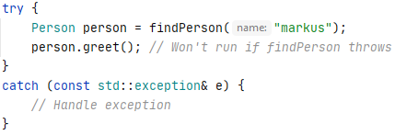
Exceptions
Functions are easier to use because no output parameters
Safer than error code : if an exception is thrown the rest of your code won’t run unless you catch the exception

Slide 5


Exceptions
It’s hard to know if a function throws, you must read the documentation to know it, and it must be up to date
noexcept(true / false) is rarely used,and it’s annoying to use because you must check the prototype of every function you call to know if it may throw
If you want to pass custom information (other than what() string) you need a custom exception type, and the only way to know it can be thrown if through documentation

Slide 6
Expected-like types
Basically it’s a variant <SuccessType, ErrorType>
But it can have a much richer API

Slide 7
Side note about optional
If your “error code type” is a boolean, or if you use a sentinel value to check for error (e.g., -1 = error, positive value = real result of function), it’s better to use std::optional
std::optional as the advantage to be standardized in C++17
Even if it’s not as feature-rich as a well crafted expected-like type, it’s way more safe to use than error codes
Its main con is that it lacks the ability to give information about the nature of the error, so it’s not suitable for every uses

Slide 8
Side note about optional
Show prototype of functions vs error code
Show how it’s used vs error code / sentinel values

