Slide 1
LLM Inference
Franco Galante

Slide 2
Lessosns Learned
Details on the functioning of LLM inference

Slide 3
Attention Mechnaism

Slide 4
Attention ? Explanation

Slide 5
Continuous Batching

Slide 6
The Role of Batches

Slide 7
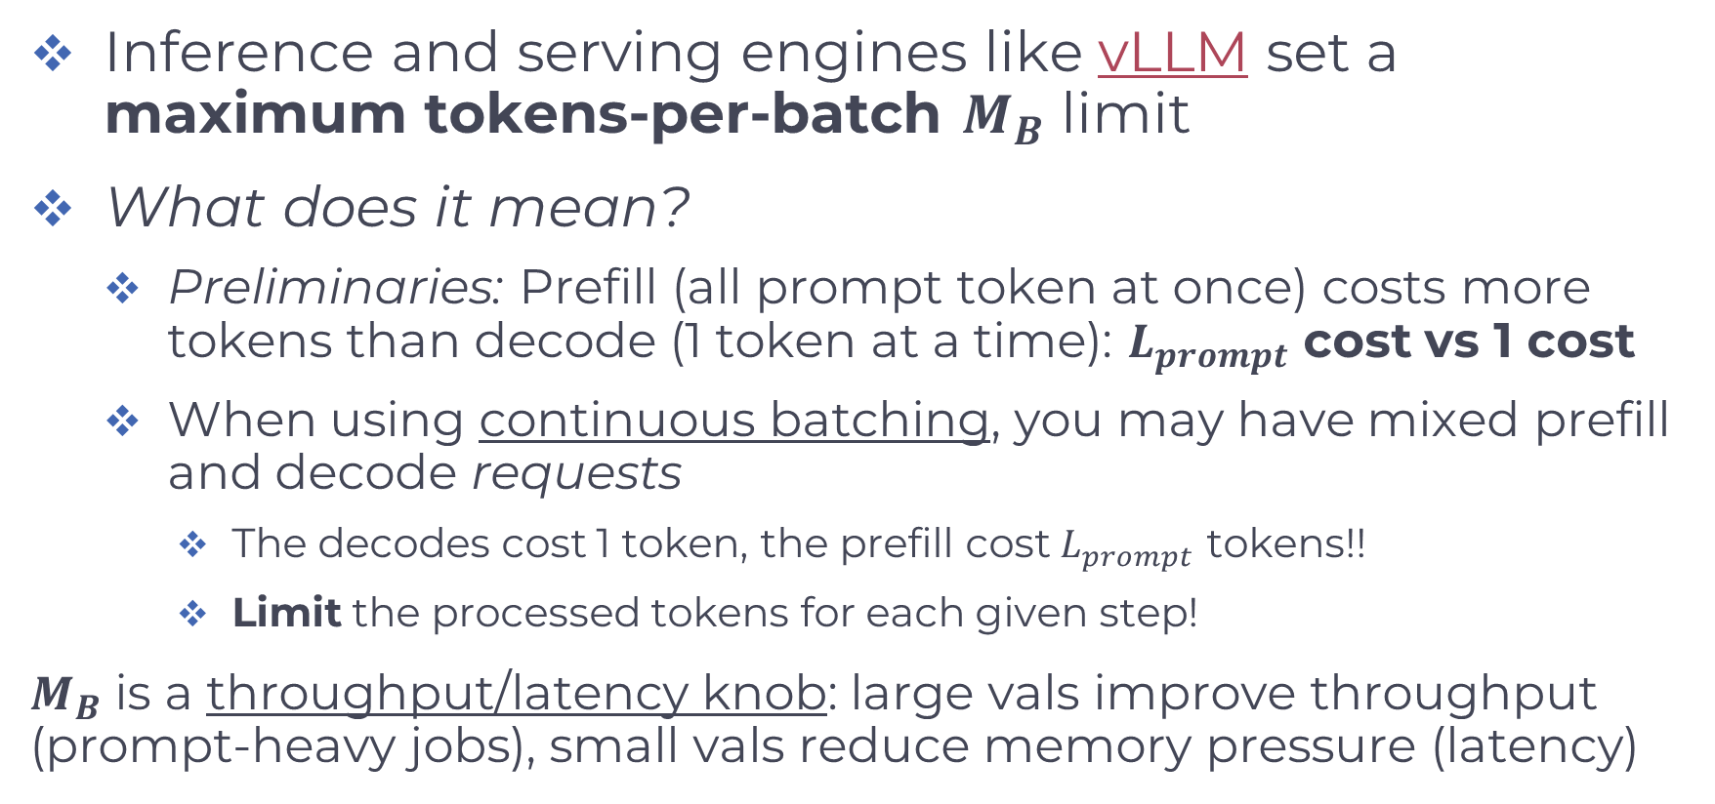
Chunked Prefill
Inference and serving engines like vLLM set a maximum tokens-per-batch $M_{B}$ limit
What does it mean?
Preliminaries: Prefill (all prompt token at once) costs more tokens than decode (1 token at a time): $L_{prompt}$ cost vs 1 cost
When using continuous batching, you may have mixed prefill and decode requests
The decodes cost 1 token, the prefill cost $L_{prompt}$ tokens!!
Limit the processed tokens for each given step!
$M_{B}$ is a throughput/latency knob: large vals improve throughput (prompt-heavy jobs), small vals reduce memory pressure (latency)

Slide 8
Chunked Prefill cont.
Why is it?
Avoid GPU Out Of Memory (OOM)
Avoid activation-memory blowups (prefill over many tokens creates large temporary activations; compute-heavy)
Intermediate activation tensors during the forward pass
Temp copies of Q, K, V during attention computation
Balance between prefill and decode
With continuous batching, prefill and decode are mixed together, if prefill can consume arbitrarily large tokens decode requests may wait behind a huge prompt pass

Slide 9
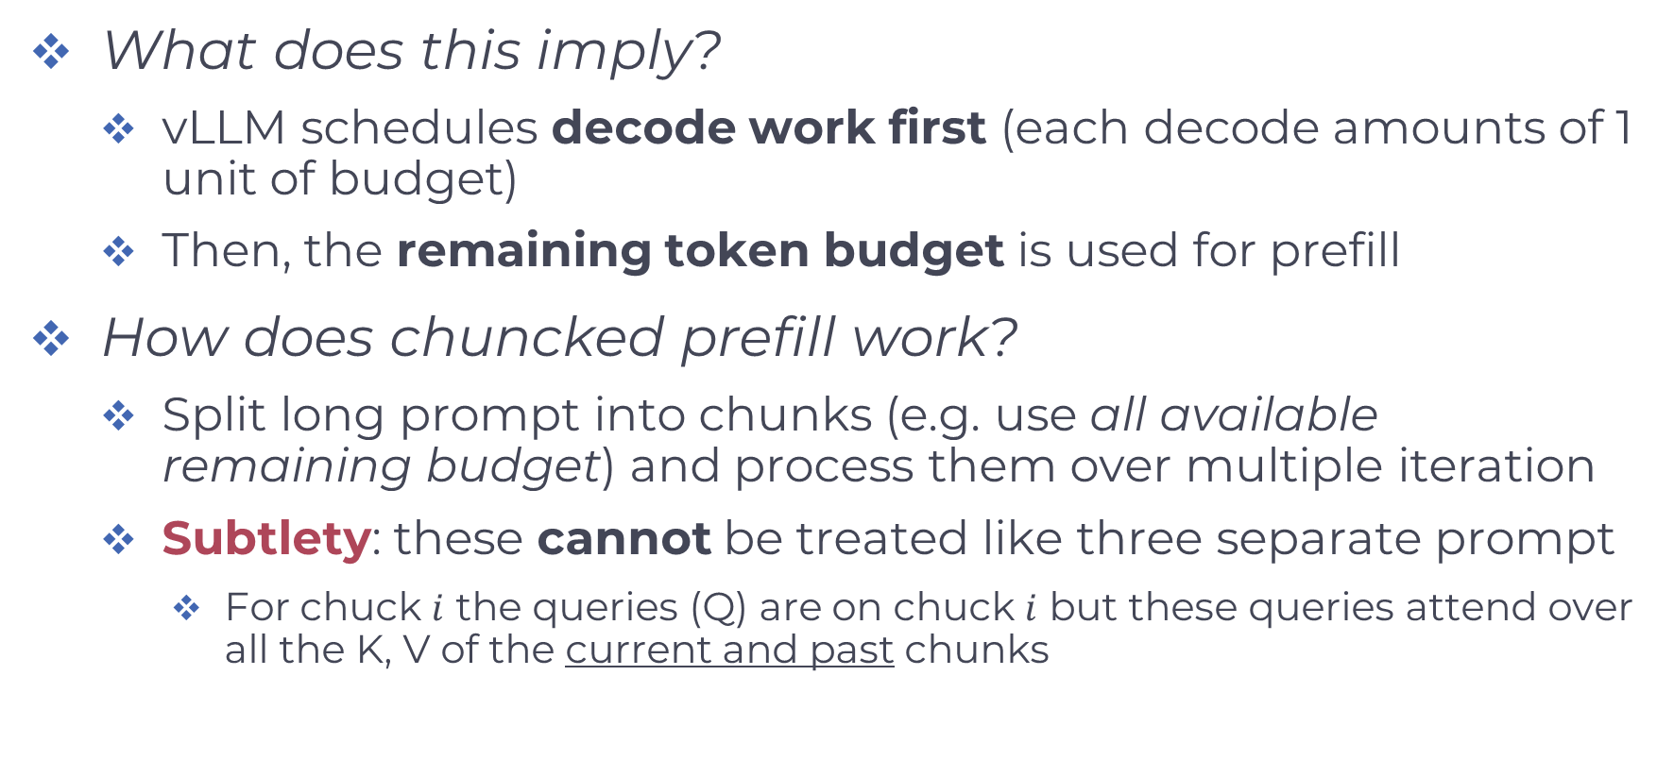
Chunked Prefill cont.
What does this imply?
vLLM schedules decode work first (each decode amounts of 1 unit of budget)
Then, the remaining token budget is used for prefill
How does chuncked prefill work?
Split long prompt into chunks (e.g. use all available remaining budget) and process them over multiple iteration
Subtlety: these cannot be treated like three separate prompt
For chuck $i$ the queries (Q) are on chuck $i$ but these queries attend over all the K, V of the current and past chunks

Slide 10
Cost of Preemption?
«Freeing» memory costs ~ 0
You do not delete the actual (GPU) memory
You work on memory-occupancy metadata
…

Slide 11
Optimizations
How to use tweeks to improve performances?

Slide 12
Speculative Decoding

Slide 13
Some Preliminary Results
Preliminary Performance Results using Vidur

Slide 14
Performance Metrics
E2ED: end-to-end delay
TTFT: time-to-first token
TPOT: time-per-output-token
Average time spent to generate each output token (decode time / number of generated tokens)
Decode-phase metric
# of preemptions (the job already done is lost)

Slide 15
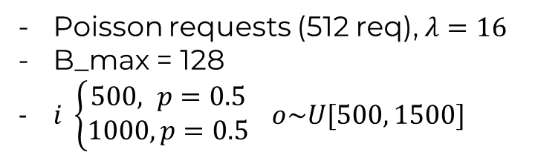
Performance Summary
Poisson requests (512 req), $λ=16$
B_max = 128
$i \left\{\begin{aligned}500, p=0.5 \\ 1000, p=0.5\end{aligned}\right.$ $o\sim U[500, 1500]$
Metric | vLLM | ORCA | FIFO (m*=0.80) | FIFO (m*=0.90) | FIFO (m*=0.95) | FIFO (m*=0.99)
E2E latency mean (s) | 544.8076 | 801.9044 | 543.5262 | 529.1693 | 526.7421 | 538.5237
TTFT mean (s) | 452.3456 | 758.2736 | 467.5548 | 446.4587 | 440.5259 | 446.8585
TPOT mean (s) | 0.0858 | 0.0429 | 0.0731 | 0.0789 | 0.0814 | 0.0849
Batch size mean | 39.7452 | 13.7797 | 34.2022 | 38.8152 | 39.9249 | 40.9609
Total preemptions | 383 | 0 | 18 | 34 | 101 | 373

Slide 16
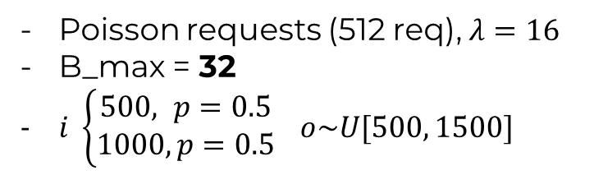
Performance Summary 2
Poisson requests (512 req), $λ=16$
B_max = 32
$i \left\{\begin{aligned}500, p=0.5 \\ 1000, p=0.5\end{aligned}\right.$ $o\sim U[500, 1500]$
Metric | vLLM | ORCA | FIFO (m*=0.80) | FIFO (m*=0.90) | FIFO (m*=0.95) | FIFO (m*=0.99)
E2E latency mean (s) | 562.8218 | 801.5652 | 559.0634 | 558.9246 | 558.9246 | 558.9246
TTFT mean (s) | 494.6221 | 757.9523 | 491.3481 | 491.1891 | 491.1891 | 491.1891
TPOT mean (s) | 0.0671 | 0.0429 | 0.0666 | 0.0666 | 0.0666 | 0.0666
Batch size mean | 30.0855 | 13.7797 | 30.6340 | 30.6358 | 30.6358 | 30.6358
Total preemptions | 0 | 0 | 0 | 0 | 0 | 0
Bottleneck:
Limited # of «servers»

Slide 17
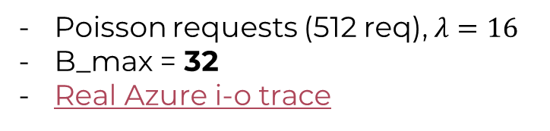
Performance Summary 3
Poisson requests (512 req), $λ=16$
B_max = 32
Real Azure i-o trace
Metric | vLLM | ORCA | FIFO (m*=0.80) | FIFO (m*=0.90) | FIFO (m*=0.95) | FIFO (m*=0.99)
E2E latency mean (s) | 80.8230 | 70.9720 | 82.4004 | 82.4198 | 82.4163 | 82.4298
TTFT mean (s) | 70.6407 | 66.5547 | 77.5347 | 77.4766 | 77.4549 | 77.4584
TPOT mean (s) | 0.3377 | 0.1465 | 0.1614 | 0.1639 | 0.1645 | 0.1649
Batch size mean | 8.8957 | 10.5003 | 10.2704 | 10.2903 | 10.2903 | 10.2903
Total preemptions | 0 | 0 | 0 | 0 | 0 | 0
Head of line blocking
ORCA is the best!

