Slide 1
AUTOMATIC IDENTIFICATION OF COPEPOD SPECIES USING HEXAGONAL PIXEL SAMPLING AND ARTIFICIAL NEURAL NETWORK
Franco Jigo C. Pacana

Slide 2
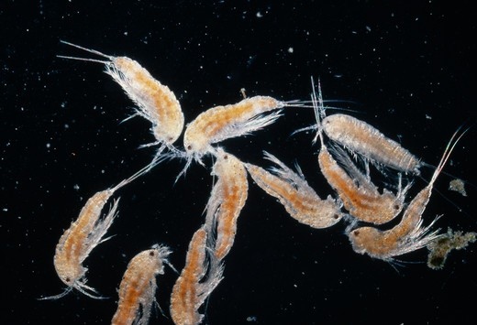
Copepods
Copepods are microscopic crustaceans which ranges 200μm to 2mm in total length. They can be found in a large number approximately 60,000 individuals per cubic meter of water.

Slide 3
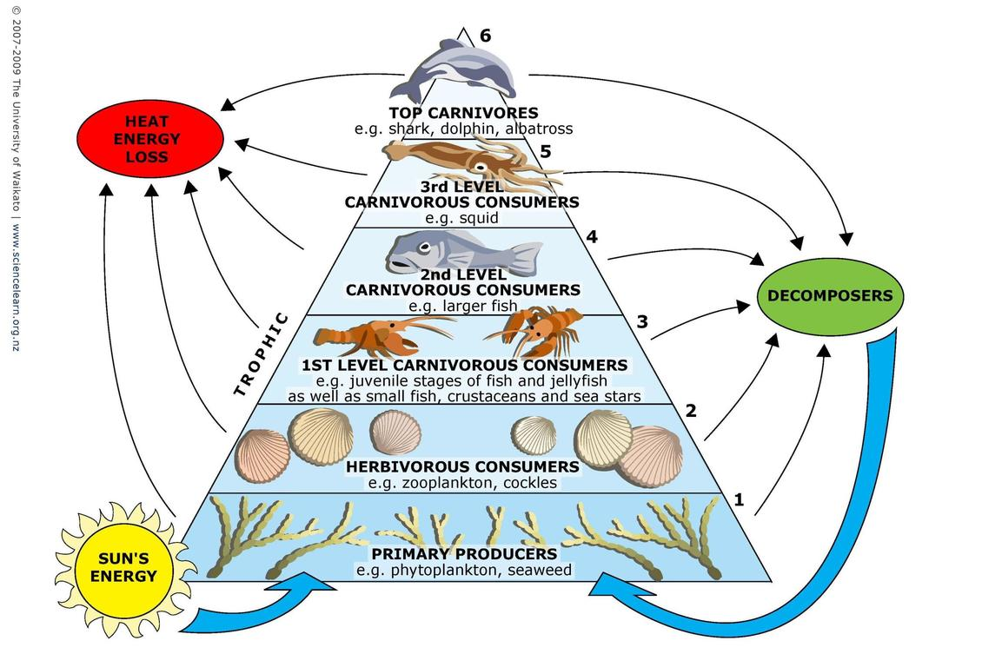
Why study copepods
Evaluation of its contribution to the mangrove trophodynamics and coastal fisheries.
Act as linking factor between phytoplankton and organisms of higher trophic level
Also act as bioindicator for changes in water quality

Slide 4
The Conventional way of Identification and Classification of Copepods
Collection from sampling sites
Preservation
Sorting
Examination and preparation
Manual Classification

Slide 5
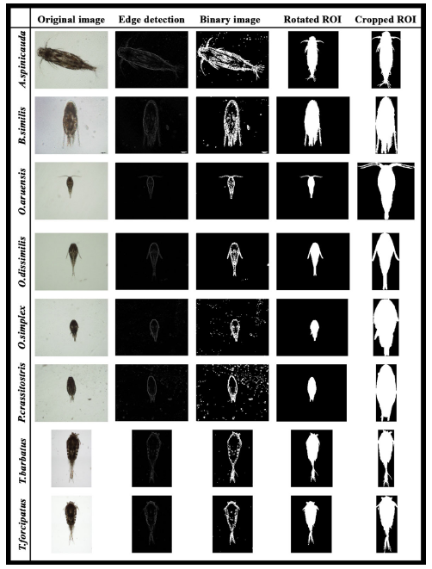
Existing novel method
The latest advancement in copepod recognition is in 2015 where Lee Kien Leow and his colleagues used image processing and artificial neural network to produce a computer software where the automatic recognition takes place of eight species of copepods but his technique uses only the conventional square grid lattice in image sampling using MATLAB’s Image processing toolbox R2013a.

Slide 6
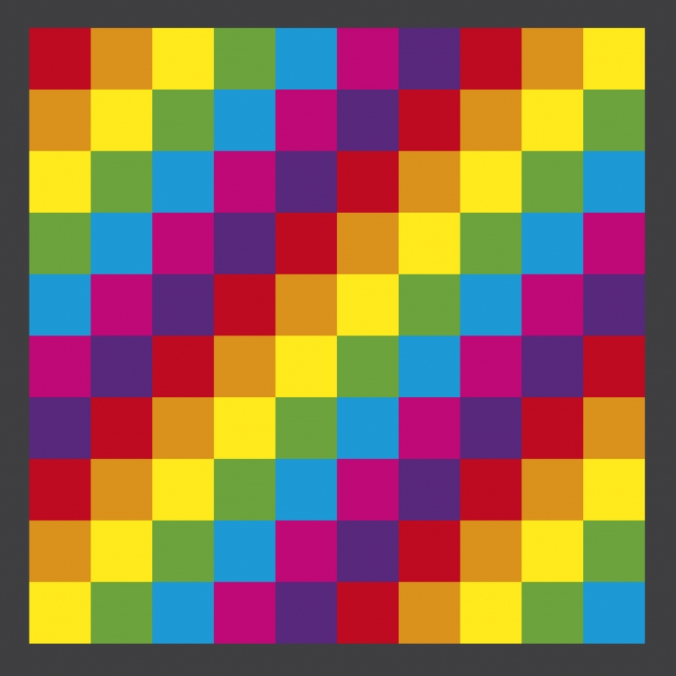

Why shift from Square to Hexagonal lattice?
Square Grid
Hexagonal Grid

Slide 7
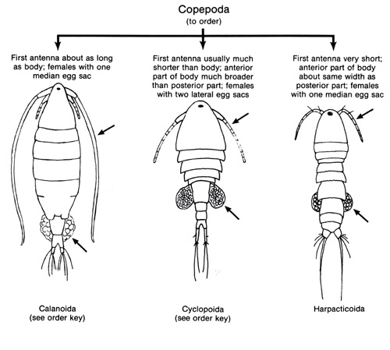
Copepod body structure
The physical structure of copepods varies greatly, however, the free-living forms of copepods have certain physical traits in common. The body is usually short and cylindrical, composed of a head, thorax, and abdomen. The lower part of the copepod's head is generally fused with its thorax; the front of its head often juts forward, like a tiny beak. Its thorax is divided into about six segments; each segment is connected to two appendages.

Slide 8
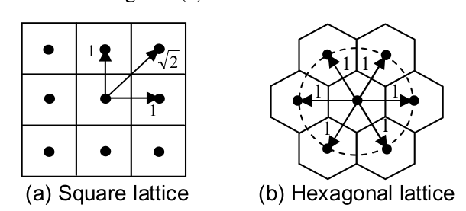
Hexagonal lattice’s advantages over square lattice for Feature extraction and Edge detection
Equidistance
Equidistance between hexagons in a hexagonal pixel means that all 6 neighbours of a center hexagon has the same distance from each other to the center hexagon with a shared edge. In contrast, the square has only four equidistant neighbours which makes it inferior from hexagonal lattice

Slide 9
Better spatial sampling Efficiency
Aliasing is an effect usually in signal processing where different signals become indistinguishable or aliases of one another when sampled. In image processing’s view, it when a sampled image’s signal is different from the original continuous signal. Peterson and Middleton found out that square lattice is not the best due to the fact that the least samples are required for the reconstruction of a wave number limited signal in hexagonal lattice.
Mersereau concluded that signals in Fourier space requires only 13.4% lesser samples to represent the same image data in hexagonal grid compared to the other lattice.

Slide 10
Other advantages of hexagonal lattice over square lattice
Isoperimetry
Uniform Connectivity
Smaller Quantization Error
Greater Angular Resolution
Higher Symmetry

Slide 11
What is it’s relation to the copepod identified in square lattice?
It is obvious to quote that the copepod’s body is composed of many curves and segments which gives the hexagonal lattice a greater advantage over the square in terms of Equidistance. This property can also produce a more accurate edge detection result thus implying a better segmentation and feature extraction performance.
While the Equidistance advantage caters the copepod’s curvy body, the second advantage which is the better sampling efficiency can cater the need for storage space in this study because neural network training requires a lot of images for system’s optimal performance. It can also address the aliasing problem in most images and can outperform square image processing in identifying sampled images.

Slide 12
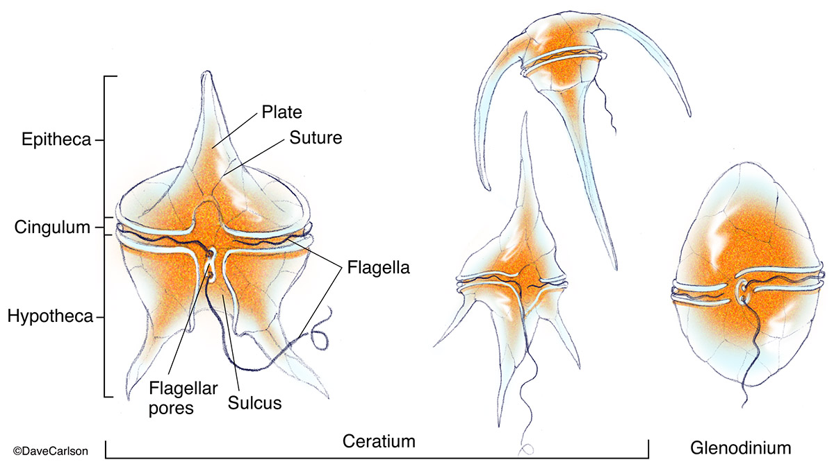
Neural Network for copepod Classification
Artificial Neural Networks have shown promising results in classifying various specimens of insects (Wang et. al, 2012), dinoflagellates by Culverhouse in 1996, metazoans and protozoans by Ginoris et. al in 2007, and many more.

Slide 13
Statement of the Problem
The current problem that Biologists face in copepod research is the conventional way of identification but this was addressed by the novel method proposed by Leow in 2015. Now, the problem with his work is that it uses square lattice which is inferior in terms of Equidistance of pixels and sampling Efficiency.

Slide 14
General Objective
The study aims to utilize hexagonal lattice sampling in recognition and classification of a copepod sample down to species level.

Slide 15
Specific Objectives
Design an application which caters automatic identification of copepods down to species level.
Utilize hexagonal lattice in image processing techniques.
Use ANN algorithm as a tool for classifying the copepods.

Slide 16
Methods
Sample Collection
-Five genera of marine copepods commonly encountered in mangrove waters will be examined: Acartia (A. spinicauda), Bestiolina (B. similis), Oithona (O. aruensis, O. dissimilis and O. simplex), Parvocalanus (P. crassirostris) and Tortanus (T. barbatus and T. forcipatus). Copepods will be sampled from four stations from the upper estuary in the Panguil bay to near shore waters of Marandin Lala Lanao Del Norte.
Image acquisition
-The desired view of the copepod body will be acquired by an Olympus digital camera (DP26) connected to a computer installed with an imaging software (Olympus cellSens Standard ver. 1.12) for real-time viewing, capturing and storing of the images.

Slide 17
Methods (Continued)
Hexagonal Pre-processing
Image Resampling using HIP framework
Interpolation using Gabor Filter
Image de-noising scheme
Addressing and Storage
Display of Hexagonal-images

Slide 18
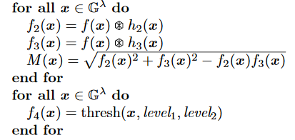
Methods (Continued)
Canny edge detector using HIP

Slide 19
Image segmentation and Feature extraction
The images will be converted to binary images with appropriate threshold.
Using the imclearborder function from the matlab, borders will be cleared and the holes that occurred during the process of converting the grayscale image into binary image will be filled using the imfill function.
Small particles below 50000 pixels will be excluded to ensure only the copepods are segmented for feature.
Orientation represented by the angle between the x-axis and the major axis of the ellipse that has the same second-moments as the region of interest (ROI) will be obtained using region properties function in Matlab. Image rotation will be done using the imrotate function so that the ROI has an orientation of 90 degrees.
The ROI of the copepod will be cropped by getting the coordinates of the boundary of copepods.
Features will be extracted from the shape descriptors represented by the binary images of the ROI using region properties function in Matlab. The measurements like area, convex area, eccentricity, major axis length, minor axis length, perimeter, solidity, equivdiameter (sqrt(4*area/pi)), extent and orientation will be determined.

Slide 20
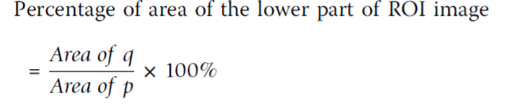
As seen in the ROI images of copepod, the lower part showed distinct shapes across the eight species. In view of this distinct attribute, a secondary feature will be derived by assigning 60% of the ROI image height measured from the posterior end (end of urosome) to the anterior end (head of copepod) of copepod body as the lower part of ROI image. This ratio will be selected after conducting several tests using a set of ratios (90%, 80%,70%, 60% and 50%). This derived feature will be calculated as:

Slide 21
Feature Selection
To avoid overfitting in the Neural Network training and to increase performance, not all the 11 extracted features will be used. The extracted features will be evaluated to make sure that only significant features will be selected to classify the copepods into their respective taxa. Forward stepwise
discriminant analysis (FSDA) was used to aid the selection of the most useful features (StatSoft Inc.). In order to visualise how well a selected feature clustered the specimens in the training set into the eight classes (species), 2D and 3D scatter plots will be graphed with different combinations of features as the axes.

Slide 22


Gabor and Wavelet de-noising Evaluation
For the performance analysis, Mean Square Error (MSE) and Peak Signal to Noise Ratio (PSNR), two commonly used measures for quantifying the error between images, will be used.

Slide 23
Artificial Neural Network Training and Performance Evaluation
The architecture of the ANN is a two-layer feed-forward network with sigmoid hidden (ten nodes) and output (eight nodes) neurons and the network will be trained with scaled conjugate gradient backpropagation.
A total of 240 sample images will be used in the training set with 30 images from each class. The input data for the input nodes of the network will have seven selected features of each specimen from the training set, whereas the target data defined eight desired output classes.
The 240 samples will be divided into three sets, the training set (168 samples, or 70% of samples), validation set (36 samples, 15%) and testing set (36 samples, 15%).

Slide 24
The performance of the network training will be evaluated using Mean Square Error (MSE) and confusion matrices. The training stopped when the MSE of the samples in the validation set started to increase indicating that the network generalization stopped improving.
The network will be trained several times to get the trained network with best performance. Another 160 independent samples (20 samples for each species) will be used for system performance evaluation. The trained network will be simulated using the testing data as input and the output will be then compared to the predicted data and recorded in a confusion matrix.

Slide 25
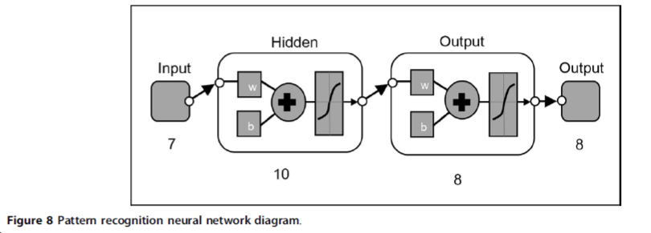

Slide 26
References
A. B. Watson and A. J. Ahumada, Jr., “A hexagonal orthogonal-oriented pyra-
mid as a model of image representation in the visual cortex,” IEEE Transac-
tions on Biomedical Engineering, vol. BME-36, pp. 97–106, Jan 1989.
R. C. Staunton and N. Storey, “A comparison between square and hexago-
nal sampling methods for pipeline image processing,” Proc. SPIE, vol. 1194,
pp. 142–151, 1989.
R. C. Staunton, “The processing of hexagonally sampled images,” Advances in
imaging and electron physics, vol. 119, pp. 191–265, 2001.
R. M. Mersereau, “The processing of Hexagonally Sampled Two-Dimensional
Signals,” Proceedings of the IEEE, vol. 67, pp. 930–949, June 1979.
A. Rosenfeld and J. L. Pfaltz, “Distance Functions on Digital Pictures,” Pat-
tern Recognition, vol. 1, pp. 33–61, 1968.
A. Rosenfeld, “Connectivity in Digital Pictures,” Journal of the Association
for Computing Machinery, vol. 17, no. 1, pp. 146–160, 1970.
L. Middleton, “The co-occurrence matrix in square and hexagonal lattices,”
in Proceedings of the 6th International Conference on Control, Automation,
Robotics and Vision, 2002.

Slide 27
references
L. Middleton, “Markov Random Fields for Square and Hexagonal Textures,”
in Proceedings of the 6th International Conference on Control, Automation,
Robotics and Vision, 2002.
L. Middleton and J. Sivaswamy, “A framework for practical hexagonal-image
processing,” Journal of Electronic Imaging, vol. 11, no. 1, pp. 104–114, 2002.
L. Middleton and J. Sivaswamy, “Edge Detection in a Hexagonal-image Pro-
cessing Framework,” Image and Vision Computing, vol. 19, no. 14, pp. 1071–
1081, 2001
L. Middleton and J. Sivaswamy, “The FFT in a Hexagonal-image Processing
Framework,” in Proceedings of Image and Vision Computing New Zealand,
pp. 231–236, 2001.
L. Middleton, J. Sivaswamy, and G. Coghill, “Shape Extraction in a Hexagonal-
Image Processing Framework,” in Proceedings of the 6th International Confer-
ence on Control, Automation, Robotics and Vision, ICARV, 2000.
R. C. Gonzalez and R. E. Woods, Digital Image Processing. Prentice Hall (New
Jersey), 2nd ed., 2001.
L. Middleton and J. Sivaswamy, “Hexagonal Image Processing A Practical Approach”,
in Proceedings of the 6th International Conference on Control, ISBN, 2005

