Slide 1

Term Project Presentation
Franco Bueno Mattera
MET CS 555
Boston University
11/30/2020

Slide 2

Project Description
Analyzing a dataset that contains information about different data analyst positions around the United States
Three main questions were proposed:
As of July 2020, what was the general distribution of the variable Salary for data analysts’ jobs?
As of July 2020, what was the most common type of company that offers data analyst positions across the United States?
As July 2020, what was the variability of salaries between the cities of New York, Chicago, Los Angeles, Charlotte (NC), San Francisco and Austin (TX)?
Notes:
For stratified and systematic, the same variable, location was used to calculate unequal probabilities

Slide 3
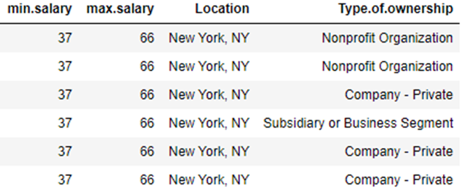
Dataset Description
Dataset with information about different data analyst positions around the United States
Obtained from Kaggle (Original data from Glassdoor)
Selected four variables
Categorical variable salary contained salary range information and it was transformed into numeric (Minimum and Maximum Salary)
From 2253 observations to 531 after cleaning
Notes:
The dataset contains information about different Data Analyst positions across the United States. It was acquired from Kaggle Datasets (Original data obtained from Glassdoor) and it was created in July 2020. Initially, it contained a total of fifteen columns and 2253 rows. After selecting the columns and factors of interest and eliminating missing values (presented as -1), the cleaned dataset contains 531 rows and four columns. One of the columns of interest (Salary) was transformed from a character variable into two numeric variables (Maximum Salary, Minimum Salary).

Slide 4
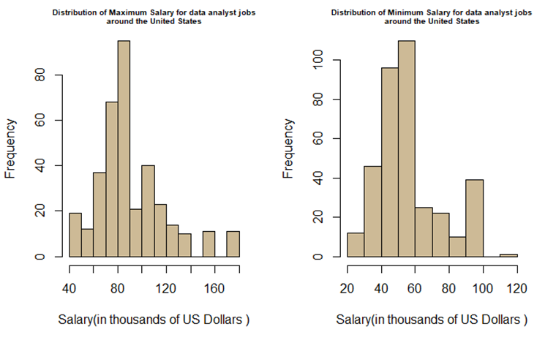
Question 1: As of July 2020, what was the general distribution of the variable Salary for data analysts’ jobs?
Salary distribution right-skewed
Resembles typical income distribution

Slide 5
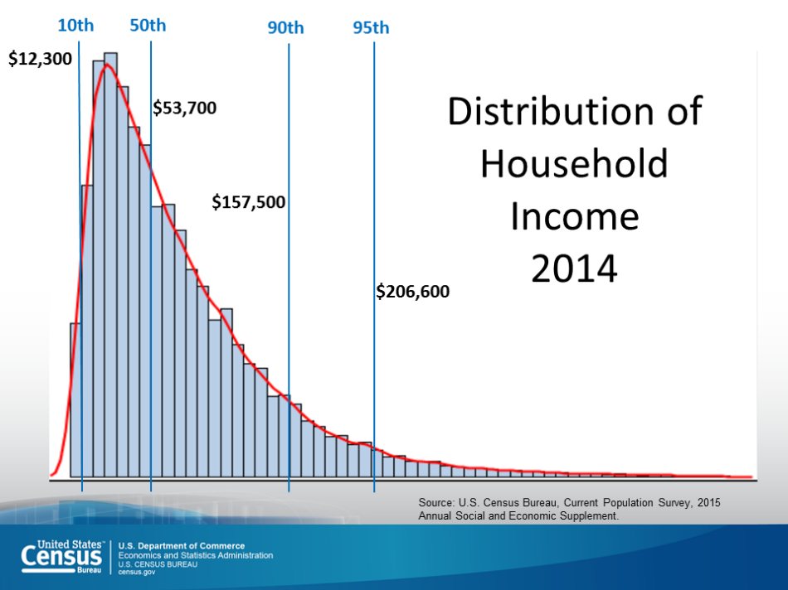
Question 1: As of July 2020, what was the general distribution of the variable Salary for data analysts’ jobs?
Salary Distribution right-skewed
Resembles typical income distribution
Source: https://www.census.gov/library/visualizations/2015/demo/distribution-of-household-income--2014.html

Slide 6
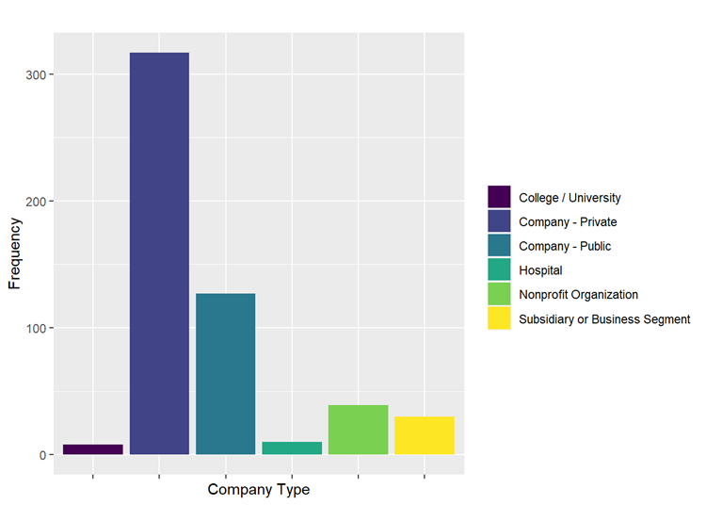
Question 2: As of July 2020, what was the most common type of company that offers data analyst positions across the United States?
College | Private | Public | Hospital | Non-Profit | Subsidiary
1.51% | 59.7% | 23.9% | 1.88% | 7.34% | 5.65%

Slide 7
Question 3: As of July 2020, what was the variability of salaries between the cities of New York, Chicago, Los Angeles, Charlotte (NC), San Francisco and Austin (TX)?
Three general approaches to answer Question 3:
Multiple samples from data (1000 of size 100)
Parametric inferential tests
Non-Parametric inferential tests
Results compared with the whole dataset
Notes:
Three general approaches to answer Question 3:
Multiple samples from data
First, to demonstrate the applicability of the Central Limit Theorem, multiple samples were drawn from each of the variables of interest and their sampling means used to answer the proposed questions. In order for this theory to be applied, the samples drawn from the population need to be representative, meaning that every unit in the population needs to have the same chance of being selected(James Mclave and Terry Sincich 2013a).To comply with this, the population of this study was assumed to be the population of interest.
Inferential Parametric Tests
Inferential Non-Parametric tests
Finally, al those results were compared to the whole dataset

Slide 8
Question 3: As of July 2020, what was the variability of salaries between the cities of New York, Chicago, Los Angeles, Charlotte (NC), San Francisco and Austin (TX)?
Four different sampling methods:
Simple random sampling
Systematic random sampling
Systematic random sample with unequal probabilities
Stratified random sampling
Notes:
Three general approaches to answer Question 3:
Multiple samples from data
First, to demonstrate the applicability of the Central Limit Theorem, multiple samples were drawn from each of the variables of interest and their sampling means used to answer the proposed questions. In order for this theory to be applied, the samples drawn from the population need to be representative, meaning that every unit in the population needs to have the same chance of being selected(James Mclave and Terry Sincich 2013a).To comply with this, the population of this study was assumed to be the population of interest.
Inferential Parametric Tests
Inferential Non-Parametric tests
Finally, al those results were compared to the whole dataset

Slide 9
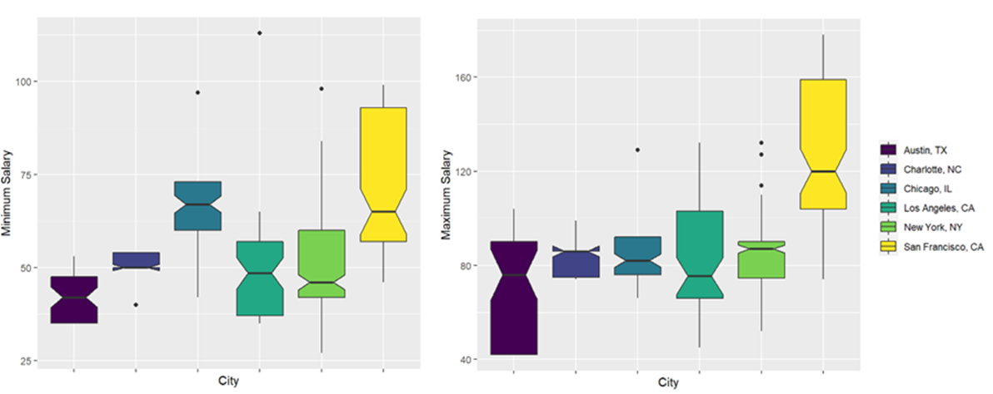
Question 3: As of July 2020, what was the variability of salaries between the cities of New York, Chicago, Los Angeles, Charlotte (NC), San Francisco and Austin (TX)?
Notes:
Three general approaches to answer Question 3:
Multiple samples from data
First, to demonstrate the applicability of the Central Limit Theorem, multiple samples were drawn from each of the variables of interest and their sampling means used to answer the proposed questions. In order for this theory to be applied, the samples drawn from the population need to be representative, meaning that every unit in the population needs to have the same chance of being selected(James Mclave and Terry Sincich 2013a).To comply with this, the population of this study was assumed to be the population of interest.
Inferential Parametric Tests
Inferential Non-Parametric tests
Finally, al those results were compared to the whole dataset

Slide 10
Pairwise differences for the whole dataset
City Pair | Differences
 | Minimum Salary | Maximum Salary
Charlotte, NC-Austin, TX | TRUE | FALSE
Chicago, IL-Austin, TX | TRUE | FALSE
Los Angeles, CA-Austin, TX | FALSE | FALSE
New York, NY-Austin, TX | FALSE | FALSE
San Francisco, CA-Austin, TX | TRUE | TRUE
Chicago, IL-Charlotte, NC | TRUE | FALSE
Los Angeles, CA-Charlotte, NC | FALSE | FALSE
New York, NY-Charlotte, NC | FALSE | FALSE
San Francisco, CA-Charlotte, NC | TRUE | TRUE
Los Angeles, CA-Chicago, IL | TRUE | FALSE
New York, NY-Chicago, IL | TRUE | FALSE
San Francisco, CA-Chicago, IL | FALSE | TRUE
New York, NY-Los Angeles, CA | FALSE | FALSE
San Francisco, CA-Los Angeles, CA | TRUE | TRUE
San Francisco, CA-New York, NY | TRUE | TRUE
Notes:
Looking at the whole dataset, for the variable ‘Minimum Salary’, it can be appreciated in Figure 5 that there are some evident differences in income between the cities. The highest income was for the city of San Francisco, followed by the city of Chicago. For the variable ‘Maximum Salary’ (Figure 5), the situation is the same but apart from San Francisco, it appears that there are no major differences in maximum salaries between the rest of the cities.
The median should be a better point estimator of salary. At least for the whole dataset

Slide 11
All methods, compared with whole dataset:
n= 100 | Parametric tests |  | Non-Parametric tests
 | Minimum Salary | Maximum Salary | Minimum Salary | Maximum Salary
Sampling Distribution Data | 0.46 | 0.60 | -
Simple Random Sampling | 0.80 | 1 | 0.60 | 0.867
Systematic Random Sampling | 0.733 | 1 | 0.60 | 0.73
Systematic w/unequal probs | 0.60 | 1 | 0.60 | 0.867
Stratified Random Sampling | 0.40 | 0.67 | 0.40 | 0.67%
Simple Random Sampling n <30 | 0.40 | 0.73 | 0.40 | 0.67%
Success probabilities at estimating differences by using parametric and non-parametric post hoc tests (paired t-test with Bonferroni correction and multiple Wilcoxson rank-sum tests):
Notes:
Looking at the whole dataset, for the variable ‘Minimum Salary’, it can be appreciated in Figure 5 that there are some evident differences in income between the cities. The highest income was for the city of San Francisco, followed by the city of Chicago. For the variable ‘Maximum Salary’ (Figure 5), the situation is the same but apart from San Francisco, it appears that there are no major differences in maximum salaries between the rest of the cities.
The median should be a better point estimator of salary. At least for the whole dataset

Slide 12
Conclusions and Lessons Learned
Income distribution for data analyst positions is the same as the general income distribution in the United States.
Most data analyst positions are from private companies
Experienced the power of the Central Limit Theorem when using parametric tests where normality assumptions are not met.
Using sampling distribution of sampling means is not good for estimating variability of very skewed populations (very low variability).
Stratified sampling was not very good at estimating differences between populations.
Notes:
Income distribution for Data analyst positions same as general income distribution
I expected to see a less skewed distribution of income for this type of positions
Central Limit Theorem seems to work for test that require normality assumption
Central limit theorem very good for estimating the means of the populations/
Stratified sampling should be done with care and with good domain knowledge since it is applicable when the population parameters are known to differ considerably (clear presence of subgroups in the population to be sampled). Systematic random sample yielded good results also, making it a good option when time and resources and scarce and when there is no pattern in the data(Andriy Blokin and Peter Westfall )

Slide 13
References
When Is It Better to Use Simple Random vs. Systematic Sampling? [Internet] [cited 2020 Nov 27,]. Available from: https://www.investopedia.com/ask/answers/071615/when-it-better-use-systematic-over-simple-random-sampling.asp.
Chang W. 2019. R graphics cookbook. Second edition, fourth release ed. Beijing, Boston, Farnham, Sebastopol, Tokyo: O'Reilly.
James Mclave, Terry Sincich. 2013a. Statistics. 413 p.
James Mclave, Terry Sincich. 2013b. Statistics. 285 p.
Jerold H. Zar. Biostatistical analysis. 127 p.
Data Analysts Jobs Dataset [Internet]. Available from: https://www.kaggle.com/andrewmvd/data-analyst-jobs .
Long JD, Teetor P. 2019. R cookbook. Second edition ed. Beijing: O'Reilly.
Pros and Cons of Stratified Random Sampling [Internet] [cited 2020 Nov 27,]. Available from: https://www.investopedia.com/ask/answers/041615/what-are-advantages-and-disadvantages-stratified-random-sampling.asp.
US Income Distribution [Internet]. Available from: https://www.census.gov/library/visualizations/2015/demo/distribution-of-household-income--2014.html.

