Slide 1



Real estate Prices Near Boston Metro Area
Franco Bueno Mattera
MET CS 555
Boston University
11/02/2020
https://pixabay.com/photos/boston-massachusetts-city-urban-1977009/

Slide 2



Introduction
Housing market volatility in 2020
Changes in real estate prices before and after 2020.
Situation in Massachusetts

Slide 3
Project Description
Study the variability of the housing market before and after 2020.
Six counties were studied:
Suffolk, Essex, Middlesex, Bristol, and Plymouth.
Two research questions:
Are there any significant differences in house sale prices between the years 2017, 2018, 2019, 2020 and between the six different chosen counties?
Is there an association between house sale prices and the years 2017, 2018, 2019, 2020 for the counties Suffolk and Plymouth, separately?
County | Norfolk | Suffolk | Essex | Middlesex | Bristol | Plymouth
Population Density | 1,536.8/sq mi | 6,221.3/sq mi | 914.2/sq mi | 1,817.9/sq mi | 797.2/sq mi | 458.1/sq mi
Notes:
For stratified and systematic, the same variable, location was used to calculate unequal probabilities

Slide 4
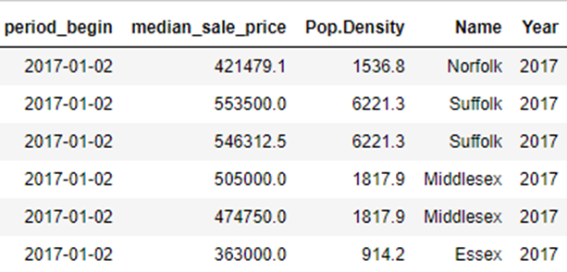
Dataset Description
Dataset obtained from Redfin:
Selected most relevant variables
Created new categorical variables
Notes:
Selected variables begin period, median sale price and created categorical variables Population Density, Name and Year
Note that the variable “period_begin” refers to the date when the house was listed as available for sale.

Slide 5
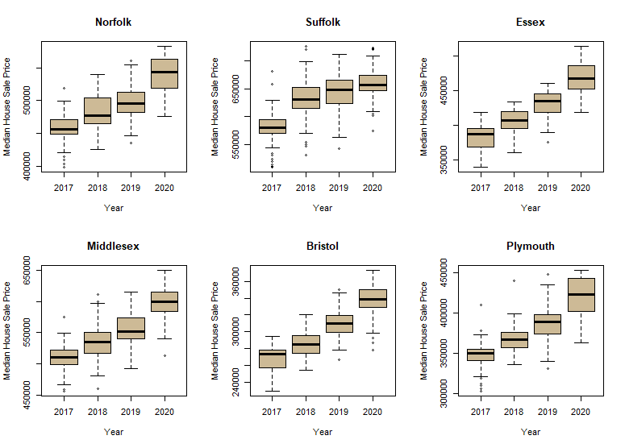
Question 1: Are there any significant differences in House Sale Prices between the years 2017, 2018, 2019, 2020 and between the six different chosen counties?
Year vs house sale price, controlling per county:
Global parametric and non-parametric test showed significant differences in house sale prices ( p-values < 2e-16 and < 0.0001 respectively)
Post-hoc pairwise comparisons showed significant differences in all pairs for parametric tests and non-parametric tests.
Hard to assess which differences are more significant than others.
Notes:
Difference are too significant to assess which pairs are more significant than others

Slide 6
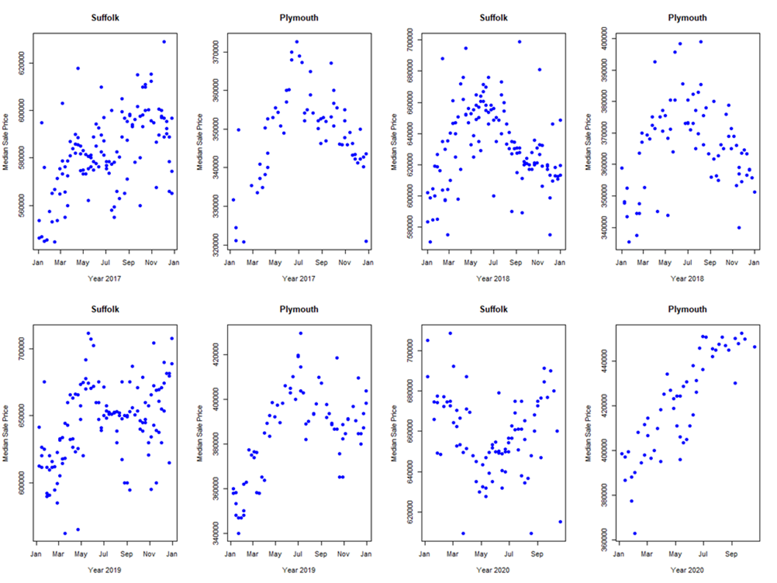
Question 2: Is there an association between house sale prices and the years 2017, 2018, 2019, 2020 for the counties Suffolk and Plymouth, separately?
Spearman Rank Correlation |  | County
 |  | Suffolk | Plymouth
2017 | ρ | 0.521 | 0.056
 | p-value | 1.66E-10 | 0.330
2018 | ρ | -0.071 | 0.021
 | p-value | 0.214 | 0.427
2019 | ρ | 0.431 | 0.492
 | p-value | 1.90E-07 | 3.76E-06
2020 | ρ | -0.100 | 0.867
 | p-value | 0.182 | < 2.2E-16
Notes:
Note that conclusions for non-parametric tests are more important since the assumptions were not met. Although parametric test like ANOVA and TtTest are resistant to the departures from those test’s assumptions.

Slide 7

Conclusions
It was possible to determine that there were indeed significant differences in house sale prices for the 6 counties studied and for all the years.
Hard to tell if those differences were more or less significant with respect to normal years.
There was indeed a change in the level of association for the counties of Plymouth and Suffolk before and after 2020, specially for Plymouth.
It is not possible to say that this change is caused by the events from 2020 but there is enough evident to suggest a deeper look into the situation, especially when considering to by property in the suburbs or sell property in the city.

Slide 8

References
Homogeneity of variance [Internet]. Available from: http://www.cookbook-r.com/Statistical_analysis/Homogeneity_of_variance/ .
Field A, Miles J, Field Z. 2013a. Discovering statistics using R. Los Angeles ; London ; New Delhi: SAGE. 681 p.
Field A, Miles J, Field Z. 2013b. Discovering statistics using R. Los Angeles ; London ; New Delhi: SAGE.
Field A, Miles J, Field Z. 2013c. Discovering statistics using R. 1. publ., reprint ed. Los Angeles, Calif. [u.a.]: Sage Publ. 188 p.
James McClave, Terry Sincich. 2013a. Nonparametric statistics. In: Statistics. . 14 p.
James McClave, Terry Sincich. 2013b. Statistics. . 223 p.
Long JD, Teetor P. 2019. R cookbook. Second edition ed. Beijing: O'Reilly.
Mihir Zaveri, New York Times. Suburban home sales boom as people move out of N.Y.C. .
Mohammad Alaghemandi, Boston University. Module-5: One-way analysis of variance. lecture - 9.
Real State Data Set [Internet]. Available from: https://www.redfin.com/news/data-center/ .
SOFIA RIVERA, Boston Magazine. 2020. Three major effects coronavirus is having on the boston housing market. .
Assumption of Independence [Internet]; c2015 [cited 2020 Nov 27,]. Available from: https://www.statisticshowto.com/assumption-of-independence/ .
Teresa Ghilarducci, Bloomberg.com. 2020. A pandemic is a terrible time to buy real estate. Bloomberg.Com;.
Massachusetts Population Density County Rank [Internet]. Available from: http://www.usa.com/rank/massachusetts-state--population-density--county-rank.htm .
Zar JH. 1998. Biostatistical analysis. 4. ed. ed. Englewood Cliffs, New Jersey: Regents/Prentice Hall. 223 p.

