Slide 1
SOFTWARE PRINCIPLES
All DEVELOPER must know…
…and apply

Slide 2
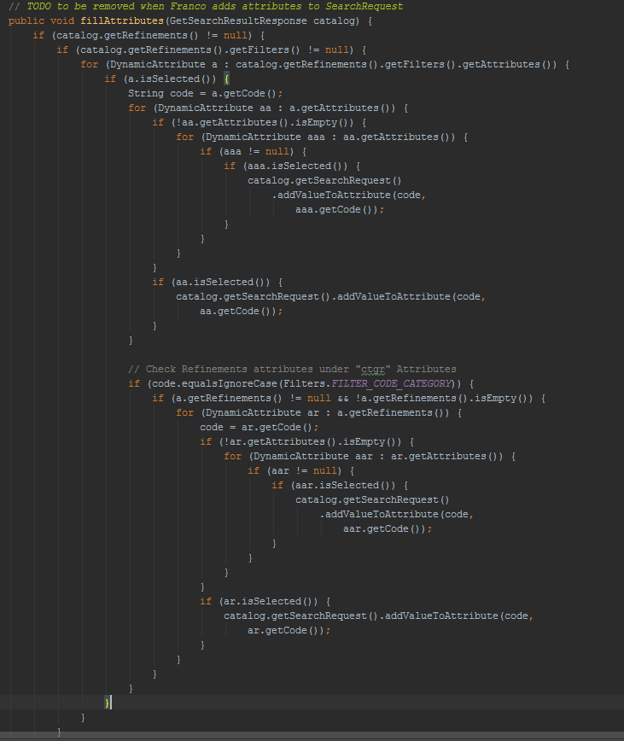

Slide 3
SOLID Principles
SOLID is an acronym for five OOD principles by Robert C. Martin (uncle bob)
These principles, when applied, help developer in
> easily maintain software
> extend software
> avoid smells
> easily refactor code
> achieve low coupling, high cohesion and string encapsulation
> software easier to read, easier to understand and easier to change

Slide 4
SOLID stands for
S SRP - Single Responsibility Principle
O OPC - Open Closed Principle
L LSP - Liskov Substitution Principle
I ISP - Interface Segregation Principle
D DIP - Dependency Inversion Principle

Slide 5
SRP Single Responsibility Principle
Class should have one and only one reason to change, meaning a class should have only one job.
If a class has more then one responsibility, then the responsibilities become coupled. Changes to one responsibility may inhibit the class ability to meet the others.
The hardest thing is to detect the responsibilities of a class according with the reason to change

Slide 6
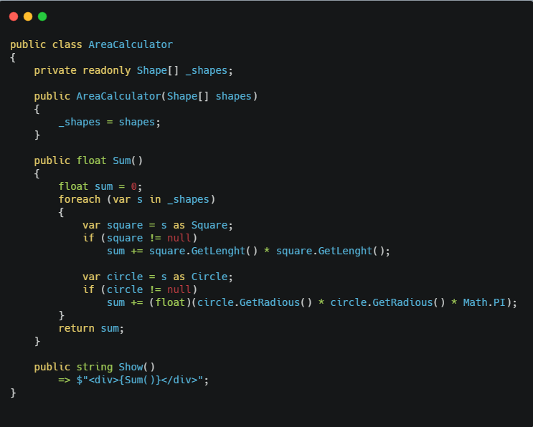
SRP Single Responsibility Principle

Slide 7
SRP Single Responsibility Principle
In the code example the AreaCalculator has both the logic to calculate area and formatting the output data, so it has two responsibilities.
We are violating the SRP principle, so we should separate the two job of the class into two different classes , each with a single responsibility.
We could add a new class called for example AreaCalculatorOutput that has the responsibility to format the output data coming from the AreaCalculator

Slide 8
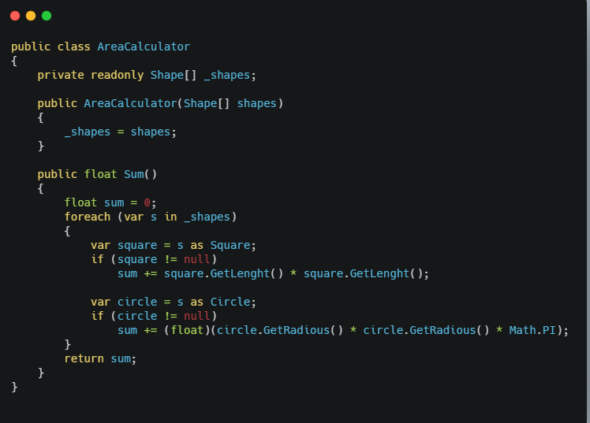
SRP Single Responsibility Principle

Slide 9
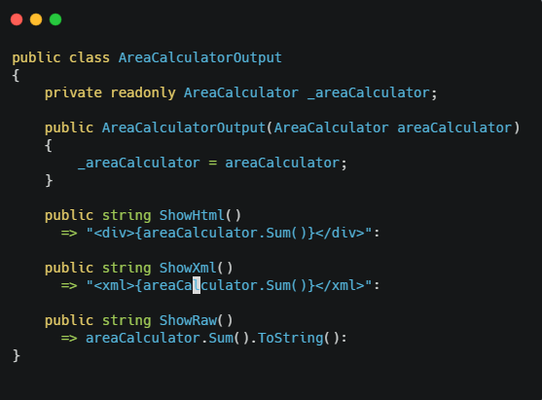
SRP Single Responsibility Principle

Slide 10
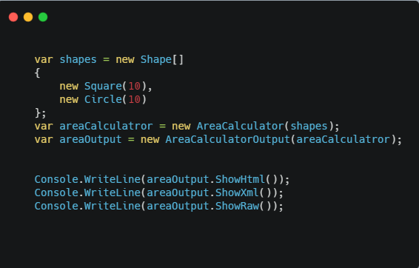
SRP Single Responsibility Principle

Slide 11
OCP Open Closed Principle
Software entities (classes, modules, functions, etc.) should be open for extension, but closed for modification.
This simply means that a class should be easily extendable without modifying the class itself.

Slide 12
OCP Open Closed Principle

Slide 13
OCP Open Closed Principle
In this case if we want the sum method to be able to sum areas of more shapes, we would have to add more if blocks to handle the area calculation of the shape.
This goes against the Open Closed principle because we must modify the class itself to obtain the new behaviour.
A better design is to remove the logic to calculate the area from the AreaCalculator an attach it into the single shape’s classes.

Slide 14
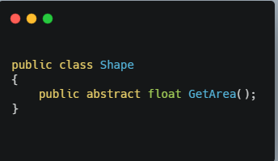
OCP Open Closed Principle
Notes:
Codice scritto in questo modo mi permette facilmente di estendere la classe che calcola l’area contemplando anche nuove Shape
Come ad esempio potrebbe essere Rectangle

Slide 15
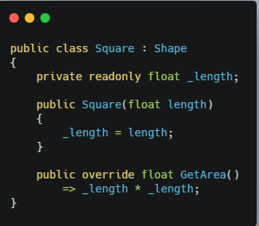
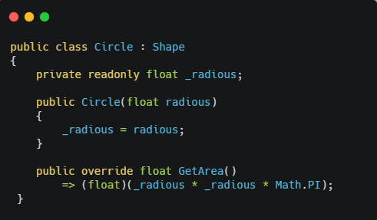
OCP Open Closed Principle
Notes:
Codice scritto in questo modo mi permette facilmente di estendere la classe che calcola l’area contemplando anche nuove Shape
Come ad esempio potrebbe essere Rectangle

Slide 16
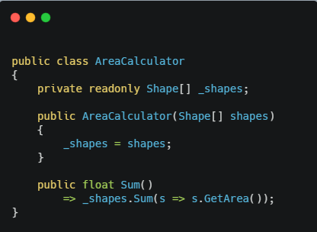
OCP Open Closed Principle
Notes:
Codice scritto in questo modo mi permette facilmente di estendere la classe che calcola l’area contemplando anche nuove Shape
Come ad esempio potrebbe essere Rectangle

Slide 17
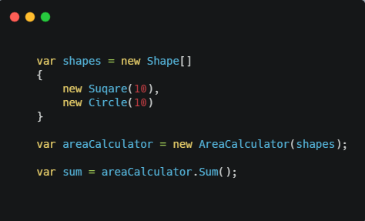
OCP Open Closed Principle
Notes:
Codice scritto in questo modo mi permette facilmente di estendere la classe che calcola l’area contemplando anche nuove Shape
Come ad esempio potrebbe essere Rectangle

Slide 18
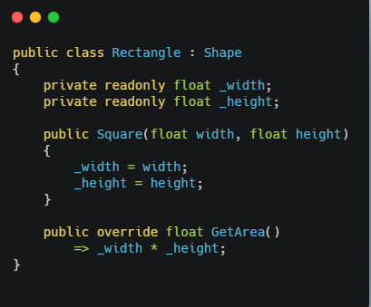
OCP Open Closed Principle

Slide 19
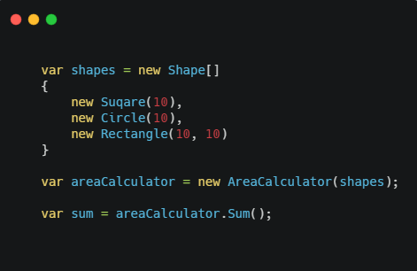
OCP Open Closed Principle

Slide 20
LSP Liskov Substitution Principle
Functions that use reference to base classes must be able to use object of derived classes without knowing it.
This mean that every subclass/derived should be substitutable for their base/parent class.
This principle is the base of Design by Contract
Notes:
-

Slide 21
LSP Liskov Substitution Principle
public class GenericCalculator
{
protected readonly Shape [] shapes;
public GenericCalculator(Shape [] shapes)
{
this.shapes = shapes;
}
public virtual float Sum()
{
return 0;
}
}
public class AreaCalculator : GenericCalculator
{
public AreaCalculator(Shape [] shapes)
: base(shapes) { }
public override float Sum()
{
return shapes.Sum(s => s.GetArea());
}
}
public class PerimeterCalculator : GenericCalculator
{
public PerimeterCalculator(Shape [] shapes)
: base(shapes) { }
public override float Sum()
{
return shapes.Sum(s => s.GetPerimeter());
}
}

Slide 22
LSP Liskov Substitution Principle
public class GenericCalculatorOutput
{
private readonly GenericCalculator calculator;
public GenericCalculatorOutput(GenericCalculator calculator)
{
this.calculator = calculator;
}
public string ShowHtml()
{
return string.Format("<div>{0}</div>", calculator.Sum());
}
}
var shapes = new Shape []
{
new Square(5),
new Circle(5)
};
var area = new AreaCalculator(shapes);
var perimeter = new PerimeterCalculator(shapes);
var outputArea = new GenericCalculatorOutput(area);
var outputPerimeter = new GenericCalculatorOutput(perimeter);
Console.WriteLine(outputArea.ShowHtml());
Console.WriteLine(outputPerimeter.ShowHtml());

Slide 23
ISP Interface Segregation Principle
A client never be forced to implement an interface that it doesn’t use or client shouldn’t be forced to depend on method they do not use.
This mean it is important to make fine grained interfaces that are client specific.

Slide 24
LSP Liskov Substitution Principle
public class GenericCalculator
{
public virtual float Sum()
{
return 0;
}
}
public class AreaCalculator : GenericCalculator
{
private readonly IShape[] shapes;
public AreaCalculator(IShape[] shapes)
{
this.shapes = shapes;
}
public override float Sum()
{
return shapes.Sum(s => s.GetArea());
}
}
public class PerimeterCalculator : GenericCalculator
{
private readonly ISquaredShape[] shapes;
public PerimeterCalculator(ISquaredShape[] shapes)
{
this.shapes = shapes;
}
public override float Sum()
{
return shapes.Sum(s => s.GetPerimeter());
}
}

Slide 25
LSP Liskov Substitution Principle
public interface IShape
{
float GetArea();
}
public interface ISquaredShape
{
float GetPerimeter();
}
public class Squared : IShape,
ISquaredShape
{
private readonly float length;
public Squared(float length)
{
this.length = length;
}
public float GetArea()
{
return length * length;
}
public float GetPerimeter()
{
return length * 4;
}
}
public class Circle : IShape
{
private readonly float radious;
public Circle(float radious)
{
this.radious = radious;
}
public float GetArea()
{
return (float)(radious * radious * Math.PI);
}
}

Slide 26
LSP Liskov Substitution Principle
var shapes = new IShape[]
{
new Squared(5),
new Circle(5)
};
var shapesSquare = new ISquaredShape[]
{
new Squared(5),
new Rectangle(5, 10),
};
var area = new AreaCalculator(shapes);
var perimeter = new PerimeterCalculator(shapesSquare);
var outputArea = new GenericCalculatorOutput(area);
var outputPerimeter = new GenericCalculatorOutput(perimeter);
Console.WriteLine(outputArea.ShowHtml());
Console.WriteLine(outputPerimeter.ShowHtml());

Slide 27
DIP Dependency Inversion Principle
Entities must depend on abstraction not on concretions.
High level module must not depend on the low level module, but they should depend on abstractions.
This principle allows for decoupling
Notes:
Alla base degli IoC
Bisogna sviluppare per interfacce e non per concrete

Slide 28
DIP Dependency Inversion Principle
public class GenericCalculator
{
protected readonly IShape[] shapes;
public GenericCalculator(IShape[] shapes)
{
this.shapes = shapes;
}
public virtual float Sum()
{
return 0;
}
}
public class AreaCalculator : GenericCalculator
{
public AreaCalculator(IShape[] shapes)
: base(shapes) { }
public override float Sum()
{
return shapes.Sum(s => s.GetArea());
}
}
public class PerimeterCalculator : GenericCalculator
{
public PerimeterCalculator(IShape[] shapes)
: base(shapes) { }
public override float Sum()
{
return shapes.Sum(s => s.GetPerimeter());
}
}

Slide 29
Practical Principles
KISS
Keep It Simple Stupid.
The most systems work best if they are kept simple rather then made complicated
Avoid OVERENGINERING

Slide 30
Practical Principles
YAGNI
You Aint Gonna Need It.

Slide 31
Resources
https://github.com/franco-melandri/SOLID
http://butunclebob.com/ArticleS.UncleBob.PrinciplesOfOod
http://www.codeproject.com/Articles/703634/SOLID-architecture-principles-using-simple-Csharp

