Slide 1
SOFTWARE
PRINCIPLES
All DEVELOPER must know…
…and apply…
when possible

Slide 2
Software Principles
SOLID Principles

Slide 3
SOLID Principles
SOLID is an acronym for five OOD principles by Robert C. Martin (uncle bob)
These principles, when applied, help developer in:
> Easily maintain software
> Easily extend software
> Avoid smell
> Easily refactor code
> Achieve low coupling, high cohesion and strong encapsulation
> Software easier to read, easier to understand and easier to change

Slide 4
SOLID stands for
S SRP Single Responsibility Principle
O OPC Open Closed Principle
L LSP Liskov Substitution Principle
I ISP Interface Segregation Principle
D DIP Dependency Inversion Principle

Slide 5
SRP Single Responsibility Principle
Class should have one and only one reason to change, meaning a class should have only one job.
If a class has more then one responsibility, then the responsibilities become coupled. Changes to one responsibility may inhibit the class ability to meet the others.
The hardest thing is to detect the responsibilities of a class according with the reason to change

Slide 6
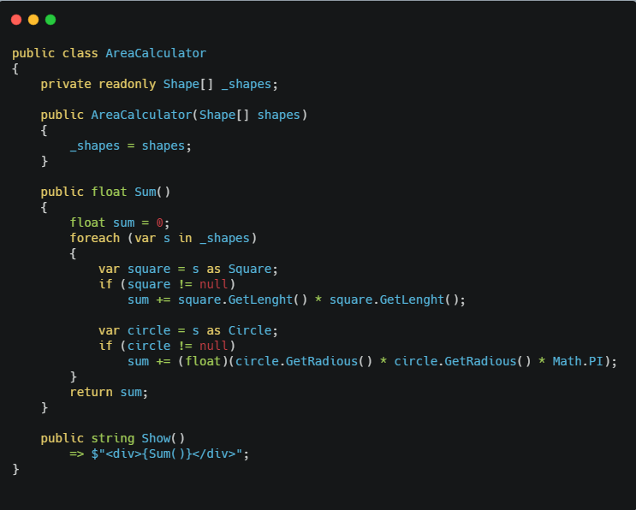
SRP Single Responsibility Principle

Slide 7
SRP Single Responsibility Principle
In the example code the AreaCalculator has both the logic to calculate area and formatting the output data, so it has two responsibilities.
We are violating the SRP principle, so we should separate the two job of the class into two different classes, each with a single responsibility.
We could add a new class called AreaCalculatorOutput that has the responsibility to format the output data coming from the AreaCalculator

Slide 8
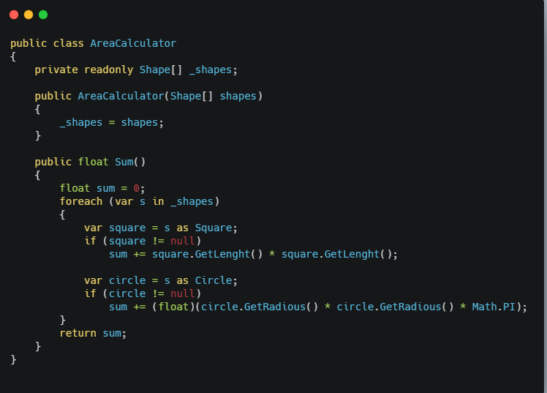
SRP Single Responsibility Principle

Slide 9
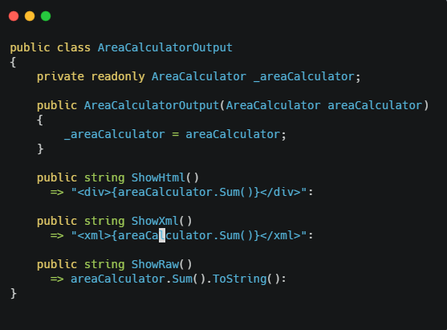
SRP Single Responsibility Principle

Slide 10
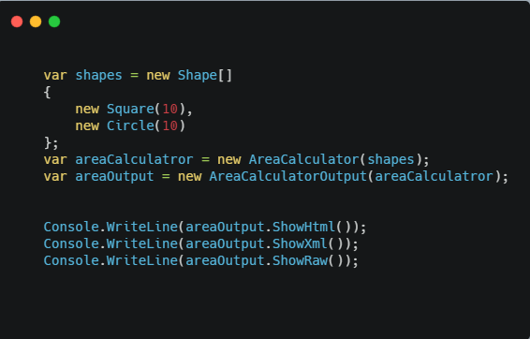
SRP Single Responsibility Principle

Slide 11
OCP Open Closed Principle
Software entities (classes, modules, functions, etc.) should be open for extension, but closed for modification.
This simply means that a class should be easily extendable without modifying the class itself.

Slide 12
OCP Open Closed Principle

Slide 13
OCP Open Closed Principle
In this case if we want the sum method to be able to sum areas of more shapes, we would have to add more if blocks to handle the area calculation of the shape.
This goes against the Open Closed Principle because we must modify the class itself to obtain the new behaviour.
A better design is to remove the logic to calculate the area from the AreaCalculator an attach it into the single shape’s classes.

Slide 14
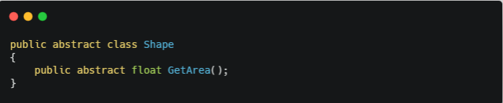
OCP Open Closed Principle
Notes:
Codice scritto in questo modo mi permette facilmente di estendere la classe che calcola l’area contemplando anche nuove Shape
Come ad esempio potrebbe essere Rectangle

Slide 15
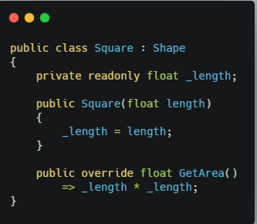
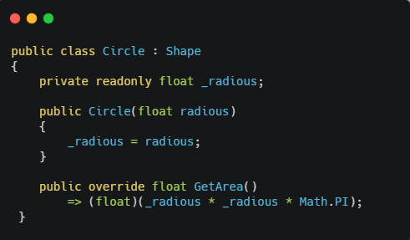
OCP Open Closed Principle
Notes:
Codice scritto in questo modo mi permette facilmente di estendere la classe che calcola l’area contemplando anche nuove Shape
Come ad esempio potrebbe essere Rectangle

Slide 16
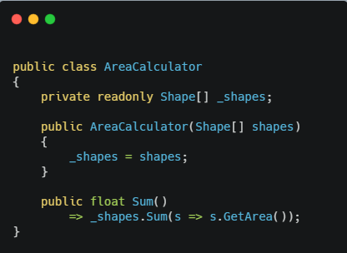
OCP Open Closed Principle
Notes:
Codice scritto in questo modo mi permette facilmente di estendere la classe che calcola l’area contemplando anche nuove Shape
Come ad esempio potrebbe essere Rectangle

Slide 17
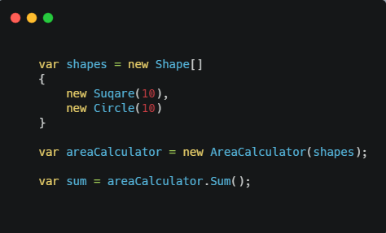
OCP Open Closed Principle
Notes:
Codice scritto in questo modo mi permette facilmente di estendere la classe che calcola l’area contemplando anche nuove Shape
Come ad esempio potrebbe essere Rectangle

Slide 18
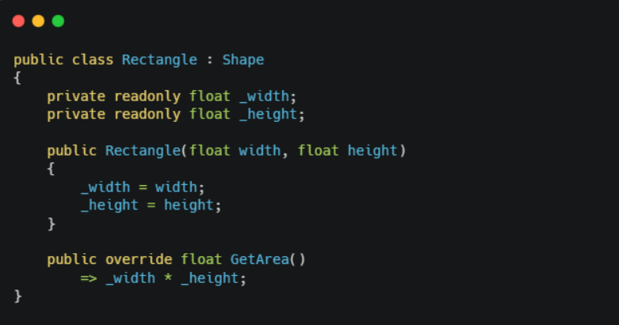
OCP Open Closed Principle

Slide 19
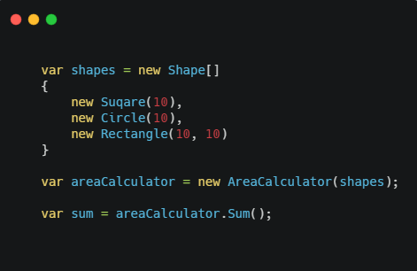
OCP Open Closed Principle

Slide 20
LSP Liskov Substitution Principle
Functions that use reference to base classes must be able to use object of derived classes without knowing it.
If S is a subtype of T, then objects of type T may be replaced with objects of type S.
This mean that every subclass/derived should be substitutable for their base/parent class.
This principle is the base of Design by Contract
Notes:
-

Slide 21
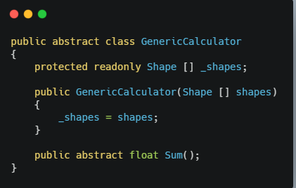
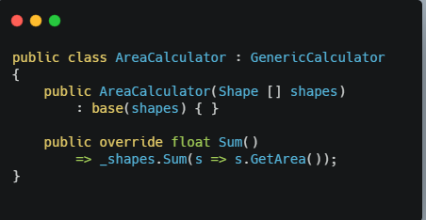
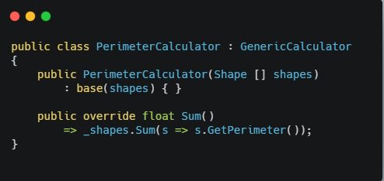
LSP Liskov Substitution Principle

Slide 22
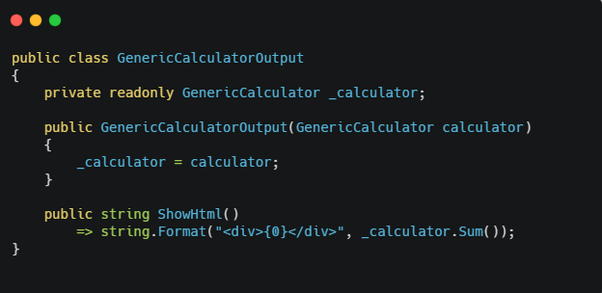
LSP Liskov Substitution Principle

Slide 23
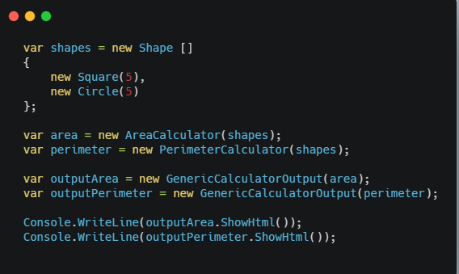
LSP Liskov Substitution Principle

Slide 24
ISP Interface Segregation Principle
A client never be forced to implement an interface that it doesn’t use or client shouldn’t be forced to depend on method they do not use.
This mean it is important to make fine grained interfaces that are client specific.

Slide 25
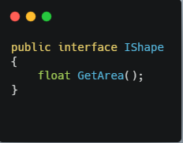
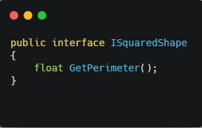
ISP Interface Segregation Principle

Slide 26
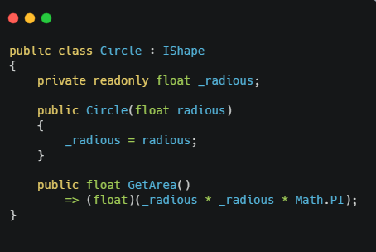
ISP Interface Segregation Principle

Slide 27
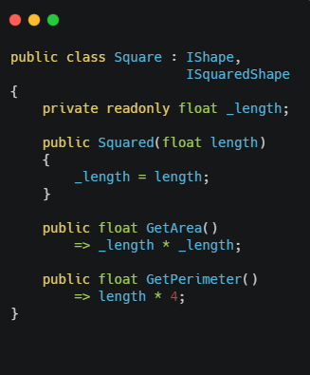
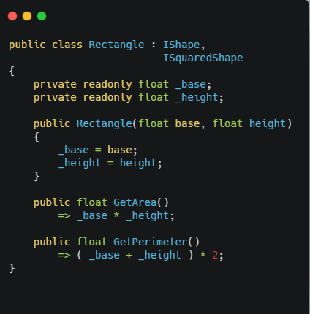
ISP Interface Segregation Principle

Slide 28
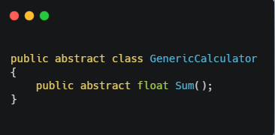
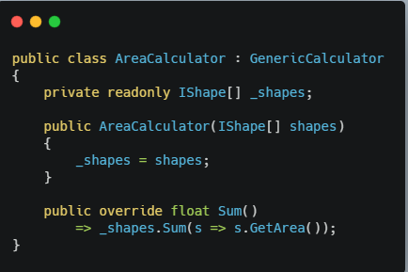
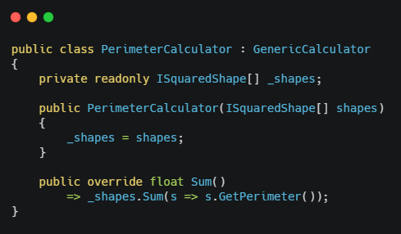
ISP Interface Segregation Principle

Slide 29
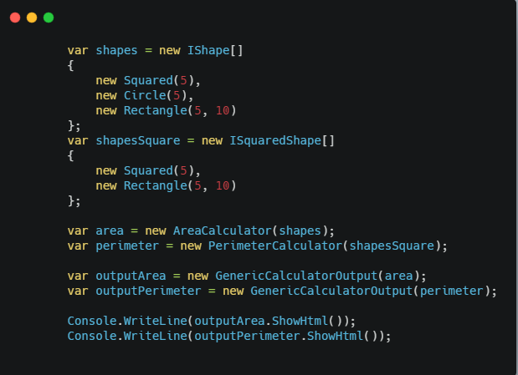
ISP Interface Segregation Principle

Slide 30
DIP Dependency Inversion Principle
Entities must depend on abstraction not on concretions.
High level module must not depend on the low level module, but they should depend on abstractions.
This principle allows for decoupling
Notes:
Alla base degli IoC
Bisogna sviluppare per interfacce e non per concrete

Slide 31
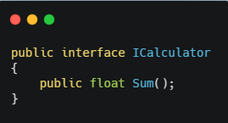
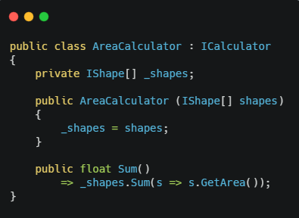
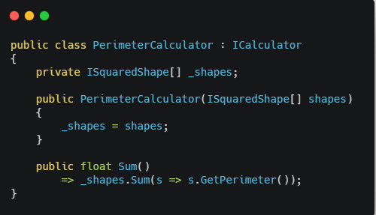
DIP Dependency Inversion Principle

Slide 32
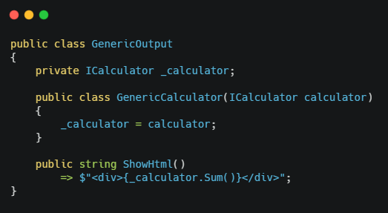
DIP Dependency Inversion Principle

Slide 33
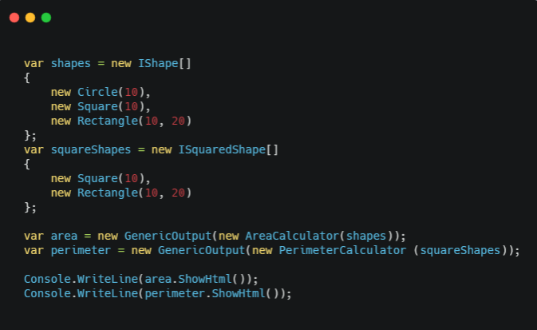
DIP Dependency Inversion Principle

Slide 34
SOLID Principles
Resources
https://github.com/francomelandri/SOLID
http://butunclebob.com/ArticleS.UncleBob.PrinciplesOfOod
http://www.codeproject.com/Articles/703634/SOLID-architecture-principles-using-simple-Csharp

Slide 35
Software Principles
Common Sense Principles

Slide 36
Practical Principles
KISS
Keep It Simple Stupid.
The most systems work best if they are kept simple rather then made complicated
Avoid OVER-ENGINEERING

Slide 37
Practical Principles
YAGNI
You Aren’t Gonna Need It.
If you don’t need it don’t do it
Avoid OVER-ENGINEERING
https://martinfowler.com/bliki/Yagni.html

Slide 38
Practical Principles
The Boy Scout Rule
Always leave the campground cleaner than you found it.
https://www.oreilly.com/library/view/97-things-every/9780596809515/ch08.html

Slide 39
Software Principles
Micro Services
Principles

Slide 40
Principles for micro services Design
IDEALS is an acronym for six micro services principles design.
These principles, when applied, help us to design a modern service-based systems (SOA)

Slide 41
IDEALS stands for
I Interface Segregation Principle
D Deployability Principle
E Event-Driven Principle
A Availabilty over Consistency Principle
L Loose coupling Principle
S Single responsibility Principle

Slide 42
Interface Segregation Principle
As we saw in OOD interface segregation principle admonish to use class implementing “fat” interfaces
Instead of a class interface with all possible methods client might needs, separate into granular interface for the clients specific needs
Interface = service contract
In the era of microservices there are a multitude of client (frontend) to the same service logic
The goal of interface segregation for microservices is that each type of frontend sees the service contract that best suits its needs in terms of contract and protocol
We can reach the goal using the API Gateway pattern or in alternative the BFF pattern

Slide 43
Interface Segregation Principle
Desktop Web
BFF
Web Apps
Mobile Web
SVC
Android
BFF
Mobile Apps
iOS
BFF
Public API
3° Party

Slide 44
Deployability
One of the most important key for a success microservice architecture
Deployability is ON YOU
For microservice developers, there are critical design decisions that go beyond the software design as module, dependencies, patterns, etc.
The realm of technology and design decisions that here we’re calling "deployability" has become critical to the success of microservices
The main reason is the simple fact that microservices dramatically increases the number of deployment units

Slide 45
Deployability
Deployability involves…
Configuring the runtime infrastructure, which includes containers, pods, clusters, persistence, security, and networking
Scaling microservices in and out, or migrating them from one runtime environment to another
Expediting the commit + build + test + deploy process.
Minimizing downtime for replacing the current version.
Synchronizing version changes of related software.
Monitoring the health of the microservices to quickly identify and remedy faults.

Slide 46
Deployability
Achieving good deployability
Automation is the key to effective deployability
Technologies and strategies to improve deployability:
Containerization and container orchestration (CRI, K8s)
Service mesh (Istio, Linkerd, and Consul Connect)
API gateway (Kong, Apiman, WSO2 API Manager, Apigee, and Amazon API Gateway)
Serverless architecture (Knative, AWS Lambda, Az Functions, GC Functions )
Monitoring tools (CloudWatch, Datadog, Prometheus, and Grafana)
Log consolidation tools (Fluentd, Graylog, Splunk, and ELK)
Tracing tools (Zipkin, Jaeger, and AWS X-Ray)

Slide 47
Deployability
Achieving good deployability
DevOps
Blue-green deployment and canary releasing
Infrastructure as Code (IaC) (Terraform, Pulumi, AWS CDK)
Continuous delivery
Progressive delivery (GitOps, Flux, Flagger)
Externalized configuration

Slide 48





Deployability
Push images
Pull images
CI/CD Push
code
Build
Deploy
Scripts
Helm
kubectl
config

Slide 49

Deployability
Push images
Pull images
CI/CD Pull (GitOps)
code
Build
Operator
config

Slide 50
Event-Driven
Microservices are typically activated using one of these connectors
> HTTP call (REST service)
> RPC-Like call (gRPC service)
> Asynchronous messages using message broker
Using Event-Driven architecture we improve scalability and throughput leveraging on Asynchronous communication
Using Event-Driven also promotes loose-coupling since message senders and receivers are independent
Using Event-Driven also improve reliability because message could be stored in the queue if some service fails

Slide 51
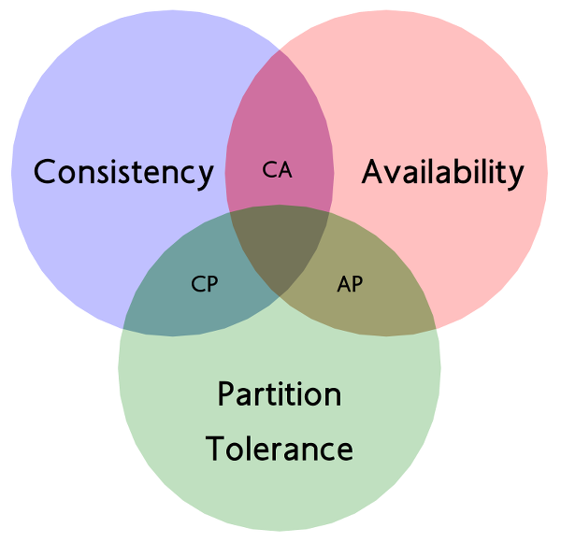
Availability over Consistency
CAP Theorem
“It’s not possible for a distributed system to simultaneously provide more than two features between Consistency, Availability and Partition tolerance”

Slide 52
Availability over Consistency
The CAP Theorem gives you two options: availability XOR consistency
For microservices, the main strategy that enables the availability choice is data replication
Service Data Replications pattern
Command Query Responsibility Segregation CQRS pattern
Event Sourcing pattern

Slide 53
Availability over Consistency
Query data store
REST service/ Query
Query operations
Client App
Replication
REST service/ Cmd
Master data store
Command operations

Slide 54
Loose-Coupling
In software engineering, coupling refers to the degree of interdependence between two software elements
Afferent coupling
Services exposes its functionality through the service contract (json, proto, xml)
The contract should not be tightly coupled to implementation details or a specific technology
Efferent coupling
Services often need to interact each other
The interaction establishes runtime dependencies that directly impact the service autonomy

Slide 55
Loose-Coupling
There are some strategies to promote Afferent and Efferent loose coupling
Publish-subscribe (message-driven pattern to decouple senders and receivers)
API gateway and BFF (intermediary component to deals with contract between clients and services)
Contract-first design (designing the contract independently of any existing code)
Hypermedia (hateoas to help clients to be more independend of service endpoint)
Adapter/Wrapper patterns (code is not dependend from concrete implementation)
Database per Microsertvice pattern (to avoid direct coupling to shared databases)

Slide 56
Single Responsibility
SRP has we know from OOD is about having cohesive functionality giving one responsibility to a class
The notion of single responsibility can be extended to the cohesiveness of services within a microservice
An important aspect of maturity in microservice design is the ability to create microservices that are not too coarse- or too fine-grained
An approach that has become popular in the industry to drive the scope of microservices is to follow Domain-Driven Design (DDD) precepts

Slide 57
IDEALS Principles
https://www.infoq.com/articles/microservices-design-ideals/

