Slide 1
Coursenotes
A Practical Introduction to
Data Structures and Algorithm Analysis
Second Edition
Clifford A. Shaffer
Department of Computer Science
Virginia Tech
Copyright © 2000, 2001
Last Updated: 01/10/2003

Slide 2
The Need for Data Structures
Data structures organize data
⇒ more efficient programs.
More powerful computers ⇒ more complex applications.
More complex applications demand more calculations.
Complex computing tasks are unlike our everyday experience.
Notes:
A primary concern for this course is efficiency.
You might believe that faster computers make it unnecessary to be concerned with efficiency. However…
So we need special training.

Slide 3
Organizing Data
Any organization for a collection of records can be searched, processed in any order, or modified.
The choice of data structure and algorithm can make the difference between a program running in a few seconds or many days.
Notes:
If you are willing to pay enough in time delay. Example: Simple unordered array of records.

Slide 4
Efficiency
A solution is said to be efficient if it solves the problem within its resource constraints.
  Space
  Time
The cost of a solution is the amount of resources that the solution consumes.
Notes:
Alternate definition: Better than known alternatives (“relatively efficient”).
Space and time are typical constraints for programs.
This does not mean always strive for the most efficient program. If the program operates well within resource constraints, there is no benefit to making it faster or smaller.

Slide 5
Selecting a Data Structure
Select a data structure as follows:
Analyze the problem to determine the resource constraints a solution must meet.
Determine the basic operations that must be supported. Quantify the resource constraints for each operation.
Select the data structure that best meets these requirements.
Notes:
Typically want the “simplest” data structure that will meet the requirements.

Slide 6
Some Questions to Ask
Are all data inserted into the data structure at the beginning, or are insertions interspersed with other operations?
Can data be deleted?
Are all data processed in some well-defined order, or is random access allowed?
Notes:
These questions often help to narrow the possibilities.
If data can be deleted, a more complex representation is typically required.

Slide 7
Data Structure Philosophy
Each data structure has costs and benefits.
Rarely is one data structure better than another in all situations.
A data structure requires:
  space for each data item it stores,
  time to perform each basic operation,
  programming effort.
Notes:
The space required includes data and overhead.
Some data structures/algorithms are more complicated than others.

Slide 8
Data Structure Philosophy (cont)
Each problem has constraints on available space and time.
Only after a careful analysis of problem characteristics can we know the best data structure for the task.
Bank example:
  Start account: a few minutes
  Transactions: a few seconds
  Close account: overnight

Slide 9
Goals of this Course
Reinforce the concept that costs and benefits exist for every data structure.
Learn the commonly used data structures.
  These form a programmer's basic data structure ``toolkit.'‘
Understand how to measure the cost of a data structure or program.
  These techniques also allow you to judge the merits of new data structures that you or others might invent.
Notes:
The first goal is a worldview to adopt
The second goal is the “nuts and bolts” of the course.
The third goal prepares a student for the future.

Slide 10
Abstract Data Types
Abstract Data Type (ADT): a definition for a data type solely in terms of a set of values and a set of operations on that data type.
Each ADT operation is defined by its inputs and outputs.
Encapsulation: Hide implementation details.

Slide 11
Data Structure
A data structure is the physical implementation of an ADT.
  Each operation associated with the ADT is implemented by one or more subroutines in the implementation.
Data structure usually refers to an organization for data in main memory.
File structure is an organization for data on peripheral storage, such as a disk drive.

Slide 12
Metaphors
An ADT manages complexity through abstraction: metaphor.
  Hierarchies of labels
Ex: transistors ⇒ gates ⇒ CPU.
In a program, implement an ADT, then think only about the ADT, not its implementation.

Slide 13
Logical vs. Physical Form
Data items have both a logical and a physical form.
Logical form: definition of the data item within an ADT.
  Ex: Integers in mathematical sense: +, -
Physical form: implementation of the data item within a data structure.
  Ex: 16/32 bit integers, overflow.

Slide 14
Data Type
ADT:
  Type
  Operations
Data Items:
Logical Form
Data Structure:
  Storage Space
  Subroutines
Data Items:
Physical Form
Notes:
In this class, we frequently move above and below “the line” separating logical and physical forms.

Slide 15
Problems
Problem: a task to be performed.
  Best thought of as inputs and matching outputs.
  Problem definition should include constraints on the resources that may be consumed by any acceptable solution.
Notes:
But NO constraints on HOW the problem is solved

Slide 16
Problems (cont)
Problems ⇔ mathematical functions
  A function is a matching between inputs (the domain) and outputs (the range).
  An input to a function may be single number, or a collection of information.
  The values making up an input are called the parameters of the function.
  A particular input must always result in the same output every time the function is computed.

Slide 17
Algorithms and Programs
Algorithm: a method or a process followed to solve a problem.
  A recipe.
An algorithm takes the input to a problem (function) and transforms it to the output.
  A mapping of input to output.
A problem can have many algorithms.

Slide 18
Algorithm Properties
An algorithm possesses the following properties:
  It must be correct.
  It must be composed of a series of concrete steps.
  There can be no ambiguity as to which step will be performed next.
  It must be composed of a finite number of steps.
  It must terminate.
A computer program is an instance, or concrete representation, for an algorithm in some programming language.
Notes:
“Correct” means computes the proper function.
“Concrete steps” are executable by the machine in question.
We frequently interchange use of “algorithm” and “program” though they are actually different concepts.

Slide 19
Mathematical Background
Set concepts and notation.
Recursion
Induction Proofs
Logarithms
Summations
Recurrence Relations
Notes:
Look over Chapter 2, read as needed depending on your familiarity with this material.
A set has no duplicates, a sequence may have duplicates.
Logarithms: We almost always use log to base 2. That is our default base.

Slide 20
Estimation Techniques
Known as “back of the envelope” or “back of the napkin” calculation
Determine the major parameters that effect the problem.
Derive an equation that relates the parameters to the problem.
Select values for the parameters, and apply the equation to yield and estimated solution.
Notes:
Look over Chapter 2, read as needed depending on your familiarity with this material.
A set has no duplicates, a sequence may have duplicates.
Logarithms: We almost always use log to base 2. That is our default base.

Slide 21
Estimation Example
How many library bookcases does it take to store books totaling one million pages?
Estimate:
  Pages/inch
  Feet/shelf
  Shelves/bookcase
Notes:
Pages/inch: Guess 500
Feet/shelf: Guess 4, actually 3
Shelves/bookcase: Guess 5, actually 7
Units check: pages/in x ft/shelf x shelf/bookcase ⇒ pages/bookcase

Slide 22
Algorithm Efficiency
There are often many approaches (algorithms) to solve a problem. How do we choose between them?
At the heart of computer program design are two (sometimes conflicting) goals.
  To design an algorithm that is easy to understand, code, debug.
  To design an algorithm that makes efficient use of the computer’s resources.

Slide 23
Algorithm Efficiency (cont)
Goal (1) is the concern of Software Engineering.
Goal (2) is the concern of data structures and algorithm analysis.
When goal (2) is important, how do we measure an algorithm’s cost?

Slide 24
How to Measure Efficiency?
Empirical comparison (run programs)
Asymptotic Algorithm Analysis
Critical resources:
Factors affecting running time:
For most algorithms, running time depends on “size” of the input.
Running time is expressed as T(n) for some function T on input size n.
Notes:
Empirical comparison is difficult to do “fairly” and is time consuming.
Critical resources: Time. Space (disk, RAM). Programmers effort. Ease of use (user’s effort).
Factors affecting running time: Machine load. OS. Compiler. Problem size. Specific input values for given problem size.

Slide 25
Examples of Growth Rate
Example 1.
// Find largest value
int largest(int array[], int n) {
int currlarge = 0; // Largest value seen
for (int i=1; i<n; i++) // For each val
if (array[currlarge] < array[i])
currlarge = i; // Remember pos
return currlarge; // Return largest
}
Notes:
As n grows, how does T(n) grow?
Cost: T(n) = c₁n + c₂ steps

Slide 26
Examples (cont)
Example 2: Assignment statement.
Example 3:
sum = 0;
for (i=1; i<=n; i++)
for (j=1; j<n; j++)
sum++;
}
Notes:
Example 2: Constant cost.
Example 3: Cost: T(n) = c₁n² + c². Roughly n² steps, with sum being n² at the end. Ignore various overhead such as loop counter increments.

Slide 27
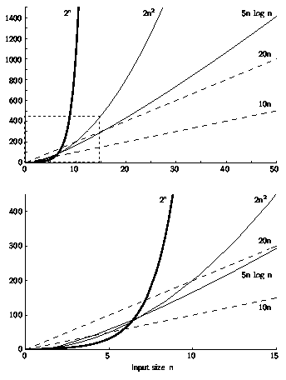
Growth Rate Graph

Slide 28
Best, Worst, Average Cases
Not all inputs of a given size take the same time to run.
Sequential search for K in an array of n integers:
  Begin at first element in array and look at each element in turn until K is found
Best case:
Worst case:
Average case:
Notes:
Best: Find at first position. Cost is 1 compare.
Worst: Find at last position. Cost is n compares.
Average: (n+1)/2 compares IF we assume the element with value K is equally likely to be in any position in the array.

Slide 29
Which Analysis to Use?
While average time appears to be the fairest measure, it may be diffiuclt to determine.
When is the worst case time important?
Notes:
Average time analysis requires knowledge of distributions. For example, the assumption of distribution used for average case in the last example.
Worst-case time is important for real-time algorithms.

Slide 30
Faster Computer or Algorithm?
What happens when we buy a computer 10 times faster?
T(n) | n | n’ | Change | n’/n
10n | 1,000 | 10,000 | n’ = 10n | 10
20n | 500 | 5,000 | n’ = 10n | 10
5n log n | 250 | 1,842 | √10 n < n’ < 10n | 7.37
2n² | 70 | 223 | n’ = √10n | 3.16
2^{n} | 13 | 16 | n’ = n + 3 | -----
Notes:
How much speedup? 10 times. More important: How much increase in problem size for same time expended? That depends on the growth rate.
n: Size of input that can be processed in one hour (10,000 steps).
n’: Size of input that can be processed in one our on the new machine (100,000 steps).
Note: for 2^{n}, if n = 1000, then n’ would be 1003.

Slide 31
Asymptotic Analysis: Big-oh
Definition: For T(n) a non-negatively valued function, T(n) is in the set O(f(n)) if there exist two positive constants c and n₀ such that T(n) <= cf(n) for all n > n₀.
Usage: The algorithm is in O(n²) in [best, average, worst] case.
Meaning: For all data sets big enough (i.e., n>n₀), the algorithm always executes in less than cf(n) steps in [best, average, worst] case.
Notes:
Must pick one of [best, average, worst] to complete the statement. Big-oh notation applies to some set of bounds.

Slide 32
Big-oh Notation (cont)
Big-oh notation indicates an upper bound.
Example: If T(n) = 3n² then T(n) is in O(n²).
Wish tightest upper bound:
While T(n) = 3n² is in O(n³), we prefer O(n²).
Notes:
It provides more information in this example to say O(n²) than O(n³).

Slide 33
Big-Oh Examples
Example 1: Finding value X in an array (average cost).
T(n) = c_{s}n/2.
For all values of n > 1, c_{s}n/2 <= c_{s}n.
Therefore, by the definition, T(n) is in O(n) for n₀ = 1 and c = c_{s}.
Notes:
We are doing average case.
c_{s} is a constant. The actual value is irrelevant.

Slide 34
Big-Oh Examples
Example 2: T(n) = c₁n² + c₂n in average case.
c₁n² + c₂n <= c₁n² + c₂n² <= (c₁ + c₂)n² for all n > 1.
T(n) <= cn² for c = c₁ + c₂ and n₀ = 1.
Therefore, T(n) is in O(n²) by the definition.
Example 3: T(n) = c. We say this is in O(1).

Slide 35
A Common Misunderstanding
“The best case for my algorithm is n=1 because that is the fastest.” WRONG!
Big-oh refers to a growth rate as n grows to ∞.
Best case is defined as which input of size n is cheapest among all inputs of size n.
Notes:
We are doing average case.
c_{s} is a constant. The actual value is irrelevant.

Slide 36
Big-Omega
Definition: For T(n) a non-negatively valued function, T(n) is in the set Ω(g(n)) if there exist two positive constants c and n₀ such that T(n) >= cg(n) for all n > n₀.
Meaning: For all data sets big enough (i.e., n > n₀), the algorithm always executes in more than cg(n) steps.
Lower bound.

Slide 37
Big-Omega Example
T(n) = c₁n² + c₂n.
c₁n² + c₂n >= c₁n² for all n > 1.
T(n) >= cn² for c = c₁ and n₀ = 1.
Therefore, T(n) is in Ω(n²) by the definition.
We want the greatest lower bound.

Slide 38
Theta Notation
When big-Oh and Ω meet, we indicate this by using Θ (big-Theta) notation.
Definition: An algorithm is said to be Θ(h(n)) if it is in O(h(n)) and it is in Ω(h(n)).
Notes:
For polynomial equations on T(n), we always have Θ. There is no uncertainty, since once we have the equation, we have a “complete” analysis.

Slide 39
A Common Misunderstanding
Confusing worst case with upper bound.
Upper bound refers to a growth rate.
Worst case refers to the worst input from among the choices for possible inputs of a given size.

Slide 40
Simplifying Rules
If f(n) is in O(g(n)) and g(n) is in O(h(n)), then f(n) is in O(h(n)).
If f(n) is in O(kg(n)) for any constant k > 0, then f(n) is in O(g(n)).
If f₁(n) is in O(g₁(n)) and f₂(n) is in O(g₂(n)), then (f₁ + f₂)(n) is in O(max(g₁(n), g₂(n))).
If f₁(n) is in O(g₁(n)) and f₂(n) is in O(g₂(n)) then f₁(n)f₂(n) is in O(g₁(n)g₂(n)).
Notes:
2. Ignore constants.
3. Drop low order terms.
4. Useful for analyzing loops.

Slide 41
Running Time Examples (1)
Example 1: a = b;
This assignment takes constant time, so it is Θ(1).
Example 2:
sum = 0;
for (i=1; i<=n; i++)
sum += n;
Notes:
Asymptotic analysis is defined for equations. We need to convert programs to equations to analyze them.
The traditional notation is Θ(1), not Θ(c).
Θ(n) even though the value of sum is n².

Slide 42
Running Time Examples (2)
Example 3:
sum = 0;
for (i=1; i<=n; j++)
for (j=1; j<=i; i++)
sum++;
for (k=0; k<n; k++)
A[k] = k;
Notes:
First statement is Θ(1). Double for loop is Σi = Θ(n²). Final for loop is Θ(n). Result: Θ(n²).

Slide 43
Running Time Examples (3)
Example 4:
sum1 = 0;
for (i=1; i<=n; i++)
for (j=1; j<=n; j++)
sum1++;
sum2 = 0;
for (i=1; i<=n; i++)
for (j=1; j<=i; j++)
sum2++;
Notes:
First loop, sum is n². Second loop, sum is (n+1)(n)/2. Both are Θ(n²).

Slide 44
Running Time Examples (4)
Example 5:
sum1 = 0;
for (k=1; k<=n; k*=2)
for (j=1; j<=n; j++)
sum1++;
sum2 = 0;
for (k=1; k<=n; k*=2)
for (j=1; j<=k; j++)
sum2++;
Notes:
First loop is Σn for k = 1 to log n, or Θ(n log n).
Second loop is Σ2^{k} for k = 0 to log n - 1, or Θ(n).

Slide 45
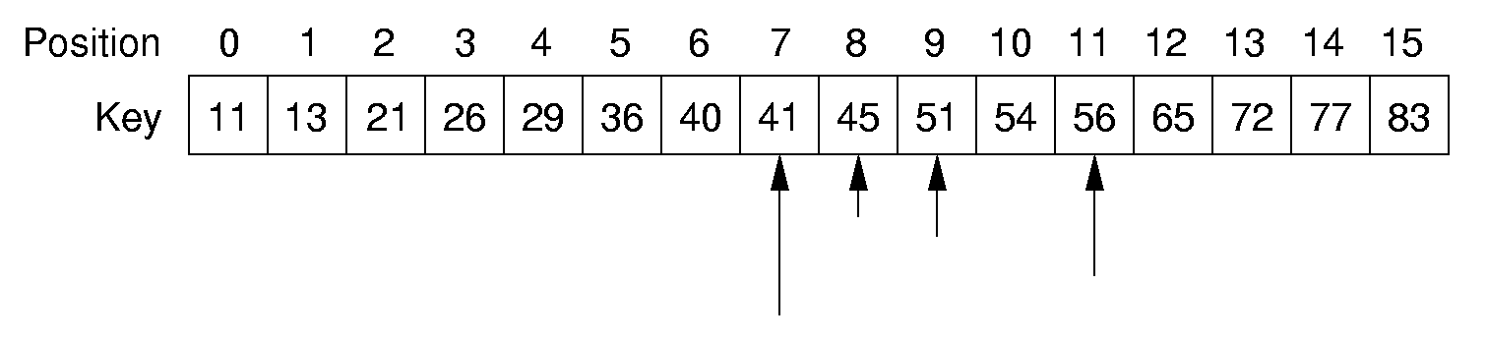
Binary Search
How many elements are examined in worst case?

Slide 46
Binary Search
// Return position of element in sorted
// array of size n with value K.
int binary(int array[], int n, int K) {
int l = -1;
int r = n; // l, r are beyond array bounds
while (l+1 != r) { // Stop when l, r meet
int i = (l+r)/2; // Check middle
if (K < array[i]) r = i; // Left half
if (K == array[i]) return i; // Found it
if (K > array[i]) l = i; // Right half
}
return n; // Search value not in array
}

Slide 47
Other Control Statements
while loop: Analyze like a for loop.
if statement: Take greater complexity of then/else clauses.
switch statement: Take complexity of most expensive case.
Subroutine call: Complexity of the subroutine.
Notes:
if statement: The probabilities for the then/else clauses being executed must be independent of n.
switch statement: The probabilities of the various clauses being executed must be independent of n.

Slide 48
Analyzing Problems
Upper bound: Upper bound of best known algorithm.
Lower bound: Lower bound for every possible algorithm.
Notes:
Analyzing problems is done a lot in a senior algorithms class.

Slide 49
Analyzing Problems: Example
Common misunderstanding: No distinction between upper/lower bound when you know the exact running time.
Example of imperfect knowledge: Sorting
1. Cost of I/O: Ω(n).
2. Bubble or insertion sort: O(n²).
3. A better sort (Quicksort, Mergesort, Heapsort, etc.): O(n log n).
4. We prove later that sorting is Ω(n log n).
Notes:
The examples so far have been easy in that exact equations always yield Θ. Thus, it is hard to distinguish Ω and O. This example should help to explain the difference. Bounds are used to describe our level of uncertainty about an algorithm.

Slide 50
Multiple Parameters
Compute the rank ordering for all C pixel values in a picture of P pixels.
for (i=0; i<C; i++) // Initialize count
count[i] = 0;
for (i=0; i<P; i++) // Look at all pixels
count[value(i)]++; // Increment count
sort(count); // Sort pixel counts
If we use P as the measure, then time is Θ(P log P).
More accurate is Θ(P + C log C).
Notes:
Example picture size: 256 colors (8 bits), 1000 by 1000 pixels.

Slide 51
Space Bounds
Space bounds can also be analyzed with asymptotic complexity analysis.
Time: Algorithm
Space Data Structure

Slide 52
Space/Time Tradeoff Principle
One can often reduce time if one is willing to sacrifice space, or vice versa.
  Encoding or packing information
    Boolean flags
  Table lookup
    Factorials
Disk-based Space/Time Tradeoff Principle: The smaller you make the disk storage requirements, the faster your program will run.

Slide 53
Lists
A list is a finite, ordered sequence of data items.
Important concept: List elements have a position.
Notation: <a₀, a₁, …, a_{n-1}>
What operations should we implement?
Notes:
Students should already be familiar with lists.
Chapter objective: Use algorithm analysis in a familiar context to compare implementations.

Slide 54
List Implementation Concepts
Our list implementation will support the concept of a current position.
We will do this by defining the list in terms of left and right partitions.
  Either or both partitions may be empty.
Partitions are separated by the fence.
<20, 23 | 12, 15>

Slide 55
List ADT
template <class Elem> class List {
public:
virtual void clear() = 0;
virtual bool insert(const Elem&) = 0;
virtual bool append(const Elem&) = 0;
virtual bool remove(Elem&) = 0;
virtual void setStart() = 0;
virtual void setEnd() = 0;
virtual void prev() = 0;
virtual void next() = 0;
Notes:
This is an example ADT that our list implementations must match.

Slide 56
List ADT (cont)
virtual int leftLength() const = 0;
virtual int rightLength() const = 0;
virtual bool setPos(int pos) = 0;
virtual bool getValue(Elem&) const = 0;
virtual void print() const = 0;
};
Notes:
This is an example ADT that our list implementations must match.

Slide 57
List ADT Examples
List: <12 | 32, 15>
MyList.insert(99);
Result: <12 | 99, 32, 15>
Iterate through the whole list:
for (MyList.setStart(); MyList.getValue(it);
MyList.next())
DoSomething(it);

Slide 58
List Find Function
// Return true iff K is in list
bool find(List<int>& L, int K) {
int it;
for (L.setStart(); L.getValue(it); L.next())
if (K == it) return true; // Found it
return false; // Not found
}

Slide 59
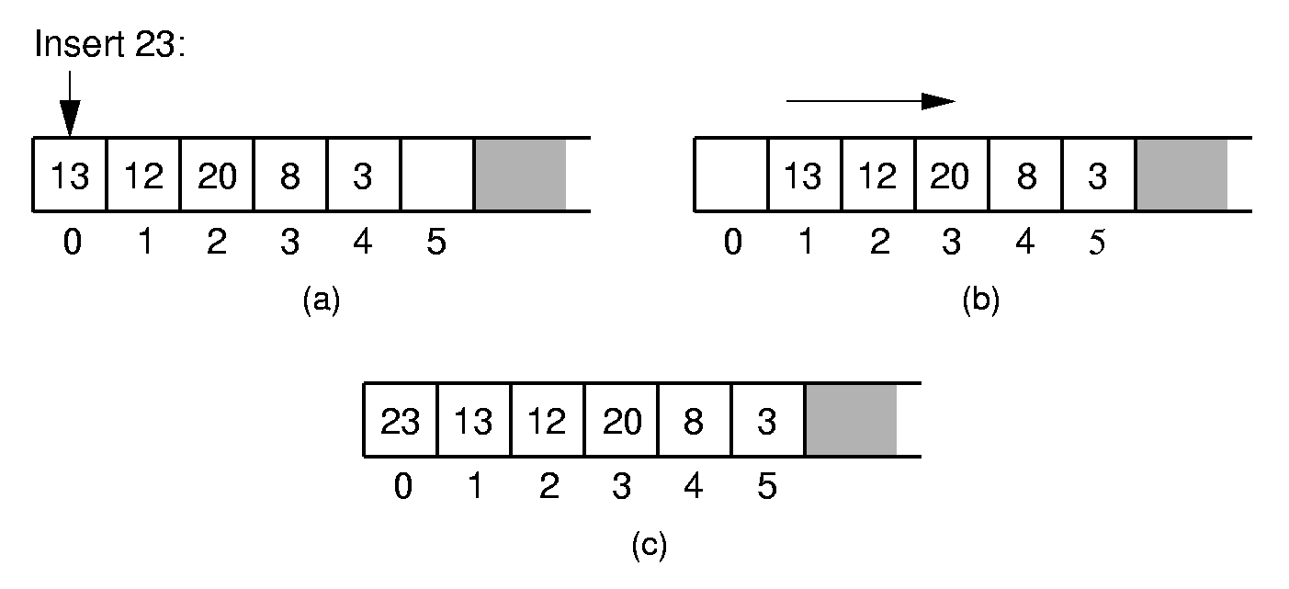
Array-Based List Insert
Notes:
Push items up/down. Cost: Θ(n).

Slide 60
Array-Based List Class (1)
template <class Elem> // Array-based list
class AList : public List<Elem> {
private:
int maxSize; // Maximum size of list
int listSize; // Actual elem count
int fence; // Position of fence
Elem* listArray; // Array holding list
public:
AList(int size=DefaultListSize) {
maxSize = size;
listSize = fence = 0;
listArray = new Elem[maxSize];
}

Slide 61
Array-Based List Class (2)
~AList() { delete [] listArray; }
void clear() {
delete [] listArray;
listSize = fence = 0;
listArray = new Elem[maxSize];
}
void setStart() { fence = 0; }
void setEnd() { fence = listSize; }
void prev() { if (fence != 0) fence--; }
void next() { if (fence <= listSize)
fence++; }
int leftLength() const { return fence; }
int rightLength() const
{ return listSize - fence; }

Slide 62
Array-Based List Class (3)
bool setPos(int pos) {
if ((pos >= 0) && (pos <= listSize))
fence = pos;
return (pos >= 0) && (pos <= listSize);
}
bool getValue(Elem& it) const {
if (rightLength() == 0) return false;
else {
it = listArray[fence];
return true;
}
}

Slide 63
Insert
// Insert at front of right partition
template <class Elem>
bool AList<Elem>::insert(const Elem& item) {
if (listSize == maxSize) return false; for(int i=listSize; i>fence; i--)
// Shift Elems up to make room
listArray[i] = listArray[i-1]; listArray[fence] = item;
listSize++; // Increment list size
return true;
}

Slide 64
Append
// Append Elem to end of the list
template <class Elem>
bool AList<Elem>::append(const Elem& item) {
if (listSize == maxSize) return false;
listArray[listSize++] = item;
return true;
}

Slide 65
Remove
// Remove and return first Elem in right
// partition
template <class Elem> bool AList<Elem>::remove(Elem& it) {
if (rightLength() == 0) return false;
it = listArray[fence]; // Copy Elem
for(int i=fence; i<listSize-1; i++)
// Shift them down
listArray[i] = listArray[i+1];
listSize--; // Decrement size
return true;
}

Slide 66
Link Class
Dynamic allocation of new list elements.
// Singly-linked list node
template <class Elem> class Link {
public:
Elem element; // Value for this node
Link *next; // Pointer to next node
Link(const Elem& elemval,
Link* nextval =NULL)
{ element = elemval; next = nextval; }
Link(Link* nextval =NULL)
{ next = nextval; }
};

Slide 67
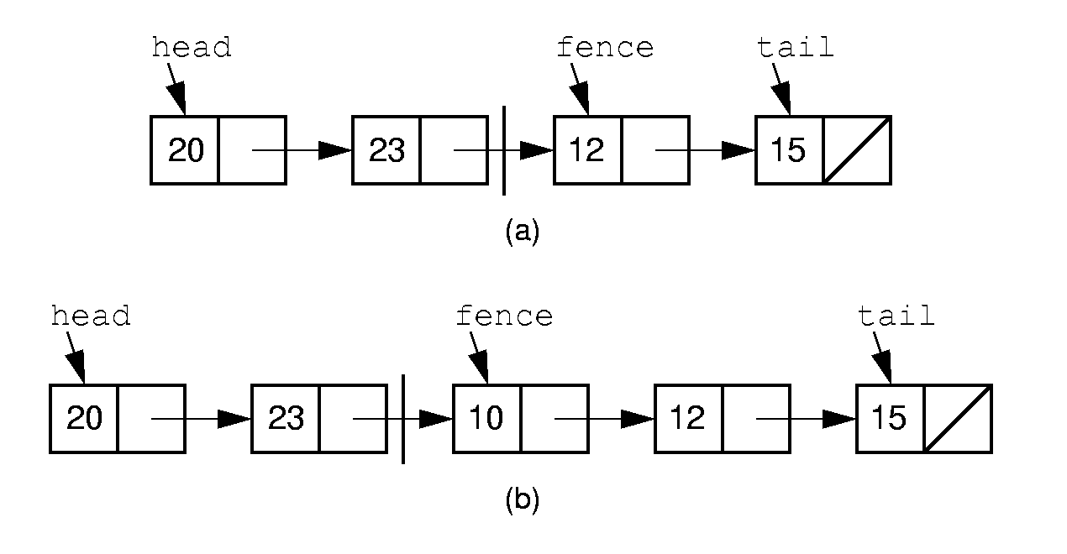
Linked List Position (1)
Notes:
Naïve approach: Fence points to first node in right partition. We want to insert 10 at the beginning of the right partition. No access if available to the node with value 23. How can we do the insert?

Slide 68
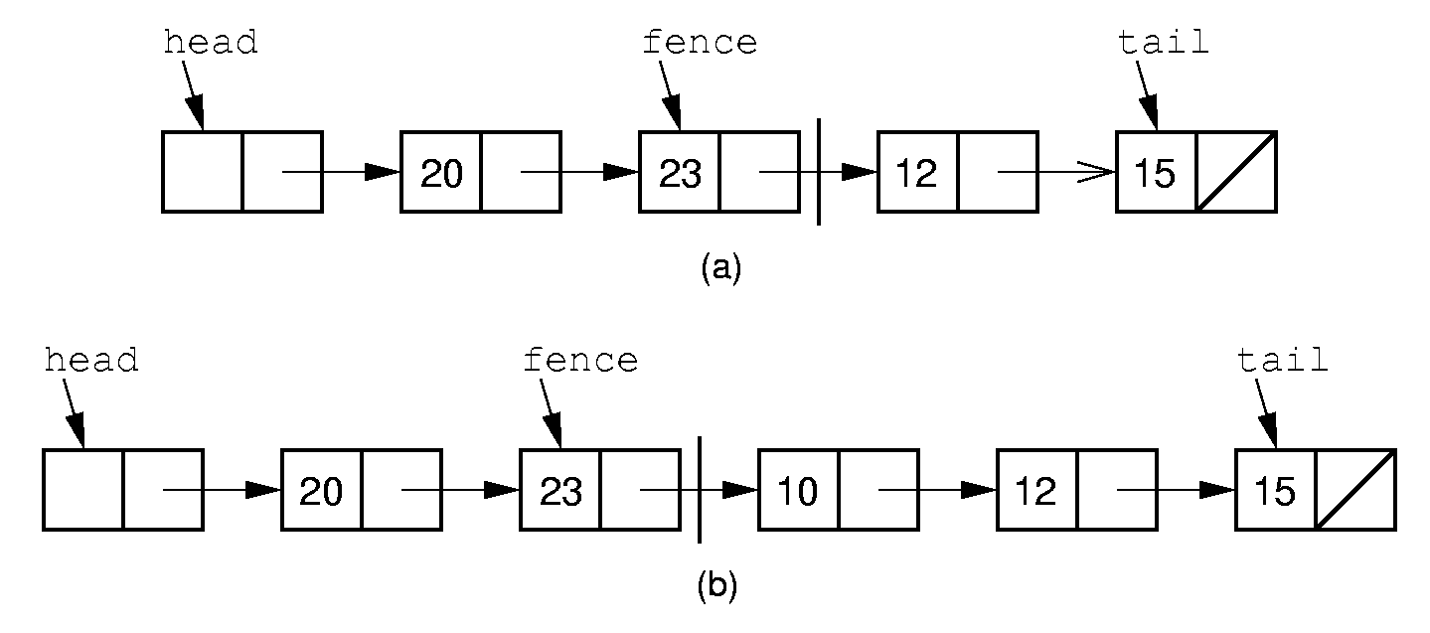
Linked List Position (2)
Notes:
Alternative Implementation: Fence points to the node preceding the actual first node in the right partition. Now we can do the insert. Also note use of the header node. The header node eliminates special cases in the code.

Slide 69
Linked List Class (1)
/ Linked list implementation
template <class Elem> class LList:
public List<Elem> {
private:
Link<Elem>* head; // Point to list header
Link<Elem>* tail; // Pointer to last Elem Link<Elem>* fence;// Last element on left
int leftcnt; // Size of left
int rightcnt; // Size of right
void init() { // Intialization routine
fence = tail = head = new Link<Elem>;
leftcnt = rightcnt = 0;
}

Slide 70
Linked List Class (2)
void removeall() { // Return link nodes to free store
while(head != NULL) {
fence = head;
head = head->next;
delete fence;
}
}
public:
LList(int size=DefaultListSize)
{ init(); }
~LList() { removeall(); } // Destructor
void clear() { removeall(); init(); }

Slide 71
Linked List Class (3)
void setStart() {
fence = head; rightcnt += leftcnt;
leftcnt = 0; }
void setEnd() {
fence = tail; leftcnt += rightcnt;
rightcnt = 0; }
void next() {
// Don't move fence if right empty
if (fence != tail) {
fence = fence->next; rightcnt--;
leftcnt++; }
}
int leftLength() const { return leftcnt; }
int rightLength() const { return rightcnt; }
bool getValue(Elem& it) const {
if(rightLength() == 0) return false;
it = fence->next->element;
return true; }

Slide 72
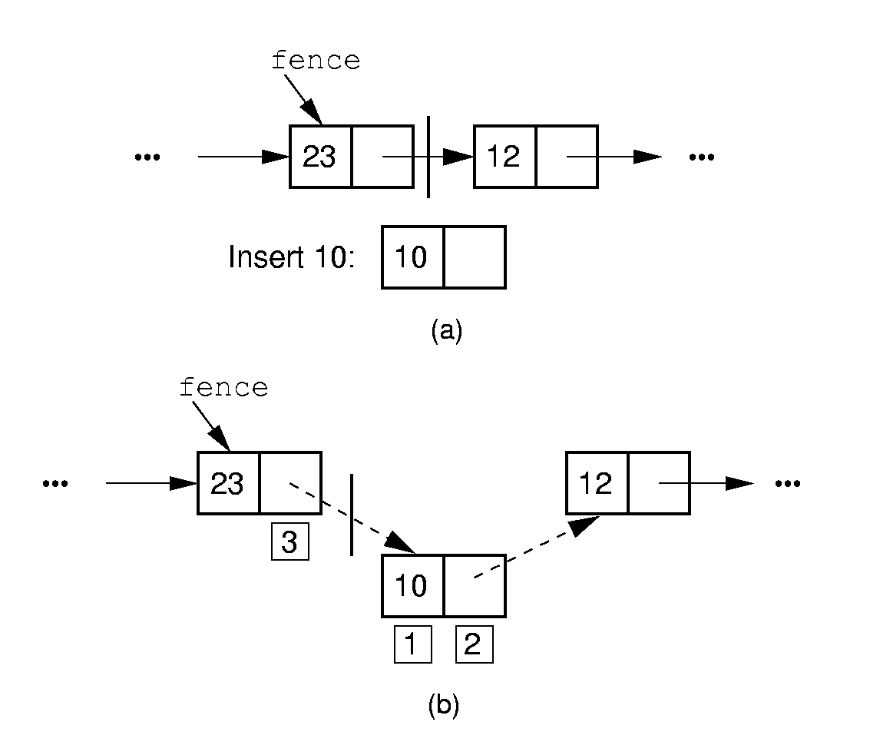
Insertion

Slide 73
Insert/Append
// Insert at front of right partition
template <class Elem>
bool LList<Elem>::insert(const Elem& item) {
fence->next =
new Link<Elem>(item, fence->next);
if (tail == fence) tail = fence->next; rightcnt++;
return true;}
// Append Elem to end of the list
template <class Elem>
bool LList<Elem>::append(const Elem& item) {
tail = tail->next =
new Link<Elem>(item, NULL);
rightcnt++;
return true;}

Slide 74
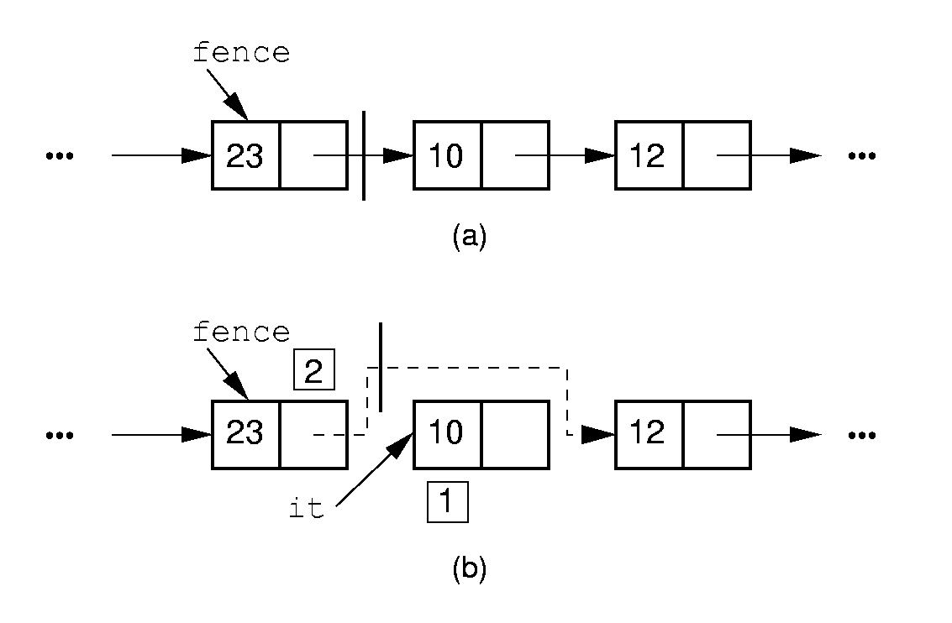
Removal

Slide 75
Remove
// Remove and return first Elem in right
// partition
template <class Elem> bool LList<Elem>::remove(Elem& it) {
if (fence->next == NULL) return false;
it = fence->next->element; // Remember val
// Remember link node
Link<Elem>* ltemp = fence->next;
fence->next = ltemp->next; // Remove
if (tail == ltemp) // Reset tail
tail = fence;
delete ltemp; // Reclaim space
rightcnt--;
return true;
}

Slide 76
Prev
// Move fence one step left;
// no change if left is empty
template <class Elem> void
LList<Elem>::prev() {
Link<Elem>* temp = head;
if (fence == head) return; // No prev Elem
while (temp->next!=fence)
temp=temp->next;
fence = temp;
leftcnt--;
rightcnt++;
}

Slide 77
Setpos
// Set the size of left partition to pos
template <class Elem>
bool LList<Elem>::setPos(int pos) {
if ((pos < 0) || (pos > rightcnt+leftcnt))
return false;
fence = head;
for(int i=0; i<pos; i++)
fence = fence->next;
return true;
}

Slide 78
Comparison of Implementations
Array-Based Lists:
Insertion and deletion are Θ(n).
Prev and direct access are Θ(1).
Array must be allocated in advance.
No overhead if all array positions are full.
Linked Lists:
Insertion and deletion are Θ(1).
Prev and direct access are Θ(n).
Space grows with number of elements.
Every element requires overhead.
Notes:
Applies to both average and worst cases.

Slide 79
Space Comparison
“Break-even” point:
DE = n(P + E);
n = DE
P + E
E: Space for data value.
P: Space for pointer.
D: Number of elements in array.

Slide 80
Freelists
System new and delete are slow.
// Singly-linked list node with freelist
template <class Elem> class Link {
private:
static Link<Elem>* freelist; // Head
public:
Elem element; // Value for this node
Link* next; // Point to next node Link(const Elem& elemval,
Link* nextval =NULL)
{ element = elemval; next = nextval; }
Link(Link* nextval =NULL) {next=nextval;}
void* operator new(size_t); // Overload
void operator delete(void*); // Overload
};

Slide 81
Freelists (2)
template <class Elem>
Link<Elem>* Link<Elem>::freelist = NULL;
template <class Elem> // Overload for new
void* Link<Elem>::operator new(size_t) {
if (freelist == NULL) return ::new Link;
Link<Elem>* temp = freelist; // Reuse
freelist = freelist->next;
return temp; // Return the link
}
template <class Elem> // Overload delete
void Link<Elem>::operator delete(void* ptr){
((Link<Elem>*)ptr)->next = freelist;
freelist = (Link<Elem>*)ptr;
}

Slide 82
Doubly Linked Lists
Simplify insertion and deletion: Add a prev pointer.
// Doubly-linked list link node
template <class Elem> class Link {
public:
Elem element; // Value for this node
Link *next; // Pointer to next node
Link *prev; // Pointer to previous node
Link(const Elem& e, Link* prevp =NULL,
Link* nextp =NULL)
{ element=e; prev=prevp; next=nextp; }
Link(Link* prevp =NULL, Link* nextp =NULL)
{ prev = prevp; next = nextp; }
};

Slide 83
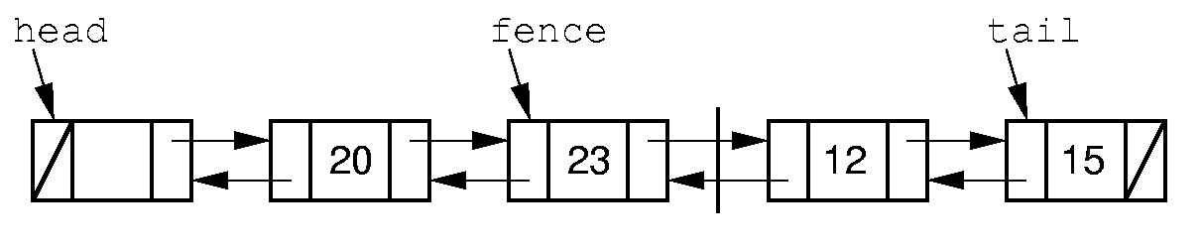
Doubly Linked Lists

Slide 84
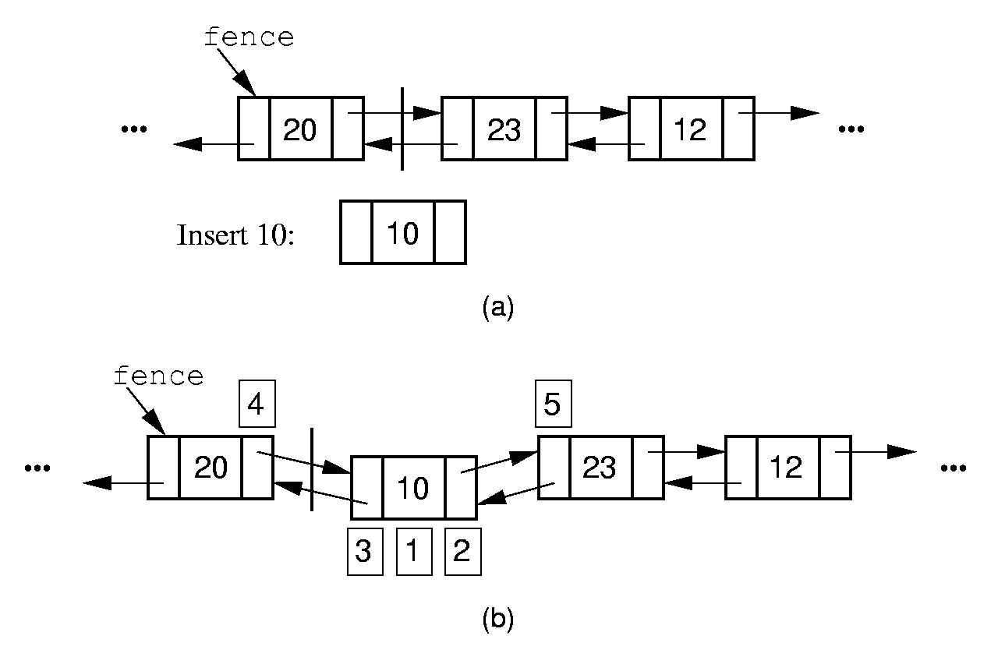
Doubly Linked Insert

Slide 85
Doubly Linked Insert
// Insert at front of right partition
template <class Elem>
bool LList<Elem>::insert(const Elem& item) {
fence->next =
new Link<Elem>(item, fence, fence->next);
if (fence->next->next != NULL)
fence->next->next->prev = fence->next;
if (tail == fence) // Appending new Elem
tail = fence->next; // so set tail
rightcnt++; // Added to right
return true;
}

Slide 86
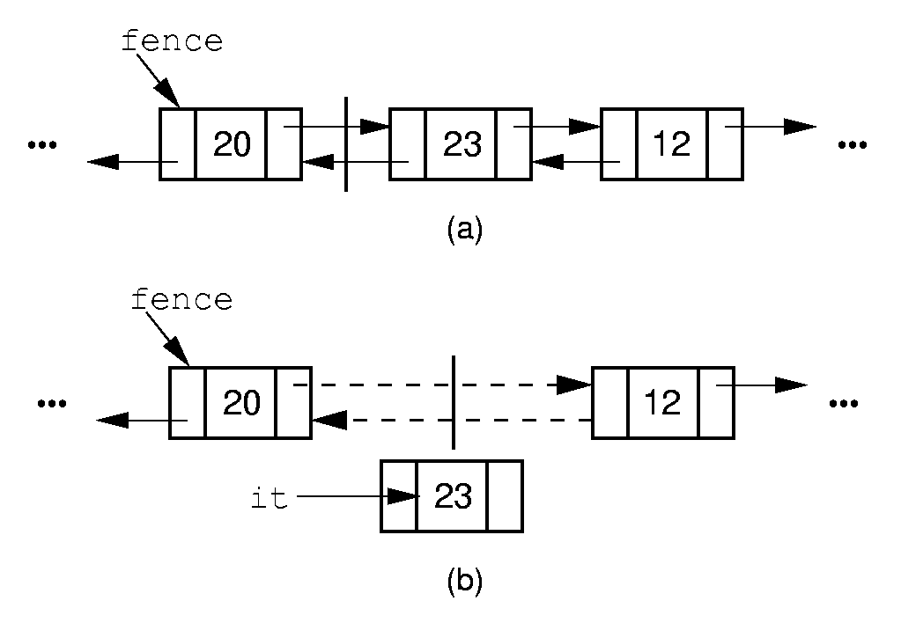
Doubly Linked Remove

Slide 87
Doubly Linked Remove
// Remove, return first Elem in right part
template <class Elem>
bool LList<Elem>::remove(Elem& it) {
if (fence->next == NULL) return false;
it = fence->next->element;
Link<Elem>* ltemp = fence->next;
if (ltemp->next != NULL)
ltemp->next->prev = fence;
else tail = fence; // Reset tail
fence->next = ltemp->next; // Remove delete ltemp; // Reclaim space
rightcnt--; // Removed from right
return true;
}

Slide 88
Dictionary
Often want to insert records, delete records, search for records.
Required concepts:
Search key: Describe what we are looking for
Key comparison
  Equality: sequential search
  Relative order: sorting
Record comparison
Notes:
Key: When describing what we are looking for, we don’t want to be required to describe the entire record, only one field of the record. If we already knew everything about the record, we probably wouldn’t need to look for it.

Slide 89
Comparator Class
How do we generalize comparison?
Use ==, <=, >=: Disastrous
Overload ==, <=, >=: Disastrous
Define a function with a standard name
  Implied obligation
  Breaks down with multiple key fields/indices for same object
Pass in a function
  Explicit obligation
  Function parameter
  Template parameter
Notes:
Here are some choices for implementing comparators. The first two are disastrous because the impose hidden, un-enforced requirements on the user. For the first, the user might provide an element type (such as strings) for which the operators are unsuitable. For the second, the user might neglect to overload the operators for the element class, and the compiler won’t catch the deficiency.
The third has more subtle problems. First, defining a standard name means the user can’t use that name him/herself. Second, it does not solve the problem of what to do when there are multiple indices for the same record, each comparing on different key fields. For example, two binary search trees used to search on a student employee ID record, one on GPA, another on salary.

Slide 90
Comparator Example
class intintCompare {
public:
static bool lt(int x, int y)
{ return x < y; }
static bool eq(int x, int y)
{ return x == y; }
static bool gt(int x, int y)
{ return x > y; }
};

Slide 91
Comparator Example (2)
class PayRoll {
public:
int ID;
char* name;
};
class IDCompare {
public:
static bool lt(Payroll& x, Payroll& y)
{ return x.ID < y.ID; }
};
class NameCompare {
public:
static bool lt(Payroll& x, Payroll& y)
{ return strcmp(x.name, y.name) < 0; }
};
Notes:
Here is an example of a class with two fields and two comparators. Note the example shows only the lt method, for brevity.

Slide 92
Dictionary ADT
// The Dictionary abstract class.
template <class Key, class Elem,
class KEComp, class EEComp>
class Dictionary {
public:
virtual void clear() = 0;
virtual bool insert(const Elem&) = 0;
virtual bool remove(const Key&, Elem&) = 0;
virtual bool removeAny(Elem&) = 0;
virtual bool find(const Key&, Elem&)
const = 0;
virtual int size() = 0;
};

Slide 93
Unsorted List Dictionary
template <class Key, class Elem,
class KEComp, class EEComp>
class UALdict : public
Dictionary<Key,Elem,KEComp,EEComp> {
private: AList<Elem>* list;
public:
bool remove(const Key& K, Elem& e) {
for(list->setStart(); list->getValue(e);
list->next())
if (KEComp::eq(K, e)) {
list->remove(e);
return true;
}
return false;
}
};
Notes:
Example implementation using the dictionary ADT and comparator. Only the remove method is shown, to illustrate use of the comparator class.

Slide 94
Stacks
LIFO: Last In, First Out.
Restricted form of list: Insert and remove only at front of list.
Notation:
Insert: PUSH
Remove: POP
The accessible element is called TOP.

Slide 95
Stack ADT
// Stack abtract class
template <class Elem> class Stack {
public:
// Reinitialize the stack
virtual void clear() = 0;
// Push an element onto the top of the stack.
virtual bool push(const Elem&) = 0;
// Remove the element at the top of the stack.
virtual bool pop(Elem&) = 0;
// Get a copy of the top element in the stack
virtual bool topValue(Elem&) const = 0;
// Return the number of elements in the stack.
virtual int length() const = 0;
};

Slide 96
Array-Based Stack
// Array-based stack implementation
private:
int size; // Maximum size of stack
int top; // Index for top element
Elem *listArray; // Array holding elements
Issues:
Which end is the top?
Where does “top” point to?
What is the cost of the operations?

Slide 97
Linked Stack
// Linked stack implementation
private:
Link<Elem>* top; // Pointer to first elem
int size; // Count number of elems
What is the cost of the operations?
How do space requirements compare to the array-based stack implementation?

Slide 98
Queues
FIFO: First in, First Out
Restricted form of list: Insert at one end, remove from the other.
Notation:
Insert: Enqueue
Delete: Dequeue
First element: Front
Last element: Rear

Slide 99
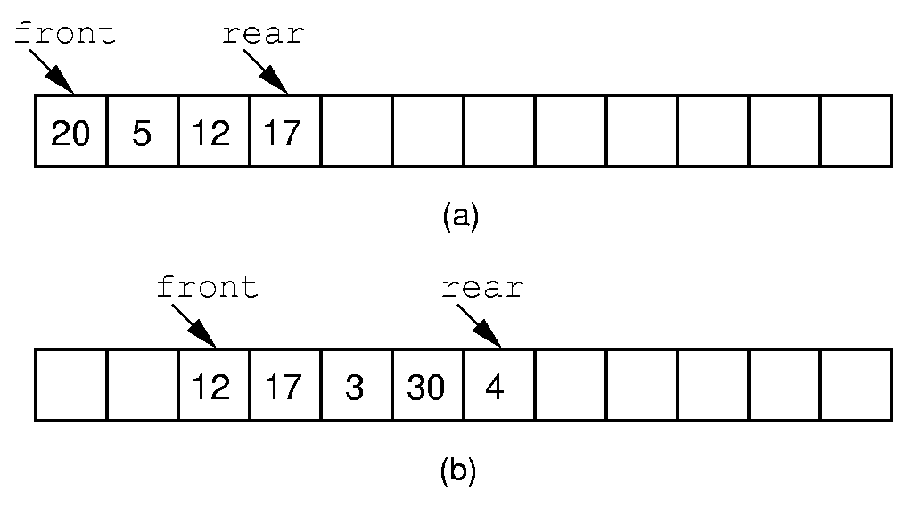
Queue Implementation (1)
Notes:
If we stick to the requirement that the queue elements be at the beginning n elements of the array, then either enqueue or dequeue must be θ(n).
Better is to let the elements “drift” within the array.
Unfortunately, as items are added and removed, the queue “drifts” toward the end. Eventually, there will be no space to the right of the queue, even though there is space in the array.

Slide 100
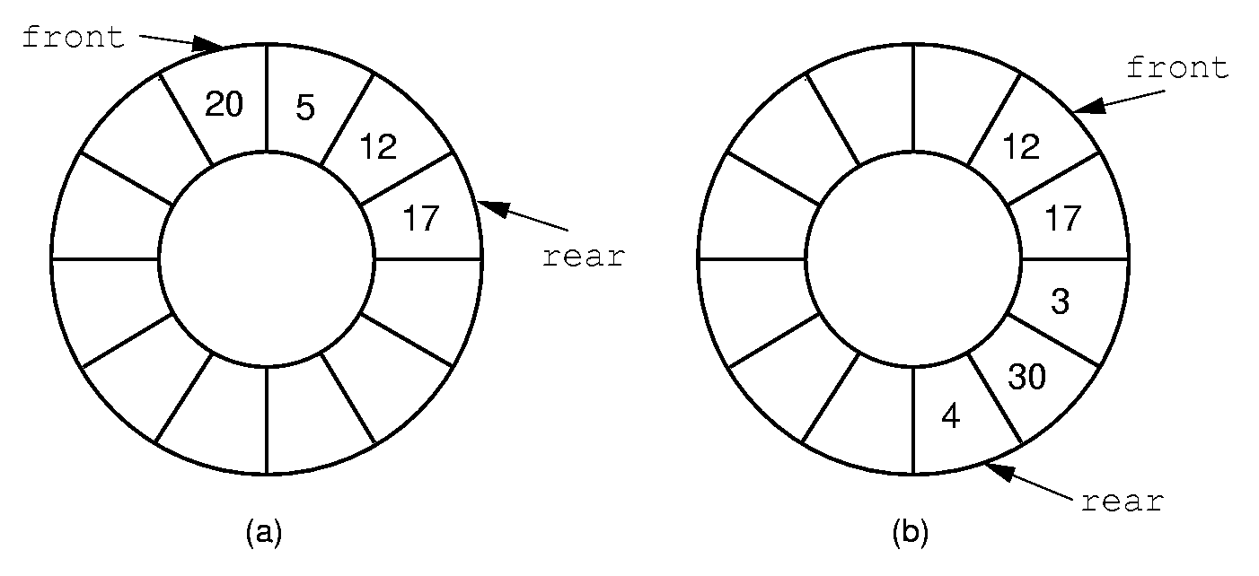
Queue Implementation (2)
Notes:
By using the mod function, we can easily achieve the effect of a “circular” queue.
This leaves one more issue. Where do the front and rear pointers go (point to the item? Or to the space before/after the item)? And, how do we distinguish a full from an empty queue?
Given a fixed position for the front element (and its pointer), there are n-1 possible states for the queue (0 through n elements in the queue for an array of size n), but only n possible positions for rear. To solve this dilemma, we must either leave an empty slot in the queue, or use and external variable to determine if the queue is empty or not.

Slide 101
Binary Trees
A binary tree is made up of a finite set of nodes that is either empty or consists of a node called the root together with two binary trees, called the left and right subtrees, which are disjoint from each other and from the root.

Slide 102
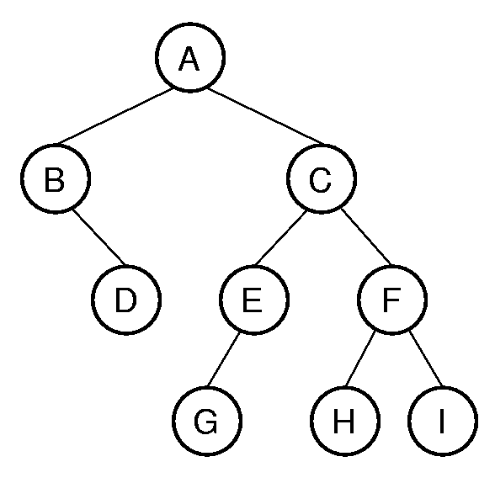
Binary Tree Example
Notation: Node, children, edge, parent, ancestor, descendant, path, depth, height, level, leaf node, internal node, subtree.
Notes:
A has depth 0. B and C from level 1. The tree has height 4. Height = max depth + 1.

Slide 103
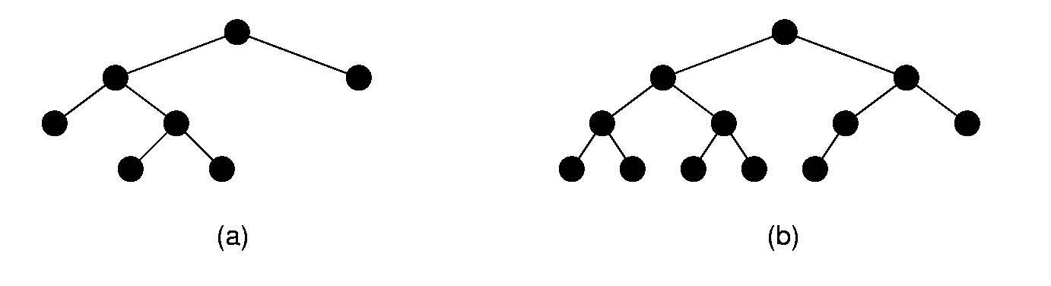
Full and Complete Binary Trees
Full binary tree: Each node is either a leaf or internal node with exactly two non-empty children.
Complete binary tree: If the height of the tree is d, then all leaves except possibly level d are completely full. The bottom level has all nodes to the left side.
Notes:
These terms can be hard to distinguish. Students will need to remember which is which, since this notation will be used several times during the course.

Slide 104
Full Binary Tree Theorem (1)
Theorem: The number of leaves in a non-empty full binary tree is one more than the number of internal nodes.
Proof (by Mathematical Induction):
Base case: A full binary tree with 1 internal node must have two leaf nodes.
Induction Hypothesis: Assume any full binary tree T containing n-1 internal nodes has n leaves.
Notes:
This theorem is important, because it helps us to calculate space requirements. It tells us how many nodes are internal and how many are leaf. We need to know this if we have separate implementations for internal and leaf nodes

Slide 105
Full Binary Tree Theorem (2)
Induction Step: Given tree T with n internal nodes, pick internal node I with two leaf children. Remove I’s children, call resulting tree T’.
By induction hypothesis, T’ is a full binary tree with n leaves.
Restore I’s two children. The number of internal nodes has now gone up by 1 to reach n. The number of leaves has also gone up by 1.

Slide 106
Full Binary Tree Corollary
Theorem: The number of null pointers in a non-empty tree is one more than the number of nodes in the tree.
Proof: Replace all null pointers with a pointer to an empty leaf node. This is a full binary tree.

Slide 107
Binary Tree Node Class (1)
// Binary tree node class
template <class Elem>
class BinNodePtr : public BinNode<Elem> {
private:
Elem it; // The node's value
BinNodePtr* lc; // Pointer to left child
BinNodePtr* rc; // Pointer to right child
public:
BinNodePtr() { lc = rc = NULL; }
BinNodePtr(Elem e, BinNodePtr* l =NULL,
BinNodePtr* r =NULL)
{ it = e; lc = l; rc = r; }

Slide 108
Binary Tree Node Class (2)
Elem& val() { return it; }
void setVal(const Elem& e) { it = e; }
inline BinNode<Elem>* left() const
{ return lc; }
void setLeft(BinNode<Elem>* b)
{ lc = (BinNodePtr*)b; }
inline BinNode<Elem>* right() const
{ return rc; }
void setRight(BinNode<Elem>* b)
{ rc = (BinNodePtr*)b; }
bool isLeaf()
{ return (lc == NULL) && (rc == NULL); }
};

Slide 109
Traversals (1)
Any process for visiting the nodes in some order is called a traversal.
Any traversal that lists every node in the tree exactly once is called an enumeration of the tree’s nodes.

Slide 110
Traversals (2)
Preorder traversal: Visit each node before visiting its children.
Postorder traversal: Visit each node after visiting its children.
Inorder traversal: Visit the left subtree, then the node, then the right subtree.

Slide 111
Traversals (3)
template <class Elem> // Good implementation
void preorder(BinNode<Elem>* subroot) {
if (subroot == NULL) return; // Empty
visit(subroot); // Perform some action
preorder(subroot->left());
preorder(subroot->right());
}
template <class Elem> // Bad implementation
void preorder2(BinNode<Elem>* subroot) {
visit(subroot); // Perform some action
if (subroot->left() != NULL)
preorder2(subroot->left());
if (subroot->right() != NULL)
preorder2(subroot->right());
}
Notes:
The first implementation is preferred.
The second implementation illustrates a common programming style by many students. It attempts to “look ahead” at the node to be called to determine if it is null or not. This is highly error prone, because the calling function must make sure not to pass in a null pointer for the tree root. It might appear to be more efficient (since it does not make recursive calls on the empty pointers), but it is not in reality since it is checking the pointers twice (to see if not null, then to process them).

Slide 112
Traversal Example
// Return the number of nodes in the tree
template <class Elem>
int count(BinNode<Elem>* subroot) {
if (subroot == NULL)
return 0; // Nothing to count
return 1 + count(subroot->left())
+ count(subroot->right());
}

Slide 113
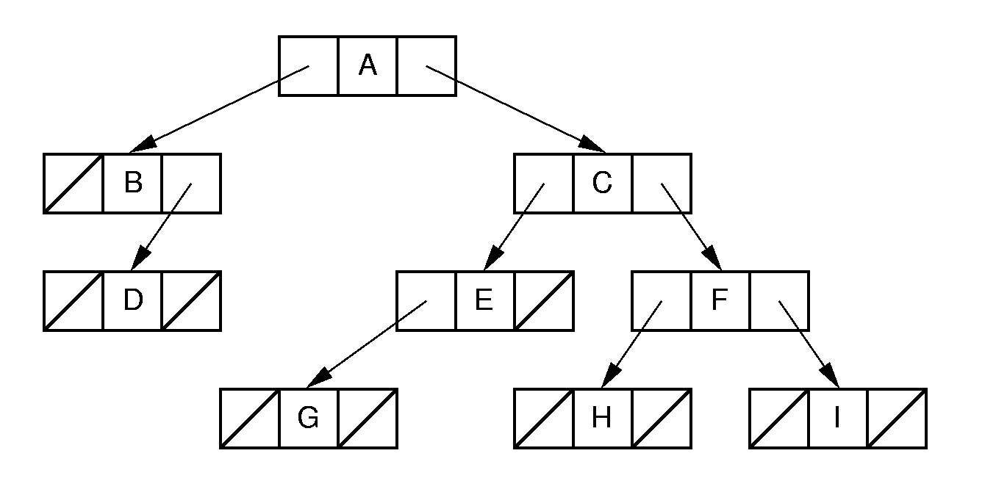
Binary Tree Implementation (1)
Notes:
Standard implementation (illustrating BinNodePtr class shown earlier). Leaf implementation is identical to internal node implementation, resulting in much wasted space due to null pointers.

Slide 114
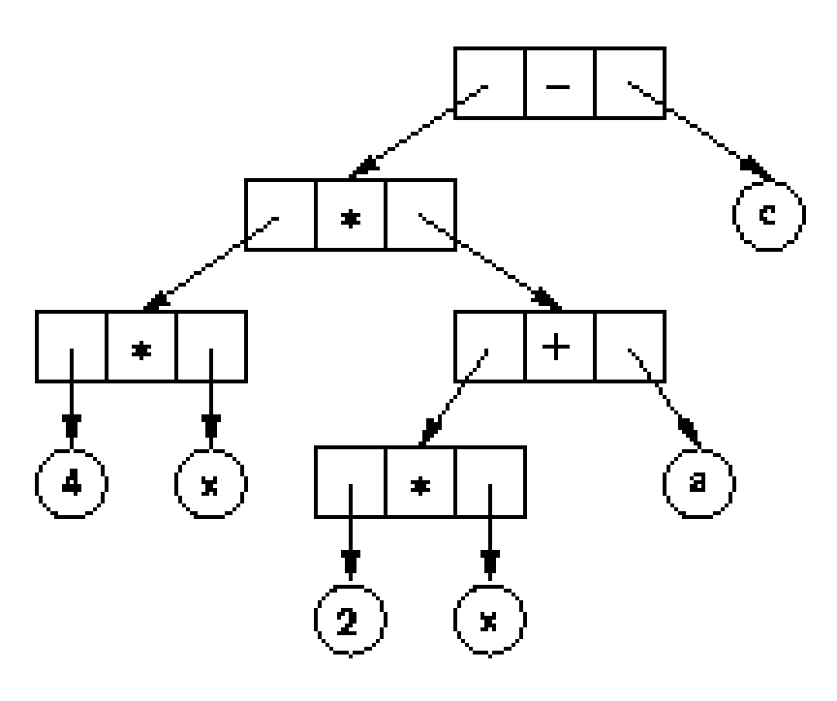
Binary Tree Implementation (2)
Notes:
Example of a tree with distinct internal and leaf node implementations.

Slide 115
Union Implementation (1)
enum Nodetype {leaf, internal};
class VarBinNode { // Generic node class
public:
Nodetype mytype; // Store type for node
union {
struct { // nternal node
VarBinNode* left; // Left child
VarBinNode* right; // Right child
Operator opx; // Value
} intl;
Operand var; // Leaf: Value only
};

Slide 116
Union Implementation (2)
// Leaf constructor
VarBinNode(const Operand& val)
{ mytype = leaf; var = val; }
// Internal node constructor
VarBinNode(const Operator& op,
VarBinNode* l, VarBinNode* r) {
mytype = internal; intl.opx = op;
intl.left = l; intl.right = r;
}
bool isLeaf() { return mytype == leaf; }
VarBinNode* leftchild()
{ return intl.left; }
VarBinNode* rightchild()
{ return intl.right; }
};

Slide 117
Union Implementation (3)
// Preorder traversal
void traverse(VarBinNode* subroot) {
if (subroot == NULL) return;
if (subroot->isLeaf())
cout << "Leaf: “
<< subroot->var << "\n";
else {
cout << "Internal: “
<< subroot->intl.opx << "\n";
traverse(subroot->leftchild());
traverse(subroot->rightchild());
}
}

Slide 118
Inheritance (1)
class VarBinNode { // Abstract base class
public:
virtual bool isLeaf() = 0;
};
class LeafNode : public VarBinNode { // Leaf
private:
Operand var; // Operand value
public:
LeafNode(const Operand& val)
{ var = val; } // Constructor
bool isLeaf() { return true; }
Operand value() { return var; }
};

Slide 119
Inheritance (2)
// Internal node
class IntlNode : public VarBinNode {
private:
VarBinNode* left; // Left child
VarBinNode* right; // Right child
Operator opx; // Operator value
public:
IntlNode(const Operator& op,
VarBinNode* l, VarBinNode* r)
{ opx = op; left = l; right = r; }
bool isLeaf() { return false; }
VarBinNode* leftchild() { return left; }
VarBinNode* rightchild() { return right; }
Operator value() { return opx; }
};

Slide 120
Inheritance (3)
// Preorder traversal
void traverse(VarBinNode *subroot) {
if (subroot == NULL) return; // Empty
if (subroot->isLeaf()) // Do leaf node
cout << "Leaf: "
<< ((LeafNode *)subroot)->value()
<< endl;
else { // Do internal node
cout << "Internal: "
<< ((IntlNode *)subroot)->value()
<< endl;
traverse(
((IntlNode *)subroot)->leftchild());
traverse(
((IntlNode *)subroot)->rightchild());
}
}

Slide 121
Composite (1)
class VarBinNode { // Abstract base class
public:
virtual bool isLeaf() = 0;
virtual void trav() = 0;
};
class LeafNode : public VarBinNode { // Leaf
private:
Operand var; // Operand value
public:
LeafNode(const Operand& val)
{ var = val; } // Constructor
bool isLeaf() { return true; }
Operand value() { return var; }
void trav() { cout << "Leaf: " << value()
<< endl; }
};

Slide 122
Composite (2)
class IntlNode : public VarBinNode {
private:
VarBinNode* lc; // Left child
VarBinNode* rc; // Right child
Operator opx; // Operator value
public:
IntlNode(const Operator& op,
VarBinNode* l, VarBinNode* r)
{ opx = op; lc = l; rc = r; }
bool isLeaf() { return false; }
VarBinNode* left() { return lc; }
VarBinNode* right() { return rc; }
Operator value() { return opx; }
void trav() {
cout << "Internal: " << value() << endl;
if (left() != NULL) left()->trav();
if (right() != NULL) right()->trav();
}
};

Slide 123
Composite (3)
// Preorder traversal
void traverse(VarBinNode *root) {
if (root != NULL)
root->trav();
}

Slide 124
Space Overhead (1)
From the Full Binary Tree Theorem:
Half of the pointers are null.
If leaves store only data, then overhead depends on whether the tree is full.
Ex: All nodes the same, with two pointers to children:
Total space required is (2p + d)n
Overhead: 2pn
If p = d, this means 2p/(2p + d) = 2/3 overhead.

Slide 125
Space Overhead (2)
Eliminate pointers from the leaf nodes:
n/2(2p) p
n/2(2p) + dn p + d
This is 1/2 if p = d.
2p/(2p + d) if data only at leaves ⇒ 2/3 overhead.
Note that some method is needed to distinguish leaves from internal nodes.
=
Notes:
This example is for full binary trees.
Half of the nodes have 2 pointers, which is overhead.
The mechanism for distinguishing leaves from internal nodes adds additional overhead not accounted for here.

Slide 126
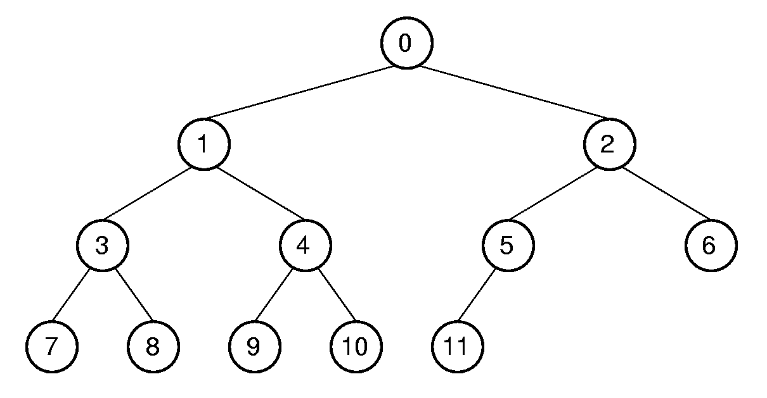
Array Implementation (1)
Position | 0 | 1 | 2 | 3 | 4 | 5 | 6 | 7 | 8 | 9 | 10 | 11
Parent | -- | 0 | 0 | 1 | 1 | 2 | 2 | 3 | 3 | 4 | 4 | 5
Left Child | 1 | 3 | 5 | 7 | 9 | 11 | -- | -- | -- | -- | -- | --
Right Child | 2 | 4 | 6 | 8 | 10 | -- | -- | -- | -- | -- | -- | --
Left Sibling | -- | -- | 1 | -- | 3 | -- | 5 | -- | 7 | -- | 9 | --
Right Sibling | -- | 2 | -- | 4 | -- | 6 | -- | 8 | -- | 10 | -- | --
Notes:
This is a good example of logical representation vs. physical implementation.
Since the complete binary tree is so limited in its shape (there is only one possible shape for n nodes), it is reasonable to expect that space efficiency can be achieved.

Slide 127
Array Implementation (1)
Parent (r) =
Leftchild(r) =
Rightchild(r) =
Leftsibling(r) =
Rightsibling(r) =
Notes:
Parent(r) = (r-1)/2 if r <> 0 and r < n.
Leftchild(r) = 2r + 1 if 2r + 1 < n.
Rightchild(r) = 2r + 2 if 2r + 2 < n.
Leftsibling(r) = r - 1 if r is even, r > 0, and r < n.
Rightsibling(r) = r + 1 if r is odd and r + 1 < n.

Slide 128
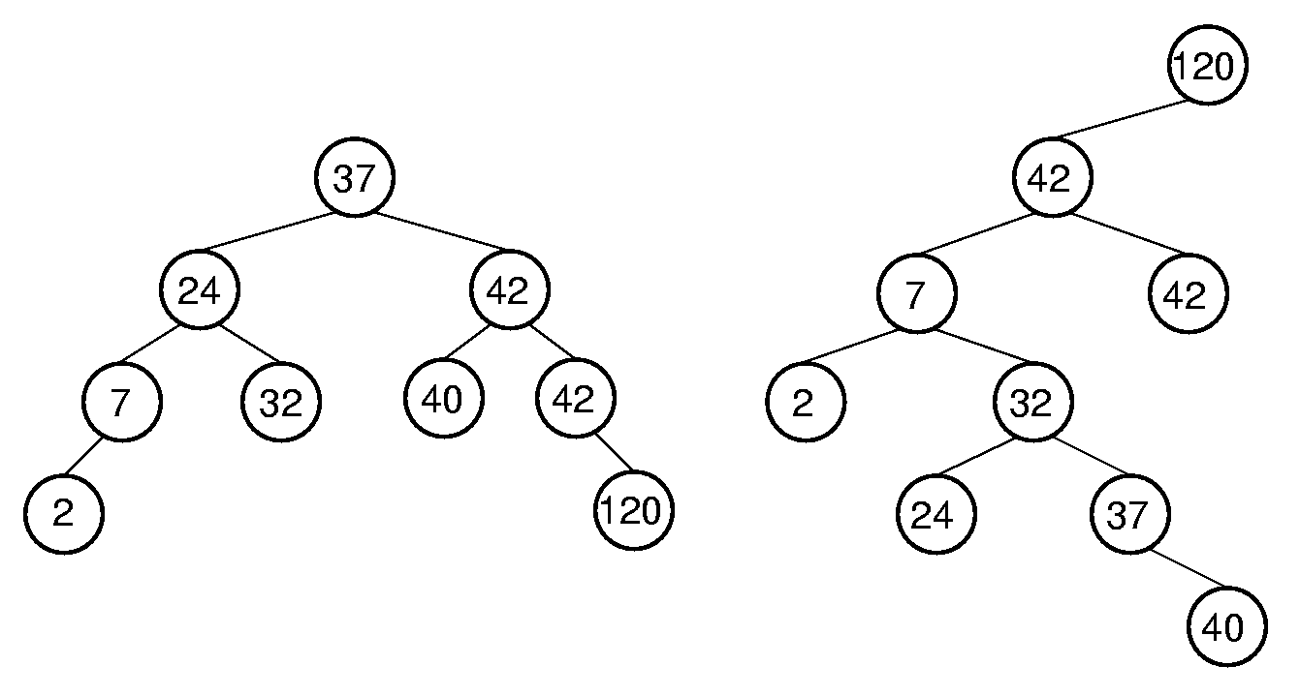
Binary Search Trees
BST Property: All elements stored in the left subtree of a node with value K have values < K. All elements stored in the right subtree of a node with value K have values >= K.
Notes:
Lists have a major problem: Either insert/delete on the one hand, or search on the other, must be Θ(n) time. How can we make both update and search efficient? Answer: Use a new data structure.

Slide 129
BST ADT(1)
// BST implementation for the Dictionary ADT
template <class Key, class Elem,
class KEComp, class EEComp>
class BST : public Dictionary<Key, Elem,
KEComp, EEComp> {
private:
BinNode<Elem>* root; // Root of the BST
int nodecount; // Number of nodes
void clearhelp(BinNode<Elem>*);
BinNode<Elem>*
inserthelp(BinNode<Elem>*, const Elem&);
BinNode<Elem>*
deletemin(BinNode<Elem>*,BinNode<Elem>*&);
BinNode<Elem>* removehelp(BinNode<Elem>*,
const Key&, BinNode<Elem>*&);
bool findhelp(BinNode<Elem>*, const Key&,
Elem&) const;
void printhelp(BinNode<Elem>*, int) const;

Slide 130
BST ADT(2)
public:
BST() { root = NULL; nodecount = 0; }
~BST() { clearhelp(root); }
void clear() { clearhelp(root); root = NULL;
nodecount = 0; }
bool insert(const Elem& e) {
root = inserthelp(root, e);
nodecount++;
return true; }
bool remove(const Key& K, Elem& e) {
BinNode<Elem>* t = NULL;
root = removehelp(root, K, t);
if (t == NULL) return false;
e = t->val();
nodecount--;
delete t;
return true; }

Slide 131
BST ADT(3)
bool removeAny(Elem& e) { // Delete min value
if (root == NULL) return false; // Empty
BinNode<Elem>* t;
root = deletemin(root, t);
e = t->val();
delete t;
nodecount--;
return true;
}
bool find(const Key& K, Elem& e) const
{ return findhelp(root, K, e); }
int size() { return nodecount; }
void print() const {
if (root == NULL)
cout << "The BST is empty.\n";
else printhelp(root, 0);
}

Slide 132
BST Search
template <class Key, class Elem,
class KEComp, class EEComp>
bool BST<Key, Elem, KEComp, EEComp>::
findhelp(BinNode<Elem>* subroot,
const Key& K, Elem& e) const {
if (subroot == NULL) return false;
else if (KEComp::lt(K, subroot->val()))
return findhelp(subroot->left(), K, e);
else if (KEComp::gt(K, subroot->val()))
return findhelp(subroot->right(), K, e);
else { e = subroot->val(); return true; }
}

Slide 133
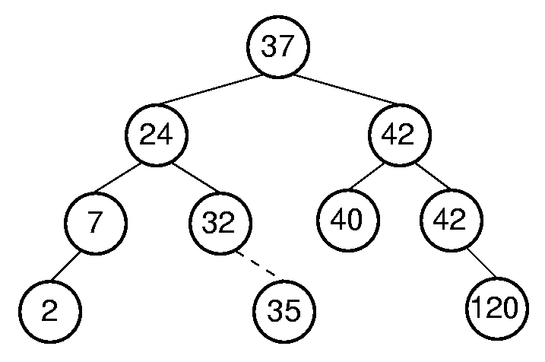
BST Insert (1)

Slide 134
BST Insert (2)
template <class Key, class Elem,
class KEComp, class EEComp>
BinNode<Elem>* BST<Key,Elem,KEComp,EEComp>::
inserthelp(BinNode<Elem>* subroot,
const Elem& val) {
if (subroot == NULL) // Empty: create node
return new BinNodePtr<Elem>(val,NULL,NULL);
if (EEComp::lt(val, subroot->val()))
subroot->setLeft(inserthelp(subroot->left(),
val));
else subroot->setRight(
inserthelp(subroot->right(), val));
// Return subtree with node inserted
return subroot;
}

Slide 135
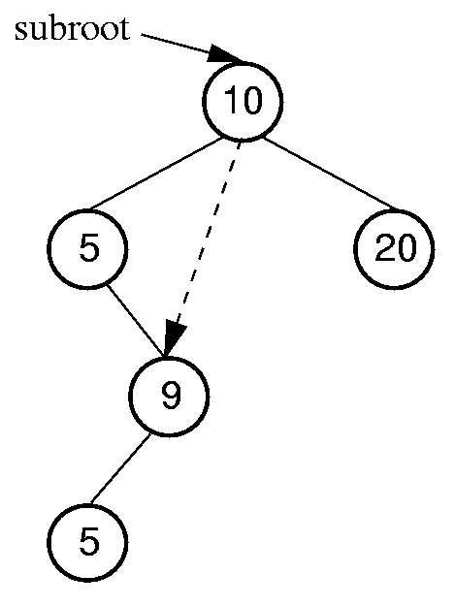
Remove Minimum Value
template <class Key, class Elem,
class KEComp, class EEComp>
BinNode<Elem>* BST<Key, Elem,
KEComp, EEComp>::
deletemin(BinNode<Elem>* subroot,
BinNode<Elem>*& min) {
if (subroot->left() == NULL) {
min = subroot;
return subroot->right();
}
else { // Continue left
subroot->setLeft(
deletemin(subroot->left(), min));
return subroot;
}
}

Slide 136
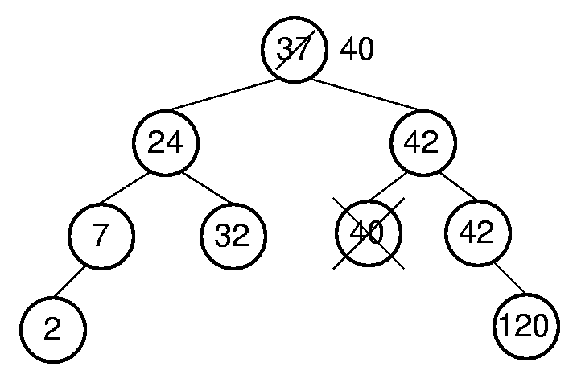
BST Remove (1)

Slide 137
BST Remove (2)
template <class Key, class Elem,
class KEComp, class EEComp>
BinNode<Elem>* BST<Key,Elem,KEComp,EEComp>::
removehelp(BinNode<Elem>* subroot,
const Key& K, BinNode<Elem>*& t) {
if (subroot == NULL) return NULL;
else if (KEComp::lt(K, subroot->val()))
subroot->setLeft(
removehelp(subroot->left(), K, t));
else if (KEComp::gt(K, subroot->val()))
subroot->setRight(
removehelp(subroot->right(), K, t));

Slide 138
BST Remove (2)
else { // Found it: remove it
BinNode<Elem>* temp;
t = subroot;
if (subroot->left() == NULL)
subroot = subroot->right();
else if (subroot->right() == NULL)
subroot = subroot->left();
else { // Both children are non-empty
subroot->setRight(
deletemin(subroot->right(), temp));
Elem te = subroot->val();
subroot->setVal(temp->val());
temp->setVal(te);
t = temp;
} }
return subroot;
}

Slide 139
Cost of BST Operations
Find:
Insert:
Delete:
Notes:
All cost depth of the node in question.
Worst case: θ(n).
Average case: θ(log n).

Slide 140
Heaps
Heap: Complete binary tree with the heap property:
Min-heap: All values less than child values.
Max-heap: All values greater than child values.
The values are partially ordered.
Heap representation: Normally the array-based complete binary tree representation.

Slide 141
Heap ADT
template<class Elem,class Comp> class maxheap{
private:
Elem* Heap; // Pointer to the heap array
int size; // Maximum size of the heap
int n; // Number of elems now in heap
void siftdown(int); // Put element in place
public:
maxheap(Elem* h, int num, int max);
int heapsize() const;
bool isLeaf(int pos) const;
int leftchild(int pos) const;
int rightchild(int pos) const;
int parent(int pos) const;
bool insert(const Elem&);
bool removemax(Elem&);
bool remove(int, Elem&);
void buildHeap();
};

Slide 142
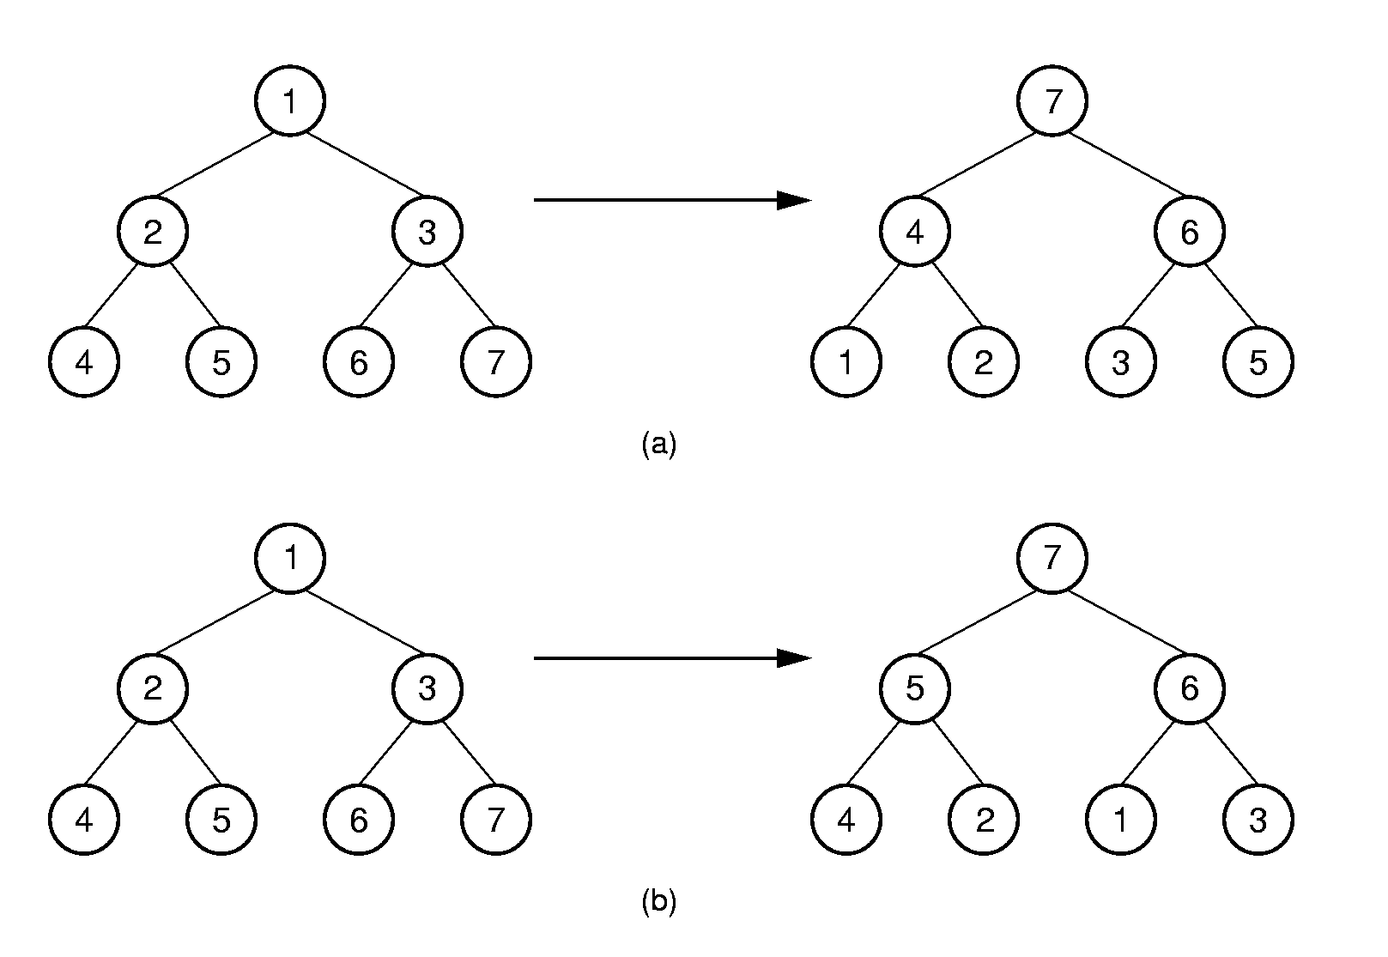
Building the Heap
(a) (4-2) (4-1) (2-1) (5-2) (5-4) (6-3) (6-5) (7-5) (7-6)
(b) (5-2), (7-3), (7-1), (6-1)
Notes:
How to get a good number of exchanges? Induction leads to the following algorithm:
Heapify the root’s subtrees, then push the root to the correct level.

Slide 143
Siftdown (1)
For fast heap construction:
Work from high end of array to low end.
Call siftdown for each item.
Don’t need to call siftdown on leaf nodes.
template <class Elem, class Comp>
void maxheap<Elem,Comp>::siftdown(int pos) {
while (!isLeaf(pos)) {
int j = leftchild(pos);
int rc = rightchild(pos);
if ((rc<n) && Comp::lt(Heap[j],Heap[rc]))
j = rc;
if (!Comp::lt(Heap[pos], Heap[j])) return;
swap(Heap, pos, j);
pos = j;
}}

Slide 144
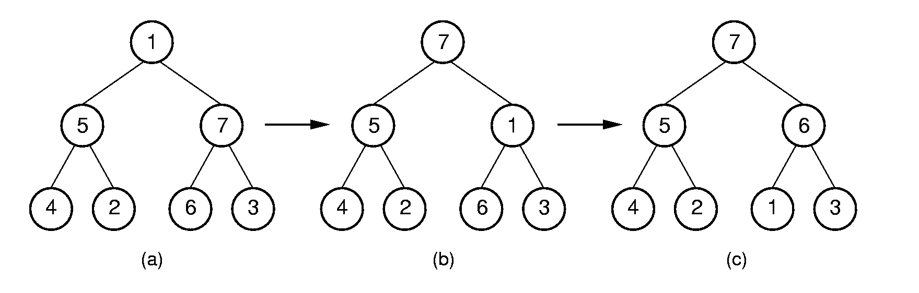
Siftdown (2)

Slide 145
Buildheap Cost
Cost for heap construction:
log n
∑ (i - 1) n/2^{i} ≈ n.
i=1
Notes:
(i-1) is number of steps down, n/2^{i} is number of nodes at that level.

Slide 146
Remove Max Value
template <class Elem, class Comp>
bool maxheap<Elem, Comp>::
removemax(Elem& it) {
if (n == 0) return false; // Heap is empty
swap(Heap, 0, --n); // Swap max with end
if (n != 0) siftdown(0);
it = Heap[n]; // Return max value
return true;
}

Slide 147
Priority Queues (1)
A priority queue stores objects, and on request releases the object with greatest value.
Example: Scheduling jobs in a multi-tasking operating system.
The priority of a job may change, requiring some reordering of the jobs.
Implementation: Use a heap to store the priority queue.

Slide 148
Priority Queues (2)
To support priority reordering, delete and re-insert. Need to know index for the object in question.
template <class Elem, class Comp>
bool maxheap<Elem, Comp>::remove(int pos,
Elem& it) {
if ((pos < 0) || (pos >= n)) return false;
swap(Heap, pos, --n);
while ((pos != 0) && (Comp::gt(Heap[pos],
Heap[parent(pos)])))
swap(Heap, pos, parent(pos));
siftdown(pos);
it = Heap[n];
return true;
}

Slide 149
Huffman Coding Trees
ASCII codes: 8 bits per character.
Fixed-length coding.
Can take advantage of relative frequency of letters to save space.
Variable-length coding
Build the tree with minimum external path weight.
Z | K | F | C | U | D | L | E
2 | 7 | 24 | 32 | 37 | 42 | 42 | 120

Slide 150
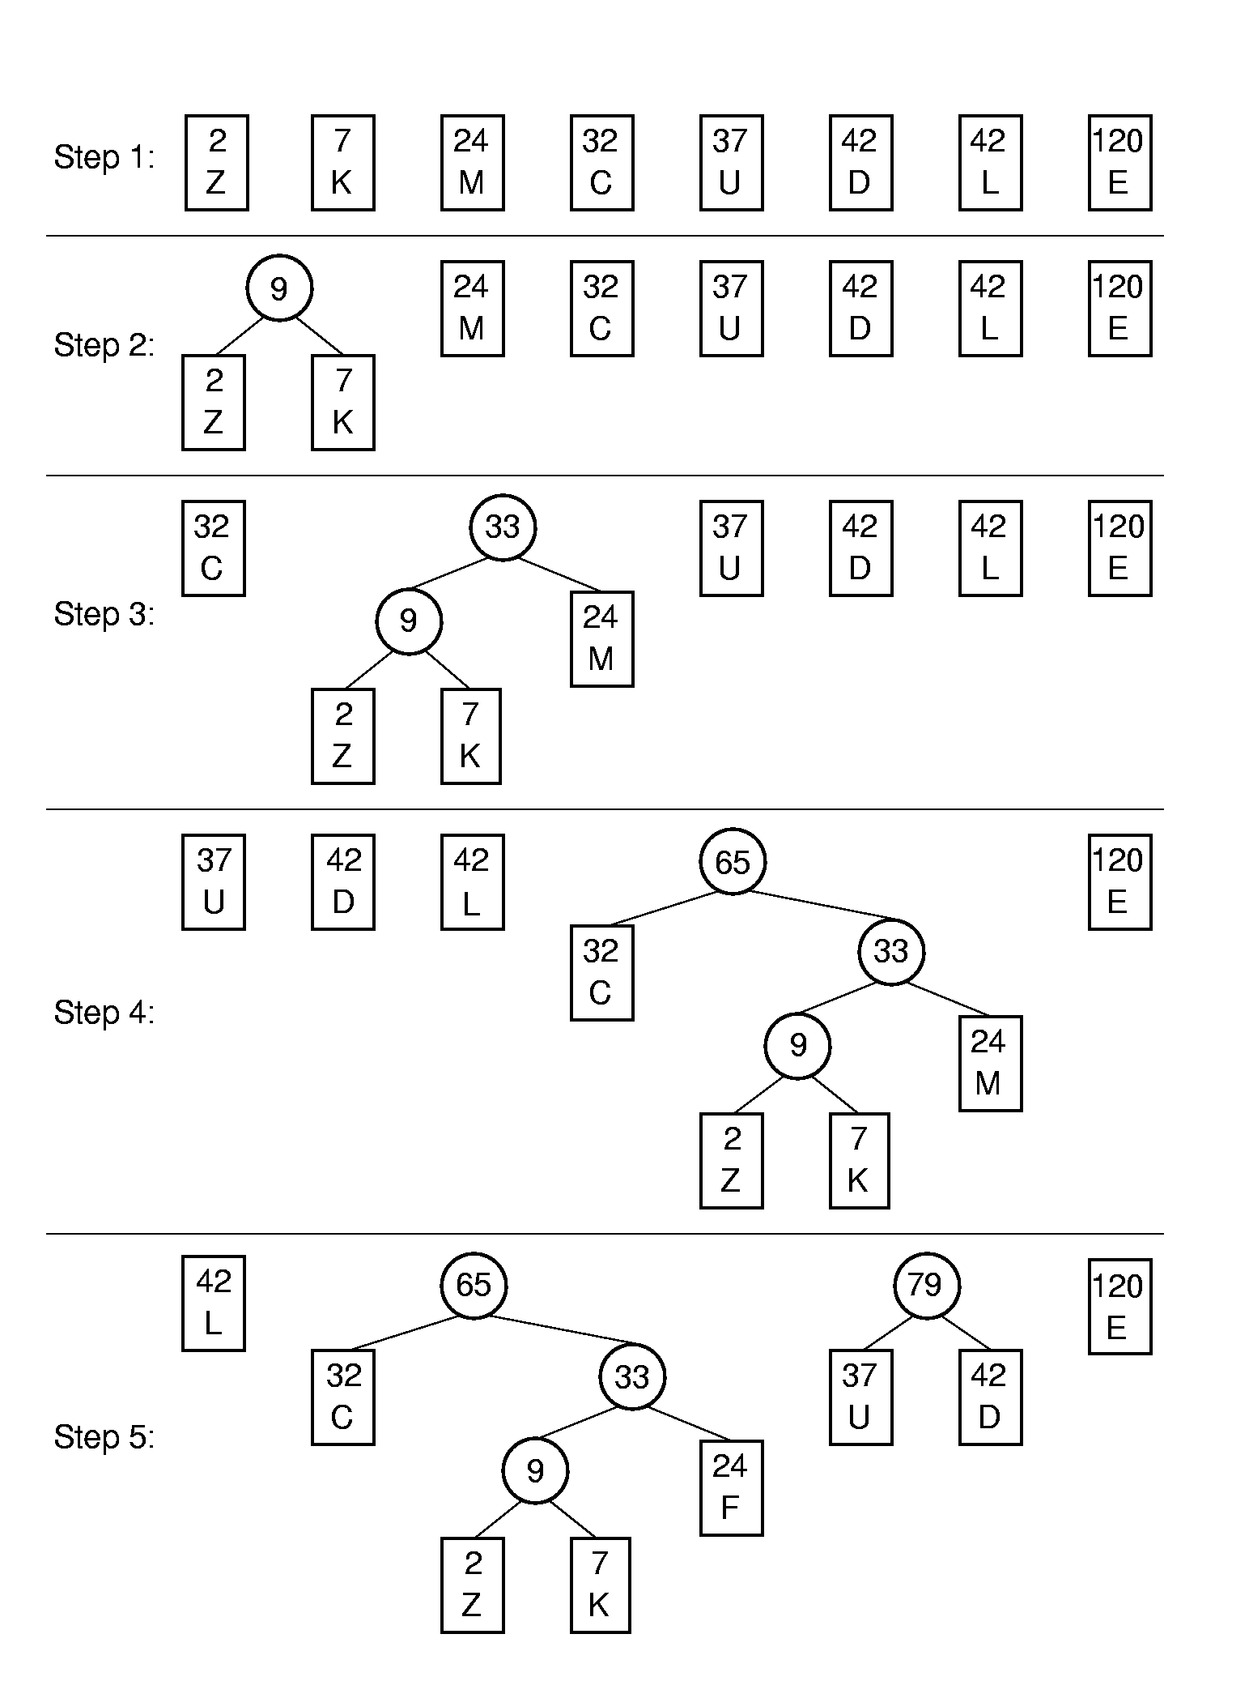
Huffman Tree Construction (1)

Slide 151
Huffman Tree Construction (2)

Slide 152
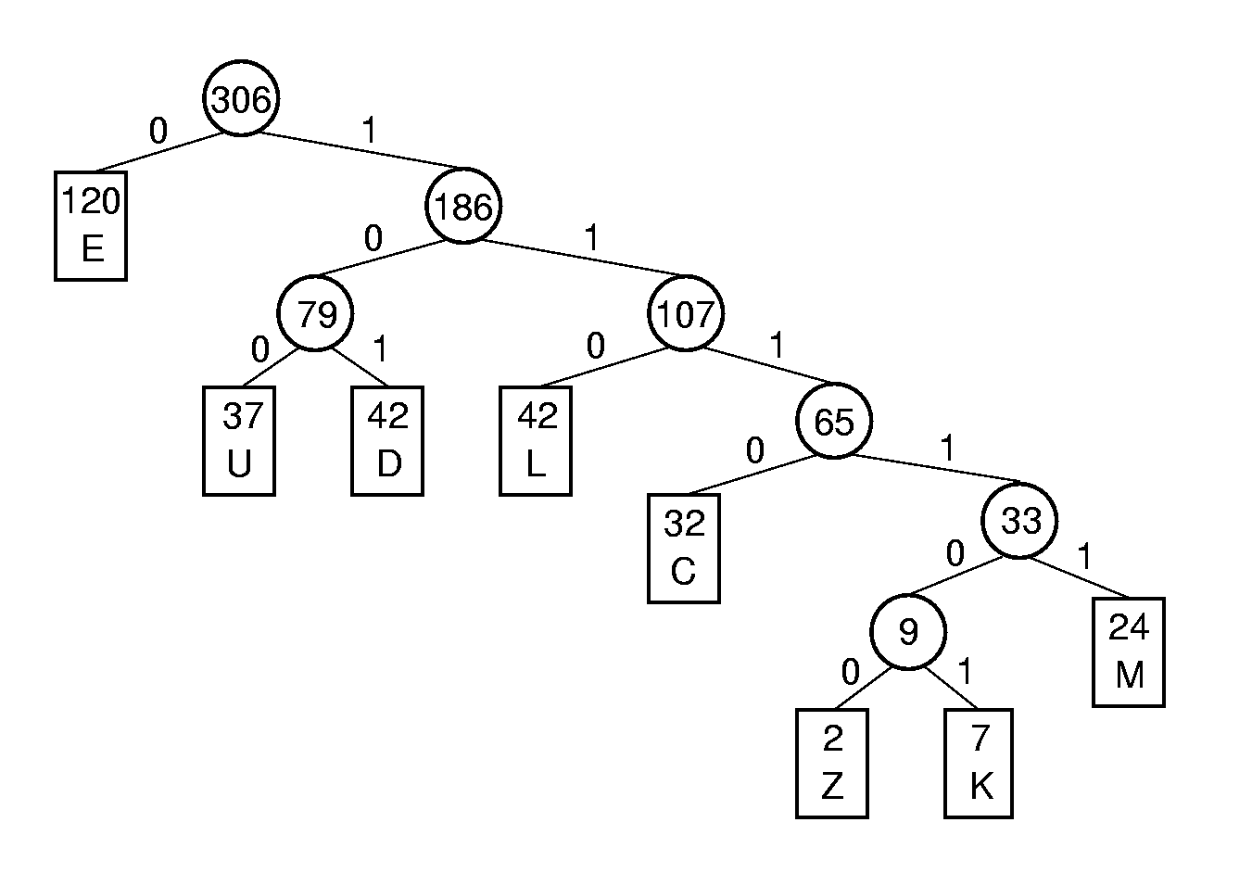
Assigning Codes
Letter | Freq | Code | Bits
C | 32
D | 42
E | 120
F | 24
K | 7
L | 42
U | 37
Z | 2
Notes:
C: 1110
D: 101
E: 0
F: 1111
K: 111101
L: 110
U: 100
Z: 111100

Slide 153
Coding and Decoding
A set of codes is said to meet the prefix property if no code in the set is the prefix of another.
Code for DEED:
Decode 1011001110111101:
Expected cost per letter:
Notes:
Code for DEED: 101 0 0 101
Decode: DUCK
Expected cost: (1 * 120 + 3 * 121 + 4 * 32 + 5 * 24 + 6 * 9)/ 306 = 785/306 = 2.57

Slide 154
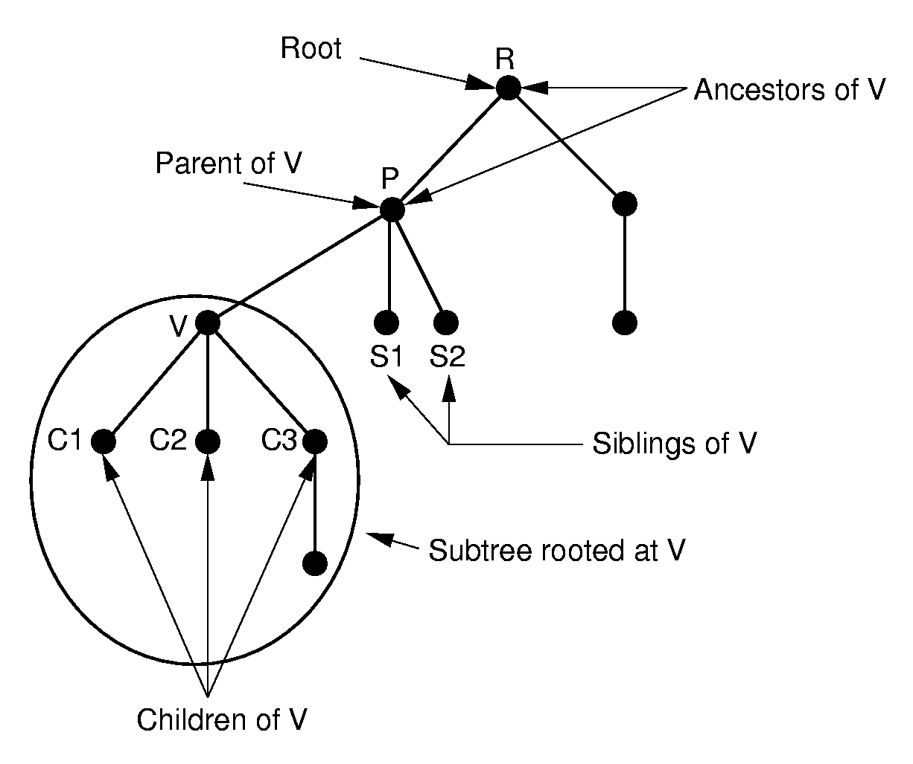
General Trees

Slide 155
General Tree Node
// General tree node ADT
template <class Elem> class GTNode {
public:
GTNode(const Elem&); // Constructor
~GTNode(); // Destructor
Elem value(); // Return value
bool isLeaf(); // TRUE if is a leaf
GTNode* parent(); // Return parent
GTNode* leftmost_child(); // First child
GTNode* right_sibling(); // Right sibling
void setValue(Elem&); // Set value
void insert_first(GTNode<Elem>* n);
void insert_next(GTNode<Elem>* n);
void remove_first(); // Remove first child
void remove_next(); // Remove sibling
};

Slide 156
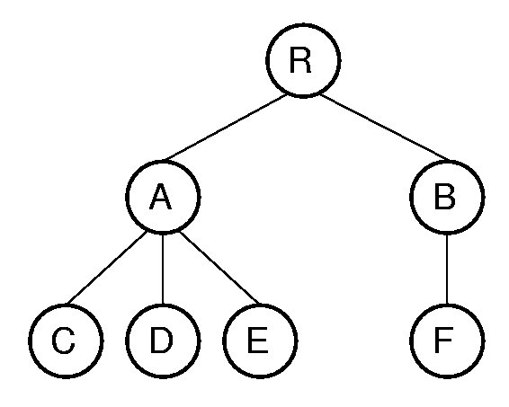
General Tree Traversal
template <class Elem>
void GenTree<Elem>::
printhelp(GTNode<Elem>* subroot) {
if (subroot->isLeaf()) cout << "Leaf: ";
else cout << "Internal: ";
cout << subroot->value() << "\n";
for (GTNode<Elem>* temp =
subroot->leftmost_child();
temp != NULL;
temp = temp->right_sibling())
printhelp(temp);
}
Notes:
Traversal: RACDEBF

Slide 157
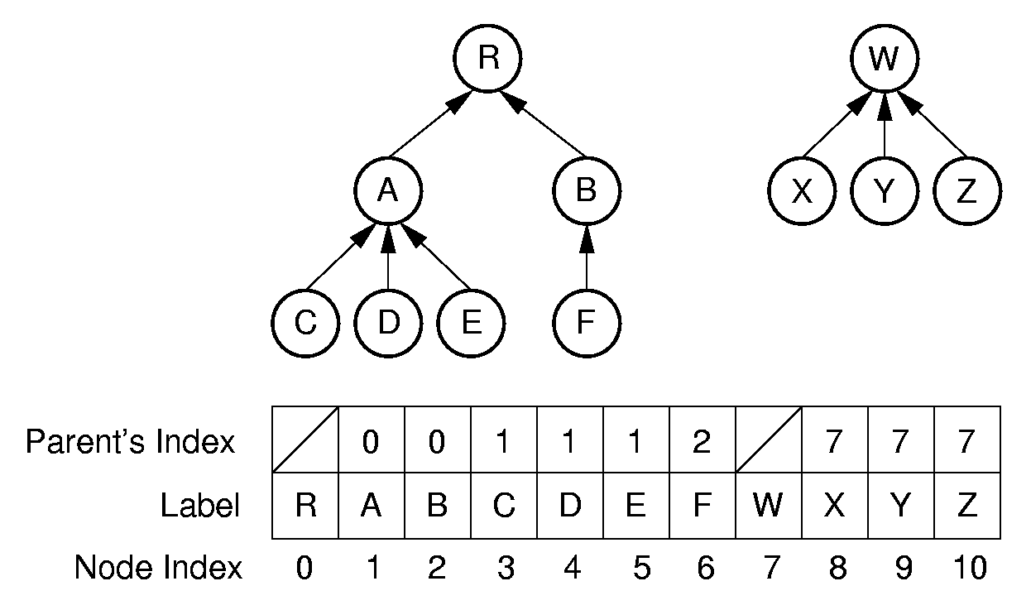
Parent Pointer Implementation

Slide 158
Equivalence Class Problem
The parent pointer representation is good for answering:
  Are two elements in the same tree?
// Return TRUE if nodes in different trees
bool Gentree::differ(int a, int b) {
int root1 = FIND(a); // Find root for a
int root2 = FIND(b); // Find root for b
return root1 != root2; // Compare roots
}
Notes:
Examples of equivalence classes:
Connected components in graphs
Point clustering

Slide 159
Union/Find
void Gentree::UNION(int a, int b) {
int root1 = FIND(a); // Find root for a
int root2 = FIND(b); // Find root for b
if (root1 != root2) array[root2] = root1;
}
int Gentree::FIND(int curr) const {
while (array[curr]!=ROOT) curr = array[curr];
return curr; // At root
}
Want to keep the depth small.
Weighted union rule: Join the tree with fewer nodes to the tree with more nodes.

Slide 160
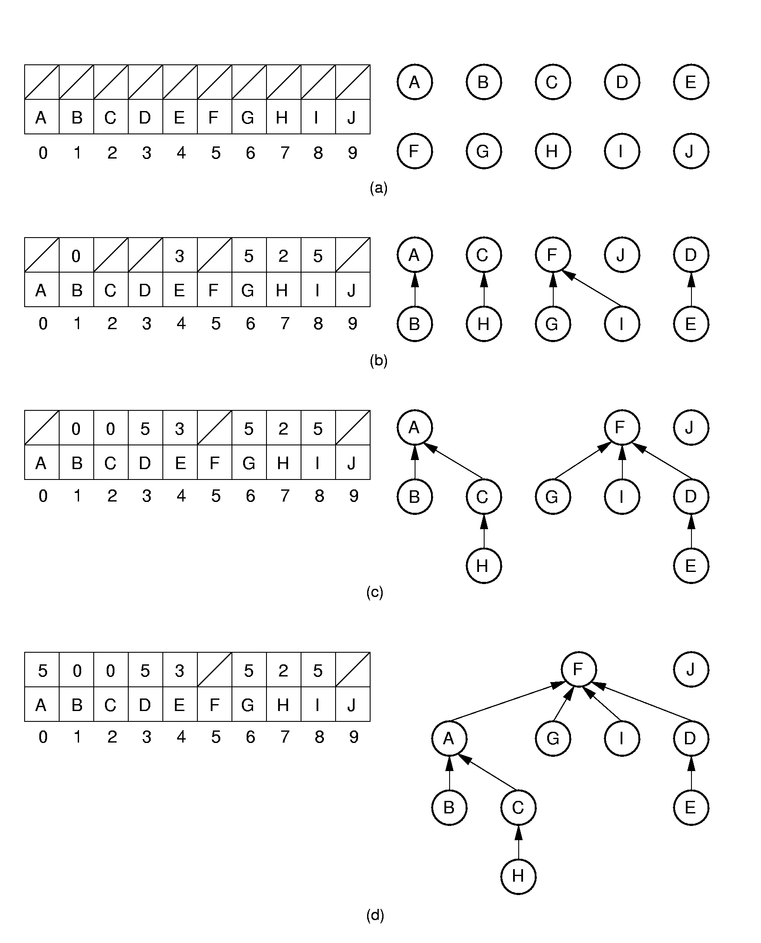
Equiv Class Processing (1)
Notes:
Initially, all objects are in separate sets (equivalence classes).
(b) shows the result of processing equivalences (A, B), (C, H), (G, F), (D, E), and (I, F).
(c) shows the result of processing equivalences (H, A) and (E, G). Note that weighted union is used.

Slide 161
Equiv Class Processing (2)
Notes:
(d) shows the result of processing equivalence (H, E).

Slide 162
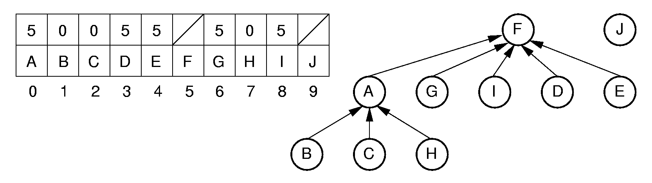
Path Compression
int Gentree::FIND(int curr) const {
if (array[curr] == ROOT) return curr;
return array[curr] = FIND(array[curr]);
}
Notes:
Path compression is used to process equivalence (H, E).

Slide 163
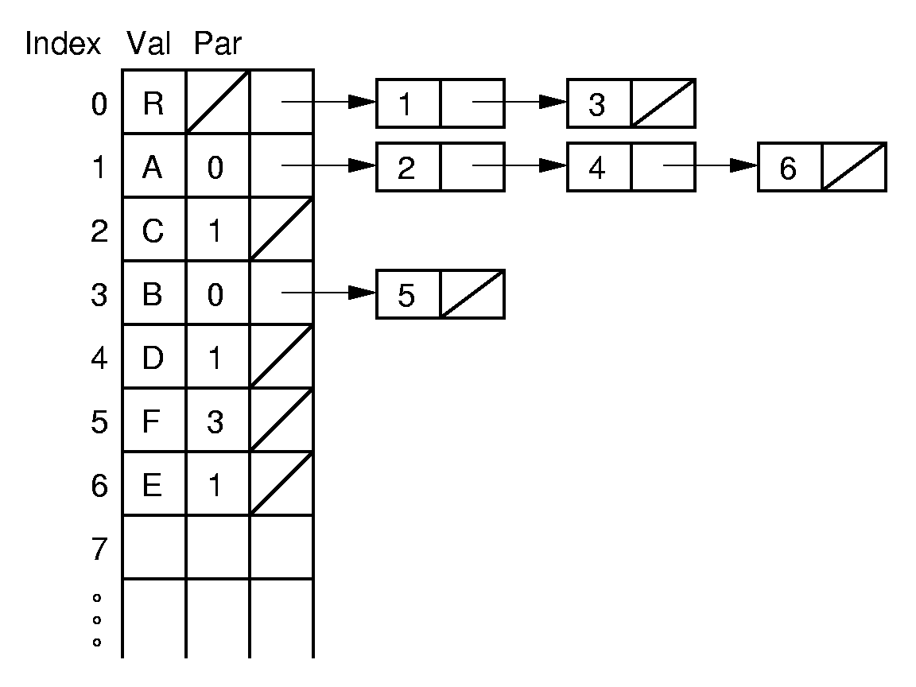
Lists of Children
Notes:
The next several slides show various possible implementations for general trees.
A key gauge for the quality of these representations is how well they perform the key tasks of left-child, right-sibling, and parent. This representation is poor for finding the right sibling of a node.

Slide 164
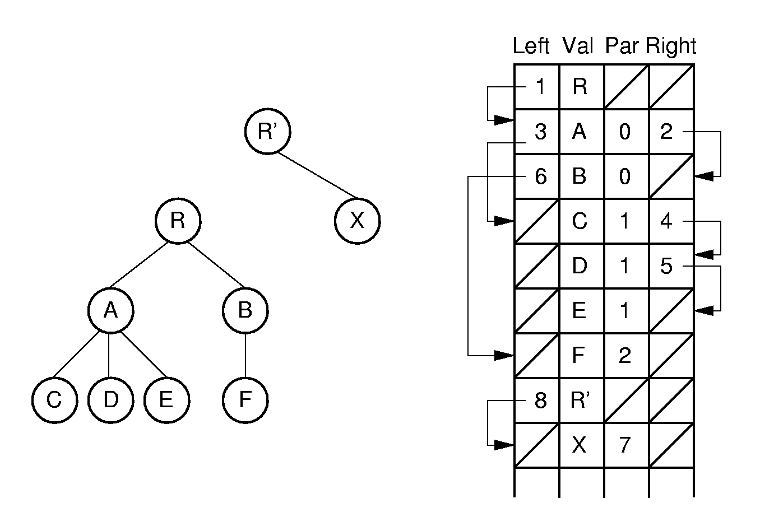
Leftmost Child/Right Sibling (1)
Notes:
Note: Two trees share the same array.

Slide 165
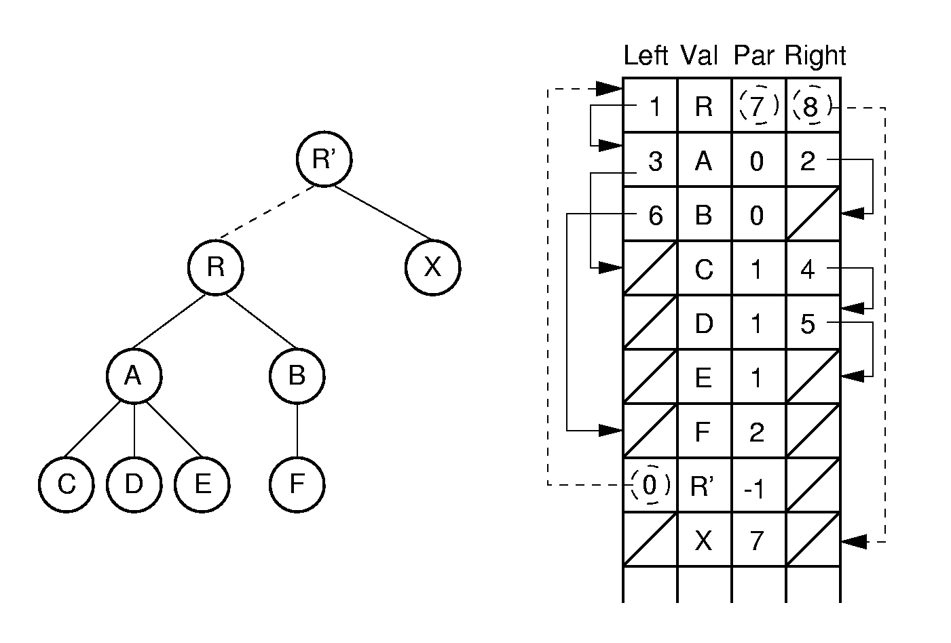
Leftmost Child/Right Sibling (2)
Notes:
Here, the two trees are joined together. Few links need to be adjusted in the implementation to support this join action.

Slide 166
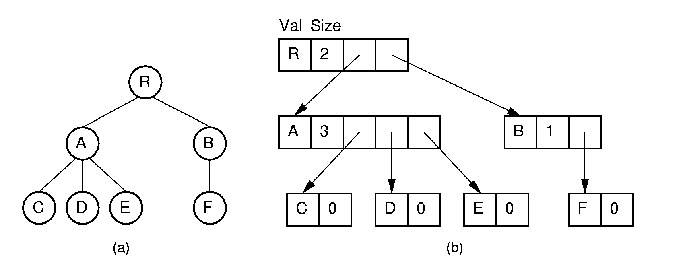
Linked Implementations (1)
Notes:
Essentially an array-based list of children.

Slide 167
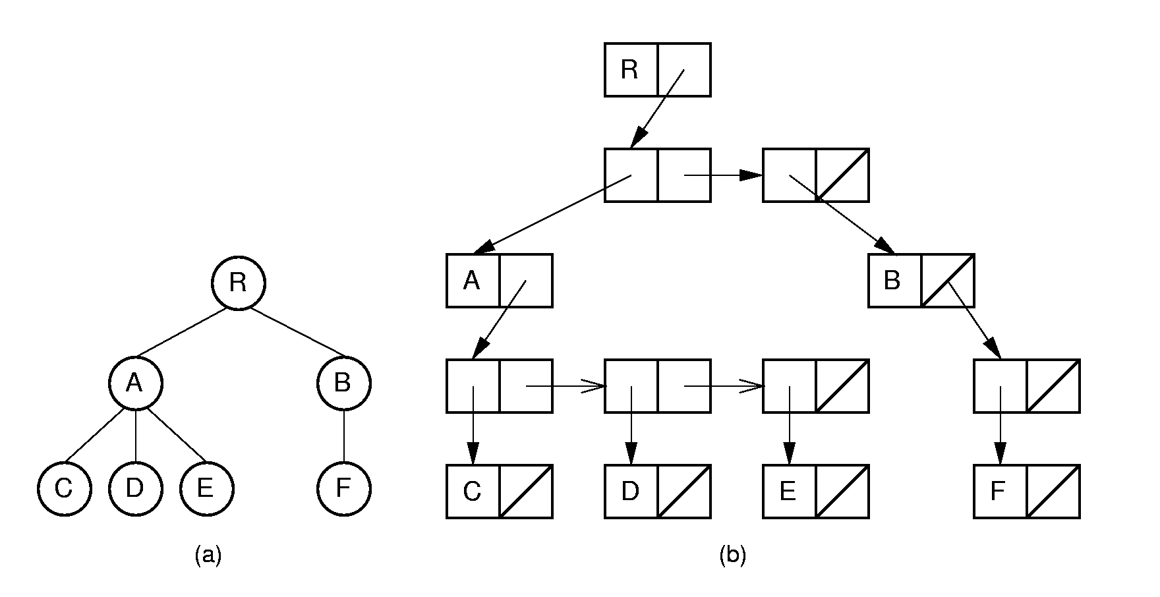
Linked Implementations (2)
Notes:
Essentially a linked list of children.

Slide 168
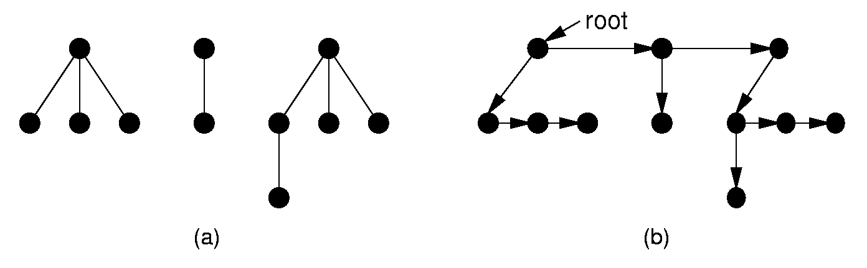
Converting to a Binary Tree
Left child/right sibling representation essentially stores a binary tree.
Use this process to convert any general tree to a binary tree.
A forest is a collection of one or more general trees.
Notes:
The result is essentially a dynamic implementation for the left child/right sibling representation for general trees.

Slide 169
Sequential Implementations (1)
List node values in the order they would be visited by a preorder traversal.
Saves space, but allows only sequential access.
Need to retain tree structure for reconstruction.
Example: For binary trees, us a symbol to mark null links.
AB/D//CEG///FH//I//
Notes:
This example refers to the tree of Figure 6.16.

Slide 170
Sequential Implementations (2)
Example: For full binary trees, mark nodes as leaf or internal.
A’B’/DC’E’G/F’HI
Example: For general trees, mark the end of each subtree.
RAC)D)E))BF)))
Notes:
The first example includes two “/” marks because the example tree is not full. Cost is one additional bit per node.
The second example refers to the general tree of Figure 6.3.

Slide 171
Sorting
Each record contains a field called the key.
  Linear order: comparison.
Measures of cost:
  Comparisons
  Swaps

Slide 172
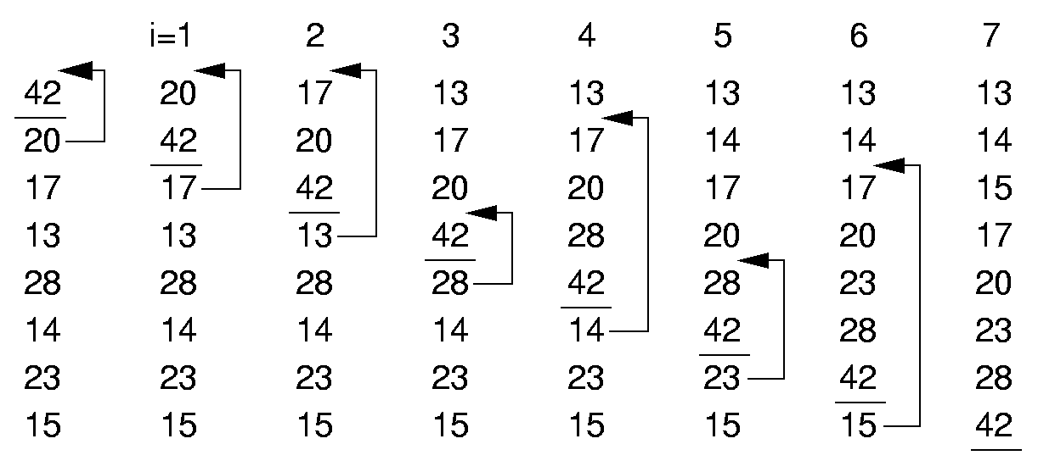
Insertion Sort (1)

Slide 173
Insertion Sort (2)
template <class Elem, class Comp>
void inssort(Elem A[], int n) {
for (int i=1; i<n; i++)
for (int j=i; (j>0) &&
(Comp::lt(A[j], A[j-1])); j--)
swap(A, j, j-1);
}
Best Case:
Worst Case:
Average Case:
Notes:
Best case is 0 swaps, n - 1 comparisons.
Worst case is n²/2 swaps and comparisons.
Average case is n²/4 swaps and comparisons.
This algorithm as the best possible best case performance. This will be important later.

Slide 174
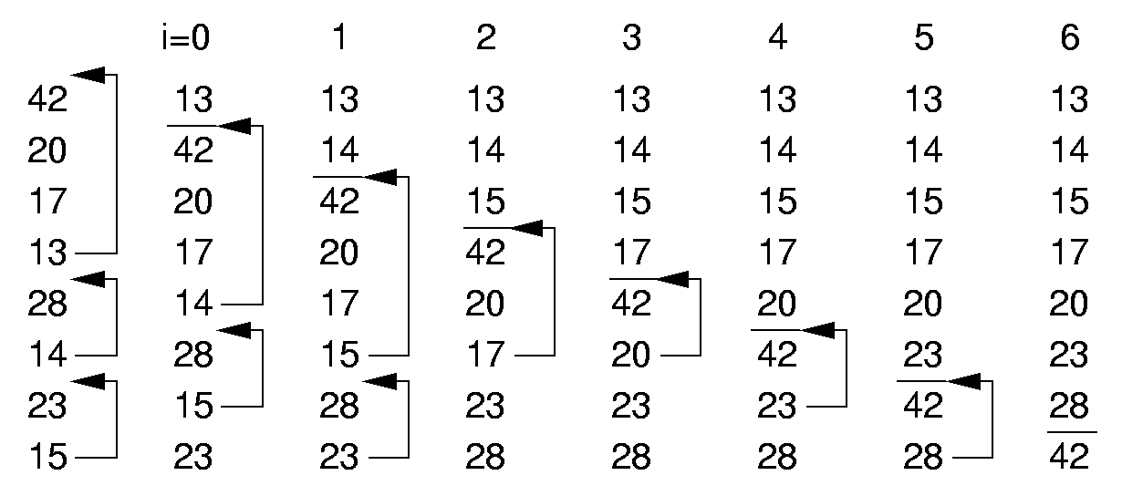
Bubble Sort (1)

Slide 175
Bubble Sort (2)
template <class Elem, class Comp>
void bubsort(Elem A[], int n) {
for (int i=0; i<n-1; i++)
for (int j=n-1; j>i; j--)
if (Comp::lt(A[j], A[j-1]))
swap(A, j, j-1);
}
Best Case:
Worst Case:
Average Case:
Notes:
Best case is 0 swaps, n²/2 comparisons.
Worst case is n²/2 swaps and comparisons.
Average case is n²/4 swaps and n²/2 comparisons.
This algorithm has no redeeming features whatsoever. It’s a shame this algorithm typically gets taught to intro students in preference to the far superior insertion sort algorithm.

Slide 176
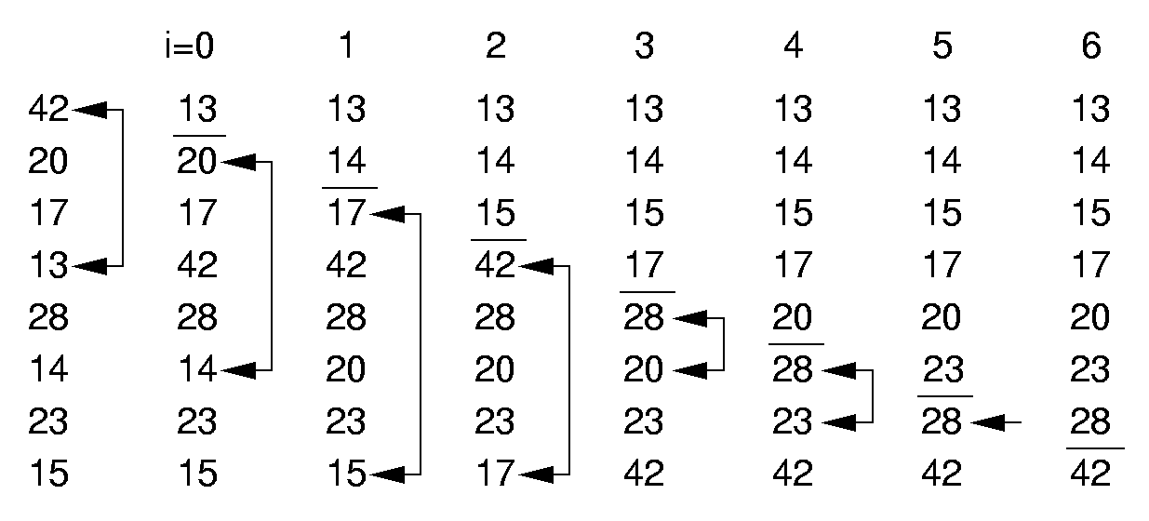
Selection Sort (1)

Slide 177
Selection Sort (2)
template <class Elem, class Comp>
void selsort(Elem A[], int n) {
for (int i=0; i<n-1; i++) {
int lowindex = i; // Remember its index
for (int j=n-1; j>i; j--) // Find least
if (Comp::lt(A[j], A[lowindex]))
lowindex = j; // Put it in place
swap(A, i, lowindex);
}
}
Best Case:
Worst Case:
Average Case:
Notes:
Best case is 0 swaps (n-1 as written), n²/2 comparisons.
Worst case is n - 1 swaps and n2/2 comparisons.
Average case is O(n) swaps and n²/2 comparisons.
This is essentially a bubble sort with the swaps deferred. It can be a significant improvement if the cost of swapping is expensive. Note that the algorithm could be implemented to require 0 swaps in the best case by testing the two locations being swapped are not the same. But this test is likely more expensive than the work saved on average.

Slide 178
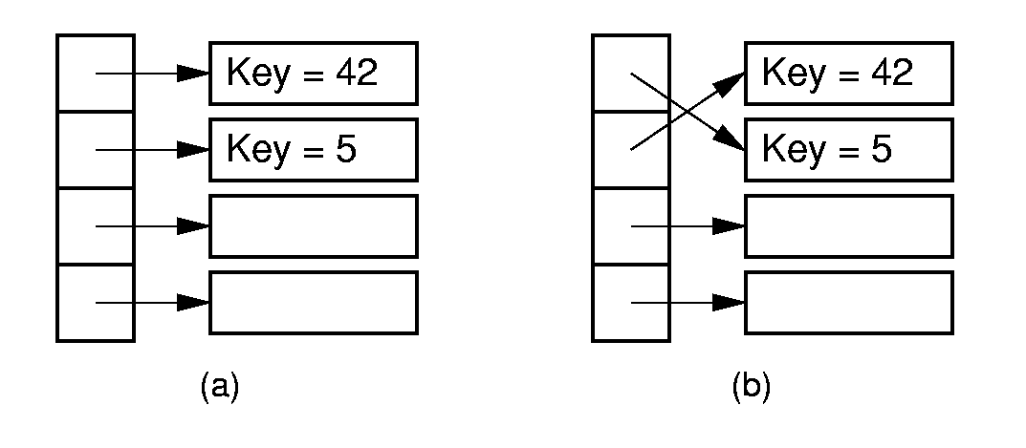
Pointer Swapping

Slide 179
Summary
 | Insertion | Bubble | Selection
Comparisons:
Best Case | Θ(n) | Θ(n²) | Θ(n²)
Average Case | Θ(n²) | Θ(n²) | Θ(n²)
Worst Case | Θ(n²) | Θ(n²) | Θ(n²)
Swaps
Best Case | 0 | 0 | Θ(n)
Average Case | Θ(n²) | Θ(n²) | Θ(n)
Worst Case | Θ(n²) | Θ(n²) | Θ(n)

Slide 180
Exchange Sorting
All of the sorts so far rely on exchanges of adjacent records.
What is the average number of exchanges required?
  There are n! permutations
  Consider permuation X and its reverse, X’
  Together, every pair requires n(n-1)/2 exchanges.

Slide 181
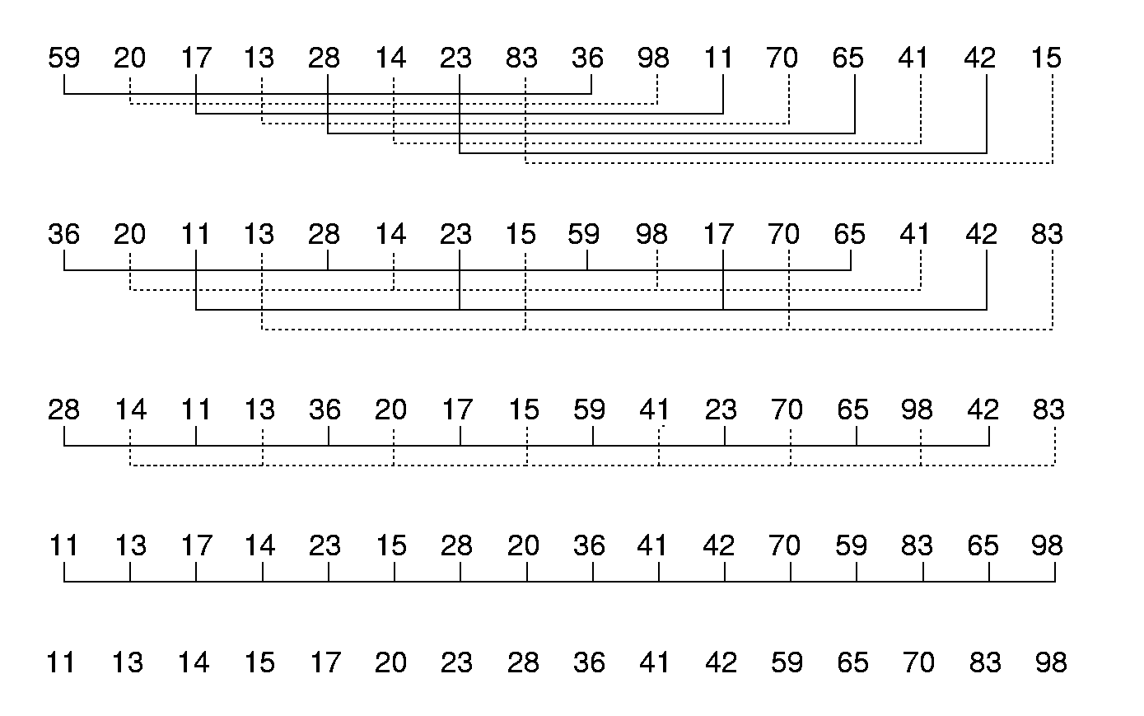
Shellsort
Notes:
Any increments will work, provided that that the last one is 1 (regular insertion sort). Shellsort takes advantage of Insertion Sort’s best-case performance.

Slide 182
Shellsort
// Modified version of Insertion Sort
template <class Elem, class Comp>
void inssort2(Elem A[], int n, int incr) {
for (int i=incr; i<n; i+=incr)
for (int j=i;
(j>=incr) &&
(Comp::lt(A[j], A[j-incr])); j-=incr)
swap(A, j, j-incr);
}
template <class Elem, class Comp>
void shellsort(Elem A[], int n) { // Shellsort
for (int i=n/2; i>2; i/=2) // For each incr
for (int j=0; j<i; j++) // Sort sublists
inssort2<Elem,Comp>(&A[j], n-j, i);
inssort2<Elem,Comp>(A, n, 1);
}
Notes:
Any increments will work, provided that that the last one is 1 (regular insertion sort). Shellsort takes advantage of Insertion Sort’s best-case performance.

Slide 183
Quicksort
template <class Elem, class Comp>
void qsort(Elem A[], int i, int j) {
if (j <= i) return; // List too small
int pivotindex = findpivot(A, i, j);
swap(A, pivotindex, j); // Put pivot at end
// k will be first position on right side
int k =
partition<Elem,Comp>(A, i-1, j, A[j]);
swap(A, k, j); // Put pivot in place
qsort<Elem,Comp>(A, i, k-1);
qsort<Elem,Comp>(A, k+1, j);
}
template <class Elem>
int findpivot(Elem A[], int i, int j)
{ return (i+j)/2; }
Notes:
Initial call: qsort(A, 0, n-1);

Slide 184
Quicksort Partition
template <class Elem, class Comp>
int partition(Elem A[], int l, int r,
Elem& pivot) {
do { // Move the bounds in until they meet
while (Comp::lt(A[++l], pivot));
while ((r != 0) && Comp::gt(A[--r],
pivot));
swap(A, l, r); // Swap out-of-place values
} while (l < r); // Stop when they cross
swap(A, l, r); // Reverse last swap
return l; // Return first pos on right
}
The cost for partition is Θ(n).

Slide 185
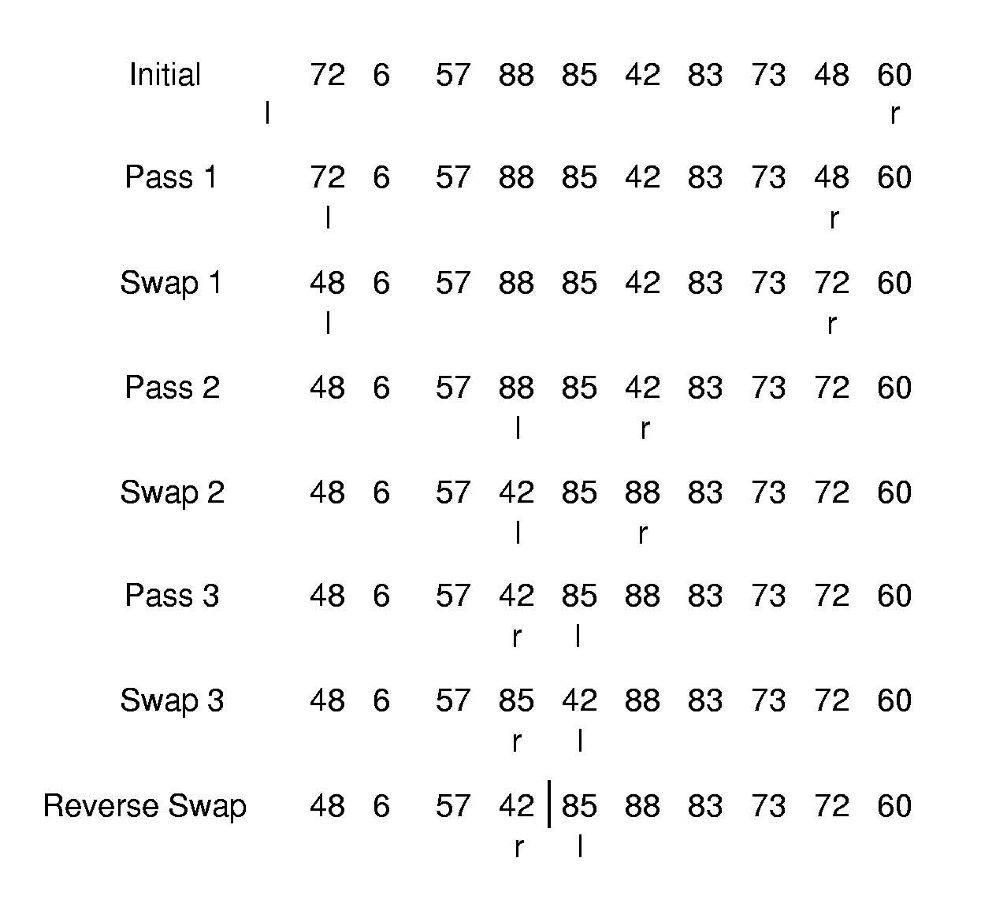
Partition Example

Slide 186
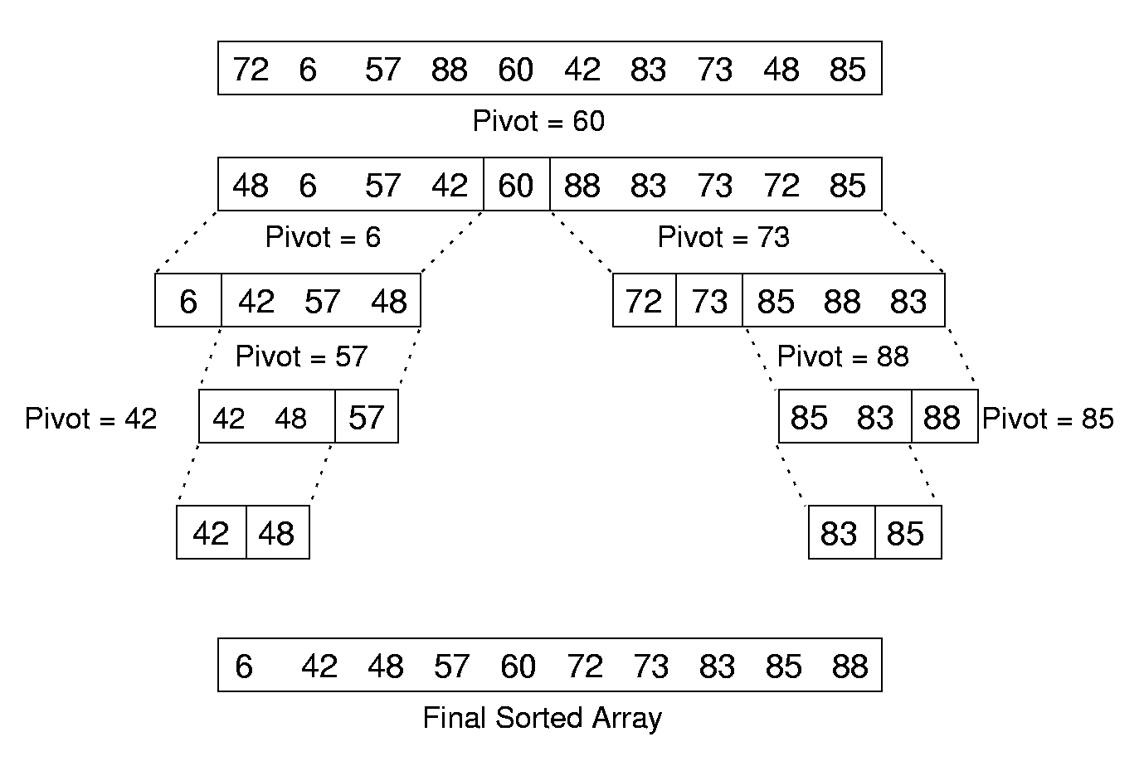
Quicksort Example

Slide 187
Cost of Quicksort
Best case: Always partition in half.
Worst case: Bad partition.
Average case:
T(n) = n + 1 + 1/(n-1) Σ(T(k) + T(n-k))
Optimizations for Quicksort:
  Better Pivot
  Better algorithm for small sublists
  Eliminate recursion
n-1
k=1
Notes:
Best and average cases are Θ(n log n). Worst case is Θ(n²).

Slide 188
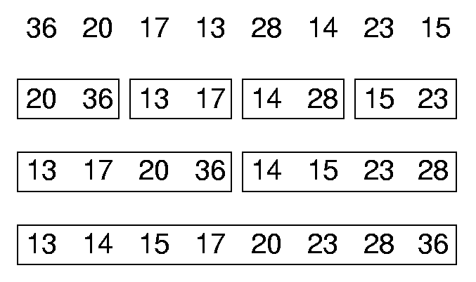
Mergesort
List mergesort(List inlist) {
if (inlist.length() <= 1)return inlist;
List l1 = half of the items from inlist;
List l2 = other half of items from inlist;
return merge(mergesort(l1),
mergesort(l2));
}

Slide 189
Mergesort Implementation
template <class Elem, class Comp>
void mergesort(Elem A[], Elem temp[],
int left, int right) {
int mid = (left+right)/2;
if (left == right) return;
mergesort<Elem,Comp>(A, temp, left, mid);
mergesort<Elem,Comp>(A, temp, mid+1, right);
for (int i=left; i<=right; i++) // Copy
temp[i] = A[i];
int i1 = left; int i2 = mid + 1;
for (int curr=left; curr<=right; curr++) {
if (i1 == mid+1) // Left exhausted
A[curr] = temp[i2++];
else if (i2 > right) // Right exhausted
A[curr] = temp[i1++];
else if (Comp::lt(temp[i1], temp[i2]))
A[curr] = temp[i1++];
else A[curr] = temp[i2++];
}}
Notes:
Mergesort is tricky to implement. The problem is to have the recursion work correctly with the space that stores the values. We do not want to continuously create new arrays.
This implementation copies the sorted sublists into a temporary array and merges back to the original array.

Slide 190
Optimized Mergesort
template <class Elem, class Comp>
void mergesort(Elem A[], Elem temp[],
int left, int right) {
if ((right-left) <= THRESHOLD) {
inssort<Elem,Comp>(&A[left],right-left+1);
return;
}
int i, j, k, mid = (left+right)/2;
if (left == right) return;
mergesort<Elem,Comp>(A, temp, left, mid);
mergesort<Elem,Comp>(A, temp, mid+1, right);
for (i=mid; i>=left; i--) temp[i] = A[i];
for (j=1; j<=right-mid; j++)
temp[right-j+1] = A[j+mid];
for (i=left,j=right,k=left; k<=right; k++)
if (temp[i] < temp[j]) A[k] = temp[i++];
else A[k] = temp[j--];
}
Notes:
Two optimizations. First, use insertion sort to sort small sublists. Second, have the two sublists run toward each other, so that their high ends meet in the middle. In this way, there is no need to test for end of list.

Slide 191
Mergesort Cost
Mergesort cost:
Mergsort is also good for sorting linked lists.
Mergesort requires twice the space.
Notes:
Cost is Θ(n log n) in the best, average, and worst cases.
When merging linked lists, send records to alternating linked lists, mergesort each, then merge the sublists.

Slide 192
Heapsort
template <class Elem, class Comp>
void heapsort(Elem A[], int n) { // Heapsort
Elem mval;
maxheap<Elem,Comp> H(A, n, n);
for (int i=0; i<n; i++) // Now sort
H.removemax(mval); // Put max at end
}
Use a max-heap, so that elements end up sorted within the array.
Cost of heapsort:
Cost of finding K largest elements:
Notes:
The time to build the heap is Θ(n). The time to remove the n elements is Θ(n log n). So, if we only remove k elements, the total cost is Θ(n + k log n).
Compare to sorting with a BST. The heap has no overhead, and is always balanced. Further, the time to build the BST is expensive, while removing the elements once the BST is built is cheap.

Slide 193
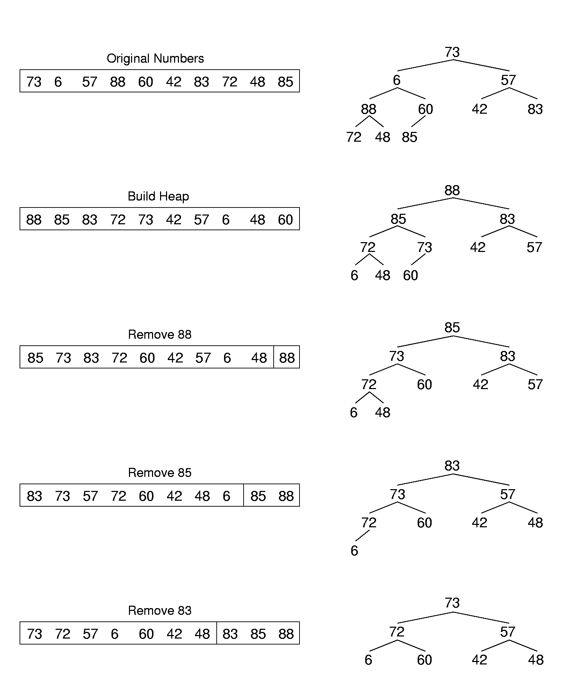
Heapsort Example (1)
Notes:
The time to build the heap is Θ(n). The time to remove the n elements is Θ(n log n). So, if we only remove k elements, the total cost is Θ(n + k log n).
Compare to sorting with a BST. The heap has no overhead, and is always balanced. Further, the time to build the BST is expensive, while removing the elements once the BST is built is cheap.

Slide 194
Heapsort Example (2)
Notes:
The time to build the heap is Θ(n). The time to remove the n elements is Θ(n log n). So, if we only remove k elements, the total cost is Θ(n + k log n).
Compare to sorting with a BST. The heap has no overhead, and is always balanced. Further, the time to build the BST is expensive, while removing the elements once the BST is built is cheap.

Slide 195
Binsort (1)
A simple, efficient sort:
for (i=0; i<n; i++)
B[A[i]] = A[i];
Ways to generalize:
  Make each bin the head of a list.
  Allow more keys than records.
Notes:
This sort is Θ(n), but it only works on a permutation of the values from 0 to n-1.

Slide 196
Binsort (2)
template <class Elem>
void binsort(Elem A[], int n) {
List<Elem> B[MaxKeyValue];
Elem item;
for (i=0; i<n; i++) B[A[i]].append(A[i]);
for (i=0; i<MaxKeyValue; i++)
for (B[i].setStart();
B[i].getValue(item); B[i].next())
output(item);
}
Cost:
Notes:
Cost might first appear to be Θ(n). Actually, it is Θ(n + MaxKeyValue).
Unfortunately, there is no necessary relationship between the size of n and the size of MaxKeyValue. Thus, this algorithm could be Θ(n²) or arbitrarily worse.

Slide 197
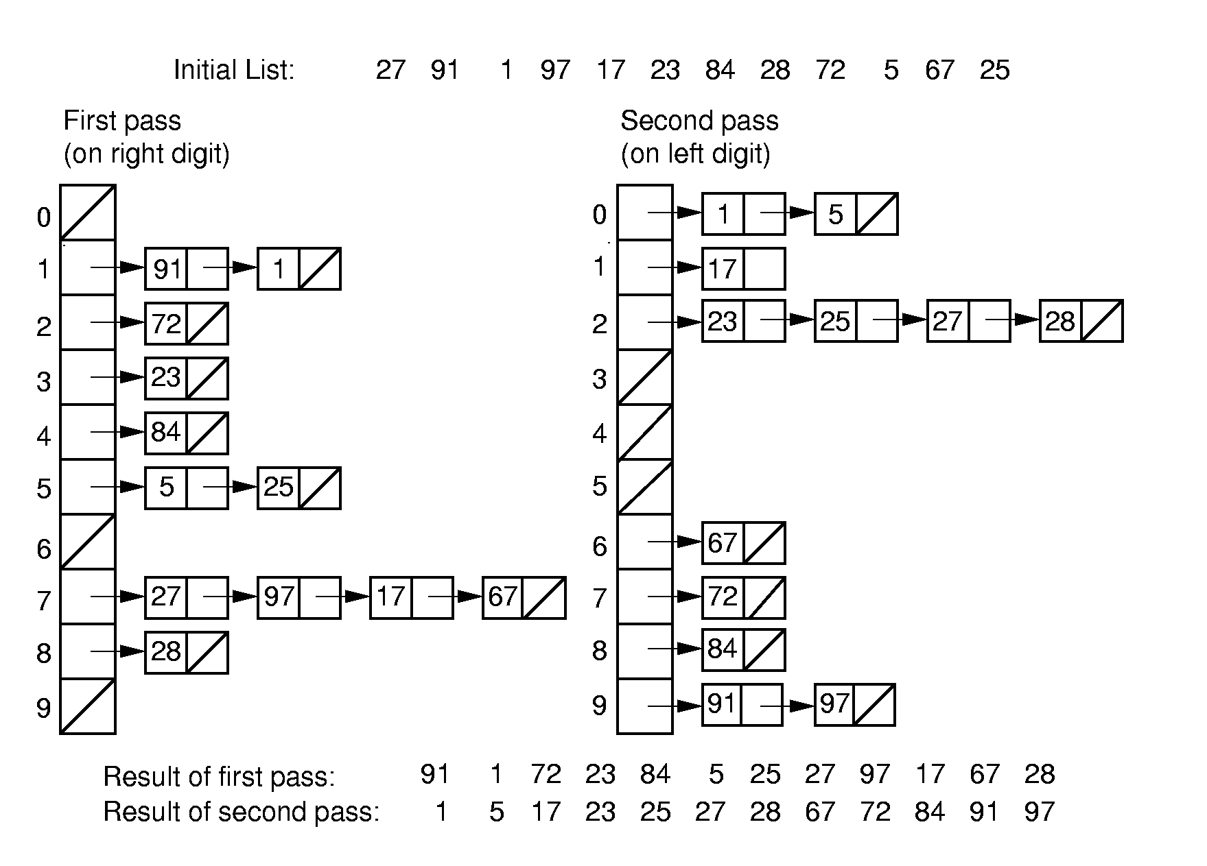
Radix Sort (1)

Slide 198
Radix Sort (2)
template <class Elem, class Comp>
void radix(Elem A[], Elem B[],
int n, int k, int r, int cnt[]) {
// cnt[i] stores # of records in bin[i]
int j;
for (int i=0, rtok=1; i<k; i++, rtok*=r) {
for (j=0; j<r; j++) cnt[j] = 0;
// Count # of records for each bin
for(j=0; j<n; j++) cnt[(A[j]/rtok)%r]++;
// cnt[j] will be last slot of bin j.
for (j=1; j<r; j++)
cnt[j] = cnt[j-1] + cnt[j];
for (j=n-1; j>=0; j--)\
B[--cnt[(A[j]/rtok)%r]] = A[j];
for (j=0; j<n; j++) A[j] = B[j];
}}

Slide 199
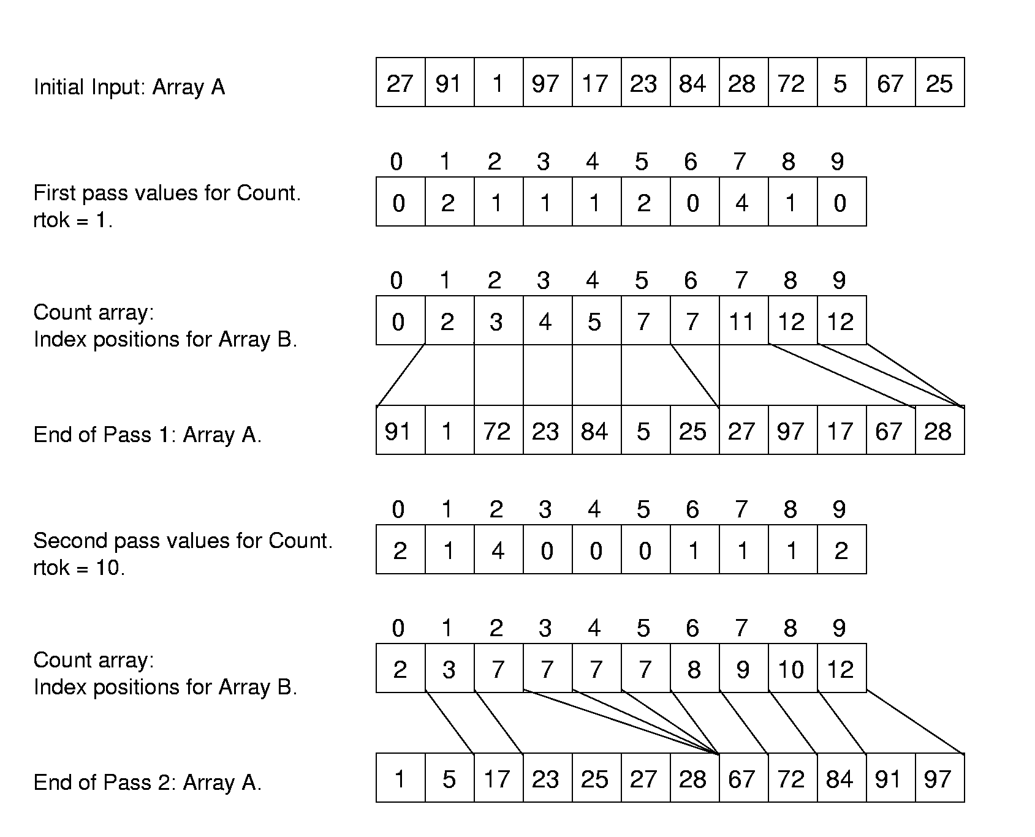
Radix Sort Example

Slide 200
Radix Sort Cost
Cost: Θ(nk + rk)
How do n, k, and r relate?
If key range is small, then this can be Θ(n).
If there are n distinct keys, then the length of a key must be at least log n.
  Thus, Radix Sort is Θ(n log n) in general case
Notes:
r is small and can be viewed as a constant.

Slide 201
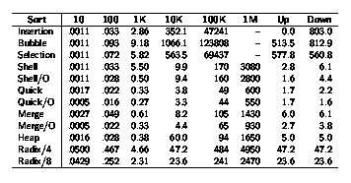
Empirical Comparison (1)
Notes:
Window 98

Slide 202
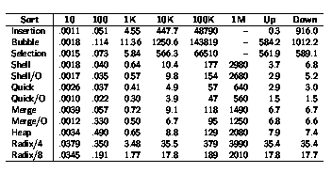
Empirical Comparison (2)
Notes:
Linux

Slide 203
Sorting Lower Bound
We would like to know a lower bound for all possible sorting algorithms.
Sorting is O(n log n) (average, worst cases) because we know of algorithms with this upper bound.
Sorting I/O takes Ω(n) time.
We will now prove Ω(n log n) lower bound for sorting.

Slide 204
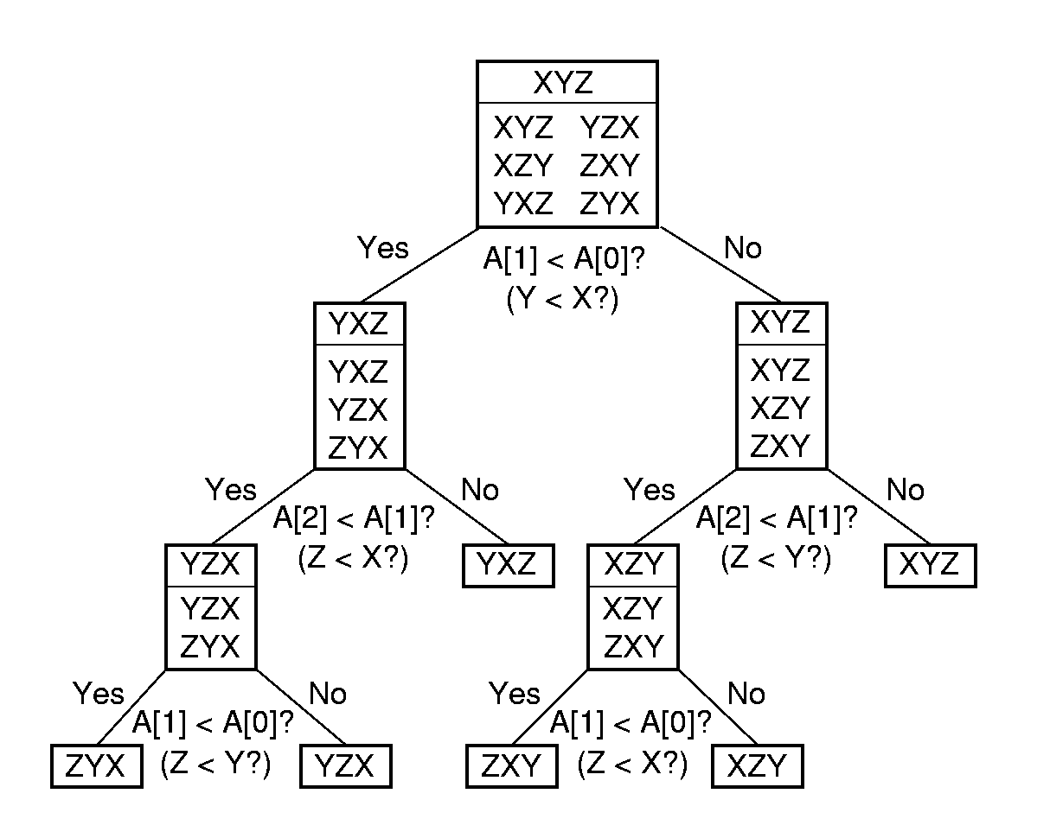
Decision Trees

Slide 205
Lower Bound Proof
There are n! permutations.
A sorting algorithm can be viewed as determining which permutation has been input.
Each leaf node of the decision tree corresponds to one permutation.
A tree with n nodes has Ω(log n) levels, so the tree with n! leaves has Ω(log n!) = Ω(n log n) levels.
Which node in the decision tree corresponds to the worst case?

Slide 206
Primary vs. Secondary Storage
Primary storage: Main memory (RAM)
Secondary Storage: Peripheral devices
  Disk drives
  Tape drives

Slide 207
Comparisons
Medium | Early 1996 | Mid 1997 | Early 2000
RAM | $45.00 | 7.00 | 1.50
Disk | 0.25 | 0.10 | 0.01
Floppy | 0.50 | 0.36 | 0.25
Tape | 0.03 | 0.01 | 0.001
RAM is usually volatile.
RAM is about 1/4 million times faster than disk.

Slide 208
Golden Rule of File Processing
Minimize the number of disk accesses!
  1. Arrange information so that you get what you want with few disk accesses.
  2. Arrange information to minimize future disk accesses.
An organization for data on disk is often called a file structure.
Disk-based space/time tradeoff: Compress information to save processing time by reducing disk accesses.

Slide 209

Disk Drives

Slide 210


Sectors
A sector is the basic unit of I/O.
Interleaving factor: Physical distance between logically adjacent sectors on a track.

Slide 211
Terms
Locality of Reference: When record is read from disk, next request is likely to come from near the same place in the file.
Cluster: Smallest unit of file allocation, usually several sectors.
Extent: A group of physically contiguous clusters.
Internal fragmentation: Wasted space within sector if record size does not match sector size; wasted space within cluster if file size is not a multiple of cluster size.

Slide 212
Seek Time
Seek time: Time for I/O head to reach desired track. Largely determined by distance between I/O head and desired track.
Track-to-track time: Minimum time to move from one track to an adjacent track.
Average Seek time: Average time to reach a track for random access.

Slide 213
Other Factors
Rotational Delay or Latency: Time for data to rotate under I/O head.
  One half of a rotation on average.
  At 7200 rpm, this is 8.3/2 = 4.2ms.
Transfer time: Time for data to move under the I/O head.
  At 7200 rpm: Number of sectors read/Number of sectors per track * 8.3ms.

Slide 214
Disk Spec Example
16.8 GB disk on 10 platters = 1.68GB/platter
13,085 tracks/platter
256 sectors/track
512 bytes/sector
Track-to-track seek time: 2.2 ms
Average seek time: 9.5ms
4KB clusters, 32 clusters/track.
Interleaving factor of 3.
5400RPM

Slide 215
Disk Access Cost Example (1)
Read a 1MB file divided into 2048 records of 512 bytes (1 sector) each.
Assume all records are on 8 contiguous tracks.
First track: 9.5 + 11.1/2 + 3 x 11.1 = 48.4 ms
Remaining 7 tracks: 2.2 + 11.1/2 + 3 x 11.1 = 41.1 ms.
Total: 48.4 + 7 * 41.1 = 335.7ms

Slide 216
Disk Access Cost Example (2)
Read a 1MB file divided into 2048 records of 512 bytes (1 sector) each.
Assume all file clusters are randomly spread across the disk.
256 clusters. Cluster read time is
(3 x 8)/256 of a rotation for about 1 ms.
256(9.5 + 11.1/2 + (3 x 8)/256) is about 3877 ms. or nearly 4 seconds.
Notes:
This is MUCH worse than the previous example.

Slide 217
How Much to Read?
Read time for one track:
  9.5 + 11.1/2 + 3 x 11.1 = 48.4ms.
Read time for one sector:
  9.5 + 11.1/2 + (1/256)11.1 = 15.1ms.
Read time for one byte:
  9.5 + 11.1/2 = 15.05 ms.
Nearly all disk drives read/write one sector at every I/O access.
  Also referred to as a page.

Slide 218
Buffers
The information in a sector is stored in a buffer or cache.
If the next I/O access is to the same buffer, then no need to go to disk.
There are usually one or more input buffers and one or more output buffers.

Slide 219
Buffer Pools
A series of buffers used by an application to cache disk data is called a buffer pool.
Virtual memory uses a buffer pool to imitate greater RAM memory by actually storing information on disk and “swapping” between disk and RAM.

Slide 220

Buffer Pools

Slide 221
Organizing Buffer Pools
Which buffer should be replaced when new data must be read?
First-in, First-out: Use the first one on the queue.
Least Frequently Used (LFU): Count buffer accesses, reuse the least used.
Least Recently used (LRU): Keep buffers on a linked list. When buffer is accessed, bring it to front. Reuse the one at end.

Slide 222
Bufferpool ADT (1)
class BufferPool { // (1) Message Passing
public:
virtual void insert(void* space,
int sz, int pos) = 0;
virtual void getbytes(void* space,
int sz, int pos) = 0;
};
class BufferPool { // (2) Buffer Passing
public:
virtual void* getblock(int block) = 0;
virtual void dirtyblock(int block) = 0;
virtual int blocksize() = 0;
};

Slide 223
Design Issues
Disadvantage of message passing:
  Messages are copied and passed back and forth.
Disadvantages of buffer passing:
  The user is given access to system memory (the buffer itself)
  The user must explicitly tell the buffer pool when buffer contents have been modified, so that modified data can be rewritten to disk when the buffer is flushed.
  The pointer might become stale when the bufferpool replaces the contents of a buffer.

Slide 224
Programmer’s View of Files
Logical view of files:
  An a array of bytes.
  A file pointer marks the current position.
Three fundamental operations:
  Read bytes from current position (move file pointer)
  Write bytes to current position (move file pointer)
  Set file pointer to specified byte position.

Slide 225
C++ File Functions
#include <fstream.h>
void fstream::open(char* name, openmode mode);
  Example: ios::in | ios::binary
void fstream::close();
fstream::read(char* ptr, int numbytes);
fstream::write(char* ptr, int numbtyes);
fstream::seekg(int pos);
fstream::seekg(int pos, ios::curr);
fstream::seekp(int pos);
fstream::seekp(int pos, ios::end);

Slide 226
External Sorting
Problem: Sorting data sets too large to fit into main memory.
  Assume data are stored on disk drive.
To sort, portions of the data must be brought into main memory, processed, and returned to disk.
An external sort should minimize disk accesses.

Slide 227
Model of External Computation
Secondary memory is divided into equal-sized blocks (512, 1024, etc…)
A basic I/O operation transfers the contents of one disk block to/from main memory.
Under certain circumstances, reading blocks of a file in sequential order is more efficient. (When?)
Primary goal is to minimize I/O operations.
Assume only one disk drive is available.
Notes:
For sequential search to be more efficient than random access to the file
adjacent logical blocks of the file must be physically adjacent.
There must be no competition for the I/O head, either with another process, or within the same process (such as thrashing between and input buffer and an output buffer).

Slide 228
Key Sorting
Often, records are large, keys are small.
  Ex: Payroll entries keyed on ID number
Approach 1: Read in entire records, sort them, then write them out again.
Approach 2: Read only the key values, store with each key the location on disk of its associated record.
After keys are sorted the records can be read and rewritten in sorted order.
Notes:
Usually the records are not rewritten in sorted order.
(1) It is expensive (random access to all records).
(2) If there are multiple keys, there is no single “correct” order.

Slide 229
Simple External Mergesort (1)
Quicksort requires random access to the entire set of records.
Better: Modified Mergesort algorithm.
  Process n elements in Θ(log n) passes.
A group of sorted records is called a run.
Notes:
Usually the records are not rewritten in sorted order.
(1) It is expensive (random access to all records).
(2) If there are multiple keys, there is no single “correct” order.

Slide 230
Simple External Mergesort (2)
Split the file into two files.
Read in a block from each file.
Take first record from each block, output them in sorted order.
Take next record from each block, output them to a second file in sorted order.
Repeat until finished, alternating between output files. Read new input blocks as needed.
Repeat steps 2-5, except this time input files have runs of two sorted records that are merged together.
Each pass through the files provides larger runs.
Notes:
Usually the records are not rewritten in sorted order.
(1) It is expensive (random access to all records).
(2) If there are multiple keys, there is no single “correct” order.

Slide 231

Simple External Mergesort (3)
Notes:
Usually the records are not rewritten in sorted order.
(1) It is expensive (random access to all records).
(2) If there are multiple keys, there is no single “correct” order.

Slide 232
Problems with Simple Mergesort
Is each pass through input and output files sequential?
What happens if all work is done on a single disk drive?
How can we reduce the number of Mergesort passes?
In general, external sorting consists of two phases:
  Break the files into initial runs
  Merge the runs together into a single run.
Notes:
The passes are sequential. But, on a single disk drive, competition for the I/O head eliminates this advantage.
But, we can get a massive improvement by reading in a block, or several blocks, and using an in-memory sort to create the initial runs.

Slide 233
Breaking a File into Runs
General approach:
  Read as much of the file into memory as possible.
  Perform an in-memory sort.
  Output this group of records as a single run.

Slide 234
Replacement Selection (1)
Break available memory into an array for the heap, an input buffer, and an output buffer.
Fill the array from disk.
Make a min-heap.
Send the smallest value (root) to the output buffer.

Slide 235

Replacement Selection (2)
If the next key in the file is greater than the last value output, then
  Replace the root with this key
  else
  Replace the root with the last key in the array
  Add the next record in the file to a new heap (actually, stick it at the end of the array).

Slide 236

RS Example

Slide 237
Snowplow Analogy (1)
Imagine a snowplow moving around a circular track on which snow falls at a steady rate.
At any instant, there is a certain amount of snow S on the track. Some falling snow comes in front of the plow, some behind.
During the next revolution of the plow, all of this is removed, plus 1/2 of what falls during that revolution.
Thus, the plow removes 2S amount of snow.
Notes:
How many disk drives do we need for the greatest benefit? Two -- one for input, one for output.

Slide 238

Snowplow Analogy (2)

Slide 239
Problems with Simple Merge
Simple mergesort: Place runs into two files.
  Merge the first two runs to output file, then next two runs, etc.
Repeat process until only one run remains.
  How many passes for r initial runs?
Is there benefit from sequential reading?
Is working memory well used?
Need a way to reduce the number of passes.
Notes:
For r initial runs, need log r passes.
We get NO benefit from sequential reading if only one disk drive is used.
Working memory is poorly used because only 2 blocks are really needed. So, we would like a way to use memory better.

Slide 240
Multiway Merge (1)
With replacement selection, each initial run is several blocks long.
Assume each run is placed in separate file.
Read the first block from each file into memory and perform an r-way merge.
When a buffer becomes empty, read a block from the appropriate run file.
Each record is read only once from disk during the merge process.

Slide 241

Multiway Merge (2)
In practice, use only one file and seek to appropriate block.

Slide 242
Limits to Multiway Merge (1)
Assume working memory is b blocks in size.
How many runs can be processed at one time?
The runs are 2b blocks long (on average).
How big a file can be merged in one pass?
Notes:
Merge b runs at one time (one block allocated to each run). Replacement selection makes the runs 2b blocks long on average.

Slide 243
Limits to Multiway Merge (2)
Larger files will need more passes -- but the run size grows quickly!
This approach trades (log b) (possibly) sequential passes for a single or very few random (block) access passes.
Notes:
In k merge passes, we process 2b^{(k+1)} blocks.
Example: 0.5MB working memory, 4KB blocks, yield 128 blocks for working memory. Average run size is 1MB, so 128MB can be sorted in one pass on average. 16GB in two merge passes.

Slide 244
General Principles
A good external sorting algorithm will seek to do the following:
  Make the initial runs as long as possible.
  At all stages, overlap input, processing and output as much as possible.
  Use as much working memory as possible. Applying more memory usually speeds processing.
  If possible, use additional disk drives for more overlapping of processing with I/O, and allow for more sequential file processing.
Notes:
Overlapping input, processing, and output is sometimes called double buffering. Not all operating systems allow this at the programmer’s level.

Slide 245
Search
Given: Distinct keys k₁, k₂, …, k_{n} and collection T of n records of the form
(k₁, I₁), (k₂, I₂), …, (k_{n}, I_{n})
where I_{j} is the information associated with key k_{j} for 1 <= j <= n.
Search Problem: For key value K, locate the record (k_{j}, I_{j}) in T such that k_{j} = K.
Searching is a systematic method for locating the record(s) with key value k_{j} = K.

Slide 246
Successful vs. Unsuccessful
A successful search is one in which a record with key k_{j} = K is found.
An unsuccessful search is one in which no record with k_{j} = K is found (and presumably no such record exists).

Slide 247
Approaches to Search
1. Sequential and list methods (lists, tables, arrays).
2. Direct access by key value (hashing)
3. Tree indexing methods.

Slide 248
Searching Ordered Arrays
Sequential Search
Binary Search
Dictionary Search

Slide 249

Lists Ordered by Frequency
Order lists by (expected) frequency of occurrence.
  Perform sequential search
Cost to access first record: 1
Cost to access second record: 2
Expected search cost:

Slide 250

Examples(1)
(1) All records have equal frequency.
Notes:
p_{i} is the probability of ith record being accessed.

Slide 251


Examples(2)
(2) Exponential Frequency
Notes:
2nd line of definition is to make the probabilities sum to 1.

Slide 252


Zipf Distributions
Applications:
  Distribution for frequency of word usage in natural languages.
  Distribution for populations of cities, etc.
80/20 rule:
  80% of accesses are to 20% of the records.
  For distributions following 80/20 rule,
Notes:
H_{n} = Σ(1/i) = log_{e}n.

Slide 253
Self-Organizing Lists
Self-organizing lists modify the order of records within the list based on the actual pattern of record accesses.
Self-organizing lists use a heuristic for deciding how to reorder the list. These heuristics are similar to the rules for managing buffer pools.
Notes:
Buffer pools are an example of a self-organizing list.

Slide 254
Heuristics
Order by actual historical frequency of access. (Similar to LFU buffer pool replacement strategy.)
Move-to-Front: When a record is found, move it to the front of the list.
Transpose: When a record is found, swap it with the record ahead of it.
Notes:
Move to front and transpose are both good. But, here are a few observations:
Move-to-front is not worse than twice “best arrangement”.
Transpose bad example: Keep swapping the last two elements.

Slide 255
Text Compression Example
Application: Text Compression.
Keep a table of words already seen, organized via Move-to-Front heuristic.
  If a word not yet seen, send the word.
  Otherwise, send (current) index in the table.
The car on the left hit the car I left.
The car on 3 left hit 3 5 I 5.
This is similar in spirit to Ziv-Lempel coding.

Slide 256

Searching in Sets
For dense sets (small range, high percentage of elements in set).
Can use logical bit operators.
Example: To find all primes that are odd numbers, compute:
0011010100010100 & 0101010101010101

Slide 257
Hashing (1)
Hashing: The process of mapping a key value to a position in a table.
A hash function maps key values to positions. It is denoted by h.
A hash table is an array that holds the records. It is denoted by HT.
HT has M slots, indexed form 0 to M-1.

Slide 258
Hashing (2)
For any value K in the key range and some hash function h, h(K) = i, 0 <= i < M, such that key(HT[i]) = K.
Hashing is appropriate only for sets (no duplicates).
Good for both in-memory and disk-based applications.
Answers the question “What record, if any, has key value K?”
Notes:
Hashing is not good for range queries.

Slide 259
Simple Examples
(1) Store the n records with keys in range 0 to n-1.
  Store the record with key i in slot i.
  Use hash function h(K) = K.
(2) More reasonable example:
  Store about 1000 records with keys in range 0 to 16,383.
  Impractical to keep a hash table with 16,384 slots.
  We must devise a hash function to map the key range to a smaller table.

Slide 260
Collisions (1)
Given: hash function h with keys k₁ and k₂. β is a slot in the hash table.
If h(k₁) = β = h(k₂), then k₁ and k₂ have a collision at β under h.
Search for the record with key K:
  Compute the table location h(K).
  Starting with slot h(K), locate the record containing key K using (if necessary) a collision resolution policy.

Slide 261
Collisions (2)
Collisions are inevitable in most applications.
  Example: 23 people are likely to share a birthday.

Slide 262
Hash Functions (1)
A hash function MUST return a value within the hash table range.
To be practical, a hash function SHOULD evenly distribute the records stored among the hash table slots.
Ideally, the hash function should distribute records with equal probability to all hash table slots. In practice, success depends on distribution of actual records stored.

Slide 263
Hash Functions (2)
If we know nothing about the incoming key distribution, evenly distribute the key range over the hash table slots while avoiding obvious opportunities for clustering.
If we have knowledge of the incoming distribution, use a distribution-dependent hash function.

Slide 264
Examples (1)
int h(int x) {
return(x % 16);
}
This function is entirely dependent on the lower 4 bits of the key.
Mid-square method: Square the key value, take the middle r bits from the result for a hash table of 2^{r} slots.

Slide 265
Examples (2)
For strings: Sum the ASCII values of the letters and take results modulo M.
int h(char* x) {
int i, sum;
for (sum=0, i=0; x[i] != '\0'; i++)
sum += (int) x[i];
return(sum % M);
}
This is only good if the sum is large compared to M.

Slide 266
Examples (3)
ELF Hash: From Executable and Linking Format (ELF), UNIX System V Release 4.
int ELFhash(char* key) {
unsigned long h = 0;
while(*key) {
h = (h << 4) + *key++;
unsigned long g = h & 0xF0000000L;
if (g) h ^= g >> 24;
h &= ~g;
}
return h % M;
}

Slide 267

Open Hashing
What to do when collisions occur?
Open hashing treats each hash table slot as a bin.

Slide 268
Bucket Hashing
Divide the hash table slots into buckets.
  Example: 8 slots/bucket.
Include an overflow bucket.
Records hash to the first slot of the bucket, and fill bucket. Go to overflow if necessary.
When searching, first check the proper bucket. Then check the overflow.

Slide 269
Closed Hashing
Closed hashing stores all records directly in the hash table.
Each record i has a home position h(k_{i}).
If another record occupies i’s home position, then another slot must be found to store i.
The new slot is found by a collision resolution policy.
Search must follow the same policy to find records not in their home slots.

Slide 270
Collision Resolution
During insertion, the goal of collision resolution is to find a free slot in the table.
Probe sequence: The series of slots visited during insert/search by following a collision resolution policy.
Let β₀ = h(K). Let (β₀, β₁, …) be the series of slots making up the probe sequence.

Slide 271
Insertion
// Insert e into hash table HT
template <class Key, class Elem,
class KEComp, class EEComp>
bool hashdict<Key, Elem, KEComp, EEComp>::
hashInsert(const Elem& e) {
int home; // Home position for e
int pos = home = h(getkey(e)); // Init
for (int i=1;
!(EEComp::eq(EMPTY, HT[pos])); i++) {
pos = (home + p(getkey(e), I)) % M;
if (EEComp::eq(e, HT[pos]))
return false; // Duplicate
}
HT[pos] = e; // Insert e
return true;
}

Slide 272
Search
// Search for the record with Key K
template <class Key, class Elem,
class KEComp, class EEComp>
bool hashdict<Key, Elem, KEComp, EEComp>::
hashSearch(const Key& K, Elem& e) const {
int home; // Home position for K
int pos = home = h(K); // Initial posit
for (int i = 1; !KEComp::eq(K, HT[pos]) &&
!EEComp::eq(EMPTY, HT[pos]); i++)
pos = (home + p(K, i)) % M; // Next
if (KEComp::eq(K, HT[pos])) { // Found it
e = HT[pos];
return true;
}
else return false; // K not in hash table
}

Slide 273
Probe Function
Look carefully at the probe function p().
pos = (home + p(getkey(e), i)) % M;
Each time p() is called, it generates a value to be added to the home position to generate the new slot to be examined.
p() is a function both of the element’s key value, and of the number of steps taken along the probe sequence.
  Not all probe functions use both parameters.

Slide 274
Linear Probing
Use the following probe function:
p(K, i) = i;
Linear probing simply goes to the next slot in the table.
  Past bottom, wrap around to the top.
To avoid infinite loop, one slot in the table must always be empty.

Slide 275

Linear Probing Example
Primary Clustering: Records tend to cluster in the table under linear probing since the probabilities for which slot to use next are not the same for all slots.
Notes:
For (a): prob(3) = 4/11, prob(4) = 1/11, prob(5) = 1/11, prob(6) = 1/11, prob(10) = 4/11.
For(b): prob(3) = 8/11, prob(4,5,6) = 1/11 each.

Slide 276
Improved Linear Probing
Instead of going to the next slot, skip by some constant c.
  Warning: Pick M and c carefully.
The probe sequence SHOULD cycle through all slots of the table.
  Pick c to be relatively prime to M.
There is still some clustering
  Ex: c=2, h(k₁) = 3; h(k₂) = 5.
  Probe sequences for k₁ and k₂ are linked together.
Notes:
If M=10 and c=2, then we effectively have created 2 hash tables (evens vs. odds).

Slide 277
Pseudo-Random Probing(1)
The ideal probe function would select the next slot on the probe sequence at random.
An actual probe function cannot operate randomly. (Why?)

Slide 278
Pseudo-Random Probing(2)
Select a (random) permutation of the numbers from 1 to M-1:
r₁, r₂, …, r_{M-1}
All insertions and searches use the same permutation.
Example: Hash table size of M = 101
  r₁=2, r₂=5, r₃=32.
  h(k₁)=30, h(k₂)=28.
  Probe sequence for k₁:
  Probe sequence for k₂:
Notes:
Probe sequence for k₁: 30, 32, 35, 62.
Probe sequence for k₂: 28, 30, 33, 60.

Slide 279
Quadratic Probing
Set the i’th value in the probe sequence as
h(K, i) = i²;
Example: M=101
  h(k₁)=30, h(k₂) = 29.
  Probe sequence for k₁ is:
  Probe sequence for k₂ is:
Notes:
Probe sequence for k₁: 30, 31, 34, 39.
Probe sequence for k₂: 29, 30, 33, 38.

Slide 280
Secondary Clustering
Pseudo-random probing eliminates primary clustering.
If two keys hash to the same slot, they follow the same probe sequence. This is called secondary clustering.
To avoid secondary clustering, need probe sequence to be a function of the original key value, not just the home position.
Notes:
Probe sequence for k₁: 30, 31, 34, 39.
Probe sequence for k₂: 29, 30, 33, 38.

Slide 281
Double Hashing
p(K, i) = i * h₂(K)
Be sure that all probe sequence constants (h₂(K)) are relatively prime to M.
  This will be true if M is prime, or if M=2^{m} and the constants are odd.
Example: Hash table of size M=101
  h(k₁)=30, h(k₂)=28, h(k₃)=30.
  h₂(k₁)=2, h₂(k₂)=5, h₂(k₃)=5.
  Probe sequence for k₁ is:
  Probe sequence for k₂ is:
  Probe sequence for k₃ is:
Notes:
Probe sequence for k₁: 30, 32, 34, 36.
Probe sequence for k₂: 28, 33, 38,43.
Probe sequence for k₃: 30, 35, 40, 45.

Slide 282

Analysis of Closed Hashing
The load factor is α = N/M where N is the number of records currently in the table.

Slide 283
Deletion
Deleting a record must not hinder later searches.
We do not want to make positions in the hash table unusable because of deletion.

Slide 284
Tombstones (1)
Both of these problems can be resolved by placing a special mark in place of the deleted record, called a tombstone.
A tombstone will not stop a search, but that slot can be used for future insertions.

Slide 285
Tombstones (2)
Unfortunately, tombstones add to the average path length.
Solutions:
Local reorganizations to try to shorten the average path length.
Periodically rehash the table (by order of most frequently accessed record).

Slide 286
Indexing
Goals:
  Store large files
  Support multiple search keys
  Support efficient insert, delete, and range queries

Slide 287
Terms(1)
Entry sequenced file: Order records by time of insertion.
  Search with sequential search
Index file: Organized, stores pointers to actual records.
  Could be organized with a tree or other data structure.
Notes:
Entry sequenced files are not practical as an organization for large databases

Slide 288
Terms(2)
Primary Key: A unique identifier for records. May be inconvenient for search.
Secondary Key: An alternate search key, often not unique for each record. Often used for search key.

Slide 289

Linear Indexing
Linear index: Index file organized as a simple sequence of key/record pointer pairs with key values are in sorted order.
Linear indexing is good for searching variable-length records.
Notes:
A linear index is good for indexing an entry sequenced file.

Slide 290

Linear Indexing (2)
If the index is too large to fit in main memory, a second-level index might be used.
Notes:
Second level index stores the first key for each disk page.

Slide 291
Tree Indexing (1)
Linear index is poor for insertion/deletion.
Tree index can efficiently support all desired operations:
  Insert/delete
  Multiple search keys (multiple indices)
  Key range search

Slide 292


Tree Indexing (2)
Difficulties when storing tree index on disk:
  Tree must be balanced.
  Each path from root to leaf should cover few disk pages.
Notes:
Second figure illustrates how difficult it can be to keep a tree balanced. In this case, rebalancing the BST to maintain the complete tree shape requires that all nodes be moved. This is too expensive to be practical.

Slide 293
2-3 Tree (1)
A 2-3 Tree has the following properties:
  A node contains one or two keys
  Every internal node has either two children (if it contains one key) or three children (if it contains two keys).
  All leaves are at the same level in the tree, so the tree is always height balanced.
The 2-3 Tree has a search tree property analogous to the BST.

Slide 294

2-3 Tree (2)
The advantage of the 2-3 Tree over the BST is that it can be updated at low cost.

Slide 295

2-3 Tree Insertion (1)

Slide 296

2-3 Tree Insertion (2)

Slide 297

2-3 Tree Insertion (3)

Slide 298
B-Trees (1)
The B-Tree is an extension of the 2-3 Tree.
The B-Tree is now the standard file organization for applications requiring insertion, deletion, and key range searches.

Slide 299
B-Trees (2)
B-Trees are always balanced.
B-Trees keep similar-valued records together on a disk page, which takes advantage of locality of reference.
B-Trees guarantee that every node in the tree will be full at least to a certain minimum percentage. This improves space efficiency while reducing the typical number of disk fetches necessary during a search or update operation.

Slide 300
B-Tree Definition
A B-Tree of order m has these properties:
  The root is either a leaf or has at least two children.
  Each node, except for the root and the leaves, has between ⎡m/2⎤ and m children.
  All leaves are at the same level in the tree, so the tree is always height balanced.
A B-Tree node is usually selected to match the size of a disk block.
  A B-Tree node could have hundreds of children.

Slide 301

B-Tree Search (1)
Search in a B-Tree is a generalization of search in a 2-3 Tree.
  Do binary search on keys in current node. If search key is found, then return record. If current node is a leaf node and key is not found, then report an unsuccessful search.
  Otherwise, follow the proper branch and repeat the process.

Slide 302
B⁺-Trees
The most commonly implemented form of the B-Tree is the B⁺-Tree.
Internal nodes of the B⁺-Tree do not store record -- only key values to guild the search.
Leaf nodes store records or pointers to records.
A leaf node may store more or less records than an internal node stores keys.

Slide 303

B⁺-Tree Example

Slide 304

B⁺-Tree Insertion

Slide 305

B⁺-Tree Deletion (1)
Notes:
Delete 18

Slide 306

B⁺-Tree Deletion (2)
Notes:
Delete 12. Borrow 18 from the second child.

Slide 307

B⁺-Tree Deletion (3)
Notes:
Delete 12. Borrow 18 from the second child.

Slide 308
B-Tree Space Analysis (1)
B⁺-Trees nodes are always at least half full.
The B*-Tree splits two pages for three, and combines three pages into two. In this way, nodes are always 2/3 full.
Asymptotic cost of search, insertion, and deletion of nodes from B-Trees is Θ(log n).
  Base of the log is the (average) branching factor of the tree.

Slide 309
B-Tree Space Analysis (2)
Example: Consider a B+-Tree of order 100 with leaf nodes containing 100 records.
  1 level B+-tree:
  2 level B+-tree:
  3 level B+-tree:
  4 level B+-tree:
Ways to reduce the number of disk fetches:
  Keep the upper levels in memory.
  Manage B+-Tree pages with a buffer pool.
Notes:
1 level: Min 0, Max 100
2 level: Min: 2 leaves of 50 for 100 records. Max: 100 leaves with 100 for 10,000 records.
3 level: Min 2 x 50 nodes of leaves, for 5000 records. Max: 100³ = 1,000,000 records.
4 level: Min: 250,00 records (2 * 50 * 50 * 50). Max: 100⁴ = 100 million records.

Slide 310
Graph Applications
Modeling connectivity in computer networks
Representing maps
Modeling flow capacities in networks
Finding paths from start to goal (AI)
Modeling transitions in algorithms
Ordering tasks
Modeling relationships (families, organizations)

Slide 311
Graphs
A graph G = (V, E) consists of a set of vertices V, and a set of edges E, such that each edge in E is a connection between a pair of vertices in V.
The number of vertices is written |V|, and the number edges is written |E|.

Slide 312

Graphs (2)

Slide 313
Paths and Cycles
Path: A sequence of vertices v₁, v₂, …, v_{n} of length n-1 with an edge from v_{i} to v_{i+1} for 1 <= i < n.
A path is simple if all vertices on the path are distinct.
A cycle is a path of length 3 or more that connects v_{i} to itself.
A cycle is simple if the path is simple, except the first and last vertices are the same.

Slide 314

Connected Components
An undirected graph is connected if there is at least one path from any vertex to any other.
The maximum connected subgraphs of an undirected graph are called connected components.

Slide 315

Directed Representation

Slide 316

Undirected Representation

Slide 317
Representation Costs
Adjacency Matrix:
Adjacency List:
Notes:
Adjacency matrix requires Θ(|V|²) space.
Adjacency list requires Θ(|V| + |E|) space.
|E| could be as low as 0, or as high as Θ(|V|²).
Which representation actually requires less space depends on the number of edges.

Slide 318
Graph ADT
class Graph { // Graph abstract class
public:
virtual int n() =0; // # of vertices
virtual int e() =0; // # of edges
// Return index of first, next neighbor
virtual int first(int) =0;
virtual int next(int, int) =0;
// Store new edge
virtual void setEdge(int, int, int) =0;
// Delete edge defined by two vertices
virtual void delEdge(int, int) =0;
// Weight of edge connecting two vertices
virtual int weight(int, int) =0;
virtual int getMark(int) =0;
virtual void setMark(int, int) =0;
};

Slide 319
Graph Traversals
Some applications require visiting every vertex in the graph exactly once.
The application may require that vertices be visited in some special order based on graph topology.
Examples:
  Artificial Intelligence Search
  Shortest paths problems

Slide 320
Graph Traversals (2)
To insure visiting all vertices:
void graphTraverse(const Graph* G) {
for (v=0; v<G->n(); v++)
G->setMark(v, UNVISITED); // Initialize
for (v=0; v<G->n(); v++)
if (G->getMark(v) == UNVISITED)
doTraverse(G, v);
}
Notes:
doTraverse might be implemented by any of the graph traversals that we are about to discuss.

Slide 321
Depth First Search (1)
// Depth first search
void DFS(Graph* G, int v) {
PreVisit(G, v); // Take action
G->setMark(v, VISITED);
for (int w=G->first(v); w<G->n();
w = G->next(v,w))
if (G->getMark(w) == UNVISITED)
DFS(G, w);
PostVisit(G, v); // Take action
}

Slide 322

Depth First Search (2)
Cost: Θ(|V| + |E|).
Notes:
Order that nodes are processed: ACBFDE

Slide 323
Breadth First Search (1)
Like DFS, but replace stack with a queue.
  Visit vertex’s neighbors before continuing deeper in the tree.
Notes:
Order that nodes are processed: ACBFDE

Slide 324
Breadth First Search (2)
void BFS(Graph* G, int start,Queue<int>*Q) {
int v, w;
Q->enqueue(start); // Initialize Q
G->setMark(start, VISITED);
while (Q->length() != 0) { // Process Q
Q->dequeue(v);
PreVisit(G, v); // Take action
for(w=G->first(v);w<G->n();w=G->next(v,w))
if (G->getMark(w) == UNVISITED) {
G->setMark(w, VISITED);
Q->enqueue(w);
}
}
}
Notes:
Order that nodes are processed: ACBFDE

Slide 325

Breadth First Search (3)
Notes:
Order that nodes are processed: ACBFDE

Slide 326
Topological Sort (1)
Problem: Given a set of jobs, courses, etc., with prerequisite constraints, output the jobs in an order that does not violate any of the prerequisites.

Slide 327
Topological Sort (2)
void topsort(Graph* G) { // Topological sort
int i;
for (i=0; i<G->n(); i++) // Initialize
G->setMark(i, UNVISITED);
for (i=0; i<G->n(); i++) // Do vertices
if (G->getMark(i) == UNVISITED)
tophelp(G, i); // Call helper
}
void tophelp(Graph* G, int v) { // Process v
G->setMark(v, VISITED);
for (int w=G->first(v); w<G->n();
w = G->next(v,w))
if (G->getMark(w) == UNVISITED)
tophelp(G, w);
printout(v); // PostVisit for Vertex v
}

Slide 328

Topological Sort (3)
Notes:
Prints in reverse order.

Slide 329
Queue-Based Topsort
void topsort(Graph* G, Queue<int>* Q) {
int Count[G->n()];
int v, w;
for (v=0; v<G->n(); v++) Count[v] = 0;
for (v=0; v<G->n(); v++) // Process edges
for (w=G->first(v); w<G->n();
w = G->next(v,w))
Count[w]++; // Add to v2's count
for (v=0; v<G->n(); v++) // Initialize Q
if (Count[v] == 0) // No prereqs
Q->enqueue(v);
while (Q->length() != 0) {
Q->dequeue(v);
printout(v); // PreVisit for V
for (w=G->first(v); w<G->n();
w = G->next(v,w)) {
Count[w]--; // One less prereq
if (Count[w] == 0) // Now free
Q->enqueue(w);
}}}
Notes:
Prints in reverse order.

Slide 330
Shortest Paths Problems
Input: A graph with weights or costs associated with each edge.
Output: The list of edges forming the shortest path.
Sample problems:
  Find shortest path between two named vertices
  Find shortest path from S to all other vertices
  Find shortest path between all pairs of vertices
Will actually calculate only distances.

Slide 331
Shortest Paths Definitions
d(A, B) is the shortest distance from vertex A to B.
w(A, B) is the weight of the edge connecting A to B.
  If there is no such edge, then w(A, B) = ∞.
Notes:
w(A, D) = 20; d(A, D) = 10 (through ABCD).

Slide 332
Single-Source Shortest Paths
Given start vertex s, find the shortest path from s to all other vertices.
Try 1: Visit vertices in some order, compute shortest paths for all vertices seen so far, then add shortest path to next vertex x.
Problem: Shortest path to a vertex already processed might go through x.
Solution: Process vertices in order of distance from s.
Notes:
This solution is known as Dijkstra’s algorithm

Slide 333
Dijkstra’s Algorithm Example
 | A | B | C | D | E
Initial | 0 | ∞ | ∞ | ∞ | ∞
Process A | 0 | 10 | 3 | 20 | ∞
Process C | 0 | 5 | 3 | 20 | 18
Process B | 0 | 5 | 3 | 10 | 18
Process D | 0 | 5 | 3 | 10 | 18
Process E | 0 | 5 | 3 | 10 | 18

Slide 334
Dijkstra’s Implementation
// Compute shortest path distances from s,
// return them in D
void Dijkstra(Graph* G, int* D, int s) {
int i, v, w;
for (i=0; i<G->n(); i++) { // Do vertices
v = minVertex(G, D);
if (D[v] == INFINITY) return;
G->setMark(v, VISITED);
for (w=G->first(v); w<G->n();
w = G->next(v,w))
if (D[w] > (D[v] + G->weight(v, w)))
D[w] = D[v] + G->weight(v, w);
}
}

Slide 335
Implementing minVertex
Issue: How to determine the next-closest vertex? (I.e., implement minVertex)
Approach 1: Scan through the table of current distances.
  Cost: Θ(|V|² + |E|) = Θ(|V|²).
Approach 2: Store unprocessed vertices using a min-heap to implement a priority queue ordered by D value. Must update priority queue for each edge.
  Cost: Θ((|V| + |E|)log|V|)

Slide 336
Approach 1
// Find min cost vertex
int minVertex(Graph* G, int* D) {
int i, v;
// Set v to an unvisited vertex
for (i=0; i<G->n(); i++)
if (G->getMark(i) == UNVISITED)
{ v = i; break; }
// Now find smallest D value
for (i++; i<G->n(); i++)
if ((G->getMark(i) == UNVISITED) &&
(D[i] < D[v]))
v = i;
return v;
}

Slide 337
Approach 2
void Dijkstra(Graph* G, int* D, int s) {
int i, v, w; // v is current vertex
DijkElem temp;
DijkElem E[G->e()]; // Heap array
temp.distance = 0; temp.vertex = s;
E[0] = temp; // Initialize heap array
minheap<DijkElem, DDComp> H(E, 1, G->e());
for (i=0; i<G->n(); i++) {// Get distances
do { if(!H.removemin(temp)) return;
v = temp.vertex;
} while (G->getMark(v) == VISITED);
G->setMark(v, VISITED);
if (D[v] == INFINITY) return;
for(w=G->first(v); w<G->n(); w=G->next(v,w))
if (D[w] > (D[v] + G->weight(v, w))) {
D[w] = D[v] + G->weight(v, w);
temp.distance = D[w]; temp.vertex = w;
H.insert(temp); // Insert in heap
}}}

Slide 338

All-Pairs Shortest Paths
For every vertex u, v ∈ V, calculate d(u, v).
Could run Dijkstra’s Algorithm |V| times.
Better is Floyd’s Algorithm.
Define a k-path from u to v to be any path whose intermediate vertices all have indices less than k.
Notes:
Floyd’s algorithm is an example of dynamic programming. The issue is how to efficiently check all the paths without computing any path more than once.
1, 3 is a 0-path, since no vertices intervene. 2, 0, 3 is a 1-path since the highest-valued vertex (aside from the endpoints) is 0. 0, 2, 3 is a 3-path, but not a 2- or 1-path. All paths are 4-paths.

Slide 339
Floyd’s Algorithm
//Floyd's all-pairs shortest paths algorithm
void Floyd(Graph* G) {
int D[G->n()][G->n()]; // Store distances
for (int i=0; i<G->n(); i++) // Initialize
for (int j=0; j<G->n(); j++)
D[i][j] = G->weight(i, j);
// Compute all k paths
for (int k=0; k<G->n(); k++)
for (int i=0; i<G->n(); i++)
for (int j=0; j<G->n(); j++)
if (D[i][j] > (D[i][k] + D[k][j]))
D[i][j] = D[i][k] + D[k][j];
}

Slide 340
Minimal Cost Spanning Trees
Minimal Cost Spanning Tree (MST) Problem:
  Input: An undirected, connected graph G.
  Output: The subgraph of G that
  1) has minimum total cost as measured by summing the values of all the edges in the subset, and
  2) keeps the vertices connected.

Slide 341

MST Example

Slide 342
Prim’s MST Algorithm
void Prim(Graph* G, int* D, int s) {
int V[G->n()]; // Who's closest
int i, w;
for (i=0; i<G->n(); i++) {// Do vertices
int v = minVertex(G, D);
G->setMark(v, VISITED);
if (v != s) AddEdgetoMST(V[v], v);
if (D[v] == INFINITY) return;
for (w=G->first(v); w<G->n();
w = G->next(v,w))
if (D[w] > G->weight(v,w)) {
D[w] = G->weight(v,w);// Update dist
V[w] = v; // Update who it came from
}
}
}
Notes:
This is an example of a greedy algorithm. Note that its only difference from Dijkstra’s algorithm is in the distance computation. Dijkstra’s algorithm distance is shortest distance from source to vertex in question. Prim’s algorithm distance is shortest distance from any vertex now in the MST to the vertex in question.

Slide 343
Alternate Implementation
As with Dijkstra’s algorithm, the key issue is determining which vertex is next closest.
As with Dijkstra’s algorithm, the alternative is to use a priority queue.
Running times for the two implementations are identical to the corresponding Dijkstra’s algorithm implementations.

Slide 344
Kruskal’s MST Algorithm (1)
Initially, each vertex is in its own MST.
Merge two MST’s that have the shortest edge between them.
  Use a priority queue to order the unprocessed edges. Grab next one at each step.
How to tell if an edge connects two vertices already in the same MST?
  Use the UNION/FIND algorithm with parent-pointer representation.

Slide 345

Kruskal’s MST Algorithm (2)

Slide 346
Kruskal’s MST Algorithm (3)
Cost is dominated by the time to remove edges from the heap.
  Can stop processing edges once all vertices are in the same MST
Total cost: Θ(|V| + |E| log |E|).

