Slide 1

Healthy Living Partner
Pitch A Product Vision
Francis Odo

Slide 2
Background
Why Are We Here?
Rising cost of healthcare is a major problem to patients and healthcare providers. KP wants to explore solutions through technological innovations that promotes healthy habits, which in return reduce or eliminate chronic disease.
A mobile app that tracks and monitors healthy habits.
[“Healthy Living Partner”]

Slide 3
The Business Case
[“Healthy Living Partner”]
© 2019 Udacity. All rights reserved.
Notes:
[ALL PARTICIPATION]

Slide 4
Initial Focus
Where are we starting?
Diabetes is a major common disease that is financially costly to the society.
Health problems : damage to the large blood vessels of the heart, brain and legs (macrovascular complications) and to small blood vessels, causing problems in the eyes, kidneys, feet and nerves
Healthcare problems : Extremely costly to diagnose. About $245B “wasteful cost” in diagnosis that could be avoided/saved
Solution focus is to prevent this disease through life changing healthy habits by tracking and monitoring, thereby reducing healthcare costs and saving lives.

Slide 5
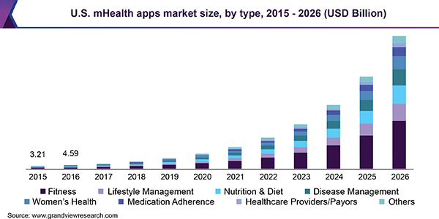
Opportunity
Mobile Health Apps Market

Slide 6
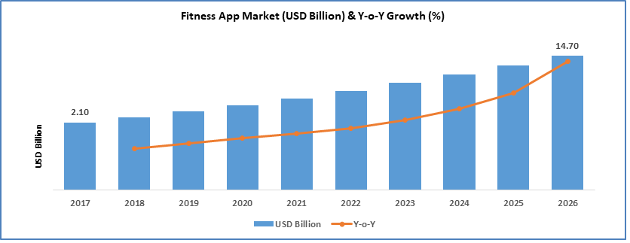
Fitness App Market Growth Projection

Slide 7
Opportunity
What’s the problem?
Mobile Health apps market size was valued USD 12.4 billion in 2018, projected to expand at a CAGR of 44.7% over the forecast period.
Estimated cost of diagnosed diabetes in 2017 is $327 B, including $237 B in direct medical costs. (https://care.diabetesjournals.org/content/early/2018/03/20/dci18-0007]
About 33 percent of American adults could have diabetes by 2050.
2018 Global healthcare sector revenue was $1.853 trillion, with an increase of 4.5% on a yearly basis.
Healthcare yearly expenditures, US spends $10,224 per person.
Americans will spend $3.65 trillion on health, which amounts to 17.8% of the country’s GDP]. https://policyadvice.net/insurance/insights/healthcare-statistics
Target Audience - Adults aged 45 to 74, plus new cases within 18 to 44
Total Addressable Market(TAM) for this opportunity - About $400 million

Slide 8
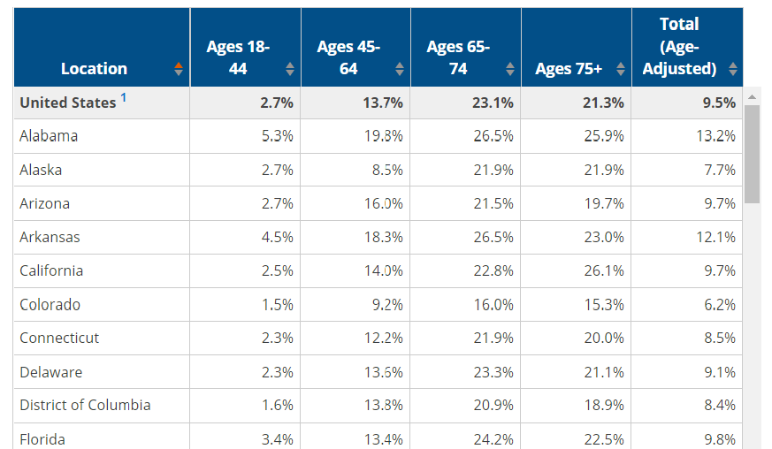
Target Audience Age Category

Slide 9
Proposal
What’s Our Solution?
A mobile application that monitors, tracks and recommends healthy habits
Healthy diet menu(Breakfast, Lunch, Dinner)
Calendar and Time Schedule
Recommend daily exercise activities
Track steps and strides daily
Blood sugar or Glucose level monitor
Alarm
API for integration

Slide 10
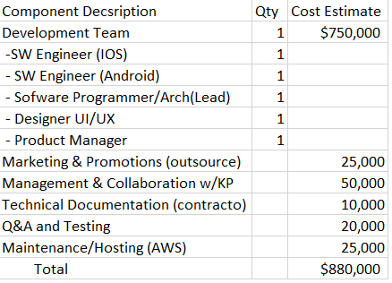
Cost of Development

Slide 11
Return On Investment(ROI)
What is the cost?
Total Estimated Cost- 880K
Subscription (monthly) - $3.99
Subscription (yearly) - $40.00
Target membership volume (12 months) - 50,000 Members
Return On Investment (ROI) - 130%

Slide 12
Measurement
How will we know if we’re successful?
Minimum Viable Product ready by the end of the first 6 months.
Business - 2000 Trial members, 1000 subscribers
Product - Member/Subscriber usage (through account activity - active user
Frequency of use or session length )
Quality - Efficiency(Ease of use), Ratings, Success stories, Feedback, App Store ratings
Development] - Pilot/Early release in 3 months ,Beta test completion in 6 months

Slide 13
Competitors
[“Healthy Living Partner”]
Notes:
[ALL PARTICIPATION]

Slide 14
Momentum - by Apple/Mathias Maehlum
Momentum Habit Tracker - App that boosts willpower and helps you reach goals
Features
Calendar
Data Export to CSV
Reminder
Interactive Notifications
Weekly Targets, Notes
No free reliable data on specific market penetration as of yet. General market projection only. Listed among top 10 apps for healthy habits with 4.6 stars

Slide 15
Habitbull - by Appholdings
Multi-platform companion to keep track of your habits and routines
Features
Repeated to do's or goals
Calendar
Streak counter and percentage successful for each habit
Inspiring quotes per category
Basic version is free, premium version is $3.99/month or $14.99/year
No free specific market penetration data yet. General market projection only. Listed among top 10 apps for healthy habits

Slide 16
Our Advantages
Why are we better?
Focus of feature package - Blood sugar monitoring, Nutrition and Exercise routine (key strength of the product).
Access to real health expert resources for tests and measures(data from KP and patients, collaboration)
Competitions focus more on “will-power” and “training your system on habits”

Slide 17
Roadmap and Vision
[“Healthy Living Partner”]
© 2019 Udacity. All rights reserved.
Notes:
[ALL PARTICIPATION]

Slide 18
Roadmap Pillars
Where do we go from here?
To create an app that assists people to live a healthy life through monitored practice, thereby preventing chronic disease.
Blood sugar-level monitor
Diet Assistant
Exercise Activity Mate
[“Healthy Living Partner”]

Slide 19
Theme 1
Blood sugar-level monitor
The meter - This feature measures the glucose level
Threshold sensor - This feature indicates acceptable boundaries and warnings
Log - Activity log with progress indicator
[“Healthy Living Partner”]

Slide 20
Theme 2
Diet Assistant
Diet menu - Menu for recommended healthy nutritional diet
Calories Indicator - Shows calories of every meal
Scheduler - Recommend meal and exercise activities for user
[“Healthy Living Partner”]

Slide 21
Theme 3
Activity Exercise Mate
Timer - Allow user to set time and measure duration of exercise activity
Exercise Activity Menu - Walking, Running, Pushup, Squats, etc.
Activity Classification - Classify exercise activities into categories based on effectiveness.
[“Healthy Living Partner”]

Slide 22
Where do we go from here?
Widening the scope
Increase subscription through collaboration with KP - 200,000 (2 yrs)
Expand product features to include API
Interface to other reporting test devices
Data collection and analysis
Establish sales channels with health insurance providers
[“Healthy Living Partner”]

Slide 23
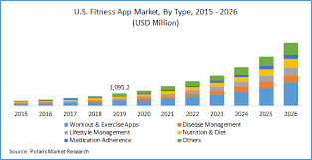
Fitness App Market Combined

