Slide 1
Healthy Living Partner
Screenshot & Prototype
https://www.figma.com/file/jWkYF0Wsq68aAYEP54olw6/Healthy-Living-Partner-(New)?node-id=0%3A1
https://www.figma.com/file/jWkYF0Wsq68aAYEP54olw6/Healthy-Living-Partner-(New)?node-id=0%3A1

Slide 2
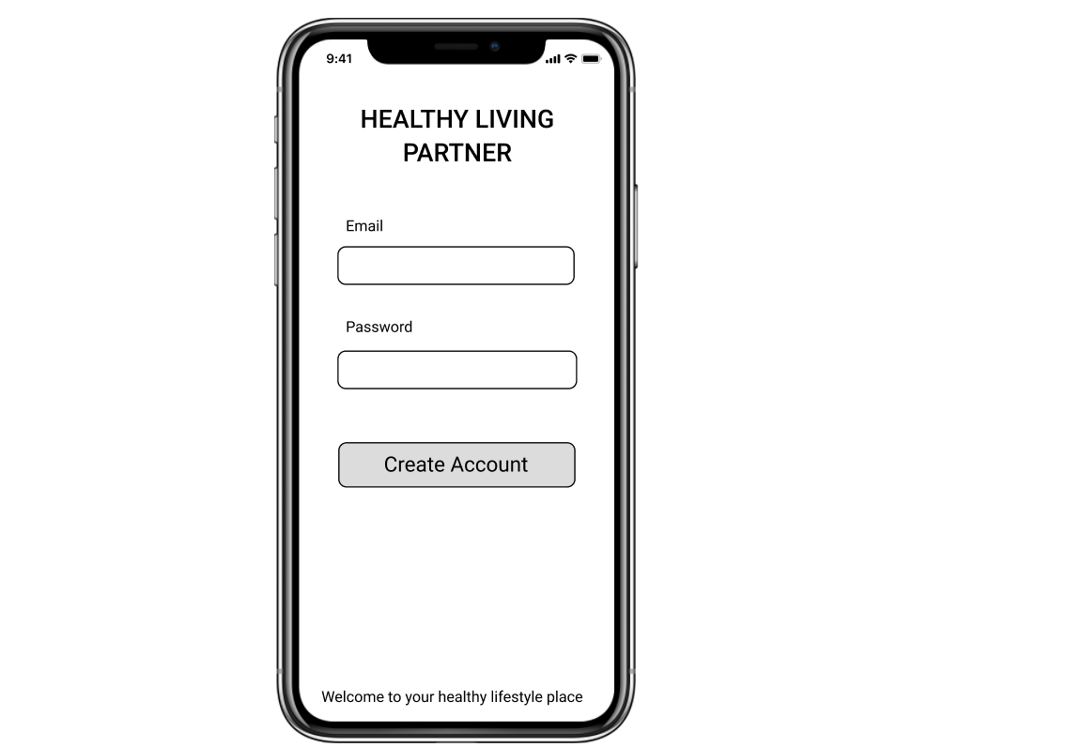
Login Page
As a healthy lifestyle app user, I want to have a secure login page with password authentication to ensure privacy so I can use he app without fear of data compromise

Slide 3
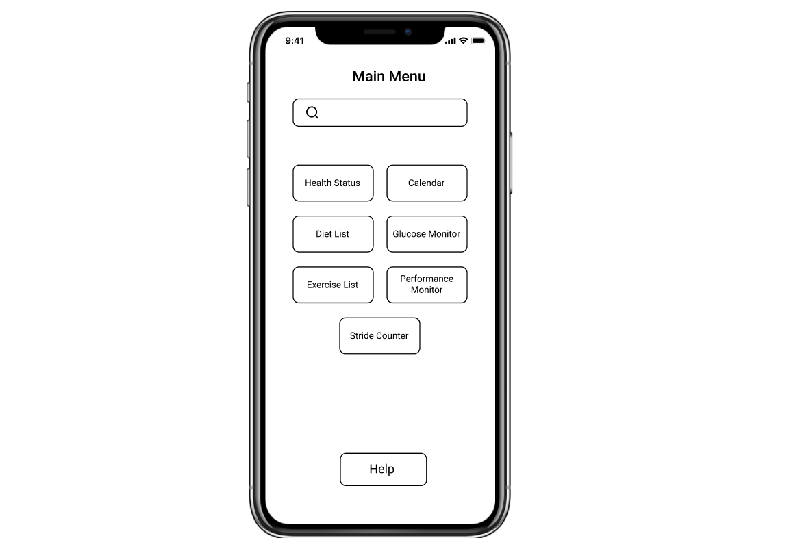
Main Menu Page
As a fitness and wellness enthusiast, I want to have access to the app main page with a list of feature options, for healthy lifestyle so that I can choose and follow the guidance to use it to improve my health condition.

Slide 4
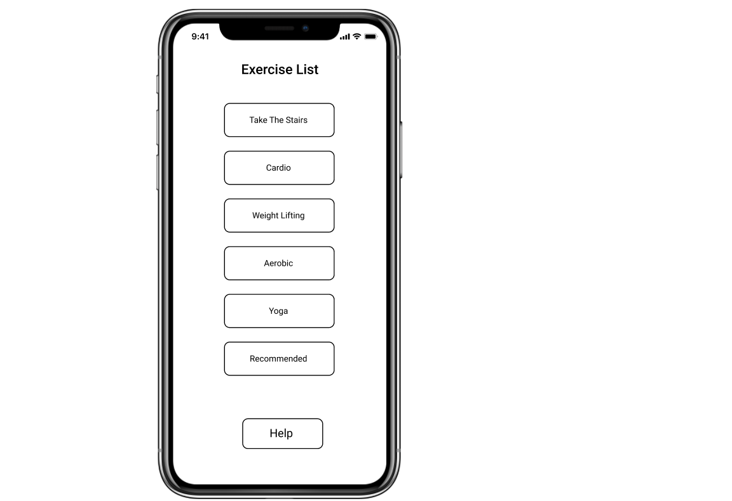
Exercise List Page
As a prediabetes patient and a fitness enthusiast, I want to create an app that will give access to Exercise List so I can have options, including recommended, to choose from for my daily exercise activities to incorporate a healthy habit and lifestyle.

Slide 5
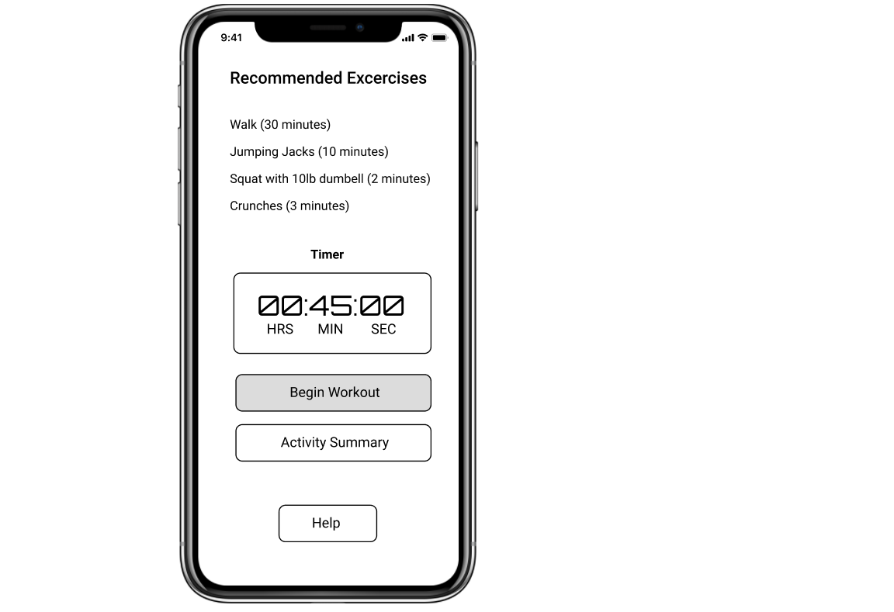

Slide 6
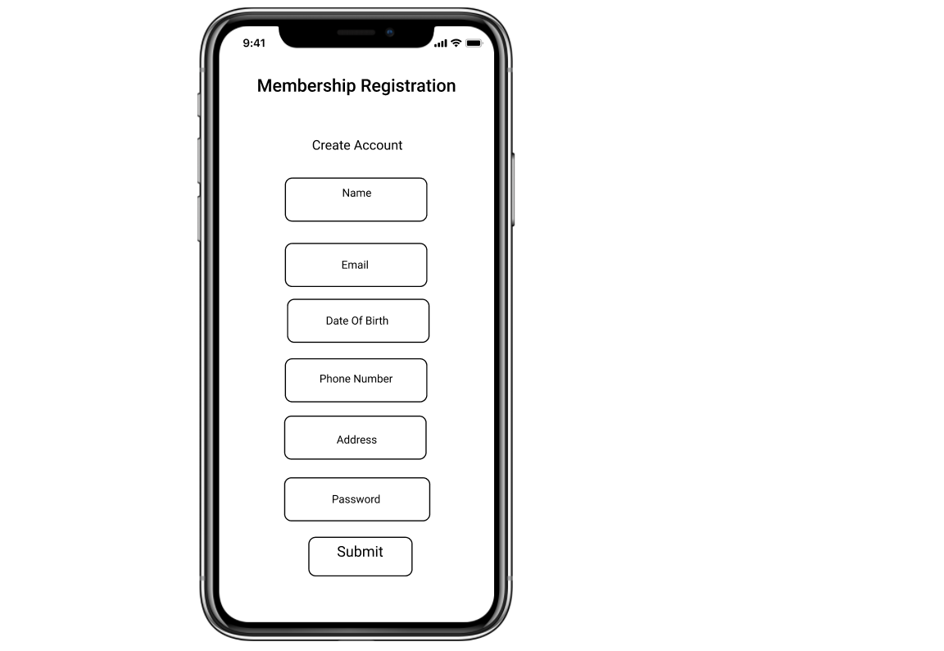

Slide 7
