Slide 1
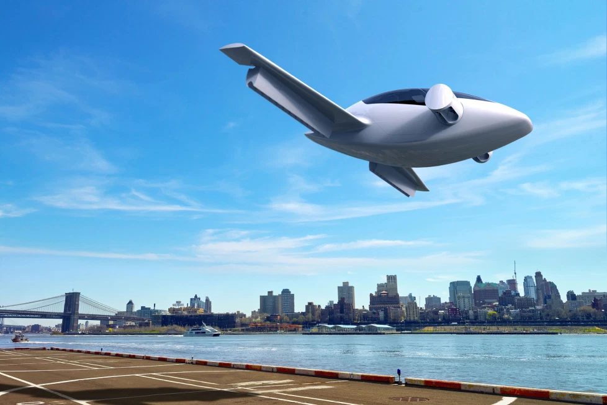
Flying Taxi
KPI and Hypothesis
Francis Odo

Slide 2
Identify a product objective for Flyber's launch. Your product objective will guide your KPIs, so identify what Flyber should optimize for. Your objective should be centered around one the following focus areas:
User Acquisition
User Engagement
User Retention
Profitability

Slide 3
Answer Slide
Objective 1-Create an ontime, safe, and online-managed affordable Flying Taxi service for short haul travel for private and business commuters.
(KR1) Development of Minimum Viable Product(MVP) for beta in less than 3
months
(KR2) Legal and compliance may may take longer time than anticipated
Objective 2-Provide an app that allow users to book, monitor and track flying taxi services in real time with backend user-event data management.
(KR1) Achieve decreasing bounce rate as user number increases
(KR2) Compliant with the industry average page load time requirement
Objective 3-Provide 2 Free flying taxi rides(one free ride per month) as promotional incentives for new registered users. Offer discount rates for returning users for every 10 rides.
(KR1) Increased user registration up to 2000 in 6 months
(KR2)Limited budget for marketing may affect promotional giveaways

Slide 4
Reasoning behind the objective focus area
Air Taxi is a completely new service in an industry that is facing a rebirth in the advent of technological innovations. It will require new regulations, guidelines and approval. Most importantly, a new user mindset for new model of short distance transportation. A great deal of effort will be required to convince and migrate users from Taxi Cab to short-haul Air Taxi.
For this reason, user acquisition is more relevant and strategic at this stage of the development.
Knowing that there is real value in the product, user engagement is secured and presumably guaranteed.
User Retention and Profitability will be next in the game plan.

Slide 5
Formulate 3-5 Key Performance Indicators (KPIs), to measure if the product is heading towards the right direction based on your objective

Slide 6
Key Performance Indicators
Key Performance Indicators (KPIs) - Flying Taxi
Complete the development of Minimum Viable Product(MVP) for the Flying Taxi and its booking and management app in about 3 months or less.
Conduct and complete Beta test in about 60 days or by the first 5 months with zero safety issues. All priority level 1 and 2 fully addressed and closed.
Achieve 2000 registered registered users 6 months after launch
Achieve decreased or downward-trending Bounce Rate within the first 6 months of deployment
Comply with the industry standard Average Page load Time of less than 2secs

Slide 7
Create hypotheses around what thresholds your KPIs would need to hit in order to determine success

Slide 8
Hypothesis - Created Around KPI Thresholds
If we have a Minimum Viable Product available in 3 months, then we will be a ble to begin formal test and QA, which will pave way for early adoption before final launch.
If able to conduct Beta in 60 days or within the first 5 months window with all technical and safety issues resolved, we can get ahead with legal and compliance, saving time and on schedule because this is usually a major hurdle area.
If able to achieve 2000 active registered users in about 6 months time frame, then there will be a realistic projection of the target on Total Addressable Market, which will open more opportunities for funding.
If we are able to achieve the industry standard Average Page Loading time of less than 2 secs, then users are more likely to return to the page and spend more time using the resources offered because users tend to avoid a slow loading page or app in general.

Slide 9
As the product manager, you make decisions based on the insights you extract, we’ll need to know the feature set we’ll include in the MVP to measure viability, while keeping operational expenditure under control:
What times/days of operation should the service run for?
How many pick-up / drop-off nodes should we have?
Where should the nodes be located?
Should we initially use copters or homegrown hardware?
Should the pricing be fixed or dynamic? At what rates?

Slide 10
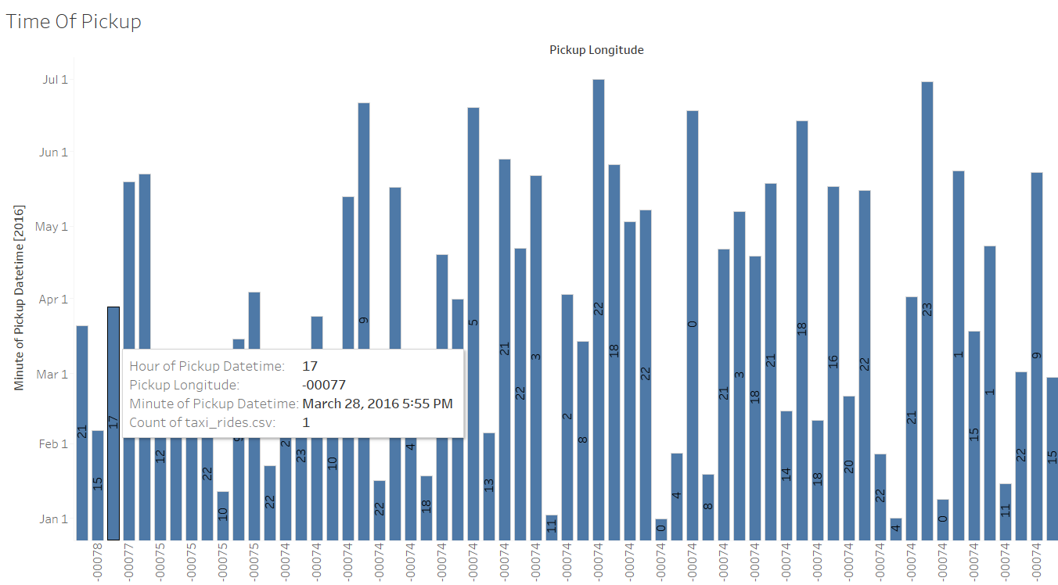

Slide 11
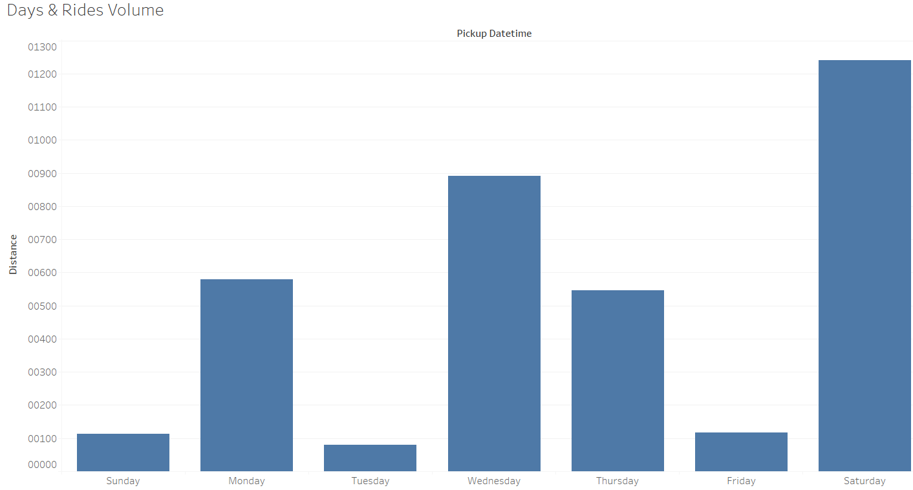

Slide 12
Answer Slide
What times/days of operation should the service run for?
Research data revealed higher pickups from 5 - 10.00 PM, service should be available throughout the day. Could change as we collect more data. (see slide 49)
Research data shows higher rides volume on Monday, Weds. Thursday and Saturday. However, service should be made available Monday through Saturday (see slide 50)
How many pick-up / drop-off nodes should we have?
Initial deployment should start with 4 Pick-up / Drop Off nodes (to be expanded based on growth). Two ground stations and Two rooftop stations.
Where should the nodes be located?
2 Locations at the lower-side Business District
1 location near or close to JFK (need more data on the exact location)
Should we initially use copters or homegrown hardware?
Initialy, establish market presence with copters, later move to more environmentally compliant craft
Should the pricing be fixed or dynamic? At what rates?
Fixed for the initial deployment at about $75(Competitive pricing strategy). Change in pricing model may be adopted later as the market matures.

Slide 13
Determine the MVP sample size & time period allotted estimated to come to a conclusion on your hypotheses.

Slide 14
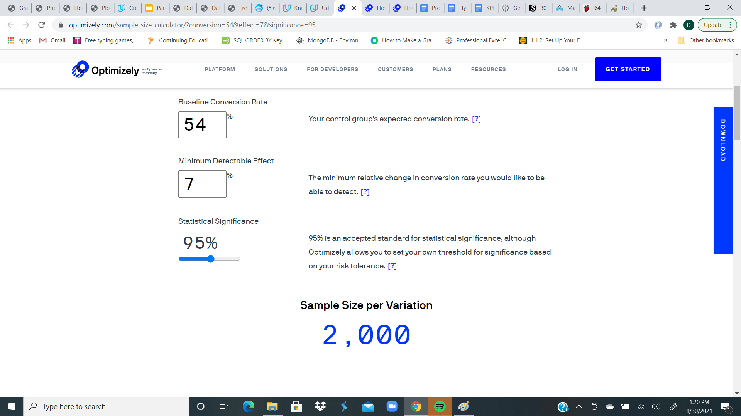
Optimizely

Slide 15
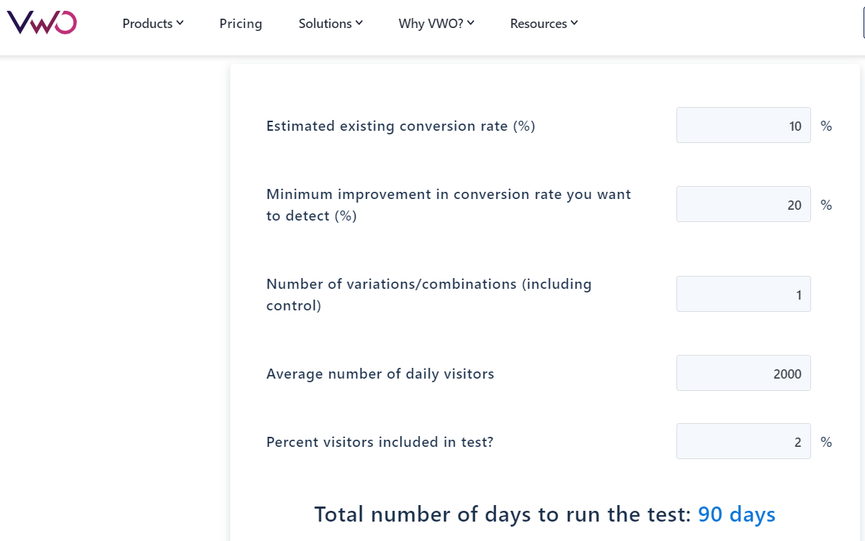

Slide 16
Answer Slide
MVP sample size - 2000 users
Time allotment - 6 months after launch
Assumptions - All conditions for KPIs are on target

Slide 17
Create an instrumentation plan for the events you need collected and logged, in order to be able to physically measure your KPIs.

Slide 18
Answer Slide
Event - userAccountCreated
Definition - This event triggers whenever a new user provides all the necessary information for
registration and click “Register” button in theFlying Taxi user registration page.
Properties - user_id, use_name, user_email, resgistration_timestamp, user_profile, user_count
Event - rideOrderCompleted
Definition - Triggers when a user viewed the Flying Taxi schedule page, select ride and destination, then cliked
“Complete Ride Order” completed a ride booking order.
Properties - order_id, passenger_count, rider_id, booking_timestamp
Event - paymentProcessedSuccessfully
Definition - This event is triggered when a user complete a Flying Taxi booking order and clicked “Process
Payment” button.
Properties - user_id, user_fullname, user_address, user_credit_card_number, security_code, expiration_date
Event - riderPickedUp
Definition - This event is triggered when the user is picked up and clicked “Onboard Flight Confirmation” button
Properties - rider_id, taxi_ride_id, passnger_count,pickup_timestamp, pickup_longitude, pickup_latitude

Slide 19
Create a qualitative feedback survey questions for users after their ride, to further understand and optimize the product for future iterations.

Slide 20
Answer Slide
User feedback questions
Is this our first experience using a Flying Taxi?
On a scale of 1 to 5, how would you rate your experience?
How likely are you to recommend Flying Taxi to a friend?
What will you like to see improved?
What did you find mostly impressive about the experience?
Will you continue to use a flying Taxi?
How easy was it to book a ride on a scale of 1 to 5?
Were you able to track and monitor the ride easily or conveniently?
How convenient is the pickup and dropoff location using a scale of 1 to 5?
Do you consider the ride safe?

Slide 21
Summarize everything you have learned into your final proposal
Identify the target population. Why did you select that target population? What are their pain points?
Create a product proposal containing claim, evidence, estimated impact, and risks
Claims should be backed by quantitative evidence, impact should assess market needs/benefits
Risks involve any known unknowns that we’ll still need to monitor post-launch
State cross-functional stakeholder teams that will need to be involved

Slide 22
Proposal - Flying Taxi
Flyber is a Flying Taxi service for short-haul travel in and out of densely populated metropolitan city. Service is planned to be offered using newly designed portable aircraft capable of vertical lift, and powered with a more quiet and environmentally suitable electronic engines.
Flying Taxi provides a relief to various pains caused by traffic congestion. The pain associated with these problems comes in different forms. Notably, financial, loss of time and productivity.
The Benefits
Flying Taxi is fast, reduces travel time significantly. For example a 1.5 hr commute could easily be done in 15 or 20 minutes.
Reduces road congestion in the sense that fewer vehicle will travel the road
Savings on road infrastructure maintenance and operating cost
Environmental pollution reduction with fewer combustion engine on the road
Flying Taxi users will have more relaxed time thereby improving quality of life
Flying Taxi can travel in a non-fixed route, flexible route

Slide 23
Answer Slide
The target population for the Flying Taxi is about 2,000 for the initial experiment. Overall target sample is about 50,000. The sample is spread across New York, New Jersey, Rhode Island and Pennsylvania metropolis. I chose this sample because the demographics travel to and from the financial district frequently. The sample is ideal for proof of concept.
Among the pain points are:
Road transportation in and out of major metropolitan or urban cities face heavy traffic congestion regularly, which leads to frequent delays and loss of time. The time loss also affect productivity.
The cost of road transportation infrastructure (construction, operation and maintenance), including terminals and bridges are increasingly high and takes much longer time to achieve. Very often, there are more call for increase in infrastructure spending.
Transit system is another costly project for federal, state and local governments. So many red tapes, including regulatory are involved.
The average citizen is significantly affected privately, publicly and with diminishing productivity.

Slide 24
Research supporting material
Determining the exact cost of road infrastructure depends on several factors, which is quite complicated.
Supporting material for transportation cost analysis is available at:: Link
Road Infrastructure Cost Analysis
Negative Effects Of Traffic Congestion
The cost to develop and maintain mobile Air Taxi infrastructure is significantly less compared to road infrastructure. This is beneficial for the the government and the society in general.

Slide 25
Risks
Risks involved, known unknowns that we’ll still need to monitor post-launch
Extended time to work through compliance related issues (Local/State/Federal)
Securing rights for more Pickup and Dropoff locations in potential high volume areas
Impact of bad weather conditions on scheduling and overall business model
Purchase or Lease agreement for more suitable and environmentally compliant crafts
Keeping operating cost under budget
Unexpected decreasing customer retention

Slide 26
Cross-functional Stakeholders
Cross-functional stakeholder teams that will need to be involved
Development team/Scrum Team
IOS Engineer
Android Engineer
Software Engineer (Lead)
Software Engineer
Product Manager
QA and Test Engineer
Legal and Compliance
Product Marketing Manager
Customer Service

