Slide 1
Healthy Living Partner
Developing the product
Francis Odo

Slide 2
Team for the project
All Teams
Customer Service
Data Analytics
Engineering (includes QA)
Legal and Compliance
Finance & Accounting
Operations
Marketing (includes Product Marketing)
Product Management
Product Design
Scrum/Development Team
One Engineering Lead
One Shared DevOps
Four Engineers
One Shared QA
Scrum master (rotational in nature)
Product Designer
Shared Data Analyst

Slide 3
Create Project Blueprint
A product launch is not just about deploying a beautifully designed,built and thoroughly tested feature. Your company needs to be equally prepared if not more to support every possible customer interaction associated with the product (e.g landing on your company website to learn more about the new feature)
© 2019 Udacity. All rights reserved.
Notes:
[ALL PARTICIPATION]

Slide 4
Coordinated Activities Map
https://docs.google.com/spreadsheets/d/1mWKMVkSJ9inoi7avbxWvFKk2QoZs-GB0OA82cMwsnag/edit#gid=158883148

Slide 5
Plan for Sprint Meeting
As a PM, it is important to stay ahead of your scrum team and be prepared for every upcoming sprint by having a target goal defined with prioritized backlog for team to start costing and breaking down the tasks
© 2019 Udacity. All rights reserved.
Notes:
[ALL PARTICIPATION]

Slide 6
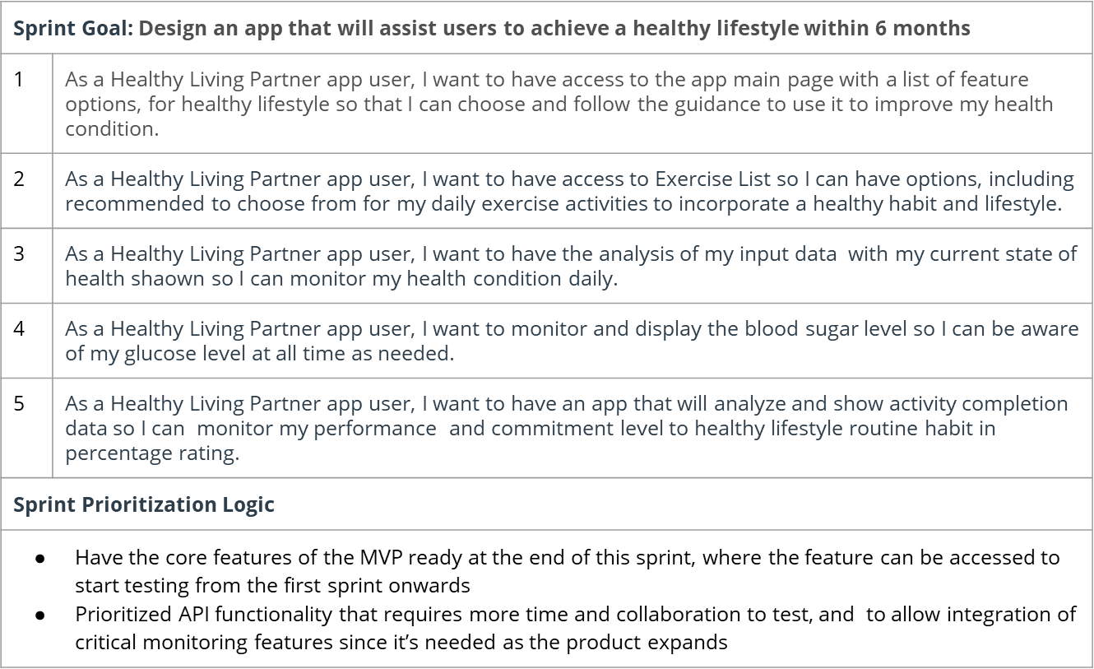
Sprint Planning Meeting Preparation

Slide 7
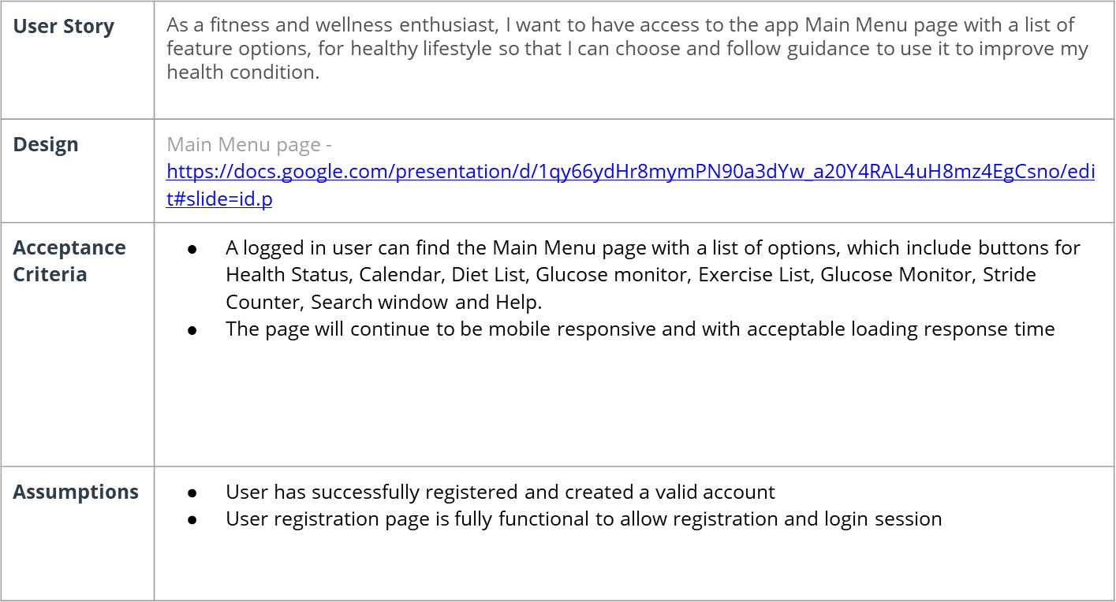
User Story 1

Slide 8
User Story 2
User Story | As a Healthy Living Partner app user, I want to have access to Exercise List so I can have options, including recommended, to choose from for my daily exercise activities to incorporate a healthy habit and lifestyle.
Design | Exercise List page https://docs.google.com/presentation/d/1qy66ydHr8mymPN90a3dYw_a20Y4RAL4uH8mz4EgCsno/edit#slide=id.gb11752cb67_0_7 https://www.figma.com/proto/jWkYF0Wsq68aAYEP54olw6/Healthy-Living-Partner-(New)?node-id=7%3A0&viewport=502%2C233%2C0.2484641671180725&scaling=scale-down
Acceptance Criteria | A logged in user with access to the Main Menu page can click on Exercise List option button and arrive at the Exercise List page, with a list of exercise activities, which include Take The Stairs, Cardio, Weight Lifting, Aerobic, Yoga, Recommended and Help. The page will continue to be mobile responsive with acceptable and compliant loading time. Access to the page should fail with “payment due” warning message if payment is due. Access to the page should fail proper login information is not provided. Page should fail with warning of ”insufficient data” if user has less than 5 days worth of consistent data Design should be ADA compliant
Assumptions | User successfully gained access to the Main Menu page User wants and selected Exercise List option from the Main Menu

Slide 9
Decoding API Documentation
PM will need to collaborate with the engineering team and provide guidance that heavily influences their development approach. When a product requires an API integration, sometimes PM need to be “technical enough” to understand the following to refine the solution with designer and development team
what information is available via the API
how is it available
possible pricing impact
Notes:
[ALL PARTICIPATION]

Slide 10
Healthy Living Partner
Based on the API documentation how would you update your solution and design? | User secure access and the type of user data to collect, including the format The Health Status Check input data required for analysis of the health status
Based on your high-level understanding of the API documentation, are there any details that you want to discuss with engineering to refine solution and/or determine feasibility | In our design and implementation of the user access and registration, will that be HIPAA compliant? Will there be PIN validation? Could we save time and money by licensing a Glucose Monitor as compared to inhouse development?

Slide 11
Re-prioritize Sprint Backlog
As a PM, unexpected issues and new feature requests will require you to triage them efficiently and re-prioritize the sprint backlog without impacting the roadmap deliverables significantly
© 2019 Udacity. All rights reserved.
Notes:
[ALL PARTICIPATION]

Slide 12
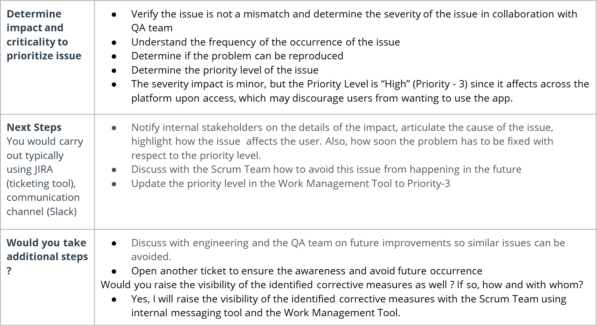
Issue 1: Landing Page loading too slow

Slide 13
Issue 2: Misaligned fields in Profile Settings
Determine impact and criticality to prioritize issue | Determine the severity level and the impact of the issue on the business value of the product Discuss the issue with the Scrum Team and arrive at how the problem can be resolved, and prevented from happening in the future Inform and discuss the details of the issue with stakeholders. Communicate solution and time to fix, as well as the rationale for the priority assigned Priority - 3. The system is fully functional to larger extent and the overall impact is minimum
Next Steps use ticketing tool (JIRA), and communication channel (Slack) | Update the priority level in Work Management Tool to Priority-3 Provide feedback to the Scrum Team on resolution using internal communication If necessary, open a new ticket to guide against future occurrence of the same issue

Slide 14
Respond to Customer Service Manager’s Email
Determine impact and criticality to prioritize the issue (1 - Critical; 2 - High; 3 - Normal; 4 - Low) | Work with QA and Test to verify the problem truly exist Determine that the problem is reproducible Determine the severity and impact level The issue is critical and Priority = 1 due to the fact that some users (20%) are unable to gain access to the system
Next Steps You would carry out typically using JIRA (ticketing tool), communication channel (Slack) | Discuss the issue with the Scrum Team to understand the problem and the root-cause. Get clarity on the solution and timeline to fix the problem Communicate the problem and the severity of its impact on the business to internal-stakeholders, as well as impacted product managers. Update priory level in the Work Management Tool
Sample Email Response | Dear CS Manager, I want to acknowledge and express my appreciation for your efforts in calling attention to this problem. QA and Test were able to verify, confirm and reproduce the issue. Further, we were able to ascertain that it affects all users attempting password reset using the link. We have identified the root-cause of the problem. The Scrum Team is currently working on the solution with ticket # 3445, Priority = 1. Expected timeline for a Hotfix is 48 hrs from now (December 27th). I have included in the notification list as well. Let me know if you need further clarification. Sincerely,

Slide 15
Handle Potentially Difficult Situations
As a PM, you will be faced with many unexpected situations where you have to make a decision or push back while managing competing priorities from stakeholders and tackling issues that could potentially affect your product launch
Notes:
[ALL PARTICIPATION]

Slide 16
Respond to CEO or GM’s request via email
Assessment and result | Open a ticket in the Work management Tool for this request Meet and discuss the details of the request with the Scrum Team Assess the current stage of the the development to determine what is possible to demo and how to craft it to meet the need of the specific potential customer Set clear goal and expectations for the demo request and arrange internal staging ahead of the requested demo.
Sample Email Response | Subject: Product Demo The progress of the Most Viable Product (MVP) is at about 65% ready with Exercise Mate, Diet Assistant and Glucose Monitor key features. However, the API library, which is essential to integration with other test products is just getting started and does not have enough to show. Would you consider using the the prototype video instead? Another approach will be to investigate the potential customer’s interest and priority so that we can tailor the Demo to their needs. Let me know your thoughts, Sincerely, Francis Odo

Slide 17
Step-in and guide the scrum team at stand up
Video Response | Questions for the Back-end- Engineer at Stand UP https://youfiles.herokuapp.com/videodictionary/?m=Video_Player_Drive&state=%7B%22ids%22:%5B%221ZxGHaVzK5ZLD8H9PcYrQ_cpfun_evbPe%22%5D,%22action%22:%22open%22,%22userId%22:%22116402669443964013933%22,%22resourceKeys%22:%7B%7D%7D

Slide 18
Handling Resource Constraints
List 2- 3 activities that you would carry out as a PM to unblock the scrum team immediately ? | Meet and discuss the QA resource constraint with Head of Engineering(QA) Notify the Scrum Team of the QA resource constraint and the impact on the Design Sprint Negotiate with Engineering for coverage for the particular activities to manage
Since the QA team member is shared across multiple projects, how would you coordinate with other PMs to de-risk your project and raise appropriate visibility ? | Meet and discuss the resource constraint with the affected Product Managers Understand how each PM is affected and assess the risk to each affected project. Negotiate time with PM that may have flexible timeline Negotiate time with Engineering(QA).
Since there is a potential risk, it is important to raise visibility amongst appropriate stakeholders | Scrum/Development Team Engineering(QA) Manager Affected Product Managers
 | The most important thing in this communication with internal stakeholders and PM is transparency in order to achieve maximum cooperation. If we manage to keep everyone in the team on the same page there will not be a need to change or reposition strategy.

Slide 19
How would you handle stakeholder feedback?
Feedback Assessment | Apart from the lack of push notification, are there any other reasons or concerns why you think the product is not good enough? Why do you think the push notification for reminder is a “must have” now versus “future “ implementation? What if we use a calendar based reminder or notification for now and offer the push notification technology in future?
Video Response | Video link - Response to the feedback on the sign-off meeting https://youfiles.herokuapp.com/videodictionary/?m=Video_Player_Drive&state=%7B%22ids%22:%5B%221p8IxG5H8b9COevOqxPTexBMHEkTqXfN4%22%5D,%22action%22:%22open%22,%22userId%22:%22116402669443964013933%22,%22resourceKeys%22:%7B%7D%7D

