Slide 1

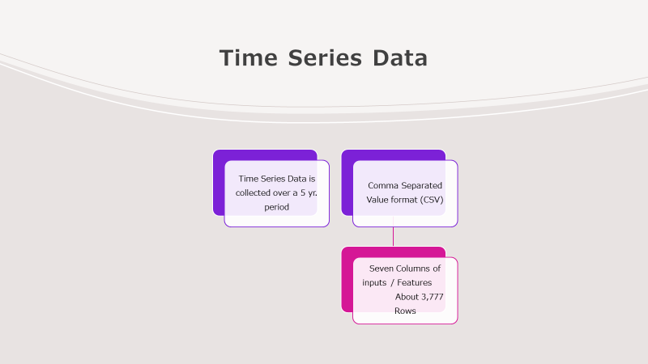


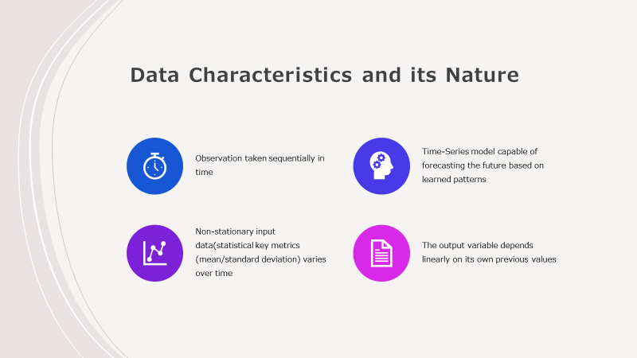
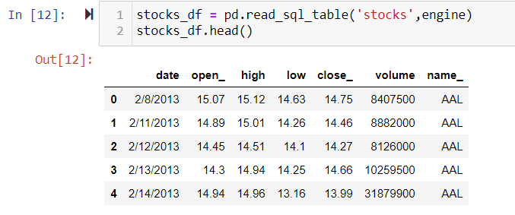
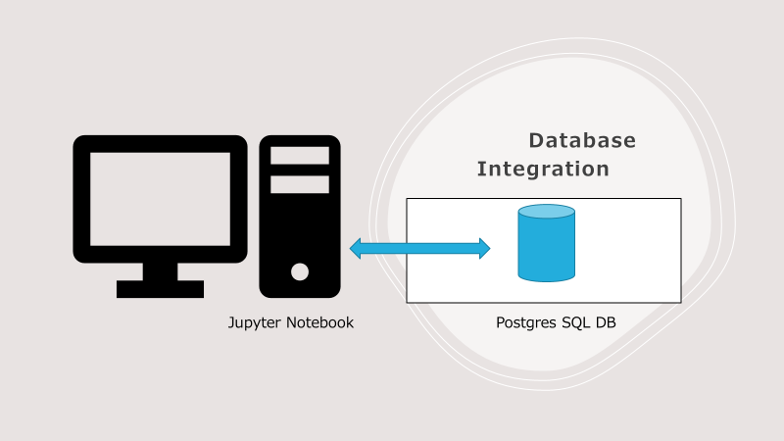
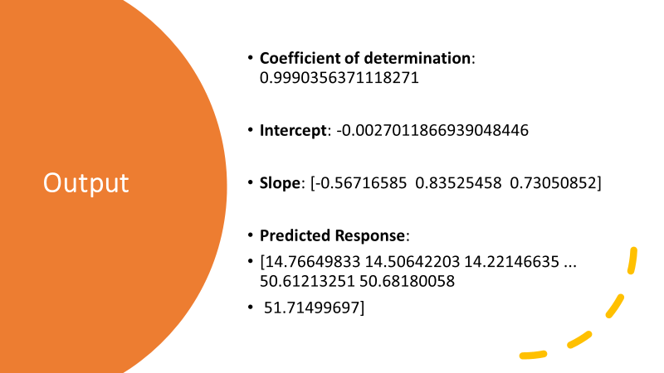
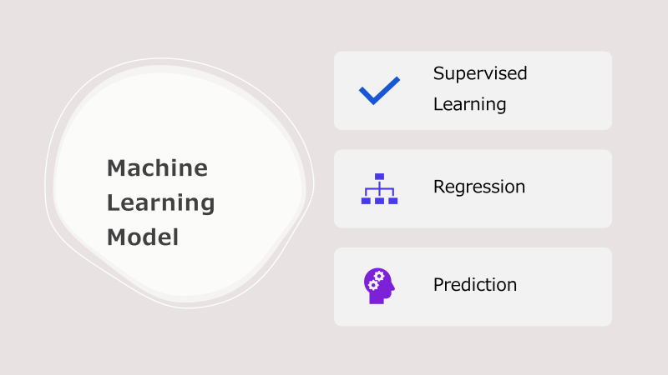

Slide 10
Output
Coefficient of determination: 0.9990356371118271
Intercept: -0.0027011866939048446
Slope: [-0.56716585 0.83525458 0.73050852]
Predicted Response:
[14.76649833 14.50642203 14.22146635 ... 50.61213251 50.68180058
51.71499697]

Slide 11

Model and Functions
Linear Regression - Continuous dependent variable
Preprocess the data
Create a model - model = LinearRegression()
Fit it - model.fit(x, y)
r_sq - model.score(x, y)
Predict Response – y_pred = model.predict(X)

Slide 12
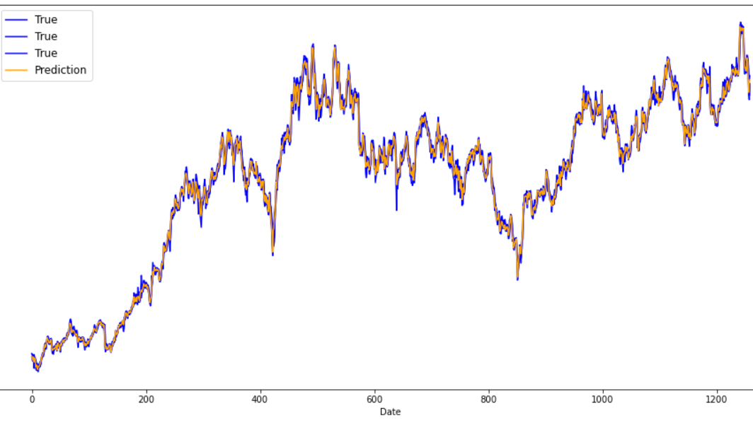
Input/Output Plot

