Slide 1
Out of the shadows

Slide 2
Summary
Abstract
Dark power
  The theory
  The refus
Backreaction
  The theory
  The debate

Slide 3
Abstract
Audoy François : Out of the shadows
The universe is always in expansion because of dark energy and it fill of dark matter, who curve the galaxies keep it in. But this energy and matter are full of mystery, because they are entirely invisible,that’s why this theory is not accepted by all scientist. There is another theory, the “backreaction”. This second theory can proved several assumptions about galaxies, it is already prove that exist but not the effects that had on the universe. To prove that scientist try to simulate the evolution of the universe, but it need to much computational resource. The “war”, to prove that dark matter is a lie, is going on and it will take long before the proofs.
Dow J., Out of the shadows, New scientist, 18 June 2016.

Slide 4
Dark power : The theory
Dark matter & Dark energie
>2/3 of the universe
Grow the universe

Slide 5
Dark power : The refus
Not completly proved

Slide 6
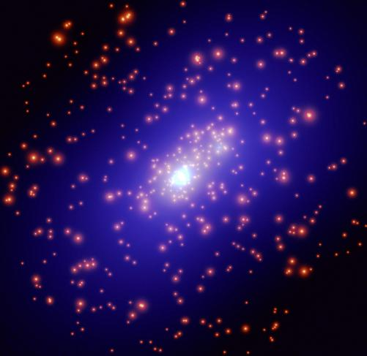
Black power
Blue : black matter
Yellow : galaxies

Slide 7
Backreaction : the theory

