Slide 1

MATLAB Code for Solving Three-dimensional Truss
Lecturer: Mehdi Ghasri

Slide 2
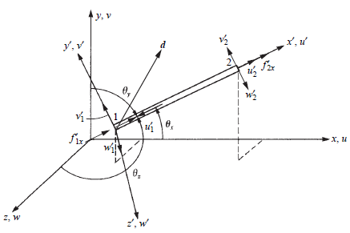

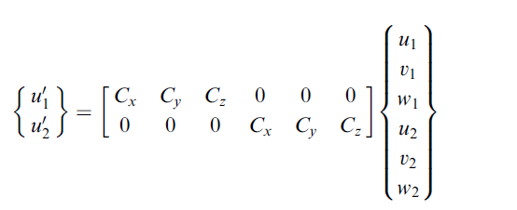


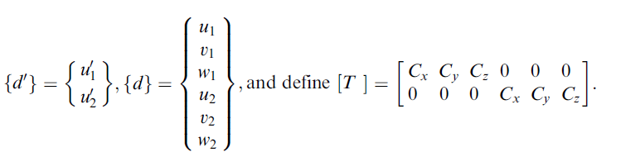
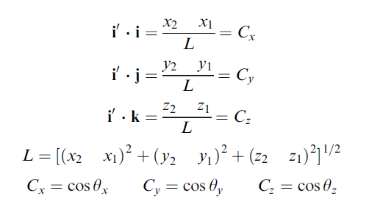


Slide 3

$$K=T^{T}\hat{K}T$$

Slide 4
The easiest way to convert 2D truss code to the 3D truss is to add a Z axis to the defined coordinate axes and increase the degrees of freedom by one degree.

Slide 5
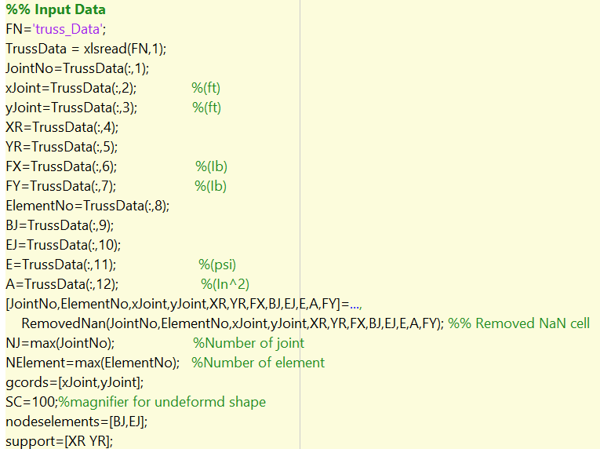
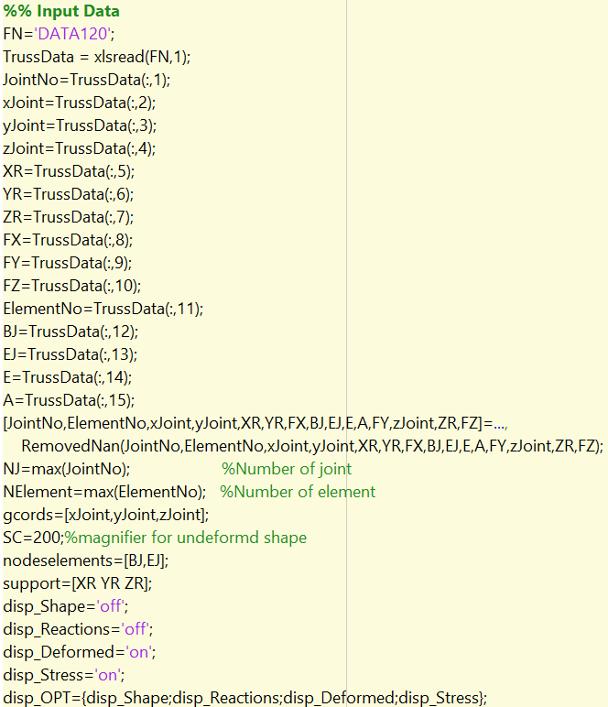
2D Truss
3D Truss

Slide 6
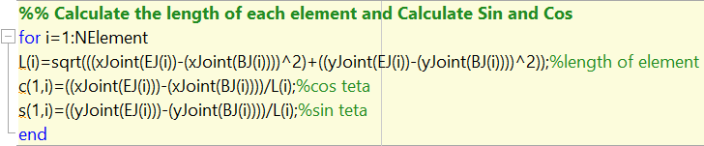
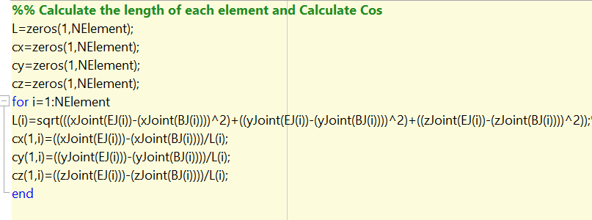
2D Truss
3D Truss

Slide 7
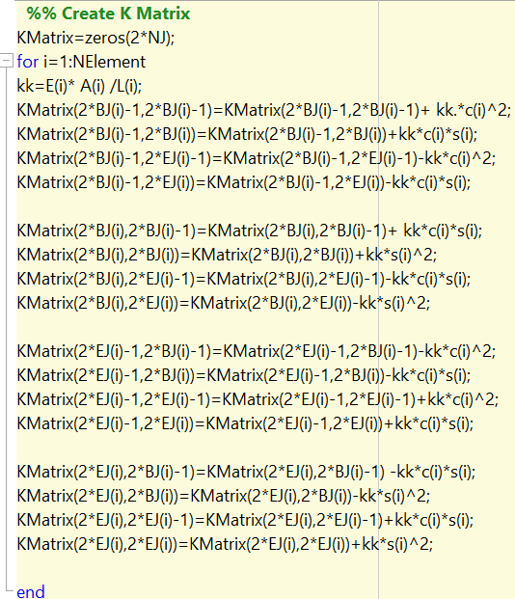
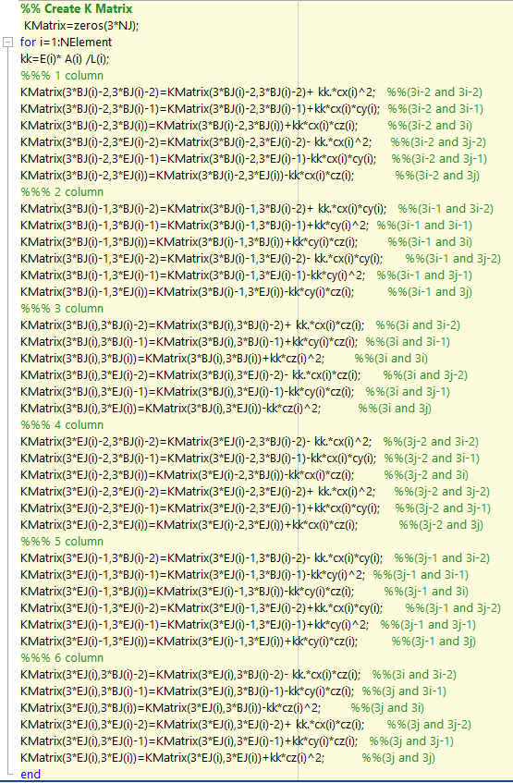
2D Truss
3D Truss

Slide 8
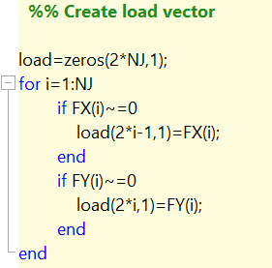
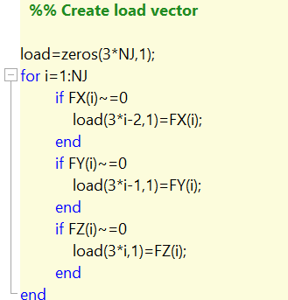
2D Truss
3D Truss

Slide 9
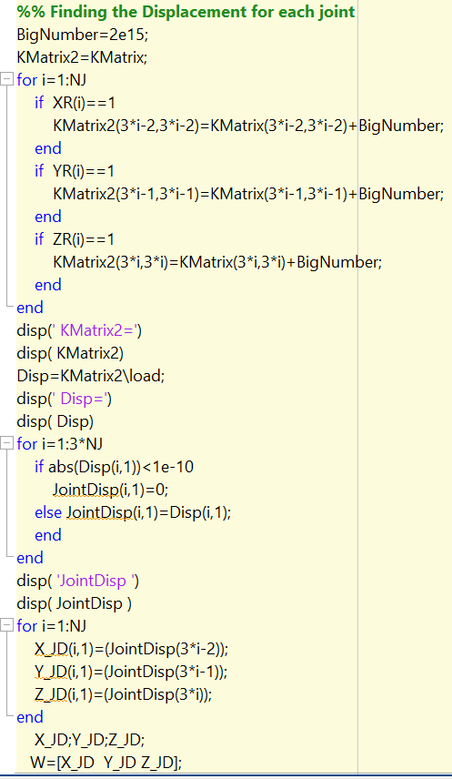
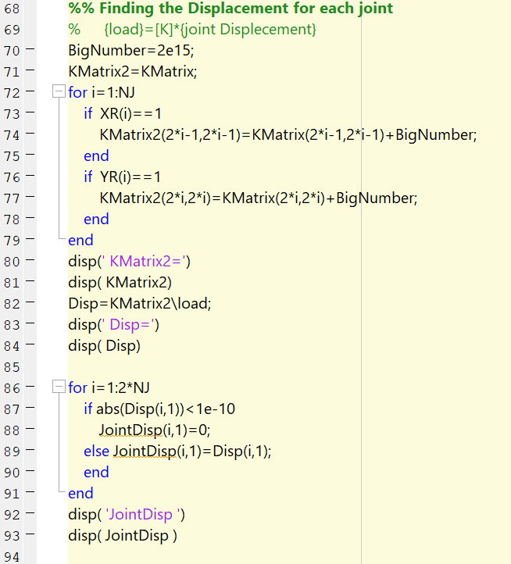
2D Truss
3D Truss

Slide 10
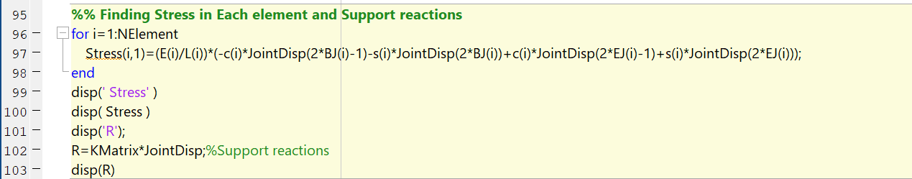
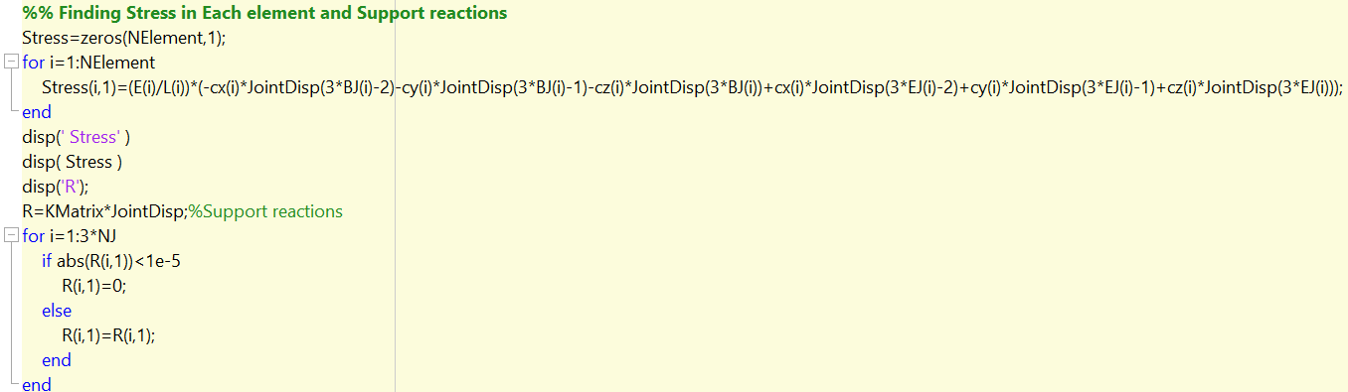
2D Truss
3D Truss

Slide 11
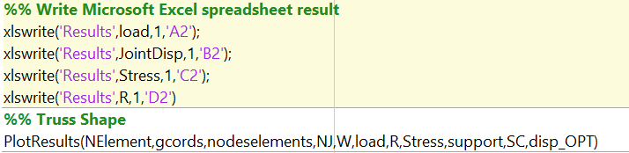

Slide 12
The End

