Slide 1

Datasets
Sebastian
@s_urchs (slack: @surchs)

Slide 2






Before we start:
cyberduck.io
https://docs.aws.amazon.com/cli/latest/userguide/cli-chap-install.html

Slide 3
If you ask yourself...
how
do I choose a good dataset?
do I find open datasets?
do I get the data?
do I work with the data?
then this is for you!

Slide 4
How do I choose a good dataset?
Ask yourself:
How easy can I get access?
How “raw” is it?
How useful is it?
Copied liberally from Chris Gorgolewski’s slides (@chrisgorgo)

Slide 5
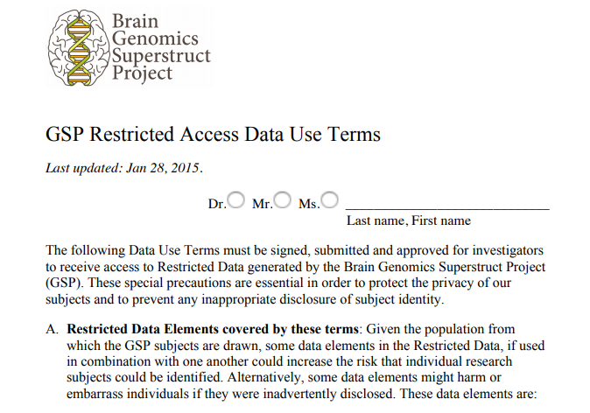
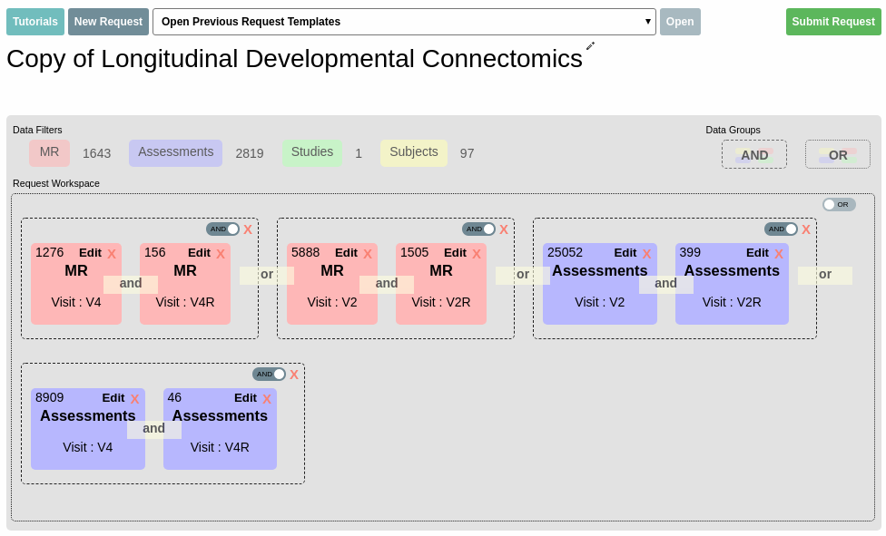
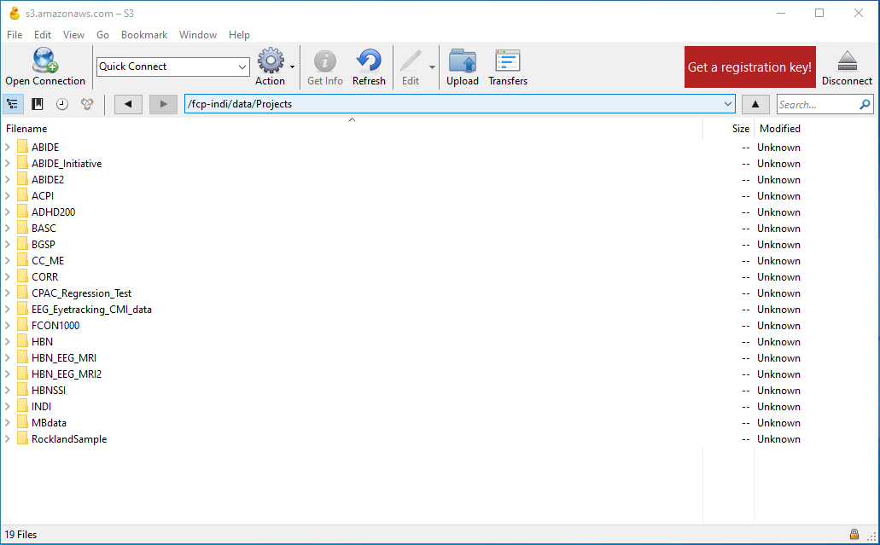

Ease of access
Signed Data Usage Agreement
Access through managed database
“Just get it”
Direct download
“It’s right there”
Hard
Easy

Slide 6

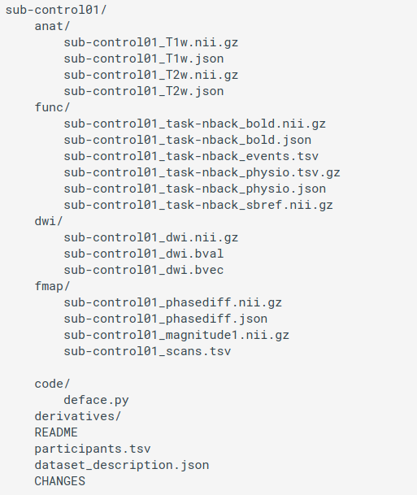
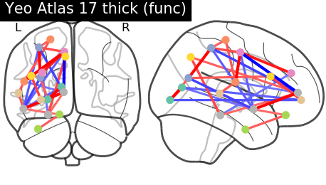
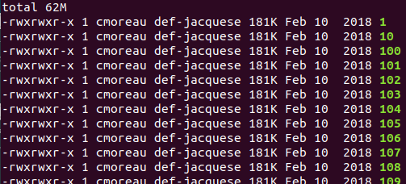
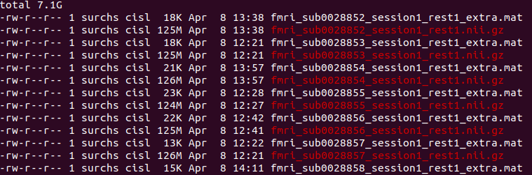
How raw is the data set
More control
Less work
Organized
Preprocessed
Derivatives
DICOM
Idiosyncratic organization
Must be converted
Ideally standard organization (BIDS)
Text-based metadata
Must be preprocessed
Minimally or fully preprocessed
Standardized organization
Data Quality metrics
Must be analyzed
Statistical maps
Summary metrics

Slide 7
How useful is the data set
Data Quality
Is there a publication describing the data
Did other studies re-use the data
Ask around
Meta Data Quality
Are the data well described (inclusion, acquisition, processing)
Are the metrics available that you are interested in?
How much missing data are there?
Data Cost
How large is the data set (storage space, download)
Are the data preprocessed?
Could you preprocess them (time, resources, knowledge) ?

Slide 8


How do I find open datasets
https://openneuro.org/
http://fcon_1000.projects.nitrc.org/

Slide 9
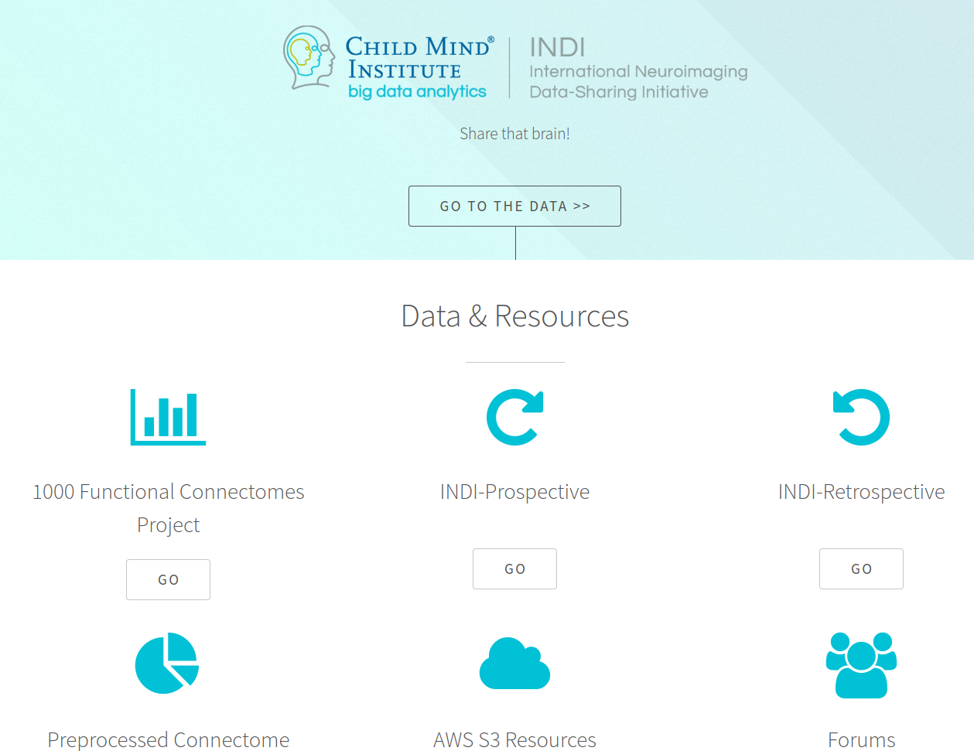
FCP-INDI
http://fcon_1000.projects.nitrc.org/

Slide 10
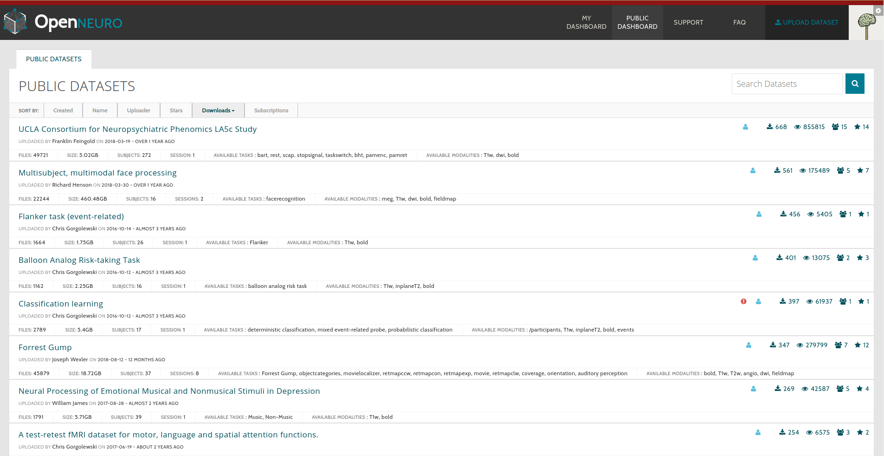
Open-Neuro
https://openneuro.org/

Slide 11
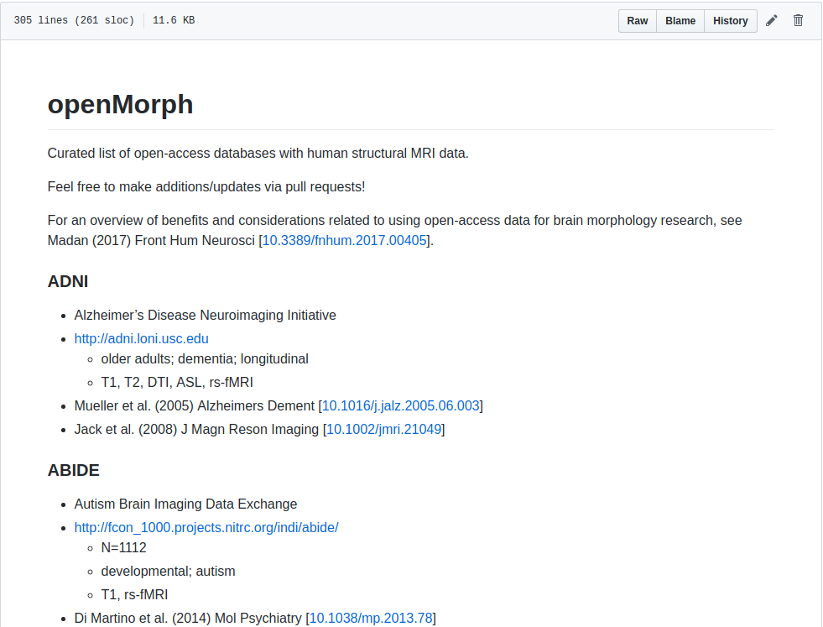
openMorph
https://github.com/cMadan/openMorph

Slide 12
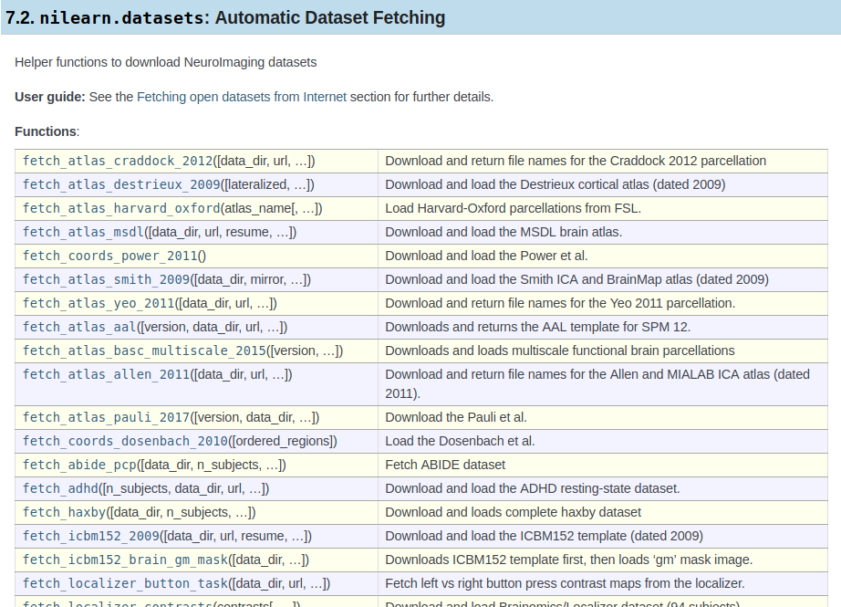
nilearn

Slide 13


How do I get the data
Directly from the Amazon S3 bucket
Through the nilearn data grabber

Slide 14
Amazon S3 example
Pick a dataset
Login to the bucket
Download the data

Slide 15
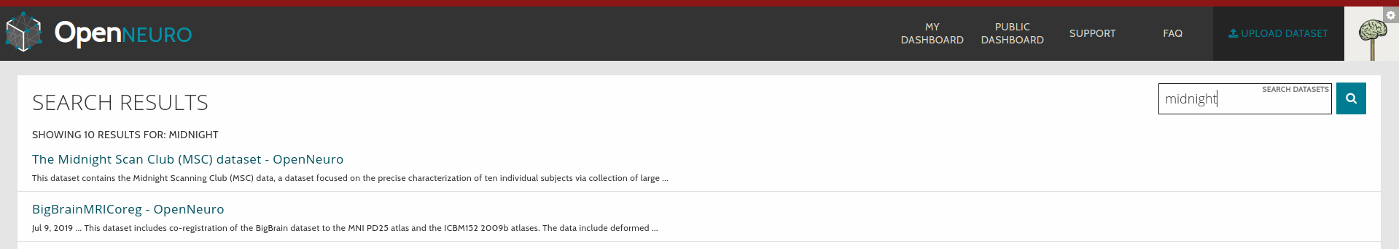
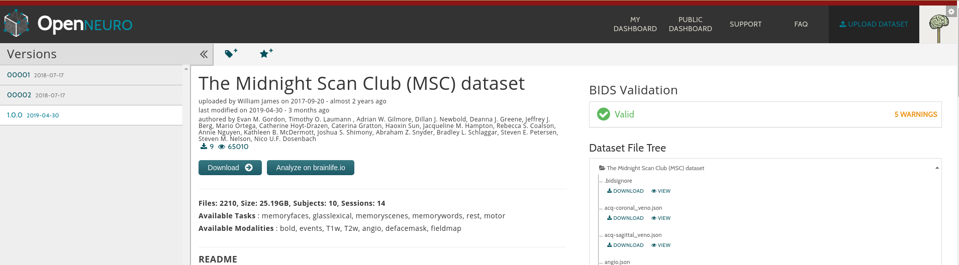
Amazon S3 - pick a dataset
Go to openneuro.org, search for ‘midnight’
Click ‘download’

Slide 16
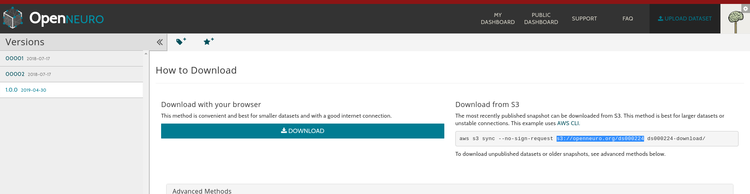
Amazon S3 - pick a dataset
Copy the AWS S3 path

Slide 17
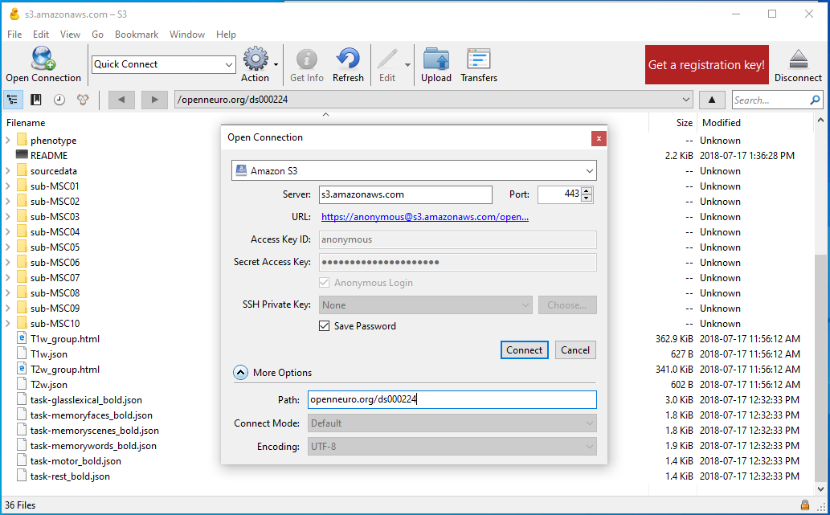
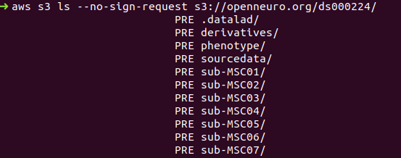
Amazon S3 - get the data
Enter the info from openneuro in the “Path” field.
Copy the line from openneuro
Replace “sync” with “ls”

Slide 18
Nilearn example
Pick a dataset
Ask nilearn to get it
Load the data

Slide 19
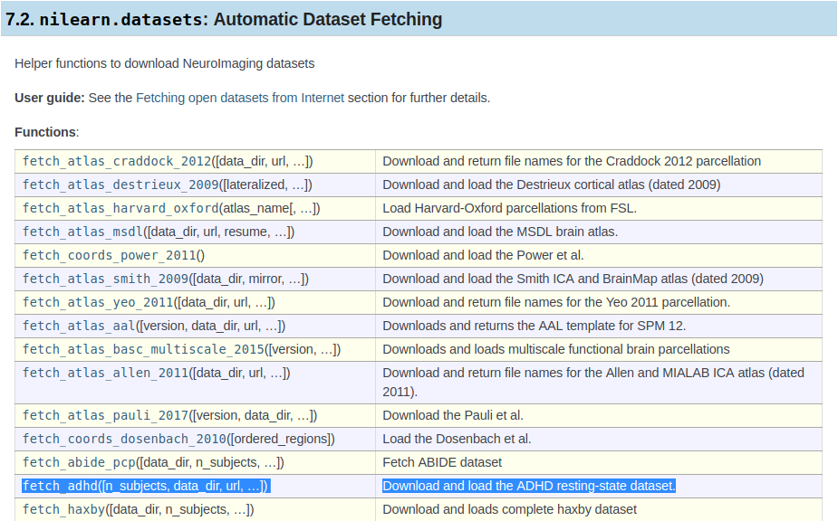
Nilearn - pick a dataset
https://nilearn.github.io/modules/reference.html#module-nilearn.datasets
Pick the ADHD 200 dataset

Slide 20
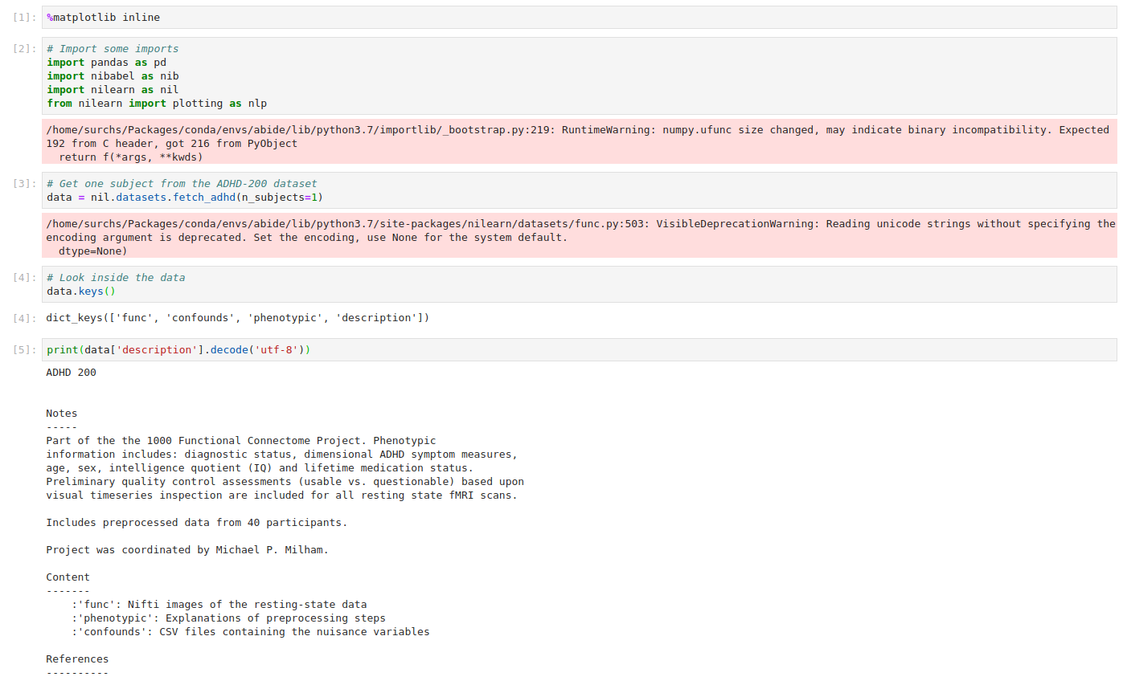
Nilearn - get the data

Slide 21
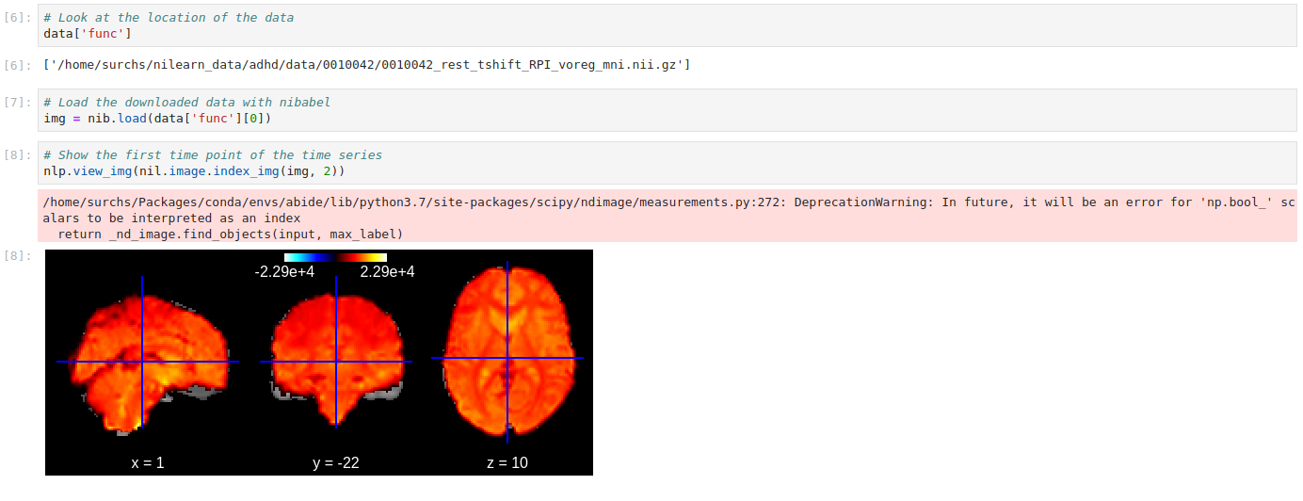
Nilearn - access the data

Slide 22
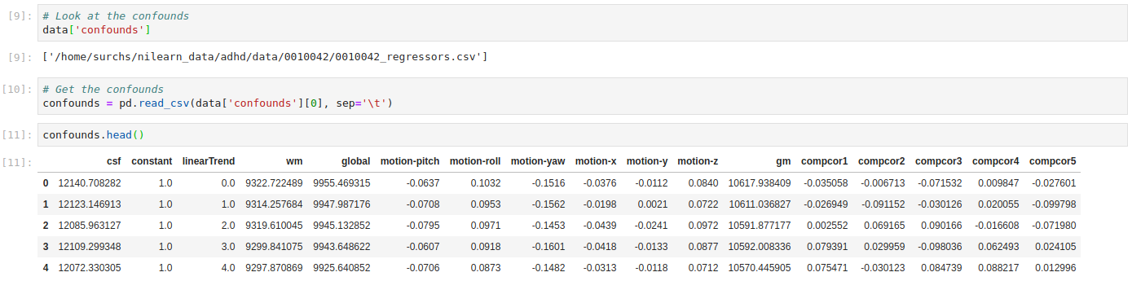
Nilearn - access the data

Slide 23
How do I work with the data
Respect the data
Sign and follow data usage agreement
Securely store identifiable information
Cite the data source

Slide 24
How do I work with the data
Respect the data
Sign and follow data usage agreement
Securely store identifiable information
Cite the data source
Document what you do
Where did you download from?
What command did you use (script if possible)
How did you select data?
What processing did you use?

Slide 25
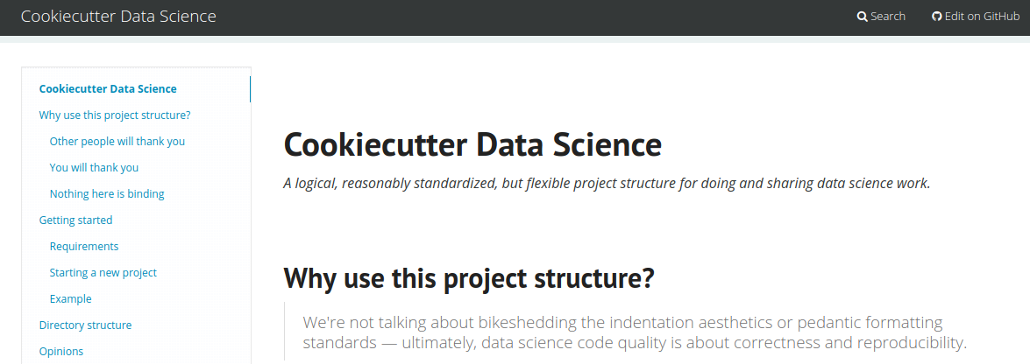
How do I work with the data
Respect the data
Sign and follow data usage agreement
Securely store identifiable information
Cite the data source
Document what you do
Where did you download from?
What command did you use (script if possible)
How did you select data?
What processing did you use?
Organize your project
Use version control!
You will thank yourself later
https://drivendata.github.io/cookiecutter-data-science/

Slide 26


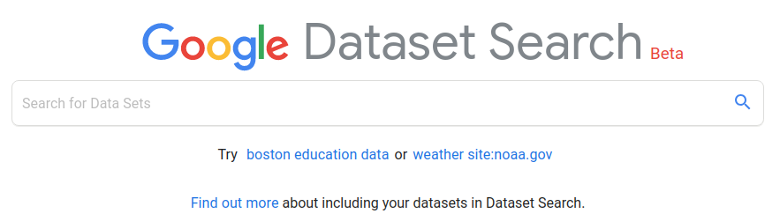

Some additional resources
https://zenodo.org/
Repository for data associated with publication
Digital object identifier
Any license
Hosted by CERN (cool)
https://figshare.com/
Repository for data
Digital object identifier
Creative Commons license
Has commercial side
https://toolbox.google.com/datasetsearch
Dataset search engine
Doesn’t store anything
Let’s you search other databases

Slide 27

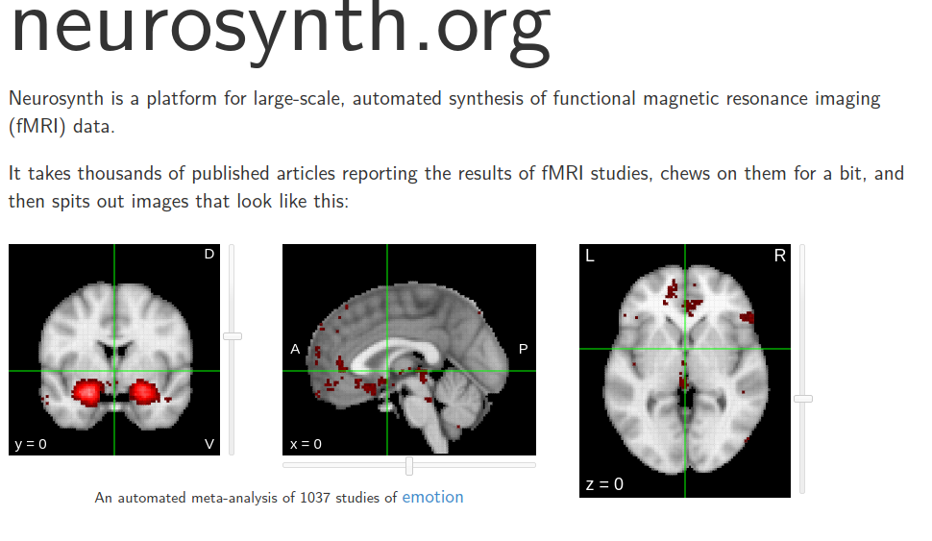
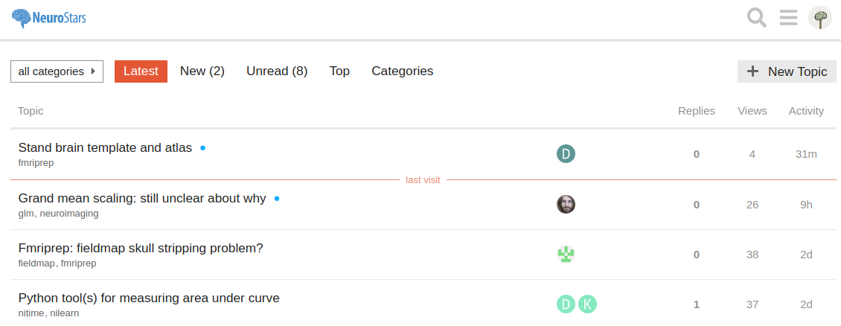
Some additional resources
https://neurovault.org/
Repository of statistical maps of completed studies
http://neurosynth.org/
Aggregated activation data maps with keyword search
Neurosynth-genes has the gene expression data from the Allen brain institute
https://neurostars.org/
Great resource for asking question and getting feedback

Slide 28



Some additional data sets
https://db.humanconnectome.org/
Very high resolution data
Publicly available data for 1200 healthy individuals
Long, repeat imaging data (task and resting state)
Deep meta data
https://www.ukbiobank.ac.uk/
> 100.000 individuals
Deep meta data
Genetics (prospective whole genome sequencing)
Extensive imaging data
Medical records
http://portal.brain-map.org/
Human brain gene expression maps
Histological and developmental atlases
Extensive mouse data

