Slide 1
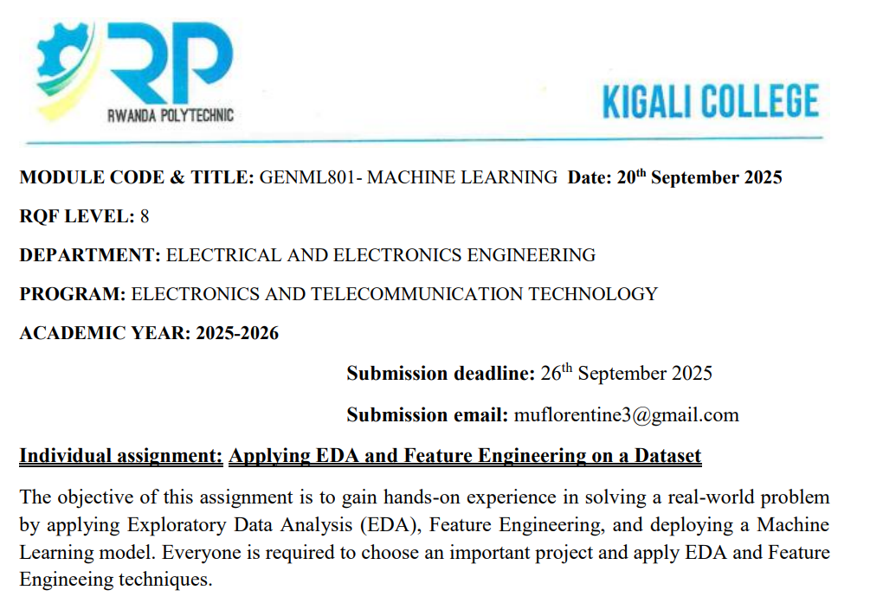

Slide 2
MUKESHIMANA Francoise
25RP20112

Slide 3
Explanation of problem statement
Access to timely healthcare in Rwanda is limited, especially in rural areas, leading to delays in patient referral and worsened outcomes. This project aims to develop a machine learning-based teleconsultation and referral system that uses age, sex, location, and vital signs to help healthcare providers quickly identify patients who need urgent referral, improving decision-making, efficiency, and patient outcomes.

Slide 4
Dataset description.
The dataset has 2000 rows and 9 columns, including demographic features (Age, Sex, Location) and vital signs (blood pressure, heart rate, body temperature, SpO₂). The target variable is Referral Decision (Yes/No), which indicates whether an individual should be referred for further medical attention.

Slide 5
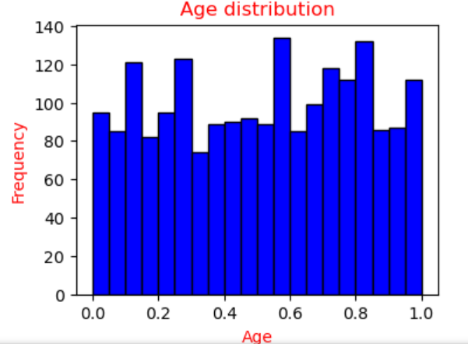
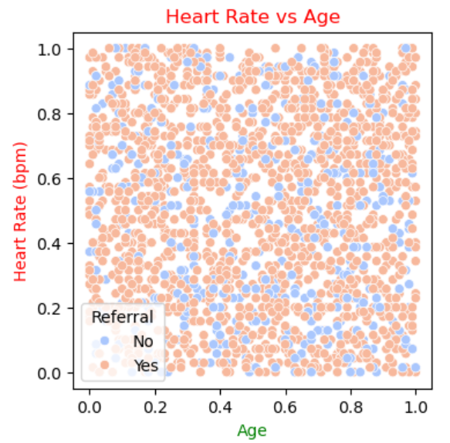
EDA findings.
Histograms
scatter plots

Slide 6
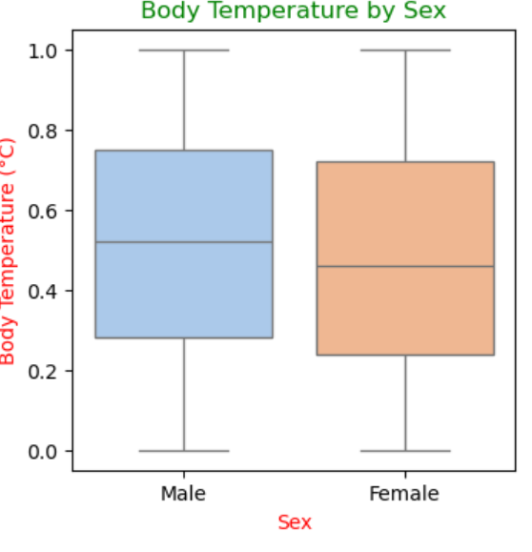
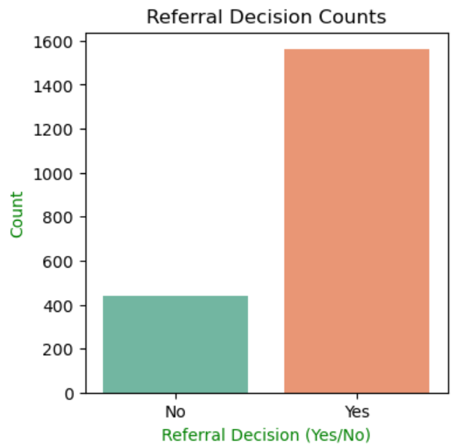
EDA findings.
Box plots
Bar charts

Slide 7
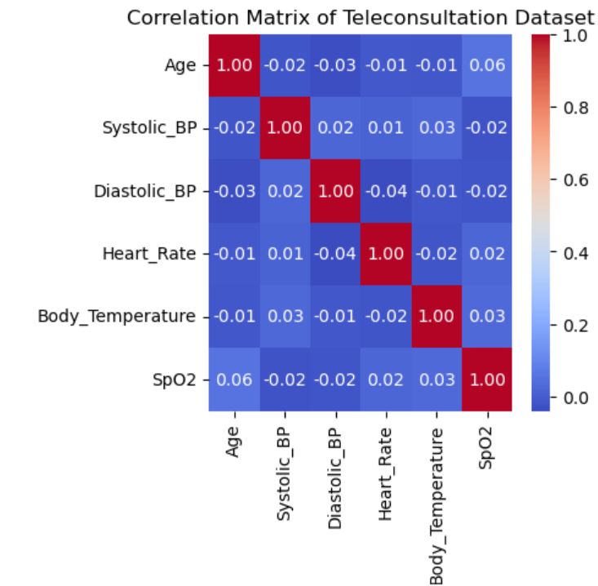
Correlation matrix

Slide 8
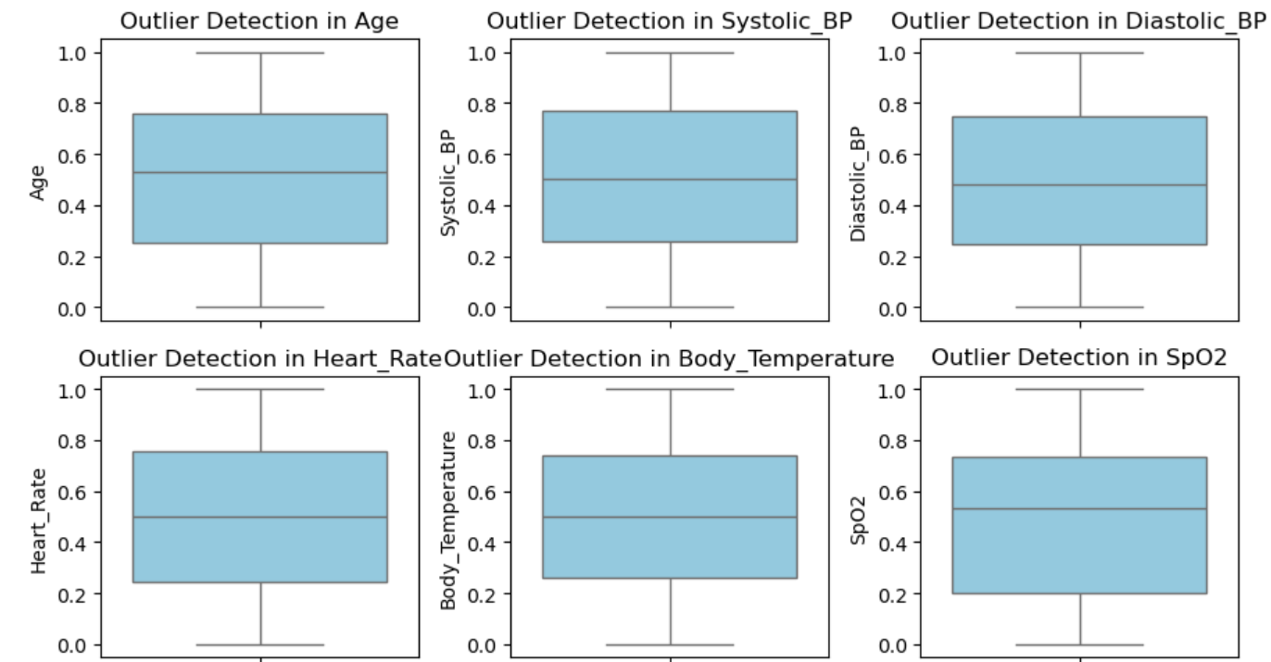
Detecting Outliers

Slide 9
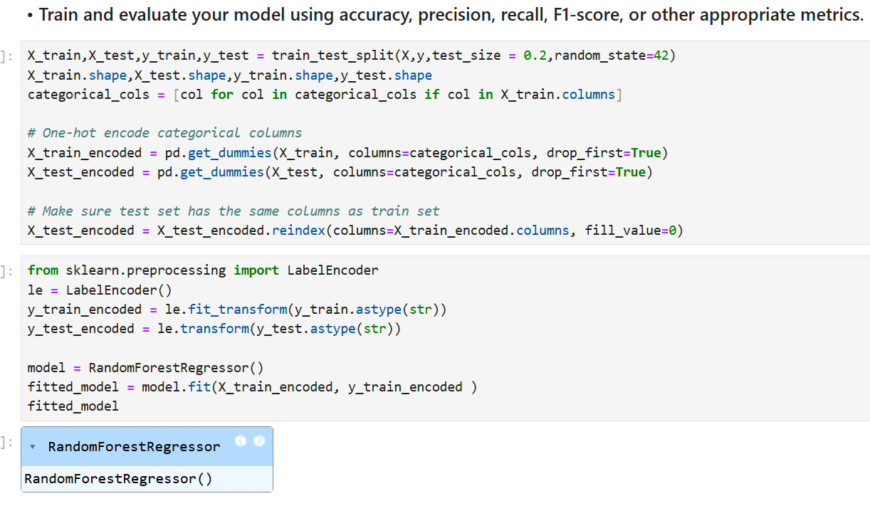
Model building and evaluation process

Slide 10
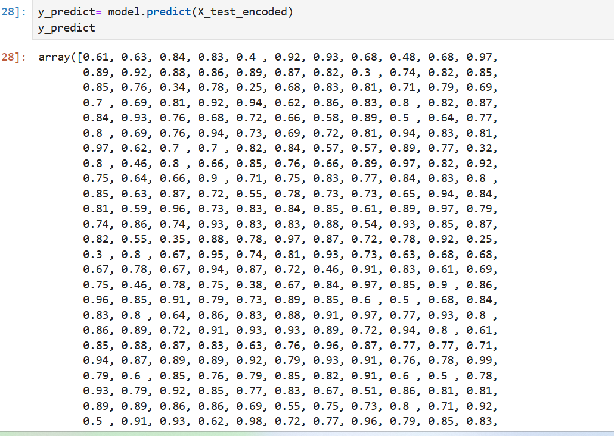
Model building and evaluation process

Slide 11
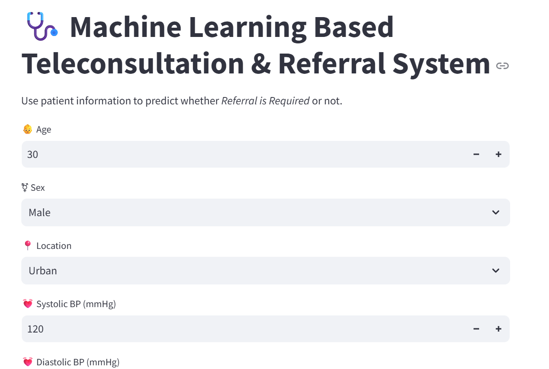
Model deployment details (screenshots for deployed model)

Slide 12
THANK YOU!!!

