Slide 1
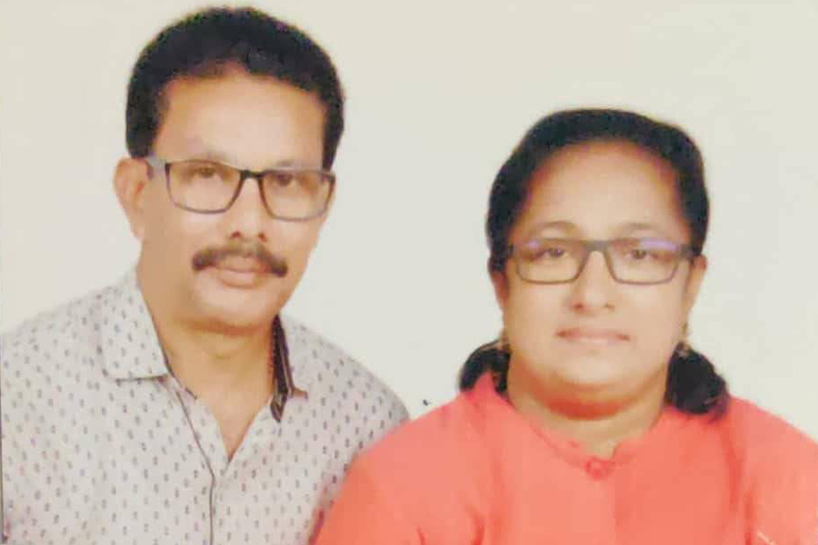
Diamond
Instituted by
Justin Vivera
Bolghatty
p.65
Justin Vivera

Slide 2
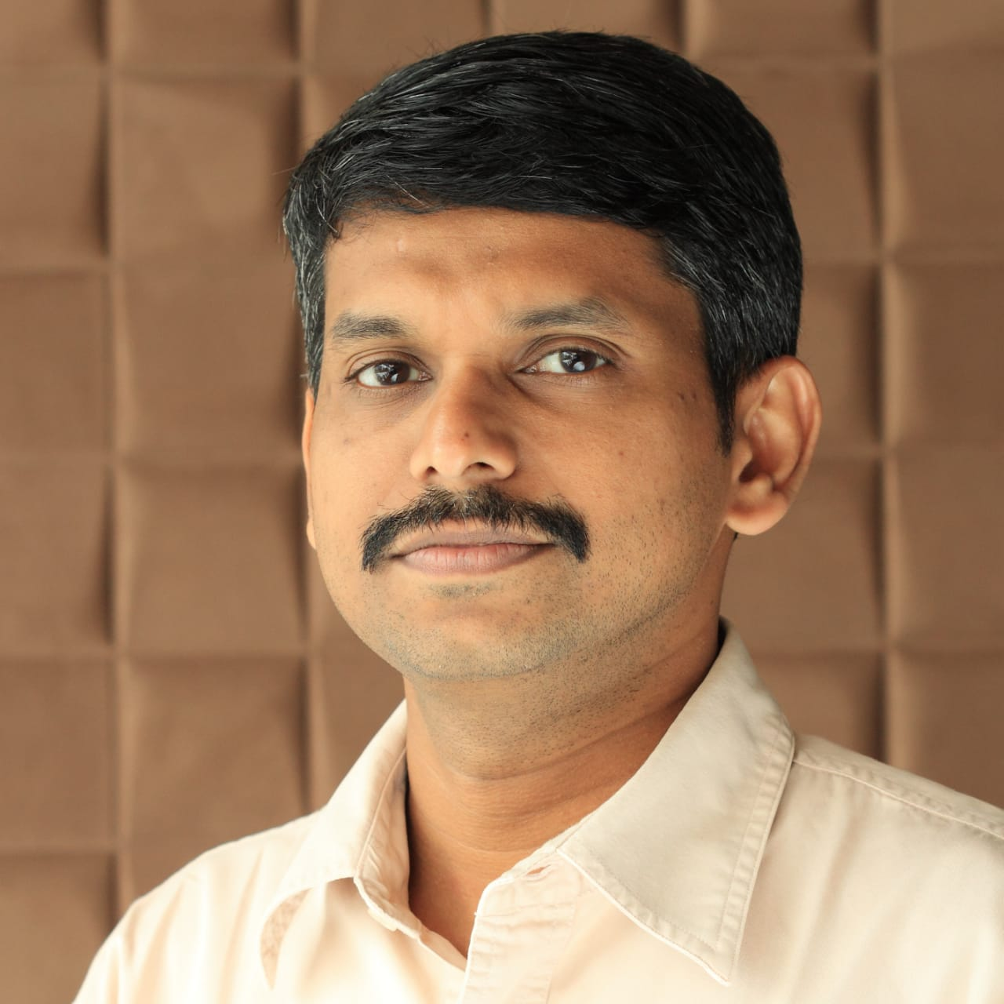
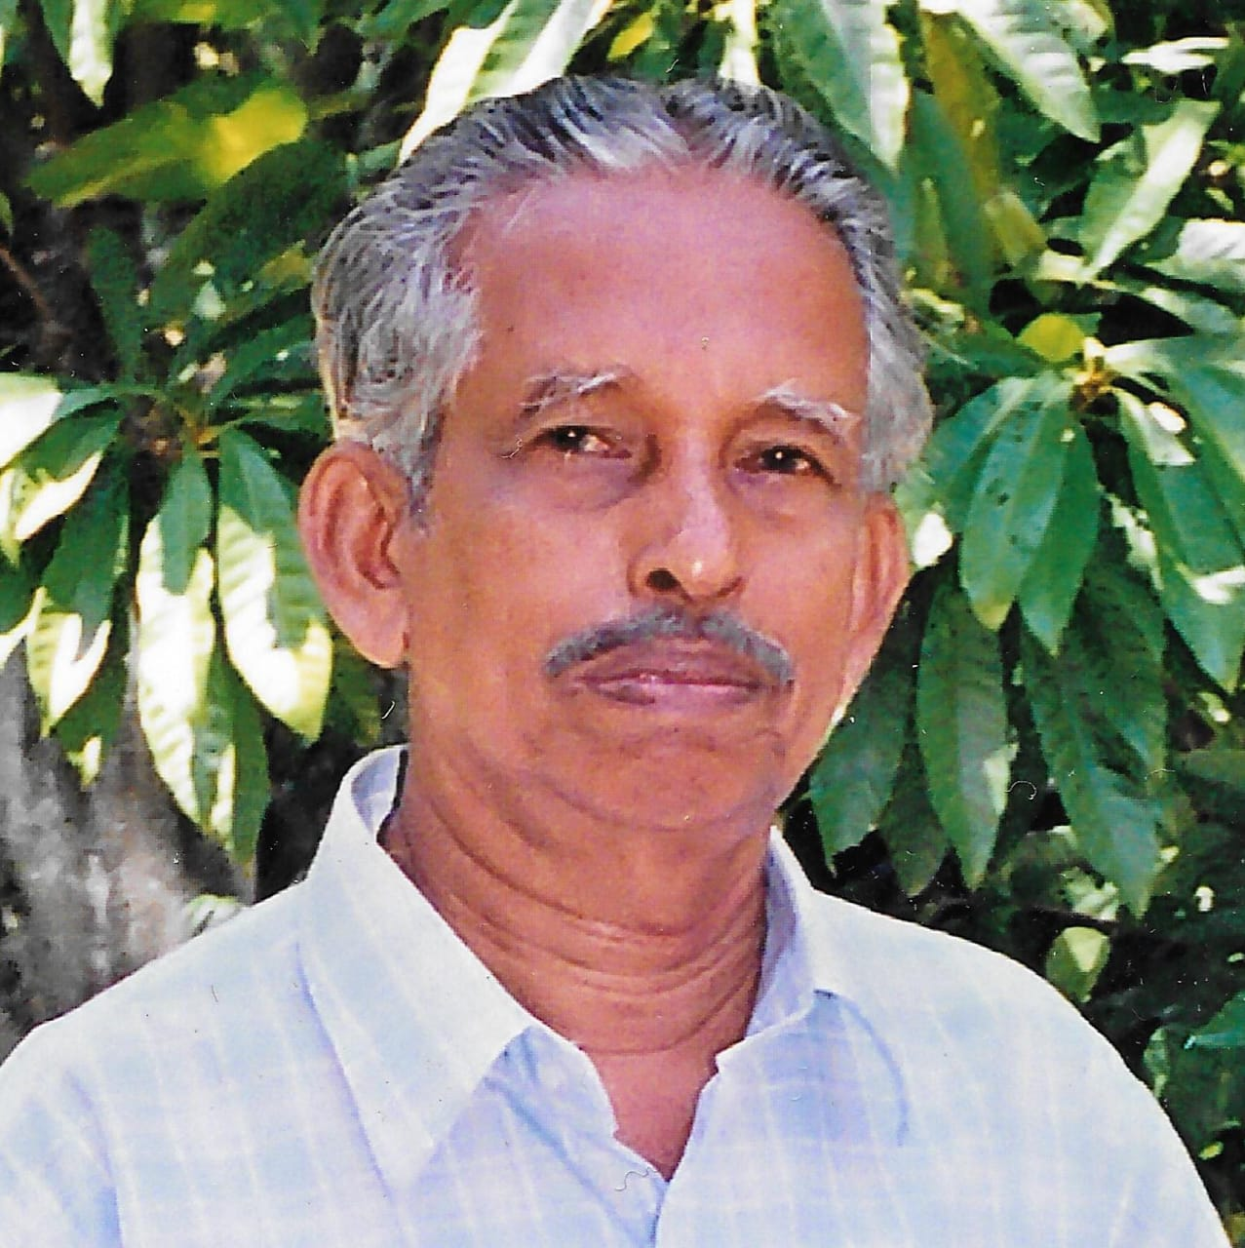
Diamond
Instituted by
Leslie Michael
Edavanakad
In Memory of Mukkath Augustine

Slide 3
Golden
Instituted by
Christopher Dominic Croning
Neerikode

Slide 4
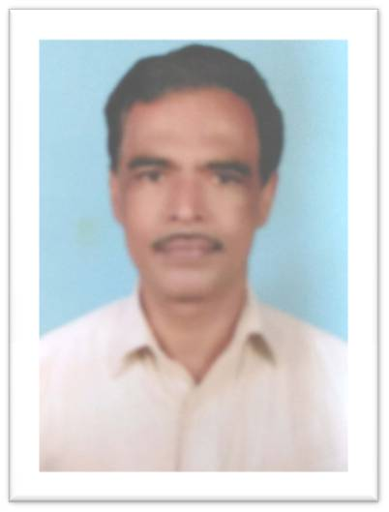
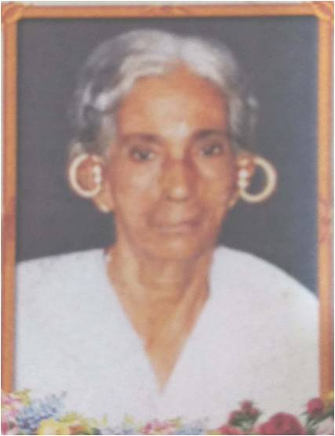
Golden
Antony M J
Kadavanthara
In Memory of Mary Joseph

Slide 5

Blessy Justine Valentine
Chathiath

Slide 6

Baby George
Muttinakam
In Memory of Pappu Rosa Elenjikkal

Slide 7


Friendz - A Group of Priests

Slide 8
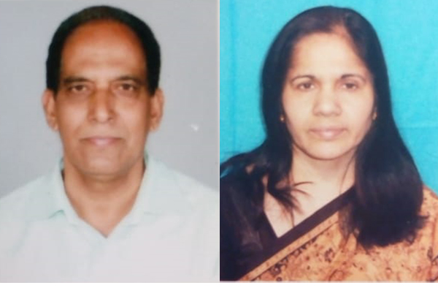
Golden
Instituted by
George Raphael & Sherly Raphael
Neerikode
In Memory of Veronica

Slide 9

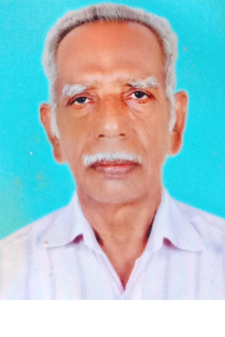
Joseph Puthenpurakkal
Vallarpadom

Slide 10

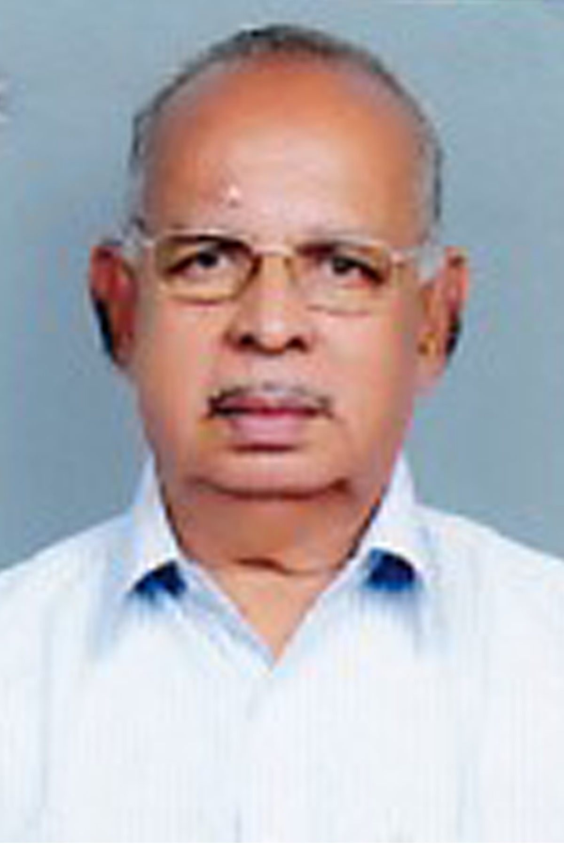
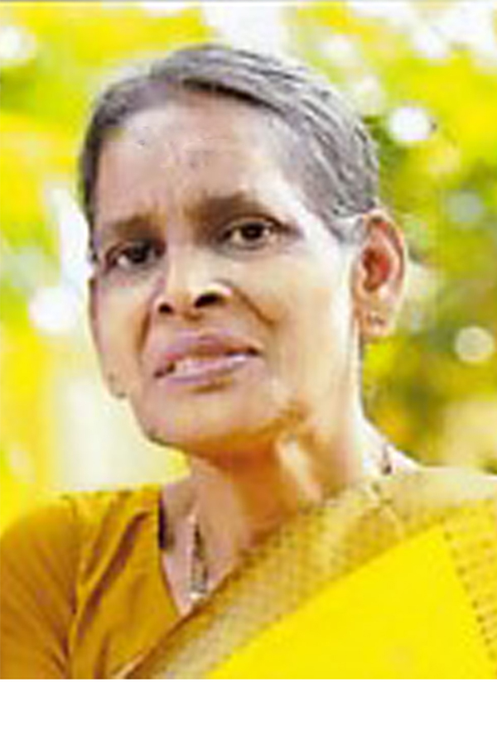
Xavier c.c
In Memory of Valsa Xavier

Slide 11
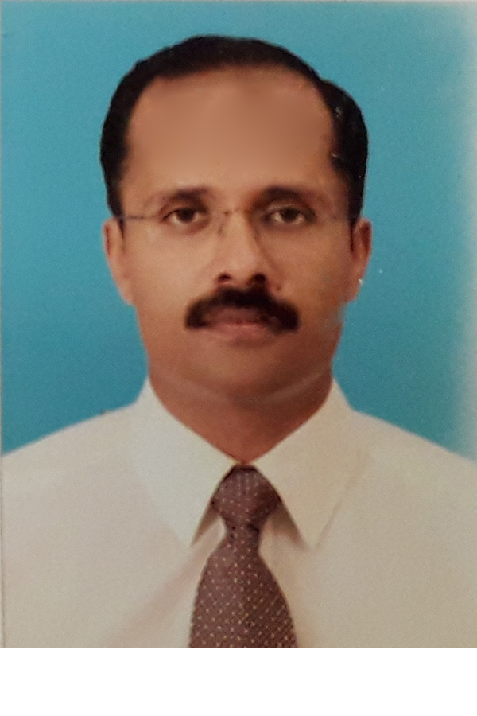

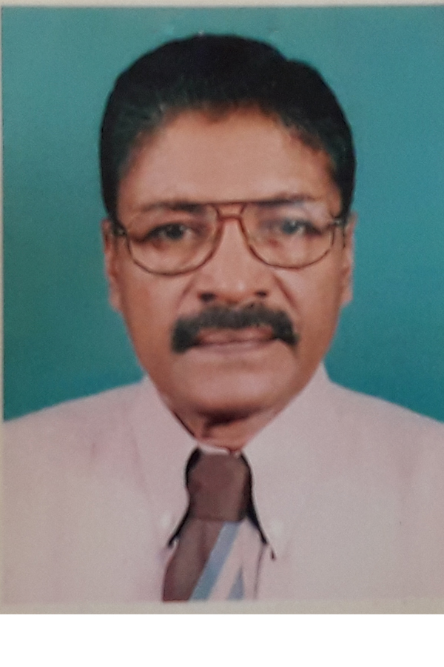
Gracy Xavier & Vinod Xavier

Slide 12

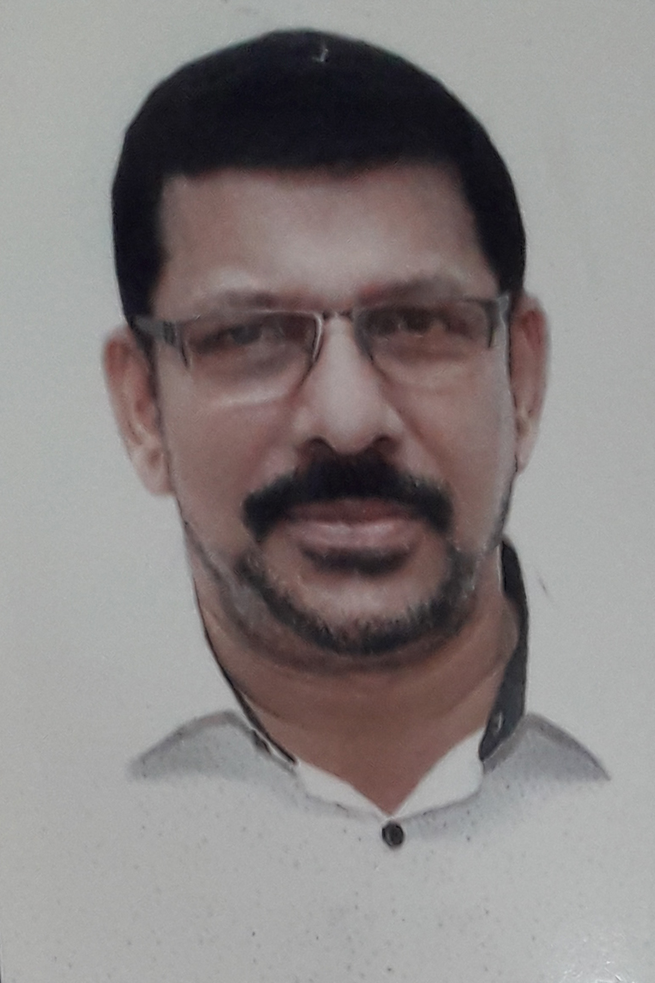
Paul P J

