Slide 1
SIMPLE ONLINE AND REALTIME TRACKING WITH A DEEP ASSOCIATION METRIC
Nicolai Wojke et.al

Slide 2
What is multiple object tracking(MOT)?
See a video to know what is MOT:
https://www.youtube.com/watch?v=xOGQ1lP7pt8
Popular solution:
First, all detections are extracted via YOLO, Faster RCNN, and so on.
Then, an association algorithm is performed to link these detections to different tracks. Usually, the association algorithm considers motion (direction, speed, …) information and appearance information.
Compared to single object tracking(SOT)
MOT is harder than SOT, since in each moment, the algorithm should decide whether a new track appears and a existing track vanishes.

Slide 3
Motivation
simple online and realtime tracking with a deep association metric (deep sort), is an extension of, simple online and realtime tracking (sort).
Motivation of sort:
Explores how simple MOT can be and how well it can perform.
Motivation of deep sort:
To reduce the large number of identity switches in sort.

Slide 4


Motion information
The state of each target at some point is modelled as:
where is bounding box center position, is aspect ratio, is height, overdot means their respective velocities in image coordinates.
A standard Kalman filter with constant velocity motion and linear observation model, is used to update the above target state.

Slide 5
Motion information
The state of each target at some point is modelled as:
where is bounding box center position, is aspect ratio, is height, overdot means their respective velocities in image coordinates.
A standard Kalman filter with constant velocity motion and linear observation model, is used to update the above target state.
What is Kalman filter?
Kalman filtering is an algorithm that uses a series of measurements observed over time, and produces estimates of unknown variables.
If you are interested in Kalman filter, see this series introduction.

Slide 6
Motion information
The state of each target at some point is modelled as:
where is bounding box center position, is aspect ratio, is height, overdot means their respective velocities in image coordinates.
A standard Kalman filter with constant velocity motion and linear observation model, is used to update the above target state.
Link detections to existing tracks:
(cost)
where is the j-th bounding box detection, is the covariance matrix of the Kalman filter prediction, is the Kalman filter prediction bounding box.
The equation calculates the (Mahalanobis) distance of groudtruth detection and the Kalman filter prediction.

Slide 7
Motion information
The state of each target at some point is modelled as:
where is bounding box center position, is aspect ratio, is height, overdot means their respective velocities in image coordinates.
A standard Kalman filter with constant velocity motion and linear observation model, is used to update the above target state.
Link detections to existing tracks:
(cost)
IOU is another kind of cost on motion information[1]. IOU simply calculates the maximum overlap ratio of any bounding box in the track and the new detection bounding box.
[1] High-Speed tracking-by-detection without using image information." Advanced Video and Signal Based Surveillance (AVSS), 2017

Slide 8


Motion information
The state of each target at some point is modelled as:
where is bounding box center position, is aspect ratio, is height, overdot means their respective velocities in image coordinates.
A standard Kalman filter with constant velocity motion and linear observation model, is used to update the above target state.
Link detections to existing tracks:
(cost)
Then apply a threshold to , to check whether it’s feasible to accept this link:
(gate)

Slide 9



Appearance information
For each bounding box detection , we compute an appearance descriptor with by L2 normalization, where comes from a convolutional neural network(wide residual).
Keep a gallery of the last associated appearance descriptors for each track , i.e, only keep the last 100 descriptors.
Distance between the i-th track and j-th detection in appearance space is the smallest cosine distance the i-th track and j-th detection that:
Then, apply a threshold to , check whether it’s feasible to accept this link:

Slide 10

Combine motion & appearance information
Combine both metrics using a weighted sum:
This term is interpreted as the cost of associating the i-th track and j-th detection.
And check whether motion and appearance are both less than the threshold:
This term is interpreted as the gate of associating the i-th track and j-th detection.

Slide 11
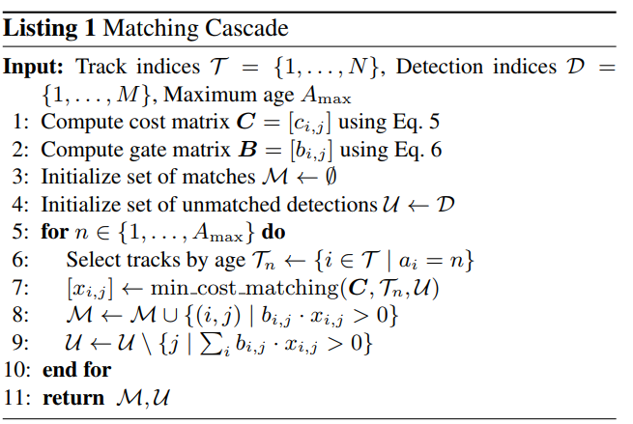
Symbols in pipeline
: every track contains all the past detections in that track.
: detections in all frames.
: tracks has no new added frame in the past frames are thought dead.
: is the cost of associating the i-th track and j-th detection.
: is the gate of associating the i-th track and j-th detection.

Slide 12
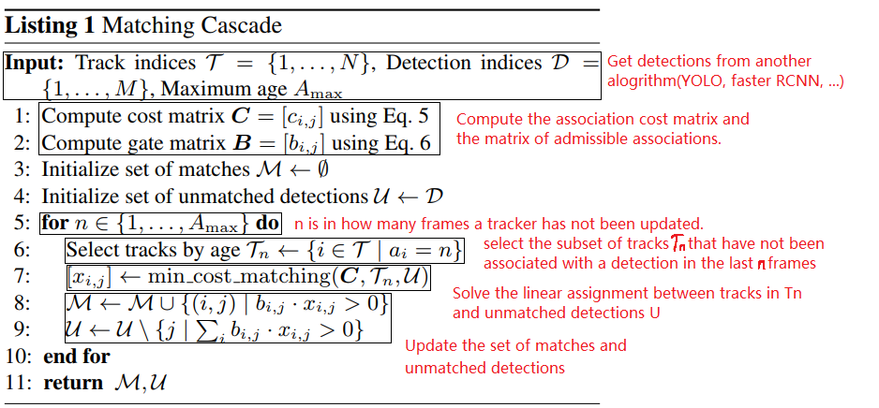
Pipeline

Slide 13
Drawback
Deep sort has relatively more false positives compared to other method.
In view of the author, there are two reasons:
1. False detections comes from detector. Enlarge the detector confidence threshold could alleviate the problem.
2. The used in their experiment is large.

Slide 14
In practice
Speed:
With YOLO detector, 14 fps on (1024, 1280, 3) resolution video on Nvidia GTX 1080.[2]
Code
Original code[3] and a better code with YOLO detector[2].
Result
Numbers and videos, can be seen at https://motchallenge.net/tracker/DeepSORT_2
[2] https://github.com/bendidi/Tracking-with-darkflow
[3] https://github.com/nwojke/deep_sort

Slide 15
Question?

