Slide 1
EDO STATE GOVERNMENT OF NIGERIA
MINISTRY OF COMMUNICATION AND DIGITAL ECONOMY
UNESCO FUNDING SUPPORT AND COLLABORATION PROPOSAL
Digital Transformation • Capacity Building • Data Sovereignty • Innovation • Education • Environmental Management • Cultural Heritage
Indicative Funding: US$3,950,000
September 2026

Slide 2
EXECUTIVE SUMMARY
The Edo State Government, through the Ministry of Communication and Digital Economy, seeks UNESCO funding support and strategic collaboration for a coordinated portfolio of ten digital transformation and capacity-building initiatives. The portfolio combines skills development, education technology, responsible artificial intelligence, protected data analysis, environmental management, public reporting, digital government, cultural heritage documentation and technology exhibition. The proposal is designed around a local ownership model: the Ministry will provide technical leadership and implementation capacity, while requested external support will principally address financing, specialised expertise, equipment, training resources, independent assurance, knowledge exchange and scale-up.
KEY HIGHLIGHTS
▸ 10 Integrated Digital Initiatives
▸ US$3.95M Indicative Budget
▸ 36-Month Implementation
▸ Local Ownership Model
▸ Skills + Systems + Innovation
▸ Cross-Sector Impact

Slide 3
STRATEGIC RATIONALE & UNESCO ALIGNMENT
UNESCO PRIORITIES SUPPORTED
ALIGNMENT WITH UNESCO FRAMEWORKS
• Inclusive and quality education and lifelong learning
▸ Digital Competency Framework for Civil Servants
• Development of digital and AI competencies
▸ AI Competency Framework for Students
• Responsible and human-centred technology
▸ AI Competency Framework for Teachers
• Strengthening institutional capacity in Africa
▸ Africa Portfolio: AI & Digital Innovation
• Environmental sustainability
• Preservation and responsible documentation of cultural heritage
▸ Digital Education & Capacity Development
• Innovation for public benefit
These frameworks provide a basis for dialogue; final eligibility and funding modality would be determined by UNESCO and relevant funding mechanisms.

Slide 4
PROGRAMME GOAL & OBJECTIVES
OVERALL PROGRAMME GOAL
To establish a sustainable, locally led digital innovation ecosystem in Edo State that strengthens human capacity, improves public and educational services, promotes responsible AI and protected data use, supports environmental sustainability, preserves cultural knowledge, and enables government and communities to benefit from locally developed digital infrastructure.
Build Workforce
Deploy Systems
Responsible AI
Build a skilled local workforce in databases, software development, Python, AI and protected data analytics.
Develop and deploy practical digital systems that address education, environment, public safety, government services and cultural heritage.
Promote responsible, privacy-aware and human-centred use of AI and digital technologies.
Institutional Capacity
Reusable Infrastructure
Inclusive Participation
Strengthen institutional capacity and reduce long-term dependence on external software outsourcing.
Create reusable digital infrastructure, standards, documentation and knowledge assets that can be maintained locally.
Provide opportunities for youth, women, educators, civil servants, technical professionals and communities to participate in digital innovation.
M&E & Governance
Establish measurable monitoring, evaluation, cybersecurity, data-governance and sustainability mechanisms across the portfolio.

Slide 5
PROJECT PORTFOLIO OVERVIEW
#
PROJECT
BUDGET
SHARE
TIMELINE
01
Relational Database & App Development Training
$300,000
7.6%
2 Weeks
02
Protected Data Analysis with AI & Python
$400,000
10.1%
1 Weeks
03
Waste Disposal & Recycling Management System
$350,000
8.9%
8 Weeks
04
Examination & Academic Performance System
$500,000
12.7%
8 Weeks
05
Digital Technology Exhibition
$200,000
5.1%
1 Weeks
06
Security & Environmental Reporting System
$450,000
11.4%
8 Weeks
07
Nigeria Data Protection AI Copilot
$450,000
11.4%
8 Weeks
08
Edo State Service Portal
$600,000
15.2%
12 Weeks
09
Traditional Stool Management System
$300,000
7.6%
8 Weeks
10
Digital Market Square (E-Commerce Hub)
$400,000
10.1%
16 Weeks
TOTAL PROGRAMME REQUEST
$3,950,000
100%

Slide 6
PROJECT 01
Relational Database Management & Application Development Training
Budget: $300,000
Timeline: 2 Weeks
OBJECTIVE
Build practical competence in relational database design, SQL, data modelling, administration and database-driven application development.
PRIMARY BENEFICIARIES
KEY DELIVERABLES
EXPECTED OUTCOMES
ICT students and graduates; government ICT staff; teachers/lecturers; young developers; women and youth entering technology careers.
• Training curriculum and laboratory • 150 trainees • Practical projects • Competency assessments • Mentor network • Training materials and certificates
• At least 150 participants trained • 70%+ demonstrate competency • At least 20 practical projects completed • Local technical support pool established

Slide 7
PROJECT 02
Protected Data Analysis Using AI & Python Programming
Budget: $400,000
Timeline: 1 Weeks
OBJECTIVE
Develop skills for secure data analysis, Python programming, AI-assisted analytics, privacy-aware processing and responsible data use.
PRIMARY BENEFICIARIES
KEY DELIVERABLES
EXPECTED OUTCOMES
Government data personnel; analysts; ICT professionals; researchers; educators; selected youth and women in STEM.
• Protected analytics training lab • 120 trainees • Secure-data exercises • Python/AI curriculum • Governance and privacy modules • Capstone projects
• At least 120 trained • 30+ analytics prototypes • Improved data-governance awareness • Personnel capable of privacy-aware analytics

Slide 8
PROJECT 03
Waste Disposal & Recycling Management System
Budget: $350,000
Timeline: 8 Weeks
OBJECTIVE
Digitise waste collection, disposal, recycling, environmental reporting, service-provider management, location tracking and operational monitoring.
PRIMARY BENEFICIARIES
KEY DELIVERABLES
EXPECTED OUTCOMES
Environmental agencies; local governments; waste operators; communities; households; recyclers; policy makers.
• Requirements study • Web/mobile platform • Dashboards and reporting workflow • GIS/location functions • Pilot deployment • Training and documentation
• Operational pilot deployed • Faster reporting and tracking • Improved visibility of waste activities • Measurable service-provider and recycling data • Evidence base for environmental planning

Slide 9
PROJECT 04
Examination, Assessment & Academic Performance System
Budget: $500,000
Timeline: 8 Weeks
OBJECTIVE
Strengthen examination administration, question management, assessment, marking, results, academic records, performance analysis and digital verification.
PRIMARY BENEFICIARIES
KEY DELIVERABLES
EXPECTED OUTCOMES
Schools; teachers; education administrators; pupils/students; parents/guardians; quality-assurance personnel; policy makers.
• End-to-end examination platform • Question and assessment workflows • Results engine and report cards • Performance analytics • Digital verification • Training and pilot/scale plan
• Reduced manual processing • Improved result integrity and traceability • Timely academic reporting • Institutional performance dashboards • Scalable education data infrastructure

Slide 10
PROJECT 05
Digital Technology Exhibition
Budget: $200,000
Timeline: 8 Weeks
OBJECTIVE
Create a public platform for demonstrating locally developed technology, AI, data systems, automation and solutions to societal challenges.
PRIMARY BENEFICIARIES
KEY DELIVERABLES
EXPECTED OUTCOMES
Students; innovators; startups; schools; government institutions; private sector; development partners; general public.
• Annual exhibition (3 cycles) • Live demonstrations • Innovation showcase • Workshops and policy dialogue • Youth challenge • Documentation and media materials
• Three exhibition cycles delivered • Increased visibility of local innovation • Partnerships generated • Youth participation increased • Technology solutions connected to institutional needs

Slide 11
PROJECT 06
Security & Societal/Environmental Reporting System
Budget: $450,000
Timeline: 8 Weeks
OBJECTIVE
Provide a secure reporting, tracking, analysis, escalation and management platform for appropriate security, societal and environmental reports.
PRIMARY BENEFICIARIES
KEY DELIVERABLES
EXPECTED OUTCOMES
Government response agencies; communities; local authorities; authorised officers; civil-society and community stakeholders.
• Secure reporting channels • Case management and workflow • Escalation and dashboards • Analytics and role-based access • Audit trails and privacy controls • Pilot deployment
• Improved report routing and case visibility • Faster administrative response • Auditable workflows • Better aggregated evidence for planning • Strengthened safeguards for sensitive information

Slide 12
PROJECT 07
Nigeria Data Protection Act AI Copilot
Budget: $450,000
Timeline: 8 Weeks
OBJECTIVE
Develop an AI-assisted compliance tool to help organisations understand and operationalise applicable Nigerian data-protection requirements.
PRIMARY BENEFICIARIES
KEY DELIVERABLES
EXPECTED OUTCOMES
Public institutions; businesses; DPO/privacy teams; legal/compliance professionals; SMEs; civil society and technology organisations.
• Knowledge base on NDPR/NDPA • Guided compliance workflows • Policy and document templates • Risk assessment support • Privacy task management • Human-review controls and governance
• Pilot AI copilot operational • Compliance workflows digitised • Improved privacy awareness • Documented governance controls • Human-in-the-loop review model • Reusable compliance resources

Slide 13
PROJECT 08
Edo State Service Portal
Budget: $600,000
Timeline 8 Weeks
OBJECTIVE
Provide a unified digital gateway for accessing government services, applications, requests, tracking, notifications and service information.
PRIMARY BENEFICIARIES
KEY DELIVERABLES
EXPECTED OUTCOMES
Citizens; businesses; government staff; public institutions; service providers; development partners.
• Service catalogue and citizen portal • Application and tracking workflows • Notifications system • Identity/access integration • Administrative dashboard and analytics • Accessibility and security testing
• Priority services available online • Reduced physical/manual transactions • Improved service tracking and transparency • Service-performance analytics • Scalable government digital-service platform

Slide 14
PROJECT 09
Traditional Stool Management System
Budget: $300,000
Timeline: 8 Weeks
OBJECTIVE
Digitally document and manage information relating to traditional institutions, stools/titles, succession records, history, recognition, administration and community information.
PRIMARY BENEFICIARIES
KEY DELIVERABLES
EXPECTED OUTCOMES
Traditional institutions; communities; cultural authorities; government cultural/administrative bodies; researchers; historians; future generations.
• Data model and registry • Historical records module • Succession and documentation workflows • Controlled access and search • Preservation strategy • Training and governance framework
• Structured digital registry • Improved preservation and retrieval • Stronger institutional documentation • Controlled access and governance • Foundation for cultural knowledge preservation

Slide 15
PROJECT 10
Digital Market Square (E-Commerce Hub)
Budget: $400,000
Timeline: 8 Weeks
OBJECTIVE
Develop a trusted digital marketplace enabling Edo State-based businesses, artisans, farmers, creative enterprises and MSMEs to promote and sell products and services online.
PRIMARY BENEFICIARIES
KEY DELIVERABLES
EXPECTED OUTCOMES
MSMEs; women and youth entrepreneurs; artisans; farmers and agro-processors; creative-sector businesses; cooperatives; consumers; logistics and payment partners.
• E-commerce marketplace platform • Vendor onboarding and verification • Product/service catalogue • Merchant dashboards and order management • Secure payment integration • Delivery/logistics workflows and analytics
• 1,000+ businesses onboarded • Increased online visibility and market access • New digital-sales opportunities for women and youth • Improved digital entrepreneurship skills • Sustainable state-level digital marketplace

Slide 16
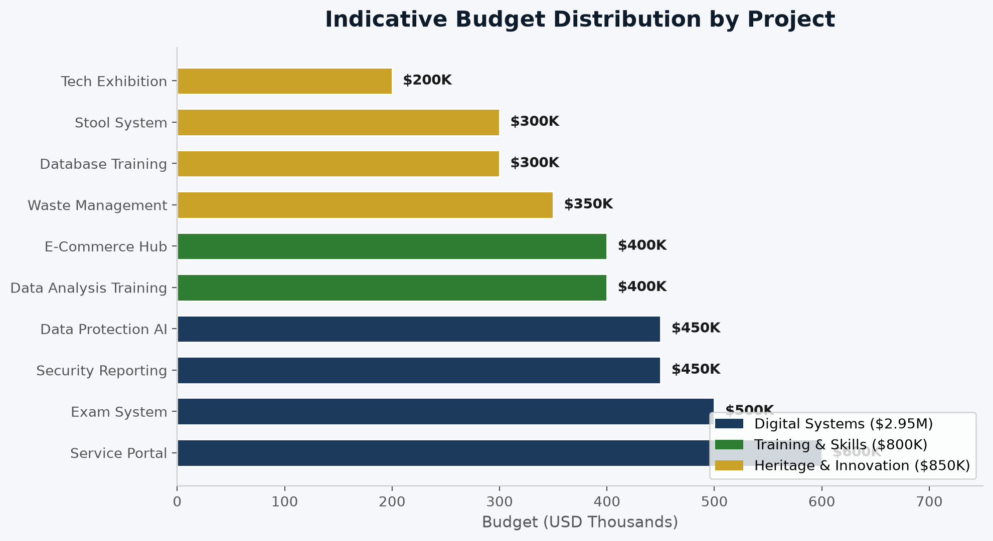
BUDGET OVERVIEW

Slide 17
PROGRAMME IMPLEMENTATION ARCHITECTURE
Lead Institution
Edo State Ministry of Communication and Digital Economy
Technical Implementation
Ministry technical teams, qualified local developers, trainers and approved specialist partners where required
Strategic Coordination
Inter-ministerial and agency steering arrangement covering education, environment, public service, culture, data governance and other relevant sectors
UNESCO Collaboration
Technical dialogue, capacity-building support, knowledge exchange, standards/guidance, financing and independent technical engagement
User Participation
Structured consultations with intended users and beneficiary institutions before each production deployment
Assurance
Cybersecurity, privacy/data-protection, accessibility, quality assurance, audit trails, documentation and independent testing

Slide 18
36-Weeks HIGH-LEVEL TIMELINE
Phase 1: Week 1–3
Programme mobilisation; baseline assessment; stakeholder consultations; detailed requirements; governance; procurement planning; training curriculum development.
Phase 2: Week 4–9
Core training cohorts; system architecture and prototypes; data-governance/security design; initial education, waste and service-portal development.
Phase 3: Week 10–18
Pilot deployments; first Digital Technology Exhibition; examination system expansion; waste and cultural registry pilots; AI/privacy copilot development.
Phase 4: Week 19–24
Evaluation and refinement; wider institutional onboarding; reporting platform and service portal expansion; second exhibition; advanced training.
Phase 5: Week 25–30
Scale-up; interoperability; operational strengthening; third-party assurance; sustainability and local support arrangements.
Phase 6: Week 31–36
Final evaluation; knowledge products; institutional handover; maintenance model; replication/scale strategy; final exhibition and dissemination.

Slide 19
CROSS-CUTTING PRINCIPLES
Human-centred design and accessibility
Local skills transfer, documentation and maintainability
Responsible and ethical AI, with human oversight for consequential decisions
Gender and youth inclusion in training and innovation opportunities
Privacy and data protection by design
Evidence-based monitoring and measurable service outcomes
Cybersecurity and role-based access controls
Sustainability, open standards where appropriate, and responsible technology procurement
Interoperability and avoidance of unnecessary vendor lock-in

Slide 20
MONITORING, EVALUATION & LEARNING
Input Indicators
Equity Indicators
Funds mobilised, trainers/technical personnel engaged, equipment and infrastructure established.
Participation of women and youth, accessibility of digital services, geographic/institutional reach and inclusion of underserved users.
Output Indicators
Quality Indicators
Trainees certified, systems developed, pilots completed, institutions onboarded, services digitised, reports processed and innovation events delivered.
Uptime, security-test results, user satisfaction, defect rates, audit findings, documentation completeness and maintenance readiness.
Outcome Indicators
Learning
Improved processing time, increased digital-service uptake, improved data quality, improved reporting visibility, stronger privacy practices, improved academic-result workflows and increased local technical capacity.
Quarterly reviews, user feedback, pilot evaluations, annual portfolio reviews and an end-of-programme independent evaluation.

Slide 21
SUSTAINABILITY & RISK MANAGEMENT
Local Technical Capacity
In-house engineering, training of civil servants, and local software maintenance ensure systems outlive external funding.
Institutional Integration
Aligning platforms with statutory MDA workflows to guarantee operational adoption across government bodies.
Infrastructure & Maintenance
Leveraging cloud infrastructure, modular open standards, and scheduled maintenance budgets for long-term scalability.
Data Privacy & Security Risks
Mitigated via role-based access control, NDPA compliance oversight, and regular security audits.
Adoption & Change Management
Mitigated through active user training, stakeholder consultations, and user-centric portal interfaces.

