Slide 1
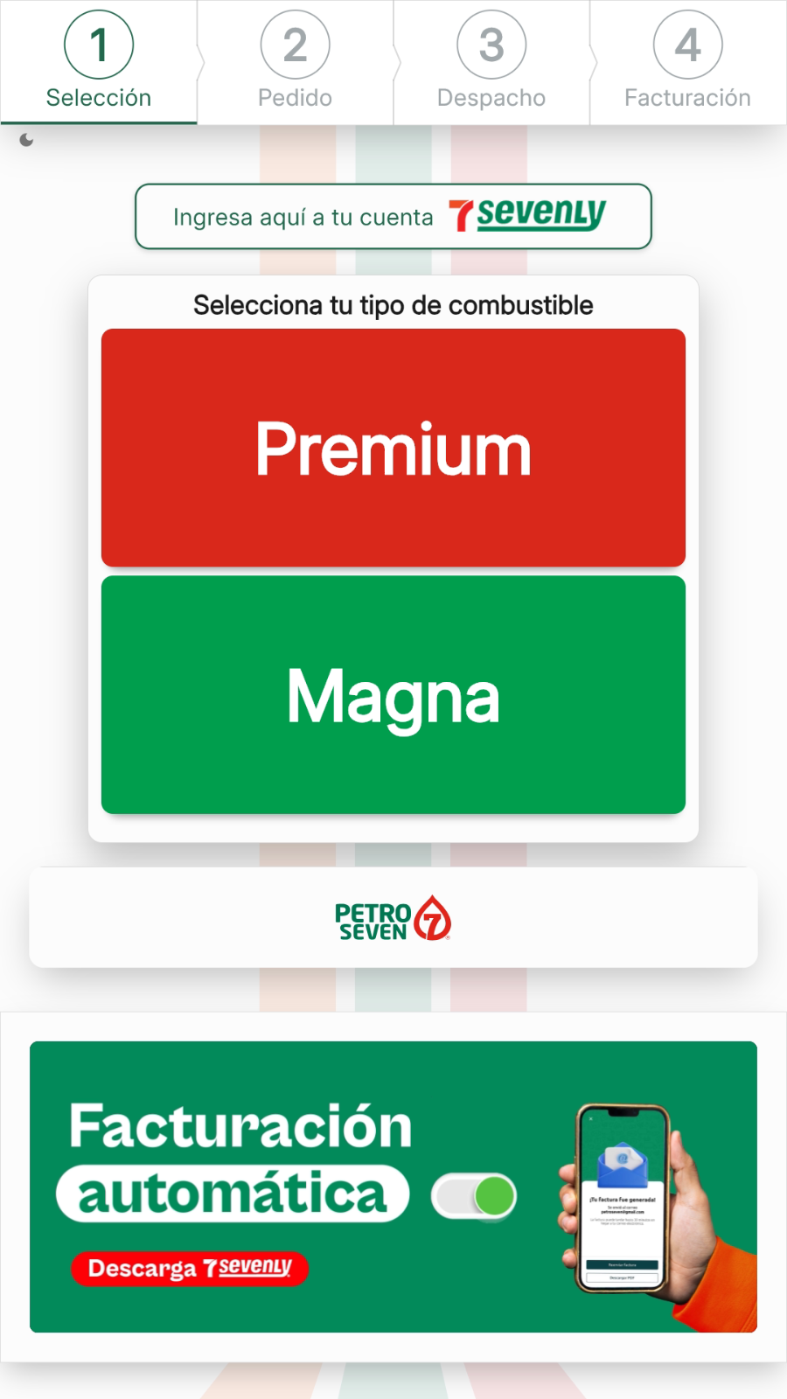
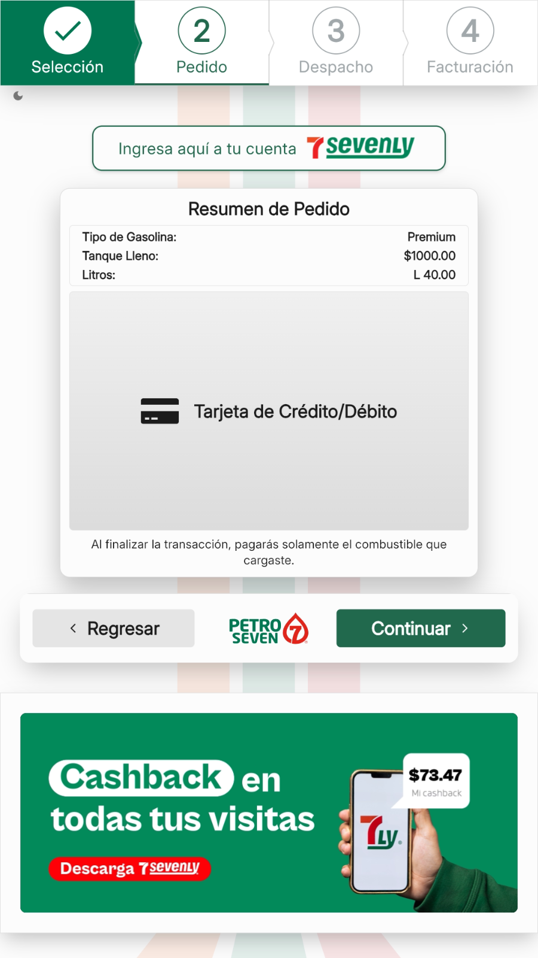
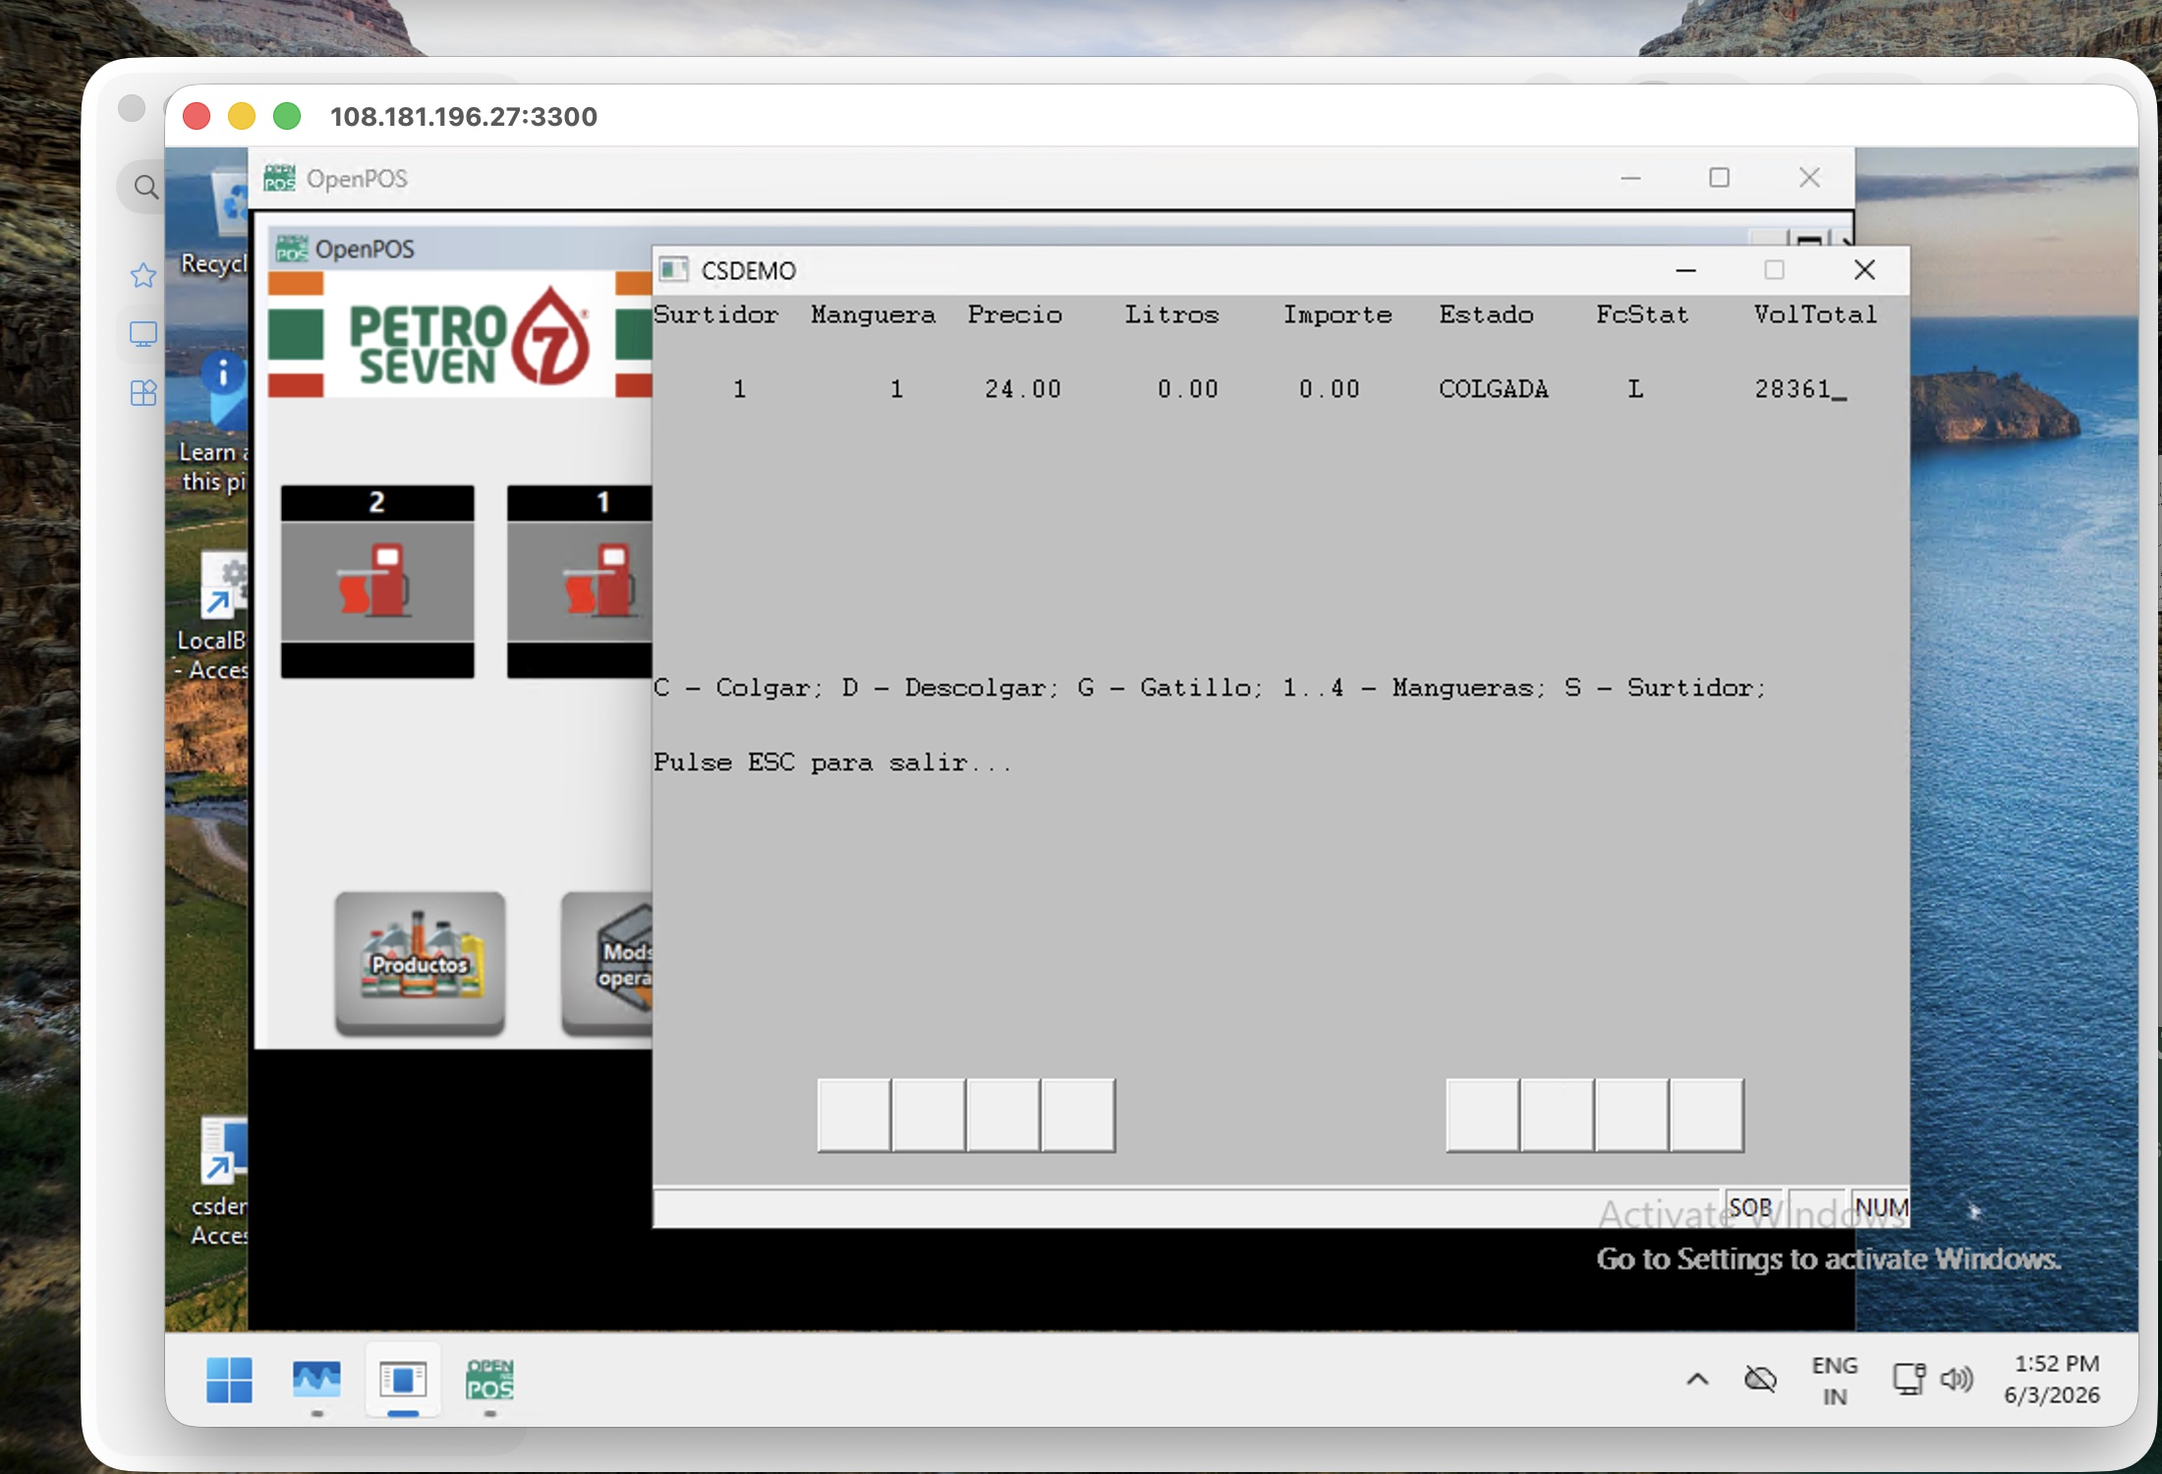
AUTOMATION PLAN
PetroSeven kiosk and virtual desktop flows
A concise view of what has been built, how the automation is structured, and what remains before broader rollout.
45%
ready / in repo
36%
remaining to automate
19%
human-assisted validation
PetroSeven Kiosk Automation Plan
01

Slide 2
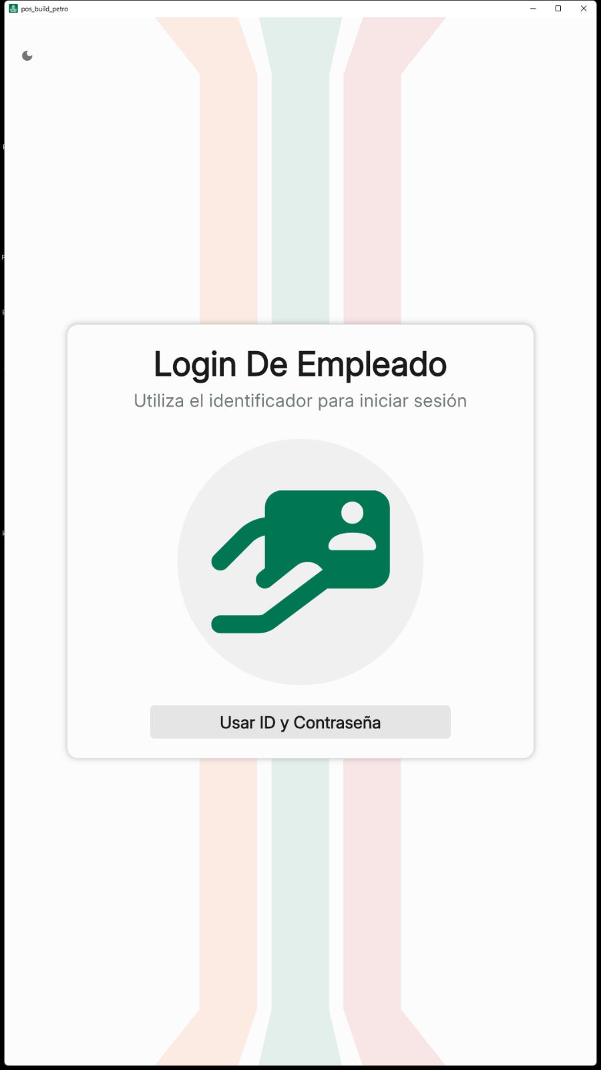
Project Objective
Build a reliable visual automation layer for kiosk sales, login, benefits, invoice, and pump-related validation flows.
Core goal
Automated UI actions
Image anchors and calibrated clicks for repeatable kiosk navigation.
Reduce repetitive kiosk validation work while keeping traceable evidence for each critical step.
Evidence by step
Screenshots and reports create an auditable record for each step.
Primary surface
Human-aware boundaries
Kiosk UI through AnyDesk/RustDesk, supported by screenshots, image assets, and controlled manual checkpoints.
Hardware, RFID, PinPad, pump operation, tickets, and external checks stay explicit.
PetroSeven Kiosk Automation Plan
02

Slide 3
Matrix Snapshot
Revised working scope from the 63-case automation matrix analyzed on 2026-06-15.
Ready / in repo
45%
How to read it
24 of 53 cases
The working scope now includes 10 cases that can run in parallel with a person at the station completing the physical validation. Only the remaining 10 hard-dependency cases stay outside the completion percentage.
Remaining to automate
36%
19 of 53 cases
Human-assisted validation
19%
10 of 63 cases
Source: PetroSeven automation matrix, revised scope; 10 hard-dependency cases remain excluded.
PetroSeven Kiosk Automation Plan
03

Slide 4
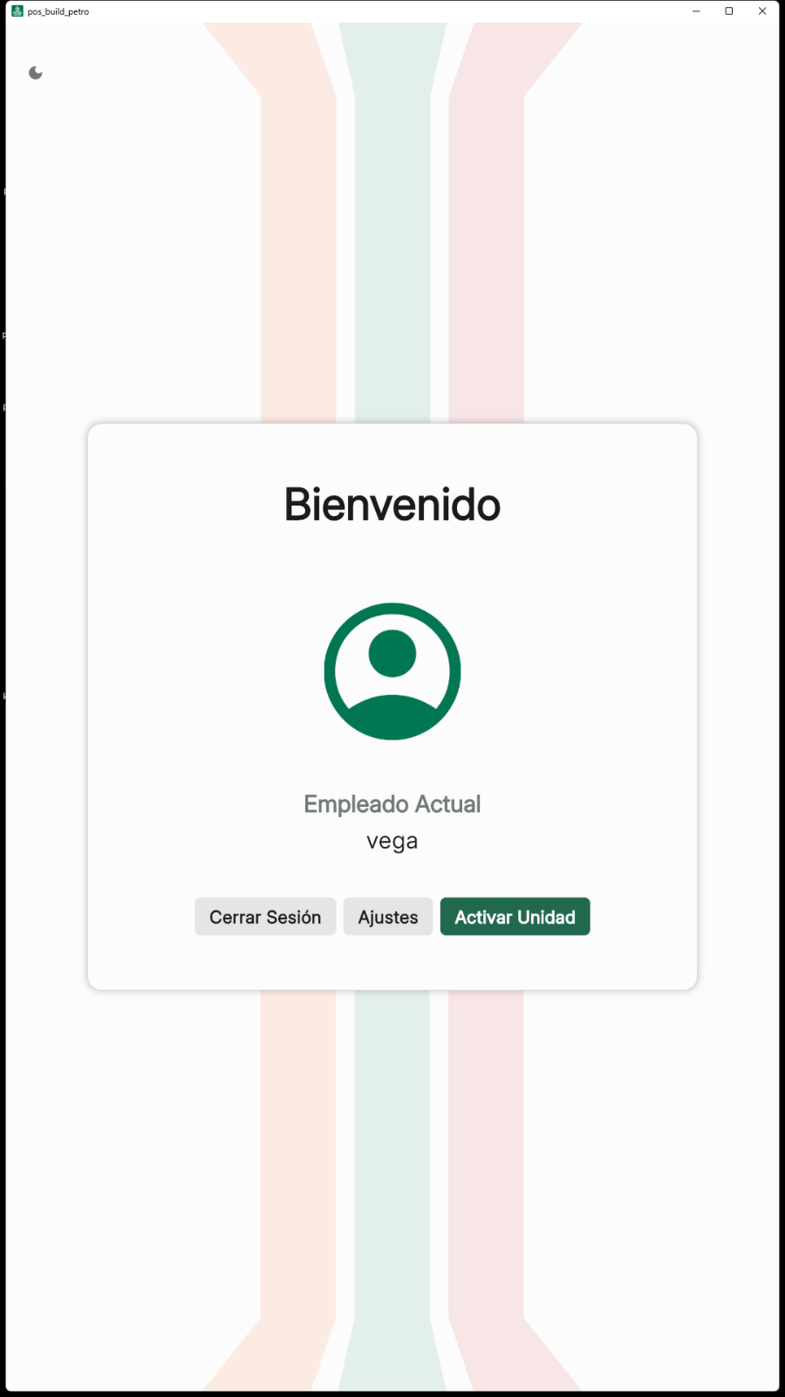
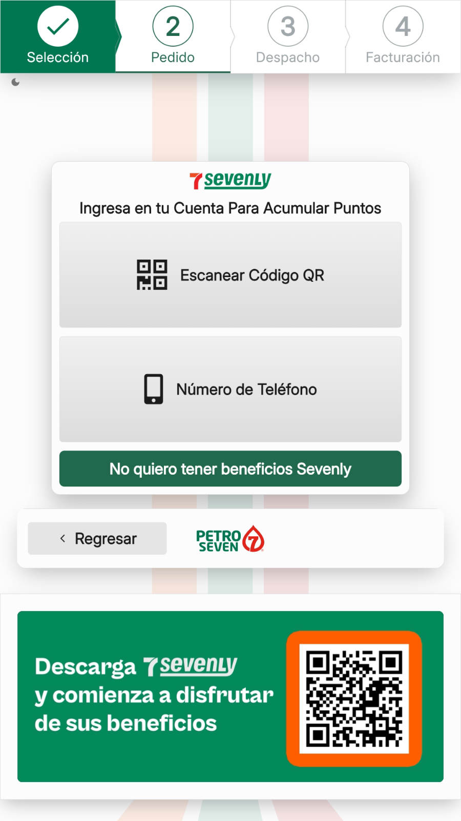
What Has Been Built
The current repo already contains a practical automation base and multiple flow-level building blocks.
Login flow
Login error
Standard employee login, 7ly login, welcome modal, and return-to-start validation.
Negative login coverage using image assets instead of hardcoded coordinates.
Sales path
Desktop simulator
Fuel selection, amount input, payment wait, and benefits prompt evidence.
Virtual pump simulator actions are represented with desktop evidence.
Reusable foundation
Features, assets, screenshots, and report generation are now aligned enough to support the next wave of scenarios.
Crash
Close the kiosco while fueling is in progress
PetroSeven Kiosk Automation Plan
04

Slide 5


Execution Model & Evidence
Automation advances the UI path; human and hardware checkpoints are isolated instead of hidden.
Image assets
Scripted flow
Screenshots
Manual checkpoint
Evidence package
Each automated step can produce screenshots and logs; hardware-dependent steps can be closed with operator video or external proof.
PetroSeven Kiosk Automation Plan
05

Slide 6
Plan to Close the Gap
Priorities that turn the current base into a repeatable delivery workflow.
1
Stabilize execution
Install/verify Behave dependencies and run dry-run plus targeted flows in the real environment.
Operating rule
If a case needs a person, device, ticket, email, or third-party response, the automation still documents the boundary and collects the right evidence.
2
Standardize assets
Move more clicks to image anchors, tighten waits, and keep coordinate fallback explicit.
3
Automate pending cases
Convert the highest-value pending matrix cases into feature tags and evidence-backed flows.
4
Control dependencies
Define manual checkpoints, required test data, and external validation evidence for cases the bot cannot close alone.
PetroSeven Kiosk Automation Plan
06

Slide 7
Completion Timeline
Finish the pending automatable cases first, then organize the full suite into Behave features.
Sprint path
Pending cases to finish
Jun 17-19
Stabilize
After pending cases
19 automatable cases remain, plus 10 station-assisted validations that can run in parallel.
Environment setup.
Jun 24-26, 2026
Login variants
Standard/error cases and controlled credential states.
Complete
Batch 1
Login + sales cases.
Migrate all flows into Behave feature files and tags.
Sales & benefits
Fuel, amount, 7LY prompt, payment wait, and visual checks.
complete
Batch 2
Benefits: tag-based runs, cleaner regression, reusable steps, and clearer QA/dev collaboration.
Invoice / external proof
Invoice flow plus tickets, email, QR, and system-response evidence.
Invoice + 7LY cases.
Dependency controls
Manual checkpoints for pump, RFID, PinPad, test data, and third parties.
Complete
Jun 22 -26
Remaining cases + docs.
Target readiness: Jun 26, 2026
PetroSeven Kiosk Automation Plan
07

Slide 8
Next:
Live Demonstration
We will move from the plan into the automation demo: login, flow execution, evidence capture, and the points where human or environment dependencies are intentionally controlled.
Automation Plan | PetroSeven

