Slide 1

PUNJAB COLLEGE OF TECHNICAL EDUCATION, LUDHIANA
Reduce Reuse Recycle (3Rs Concept)
SUBMITTED TO:MS Harmanjot Kaur
Faculty of MLS
MAIL ID-harmanjot@pcte.edu.in
SUBMITTED BY – Celina A. Dorbor
ADMISSION NO.- 2025MLS2930
IMAIL ID- celinadorbor1@gmail.com

Slide 2
TABLE OF CONTENTS
1. Introduction
2.Reduse
3.Reuse
4.Recycle
5.Advantages
6.Examples
7.Conclusion
8.References

Slide 3
INTRODUCTION
It is a waste management hieracy designed to minimize enviroment impact.This approach saves resources and reduce landfill waste.

Slide 4
Reduce
Most effective step
Focusing on purchasing less.
Avoid buying unused items.
Option for digitals recepts
Advantages
Enviromental Protection
Cost Saving
Examples
Usages of reusble bags
Purchase less packaging products
Repair instead of replace.

Slide 5
Reuse
Extend usage of products
Repairing of items
Again and again uses
Advantages
Container Packaging
Refixing
Secong hand purchasing
Sharing unwanted items
Examples
Reduced Consumption
Less waste
Switch to reusable items

Slide 6
Recycle
Advantages
Conversion of Natural Resources
Pollution Reduction
Economic Benefits
Turning waste into new materials
Diversion of garbage from landfills
Lowering of pollution
Examples
Newpaper-egg cartons
Office paper-face tissues
Bottles caps-car batteries

Slide 7
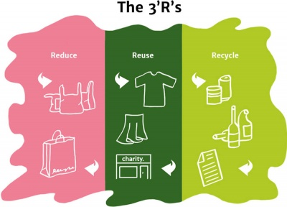

Slide 8
CONCLUSION

Slide 9
REFERENCES
https://www.ils.res.in/three-r-reduce-reuse-recycle/
https://roguedisposal.com/resources/education/recycling/exploring-the-three-rs-of-waste-management-reduce-reuse-recycle

Slide 10


