Slide 1
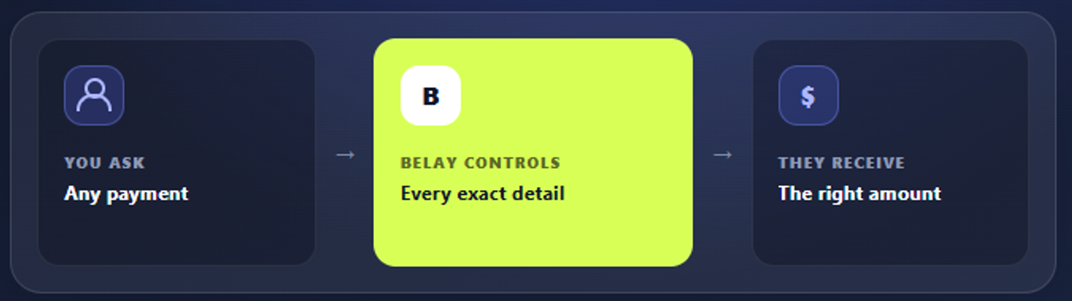
B
belay
B2B INFRASTRUCTURE FOR AGENT PAYMENTS
The control layer between
ONE CONTROL CONTRACT
AI intent and money
Belay turns an AI payment request into exact authority, one controlled execution, and linked proof.
One bounded payment with one linked record
BUILT FOR
AI platforms, fintech operations teams, and financial institutions
TEAM
Abdulaziz
Amir Khan
Yang
Frank
Fintech startup founder
Computer Science sophomore
University of Connecticut
Computer Science and Business sophomore
Harvard
Astrophysics PhD researcher
Northeastern and MIT
Notes:
0:00–0:13 | Speaker: Abdulaziz
AI agents can shop and call payment APIs. The unsolved step is control: did the agent follow the user’s exact instruction, and what happened when the payment result became unclear? Belay is that control layer.
Team biographies were supplied by the user. UConn is the University of Connecticut: https://uconn.edu/about-us/

Slide 2
B
belay
An authorized agent can still pay the wrong thing twice
EXISTING U.S. PAYMENT FLOW
8.1B
The payment API works. The handoff from a human instruction to machine execution can still fail.
01
Ambiguity
B2B ACH payments in 2025
The AI misreads the payee, amount, reference, or deadline.
$63.1T
02
Overreach
Broad permission becomes a payment the user did not mean to approve.
transferred across those payments
03
Uncertainty
Payment flow, not Belay TAM
A lost response looks like failure and triggers a duplicate retry.
Loss, disputes, and manual investigation appear when authority and outcome cannot be proven.
Source: Nacha, 2025 ACH Network statistics
Notes:
0:13–0:32 | Speaker: Amir Khan
Three failures create losses: the AI misreads the payee or amount, broad permission becomes an unintended payment, and a timeout triggers a duplicate retry. This matters across 8.1 billion U.S. B2B ACH payments in 2025. Rails prove money moved, but not that the agent followed the instruction.
Source: Nacha reports 8.08 billion B2B ACH payments valued at $63.11 trillion in 2025. This is existing payment flow, not Belay TAM. https://www.nacha.org/content/ach-network-volume-and-value-statistics
Additional market context, not shown: U.S. Census reports $340.2 billion in seasonally adjusted U.S. retail e-commerce sales in Q2 2026. https://www.census.gov/retail/ecommerce.html

Slide 3
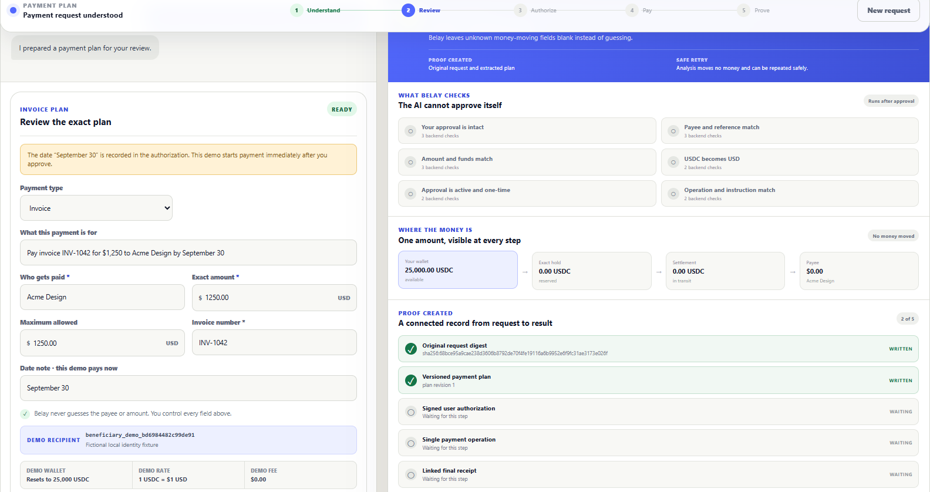
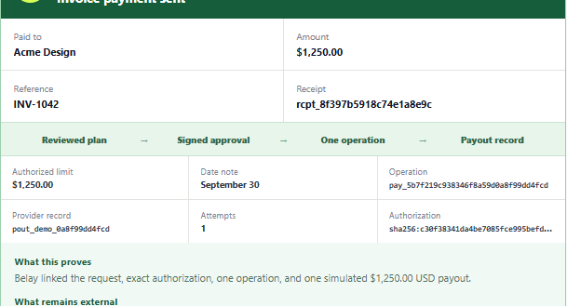
B
belay
One request becomes one controlled payment record
The customer and backend read the same persisted event.
WORKING LOCAL MVP
01
Request
Ask for an invoice, tax payment, insurance premium, or purchase.
02
Review
Belay keeps unknown money details blank until the user supplies them.
03
Authorize once
The approval fixes the payee, amount, reference, and maximum.
04
Execute and prove
Deterministic checks enforce one operation and link the receipt.
SIMULATED USDC IN SIMULATED USD OUT
No live wallet, bank, chain, merchant, or government API is connected in this MVP.
Notes:
0:32–1:03 | Speaker: Abdulaziz | Prefer the live browser; this slide is the static fallback.
Here is the simulator. I ask Belay to pay invoice INV-1042 for $1,250. It builds an editable plan and leaves unknown fields blank. I approve the recipient, amount, reference, and limit. Deterministic checks enforce one operation ID, simulate USDC settlement with USD delivery, and link instruction, approval, and result in one receipt. If a response is lost, Belay checks that operation before any retry.
Demo boundary: the browser, HTTP API, persisted state, revision checks, and ledger run locally. The request extractor, signature, wallet, USDC hold, conversion, USD payout, and payee confirmation are fictional fixtures. The generalized mission UI simulates the normal path. The legacy purchase API contains the implemented lost-payout investigation bridge.

Slide 4
B
belay
Business model, ecosystem, and pre-seed ask
PROPOSED PRICING
RAISING
$2,000 / month
$1.5M
PRE-SEED 18 MONTHS
+ $0.25 per controlled operation
No Belay percentage take rate. External network, conversion, and payout fees pass through.
Security and protocol engineering
$675K
ILLUSTRATIVE ECONOMICS
Regulated settlement integrations
$300K
$36.5K
~85%
$3.65M
Independent security, compliance, legal
$225K
annual revenue per customer
target gross margin
annual revenue at 100 customers
Infrastructure and observability
$150K
WHERE BELAY FITS
Design-partner pilots and operations
$150K
Google AP2
Mandate language
Stripe, Visa, Mastercard
Credentials and rails
MILESTONES
3 design partners 1 regulated corridor
Independent review Low-limit live pilot
Belay
Execution control, recovery, and linked evidence
All pricing, margin, customer, and funding figures are targets. Revenue model assumes 50,000 operations per customer each year.
Notes:
1:03–1:27 | Speaker: Amir Khan
We sell to AI platforms, fintech teams, and financial institutions through subscription and fixed operation fees, with no Belay percentage take rate. Stripe, Google AP2, and payment networks are opening the rails. Belay controls execution and recovery. We are raising $1.5 million for regulated integrations, independent security review, and three design-partner pilots.
Illustrative economics, not traction: $24,000 annual platform fee plus 50,000 operations at $0.25 gives $36,500 annual revenue per customer. Modeled direct cost is $250 per month plus $0.05 per operation, or $5,500 per year, producing a target gross margin of 84.9%. At 100 customers, annual revenue would be $3.65 million. External gas, network, FX, conversion, and payout fees pass through.
Sources:
Google AP2: https://cloud.google.com/blog/products/ai-machine-learning/announcing-agents-to-payments-ap2-protocol
Stripe Agentic Commerce: https://docs.stripe.com/agentic-commerce
Visa Intelligent Commerce: https://usa.visa.com/about-visa/newsroom/press-releases.releaseId.22276.html
Mastercard Agent Pay: https://newsroom.mastercard.com/news/press/2025/april/mastercard-unveils-agent-pay-pioneering-agentic-payments-technology-to-power-commerce-in-the-age-of-ai/
Positioning: AP2 defines a mandate language. Payment providers supply credentials and rails. Belay enforces one controlled, recoverable payment operation and links its evidence.

Slide 5
Notes:
1:27–1:30 | Hold for three seconds. No speech. Keep the slide blank.

