Slide 1
Intel Device Resource Management Library Idea2Reality
Copyright (C) 2017 Intel Corporation. All rights reserved

Slide 2
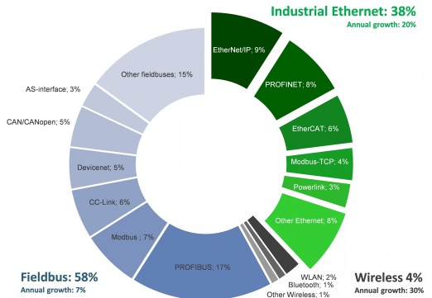
The device connectivity issue is a critical problem for the growth of the industrial IoT
Dozens of industrial bus protocols and standards
Industrial giants favor their own standards
Caused significant development time and cost for industrial IoT projects
Roadblock for generating data fuel to cloud in Industrial segment

Slide 3
Redistributable Plugin solution for ecosystem to create, share and reuse implementation of industrial protocols
A mechanism of implementing/wrapping bus protocols in unified programming interface
Redistributable Plugin solution for carrying the interface implementation
Enable multiple parties to implement different bus protocols
Enable ecosystem to create, share and reuse plugins for industrial protocols, then eventually reach a good coverage and solve the connectivity issues

Slide 4
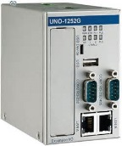
Key Design Concept
Integrated IoT APP programming model
Single application
Provide plugin container and RESTFUL call interface among plugins
Provide plugin SDK for developing plugin for industrial bus
Provide resource broker and IoT app SDK for user applications to access devices
Device connector
IoT Logical
Cloud connector
Plugin SDK
App SDK
Device connector plugin
IoT APP
Cloud connector plugin
Device connector plugin
IoT APP
Cloud connector plugin
Decoupled IoT APP programming model

Slide 5
Software Architecture
User developed edge App
User developed Bus Plugin
Software and Configuration management (AMS)
IoT App SDK
iAgent Process
IoT App
IoT App
iAgent Core
Plugin Container
IoT App
IoT App
Industrial Bus Plugin SDK
iAgent library (Java/Python)
Modbus
LWM2M
S7
PROFIBUS
…
Java Runtime Engine/Python
OS (Linux, Open WRT)
5

