Slide 1
S
A
B
C
D
S
C
S
A
B
D
E
F
......

Slide 2
S
A
B
C
D
C
D
E
F
C
F
D
E
F
C
F
G

Slide 3
S
A
B
C
D
C
E
F
F
E
F
G

Slide 4
F
B
E
C
A
D
I
G
H

Slide 5
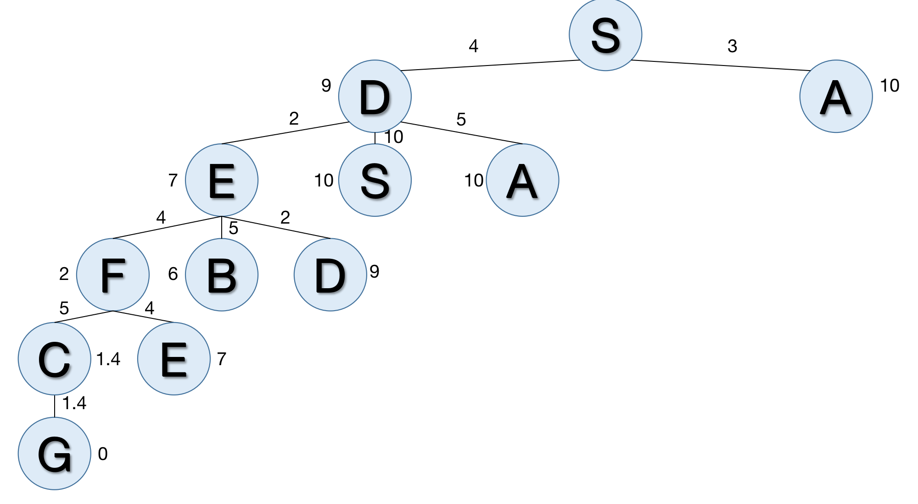
S
A
D
S
B
D
E
S
A
A
D
A
C
E
E
S
A
D
F
B
A
D
S
B
D
S
B
D
E
S
A
S
B
D
G

Slide 6
3
S
4
A
D
13
14
4
3
5
13
B
S
D
16
17
4
5
4
12.4
C
E
A
19
21
1.4
G
12.4

Slide 7
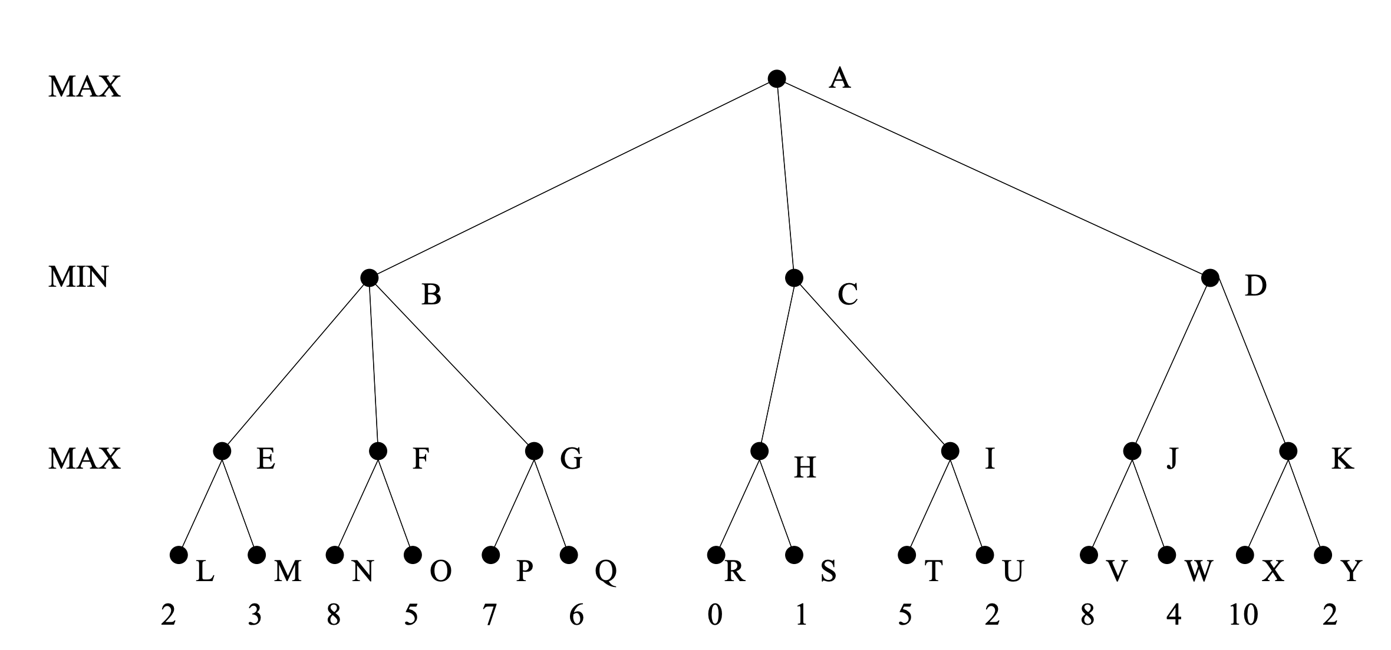
8
3
1
8
3
8
7
1
5
8
10

Slide 8
8
3
1
8
3
8
7
1
5
8
10

Slide 9
8
3
1
8
3
8
7
1
5
8
10

Slide 10
(￢P∨Q∨S∨T)
￢T
￢Q
(￢U∨T∨￢S)
(￢U∨T∨P)
U
(￢P∨Q∨S)
(￢U∨￢S)
(￢U∨P)
(￢P∨S)
￢S
P
￢P
Contradiction! {}

Slide 11
[∀w Like(Tony,w) ⇒ ￢Like(Mike, w)] ∧ [∀w ￢Like(Tony,w) ⇒ Like(Mike, w)]
Like(Tony, Rain) ∧ Like(Tony, Snow)
∀p ￢Skier(p) ∨ Like(p, snow)
∀m BelongTo(m, Alpine Club) ⇒ Skier(m) ∨ MountainClimber(m)
BelongTo(Mike, Alpine Club)
￢[∃p BelongTo(p, Alpine Club) ∧MountainClimber(p) ∧ ￢Skier(p)]
∀w Like(Tony,w) ⇒ ￢Like(Mike, w)
Like(Tony, Snow)
{w/Snow}
￢Like(Mike, Snow)
{p/Mike}
{m/Mike}
∃p ￢BelongTo(p, Alpine Club) ∨ ￢[MountainClimber(p) ∧ ￢Skier(p)]
Skier(Mike) ∨ MountainClimber(Mike)
{p/Mike}
￢Skier(Mike)
MountainClimber(Mike)
￢[MountainClimber(Mike) ∧ ￢Skier(Mike)]
MountainClimber(Mike) ∧ ￢Skier(Mike)
Empty Resolution!
Contradiction!
{}

Slide 12
put-table(B)
State0
put-on(D,B)
State1
put-on(B,D)
State2
State3
put-on(A,D)
put-on(D,B)
put-table(A)
put-on(A,B)
put-table(A)
put-on(A,B)
put-on(D,A)
State4
State5
State6
State7
State8
State9
State10

Slide 13
State0: On(B, A), On(A, C), On(C, Table), On(D, Table), Clear(B), Clear(D). State1: On(B, Table), Clear(A), On(A, C), On(C, Table), On(D, Table), Clear(B), Clear(D). State2: On(A, C), On(B, D), On(C, Table), On(D, Table), Clear(A), Clear(B). State3: On(D, B), On(B, A), On(A, C), On(C, Table), Clear(D). State4: On(A, D), On(B, Table), On(C, Table), On(D, Table), Clear(A), Clear(B), Clear(C). State5: On(A, Table), On(B, Table), On(C, Table), On(D, Table), Clear(A), Clear(B), Clear(C), Clear(D). State6: On(A, B), On(B, Table), On(C, Table), On(D, Table), Clear(A), Clear(C), Clear(D). State7: On(A, C), On(B, Table), On(C, Table), On(D, A), Clear(B), Clear(D). State8: On(A, C), On(B, D), On(C, Table), On(D, Table), Clear(A), Clear(B). State9: On(A, Table), On(B, D), On(C, Table), On(D, Table), Clear(A), Clear(B), Clear(C). State10: On(A, C), On(B, Table), On(C, Table), On(D, A), Clear(B), Clear(D). State11: On(A, B), On(B, Table), On(C, Table), On(D, Table), Clear(A), Clear(C), Clear(D). State12: On(A, D), On(B, A), On(C, Table), On(D, Table), Clear(B), Clear(C). State13: On(A, D), On(B, C), On(C, Table), On(D, Table), Clear(A), Clear(B). State14: On(A, D), On(B, Table), On(C, A), On(D, Table), Clear(B), Clear(C). State15: On(A, D), On(B, Table), On(C, B), On(D, Table), Clear(A), Clear(C). State16: On(A, D), On(B, Table), On(C, Table), On(D, Table), Clear(A), Clear(B), Clear(C).

Slide 14
B
(1)
A
(3)
D
C
D
(2)
B
B
A
A
B
A
C
D
(5)
(6)
C
D
C
(4)
(7)
(8)
D
A
A
A
D
A
B
C
D
B
C
D
A
B
C
D
B
C
B
C
(9)
(10)
(11)
(12)
B
C
A
C
A
B
A
A
C
D
B
D
C
D
B
D
(13)
C
B
GOAL CONDITION REACHED!
A
D

Slide 15
B
2
A
C
D
1
1
1
D
4
B
4
A
B
4
A
B
A
C
D
C
C
D
1
1
1
1
1
4
1
1
D
B
A
A
5
A
6
D
A
6
A
4
A
B
5
B
C
D
B
C
D
A
B
C
D
B
C
B
C
C
D
C
D
5
1
1
1
1
B
4
4
5
C
5
A
C
A
B
A
A
C
D
B
D
C
D
B
D
1
C
4
B
GOAL CONDITION REACHED!
A
D

