Slide 1
S
A
B
C
D
S
C
S
A
B
D
E
F
......

Slide 2
S
A
B
C
D
C
D
E
F
C
F
D
E
F
C
F
G

Slide 3
S
A
B
C
D
C
E
F
F
E
F
G

Slide 4
F
B
E
C
A
I
D
G
H

Slide 5
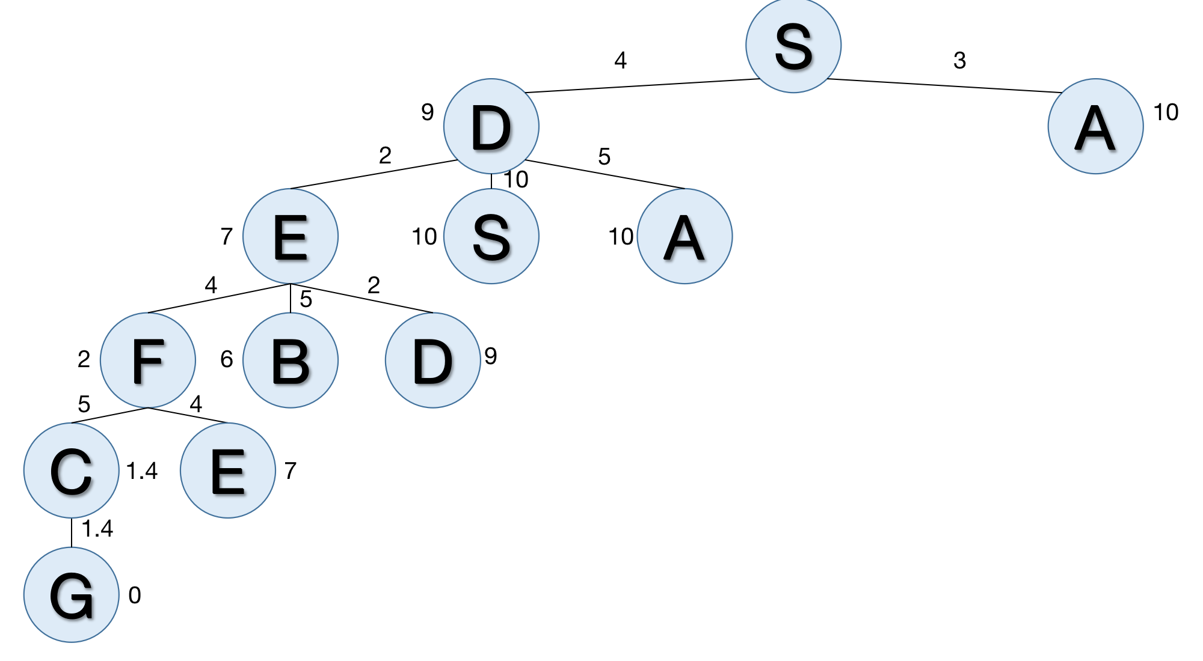
S
A
D
S
B
D
E
S
A
A
D
A
C
E
E
S
A
D
F
B
A
D
S
B
D
S
B
D
E
S
A
S
B
D
G

Slide 6
S
3
4
13
A
D
14
4
5
3
B
S
D
13
16
17
4
5
4
C
E
A
12.4
19
21
1.4
G
12.4

Slide 7
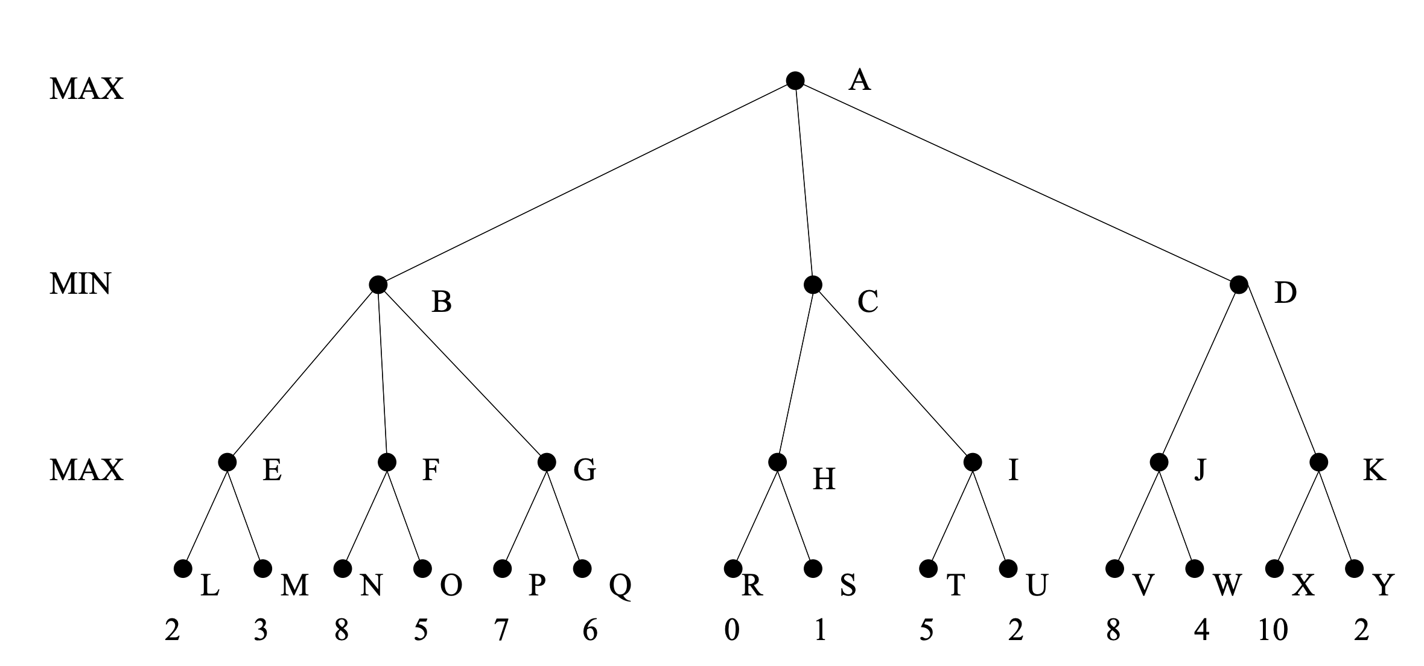
8
3
1
8
3
8
7
1
5
8
10

Slide 8
8
3
1
8
3
8
7
1
5
8
10

Slide 9
8
3
1
8
3
8
7
1
5
8
10

Slide 10
(￢P∨Q∨S∨T)
￢T
￢Q
(￢U∨T∨￢S)
(￢U∨T∨P)
U
(￢P∨Q∨S)
(￢U∨￢S)
(￢U∨P)
(￢P∨S)
￢S
P
￢P
Contradiction! {}

Slide 11
A→G，A

