Slide 1
Electron and Hadron Polarimetry
WBS 6.03.01.11
Frank Rathmann
Dave Gaskell
L3 Manager WBS 6.03.01.11
L4 Manager WBS 6.03.01.11.01
BNL
JLab
Director's Review of the EIC Detector Subproject to Assess Baseline Readiness
February 3rd – 5th, 2026

Slide 2
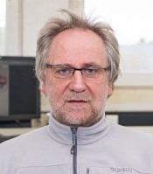

About us
Frank Rathmann
L3 Manager Polarimetry: WBS 6.03.01.11
Joined BNL in 2023
Expertise:
Polarized sources, beams, and polarimetry
Symmetry violations
PhD 1994, Habilitation 2000​
Dave Gaskell
L4 Manager Electron Polarimetry: WBS 6.03.01.11.01
Staff scientist at JLab since 2002
Expertise:
Moller and Compton electron polarimetry
Hadronic physics (nuclear effects, SIDIS, exclusive reactions)
PhD 2001

Slide 3
Outline
Requirements
Scope Summary and Definition
Dependencies
Recommendations
Technical Progress
Major Interfaces
Quality Assurance
Major Acquisition Plan
Production Planning
Schedule
Costs
Staffing
Risks
Cost Trace Examples
Summary

Slide 4
Charge Questions
Is the design of the EIC Detector (ePIC) Subproject technically sound, sufficiently mature and on a trajectory to support a CD-2 baseline in FY2026? Will the DET subproject be ready for a DOE CD-2 review in the 4Q FY26?
Is the Detector scope well defined, with clear responsibilities? Does the baseline, including U.S. and international contributions, reflect full scope and requirements? Is the scope integrated into the EIC subproject structure such that future design evolution of complementary scope in other subprojects will not cause excessive rework or costly redesigns? Are interfaces clearly defined and controlled?
Are the DET cost and schedule estimates sufficiently complete and reliable and on a trajectory to establish baseline on the projected timeline? Do the estimates include adequate cost, schedule, and scope contingency to address the risks inherent in the remaining work and are the risks being properly managed?
Is the DET subproject being properly managed (e.g., properly organized, adequately staffed) for its successful execution? Does the baseline include the full scope, with mechanisms to manage international contributions?
Are ES&H, Procurement, and Quality being properly addressed? Is performance on CD-3A items related to DET scope satisfactory? No CD-3a/b scope
Has the project responded appropriately to recommendations from prior DOE/SC reviews?

Slide 5
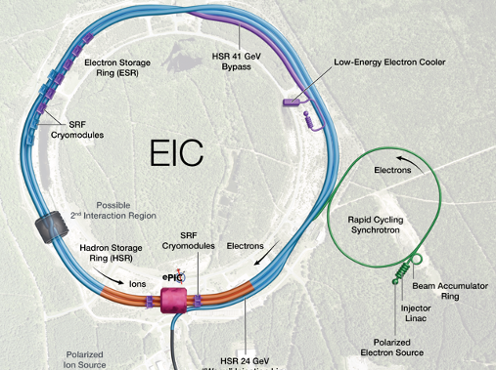
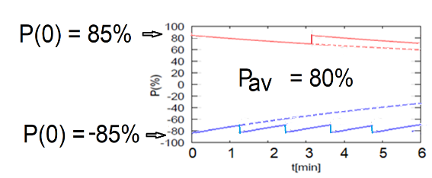
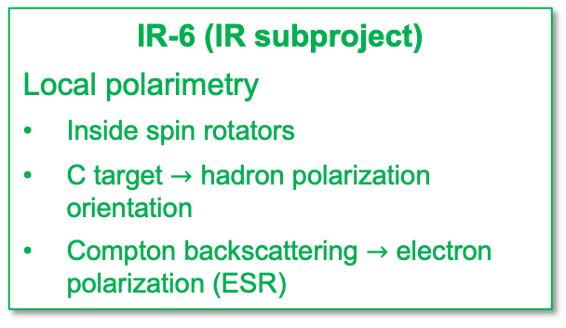
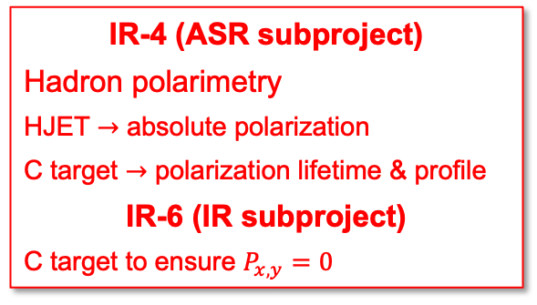

Scope Introduction
Charge #1, #5
IR-6 (IR subproject)
Local polarimetry
Inside spin rotators
C target $→$ hadron polarization orientation
Compton backscattering $→$ electron polarization (ESR)
RCS (EIN subproject)
Compton backscattering for electron polarization
IR-4 (ASR subproject)
Hadron polarimetry
HJET $→$ absolute polarization
C target $→$ polarization lifetime & profile
IR-6 (IR subproject)
C target to ensure $P_{x,y}=0$
$$10 \text{ns}$$
transverse
longitudinal
Electron and hadron bunches stored for several hours.

Slide 6
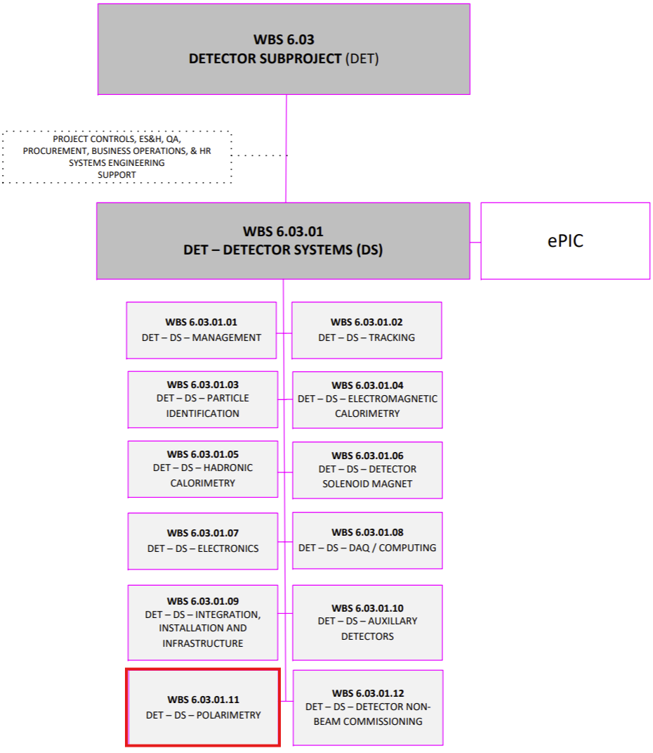
Scope Summary
Charge #1
6.03.01.11 | DET - DS - Polarimetry | F. Rathmann (BNL)
Scope Description: Includes all design and construction activities needed for hadron and electron beam polarimetry in the hadron SR and the lepton RCS and ESR.

Slide 7
Scope Definition (from WBS, abbreviated)
Charge #1
h-Polarimetry:
Upgrade hadron polarimeters to the needs for EIC physics and machine requirements.
Needs absolute polarization measurement and measurements
Provide polarization lifetime and polarization over transverse size of hadron bunch
Design and constructing of hadron polarimeter in IR to measure degree of spin orientation
Particularly critical if direction of hadron beam polarization is longitudinal
Hadron Polarimetry HJET:
Update current RHIC polarimeters to reach
Required systematic uncertainties ~1%, and work under more demanding EIC machine parameters
Avoid beam induced depolarization of target atoms
Stronger magnetic guide field needed to operate the HJET
Background determination for unpolarized H2 molecules by implementation of quadrupole mass spectrometer
New DAQ-systems, new silicon detectors for both the HJET (IR-4) and pC polarimeters (IR-4) and a new target station for the pC polarimeters (in IR-6).
Hadron Polarimetry Fiber Targets:
pC polarimeter located as close as possible to IP between spin rotators
proper location identified for second double-target pC polarimeter near IR-6
New setup with silicon detectors and data acquisition system needed
Both systems at IR-4 and IR-6 capable to handle much higher EIC bunch repetition frequency compared to RHIC
pC target systems need to avoid wake field excitation due to metallic target holders.

Slide 8
Scope Definition (from WBS, abbreviated)
Charge #1
e-Polarimetry:
Includes activities to design and construct the electron polarimeters for RCS and ESR
Lepton Polarimetry in the Storage Ring:
Design and construct a Compton polarimeter with a systematic uncertainty of order 1% and high statistical precision to measure polarization bunch-by-bunch.
Measure both Compton scattered lepton and backscattered Compton photon.
Compton polarimeter consists of a laser system, 1 electro magnetic calorimeter, 2 position sensitive detectors, their readout electronics and DAQ system and lepton and laser beam position control systems.
Lepton Polarimetry in the RCS:
Design and construct Compton polarimeter for RCS.
Development critical as RCS parameters of 100 ms ramp from 400 MeV to 18 GeV with 1Hz ramp repetition rate and 10 nC in bunch are demanding to measure polarization.
Measure only backscattered Compton photon.
Compton polarimeter consists of laser system, 1 electro magnetic calorimeter, 1 position sensitive detector, their readout electronics and DAQ system and lepton and laser beam position control systems.

Slide 9
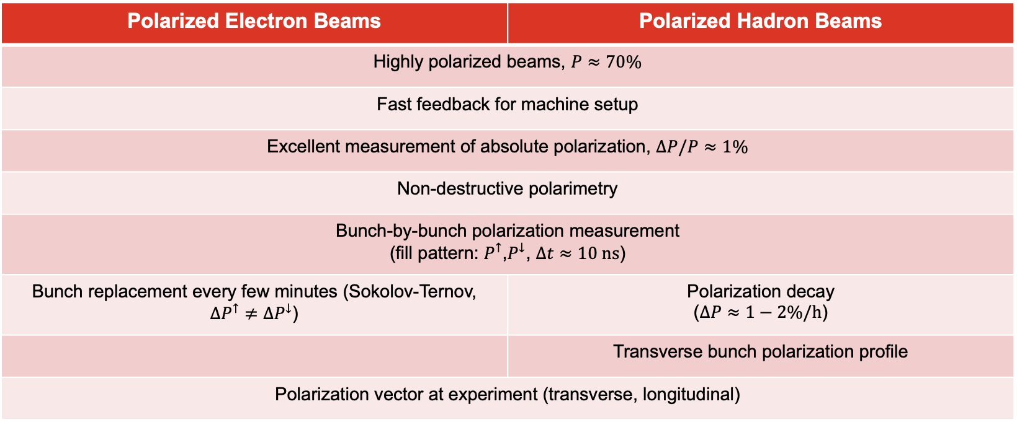
High Level Requirements
Charge #2
Polarized Electron Beams | Polarized Hadron Beams
Highly polarized beams, $P≈70\%$
Fast feedback for machine setup
Excellent measurement of absolute polarization, $ΔP/P≈1\%$
Non-destructive polarimetry
Bunch-by-bunch polarization measurement (fill pattern: $P^{↑}$,$P^{↓}$, $Δt≈10 ns$)
Bunch replacement every few minutes (Sokolov-Ternov, $∆P^{↑}≠∆P^{↓}$) | Polarization decay ($∆P≈1−2\%/h$)
 | Transverse bunch polarization profile
Polarization vector at experiment (transverse, longitudinal)
Detector system requirements for Electron Polarimetry and Hadron Polarimetry listed in https://eic.jlab.org/Requirements/DET.html and here.

Slide 10
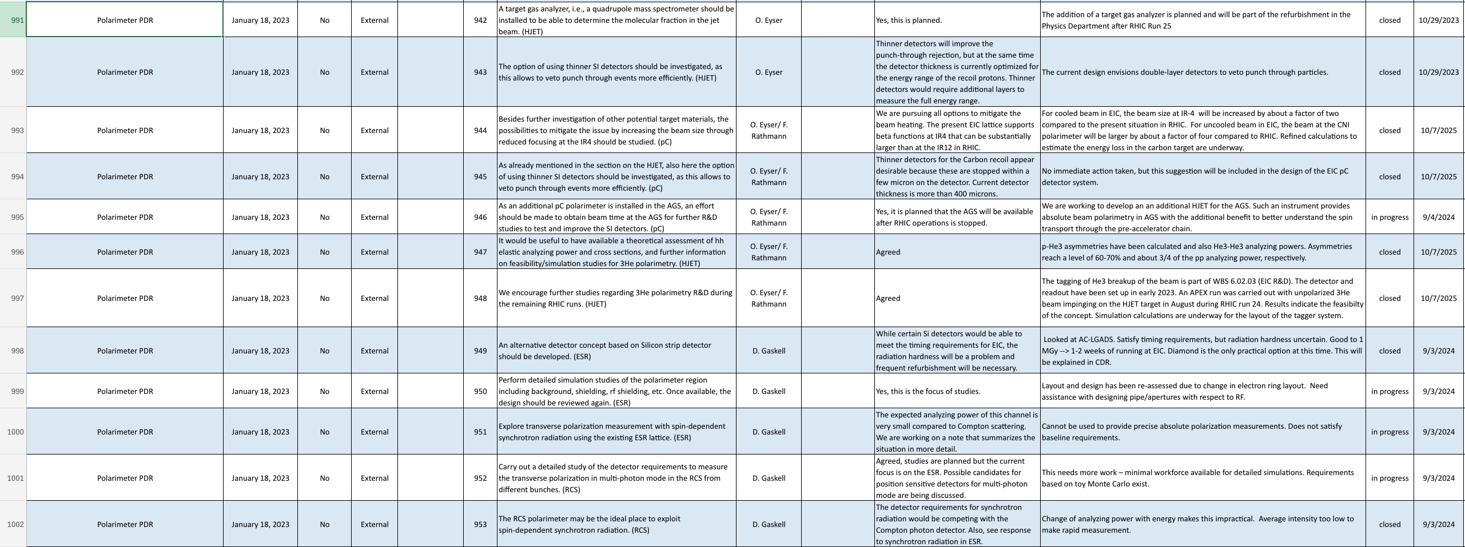
Recommendations
Charge #6

Slide 11
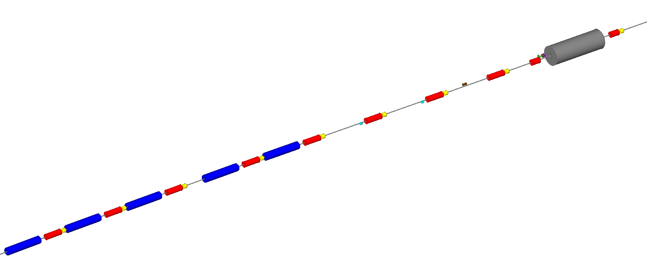
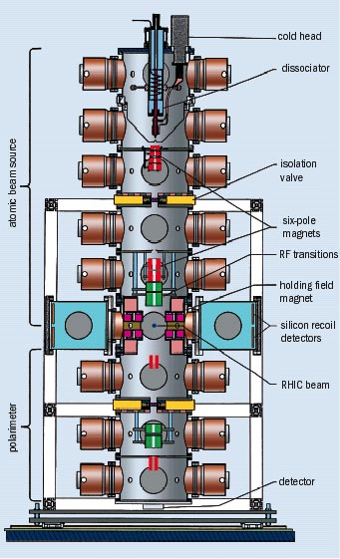
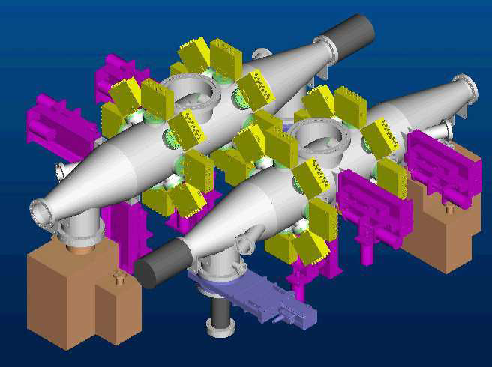
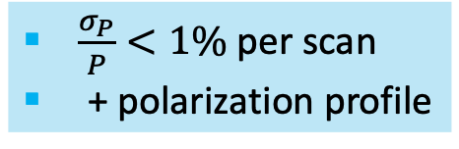

Polarimeters
Charge #1
Compton Polarimeter Components:
Laser system (under development)
Position sensitive detectors (diamond strips) for scattered electrons and backscattered photons
Calorimeter for backscattered photons
Laser IP​
74 m upstream of IP-6
Photon Detector
(30 m from Laser IP)
Crab cavity
Electron Detector
Q3EF
D2EF
D3EF
θ_{B}=13 mr
Q4EF
Q5EF
D4EF
θ_{B}=1.5 mr
Q6EF
D5EF
θ_{B}=1.5 mr
Q7EF
ESR will operate in single-photon mode, RCS in multiphoton mode
D6EF
θ_{B}=12 mr
*
Q8EF
ESR Compton layout
Q10EF
Q9EF
HJET polarimeter provides absolute measurements, but slow:
pC polarimeter provides fast, relative measurement:
$\frac{σ_{P}}{P}<1\%$per scan
+ polarization profile
$\frac{σ_{P}}{P}≈3\%$per 4 hours

Slide 12
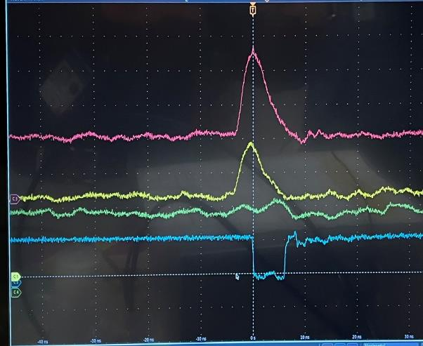
Tech. Progress: ESR Laser and Position Detector
Charge #2
Laser system based on similar system used in JLab injector and LERF
Fiber amplifier obtained - work underway in Compton polarimetry laser lab at JLab
Diamond strip detectors will be used for position-sensitive measurements
Custom ASIC readout required
New “FLAT32” chip based on “CALYPSO” (used at LHC) developed for JLab/MOLLER (complete)
Meets timing requirements of EIC (10 ns)
RCS polarimeter will use same detectors as ESR
→ different laser (low duty cycle, commercially available)
10 ns

Slide 13
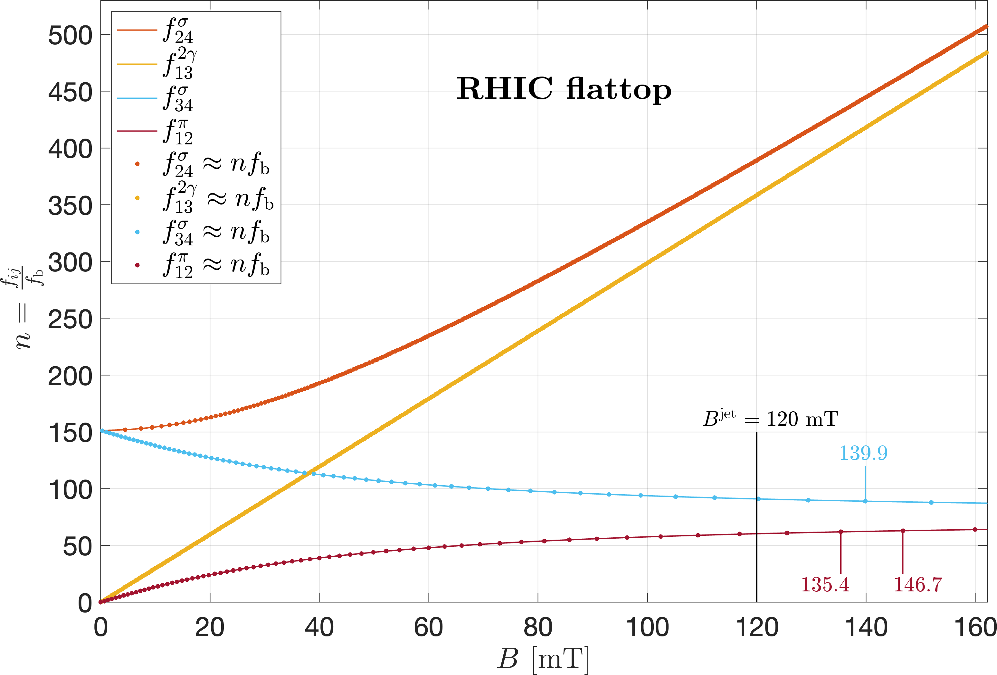
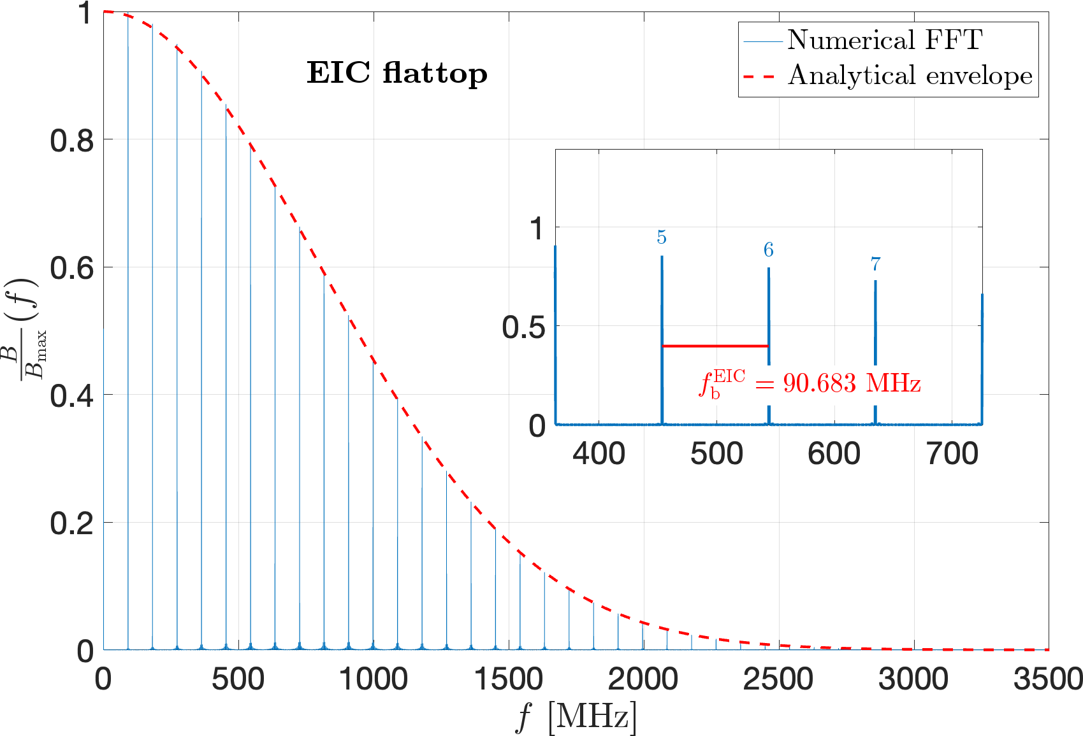
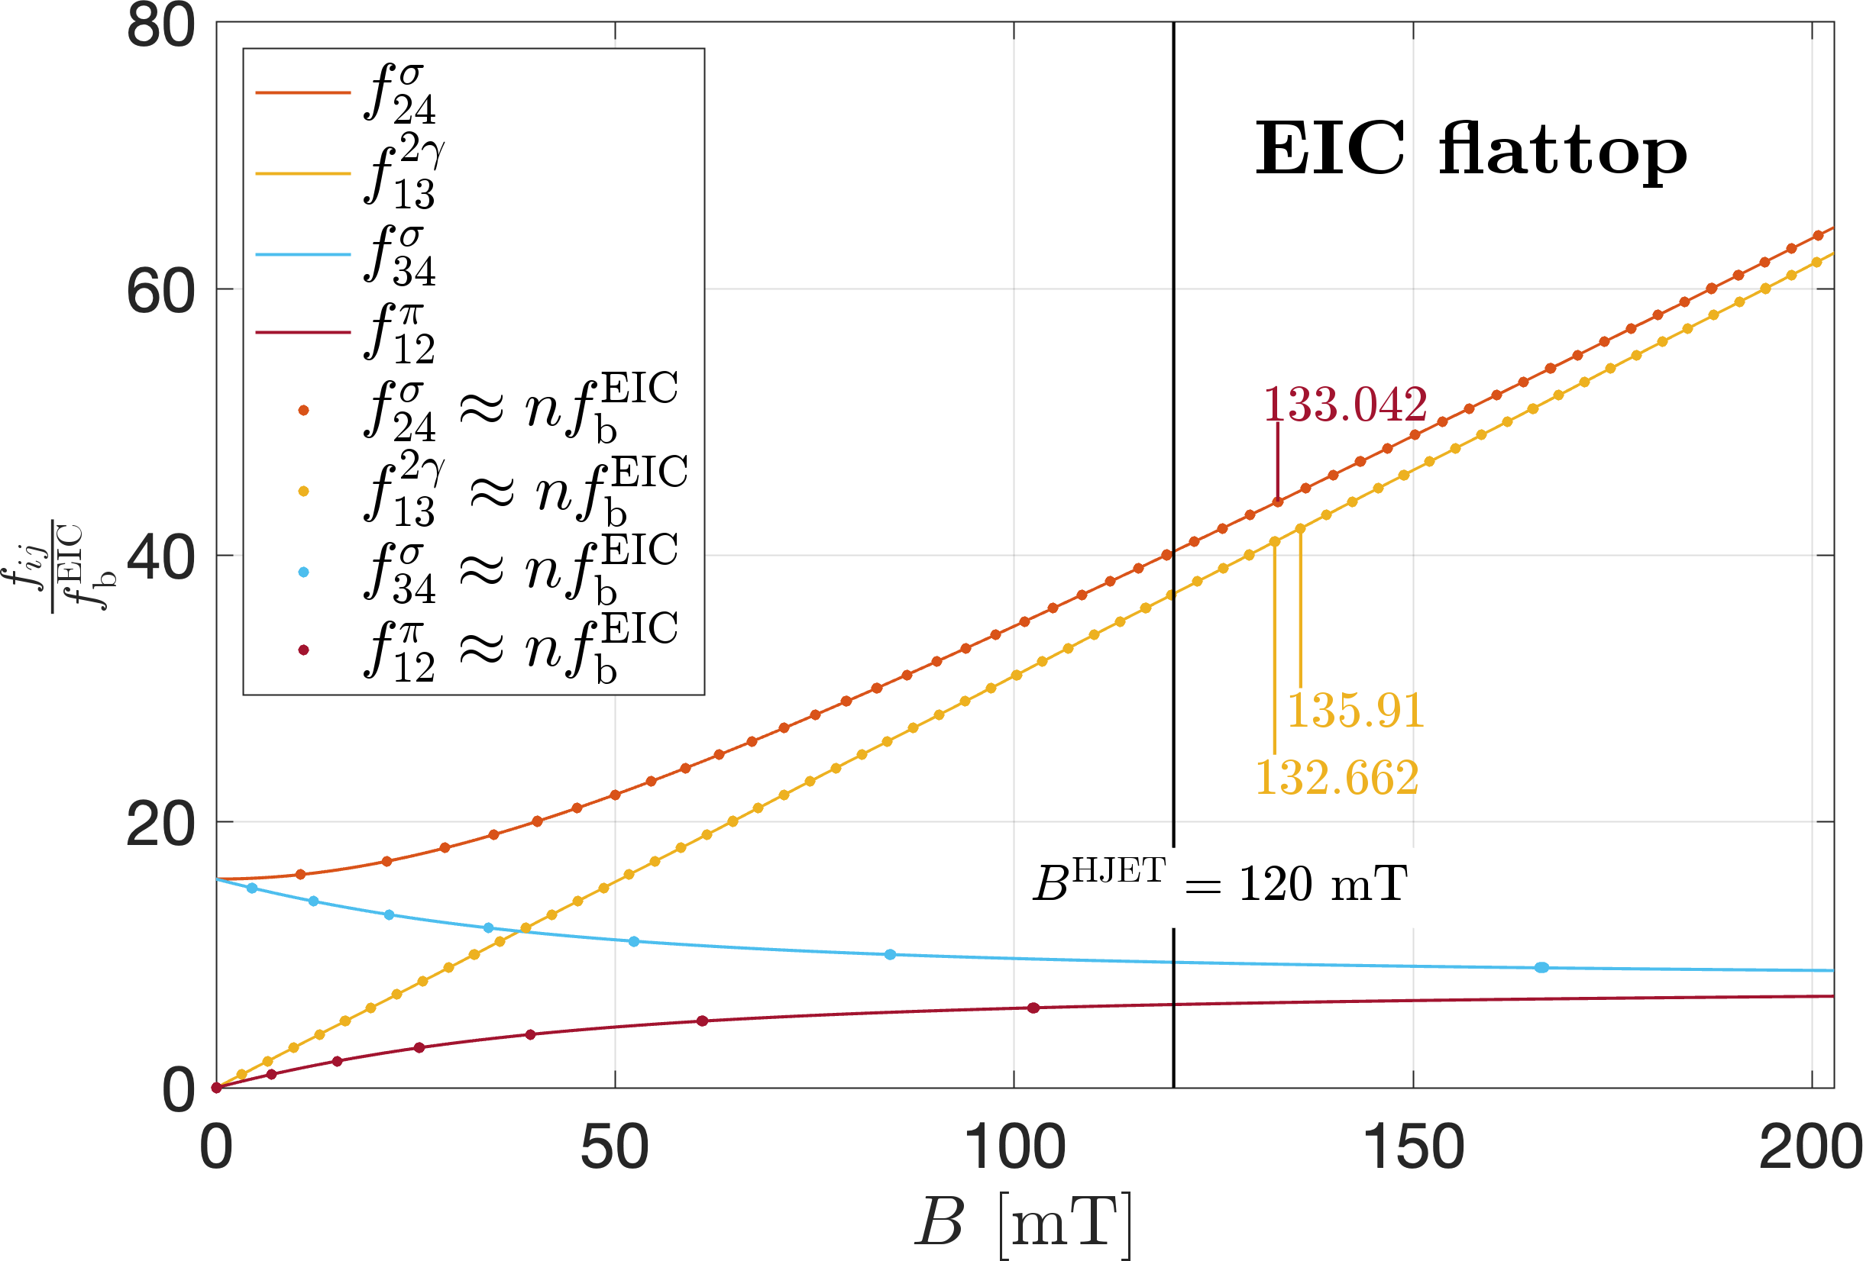
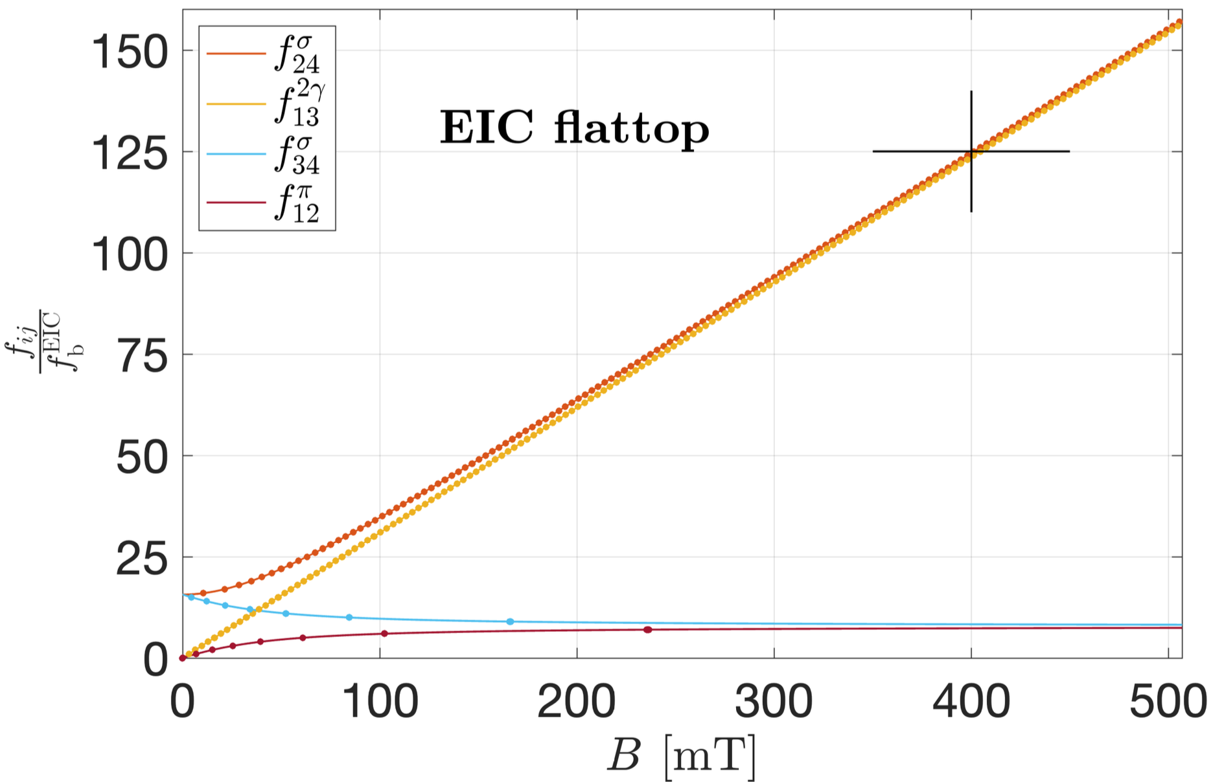
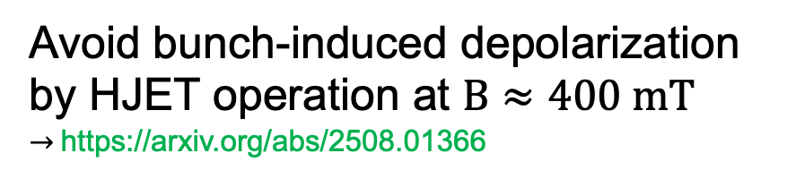
Tech. Progress: Bunch-induced depol.
Charge #2
No operation like that at EIC
Bunch repetition frequency increased by factor of 10. RHIC: $9.381 MHz, \text{EIC}: 90.683 MHz$
ok
Avoid bunch-induced depolarization by HJET operation at $B≈400 mT$ $→$https://arxiv.org/abs/2508.01366
Operate
HJET here
13

Slide 14
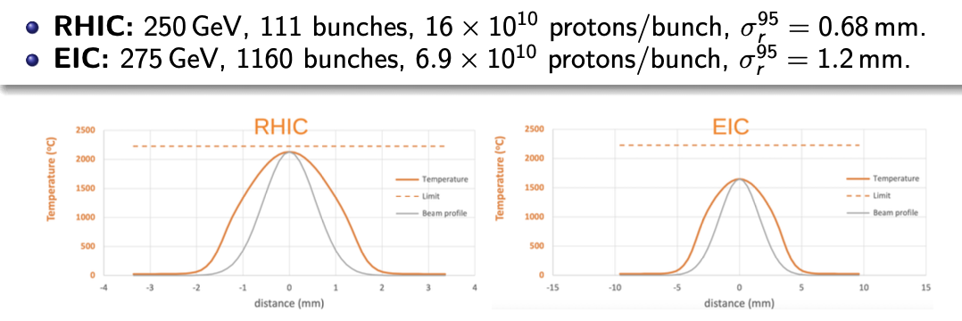
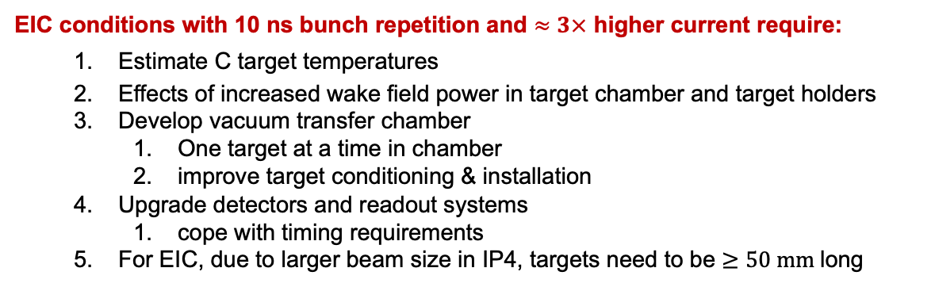

Technical Progress : pC polarimeter
Charge #2
EIC conditions with 10 ns bunch repetition and $≈3×$ higher current require:
Estimate C target temperatures
Effects of increased wake field power in target chamber and target holders
Develop vacuum transfer chamber
One target at a time in chamber
improve target conditioning & installation
Upgrade detectors and readout systems
cope with timing requirements
For EIC, due to larger beam size in IP4, targets need to be $≥50 mm$long
With realistic beam sizes at IP4, target heating at EIC reduced compared to EIC: (code P. Thieberger)
RHIC: 250 GeV, 111 bunches, $16×{10}^{10}$p/bunch, $σ_{r}^{95}=0.68 mm$
EIC: 275 GeV, 1160 bunches, $.96×{10}^{10}$p/bunch, $σ_{r}^{95}=1.2 mm$
$→$ changed ID #128 in Risk Registry to low
Independent modeling approach of C target heating by proton beams (in progress)
14

Slide 15
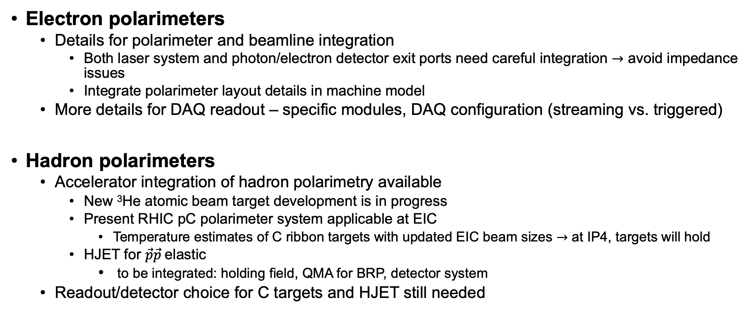
Technical Path Forward
Charge #2
Electron polarimeters
Details for polarimeter and beamline integration
Both laser system and photon/electron detector exit ports need careful integration $→$ avoid impedance issues
Integrate polarimeter layout details in machine model
More details for DAQ readout – specific modules, DAQ configuration (streaming vs. triggered)
Hadron polarimeters
Accelerator integration of hadron polarimetry available
New ³He atomic beam target development is in progress
Present RHIC pC polarimeter system applicable at EIC
Temperature estimates of C ribbon targets with updated EIC beam sizes $→$ at IP4, targets will hold
HJET for $\vec{p}\vec{p}$elastic
to be integrated: holding field, QMA for BRP, detector system
Readout/detector choice for C targets and HJET still needed

Slide 16
Dependencies
Charge #1,2
No internal dependencies (no CD3a/CD3b scope)
Off-project activities Electron polarimetry (6.03.01.11.01)
Movement and preparation of mobile laser lab | To be ready end of Q3/2028 | 0.5 FTE
EH&S support for laser lab operation | Starting Q3/2028
Laser safety training | Ready by Q3/2028
ESR laser system support
Off-project activities Hadron Polarimetry (6.03.01.11.02)
Workspace preparation at highbay | To be ready end of Q3/2025 | 0.25 FTE
Rigging | Two periods: end of 2024 and end of 2029 | 1 FTE
Update and refurbishment of existing equipment

Slide 17
Major Interfaces
Charge #4
All interfaces for the polarimeters have been identified
https://eic.jlab.org/Documents/DET/Interfaces/DET-Interfaces-Current.pdf
Draft internal interface control document for electron polarimeters
https://eic.jlab.org/Documents/DET/Interfaces/ICD-Current/DET-DS-POL-EPOL-Internal-ICD.docx
Final internal interface control document for hadron polarimeters
https://eic.jlab.org/Documents/DET/Interfaces/ICD-Current/DET-DS-POL-HPOL-Internal-ICD.docx
Several draft external interface control documents for both polarimeters to be completed

Slide 18
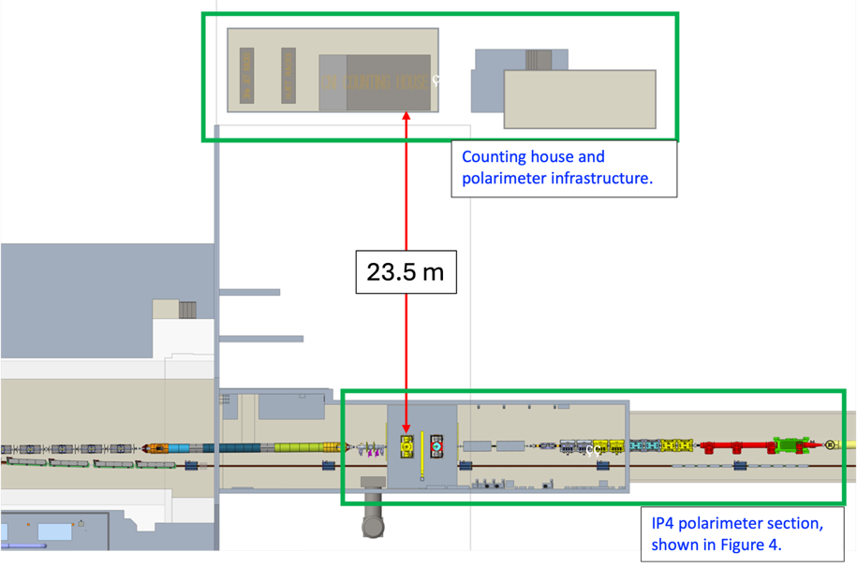
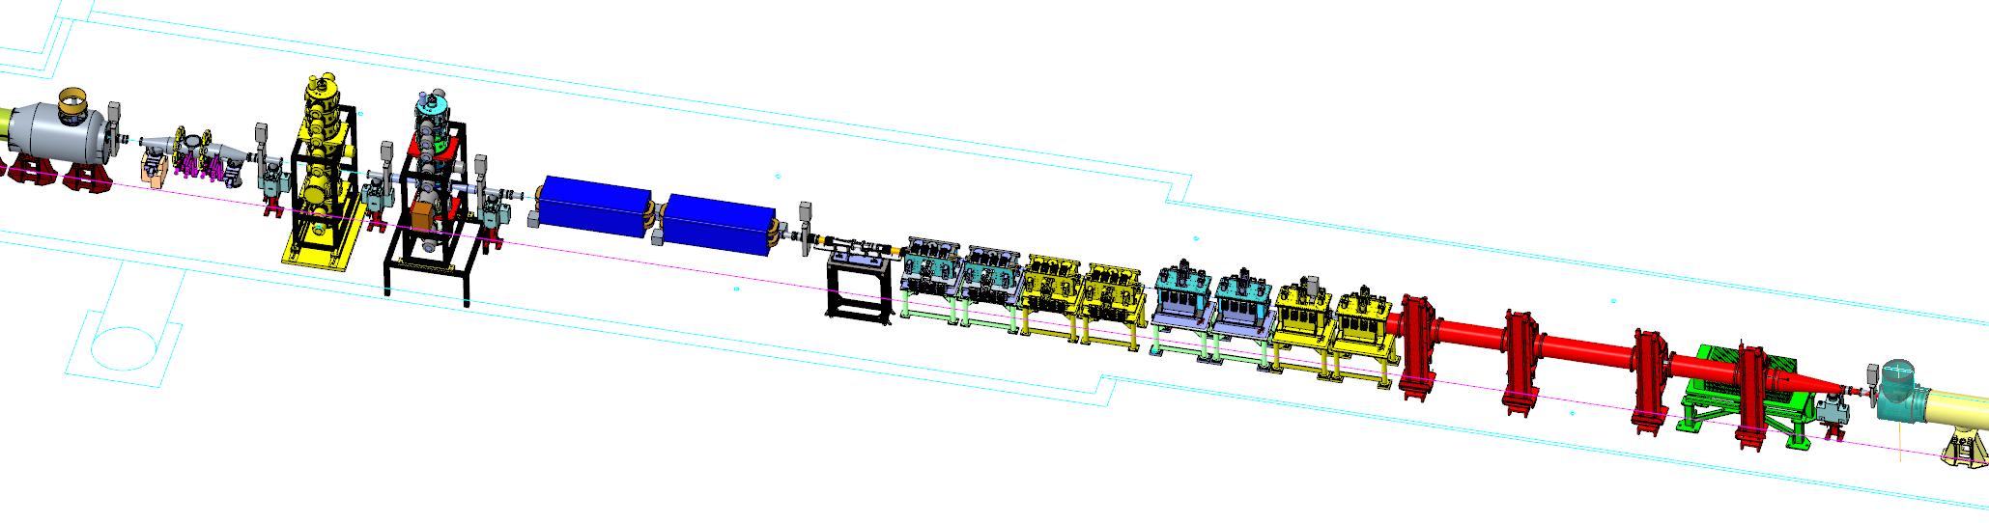
Example: Interface for hadron polarimeters
Hadron Polarimetry Systems (6.03.01.11.02) to Detector System (6.03.01)
Overview interface relationships
Sub-systems within Detector System with interfaces to the Hadron Polarimetry Systems.
DAQ and Computing Systems (DET-DS-COMP):
Interface relationship between ICD reference & sub-system
Electronic Systems (DET-DS-ELEC):
Interface relationship between ICD reference & sub-system
Counting house and polarimeter infrastructure
Triplet (Q3)
CNI
3He Jet
HJet
Longit SC Pickup
2X Warm D0
IP4 polarimeter
section
4X Horiz SC Kicker
4X Vert SC Kicker
HJet Tagger Drift /
Tagging System
Ion Pump
Q4
HSR

Slide 19
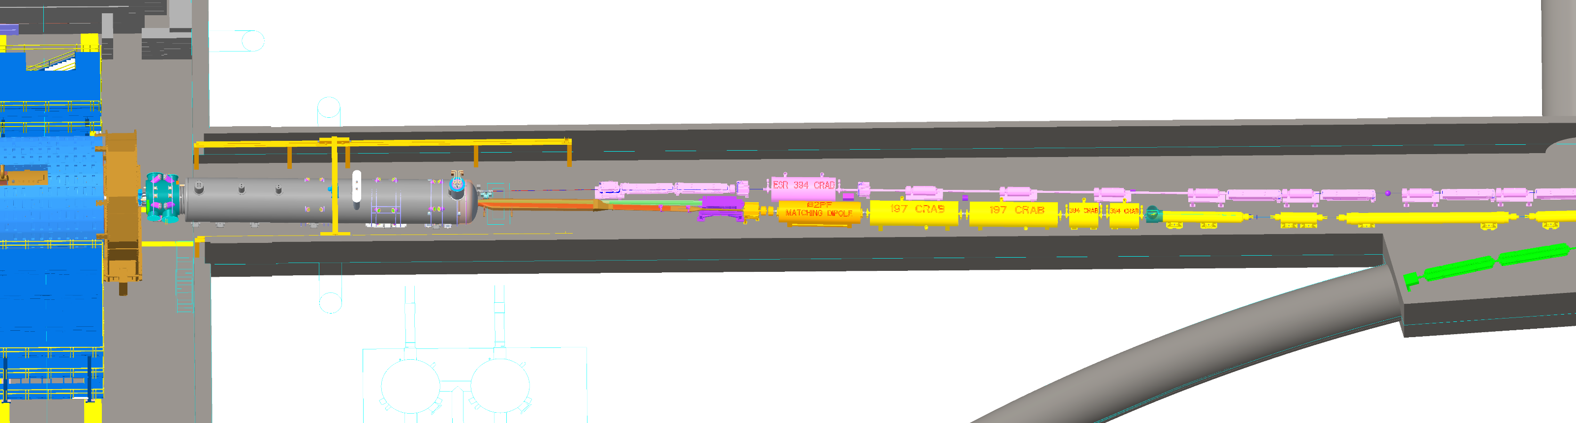
Example: Interface for electron polarimeters
Electron Polarimetry Systems (6.03.01.11.01) to Detector System (6.03.01)
Overview interface relationships
Sub-systems within Detector System with interfaces to the Electron Polarimetry Systems.
DAQ and Computing Systems (DET-DS-COMP):
Interface relationship between ICD reference & sub-system
Electronic Systems (DET-DS-ELEC):
Interface relationship between ICD reference & sub-system
Counting House DAQ and slow controls
Crab Cavity
Photon
detector
Electron
detector
Weak dipoles
θ_{B}=1.5 mr
IP6
Laser IP

Slide 20
Quality Assurance
Charge #1,5
Described in Quality Control Plan
→ https://eic.jlab.org/Documents/DET/Quality/References/Detector-6.10-QualityControlPlan.pdf
Electron polarimeters:
QA: Components requiring quality control
ESR laser → seed laser, amplifiers, fiber, reflective window
RCS laser → laser power and pointing stability
Diamond detectors → tests of detectors and FLAT32 with cosmics and radioactive sources
Photon calorimeters → tests with cosmics and sources. Tests in JLab polarimeters possible depending on beam schedule – synergy with forward ecal
Hadron polarimeters:
QA: Components requiring quality control
HJET plus Breit-Rabi polarimeter with modified holding field
QMA to scan atomic beam profile to determine unpolarized H₂ fraction
Recoil detector system and electronics readout for 11 ns bunch spacing

Slide 21
Major Acquisition Planning
Charge #2,3,5
Polarimetry has a total of around $4.3M in materials requisitions.
There are six “Significant” procurements (> $250K). The remainder are Standard (< $250K) or Basic (< $25K) procurements.
Significant Procurements include:
Vacuum system for HJET (1 procurement)
pC polarimeter target loading station (1 procurement)
Metallization of the ESR and RCS diamond position sensitive detectors (2 procurements)
ASIC design and production for diamond readout (2 procurements)
Likely that ASIC development can be used synergistically with minor configuration changes

Slide 22
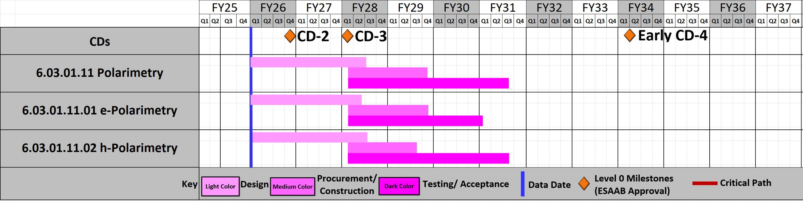
Schedule
Charge #3
Polarimeters are required before detector $→$ needed for initial beam checks and setup
Polarimetry readiness consistent with accelerator schedule

Slide 23
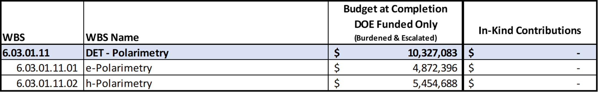
Costs: Budget at Completion
Charge #3
Budget for electron and hadron polarimeters comparable
No in-kind contributions

Slide 24
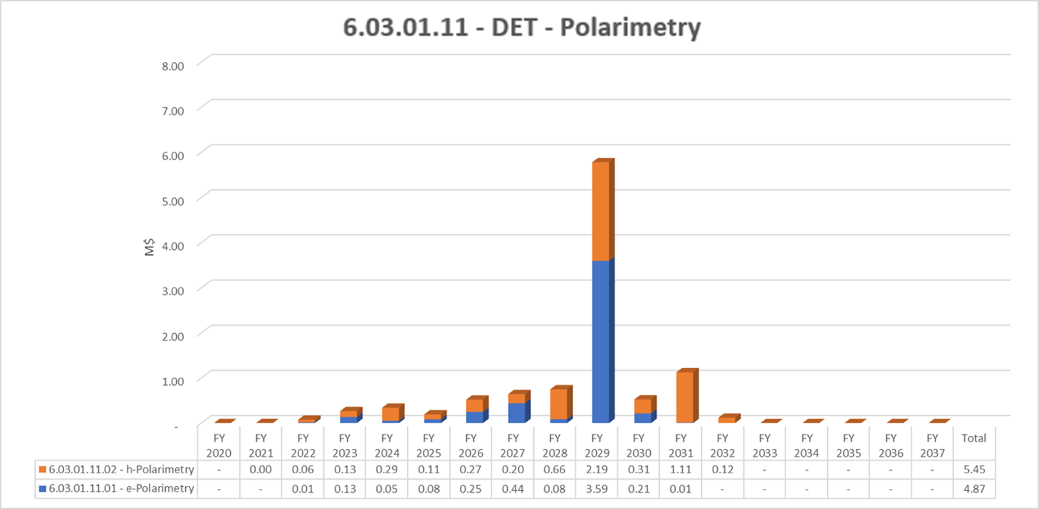
Costs: Budget Profile
Charge #3
Bulk of the procurements will be carried out in FY29

Slide 25
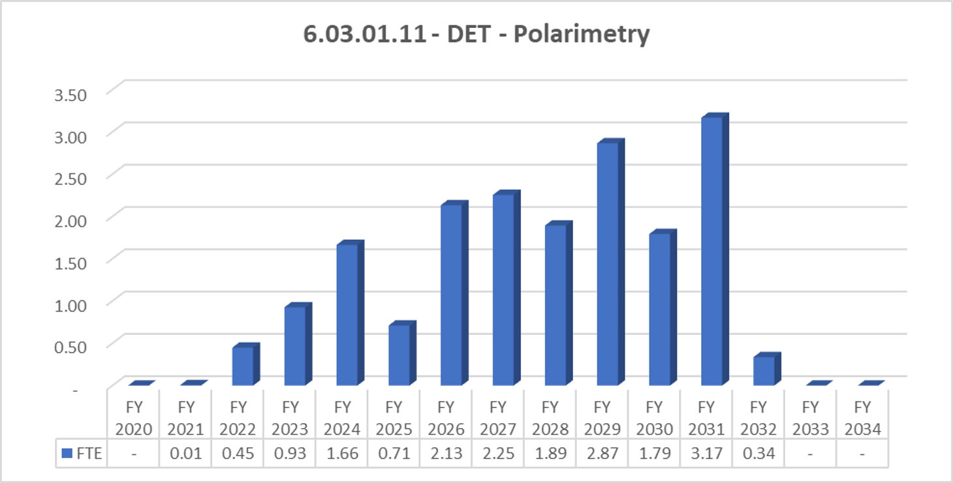
Staffing and Organization
Charge #3
Trends:
Costed labor per year varies to match workforce and experience needed​
Extraction of HJET polarimeter from IP12 and set up in high bay 510, in progress
Extraction of pC polarimeters from IP12, in progress
Refurbishment of HJET and design of new components, in progress

Slide 26
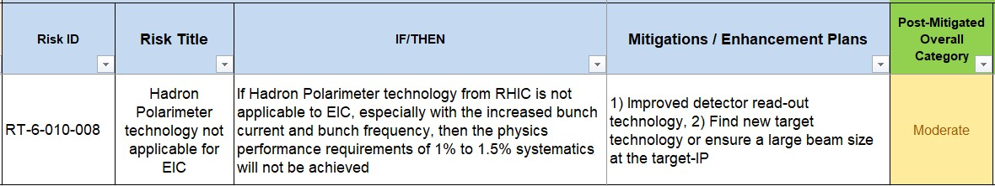
Risks
Charge #3
Clarification of above risk assessment
The hadron polarimeter technology as a whole is applicable to the EIC.
Increased bunch repetition frequency will be addressed with modern, fast detector readout.
C target-related risks are further reduced, as was shown, by the larger beam size at IP4 compared to IP12.
With these mitigation paths, the associated risk can be updated to low.
Overall, the previously identified risks in the above ID should be considered to low.

Slide 27
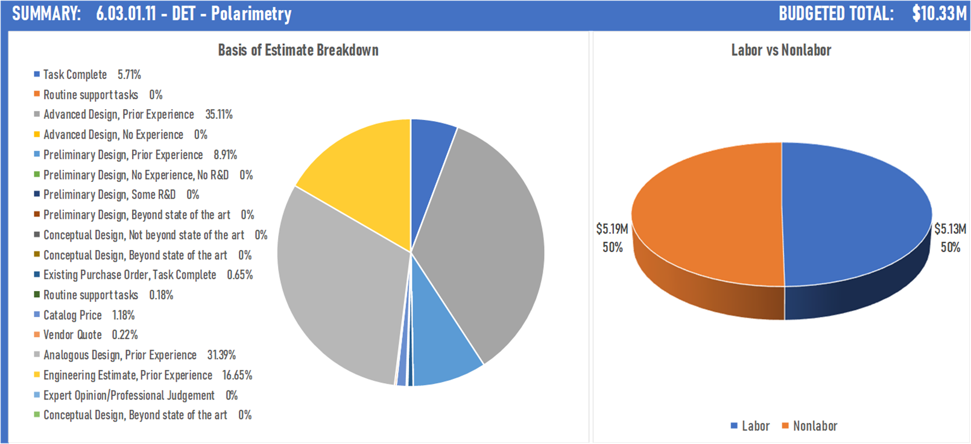
Basis of Estimate
Charge #3
Labor and nonlabor roughly equal
Most of BOE based on prior experience at BNL and JLab

Slide 28
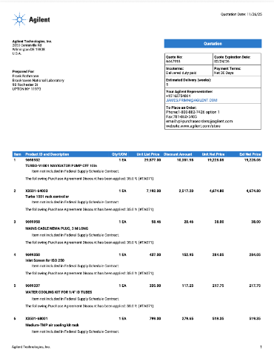
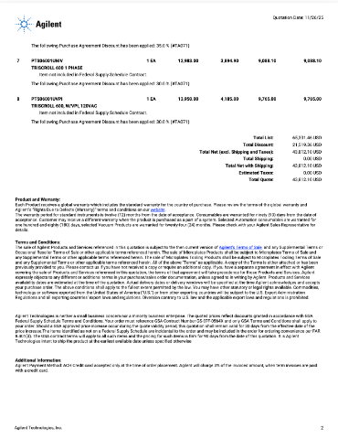
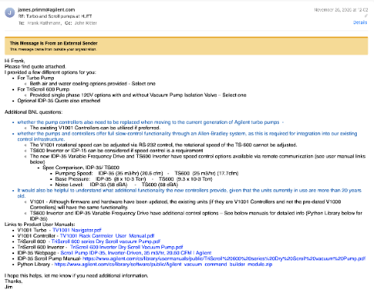
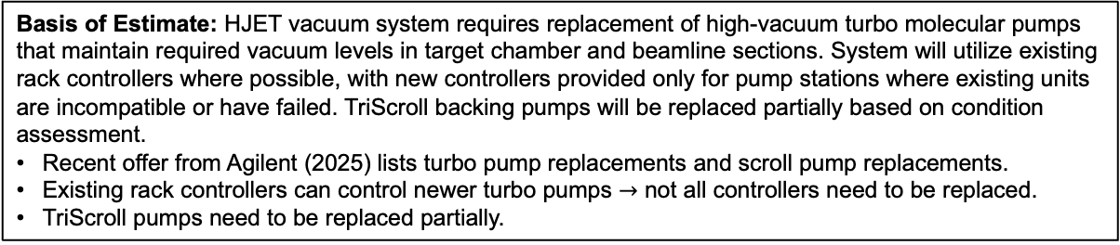
Cost Trace (Hadron Polarimetry)
Charge #3
WBS: 6.03.01.11.02.01 E1014_05360 Item: HJET vacuum system - 19 pumps with controllers - RCV Estimated Total: $500,000
Basis of Estimate: HJET vacuum system requires replacement of high-vacuum turbo molecular pumps that maintain required vacuum levels in target chamber and beamline sections. System will utilize existing rack controllers where possible, with new controllers provided only for pump stations where existing units are incompatible or have failed. TriScroll backing pumps will be replaced partially based on condition assessment.
Recent offer from Agilent (2025) lists turbo pump replacements and scroll pump replacements.
Existing rack controllers can control newer turbo pumps $→$ not all controllers need to be replaced.
TriScroll pumps need to be replaced partially.
Cost Breakdown from Agilent Quote #6447918 (November 26, 2025):
Item | Qty | Unit Price | Total
TURBO-V1001 pumps | 19 | $19,225 | $365,276
Turbo 1001 rack controllers | 5 | $4,675 | $23,374
TRISCROLL 600 backing pumps | 5 | $9,400 | $47,000
Accessories (cables, screens, cooling kits) | 19 sets | ~$1,060 | $20,124
Hardware Subtotal |  |  | $455,774
Installation, commissioning |  |  | $44,226
Total Estimated Cost |  |  | $500,000

Slide 29
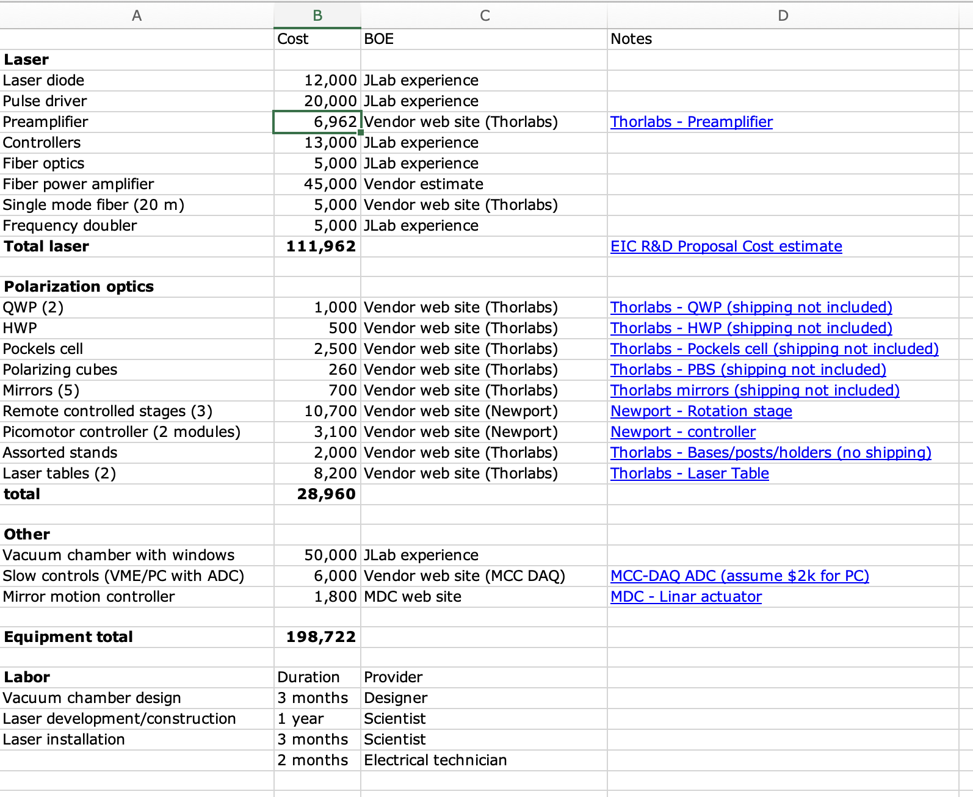
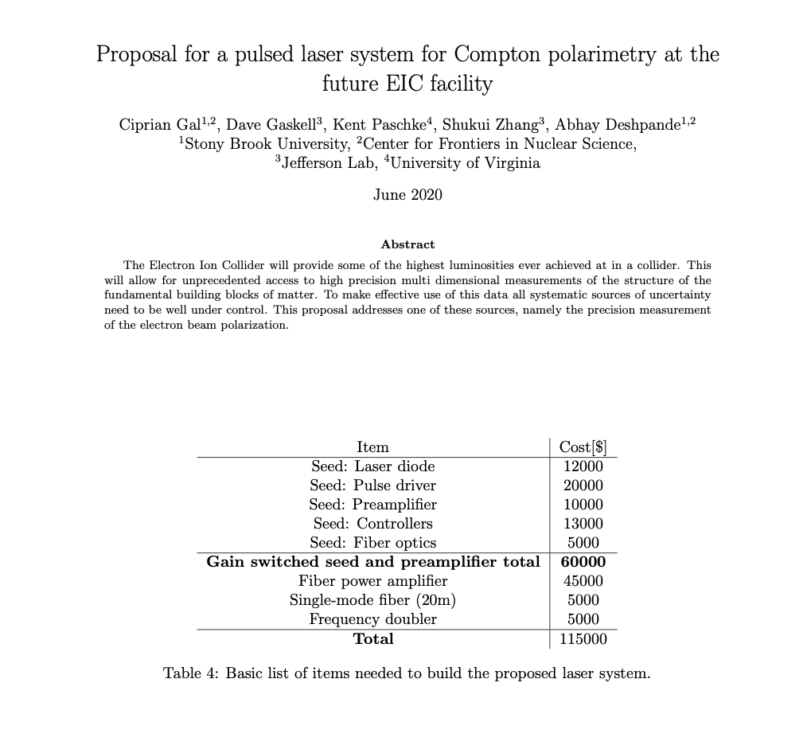
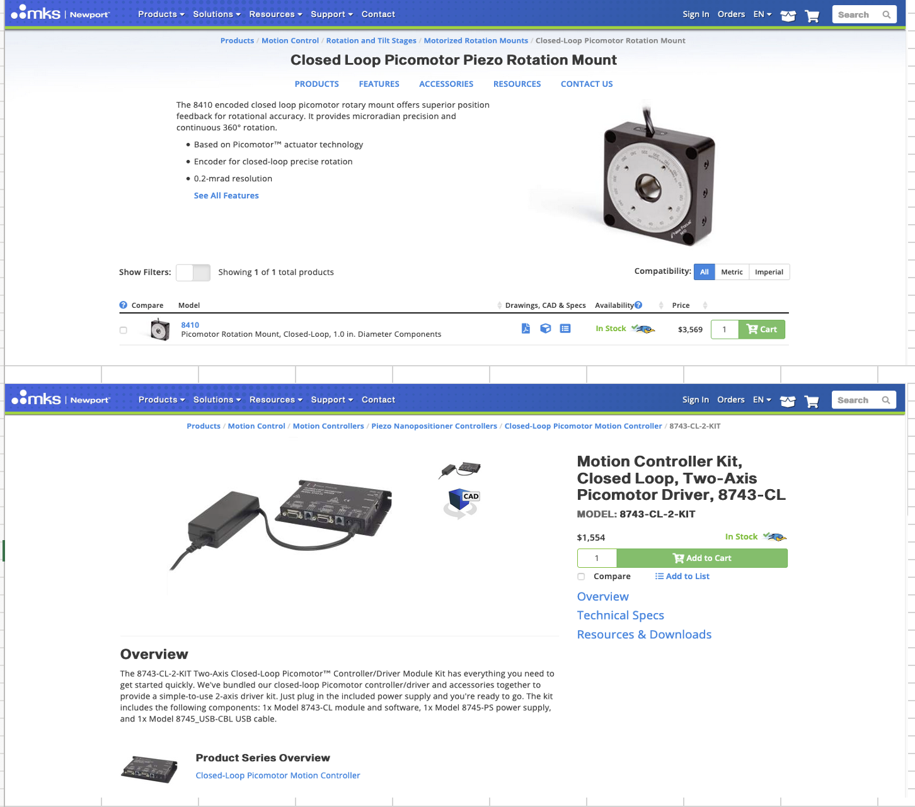
Cost Trace (ESR Laser System)
Charge #3
Remote motion
→ vendor web site
ERD 26 Proposal

Slide 30

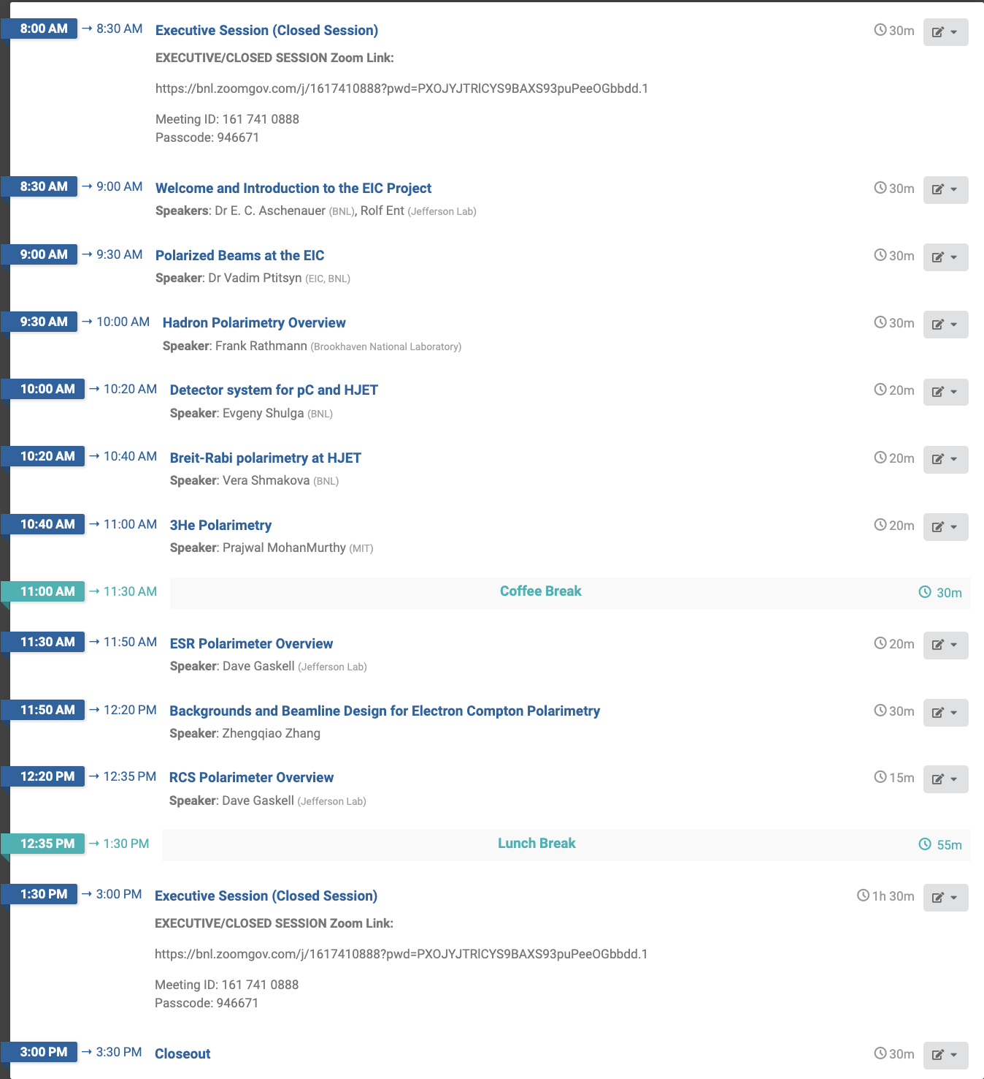
Preliminary Design Review on Polarimetry
Review Committee:
Electrons:
Dipangkar Dutta (Mississippi State University, USA)
Aurélien Martens (Université Paris-Saclay, France)
Hadrons:
Ralf Gebel (Forschungszentrum Jülich, Germany)
Paolo Lenisa (University of Ferrara, Italy)

Slide 31
Summary
Technically mature designs:
Electron polarimetry: Compton polarimeters in RCS and ESR using fiber amplifier laser systems and diamond strip detectors with custom FLAT32 ASIC readout
Hadron polarimetry: HJET polarimeter for absolute measurements plus carbon fiber target polarimeters for fast relative measurements and transverse profile
Preliminary Design Review on Polarimetry February 18, 2025
EIC-specific challenges resolved:
Electron: 10 ns bunch timing requirements met with FLAT32 ASIC (developed for MOLLER)
Hadron: Bunch-induced depolarization avoided with 400 mT HJET operation; carbon target heating acceptable at realistic EIC beam sizes; dielectric target holders minimize wake field power; quadrupole mass spectrometer for molecular hydrogen background
Scope complete: $10.2M total ($4.9M electron, $5.4M hadron). No internal dependencies. Interfaces identified and documented. Schedule aligned with accelerator needs (ready FY2030-2031)
Requirements met: Both systems achieve ΔP/P ≈ 1% systematic uncertainty for ESR and HSR with bunch-by-bunch capability
Polarimetry is ready for CD-2 baseline establishment

Slide 32
Backup

Slide 33
Electron Polarimeters
Charge #2
ESR Polarimeter Components:
RF-pulsed laser system (under development)
Position sensitive detectors (diamond strips) for scattered electrons and backscattered photons
Calorimeter for backscattered photons
Will operate in single-photon mode
Laser IP​
74 m upstream of IP-6
Photon Detector
(30 m from Laser IP)
Crab cavity
Electron Detector
Q3EF
D2EF
D3EF
θ_{B}=13 mr
Q4EF
Q5EF
D4EF
θ_{B}=1.5 mr
Q6EF
D5EF
θ_{B}=1.5 mr
Q7EF
D6EF
θ_{B}=12 mr
*
Q8EF
Q10EF
Q9EF
RCS properties
RCS accelerates electron bunches from 3 GeV to full beam energy (5-18 GeV)
Bunch repetition rate: 2 Hz
Bunch charge: up to 28 nA
Ramping time: 100 ms
RCS Polarimetry challenges
Analyzing power depends on beam energy
Low average current
Bunch lifetime is short
RCS Compton Polarimeter
Average over several bunches – can tag accelerating bunches to get information on bunches at fixed energy
Requires measurement in multiphoton mode (many backscattered photons/electron bunch)
Will use same detector technologies as ESR Compton

Slide 34
Technical Progress: ESR Compton Laser
Laser system based on similar system used in JLab injector and LERF
Gain-switched diode seed laser 10 ps pulses @ 1064 nm
Variable frequency allows optimal use at different bunch frequencies (100 MHz vs 25 MHz)
Fiber amplifier → average power 10-20 W
Optional: Frequency doubling system (LBO or PPLN)
Partially reflective exit window to monitor reflected laser polarization
Gain-switched seed laser components procured under earlier generic EIC R&D
Fiber amplifier obtained - work underway in Compton polarimetry laser lab at JLab

Slide 35
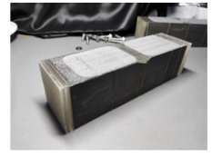
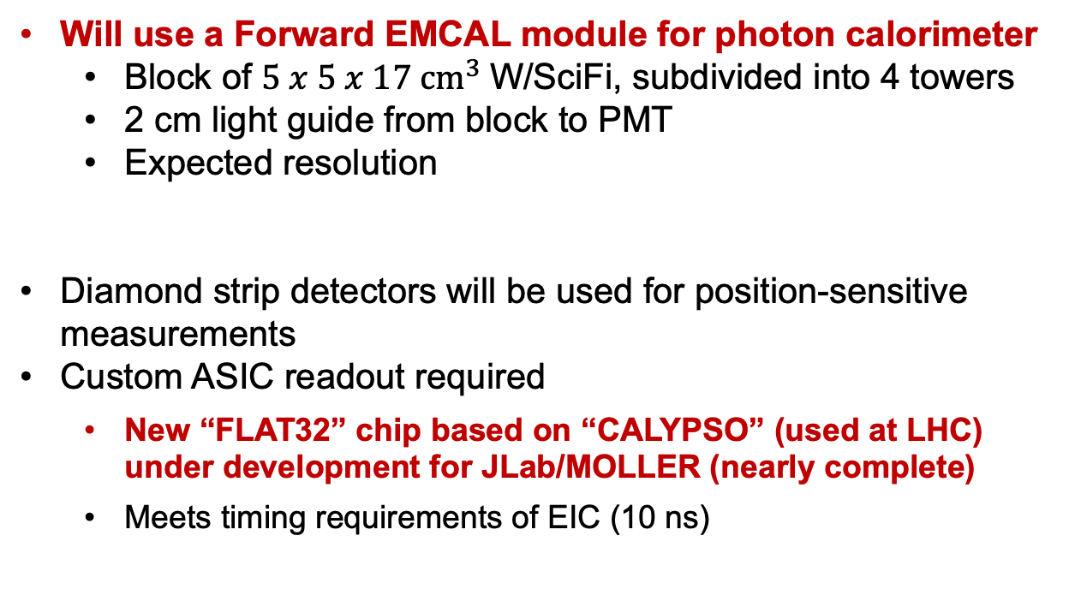
Technical Progress: Compton Polarimeter Detectors
Will use a Forward EMCAL module for photon calorimeter
Block of $5 x 5 x 17 {cm}^{3}$W/SciFi, subdivided into 4 towers
2 cm light guide from block to PMT
Expected resolution
Diamond strip detectors will be used for position-sensitive measurements
Custom ASIC readout required
New “FLAT32” chip based on “CALYPSO” (used at LHC) under development for JLab/MOLLER (nearly complete)
Meets timing requirements of EIC (10 ns)
10 ns

Slide 36
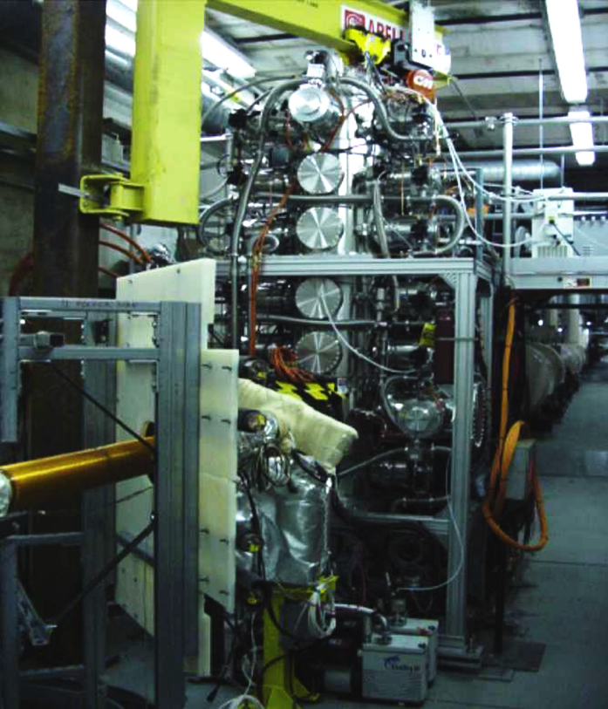
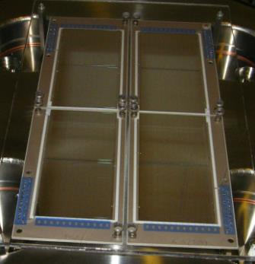
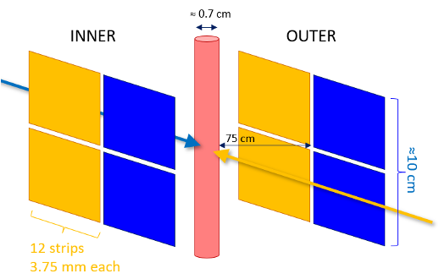
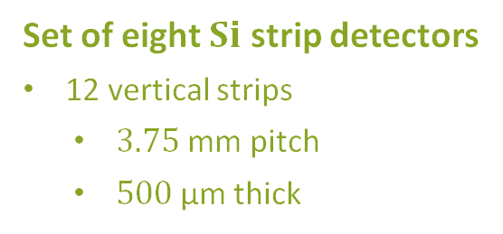
Polarized Atomic Hydrogen Jet Target
Dissociator
Set of eight $Si$ strip detectors
12 vertical strips
$3.75 \text{mm}$ pitch
$500 \text{μ}\text{m}$ thick
Holding field
Detectors
beam

Slide 37
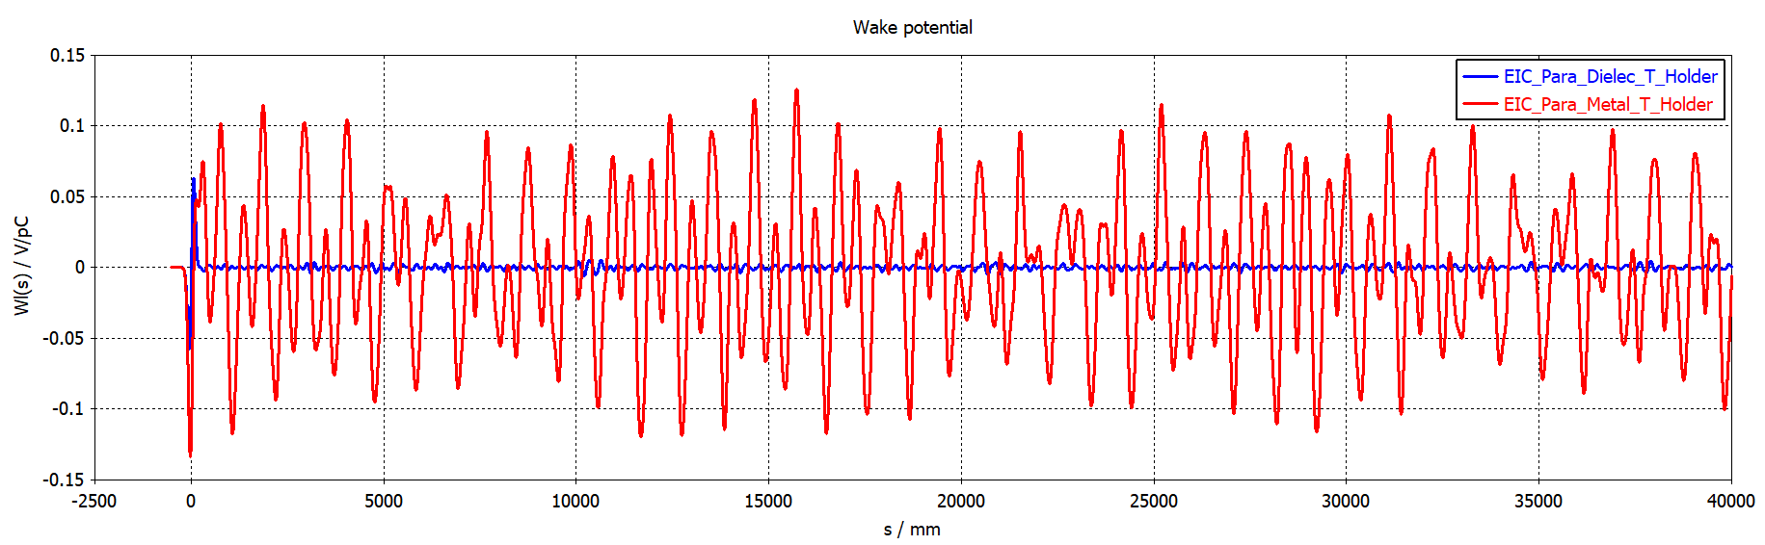
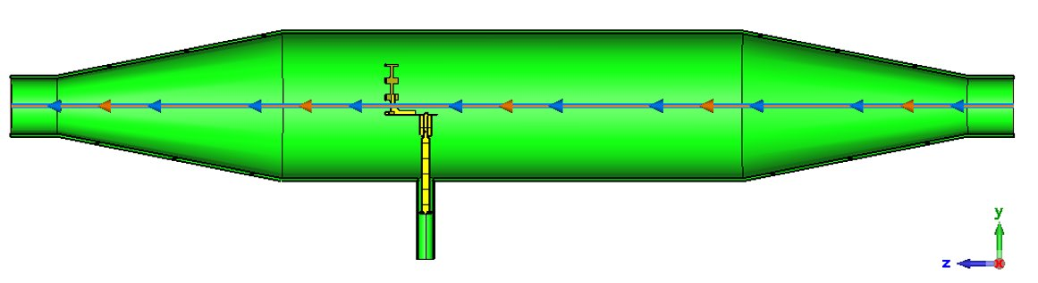
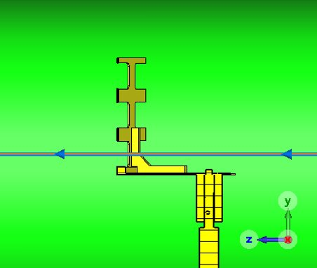
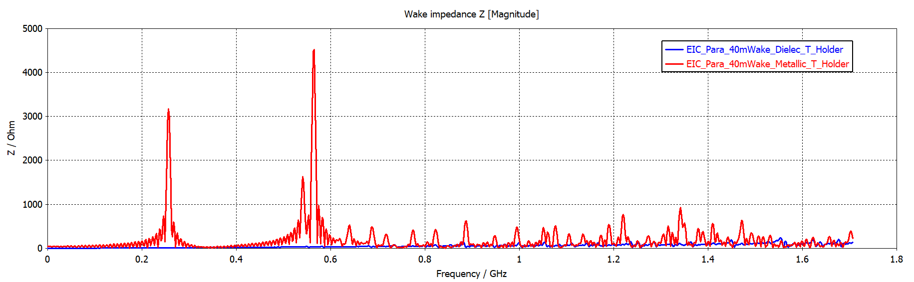
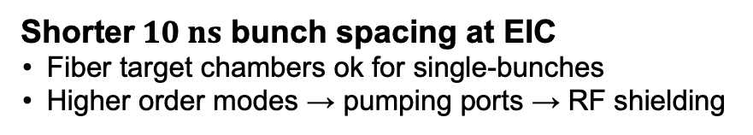
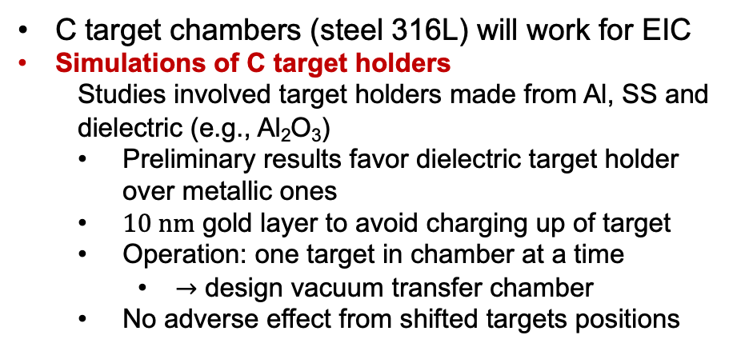
C fiber target polarimeter: impedance calculations I
Shorter$10 ns$ bunch spacing at EIC
Fiber target chambers ok for single-bunches
Higher order modes → pumping ports → RF shielding
Fresh results from Medani Sangroula (CAD)
Wake field potential
C target chambers (steel 316L) will work for EIC
Simulations of C target holders
Studies involved target holders made from Al, SS and dielectric (e.g., Al₂O₃)
Preliminary results favor dielectric target holder over metallic ones
$10 nm$ gold layer to avoid charging up of target
Operation: one target in chamber at a time
$→$ design vacuum transfer chamber
No adverse effect from shifted targets positions
Wake impedance
Improved performance of machine when dielectric target holder will be used

Slide 38




C fiber target polarimeter: impedance calculations II
Shifted dielectric target positions:
Like RHIC, EIC will use multiple targets on same target holders
Wake field potential
Wakefield amplitude decrease with target holder shifted down
Similar behavior when different C targets are inserted into beam from same target holder

Slide 39
Hadron polarimetry layout at IP4
Choice of location driven by required drift space
Carbon and polarized H and ³He targets all located in one place
Minimize spin rotations between polarimeters
Enable efficient use of common infrastructure
Triplet (Q3)
CNI
3He Jet
HJet
2X Warm D0
Longit SC Pickup
4X Horiz SC Kicker
4X Vert SC Kicker
HJet Tagger Drift /
Tagging System
Q4
Ion Pump
HSR
12.3 m
8.0 m
E. Link
5/16/2025

