Slide 1
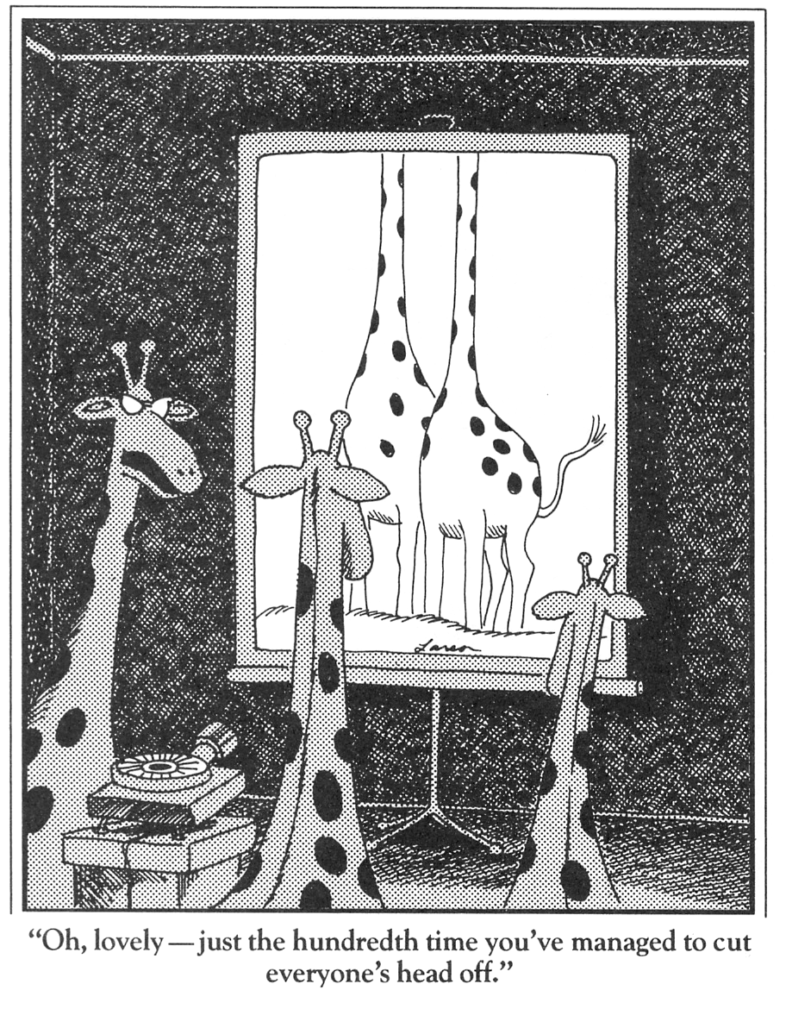
The Graphics Pipeline:
Clipping &
Line Rasterization

Slide 2
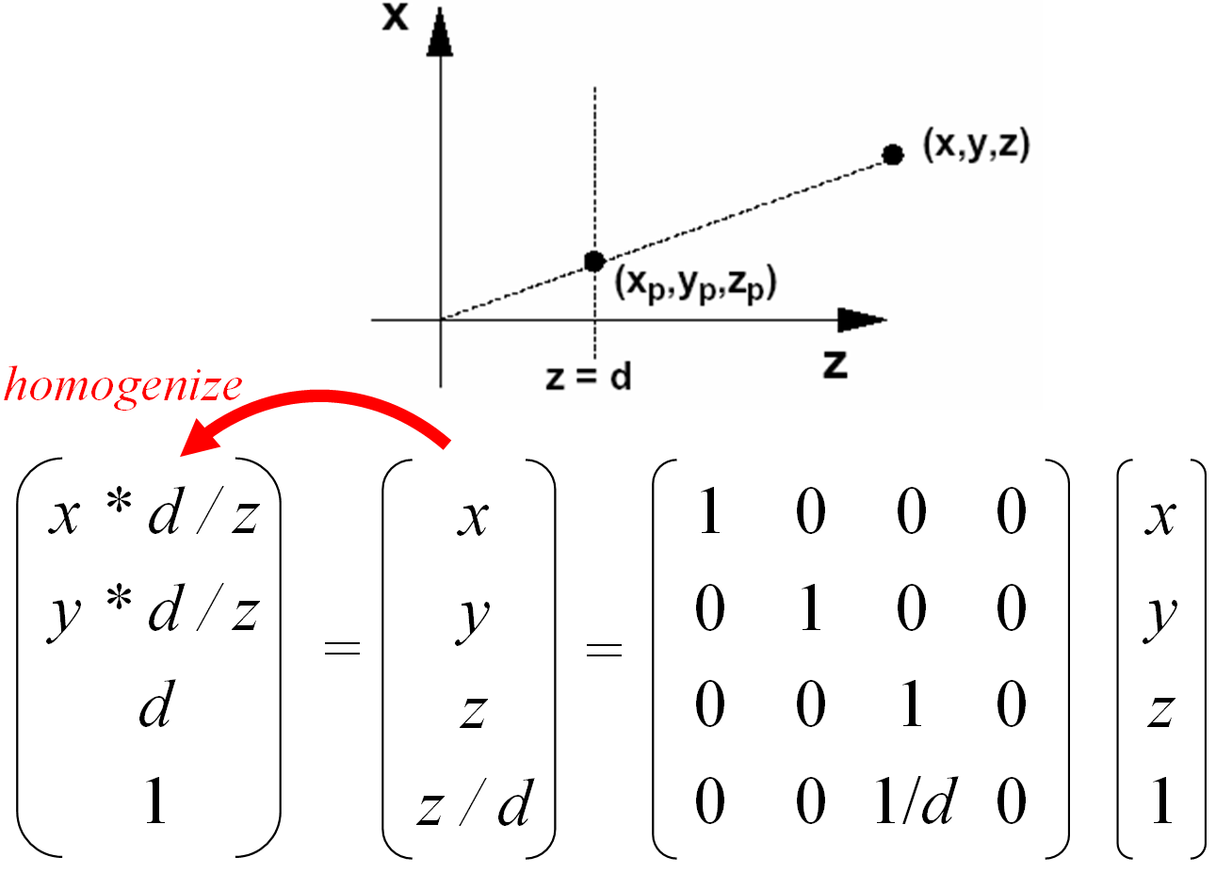
Last Time?
Modeling
Transformations
Ray Tracing vs. Scan Conversion
Overview of the Graphics Pipeline
Projective Transformations
Illumination
(Shading)
Viewing Transformation
(Perspective / Orthographic)
Clipping
Projection
(to Screen Space)
Scan Conversion
(Rasterization)
Visibility / Display

Slide 3
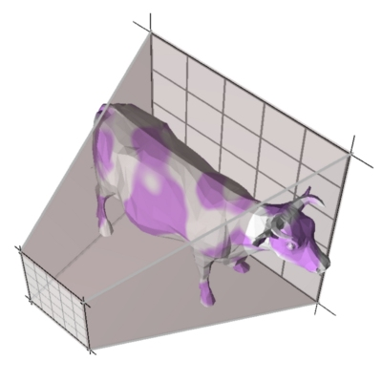
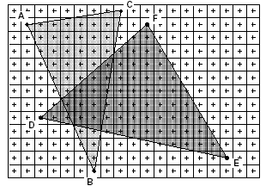
Today: Clipping & Line Rasterization
Modeling
Transformations
Portions of the
object outside the
view frustum
are removed
Rasterize
objects
into pixels
Illumination
(Shading)
Viewing Transformation
(Perspective / Orthographic)
Clipping
Projection
(to Screen Space)
Scan Conversion
(Rasterization)
Visibility / Display

Slide 4
Today
Why Clip?
Line Clipping
Polygon clipping
Line Rasterization

Slide 5
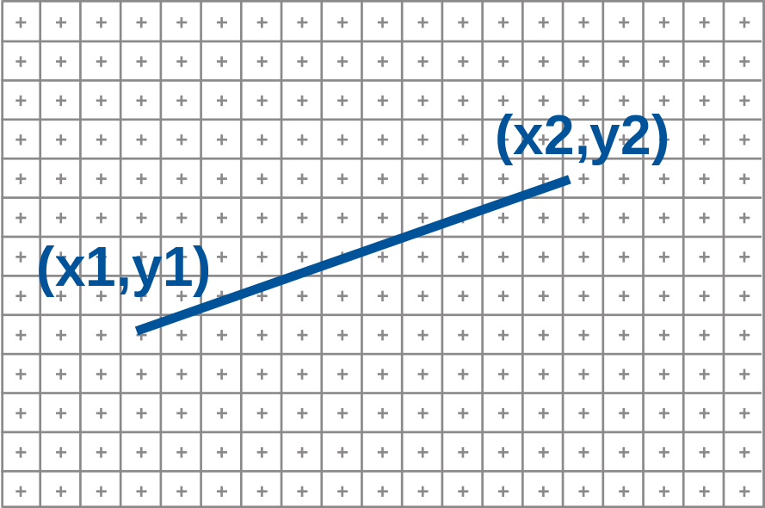
Framebuffer Model
Raster Display: 2D array of picture elements (pixels)
Pixels individually set/cleared (greyscale, color)
Window coordinates: pixels centered at integers
glBegin(GL_LINES)
glVertex3f(...)
glVertex3f(...)
glEnd();

Slide 6
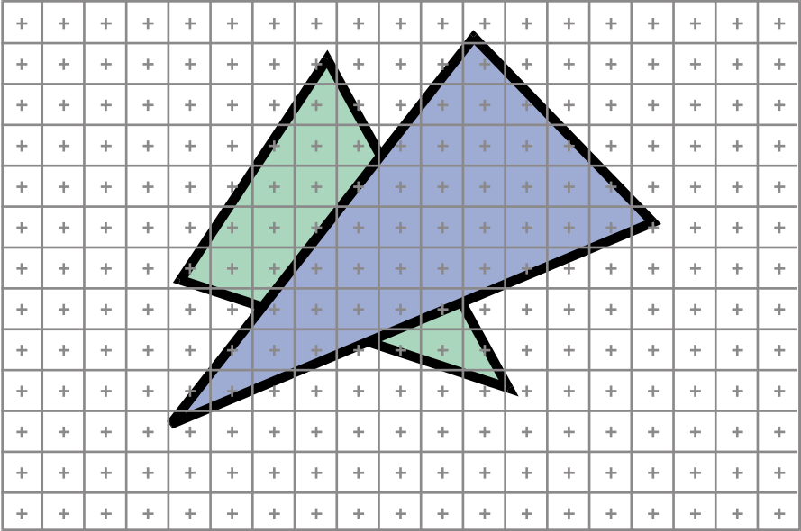
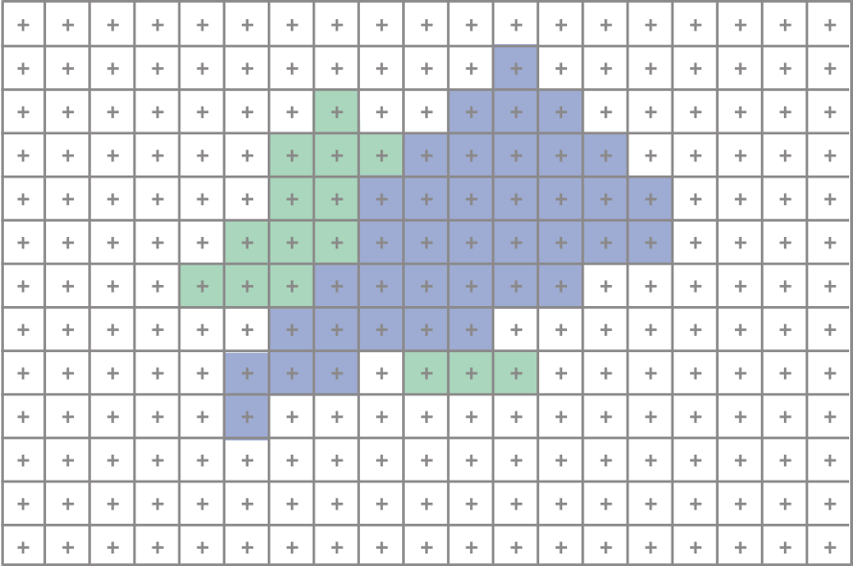
2D Scan Conversion
Geometric primitives
  (point, line, polygon, circle, polyhedron, sphere... )
Primitives are continuous; screen is discrete
Scan Conversion: algorithms for efficient generation of the samples comprising this approximation

Slide 7
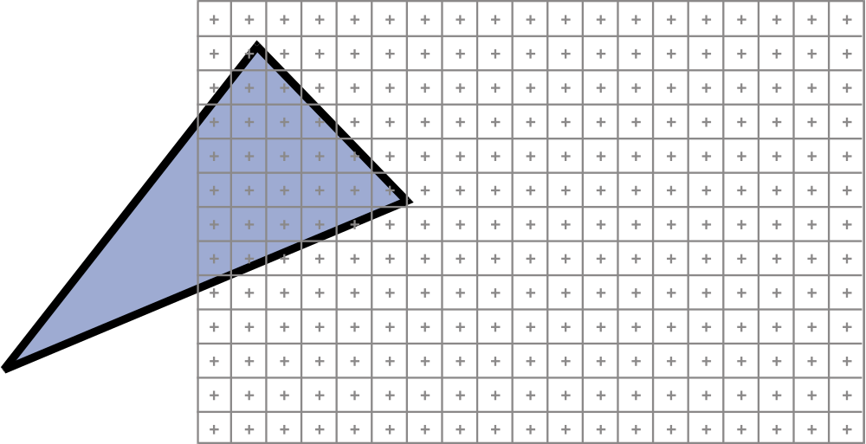
Clipping problem
How do we clip parts outside window?

Slide 8
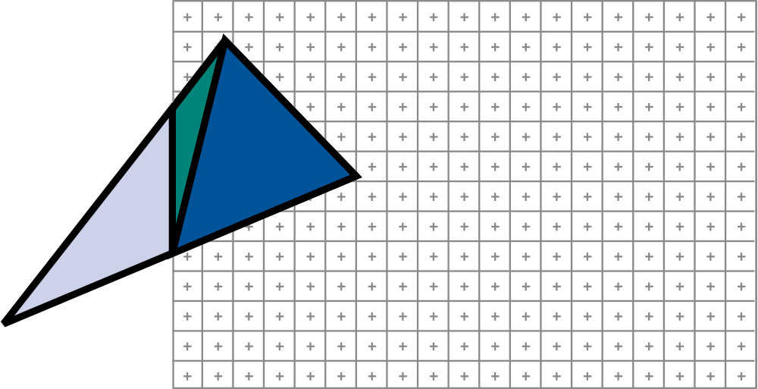
Clipping problem
How do we clip parts outside window?
Create two triangles or more. Quite annoying.

Slide 9
Also, what if the p_{z} is < eye_{z}?
+
z axis →
(eye_{x}, eye_{y}, eye_{z})
image plane

Slide 10
The Graphics Pipeline
Modeling
Transformations
Former hardware relied on full clipping
Modern hardware mostly avoids clipping
  Only with respect to
  plane z=0
In general, it is useful to learn clipping because it is similar to many geometric algorithms
Illumination
(Shading)
Viewing Transformation
(Perspective / Orthographic)
Clipping
Projection
(to Screen Space)
Scan Conversion
(Rasterization)
Visibility / Display

Slide 11
Full Clipping
"clip" geometry to view frustum
z axis
(eye_{x}, eye_{y}, eye_{z})
image plane

Slide 12
One-plane clipping
"clip" geometry to near plane
z axis
(eye_{x}, eye_{y}, eye_{z})
image plane

Slide 13
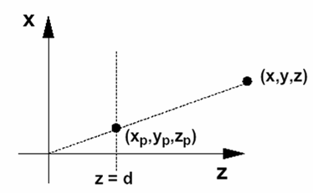
When to clip?
Perspective Projection: 2 conceptual steps:
  4x4 matrix
  Homogenize
    In fact not always needed
    Modern graphics hardware performs most operations in 2D homogeneous coordinates
homogenize
x * d / z
y * d / z
d/z
1
x
y
1
z / d
1
0
0
0
0
1
0
0
0
0
0
1/d
0
0
1
0
x
y
z
1
=
=

Slide 14
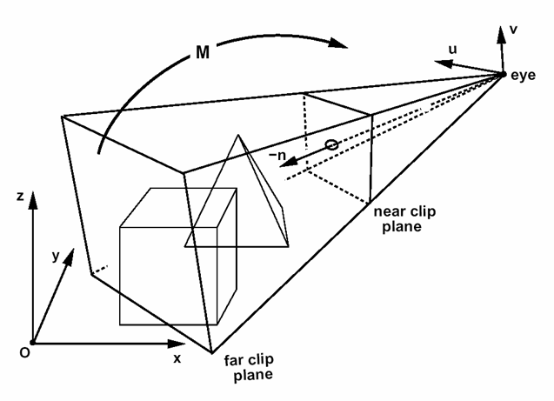
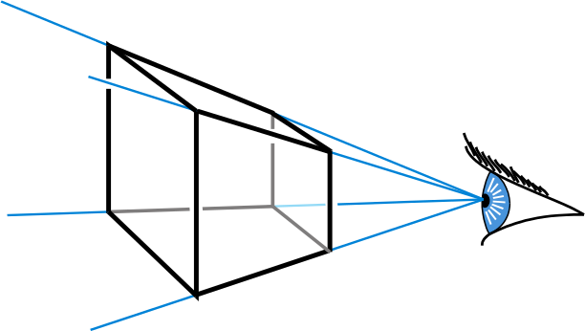
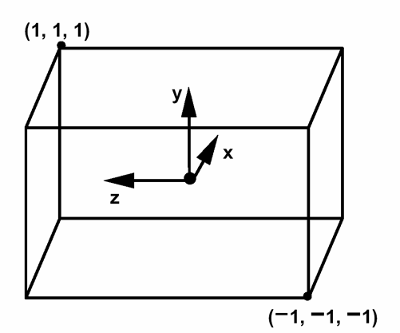
When to clip?
Before perspective transform
in 3D space
  Use the equation of 6 planes
  Natural, not too degenerate
In homogeneous coordinates after
perspective transform (Clip space)
  Before perspective divide
  (4D space, weird w values)
  Canonical,independent of camera
  The simplest to implement in fact
In the transformed 3D screen space
after perspective division
  Problem: objects in the plane of the camera

Slide 15
Working in homogeneous coordinates
In general, many algorithms are simpler in homogeneous coordinates before division
  Clipping
  Rasterization

Slide 16
Today
Why Clip?
Line Clipping
Polygon clipping
Line Rasterization

Slide 17
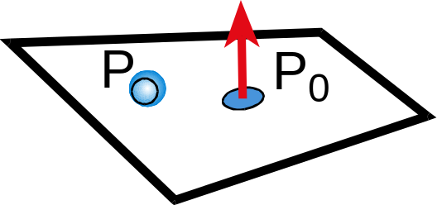
Implicit 3D Plane Equation
Plane defined by:
  point p & normal n OR
  normal n & offset d OR
  3 points
Implicit plane equation
  Ax+By+Cz+D = 0

Slide 18
Homogeneous Coordinates
Homogenous point: (x,y,z,w)
  infinite number of equivalent
  homogenous coordinates:
  (sx, sy, sz, sw)
Homogenous Plane Equation:
Ax+By+Cz+D = 0 → H = (A,B,C,D)
  Infinite number of equivalent plane expressions: sAx+sBy+sCz+sD = 0 → H = (sA,sB,sC,sD)
H = (A,B,C,D)

Slide 19
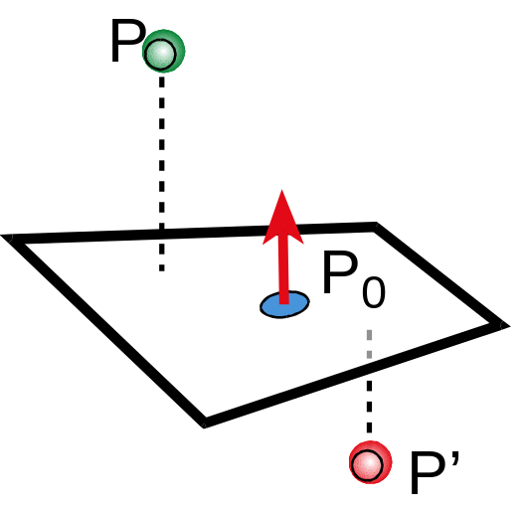
Point-to-Plane Distance
If (A,B,C) is normalized:
  d = H•p = H^{T}p
  (the dot product in
  homogeneous coordinates)
d is a signed distance
  positive = "inside"
  negative = "outside"
d
H = (A,B,C,D)

Slide 20
Clipping a Point with respect to a Plane
If d = H•p ≥ 0
Pass through
If d = H•p < 0:
Clip (or cull or reject)
d
H = (A,B,C,D)

Slide 21
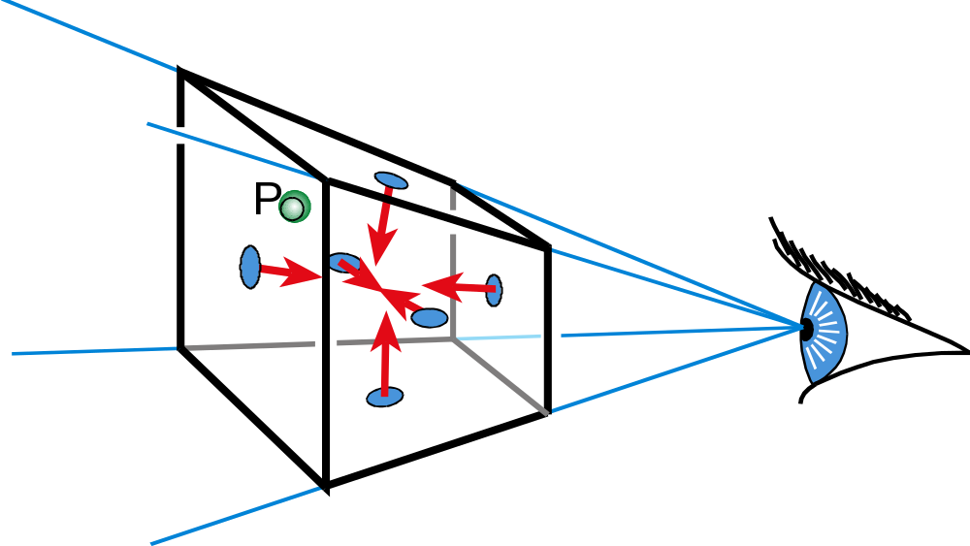
Clipping with respect to View Frustum
Test against each of the 6 planes
  Normals oriented towards the interior
Clip (or cull or reject) point p if any H•p < 0

Slide 22
What are the View Frustum Planes?
(right*far/near, top*far/near, –far)
H_{near} =
H_{far} =
H_{bottom} =
H_{top} =
H_{left} =
H_{right} =
( 0 0 –1 –near)
( 0 0 1 far )
( 0 near bottom 0 )
( 0 –near –top 0 )
( left near 0 0 )
(–right –near 0 0 )
(left, bottom, –near)

Slide 23
Recall: When to clip?
Before perspective transform
in 3D space
  Use the equation of 6 planes
  Natural, not too degenerate
In homogeneous coordinates after
perspective transform (Clip space)
  Before perspective divide
  (4D space, weird w values)
  Canonical,independent of camera
  The simplest to implement in fact
In the transformed 3D screen space
after perspective division
  Problem: objects in the plane of the camera

Slide 24
Questions?
You are now supposed to be able to clip points wrt view frustum
Using homogeneous coordinates

Slide 25
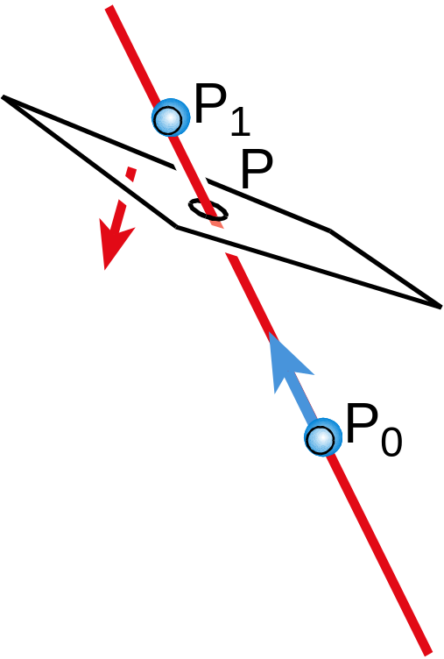
Line – Plane Intersection
Explicit (Parametric) Line Equation
  L(t) = P₀ + t * (P₁ – P₀)
  L(t) = (1-t) * P₀ + t * P₁
How do we intersect?
  Insert explicit equation of line into
  implicit equation of plane
Parameter t is used to
interpolate associated attributes
(color, normal, texture, etc.)

Slide 26
Segment Clipping
If H•p > 0 and H•q < 0
If H•p < 0 and H•q > 0
If H•p > 0 and H•q > 0
If H•p < 0 and H•q < 0
p
q

Slide 27
Segment Clipping
If H•p > 0 and H•q < 0
  clip q to plane
If H•p < 0 and H•q > 0
If H•p > 0 and H•q > 0
If H•p < 0 and H•q < 0
p
n
q

Slide 28
Segment Clipping
If H•p > 0 and H•q < 0
  clip q to plane
If H•p < 0 and H•q > 0
  clip p to plane
If H•p > 0 and H•q > 0
If H•p < 0 and H•q < 0
n
p
q

Slide 29
Segment Clipping
If H•p > 0 and H•q < 0
  clip q to plane
If H•p < 0 and H•q > 0
  clip p to plane
If H•p > 0 and H•q > 0
  pass through
If H•p < 0 and H•q < 0
p
n
q

Slide 30
Segment Clipping
If H•p > 0 and H•q < 0
  clip q to plane
If H•p < 0 and H•q > 0
  clip p to plane
If H•p > 0 and H•q > 0
  pass through
If H•p < 0 and H•q < 0
  clipped out
p
n
q

Slide 31
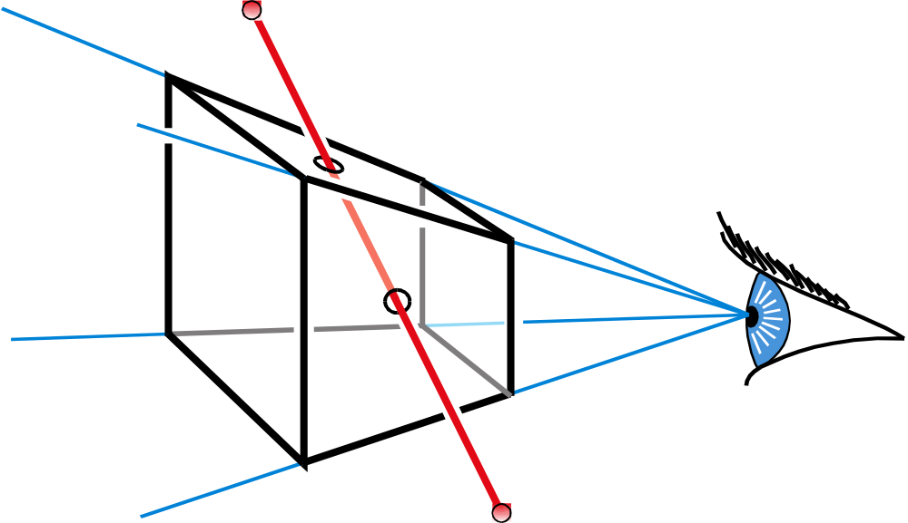
Clipping against the frustum
For each frustum plane H
  If H•p > 0 and H•q < 0, clip q to H
  If H•p < 0 and H•q > 0, clip p to H
  If H•p > 0 and H•q > 0, pass through
  If H•p < 0 and H•q < 0, clipped out
Result is a single segment. Why?

Slide 32
Questions?
You are now supposed to be able to clip segments wrt view frustum

Slide 33
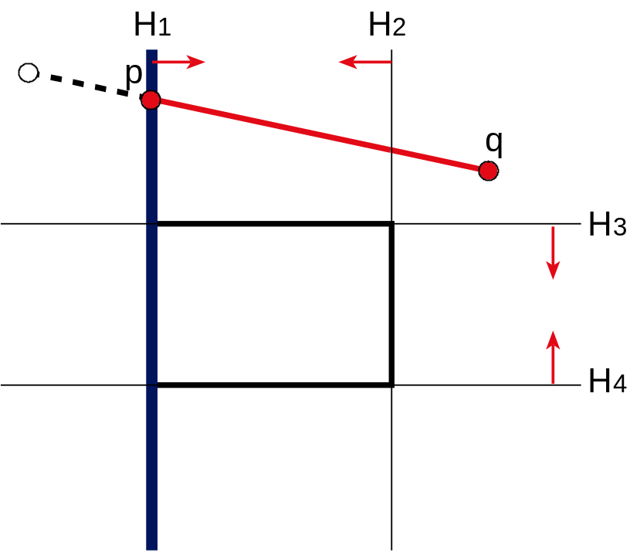
Is this Clipping Efficient?
For each frustum plane H
  If H•p > 0 and H•q < 0, clip q to H
  If H•p < 0 and H•q > 0, clip p to H
  If H•p > 0 and H•q > 0, pass through
  If H•p < 0 and H•q < 0, clipped out

Slide 34
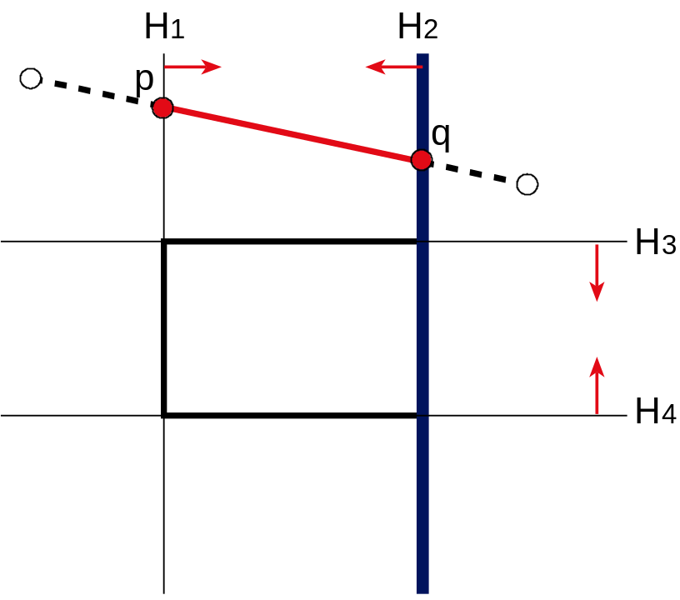
Is this Clipping Efficient?
For each frustum plane H
  If H•p > 0 and H•q < 0, clip q to H
  If H•p < 0 and H•q > 0, clip p to H
  If H•p > 0 and H•q > 0, pass through
  If H•p < 0 and H•q < 0, clipped out

Slide 35
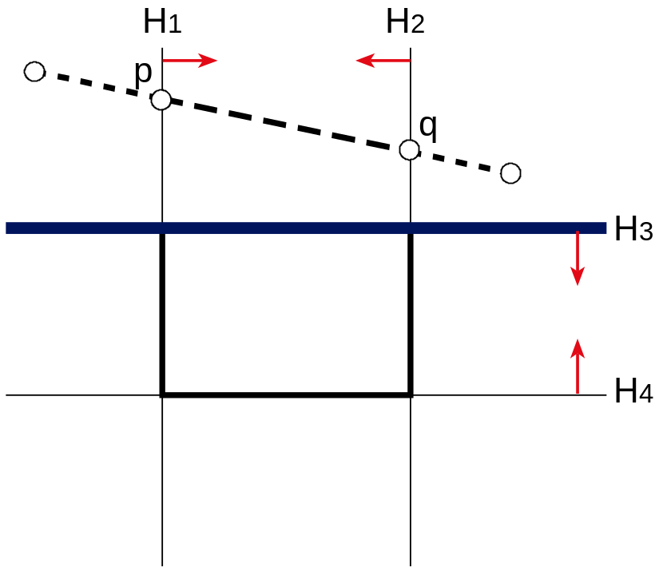
Is this Clipping Efficient?
For each frustum plane H
  If H•p > 0 and H•q < 0, clip q to H
  If H•p < 0 and H•q > 0, clip p to H
  If H•p > 0 and H•q > 0, pass through
  If H•p < 0 and H•q < 0, clipped out
What is the problem?
The computation of
the intersections, and
any corresponding
interpolated values
is unnecessary
Can we detect this earlier?

Slide 36
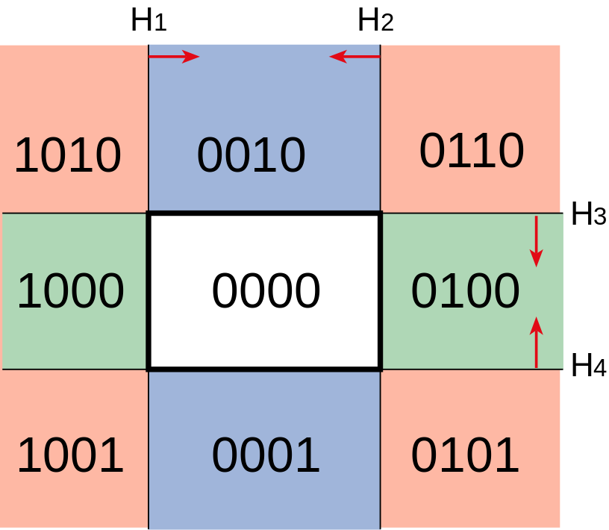
Improving Efficiency: Outcodes
Compute the sidedness of each vertex with
respect to each bounding plane (0 = valid)
Combine into binary outcode using logical AND
p
q
Outcode of p : 1010
Outcode of q : 0110
Outcode of [pq] : 0010
Clipped because there is a 1

Slide 37
Improving Efficiency: Outcodes
When do we fail to save computation?
q
Outcode of p : 1000
Outcode of q : 0010
p
Outcode of [pq] : 0000
Not clipped

Slide 38
Improving Efficiency: Outcodes
It works for arbitrary primitives
And for arbitrary dimensions
Outcode of p : 1010
Outcode of q : 1010
Outcode of r : 0110
Outcode of s : 0010
Outcode of t : 0110
Outcode of u : 0010
Outcode : 0010
Clipped

Slide 39
Questions?
You are now supposed to be able to make clipping efficient using outcodes

Slide 40
Today
Why Clip?
Line Clipping
Polygon clipping
Line Rasterization

Slide 41
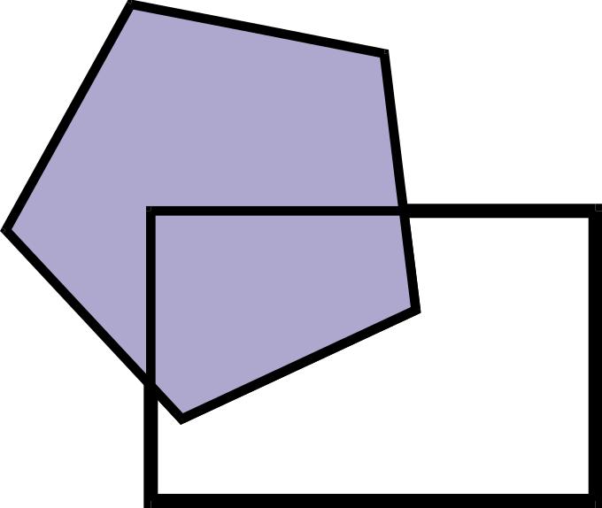
Polygon clipping

Slide 42
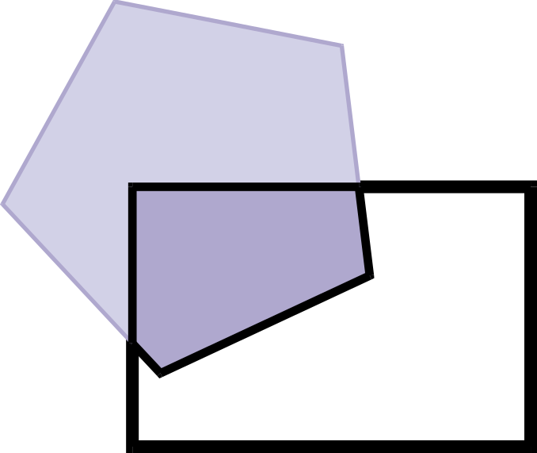
Polygon clipping

Slide 43
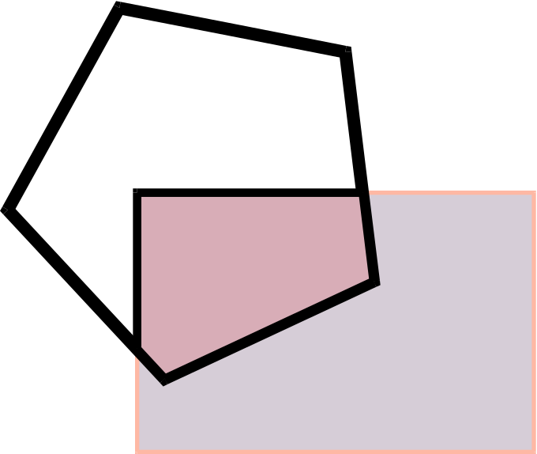
Polygon clipping
Clipping is symmetric

Slide 44
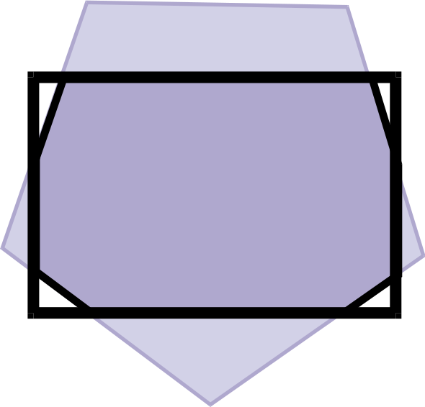
Polygon clipping is complex
Even when the polygons are convex

Slide 45
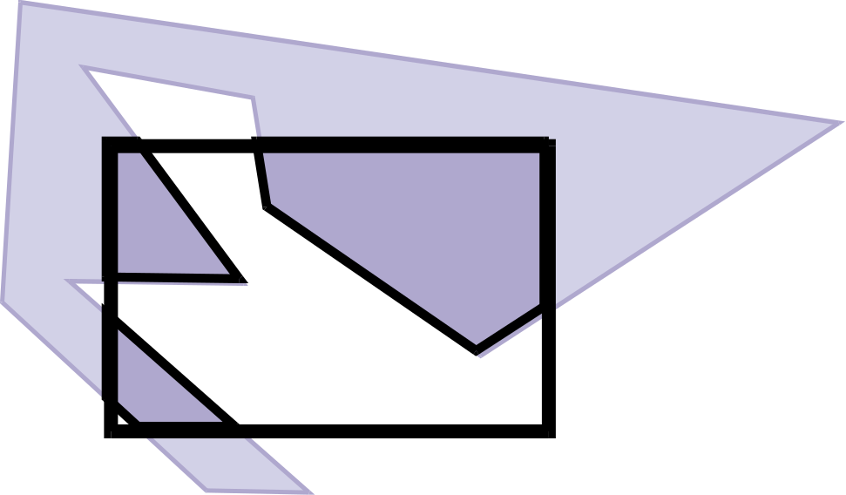
Polygon clipping is nasty
When the polygons are concave

Slide 46
Naïve polygon clipping?
N*m intersections
Then must link all segment
Not efficient and not even easy

Slide 47
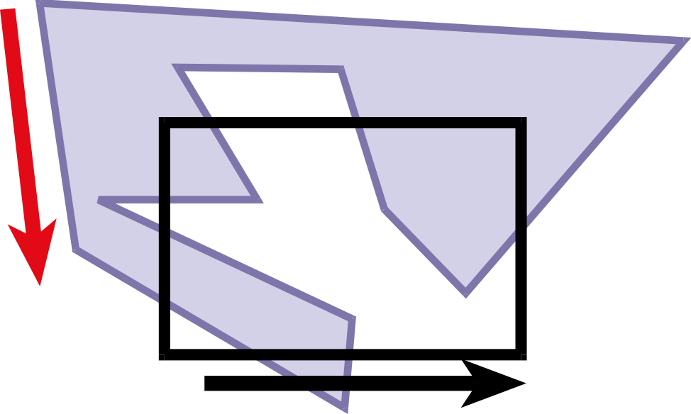
Weiler-Atherton Clipping
Strategy: “Walk" polygon/window boundary
Polygons are oriented (CCW)

Slide 48
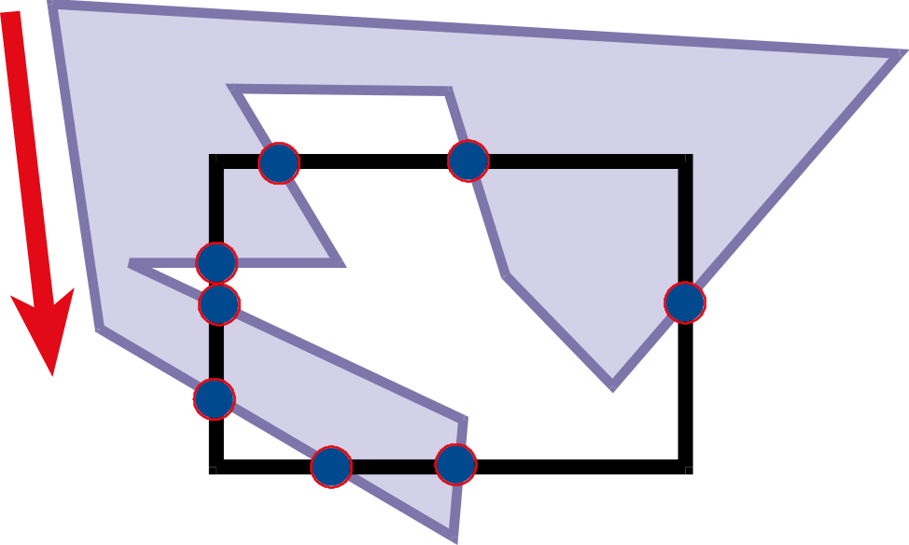
Weiler-Atherton Clipping
Compute intersection points

Slide 49
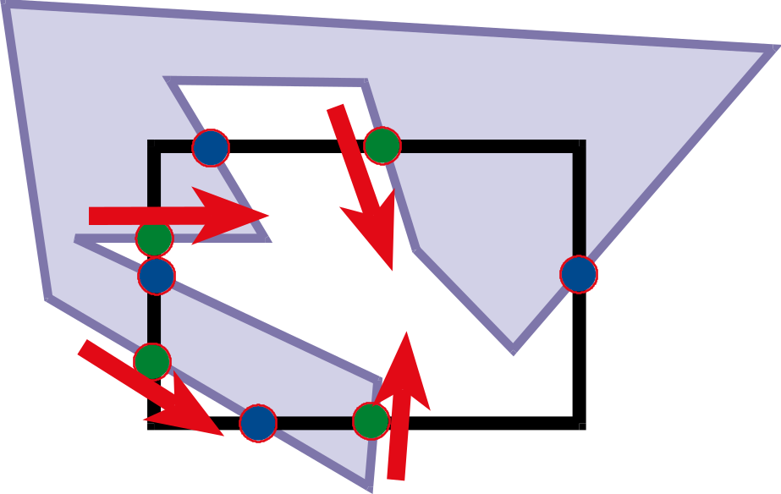
Weiler-Atherton Clipping
Compute intersection points
Mark points where polygons enters clipping window (green here)

Slide 50
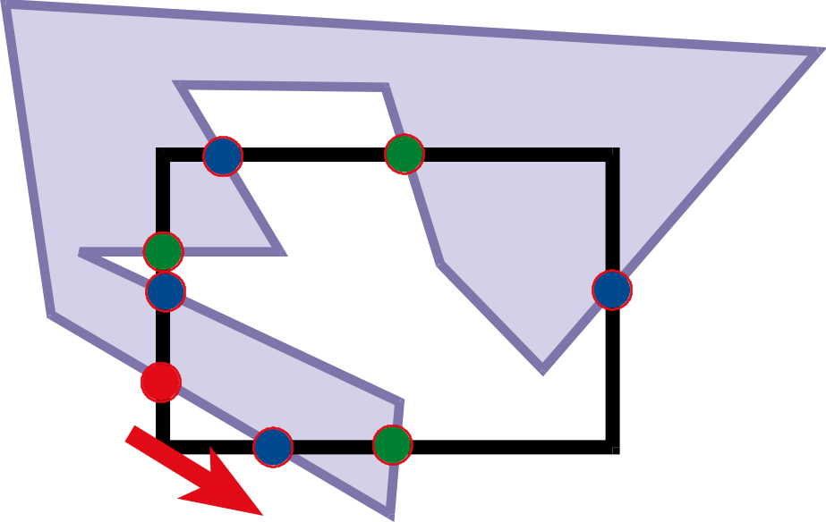
Clipping
While there is still an unprocessed entering intersection
Walk" polygon/window boundary

Slide 51
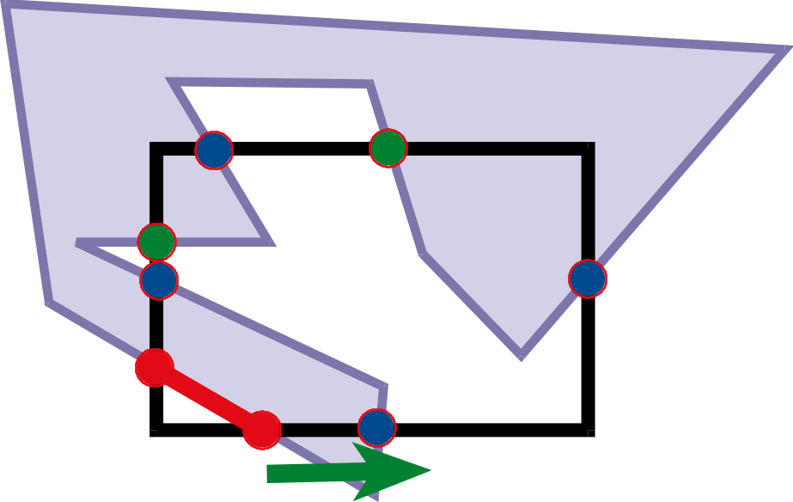
Walking rules
Out-to-in pair:
  Record clipped point
  Follow polygon boundary (ccw)
In-to-out pair:
  Record clipped point
  Follow window boundary (ccw)

Slide 52
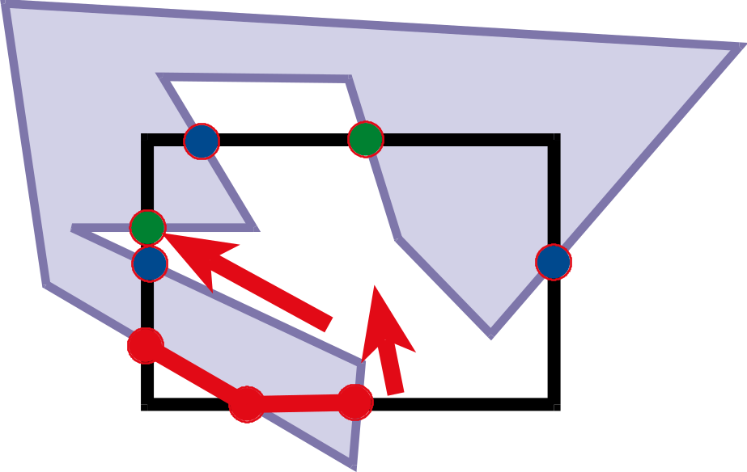
Walking rules
Out-to-in pair:
  Record clipped point
  Follow polygon boundary (ccw)
In-to-out pair:
  Record clipped point
  Follow window boundary (ccw)

Slide 53
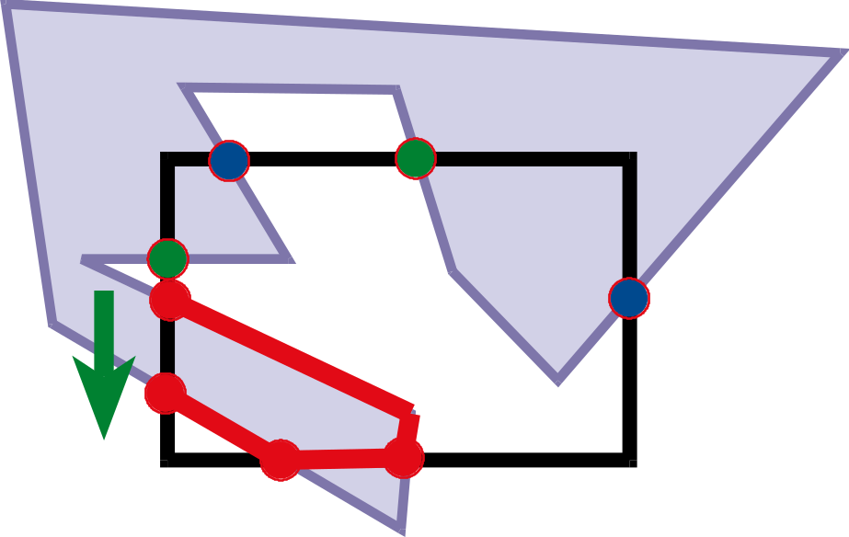
Walking rules
Out-to-in pair:
  Record clipped point
  Follow polygon boundary (ccw)
In-to-out pair:
  Record clipped point
  Follow window boundary (ccw)

Slide 54
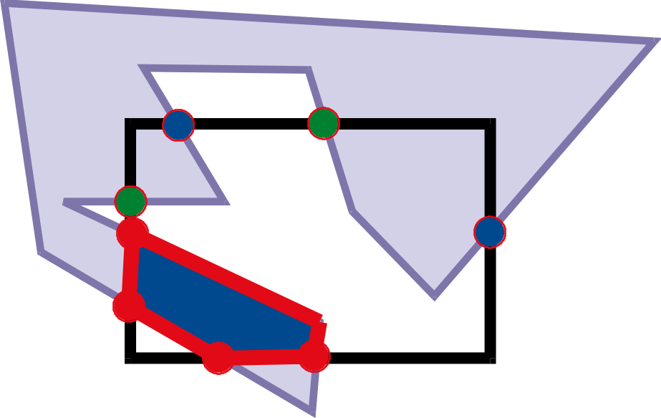
Walking rules
Out-to-in pair:
  Record clipped point
  Follow polygon boundary (ccw)
In-to-out pair:
  Record clipped point
  Follow window boundary (ccw)

Slide 55
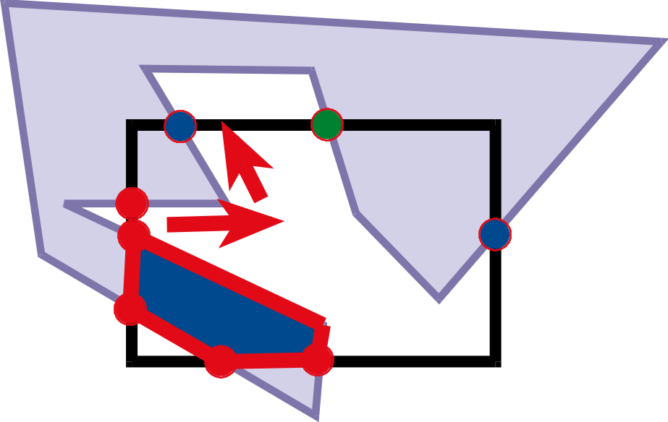
Walking rules
While there is still an unprocessed entering intersection
Walk" polygon/window boundary

Slide 56
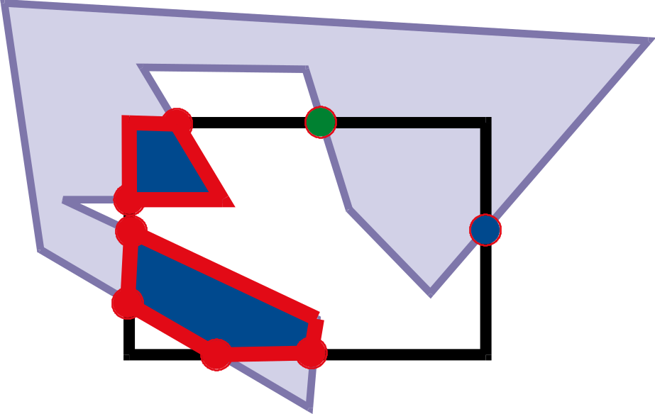
Walking rules
While there is still an unprocessed entering intersection
Walk" polygon/window boundary

Slide 57
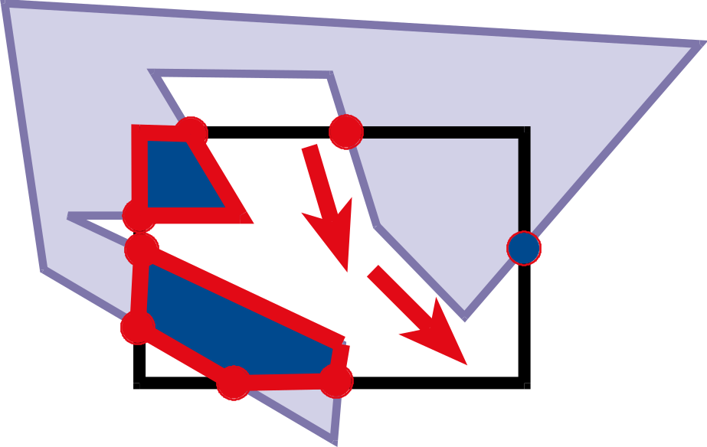
Walking rules
While there is still an unprocessed entering intersection
Walk" polygon/window boundary

Slide 58
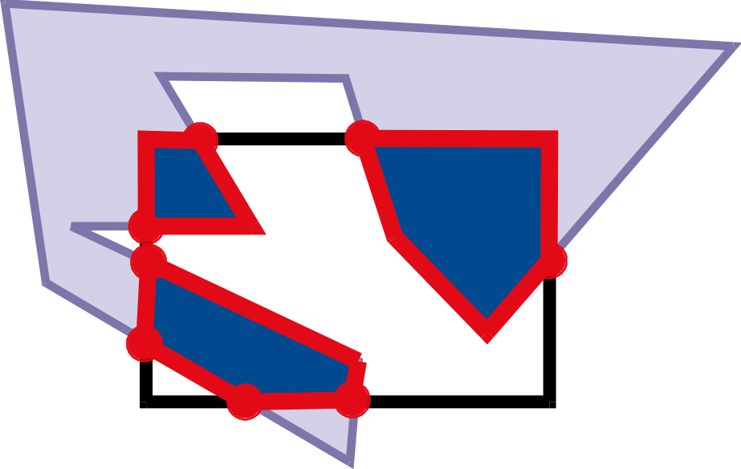
Walking rules
While there is still an unprocessed entering intersection
Walk" polygon/window boundary

Slide 59
Weiler-Atherton Clipping
Importance of good adjacency data structure
(here simply list of oriented edges)

Slide 60
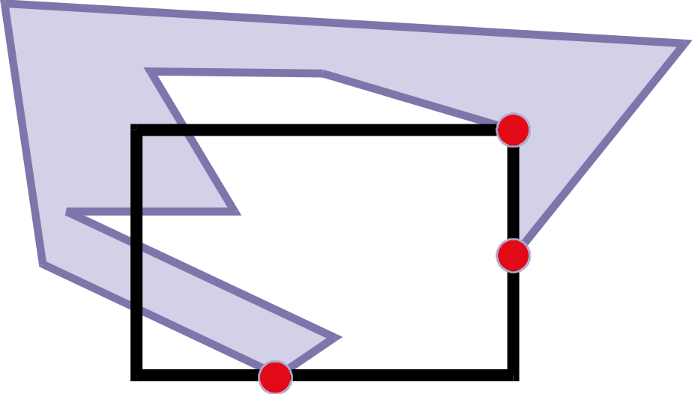
Robustness, precision, degeneracies
What if a vertex is on the boundary?
What happens if it is “almost” on the boundary?
  Problem with floating point precision
Welcome to the real world of geometry!

Slide 61
Clipping
Many other clipping algorithms:
Parametric, general windows, region-region, One-Plane-at-a-Time Clipping, etc.

Slide 62
Questions?

Slide 63
Today
Why Clip?
Line Clipping
Polygon clipping
Line Rasterization

Slide 64
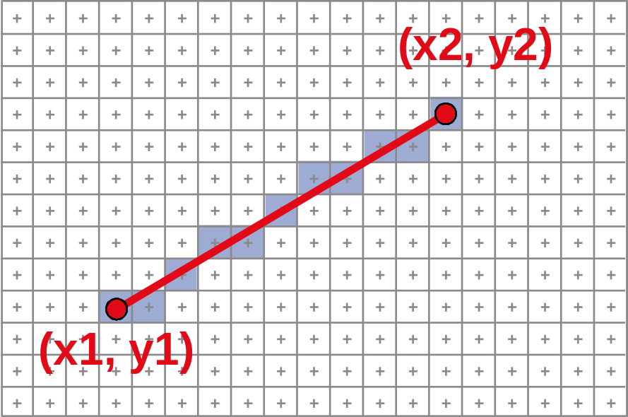
Scan Converting 2D Line Segments
Given:
  Segment endpoints (integers x1, y1; x2, y2)
Identify:
  Set of pixels (x, y) to display for segment

Slide 65
Line Rasterization Requirements
Transform continuous primitive into
discrete samples
Uniform thickness & brightness
Continuous appearance
No gaps
Accuracy
Speed

Slide 66
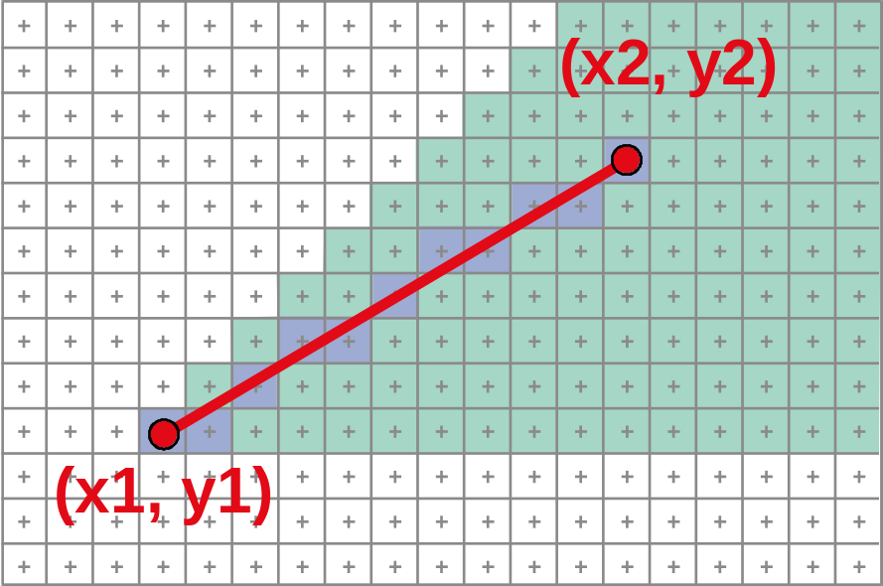
Algorithm Design Choices
Assume:
  m = dy/dx, 0 < m < 1
Exactly one pixel per column
  fewer → disconnected, more → too thick

Slide 67
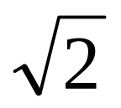
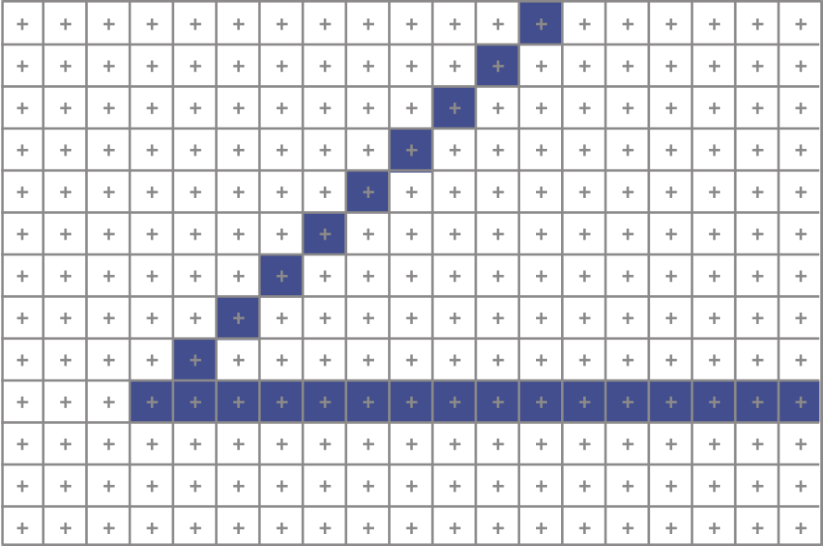
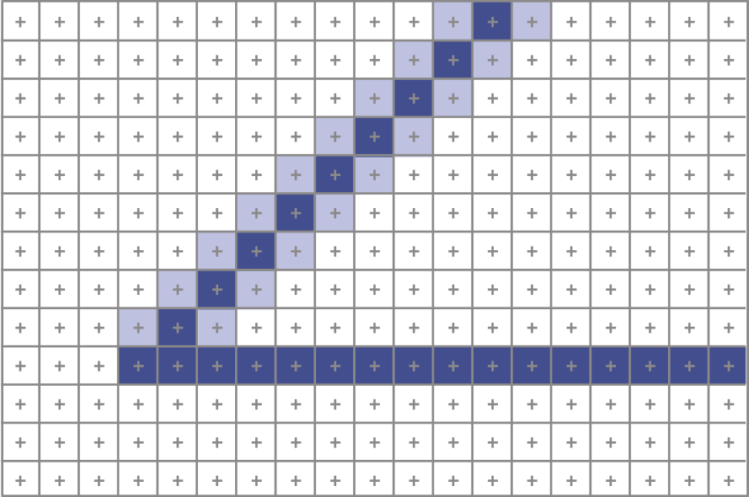
Algorithm Design Choices
Note: brightness can vary with slope
  What is the maximum variation?
How could we compensate for this?
  Answer: antialiasing

Slide 68
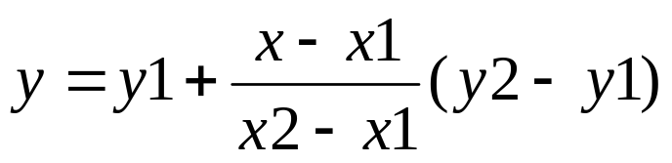
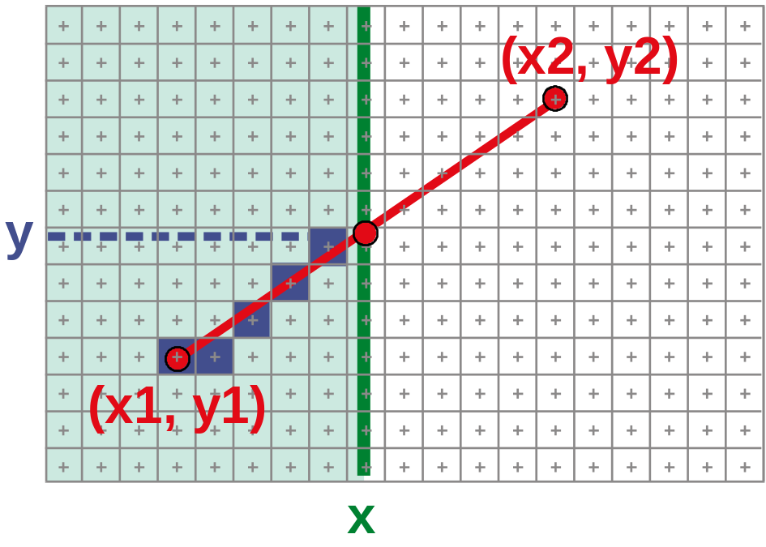

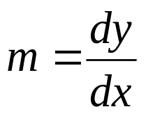
Naive Line Rasterization Algorithm
Simply compute y as a function of x
  Conceptually: move vertical scan line from x1 to x2
  What is the expression of y as function of x?
  Set pixel (x, round (y(x)))

Slide 69

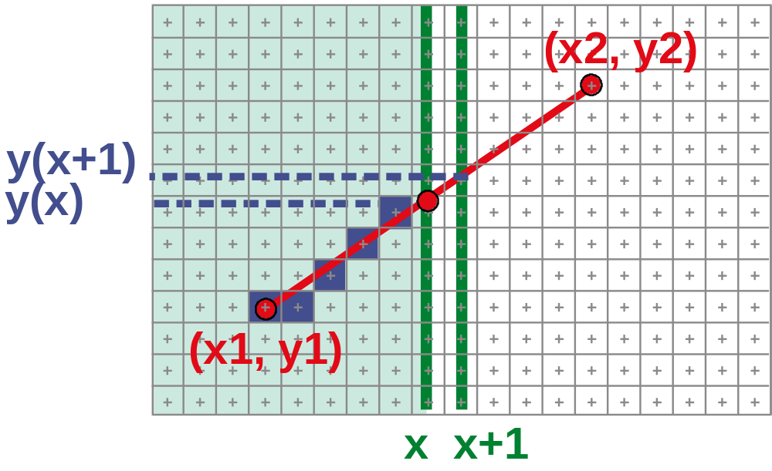
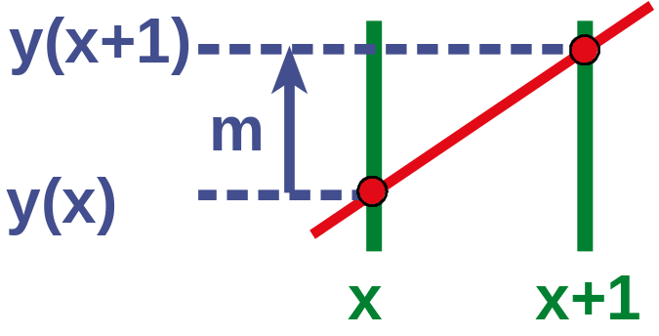
Efficiency
Computing y value is expensive
Observe: y += m at each x step (m = dy/dx)

Slide 70

Bresenham's Algorithm (DDA)
Select pixel vertically closest to line segment
  intuitive, efficient,
  pixel center always within 0.5 vertically
Same answer as naive approach

Slide 71

Bresenham's Algorithm (DDA)
Observation:
  If we're at pixel P (x_{p}, y_{p}), the next pixel must be either E (x_{p}+1, y_{p}) or NE (x_{p}, y_{p}+1)
  Why?

Slide 72

Bresenham Step
Which pixel to choose: E or NE?
  Choose E if segment passes below or
  through middle point M
  Choose NE if segment passes above M

Slide 73

Bresenham Step
Use decision function D to identify points underlying line L:
D(x, y) = y-mx-b
  positive above L
  zero on L
  negative below L
D(p_{x},p_{y}) =
vertical distance from point to line

Slide 74

Bresenham's Algorithm (DDA)
Decision Function:
  D(x, y) = y-mx-b
Initialize:
  error term e = –D(x,y)
On each iteration:
  update x:
  update e:
  if (e ≤ 0.5):
  if (e > 0.5):
x' = x+1
e' = e + m
y' = y (choose pixel E)
y' = y + (choose pixel NE) e' = e - 1

Slide 75
Summary of Bresenham
initialize x, y, e
for (x = x1; x ≤ x2; x++)
  plot (x,y)
  update x, y, e
Generalize to handle all eight octants using symmetry
Can be modified to use only integer arithmetic

Slide 76

Line Rasterization
We will use it for ray-casting acceleration
March a ray through a grid

Slide 77



Grid Marching vs. Line Rasterization
Ray Acceleration:
Must examine every cell the line touches
Line Rasterization:
Best discrete approximation of the line

Slide 78
Questions?

Slide 79

Circle Rasterization
Generate pixels for 2nd octant only
Slope progresses from 0 → –1
Analog of Bresenham
Segment Algorithm

Slide 80
Circle Rasterization
Decision Function:
  D(x, y) =
Initialize:
  error term e =
On each iteration:
  update x:
  update e:
  if (e ≥ 0.5):
  if (e < 0.5):
x² + y² – R²
–D(x,y)
R
x' = x + 1
e' = e + 2x + 1
y' = y (choose pixel E)
y' = y - 1 (choose pixel SE), e' = e + 1

Slide 81
Philosophically
Discrete differential analyzer (DDA):
Perform incremental computation
Work on derivative rather than function
Gain one order for polynomial
  Line becomes constant derivative
  Circle becomes linear derivative

Slide 82
Questions?

Slide 83




Antialiased Line Rasterization
Use gray scales to avoid jaggies
Will be studied later in the course
aliased
antialiased

Slide 84
High-level concepts for 6.837
Linearity
Homogeneous coordinates
Convexity
Discrete vs. continuous

Slide 85
Thursday
Polygon Rasterization
& Visibility

