Slide 1
Acceleration Data Structures for Ray Tracing

Slide 2
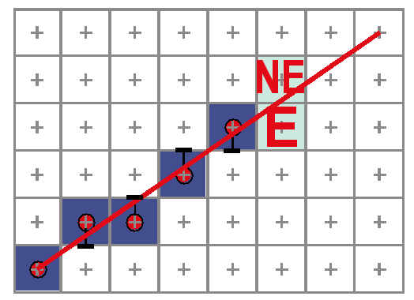
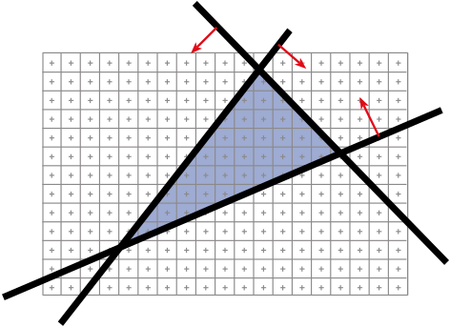
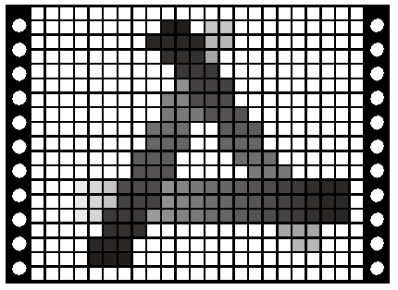
Last Time:
Modeling
Transformations
Graphics Pipeline!!
Clipping
Line & Polygon
Rasterization
  Bresenham (DDA)
Visibility
  Depth Buffer
  (z-buffer)
Illumination
(Shading)
Viewing Transformation
(Perspective / Orthographic)
Clipping
Projection
(to Screen Space)
Scan Conversion
(Rasterization)
Visibility / Display

Slide 3
Schedule
Wed Oct 13thAssignment 4 due
(Shadows, Reflection, & Refraction)
Wed Oct 20th Assignment 5 due
(Voxel Rendering)
Review Session for Quiz 1
  Monday 25th, 7:30 – 9pm, room TBA
Tuesday October 26th, in class: Quiz 1

Slide 4
Today
Motivation – Distribution Ray Tracing
  Soft shadows
  Antialiasing (getting rid of jaggies)
  Glossy reflection
  Motion blur
  Depth of field (focus)
Bounding Boxes
Spatial Acceleration Data Structures
Flattening the Transformation Hierarchy

Slide 5
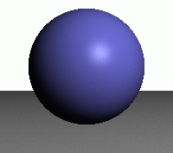
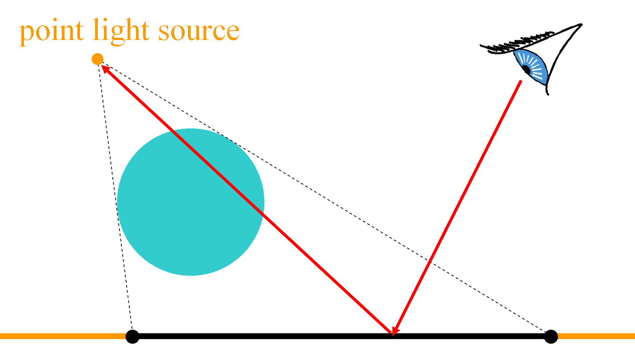
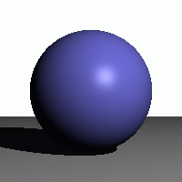
Shadows
one shadow ray per intersection per point light source
no shadow rays
one shadow ray

Slide 6

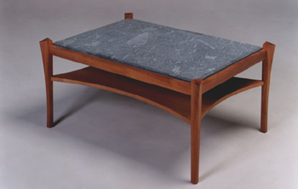
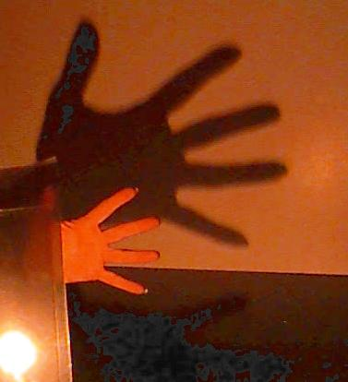
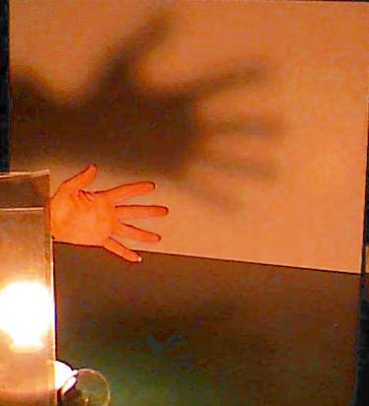
Shadows & Light Sources
http://www.davidfay.com/index.php
clear bulb
frosted bulb
http://3media.initialized.org/photos/2000-10-18/index_gall.htm
http://www.pa.uky.edu/~sciworks/light/preview/bulb2.htm

Slide 7

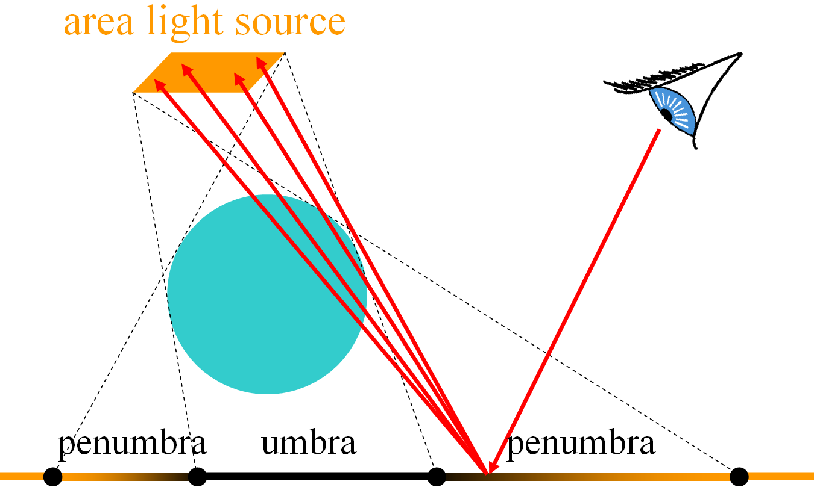

Soft Shadows
multiple shadow rays to sample area light source
one shadow ray
lots of shadow rays

Slide 8


Antialiasing – Supersampling
multiple rays per pixel
jaggies
w/ antialiasing
point light
area light

Slide 9

Reflection
one reflection ray per intersection
θ
θ
perfect mirror

Slide 10
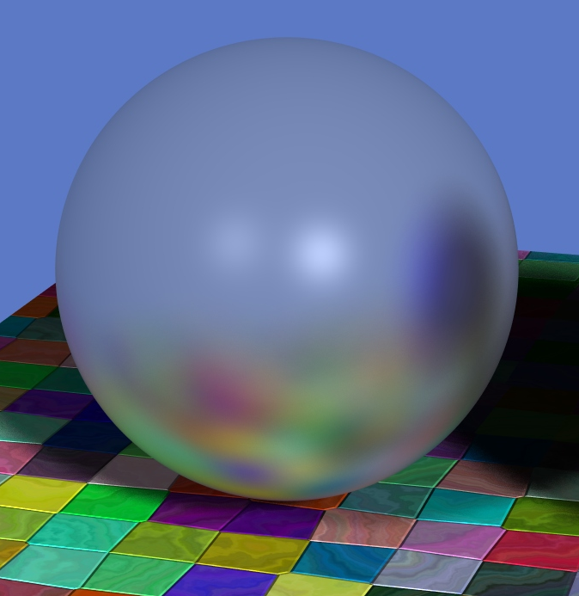
Glossy Reflection
multiple reflection rays
Justin Legakis
θ
θ
polished surface

Slide 11
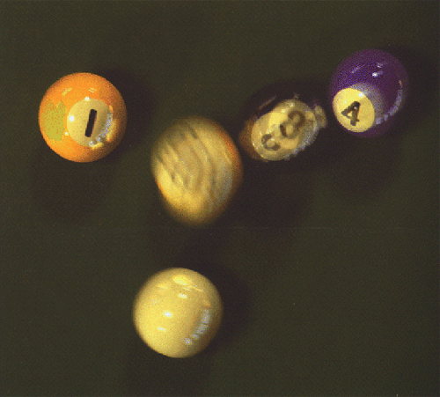
Motion Blur
Sample objects temporally
Rob Cook

Slide 12
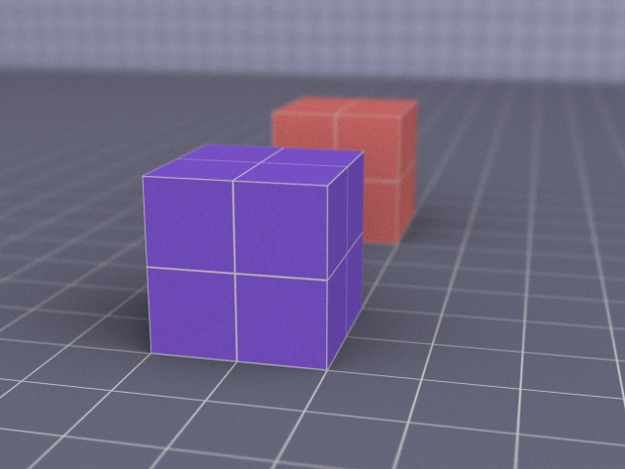

Depth of Field
multiple rays per pixel
film
focal length
Justin Legakis

Slide 13
Ray Tracing Algorithm Analysis
Ray casting
Lots of primitives
Recursive
Distributed Ray
Tracing Effects
  Soft shadows
  Anti-aliasing
  Glossy reflection
  Motion blur
  Depth of field
  cost ≈ height * width *
  num primitives *
  intersection cost *
  size of recursive ray tree *
  num shadow rays *
  num supersamples *
  num glossy rays *
  num temporal samples *
  num focal samples *
  . . .
can we reduce this?

Slide 14
Questions?

Slide 15
Today
Motivation – Distribution Ray Tracing
Bounding Boxes
  of each primitive
  of groups
  of transformed primitives
Spatial Acceleration Data Structures
Flattening the Transformation Hierarchy

Slide 16
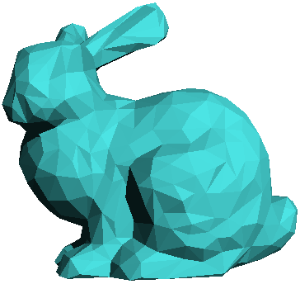

Acceleration of Ray Casting
Goal: Reduce the number of ray/primitive intersections

Slide 17
Conservative Bounding Region
First check for an intersection with a conservative
bounding region
Early reject

Slide 18
Conservative Bounding Regions
tight → avoid
false positives
fast to intersect
bounding sphere
non-aligned bounding box
axis-aligned bounding box
arbitrary convex region (bounding half-spaces)

Slide 19
Intersection with Axis-Aligned Box
From Lecture 2, Ray Casting II
For all 3 axes,
calculate the intersection
distances t₁ and t₂
t_{near} = max (t_{1x}, t_{1y}, t_{1z})
t_{far} = min (t_{2x}, t_{2y}, t_{2z})
If t_{near}> t_{far},
box is missed
If t_{far}< t_{min},
box is behind
If box survived tests,
report intersection at t_{near}
t_{2x}
t_{far}
y=Y2
t_{2y}
t_{near}
t_{1x}
y=Y1
t_{1y}
x=X1
x=X2

Slide 20
Bounding Box of a Triangle
(x_{max}, y_{max}, z_{max})
(x₀, y₀, z₀)
= (max(x₀,x₁,x₂),
max(y₀,y₁,y₂),
max(z₀,z₁,z₂))
(x₁, y₁, z₁)
(x₂, y₂, z₂)
(x_{min}, y_{min}, z_{min})
= (min(x₀,x₁,x₂),
min(y₀,y₁,y₂),
min(z₀,z₁,z₂))

Slide 21
Bounding Box of a Sphere
(x_{max}, y_{max}, z_{max})
= (x+r, y+r, z+r)
r
(x, y, z)
(x_{min}, y_{min}, z_{min})
= (x-r, y-r, z-r)

Slide 22
Bounding Box of a Plane
(x_{max}, y_{max}, z_{max})
= (+∞, +∞, +∞)*
n = (a, b, c)
ax + by + cz = d
(x_{min}, y_{min}, z_{min})
= (-∞, -∞, -∞)*
* unless n is exactly perpendicular to an axis

Slide 23
Bounding Box of a Group
(x_{max}, y_{max}, z_{max})
(x_{max_a}, y_{max_a}, z_{max_a})
= (max(x_{max_a},x_{max_b}),
max(y_{max_a},y_{max_b}),
max(z_{max_a},z_{max_b}))
(x_{max_b}, y_{max_b}, z_{max_b})
(x_{min_b}, y_{min_b}, z_{min_b})
(x_{min_a}, y_{min_a}, z_{min_a})
(x_{min}, y_{min}, z_{min})
= (min(x_{min_a},x_{min_b}),
min(y_{min_a},y_{min_b}),
min(z_{min_a},z_{min_b}))

Slide 24
Bounding Box of a Transform
(x'_{max}, y'_{max}, z'_{max})
= (max(x₀,x₁,x₂,x₃,x₄,x₅,x₆,x₇),
max(y₀,y₁,y₂,y₃,y₄,x₅,x₆,x₇),
max(z₀,z₁,z₂,z₃,z₄,x₅,x₆,x₇))
(x_{max}, y_{max}, z_{max})
M
(x₃,y₃,z₃) =
M (x_{max},y_{max},z_{min})
(x₂,y₂,z₂) =
M (x_{min},y_{max},z_{min})
(x₁,y₁,z₁) =
M (x_{max},y_{min},z_{min})
(x₀,y₀,z₀) =
M (x_{min},y_{min},z_{min})
(x_{min}, y_{min}, z_{min})
(x'_{min}, y'_{min}, z'_{min})
= (min(x₀,x₁,x₂,x₃,x₄,x₅,x₆,x₇),
min(y₀,y₁,y₂,y₃,y₄,x₅,x₆,x₇),
min(z₀,z₁,z₂,z₃,z₄,x₅,x₆,x₇))

Slide 25
Special Case: Transformed Triangle
Can we do better?
M

Slide 26
Special Case: Transformed Triangle
(x_{max}, y_{max}, z_{max})
= (max(x'₀,x'₁,x'₂),
max(y'₀,y'₁,y'₂),
max(z'₀,z'₁,z'₂))
(x₀, y₀, z₀)
M
(x'₀,y'₀,z'₀) =
M (x₀,y₀,z₀)
(x₁, y₁, z₁)
(x'₁,y'₁,z'₁) =
M (x₁,y₁,z₁)
(x'₂,y'₂,z'₂) =
M (x₂,y₂,z₂)
(x₂, y₂, z₂)
(x_{min}, y_{min}, z_{min})
= (min(x'₀,x'₁,x'₂),
min(y'₀,y'₁,y'₂),
min(z'₀,z'₁,z'₂))

Slide 27
Questions?

Slide 28
Today
Motivation – Distribution Ray Tracing
Bounding Boxes
Spatial Acceleration Data Structures
  Regular Grid
  Adaptive Grids
  Hierarchical Bounding Volumes
Flattening the Transformation Hierarchy

Slide 29
Regular Grid

Slide 30
Create Grid
Find bounding box of scene
Choose grid resolution
(n_{x}, n_{y}, n_{z})
grid_{x} need
not = grid_{y}
Cell (i, j)
grid_{y}
grid_{x}

Slide 31
Insert Primitives into Grid
Primitives that overlap multiple cells?
Insert into
multiple cells (use pointers)

Slide 32
For Each Cell Along a Ray
Does the cell contain an intersection?
Yes: return closest
intersection
No: continue

Slide 33
Preventing Repeated Computation
Perform the computation once, "mark"
the object
Don't
re-intersect
marked
objects

Slide 34
Don't Return Distant Intersections
If intersection t is not within the cell range, continue (there may be something closer)

Slide 35
Which Cells Should We Examine?
Should we intersect
the ray with
each voxel?
No! we can
do better!

Slide 36
Where Do We Start?
Intersect ray
with scene
bounding box
Ray origin
may be inside
the scene
bounding box
Cell (i, j)
t_{next_y}
t_{next_x}
t_{min}
t_{next_y}
t_{min}
t_{next_x}

Slide 37
Is there a Pattern to Cell Crossings?
Yes, the horizontal and vertical crossings have regular spacing
dt_{x} = grid_{x} / dir_{x}
dir_{y}
grid_{y}
dt_{y} = grid_{y} / dir_{y}
dir_{x}
grid_{x}

Slide 38
What's the Next Cell?
if ( t_{next_x} < t_{next_y} )
i += sign_{x}
t_{min} = t_{next_x}
t_{next_x} += dt_{x}
else
j += sign_{y}
t_{min} = t_{next_y}
t_{next_y} += dt_{y}
Cell (i+1, j)
Cell (i, j)
t_{next_y}
t_{next_x}
t_{min}
dt_{y}
(dir_{x}, dir_{y})
dt_{x}
if (dir_{x} > 0) sign_{x} = 1 else sign_{x} = -1
if (dir_{y} > 0) sign_{y} = 1 else sign_{y} = -1

Slide 39
What's the Next Cell?
3DDDA – Three Dimensional Digital
Difference Analyzer
Similar to Bresenham’s
Line Rasterization!

Slide 40
Pseudo-Code
create grid
insert primitives into grid
for each ray r
find initial cell c(i,j), t_{min}, t_{next_x} & t_{next_y}
compute dt_{x}, dt_{y}, sign_{x} and sign_{y}
while c != NULL
for each primitive p in c
intersect r with p
if intersection in range found
return
c = find next cell

Slide 41
Regular Grid Discussion
Advantages?
  easy to construct
  easy to traverse
Disadvantages?
  may be only sparsely filled
  geometry may still be clumped

Slide 42

A Note about Typos
Typos happen in lecture notes
  Don’t be afraid of thinking and asking questions
  Please tell us about any typos you find
  & we’ll fix them ASAP
Typos happen in textbooks
  The pseudocode for the 3DDDA
  ray/grid marching in Shirley is buggy
  Think, don’t just copy directly

Slide 43
Questions?

Slide 44
Today
Motivation – Distribution Ray Tracing
Bounding Boxes
Spatial Acceleration Data Structures
  Regular Grid
  Adaptive Grids
  Hierarchical Bounding Volumes
Flattening the Transformation Hierarchy

Slide 45
Adaptive Grids
Subdivide until each cell contains no more than
n elements, or maximum depth d is reached
Nested Grids
Octree/(Quadtree)

Slide 46
Primitives in an Adaptive Grid
Can live at intermediate levels, or
be pushed to lowest level of grid
Octree/(Quadtree)

Slide 47
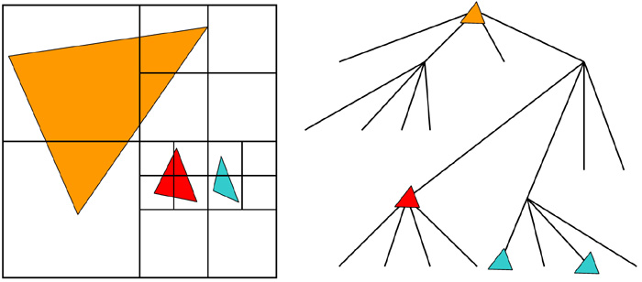
Adaptive Grid Discussion
Advantages?
  grid complexity matches geometric density
Disadvantages?
  more expensive to traverse (especially octree)

Slide 48
Today
Motivation – Distribution Ray Tracing
Bounding Boxes
Spatial Acceleration Data Structures
  Regular Grid
  Adaptive Grids
  Hierarchical Bounding Volumes
Flattening the Transformation Hierarchy

Slide 49
Bounding Volume Hierarchy
Find bounding box of objects
Split objects into two groups
Recurse

Slide 50
Bounding Volume Hierarchy
Find bounding box of objects
Split objects into two groups
Recurse

Slide 51
Bounding Volume Hierarchy
Find bounding box of objects
Split objects into two groups
Recurse

Slide 52
Bounding Volume Hierarchy
Find bounding box of objects
Split objects into two groups
Recurse

Slide 53
Bounding Volume Hierarchy
Find bounding box of objects
Split objects into two groups
Recurse

Slide 54
Where to split objects?
At midpoint OR
Sort, and put half of the objects on each side OR
Use modeling hierarchy

Slide 55
Intersection with BVH
Check sub-volume with closer intersection first

Slide 56
Intersection with BVH
Don't return intersection immediately if the other subvolume may have a closer intersection

Slide 57
Bounding Volume Hierarchy Discussion
Advantages
  easy to construct
  easy to traverse
  binary
Disadvantages
  may be difficult to choose a good split for a node
  poor split may result in minimal spatial pruning

Slide 58
Today
Motivation – Distribution Ray Tracing
Bounding Boxes
Spatial Acceleration Data Structures
Flattening the Transformation Hierarchy

Slide 59
Transformation Hierarchy
Group & Transformation hierarchy may not be a good spatial hierarchy
group
transform
transform
A
C
group
Flatten
transform
group
B
transform
transform
transform
A B
C D
C E
transform
transform
D
E

Slide 60
Assignments 5 & 6
Assignment 5: Voxel Rendering
  Bounding boxes for primitives
  Sphere voxelization
  Regular grid data structure
  Fast ray-grid intersection
  Flatten the transformation hierarchy
Assignment 6: Grid Acceleration & Solid Textures
  Accelerated ray tracing (6)
  Analyze ray tracing statistics
  (average # of rays, intersections, etc. per pixel)
  Solid textures (next time)
  Extra Credit: Distribution Ray Tracing

Slide 61
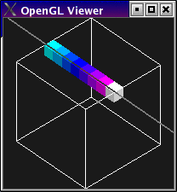
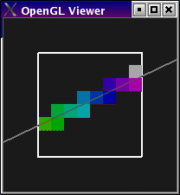
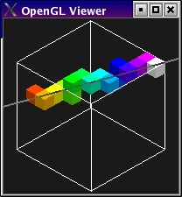
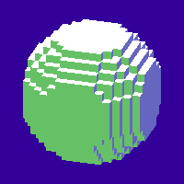
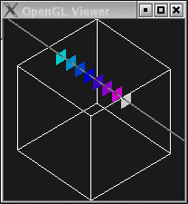
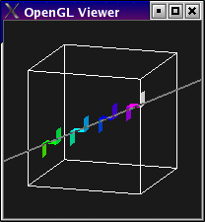
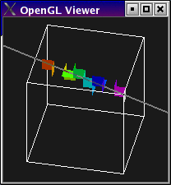
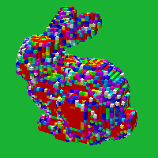
Ray Marching Visualization
sphere voxelization
cells traversed
primitive density
entered faces

Slide 62
Next Time:
Texture Mapping

