Slide 1
Sampling and
Monte-Carlo Integration

Slide 2
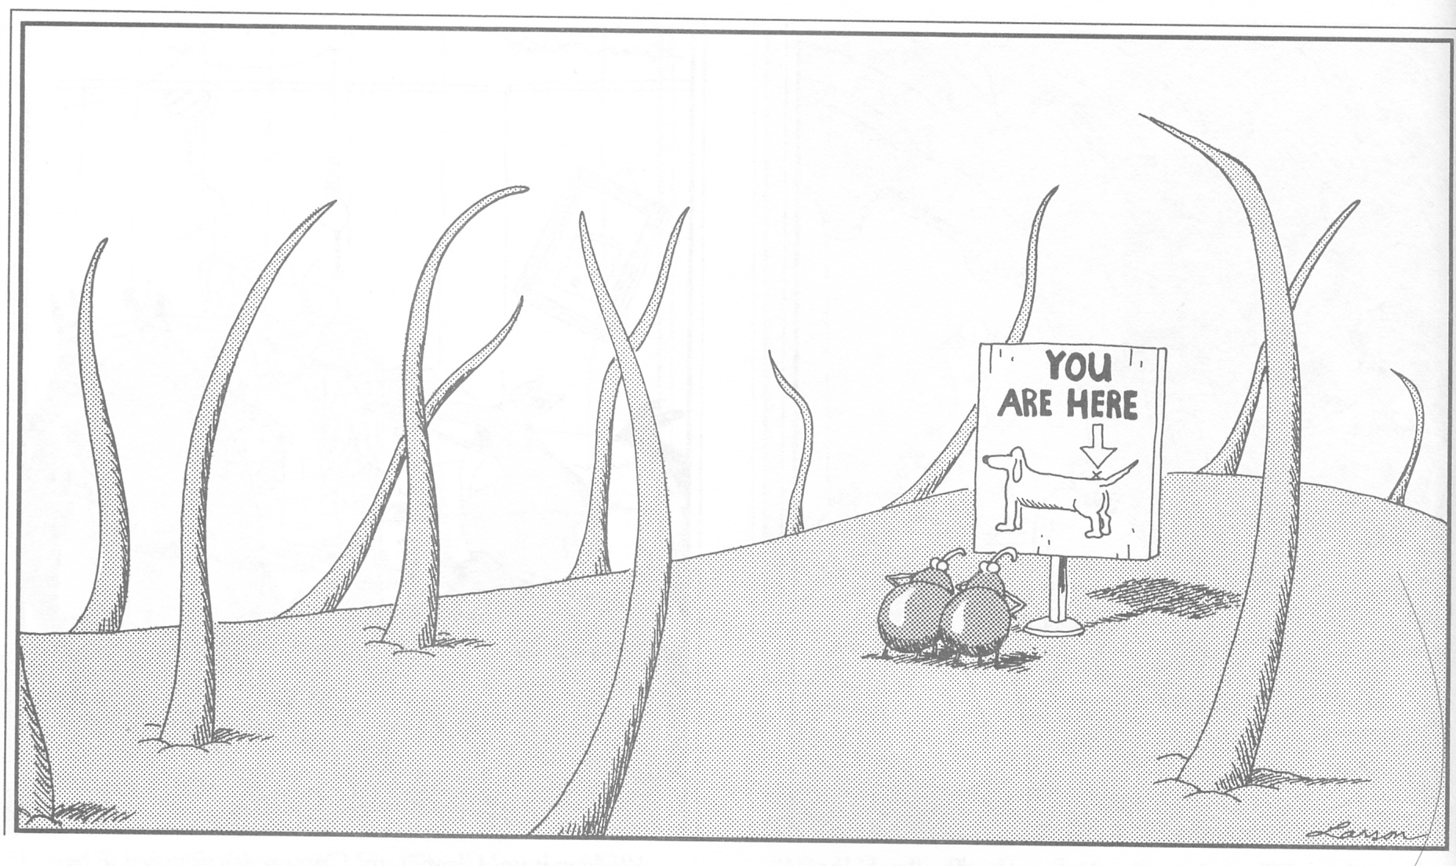
Sampling and Monte-Carlo Integration

Slide 3
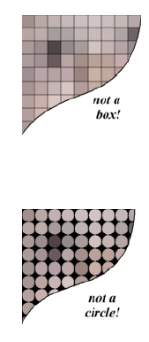
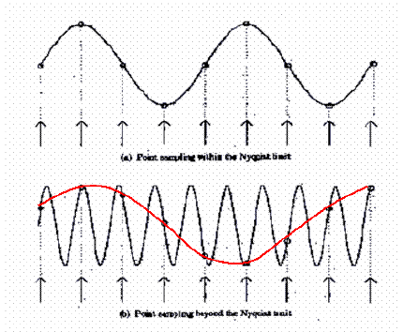
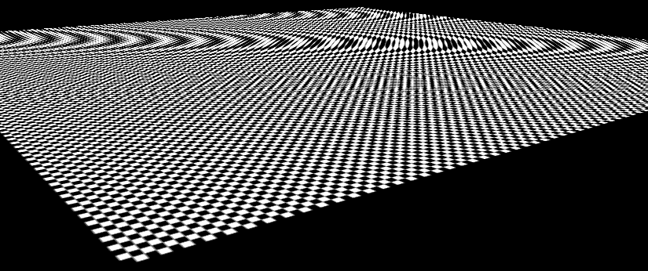
Last Time
Pixels are samples
Sampling theorem
Convolution & multiplication
Aliasing: spectrum replication
Ideal filter
  And its problems
Reconstruction
Texture prefiltering, mipmaps

Slide 4
Quiz solution: Homogeneous sum
(x₁, y₁, z₁, 1) + (x₂, y₂, z₂, 1)
= (x₁+x₂, y₁+y₂, z₁+z₂, 2)
¼ ((x₁+x₂)/2, (y₁+y₂)/2, (z₁+z₂)/2)
This is the average of the two points
General case: consider the homogeneous version of
(x₁, y₁, z₁) and (x₂, y₂, z₂) with w coordinates w₁ and w₂
(x₁ w₁, y₁ w₁, z₁ w₁, w₁) + (x₂ w₂, y₂ w₂, z₂ w₂, w₂)
= (x₁ w₁+x₂w₂, y₁ w₁+y₂w₂, z₁ w₁+z₂w₂, w₁+w₂)
¼ ((x₁ w₁+x₂w₂ )/(w₁+w₂) ,(y₁ w₁+y₂w₂ )/(w₁+w₂),
(z₁ w₁+z₂w₂ )/(w₁+w₂))
This is the weighted average of the two geometric points

Slide 5
Today’s lecture
Antialiasing in graphics
Sampling patterns
Monte-Carlo Integration
Probabilities and variance
Analysis of Monte-Carlo Integration

Slide 6
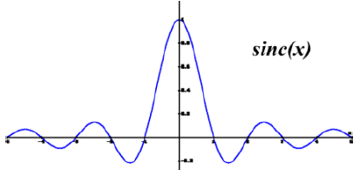
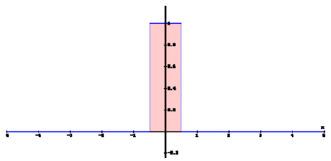
Ideal sampling/reconstruction
Pre-filter with a perfect low-pass filter
  Box in frequency
  Sinc in time
Sample at Nyquist limit
  Twice the frequency cutoff
Reconstruct with perfect filter
  Box in frequency, sinc in time
And everything is great!

Slide 7
Difficulties with perfect sampling
Hard to prefilter
Perfect filter has infinite support
  Fourier analysis assumes infinite signal and complete knowledge
  Not enough focus on local effects
And negative lobes
  Emphasizes the two problems above
  Negative light is bad
  Ringing artifacts if prefiltering or supports are not perfect

Slide 8
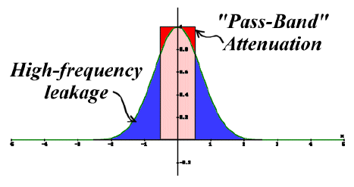
At the end of the day
Fourier analysis is great to understand aliasing
But practical problems kick in
As a result there is no perfect solution
Compromises between
  Finite support
  Avoid negative lobes
  Avoid high-frequency leakage
  Avoid low-frequency attenuation
Everyone has their favorite cookbook recipe
  Gaussian, tent, Mitchell bicubic

Slide 9
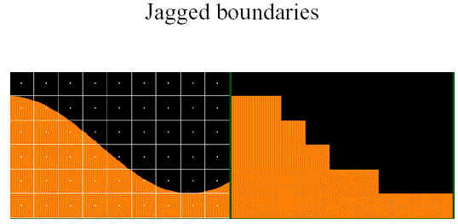
The special case of edges
An edge is poorly captured by Fourier analysis
  It is a local feature
  It combines all frequencies (sinc)
Practical issues with edge aliasing lie more in the jaggies (tilted lines) than in actual spectrum replication

Slide 10
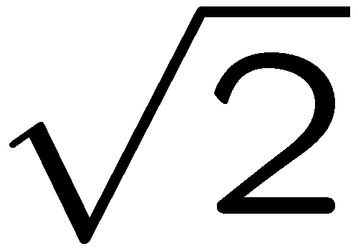
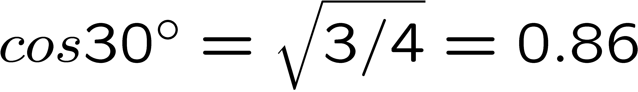
Anisotropy of the sampling grid
More vertical and horizontal bandwidth
  E.g. less bandwidth in diagonal
A hexagonal grid would be better
  Max anisotropy
  But less practical

Slide 11
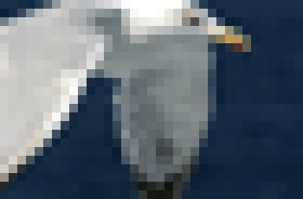

Anisotropy of the sampling grid
More vertical and horizontal bandwidth
A hexagonal grid would be better
  But less practical
Practical effect: vertical and horizontal direction show when doing bicubic upsampling
Low-res image
Bicubic upsampling

Slide 12
Philosophy about mathematics
Mathematics are great tools to model
(i.e. describe) your problems
They afford incredible power, formalism, generalization
However it is equally important to understand the practical problem and how much the mathematical model fits

Slide 13
Questions?

Slide 14
Today’s lecture
Antialiasing in graphics
Sampling patterns
Monte-Carlo Integration
Probabilities and variance
Analysis of Monte-Carlo Integration

Slide 15
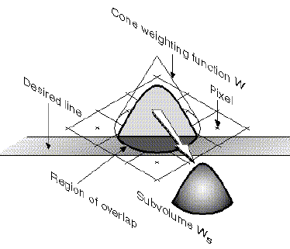
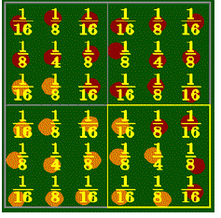
Supersampling in graphics
Pre-filtering is hard
  Requires analytical visibility
  Then difficult to integrate analytically with filter
Possible for lines, or if visibility is ignored
usually, fall back to supersampling

Slide 16
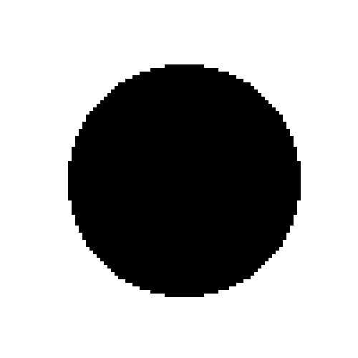
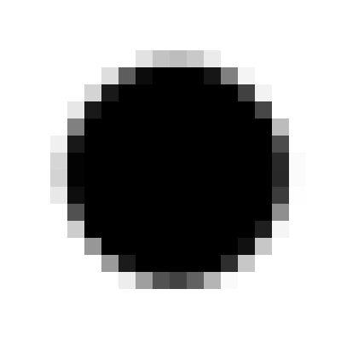
Uniform supersampling
Compute image at resolution k*width, k*height
Downsample using low-pass filter
(e.g. Gaussian, sinc, bicubic)

Slide 17

Uniform supersampling
Advantage:
  The first (super)sampling captures more high frequencies that are not aliased
  Downsampling can use a good filter
Issues
  Frequencies above the (super)sampling limit are still aliased
Works well for edges, since
spectrum replication is less an issue
Not as well for repetitive textures
  But mipmapping can help

Slide 18
Multisampling vs. supersampling
Observation:
  Edge aliasing mostly comes from visibility/rasterization issues
  Texture aliasing can be prevented using prefiltering
Multisampling idea:
  Sample rasterization/visibility at a higher rate than shading/texture
In practice, same as supersampling, except that all the subpixel get the same color if visible

Slide 19
Multisampling vs. supersampling
For each triangle
  For each pixel
    Compute pixelcolor //only once for all subpixels
    For each subpixel
      If (all edge equations positive &&
      zbuffer [subpixel] > currentz )
        Then Framebuffer[subpixel]=pixelcolor
The subpixels of a pixel get different colors only at edges of triangles or at occlusion boundaries
Example:
2 Gouraud-
shaded
triangles
Subpixels in
supersampling
Subpixels in
multisampling

Slide 20
Questions?

Slide 21
Uniform supersampling
Problem: supersampling only pushes the problem further: The signal is still not bandlimited
Aliasing happens

Slide 22
Jittering
Uniform sample + random perturbation
Sampling is now non-uniform
Signal processing gets more complex
In practice, adds noise to image
But noise is better than aliasing Moiré patterns

Slide 23
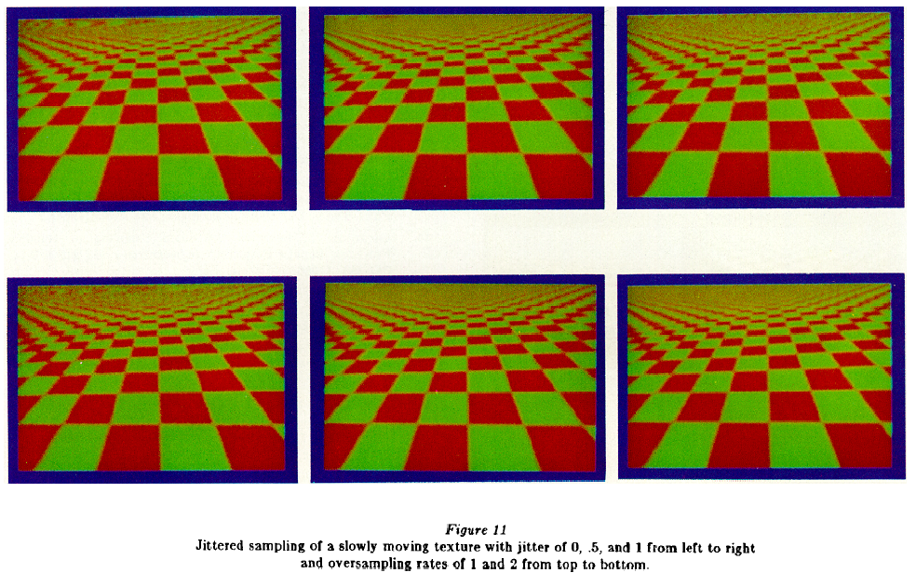
Jittered supersampling
Regular, Jittered Supersampling

Slide 24
Jittering
Displaced by a vector a fraction of the size of the subpixel distance
Low-frequency Moire (aliasing) pattern replaced by noise
Extremely effective
Patented by Pixar!
When jittering amount is 1, equivalent to stratified sampling (cf. later)

Slide 25
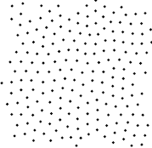
Poisson disk sampling and blue noise
Essentially random points that are not allowed to be closer than some radius r
Dart-throwing algorithm:
Initialize sampling pattern as empty
Do
  Get random point P
  If P is farther than r from all samples
    Add P to sampling pattern
Until unable to add samples for a long time
From Hiller et al.
r

Slide 26
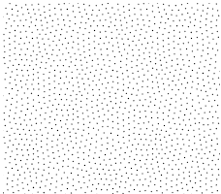
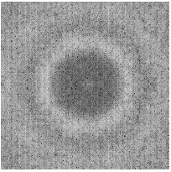
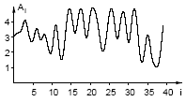
Poisson disk sampling and blue noise
Essentially random points that are not allowed to be closer than some radius r
The spectrum of the Poisson disk pattern is called blue noise:
No low frequency
Other criterion:
Isotropy
(frequency content
must be the same
for all direction)
Poisson disk pattern
Fourier transform
Anisotropy
(power spectrum
per direction)

Slide 27
Recap
Uniform supersampling
  Not so great
Jittering
  Great, replaces aliasing by noise
Poisson disk sampling
  Equally good, but harder to generate
  Blue noise and good (lack of) anisotropy

Slide 28
Adaptive supersampling
Use more sub-pixel samples around edges

Slide 29
Adaptive supersampling
Use more sub-pixel samples around edges
Compute color at small number of sample
If their variance is high
  Compute larger number of samples

Slide 30
Adaptive supersampling
Use more sub-pixel samples around edges
Compute color at small number of sample
If variance with neighbor pixels is high
  Compute larger number of samples

Slide 31
Problem with non-uniform distribution
Reconstruction can be complicated
80% of the samples are black
Yet the pixel should be light grey

Slide 32
Problem with non-uniform distribution
Reconstruction can be complicated
Solution: do a multi-level reconstruction
  Reconstruct uniform sub-pixels
  Filter those uniform sub-pixels

Slide 33
Recap
Uniform supersampling
  Not so great
Jittering
  Great, replaces aliasing by noise
Poisson disk sampling
  Equally good, but harder to generate
  Blue noise and good (lack of) anisotropy
Adaptive sampling
  Focus computation where needed
  Beware of false negative
  Complex reconstruction

Slide 34
Questions?

Slide 35
Today’s lecture
Antialiasing in graphics
Sampling patterns
Monte-Carlo Integration
Probabilities and variance
Analysis of Monte-Carlo Integration

Slide 36
Shift of perspective
So far, Antialiasing as signal processing
Now, Antialiasing as integration
Complementary yet not always the same

Slide 37
Why integration?
Simple version:
compute pixel coverage
More advanced:
Filtering (convolution)
is an integral
pixel = s filter * color
And integration is useful in tons of places in graphics

Slide 38
Monte-Carlo computation of π
Take a square
Take a random point (x,y) in the square
Test if it is inside the ¼ disc (x²+y² < 1)
The probability is π /4
y
x

Slide 39
Monte-Carlo computation of π
The probability is π /4
Count the inside ratio n = # inside / total # trials
π ≈ n * 4
The error depends on the number or trials

Slide 40
Why not use Simpson integration?
Yeah, to compute π,
Monte Carlo is not very efficient
But convergence is independent of dimension
Better to integrate high-dimensional functions
For d dimensions, Simpson requires N^{d} domains

Slide 41
Dumbest Monte-Carlo integration
Compute 0.5 by flipping a coin
1 flip: 0 or 1=> average error =0.5
2 flips: 0, 0.5, 0.5 or 1 =>average error=0. 25
4 flips: 0 (*1),0.25 (*4), 0.5 (*6), 0.75(*4), 1(*1)
=> average error =0.1875
Does not converge very fast
Doubling the number of samples does not double accuracy

Slide 42
Questions?

Slide 43
Today’s lecture
Antialiasing in graphics
Sampling patterns
Monte-Carlo Integration
Probabilities and variance
Analysis of Monte-Carlo Integration
BEWARE:
MATHS INSIDE

Slide 44
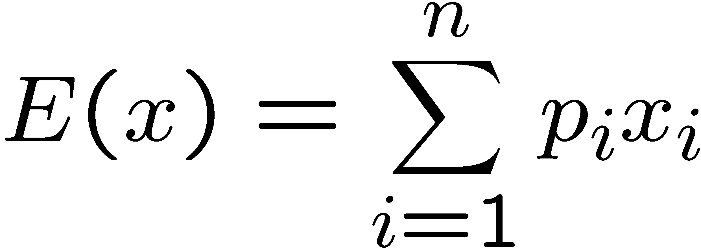
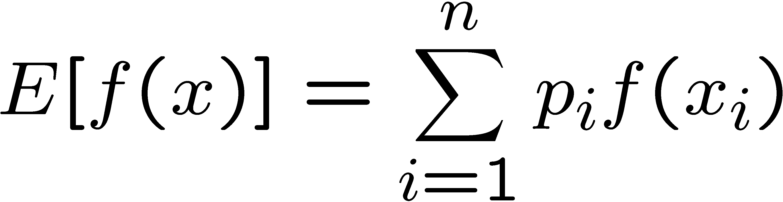
Review of probability (discrete)
Random variable can take discrete values x_{i}
Probability p_{i} for each x_{i}
  0 · p_{i} · 1
  If the events are mutually exclusive, Σ p_{i} =1
Expected value
Expected value of function of random variable
  f(x_{i}) is also a random variable

Slide 45
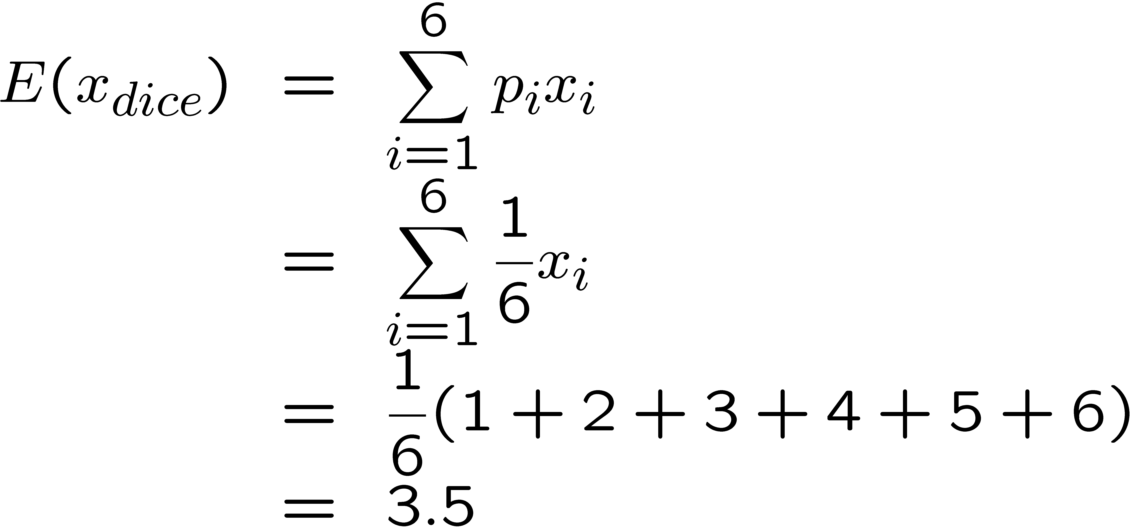
Ex: fair dice

Slide 46
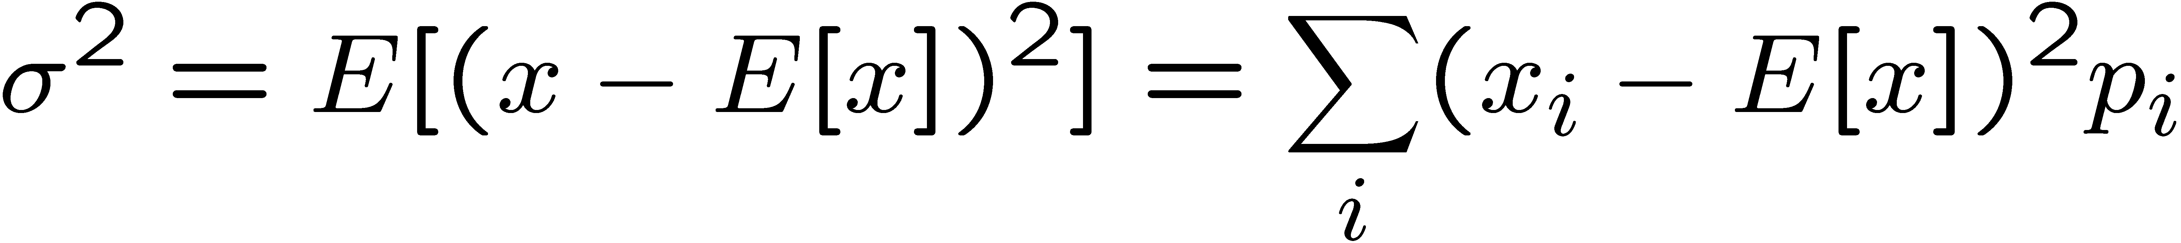
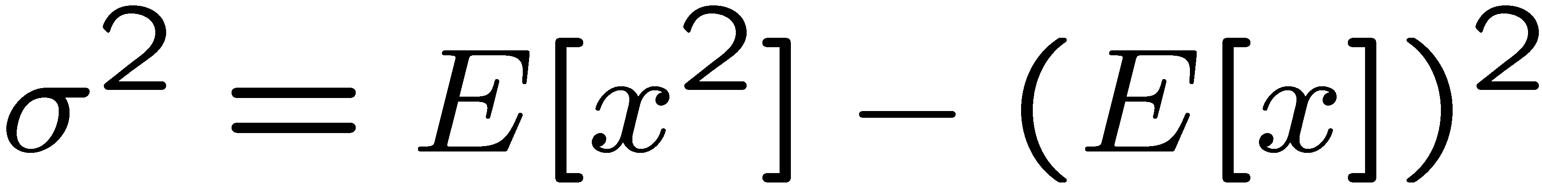
Variance & standard deviation
Variance σ ²:
Measure of deviation from expected value
Expected value of square difference (MSE)
Also
Standard deviation σ:
square root of variance (notion of error, RMS)

Slide 47
Questions?

Slide 48
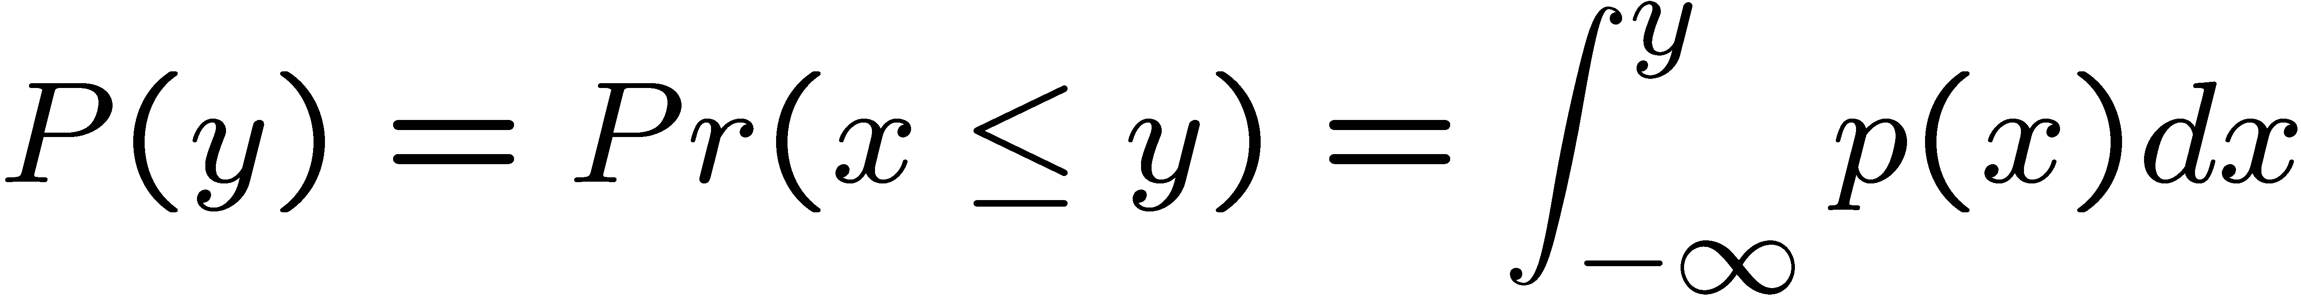
Continuous random variables
Real-valued random variable x
Probability density function (PDF) p(x)
  Probability of a value between x and x+dx is p(x) dx
Cumulative Density Function (CDF) P(y):
  Probability to get a value lower than y

Slide 49
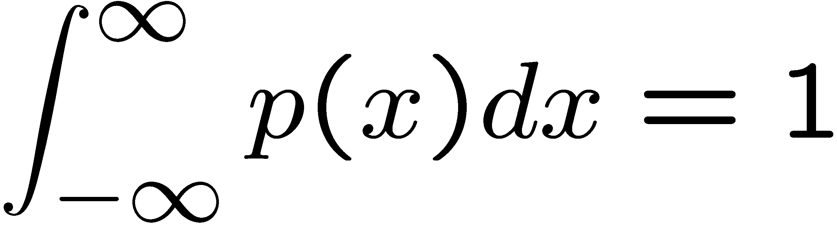
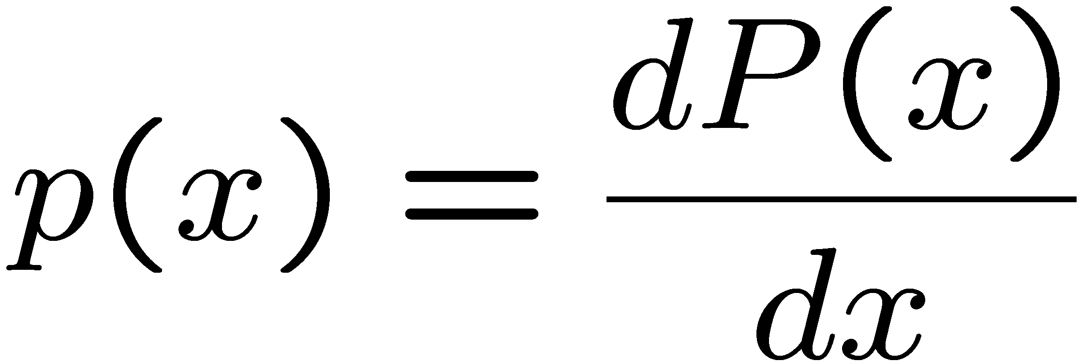
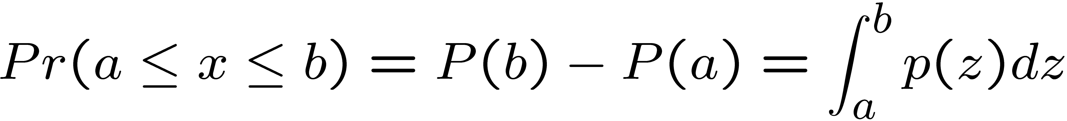
Properties
p(x) ¸ 0 but can be greater than 1 !!!!
P is positive and non-decreasing

Slide 50
Properties
p(x) ¸ 0 but can be greater than 1 !!!!
P is positive and non-decreasing

Slide 51
Example
Uniform distribution between a and b
Dirac distribution

Slide 52
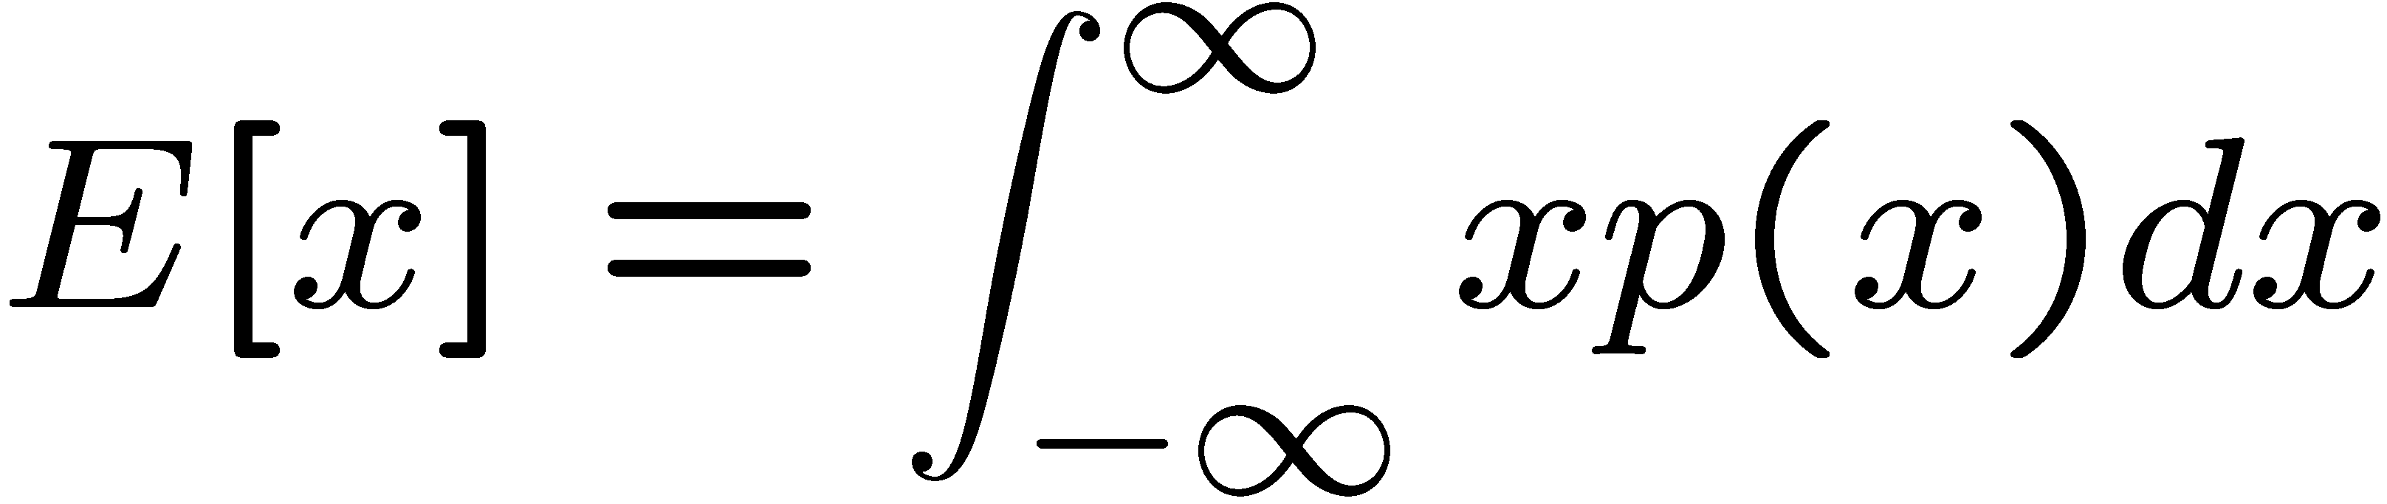
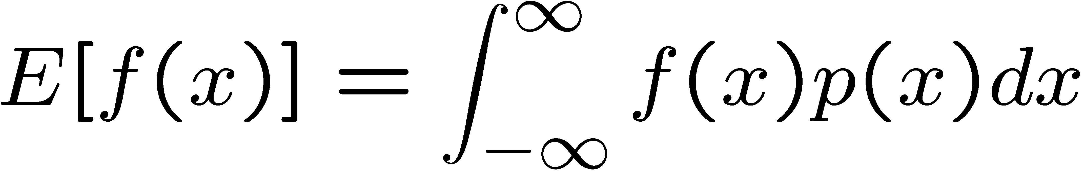
Expected value
Expected value is linear
E[f₁(x) + a f₂(x)] = E[f₁(x)] + a E[f₂(x)]

Slide 53
Variance
Variance is not linear !!!!
σ²[x+y] = σ²[x] + σ²[y] + 2 Cov[x,y]
Where Cov is the covariance
  Cov[x,y] = E[xy] - E[x] E[y]
  Tells how much they are big at the same time
  Null if variables are independent
But σ²[ax] = a² σ²[x]

