Slide 1
Agenda
1
JavaScript Basics
JavaScript Objects
JavaScript Functions
JavaScript HTML DOM
AJAX
2
3
4
5
Confidential – Oracle Internal/Restricted/Highly Restricted

Slide 2
JS Basics
JavaScript is not type-safe
  var keyword to declare variables
    One Statement, Many Variables
      var person = "John Doe", carName = "Volvo", price = 200;
Separated by semicolons;
JavaScript identifiers are caseSensitive
Hoisting is JavaScript's default behavior of moving all declarations to the top of the current scope
  Function declaration takes precedence over variable declarations
  Variable initializations are not hoisted
Confidential – Oracle Internal/Restricted/Highly Restricted

Slide 3
Scope
Local
  Declared within a JavaScript function, become LOCAL to the function
  Can only be accessed within the function
Global
  Declared outside a function, becomes GLOBAL
  All scripts and functions on a web page can access it
Lifetime of JavaScript Variables
  Local variables are deleted when the function is completed
  Global variables are deleted when you close the browser window (or tab), but remains available to new pages loaded into the same window
    Do NOT create global variables unless you intend to
Confidential – Oracle Internal/Restricted/Highly Restricted

Slide 4
Types
undefined == null, but undefined !== null
  undefined means a variable has been declared but has not yet been assigned a value
  null is an assignment value. It can be assigned to a variable as a representation of no value
  typeof(undefined) === “undefined”, typeof(null) === “object”
  “==” means equal to
  “===” mean equal value and same type
Confidential – Oracle Internal/Restricted/Highly Restricted

Slide 5
JS Objects
Example
  var car = "Fiat";
  var car = {type: "Fiat",
  tirePressure: [37, 37, 35, 35],
  color: "white",
  speed: 0,
  drive: function() {this.speed = 10} };
    car.type == “Fiat”
    car[“type”] == “Fiat”
    car.drive();
The name:values pairs are called properties
Methods are actions that can be performed on objects
Confidential – Oracle Internal/Restricted/Highly Restricted

Slide 6
JSON
JSON stands for JavaScript Object Notation
Lightweight data interchange format
Language independent
JSON Syntax Rules
  Data is in name/value pairs
  Data is separated by commas
  Curly braces hold objects
  Square brackets hold arrays
Confidential – Oracle Internal/Restricted/Highly Restricted

Slide 7
Functions
Callbacks
  Functions are of the type Object, can be -
    Stored in variables
    Passed as arguments to functions
    Created within functions
    Returned from functions
Confidential – Oracle Internal/Restricted/Highly Restricted

Slide 8
Functions
Closures
  In JavaScript, variables defined outside a function automatically become available inside the function - lexical scoping
  A closure is an inner function that has access to the outer (enclosing) function’s variables - scope chain
  Global variables can be made local (private) with closures
  Closures’ Rules
    Closures have access to the outer function’s variable even after the outer function returns
    Closures store references - not the value - to the outer function’s variables
  https://jsfiddle.net/7rah3za8/
Confidential – Oracle Internal/Restricted/Highly Restricted

Slide 9

HTML DOM
DOM
  When a web page is loaded, the browser creates a Document Object Model of the page
  HTML DOM model is constructed as a tree of Objects
Confidential – Oracle Internal/Restricted/Highly Restricted

Slide 10
HTML DOM
With the object model, JavaScript can –
  change all the HTML elements in the page
  change all the HTML attributes in the page
  change all the CSS styles in the page
  remove existing HTML elements and attributes
  add new HTML elements and attributes
  react to all existing HTML events in the page
  create new HTML events in the page
  https://www.w3schools.com/js/js_htmldom_methods.asp
Confidential – Oracle Internal/Restricted/Highly Restricted

Slide 11
Events
HTML events are "things" that happen to HTML elements
  JavaScript can "react" on these events
    onchange
    onclick
    onmouseover
    onmouseout
    onkeydown
    onload
    Etc…
Confidential – Oracle Internal/Restricted/Highly Restricted

Slide 12
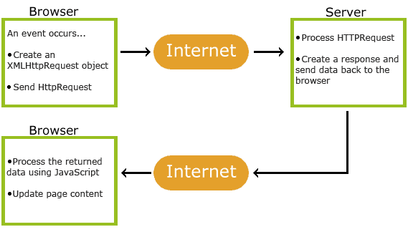
AJAX
AJAX = Asynchronous JavaScript And XML
  Read data from a web server - after the page has loaded
  Update a web page without reloading the page
  Send data to a web server - in the background
AJAX uses a combination of
  A browser built-in XMLHttpRequest object (to request data from a web server)
  JavaScript and HTML DOM (to display or use the data)
Confidential – Oracle Internal/Restricted/Highly Restricted

Slide 13
Promise
A promise is an object that may produce a single value some time in the future -
  Either a resolved value (fulfilled)
  or a reason that it’s not resolved (rejected)
Promises can be chained together to control asynchronous functions in synchronous flows
  Promise.then()
  Promise.all()
  Promise.race()
http://jsfiddle.net/u74L4n1t/
Confidential – Oracle Internal/Restricted/Highly Restricted

Slide 14
Resources
https://www.w3schools.com/js/default.asp
http://javascriptissexy.com/understand-javascript-callback-functions-and-use-them/
https://www.youtube.com/watch?v=71AtaJpJHw0
http://javascriptissexy.com/javascript-variable-scope-and-hoisting-explained/
http://javascriptissexy.com/understand-javascript-closures-with-ease/
Confidential – Oracle Internal/Restricted/Highly Restricted

