Slide 1
Agenda
1
Development Process
Delivery Process
Future Plans
2
3
Confidential – Oracle Internal/Restricted/Highly Restricted

Slide 2
Development Process
Development: Windows/Mac laptops
  IDE/Editor: Netbeans, VS Code or Atom (HED), IntelliJ (HCM)
Source Control: ODCS/GIT
Continuous Integration: Jenkins image integrated with ODCS
Artifactory
  Currently using internal FMW hosting of JFrog artifactory
Confidential – Oracle Internal/Restricted/Highly Restricted

Slide 3
Current Approach
Jenkins
Build
SSH Push
ADE Pull
Development
ODCS
V2MIB
17.05.0
V2MIB
min
V2MIB
min
Editor or IDE
Developer Laptop
GIT Clone > Code > Test > CI
V2MIBHEDC
17.08.0
V2MIBHEDC
min
V2MIBHEDC
min
Dev1
Commit > Push
Dev2
Merge Req
V2MIBHEDD
17.11.0
V2MIBHEDD
min
V2MIBHEDD
min
Local tasks to perform CI Tasks
Dev…n
Fail
Pass
Jenkins
Versioning
Minification
Bundling
Lint
Unit Test
Selenium
Confidential – Oracle Internal/Restricted/Highly Restricted

Slide 4

Proposed Approach
Jenkins
Build
Artifactory
ADE Pull
Development
ODCS
V2MIB
17.05.0
hey-student
17.08.01.tgz
17.08.02.tgz
17.08.n.tgz
17.11.01…n.tgz
18.02.01…n.tgz
hcm-recruiting
17.08.01…n.tgz
17.11.01…n.tgz
18.02.01…n.tgz
oraclejet
2.2.0.tgz
2.3.0.tgz
3.0.0.tgz
fnd-common
17.08.01…n.tgz
17.11.01…n.tgz
18.02.01…n.tgz
crm-common
17.08.01…n.tgz
17.11.01…n.tgz
18.02.01…n.tgz
V2MIB
Editor or IDE
Developer Laptop
GIT Clone > Code > Test > CI
V2MIBHEDC
17.08.0
V2MIBHEDC
Dev1
Commit > Push
Dev2
Merge Req
V2MIBHEDD
17.11.0
V2MIBHEDD
Local tasks to perform CI Tasks
Dev…n
Fail
Pass
Jenkins
Yarn install
Product level Bundle
Versioning
Version-config
JAR
Confidential – Oracle Internal/Restricted/Highly Restricted

Slide 5
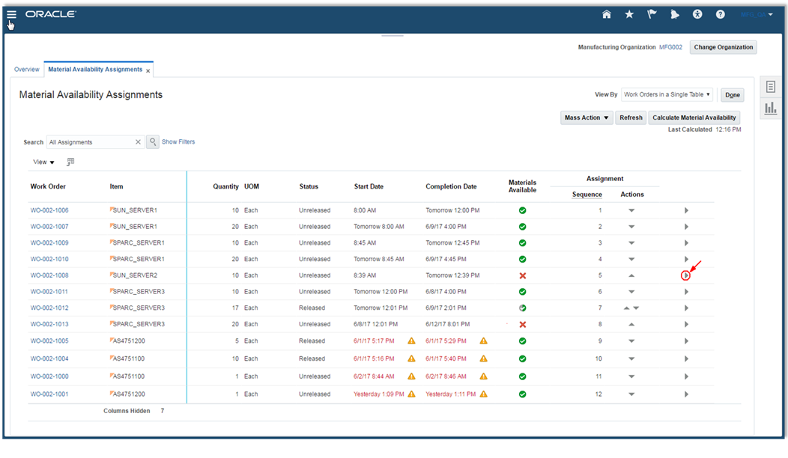
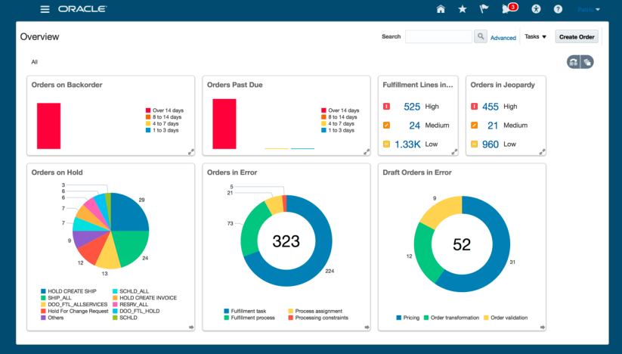
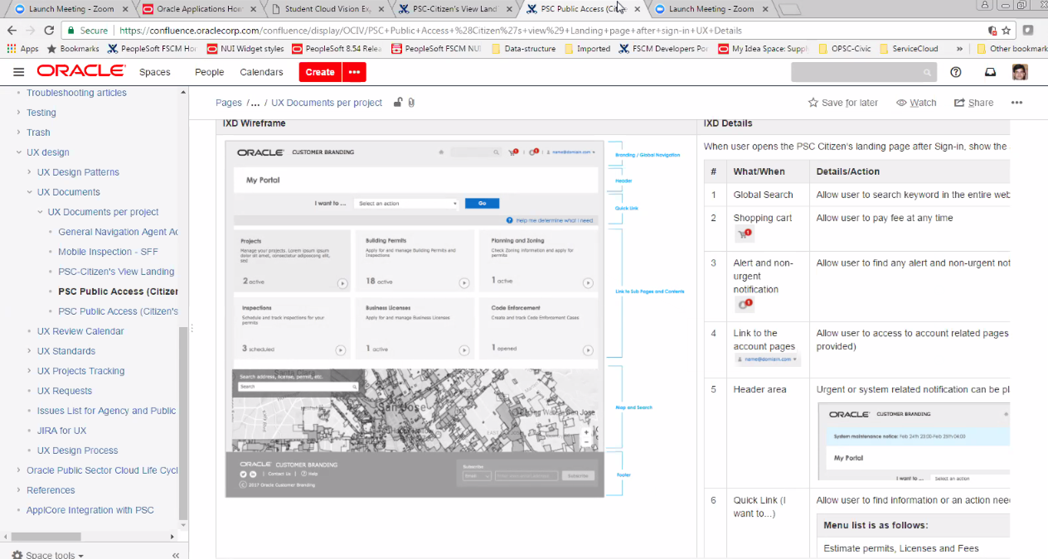
JET for SaaS
Terminology
JET for SaaS (J4S) Component
J4S Standard Page Layout
J4S Custom Page Layout
Lowest level of JET components used in Apps
Represents a UX Pattern
Built by approved J4S Layout Creators
Easy to consume by Apps
Configuration-ready
A ready-to-consume collection of J4S components + page model defining a complete page or set of pages in an application
Built by approved J4S Layout Creators
Easy for Apps to consume in VBCS
  does not require understanding of JET or page model syntax
Easy to Upgrade & configuration-ready
  Shields the apps team from any underlying changes (JET, UX)
Assembled by Application teams for domain-specific needs using J4S components as building blocks
  Requires proper approval from J4S team
Easy to assemble in VBCS
  does not require understanding of JET or page model syntax
Easy to upgrade & configuration-ready
  Behaves the same as Standard Page Layout
Confidential – Oracle Internal/Restricted/Highly Restricted

Slide 6
Page Model
Page model fully describes the contents and behaviors of a page or a module
  A page model is a JSON file
  An application consists of a series of page models
  Page models contain the component structure, the action chains, and the variables
Confidential – Oracle Internal/Restricted/Highly Restricted

Slide 7
Shopping cart - Desktop
Confidential – Oracle Internal/Restricted/Highly Restricted

