Slide 1
Agenda
1
Redux
Metadata-driven application
Use of Promise
Data Loading
Other Best Practices
2
3
4
5
Confidential – Oracle Internal/Restricted/Highly Restricted

Slide 2
Introduction to Redux
Predictable State container
State
  Server responses
  Cached data
  Local changes on the UI
Three principals
  Single source of truth: Store
  State is read-only; Change state by emitting an action
  Changes are made with pure functions: reducers
Confidential – Oracle Internal/Restricted/Highly Restricted
Notes:
https://confluence.oraclecorp.com/confluence/display/ERPTech/Redux+with+JET

Slide 3
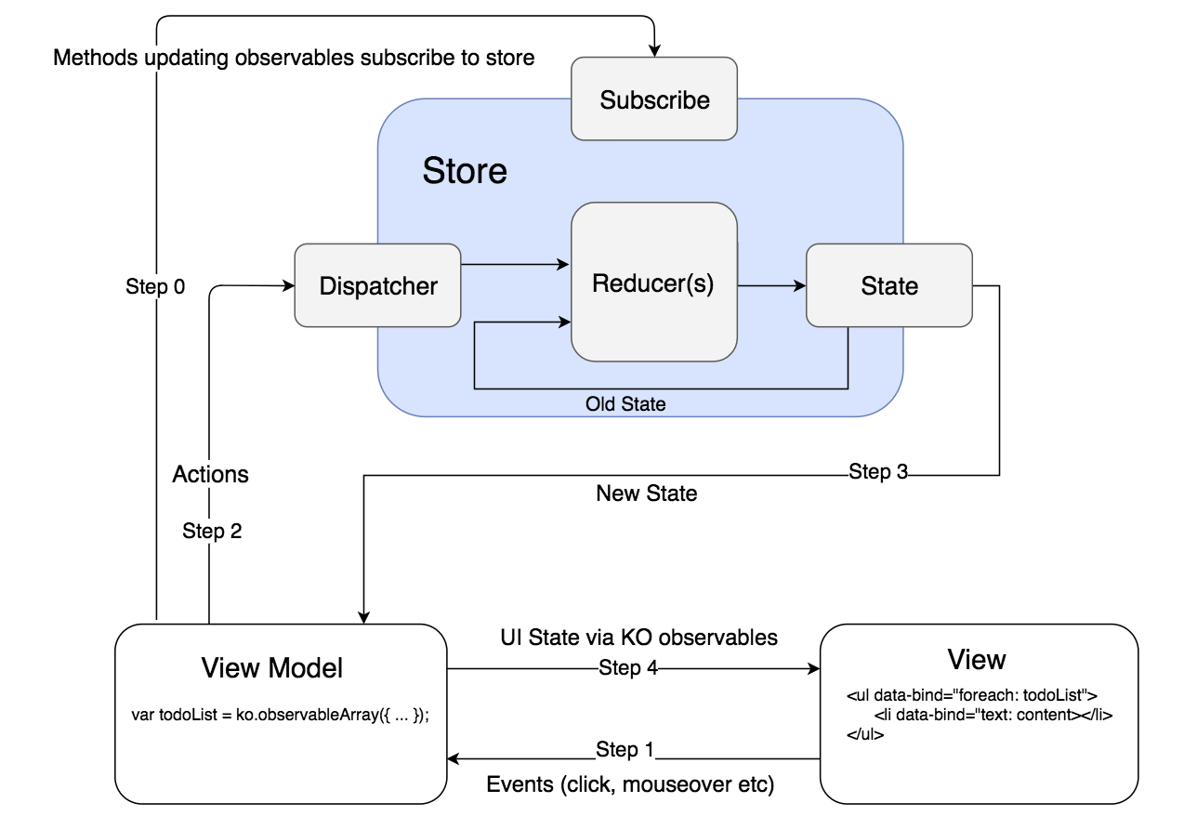
Redux with knockout
Step 3
Confidential – Oracle Internal/Restricted/Highly Restricted
Notes:
https://confluence.oraclecorp.com/confluence/download/attachments/435571163/Redux.pptx?version=1&modificationDate=1501242068000&api=v2

Slide 4
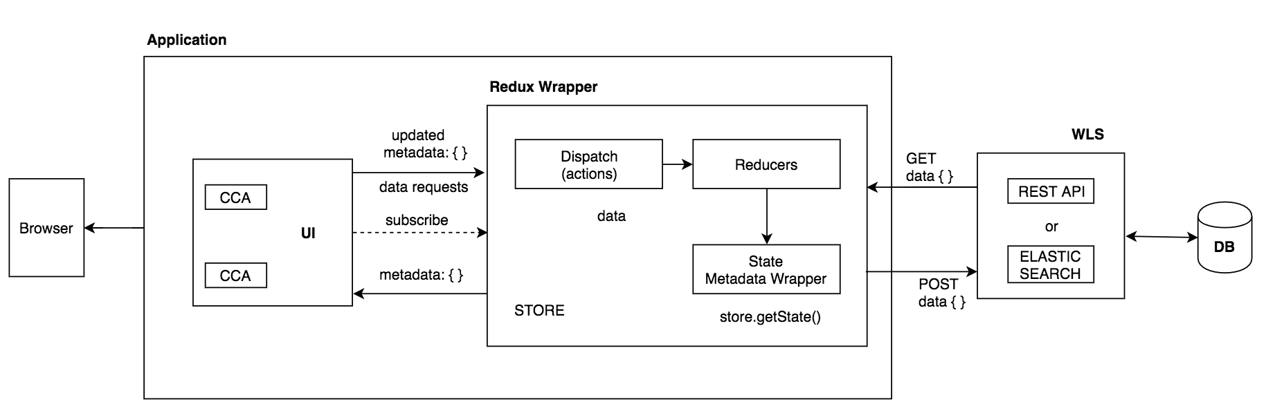
Redux in JET
Confidential – Oracle Internal/Restricted/Highly Restricted

Slide 5
Metadata Driven Application
UI will be a superset of CCA components
Each CCA takes a metadata JSON and translates it into the UI
The outer skeleton will be defined by the developers and its contents will be read in the JSON format
The VBCS framework follows a Page Model Architecture where the entire page is defined as a JSON
Future goal is to reuse the components’ metadata to define the Page Model metadata while migrating to VBCS
Confidential – Oracle Internal/Restricted/Highly Restricted

Slide 6
Use of Promises
To handle asynchronous operations easily
States -
  Resolved: Fulfilled, Rejected, Settled
  Unresolved: Pending
JET Adoption
  Chaining of then()
  Promise.all()
  Loading indicator with Promises
Example - AJAX calls using promises - Wiki
Confidential – Oracle Internal/Restricted/Highly Restricted

Slide 7
Code Quality Inspection
SonarQube is an open source platform for continuous inspection of code quality
It covers a wide area of code quality checkpoints which include
  Architecture & Design
  Complexity
  Duplications
  Coding Rules
  Potential Bugs
  Unit Test
  Etc.
Confidential – Oracle Internal/Restricted/Highly Restricted

Slide 8
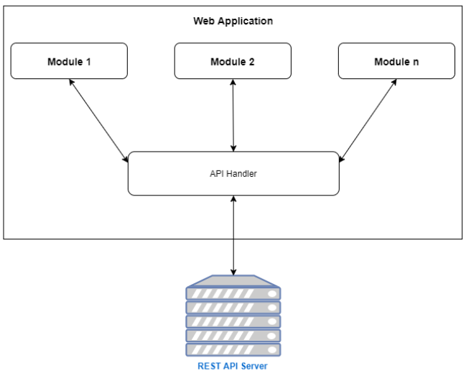
API Handler
Centralizing REST Calls
  To centralize the $.ajax() calls and the setting for the same would be centralized
  The uptake module just need to pass few attributes necessary to make a call and get the necessary data
Confidential – Oracle Internal/Restricted/Highly Restricted

Slide 9
Jenkins Pipeline
Source control Jenkins scripts along with the application
  Easier to migrate to other development environment
  Introduce ability to customize Jenkins jobs by passing parameters
Confidential – Oracle Internal/Restricted/Highly Restricted

Slide 10
Modularizing Gulp Build
Modulare gulp build in to multiple gulp configs
  Separate one big file to different ones based on functionality – minification, linting, bundling, etc.
    Easy for maintenance
    Easy for migration
Confidential – Oracle Internal/Restricted/Highly Restricted

Slide 11
Continuous Integration
CI tasks
  Minification, linting, unit testing, Selenium testing, etc.
Automatically triggered tests -
  Local git hook to check code integrity before source controlling
  Webhook on ODCS to test the code change before merging branches
Confidential – Oracle Internal/Restricted/Highly Restricted

Slide 12
Jenkins
Build
SSH Push
ADE Pull
Development
ODCS
V2MIB
17.05.0
V2MIB
min
V2MIB
min
Editor or IDE
Developer Laptop
GIT Clone > Code > Test > CI
V2MIBHEDC
17.08.0
V2MIBHEDC
min
V2MIBHEDC
min
Dev1
Commit > Push
Dev2
Merge Req
V2MIBHEDD
17.11.0
V2MIBHEDD
min
V2MIBHEDD
min
Local tasks to perform CI Tasks
Dev…n
Fail
Pass
Jenkins
Versioning
Minification
Bundling
Lint
Unit Test
Selenium
Oracle Confidential – Internal/Restricted/Highly Restricted

Slide 13
Testing
Test cases should be categorized as module specific ones and those to test the integration with the underlying application
  Module specific tests should be shipped along with the module if it is being consumed by a different application
  Example, if AP uses ApplCore's simple Panel CCA, during the local UI testing, include the test cases from the Simple Panel CCA's package and test along with the whole application
Confidential – Oracle Internal/Restricted/Highly Restricted

Slide 14
Data Loading
Lazy Loading
  Do not load until user scrolls
Progressive Loading
  Load resources with lower priorities after the core functions get rendered
Predictive Loading
  Pre-load data before user’s action, based on the prediction of user’s intention
    For example, load the next page of the search result while the user is still on the current page
Confidential – Oracle Internal/Restricted/Highly Restricted

Slide 15
Service Workers
A service worker is a script that your browser runs in the background
  Separated from a web page, provide features that don’t need user interaction
    Push notifications
    Background data sync
    Etc.
Example - Using service workers for progressive data loading - Wiki
Confidential – Oracle Internal/Restricted/Highly Restricted

Slide 16
Web Workers
Bring threading to JavaScript
  By default, JavaScript on the browser runs on a single thread
  Process multiple scripts at the same time
  Make multiple AJAX requests in parallel
Confidential – Oracle Internal/Restricted/Highly Restricted

Slide 17
Bookmarkability
ojRouter has a bookmarkable storage feature to save the state of a page by adding additional parameters to the URL
  This new parameter will correspond to the changes in the page
    Use query parameters (http://myjetapp.net/index.html?root=books&bookid=2) when your application contains only a few views that the user will bookmark and that are not associated with a complex state
    Use path segments to display simpler URLs, especially for nested paths such as http://myjetapp.net/books/2
Confidential – Oracle Internal/Restricted/Highly Restricted

Slide 18
Defaulting
Default value based on user preference
  For example, currency code based on user’s locale
    Need to retrieve user preference information from REST endpoint, and assign the value to the field
Default value based on the input on another field
  For example, business unit based on purchase order
    Need to implement the logic on the client side, and get the default value from REST endpoint, preferably as a child resource of the depending entry – in this case, the PO
Confidential – Oracle Internal/Restricted/Highly Restricted

Slide 19
Validation
Web application should validate the inputs on the client side before submitting to the server
  ADF apps constantly talk to the server
  JET apps interact with server via REST – stateless
Solutions
  Short-term - No validation on the client side. Post the entire payload to the server, and display the error message provided by the server on the UI
  Mid-term - Still no validation on the client side, but require server to provide machine-readable error. Identify the incorrect fields and help users to correct them
  Long-term - Store validation rules on the client side and validate the inputs in real-time
Confidential – Oracle Internal/Restricted/Highly Restricted

Slide 20
Caching
Decide caching strategy based on the nature of the data
  Stability of the data
    Dataset that doesn’t get changed frequently – currency code, city name
  Time-sensitivity of the data
    Course description vs. course availability
Advanced caching based on usage
  Cache the most frequently used entries of an LOV – suppliers, payment terms
Scope of caching
  Local caching
  CDN
Confidential – Oracle Internal/Restricted/Highly Restricted

Slide 21
Cross-Platform Design
If the UI for these three modes – desktop, tablet, mobile – is considerably different
  Identify earlier to be able to maintain different views for each
If a responsive UI approach is followed
  Make sure that the components used on the view align with the designs for the other screens
Confidential – Oracle Internal/Restricted/Highly Restricted

Slide 22
Modularity and Resuability
If one module fails, load the page showing the others. Modularity has to be defined such that the user is not confused with the information shown.
  For example -
    In AP, if the review tab is broken, the rest of the page with relevant information should be shown
    If the review header is broken, it may not be relevant to show the lines and other review item specific information
An architecture like this may be achieved by not having too many dependencies between the different modules. Maintain independence to be able to self contained on an entirely different application
Confidential – Oracle Internal/Restricted/Highly Restricted

