Slide 1
Discussion on abstract and key words writing
学术英语写作001班
Group 1：韩昊辰 杨松鸣 张恩宁 周阳 邵一均
汇报人：韩昊辰

Slide 2
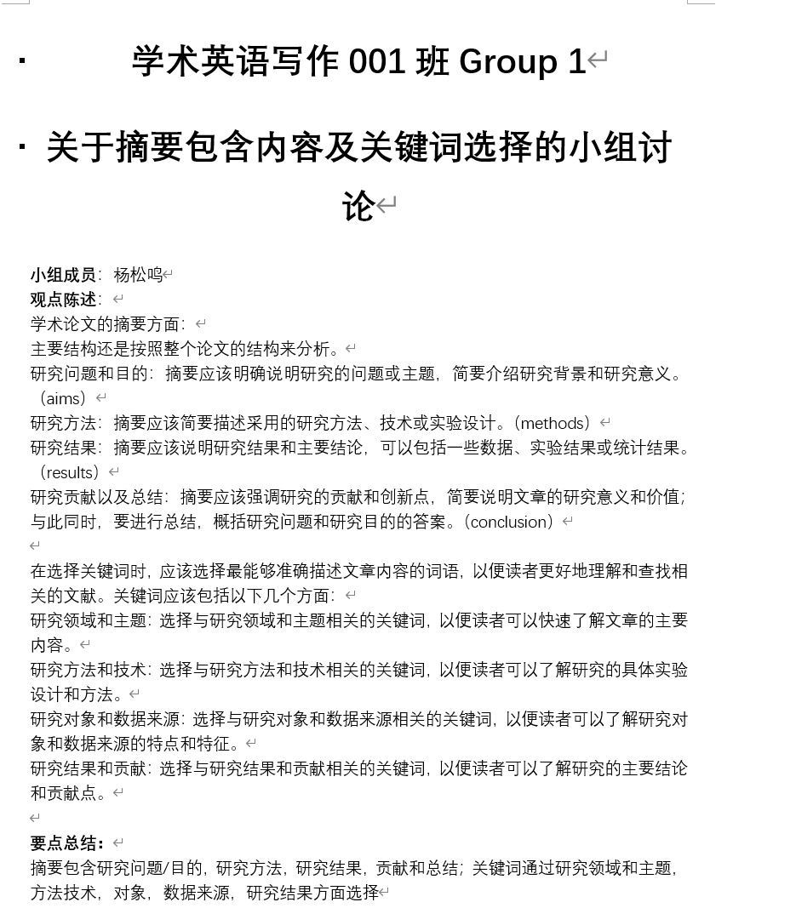
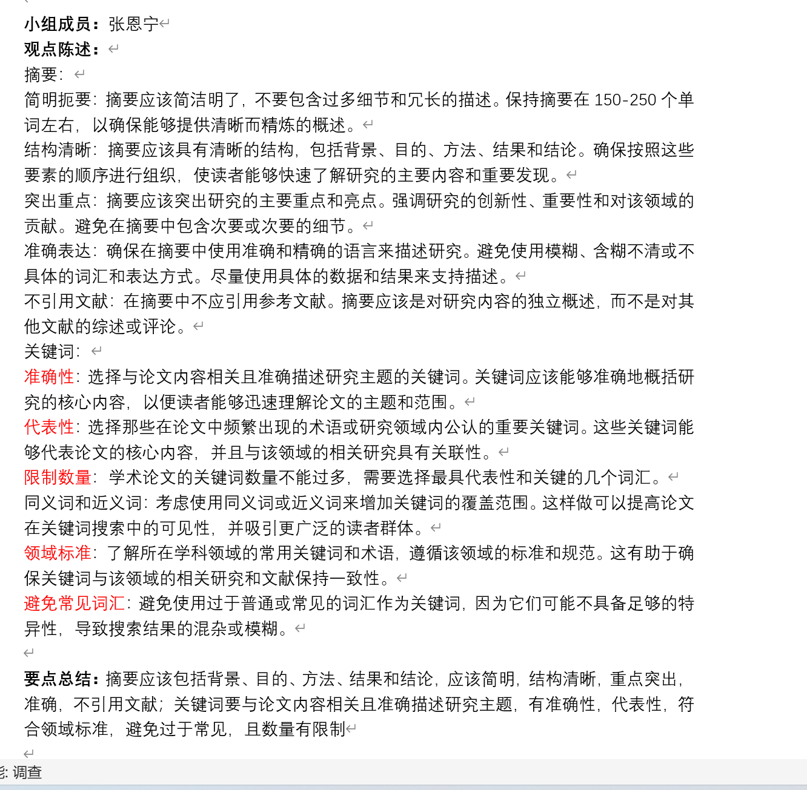
Group discussion

Slide 3
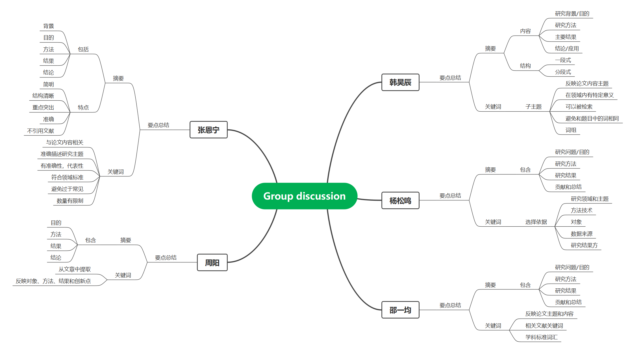
Mind map of group discussion
Content
Structure
Feature
Select criteria
Of abstract and key words

Slide 4
The content of abstract
Research background/goal
Research methods
Major findings
Conclusion and application
Not every abstract contains them all!

Slide 5
Example1 of abstract
Extending the Technology Acceptance Model (TAM) for studying the e-learning acceptance is not a new research topic, and it has been tackled by many scholars. However, the development of a comprehensive TAM that could be able to examine the e-learning acceptance under any circumstances is regarded to be an essential research direction. To identify the most widely used external factors of the TAM concerning the e-learning acceptance, a literature review comprising of 120 significant published studies from the last twelve years was conducted. The review analysis indicated that computer selfefficacy, subjective/social norm, perceived enjoyment, system quality, information quality, content quality, accessibility, and computer playfulness were the most common external factors of TAM. Accordingly, the TAM has been extended by the aforementioned factors to examine the students’ acceptance of e-learning in five different universities in the United Arab of Emirates (UAE). A total of 435 students participated in the study. The results indicated that system quality, computer self-efficacy, and computer playfulness have a significant impact on perceived ease of use of e-learning system. Furthermore, information quality, perceived enjoyment, and accessibility were found to have a positive influence on perceived ease of use and perceived usefulness of e-learning system.
Research Background
Research Methods
Major findings
No Conclusion/implication

Slide 6
Example2 of abstract
Research Background
Promoting Internet development and eliminating energy poverty are two important policy agendas for China in the era of digital economy. In the context of "Internet + energy", there is a need to explore whether the development of the Internet can alleviate energy poverty.
推动互联网发展和消除能源贫困是中国在数字经济时代的两大重要政策议程。在“互联网+能源”的大背景下，有必要探讨互联网的发展能否缓解能源贫困。
The aim of this study is to test the influence and transmission mechanism of the development of Internet on energy poverty in China by using provincial panel data from 2011 to 2019.
本研究利用2011 - 2019年的省级面板数据，检验互联网发展对中国能源贫困的影响及其传导机制。
The study found that: (1) energy poverty is still widespread in China, especially in the central and western regions. And the low energy affordability is its major source; (2) the development of Internet can alleviate energy poverty. On one hand, it can improve energy affordability by promoting economic development and technological progress. On the other hand, it also helps to enhance the availability of energy by promoting technological advances and improving knowledge level; and (3) there are nonlinear and regional heterogeneous effects of the development of Internet on the alleviation of energy poverty.
研究发现:(1)能源贫困在中国仍然普遍存在，特别是在中西部地区。低能源负担能力是其主要来源;(2)互联网的发展可以缓解能源贫困。一方面，它可以通过促进经济发展和技术进步来提高能源的可负担性。另一方面，它也有助于通过促进技术进步和提高知识水平来提高能源的可用性;③互联网发展对能源贫困的缓解存在非线性和区域异质性效应。
Based on the above results, corresponding policy suggestions for China to alleviate energy poverty are provided.
基于上述结果，为中国缓解能源贫困提供了相应的政策建议。
Research Goal
Major findings
Imlication
No Methods

Slide 7
Reason for missing part?
Important part with more attentions
Due to limited space of abstract

Slide 8
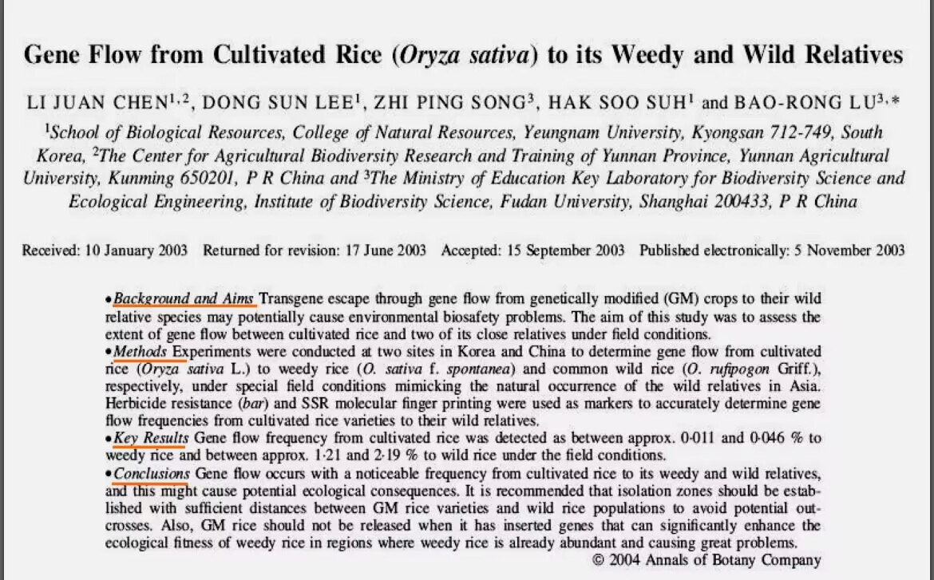
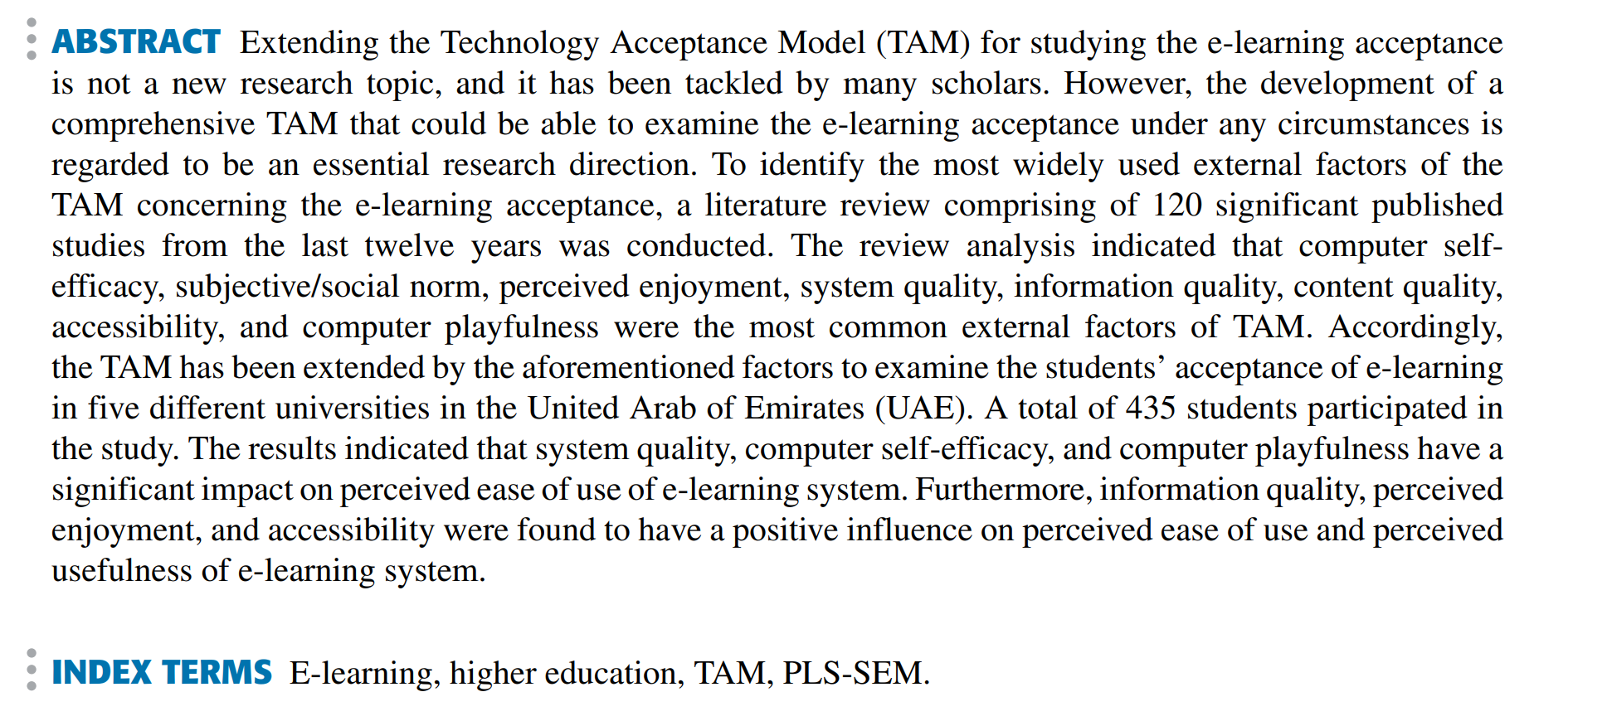
The structure of abstract: One-paragraph or Piecewise?
One-paragraph abstract
Piecewise abstract (Occurred in Biomedical journal)

Slide 9
Accuracy
What are key words like?
Feature of key words
Criteria of key words
Specific meaning in the research field
Professional phrase instead of general words
Representativeness
Reflect the content/theme of the research
Avoid “crash” words in the title
Practicality
Searchable
Num often 3-5

Slide 10
research filed/theme research methods research object data source results
Then how to write key words?
Consider these:

Slide 11
Example of key words
Research object
Filed
Professional phrase
Searchable
关键词：Energy poverty; Internet development; Mediation mechanism; China
摘要：Promoting Internet development and eliminating energy poverty are two important policy agendas for China in the era of digital economy. In the context of "Internet + energy", there is a need to explore whether the development of the Internet can alleviate energy poverty. The aim of this study is to test the influence and transmission mechanism of the development of Internet on energy poverty in China by using provincial panel data from 2011 to 2019. The study found that: (1) energy poverty is still widespread in China, especially in the central and western regions. And the low energy affordability is its major source; (2) the development of Internet can alleviate energy poverty. On one hand, it can improve energy affordability by promoting economic development and technological progress. On the other hand, it also helps to enhance the availability of energy by promoting technological advances and improving knowledge level; and (3) there are nonlinear and regional heterogeneous effects of the development of Internet on the alleviation of energy poverty. Based on the above results, corresponding policy suggestions for China to alleviate energy poverty are provided.

Slide 12
Thanks for listening!
学术英语写作001班
Group 1：韩昊辰 杨松鸣 张恩宁 周阳 邵一均
汇报人：韩昊辰

